Slide 1
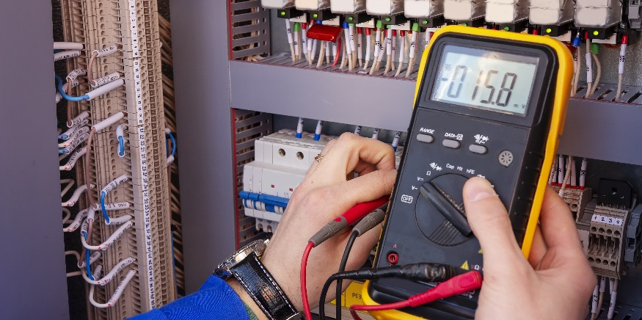
Understanding the Breadboard

Slide 2
Understanding a Breadboard
Understand how to make circuit connections on a breadboard.
Determine if circuits on a breadboard are wired correctly.

Slide 3
Breadboard Configuration for Inst. Projects
5V
GND
Component Wiring Area
Rows are connected.
Adjacent rows are not connected.
abcde row is not connected to fghij row.
Columns are not connected.
GND
9V

Slide 4
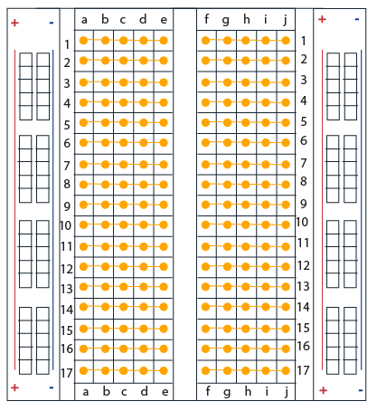
How does the breadboard work?
Rows are connected
Columns are not connected
Breadboards have rows (numbered)
Using your experience from building circuits, describe how you think the rows and columns are OR are not connected.
Rows are connected except across the gap (between columns e and f).
Columns are not connected.
and columns (lettered).
Not connected over the gap
Note: we are not talking about the bus strip (+ and – side columns). You should know from a previous lesson these columns are connected.

Slide 5
Peeling back the cover of a breadboard
Notice the metal strips.
These strips are conductors which allows connectivity.
Rows are connected except across the gap.
Columns are not connected.
Bus strip columns are connected.

Slide 6
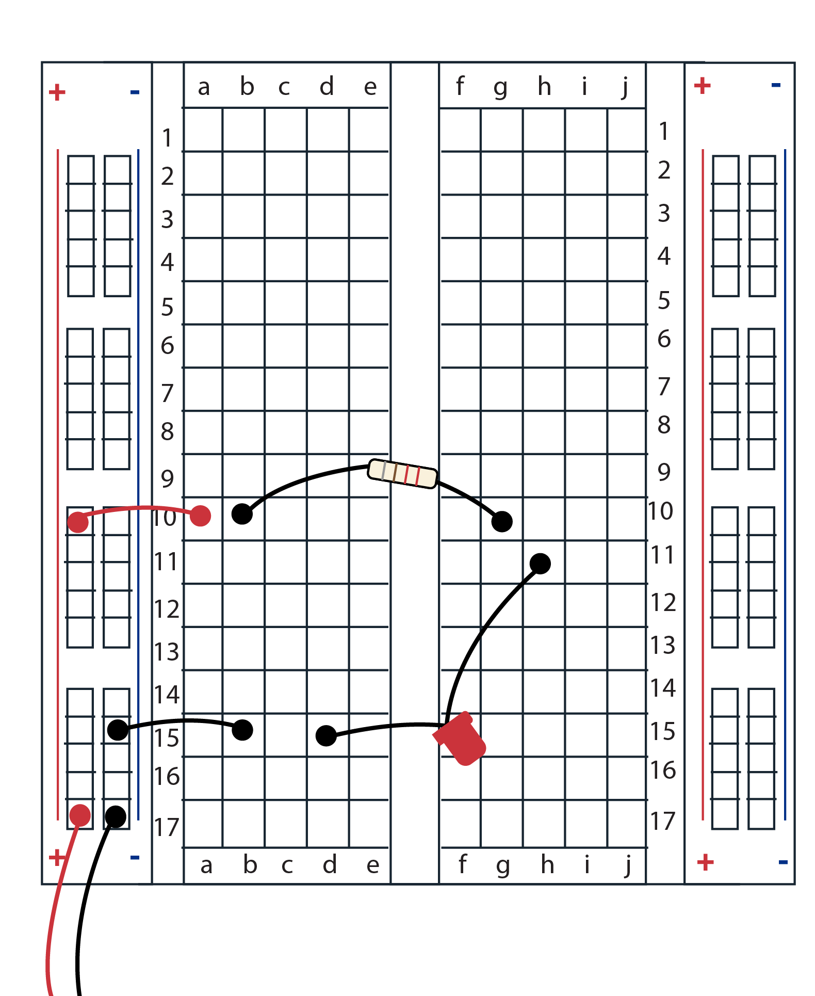
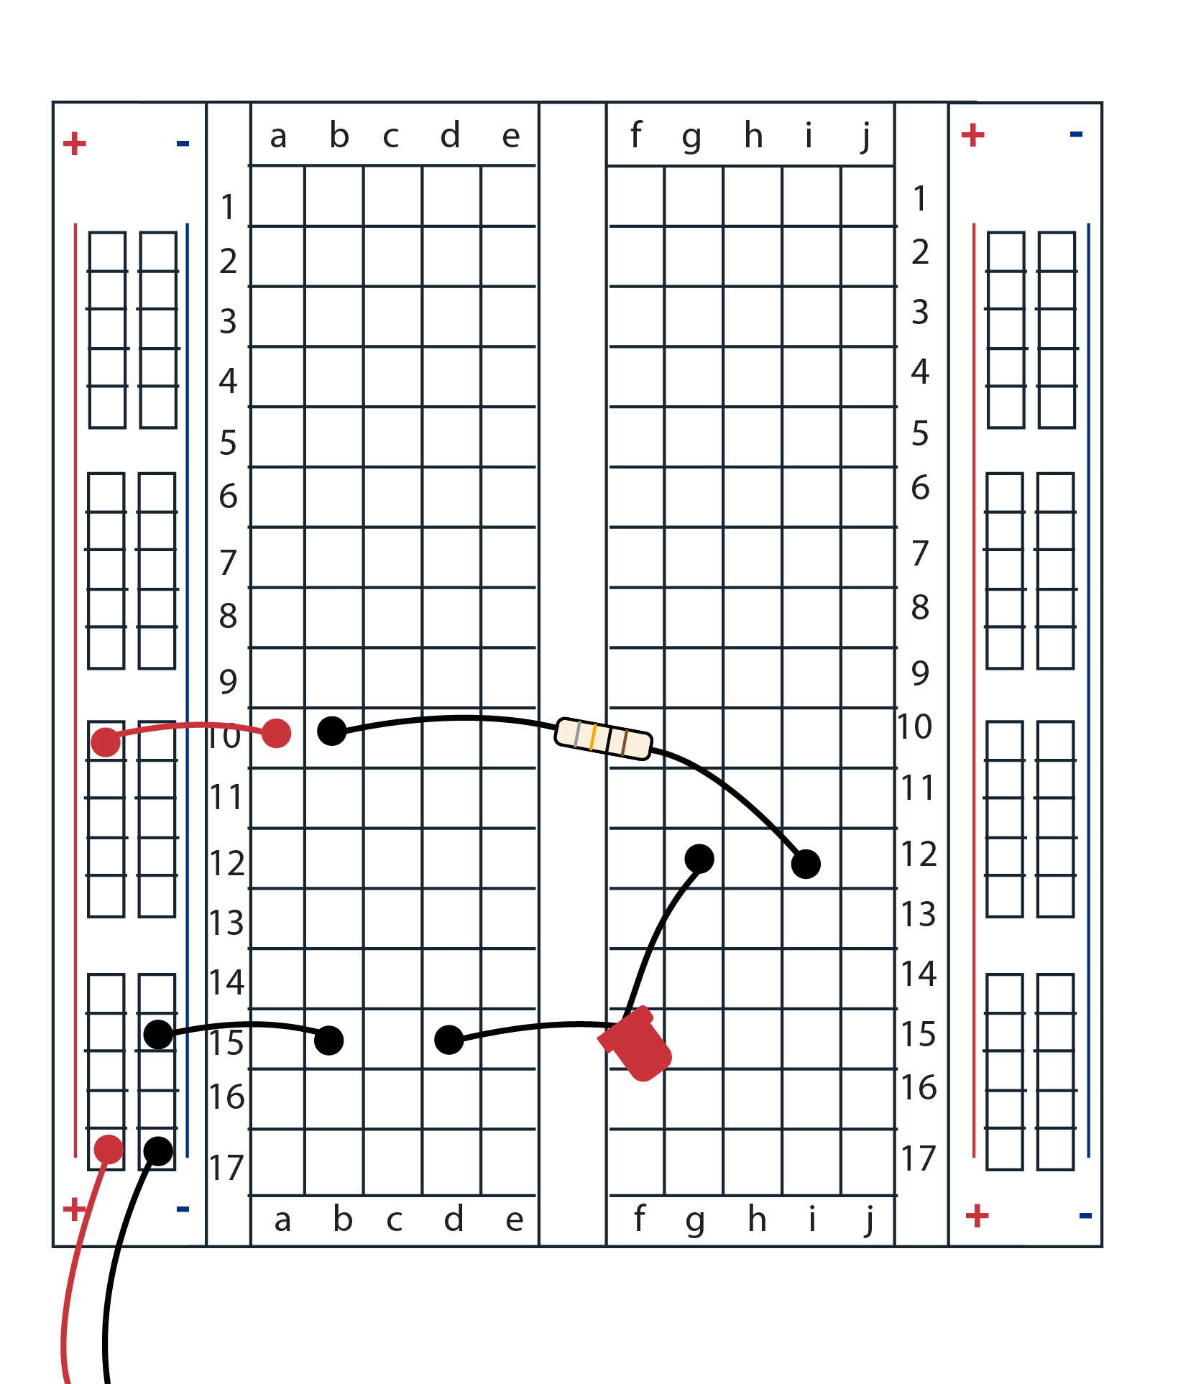
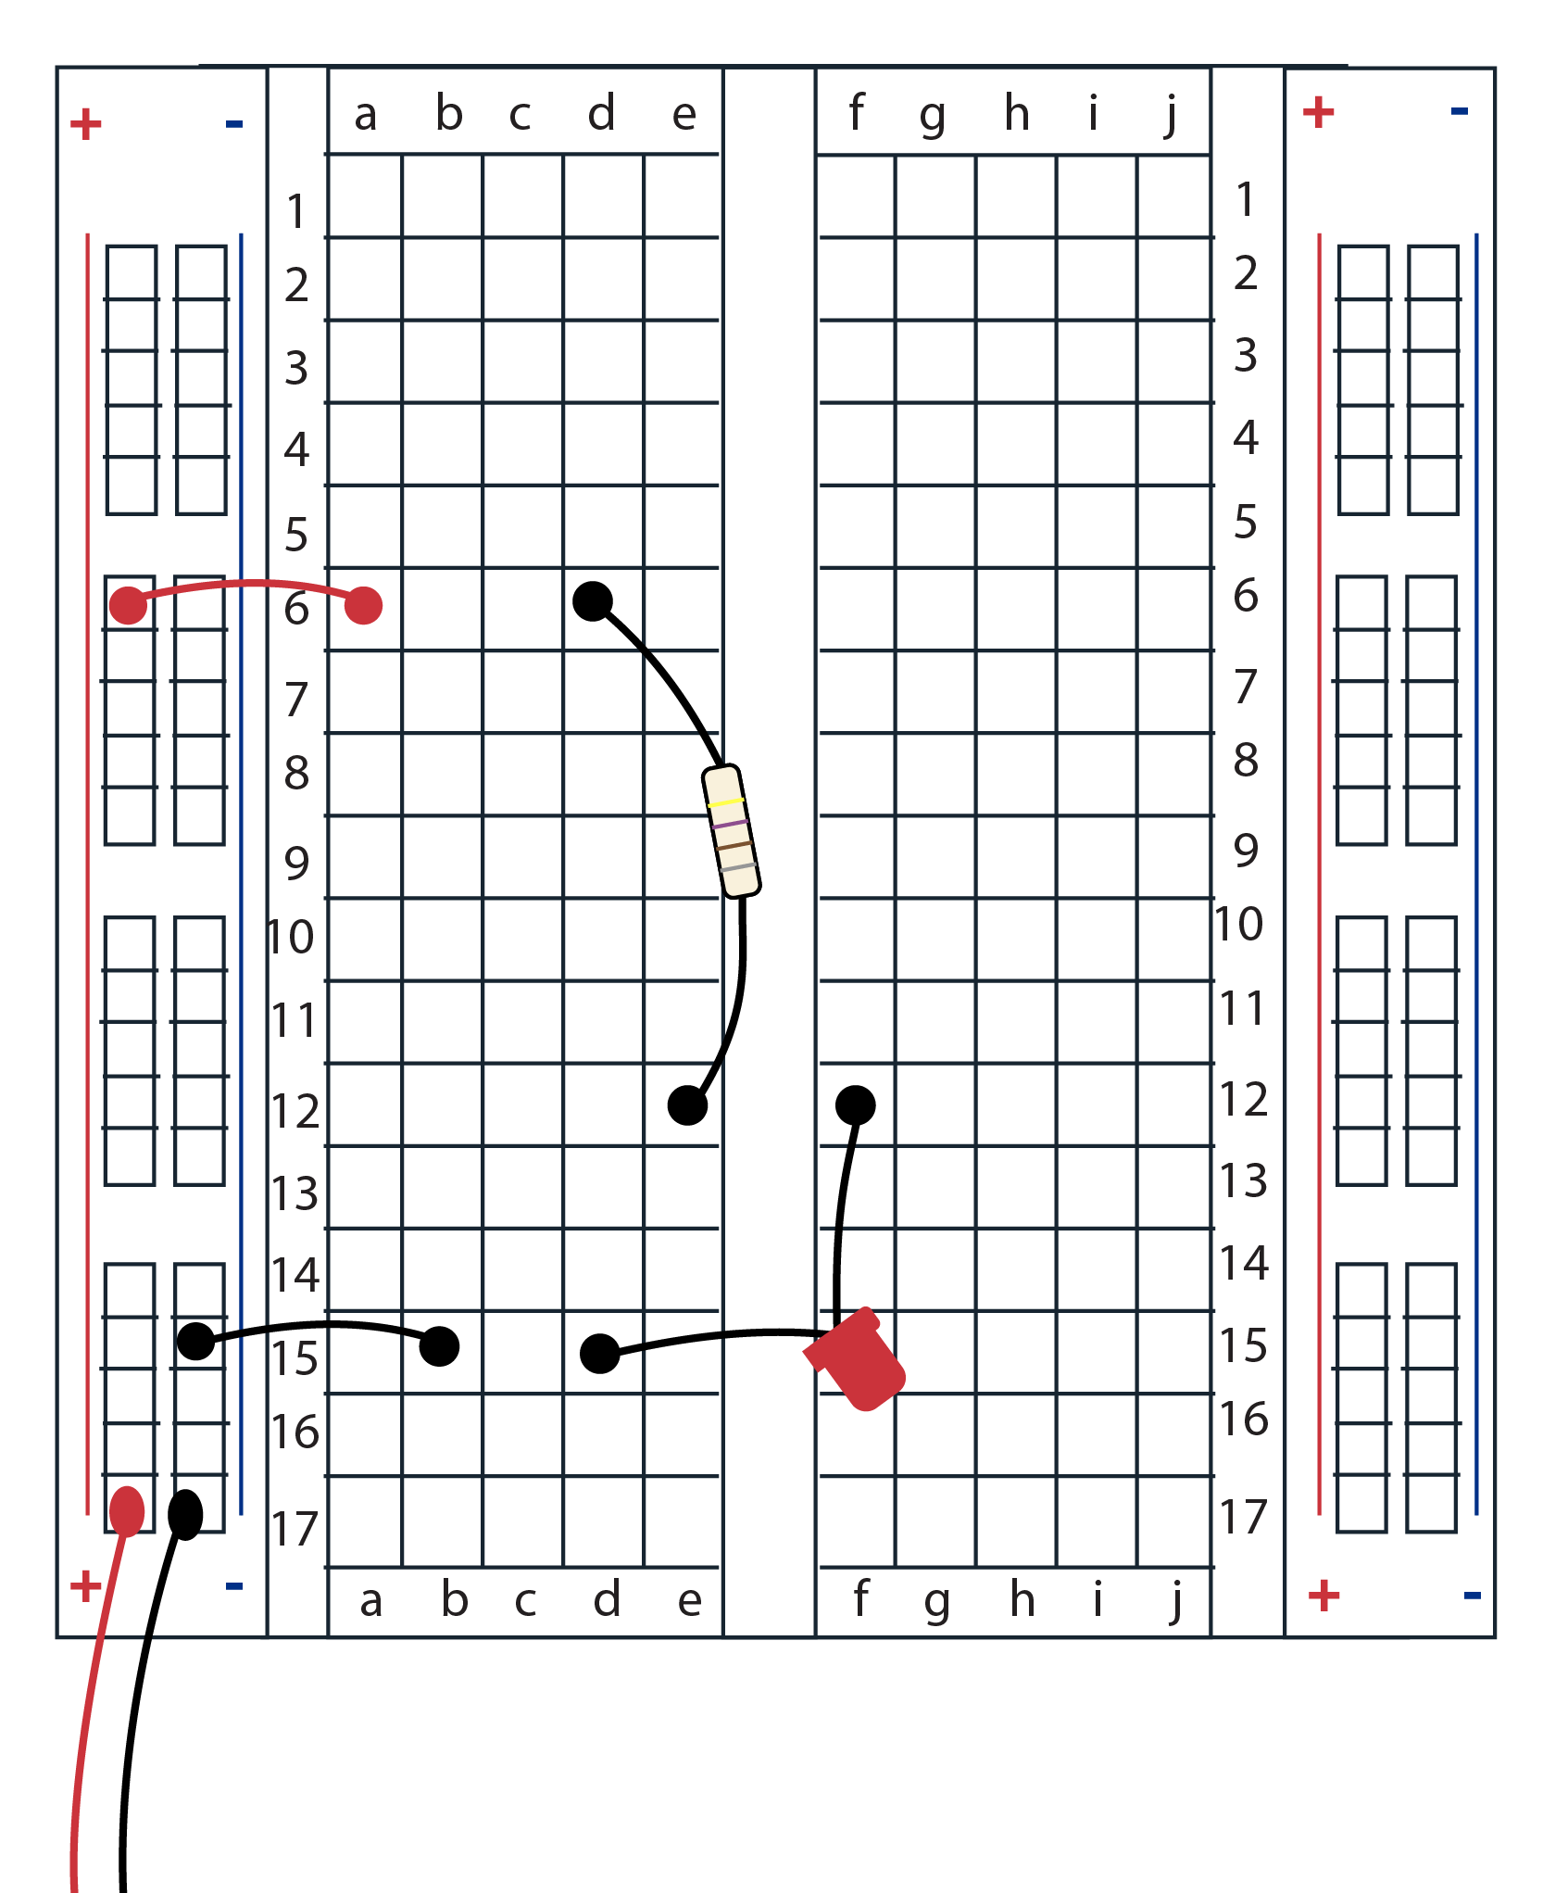
Identify the correctly built circuits
Explain why or why these are not correctly built (assume the LED is connected in the right orientation and the us strip is connected properly to the voltage source).
Rows 10 and 11 are not connected
All components are connected properly
Row 12 is not connected across the gap

Slide 7
Assignment
Complete NCCER Electrical Level 1 Module 3 Assignment

