Slide 1
First Five 05d
If a 12V power supply is connected to terminals A and B,
how much current is passing through the 120Ω resistor.
What is the voltage at node C?
How much current is flowing through the 220Ω resistor?
A
120Ω
C
1KΩ
220Ω
B

Slide 2
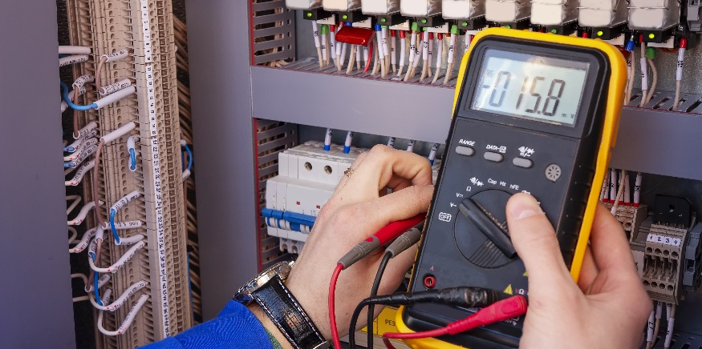
Troubleshooting Your Multimeter

Slide 3
Is the dial set to the correct setting?
Battery Load Test – Tests small batteries
DCV – Measures DC Volts
ACV – Measures AC Volts
Ω – Measures Resistance
DCmA – Measures DC Current in mA (0-200mA)
ACmA – Measures AC Current in mA (0-200mA)
– Tests Diodes
DC10A – Measures DC Current in MA (0-10A)
– Tests Continuity Between Two Points
Red lead plugged in here to measure everything but DC10A
Red lead plugged in here only when measuring current larger than 200mA
Black lead plugged into COM

Slide 4
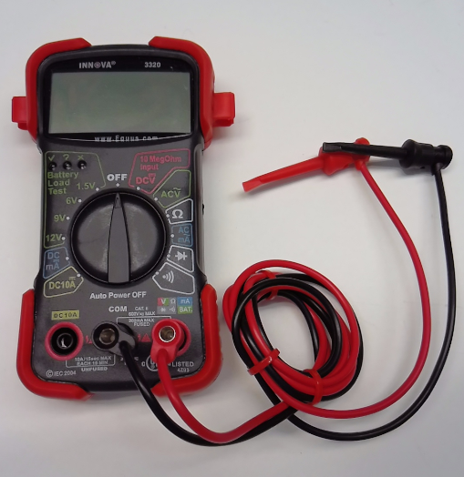
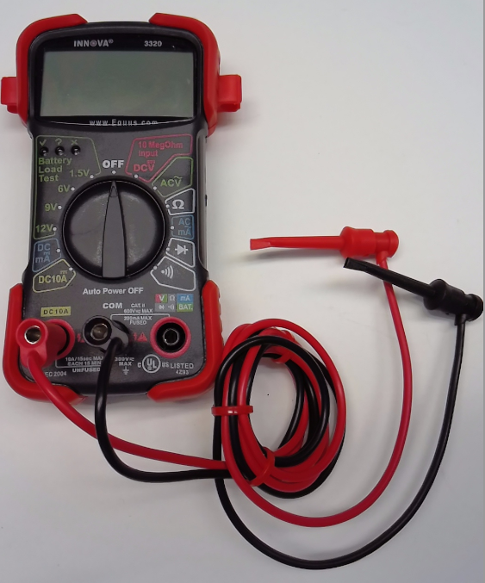
Are the leads plugged in correctly?
Black lead should be plugged into the “COM” input jack. This is referring to ground.
Use the “DC10A” input jack when measuring larger currents up to 10A. Dial should be turned to DC10A position.
Use this input jack when measuring or testing voltage (AC/DC), batteries, resistance, continuity, diodes, and small currents up to 200mA. This jack is more commonly used in our classes.

Slide 5
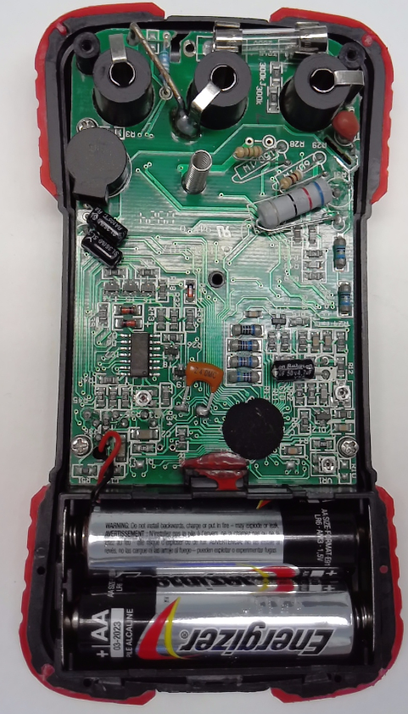
Did you blow a fuse?
Fuses are blown most often when measuring current given these scenarios:
Current is greater than 200mA, but settings were used for less than 200mA.
Current is measured improperly (e.g., if measured like voltage across components instead of through the circuit).
Fuses get blown often when measuring current. It is okay if you blow a fuse; just replace it with a new one!
Good Fuse
(Wire is straight)
Blown Fuse
(Wire is Broken)

Slide 6
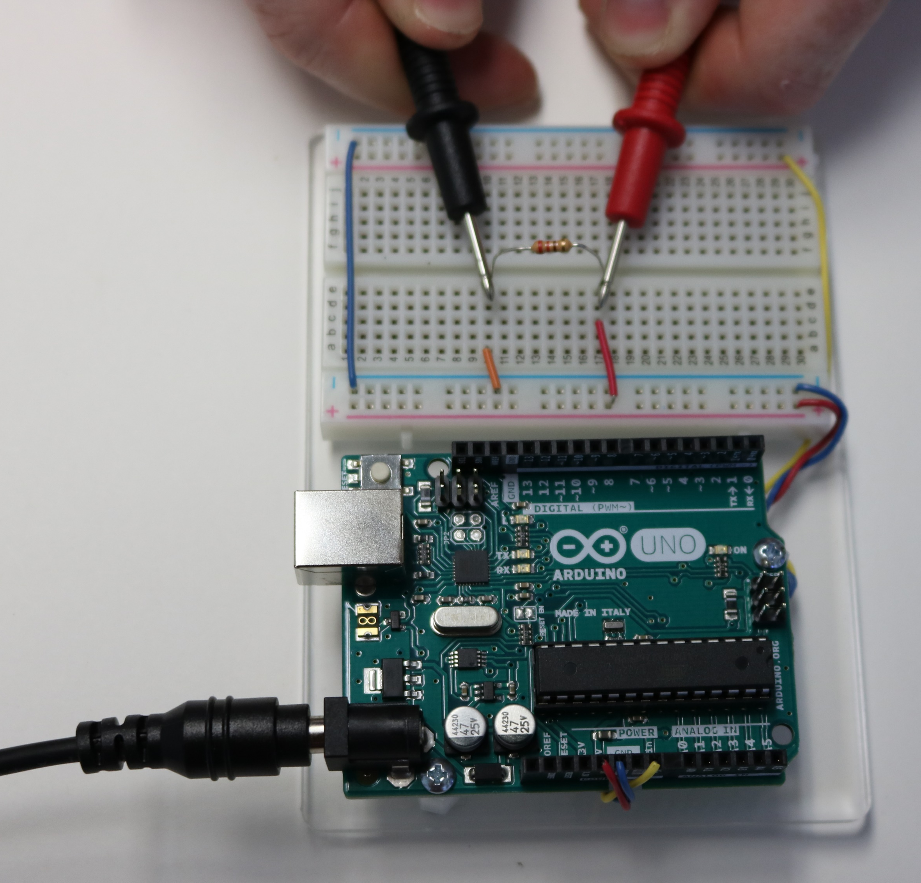
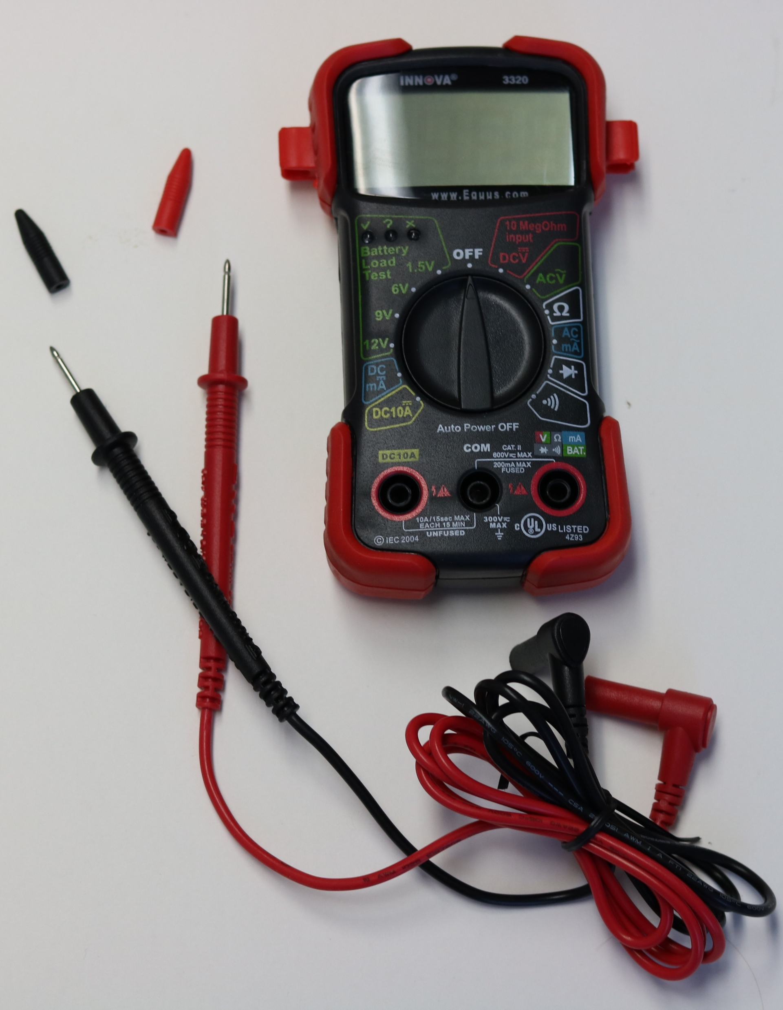
Pinchers vs Probes
Pinchers
Probes
Must hold with hands
Touch end of probe on wire/metal being measured
Pinchers
Hands free
Clip end of pinchers on on wire/metal being measured
Probes

