Slide 1
First Five 4c

Slide 2
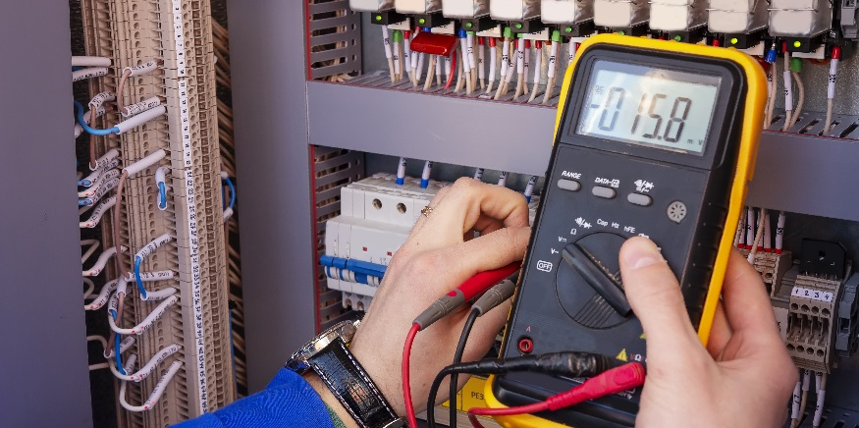
Serial Monitor and for Statements

Slide 3
Serial Monitor and for Statements
Print information to the Arduino IDE serial monitor.
Use for statements to execute program loops in a sketch.

Slide 4
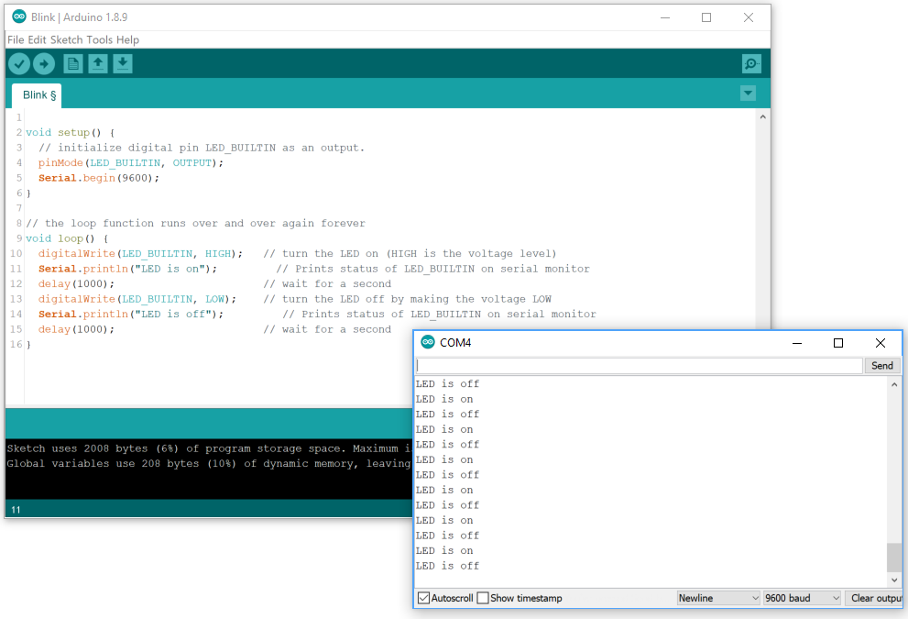
Using the Serial Monitor
Sometimes you want to see what is happening inside the Arduino.
Troubleshooting purposes
Monitoring the status of something in your sketch
Getting feedback or data
The serial monitor acts like a window into the brain of the Arduino.

Slide 5
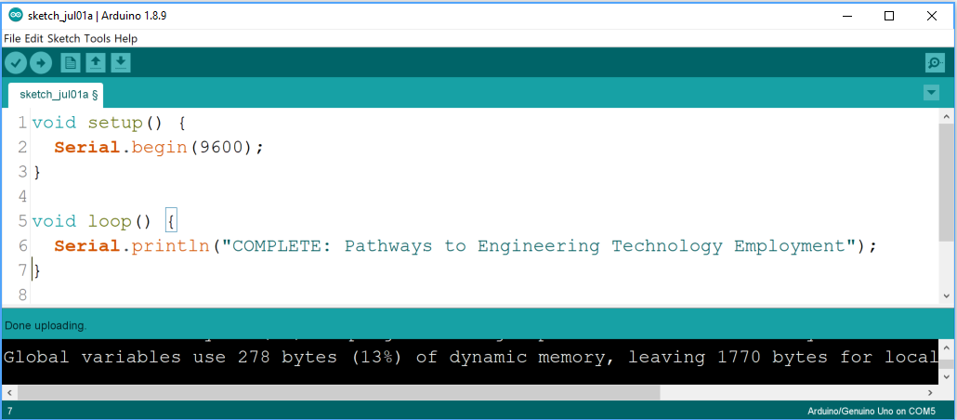
Printing to the Serial Monitor
Click here to make your serial monitor appear.
Type this sketch into the Arduino IDE to see what happens.
The text repeats itself in the serial monitor over and over on the same line.
Whenever the serial monitor is being used, you have to have Serial.begin(9600); in the setup function. 9600 is the baud rate (how fast the serial monitor and Arduino communicate); do not change this value.
Add ln to the end of print (making the statement Serial.println(“text text”). What happens?
To print to the serial monitor start with Serial.print(). If you are typing text, inside the (), put your text inside “”.
Where can you put the print statement to make the text appear only once on the serial monitor?
Setup function after Serial.begin(9600); statement. Try it out!

Slide 6
Printing a Set Number of Times
Can you make the statement print only 5 times?
You could type the same statement in the setup function 5 times.
without for statement (writing the statement 5 times in setup function)
void setup(){
Serial.begin(9600);
Serial.println("COMPLETE: Pathways to Engineering Technology Employment");
Serial.println("COMPLETE: Pathways to Engineering Technology Employment");
Serial.println("COMPLETE: Pathways to Engineering Technology Employment");
Serial.println("COMPLETE: Pathways to Engineering Technology Employment");
Serial.println("COMPLETE: Pathways to Engineering Technology Employment");
}
void loop() {
}
There must be a more efficient way!? What if you had to print it 100 or 1000 times?

Slide 7
Printing a Set Number of Times
You can use a for statement to control the number of times the Arduino executes something.
with for statement (writing the statement once, but printing it 5 times)
void setup(){
Serial.begin(9600);
for(int i=0; i<5; i++) {
Serial.println("COMPLETE: Pathways to Engineering Technology Employment");
}
}
void loop() {
}
Notice nothing is written in the loop function, but you still have to write it in your sketch.
Adapt your code to use the for statement to print to the serial monitor only 5 times.

Slide 8
What is the int for?
let’s talk about the “int” part of the statement before we discuss how the for statement works.
Anytime you use a value that the Arduino program does not recognize (not pre-defined) you have to tell the Arduino you are doing that, give the value a name, and a space allotment.
In a for statement, we need to have an account (or counter) for the number of times something is done.
The counter is a variable that changes with each iteration.
We call the counter “i” and the “i” changes with each iteration of the for statement.
You could name it variable anything you want (cow, chair, apple), but usually you name it something that applies to what it does (e.g.; i for iteration).
The “int” part is the space allotment for the variable.
An int represents an integer (a whole number) that ranges from -32,768 and 32,767
For a counter does it make sense to use an int?
for(int i=0; i<5; i++) {
Serial.println("COMPLETE: Pathways to Engineering Technology Employment");
}

Slide 9
How For Statements Work
You can read the for statement like a sentence to help you understand how it works.
For the integer variable i starting at 0 and continuing as long as i is less than 5 when increasing by 1 value each iteration, do the commands between the {}.
declare i as an integer (a number that can vary between -32,768 and 32,767)
the first value of i will be zero
i=0 the first time through loop
i=1 the second time through loop
i=2 the third time through loop
i=3 the fourth time through loop
i=4 the fifth time through loop
continue to loop as long as i is less than 5
increment i each time through loop
for(int i=0; i<5; i++) {
Serial.println("COMPLETE: Pathways to Engineering Technology Employment");
}
Commands between {} being executed in the for statement

Slide 10
Numbering the Lines on the Serial Monitor
Why do you think it could be useful to print the number of each iteration on the serial monitor?
What can you program to be printed that will make the iteration show up on the serial monitor?
Can you add a number at the beginning of the statement in “”?
Serial.println("1 COMPLETE: Pathways to Engineering Technology Employment");
No, the value will not change with each iteration.
You need to print the iteration value each time it changes.
Type Serial.println(i); before the other Serial.println line and see what happens.
Does the value of i change each time?
Yes
i is a variable and a variable does not have the “” marks around it in the print statement. If you are printing a string of text it needs the “” around it.
Why does this command not have the i in “”?
Is the number of iteration on the same line as the printed text?
No
What can you do to make it not print to the next line?
Remove the ln from the statement printing the iteration value.
How can you make it have a space between the number and the printed text?
Because the serial monitor prints exactly the content between the “”, you can add spaces at the beginning of the text after the “ to give space between the number and the text. Try it out!

Slide 11
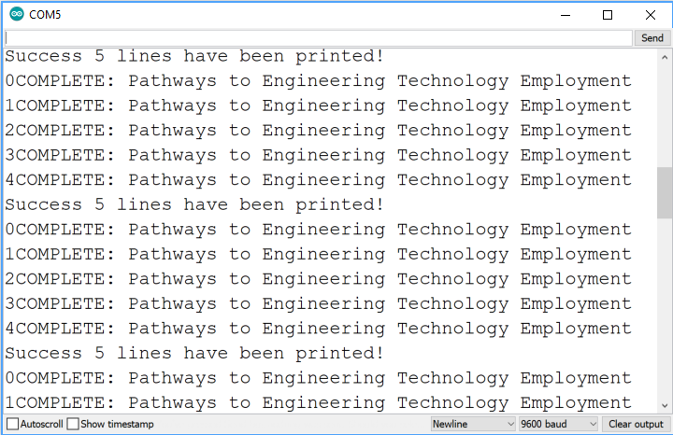
Printing to the Serial Monitor
Can you make it print 5 iterations and then start over and print 5 more iterations indefinitely?
Where and how would you type the phrase Success 5 lines have been printed! only once on its own line after the fifth time the text is printed before it starts repeating again? Experiment with the code to figure it out!
Move the entire for statement into the loop function.
Type the command in the loop function, but outside of the for statement (between the second to last } and last }.
void setup(){
Serial.begin(9600);
}
void loop() {
for(int i=0; i<5; i++) {
Serial.print(i);
Serial.println(" COMPLETE: Pathways to Engineering Technology Employment");
}
}
void setup(){
Serial.begin(9600);
for(int i=0; i<5; i++) {
Serial.print(i);
Serial.println(" COMPLETE: Pathways to Engineering Technology Employment");
}
}
void loop() {
}
void setup(){
Serial.begin(9600);
}
void loop() {
for(int i=0; i<5; i++) {
Serial.print(i);
Serial.println(" COMPLETE: Pathways to Engineering Technology Employment");
}
Serial.println(“Success 5 lines have been printed");
}
Tip: Uncheck the Autoscroll box to stop the scrolling and see the text.

Slide 12
Experimenting with Serial Monitor
Print some information about yourself to the serial monitor. Include the following information in an order/presentation of your choosing:
Your full name
Your favorite foods
Your favorite movies
A fun fact about yourself
A counter that starts at 5 and ends at 8.
A counter that starts at 1 and ends at 10
Some things to do with your sketch:
Print something(s) only once.
Print a counter only once.
Print something(s) indefinitely.
Print a counter indefinitely.
Print something(s) indefinitely before the counter.
Print something(s) indefinitely after the counter.

Slide 13
Experiment with for statements
Examples of different for statements:
for(int i=0; i<5; i++) { commands for action }
for(int i=100; i>20; i--) {commands for action }
for(int i=0; i<80; i+=2) {commands for action }
for(int i=50; i>=0; i-=5) {commands for action }
for(int i=2; i<100; i=i*1.5) {commands for action }
• increment i by one each time (0,1,2,3,4)
• decrement i by one each time (100,99,98,…,22, 21)
• increment i by 2 each time (0,2,4,6,…,76,78)
• decrement i by 5 each time (50,45,40,35,…,5,0)
• multiply i by 1.5 each time (2,3,4,6,9,13,19,28,42,63,94)

Slide 14
Experiment with for statements
Try to display different patterns. Some suggestions are:
1, 2, 3, …100
100, 99, 98, …-27
0, 3, 6, 9, …69
1000, 950, 900, …50
1, 2, 4, 8, 16, …1024
1024, 512, 256, …1
1, 4, 9, 16, 25, …100
Print them once or have them repeating indefinitely
Remember this depends on where you place the for statement (setup vs loop function).

Slide 15
Recap Printing to the Serial Monitor and for Statements
What is the difference between how you write the commands for printing text vs printing a variable?
What happens when you write your write the print commands in the for statement
What happens when you write your write the print commands outside of the for statement?
What happens when you write your write the print commands in the loop function?
Text is nested between “” in the Serial.print() command and the serial monitor displays everything within the text.
A variable does not have “” around it in the Serial.print() command and it changes depending on what the value of the variable is at the moment it is printed.
Text/variable will display each time the for loop is executed.
Text/variable will display once (repeated indefinitely if in loop function).
Text/variable will display indefinitely.

Slide 16
Recap Printing to the Serial Monitor and for Statements
What happens when you write your write the print commands in the setup function?
What will including ln with your print command do?
How do for statements work?
Text/variable will display only once.
Prints the text in the print command and then moves the curser to the next line.
Executes a set of commands for a pre determined number of iterations.
Is written using three main arguments:
Starting point
Conditional statement to be met in order for the for statement to be executed
The amount of increase/decrease the iteration is for the for statement

Slide 17
Assignment

