Slide 1
First Five 4d
Get kits and and make LED blink 5 times (see below)

Slide 2
Blinking LEDs and for Statements

Slide 3
Blinking LEDs and for Statements
Wire a series of resistors and LEDs on a breadboard.
Use for statements to blink a series of LEDs.

Slide 4
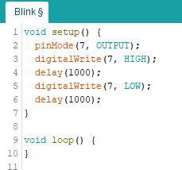
Make an LED blink 5 times
What type of statements will you need to use to accomplish this?
The code below turns on the LED for 1 second and off for 1 second.
How can you make it repeat that sequence 5 times?
Write a sketch that makes your LED blink on for a half second and off for a half second 12 times.
for Statements
Pin 7
Between lines 2 and 3 add:
for(int i=0; i<5; i++) {
220Ω
Between lines 6 and 7 add:
}

Slide 5
Make an LED repeatedly blink in different patterns
Make an LED blink in this sequence:
On for 500ms and off for 500ms, 5 times.
On for 750ms and off for 200ms, 8 times.
On for 100ms and off for 400ms, 10 times.
Repeat a., b., and c.
Getting started:
Where will the main portion of your sketch be located?
How many for statements will you need in your sketch?
Will anything be written in the setup function?
Loop function
3, one for each set of blinking patterns
Yes, the pinMode() command

Slide 6
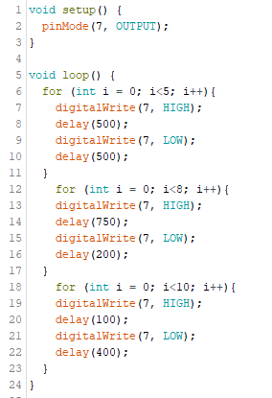

Slide 7
Experimenting with LEDs and Blinking patterns
Set up three red LED, three yellow LED, and three green LED circuits all in line (9 total circuits).
Each circuit should have a 220Ω resistor.
Each circuit should be connected to a different digital pin (suggestion: pins 2 – 10).
Digital Pin
220Ω

Slide 8
Experimenting the LEDs and Blinking patterns
Activity 1:Try to program the first 3 LEDs to blink on then off one right after the other so that it looks like the LEDs are chasing one another.
For example, when pin 2 turns off, pin 3 turns on at the same time. Then, when pin 3 turns off, pin 4 turns on at the same time.
Make it repeat this pattern indefinitely.

Slide 9
Experimenting the LEDs and Blinking patterns
Activity 2: Use a single for loop to accomplish the above task for all of the LEDs.
for(int i=0; i<5; i++) {

Slide 10
Using a for loop to turn successive LEDs on and off
void loop() {
for (int i = 2; i<11; i++);
digitalWrite (i, high);
delay(1000);
digitalWrite (i, low);
}

