Slide 1
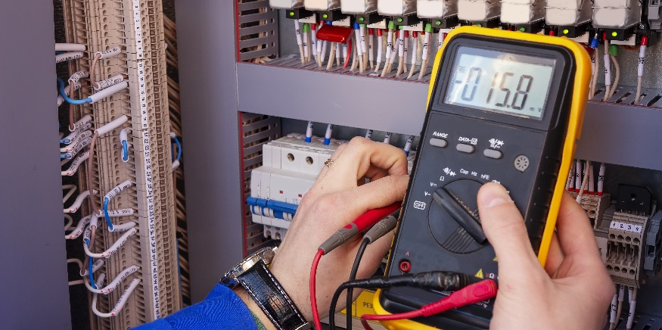
Momentary Switches

Slide 2
Momentary Switches
Use the multimeter continuity function to test a momentary switch.
Wire a momentary switch on a breadboard.
Identify two main orientation of switches: Normally Open (NO) and Normally Closed (NC)

Slide 3
Momentary Push Button Switch
Your push button switch has 4 terminals.
To understand the switch better, use the multimeter to determine continuity (what is connected and what is not).
Determining Continuity:
Turn your multimeter to the continuity setting.
Connect the red lead to A and the black lead to B. Do not press the switch.
If the multimeter beeps, the leads are connected.
Repeat for all possible combinations of connections. Use the table structure provided to record your findings.
Top View
Side View
Terminal | A | B | C | D
A
B
C
D
A
B
Bottom View
C
D
How could checking for continuity help you when building circuits?

Slide 4
Momentary Push Button Switch
A
B
C
D
Continuity for terminals when switch is not pressed:
Repeat process to determine continuity when switch is pressed:
SWITCH NOT PRESSED
Terminal | A | B | C | D
A
B
C
D
SWITCH IS PRESSED
Terminal | A | B | C | D
A
B
C
D
Everything is connected when the switch is pressed.
How do you think that influence the way you connect circuitry to the switch?

Slide 5
Momentary Push Button Switch
Switch is not pressed:
A-B are connected
C-D are connected
Switch is pressed:
A-B-C-D are all connected
A
B
C
D
Will an LED turn on when the switch is pressed if you connect power (5V) to C and a resistor and LED from D to ground?
Try it! Build the circuit and see if your hypothesis was correct.
The LED does not turn on and off because the circuit is never not connected. The same would happen if you connected the circuit to A and B in the same way.
C
D
A
B
Try to build a circuit with the LED to make it turn on only when the switch is pressed.
Draw a schematic of the circuit after you build it.
NOTICE: Push button switches are usually connected across the gap on a breadboard to prevent any shorts.

Slide 6
Momentary Push Button Switch
A
B
C
D
There are a few possible solutions that will give you the right result. Here are two:
5V
5V
C
C
B
A
220Ω
220Ω
Solution 1: Connect Power to C and LED/Resistor to B and ground
Solution 2: Connect Power to C and LED/Resistor to A and ground

Slide 7
Momentary Push Button Switch
A
B
C
D
Can you combine the two solutions to make the switch turn on and off two LEDs?
Because two sides can connect components, the schematic for a push button switch can be updated:
Yes
C
D
5V
button
Two main orientations for switches:
Normally Open (NO) – contacts on switch are open and will close when the switch is activated.
Normally Closed (NC) – contacts on switch are closed and will open when the switch is activated.
A
B
C
D
A
B
220Ω
220Ω
Is your switch wired to be Normally Open or Normally Closed?
Normally Open (NO)

