Slide 1
First Five 9a

Slide 2
Linear Regression

Slide 3
Linear Regression
Add a linear trendline to a plot in a spreadsheet.
Find a linear equation that models the data in a plot. (Format Trendline tab)
Use the coefficient of determination to determine the goodness of fit for a trendline.

Slide 4
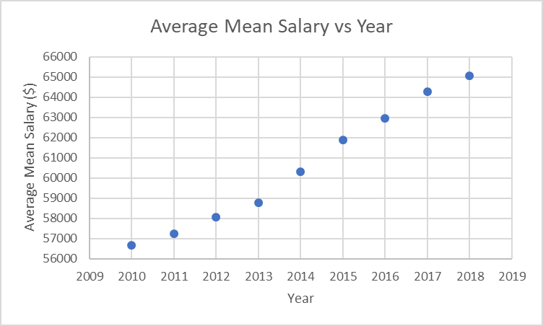
Electrical and Electronics Engr Technicians Salary
Below is data from the Bureau of Labor Statistics showing the average mean salary for Electrical and Electronics Engineering Technicians from 2010-2018.
Plot the raw data in Excel using a scatter plot
Average Mean Salary (y-axis) vs Year (x-axis)
Be sure to put a title and axes labels.
Year | Average Mean Salary ($)
2010 | 56690
2011 | 57240
2012 | 58070
2013 | 58770
2014 | 60330
2015 | 61870
2016 | 62950
2017 | 64290
2018 | 65050

Slide 5
Find an Equation that Models the Data
Having an equation that represents the data can be useful.
Why do you think an equation would be helpful?
This line can be used to represent the data
But look at the error. (distance from the raw data point and the point on the line).
Can we draw a better line?
This line appears to be a better representation of the data.
It still has large amounts of error.
We can have Excel generate a trendline that minimizes these errors to give us the best fit.

Slide 6
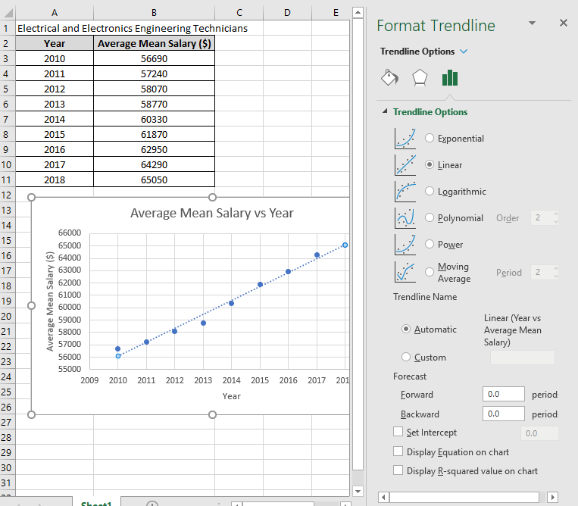
Find an Equation that Models the Data
A trendline in Excel is generated using a process called regression which is a measure of the relationship between two variables.
Excel uses least squares linear regression which generates the best line to represent the data by minimizing the errors.
Step 2: The format trendline window should open to the right. Check “linear” and check the box for “Display Equation on Chart.”
Step 1: Right click the data series points and click add trendline.

Slide 7
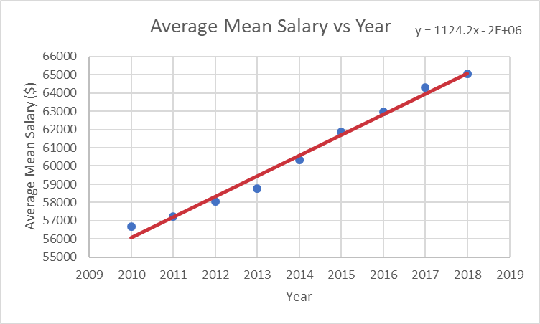
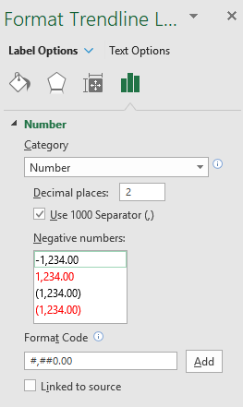
Find an Equation that Models the Data
Step 4: Change the category to “Number” and choose the how many decimal places you would like the equation to display.
Step 3: If the equation includes an E, that represents x10, but you loose a lot of values. Click on the equation to highlight it and right click for options to pop up. Click on “Format Trendline Label.”
You will not have to do step 3 and 4 every time.

Slide 8
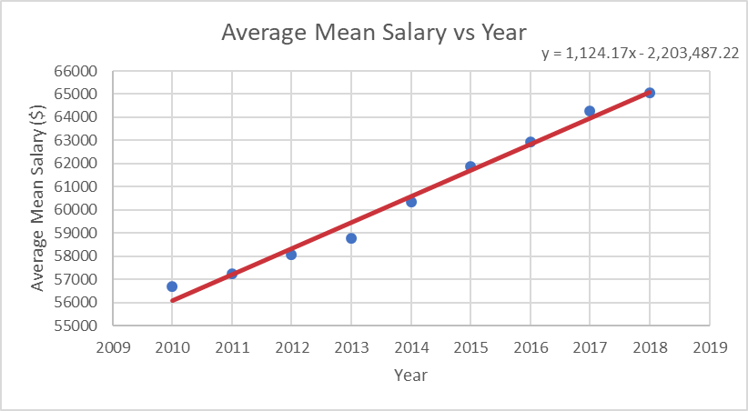
Find an Equation that Models the Data
Equation:
$$y=1124.2x−2{∙(10)}^{6}$$
But since the x and y values represent real things, you can rewrite it to be:
$$salary=1124.17(year)−2203487.22$$
If the trend remains the same, what value will the salary be in 2019?
$$salary=1124.17(2019)−2203487.22$$
$$salary=\$66212.01$$

Slide 9
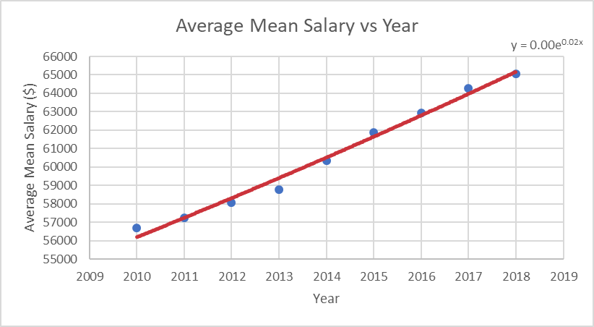
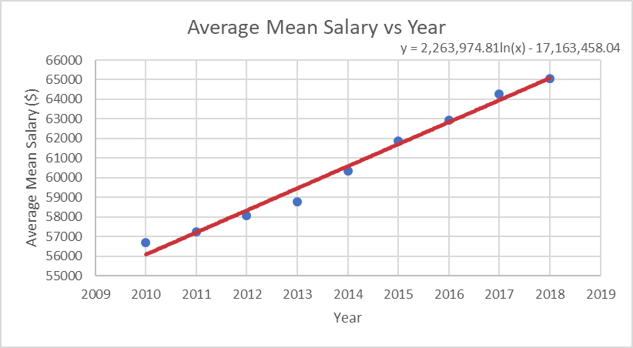
Other Trendline Options
Notice there are other trendline options built into Excel. Click through them and see how the trendline changes with each one.
Exponential
Logarithmic
They all look good, but how do you know which one is the best fit?
Power

Slide 10
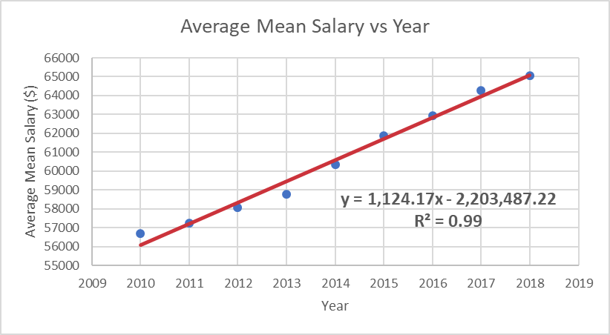
How do you know if the fit is good?
The “coefficient of determination,” more commonly referred to as r², will be used to determine the “goodness of the fit”
In addition to checking to display the equation on the chart you can check “Display R-squared value on chart” to know how good the fit is.
The closer to 1 the better the fit. The closer to 0 the worse the fit.
Linear gives a near perfect fit.
For the purposes of this class, you will use linear fits.

