Slide 1
First Five 9d

Slide 2
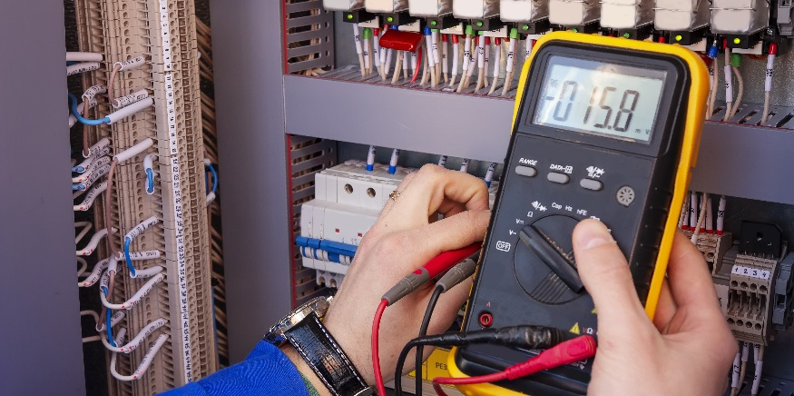
Programming Fundamentals

Slide 3
Programming Fundamentals
Review fundamental programming concepts and code.
Print to the serial monitor.
Write code in the main loop.
Use a for loop.
Measure voltage using analogRead.
Write if statements.
Use different data types.

Slide 4
Programming Review
Remove wires and other circuit components from your breadboard and Arduino (you can leave the wires connecting 5V and Ground to the breadboard)
Use this set up to review programming fundamentals:
Printing to your serial monitor
Writing code in the main loop
Using a for Loop
Measuring voltage using analogRead
Writing if Statements
Using different data types

Slide 5
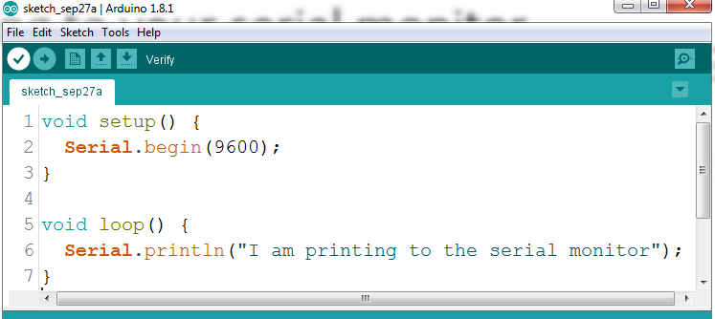
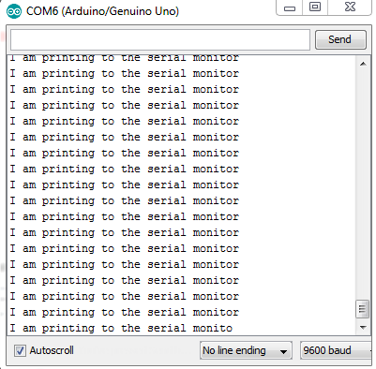
Printing to your serial monitor
Click here to make the serial monitor appear
Sets the baud rate for the serial monitor. Tells the serial monitor that you will be printing to it.
Adding ln to the in the Serial.println command makes the text move to the next line
Serial.print() is the command that sends information to be printed on the serial monitor
Text to be printed is in-between quotations inside the (). If printing a variable instead of text, you would put the variable name without “”.

Slide 6
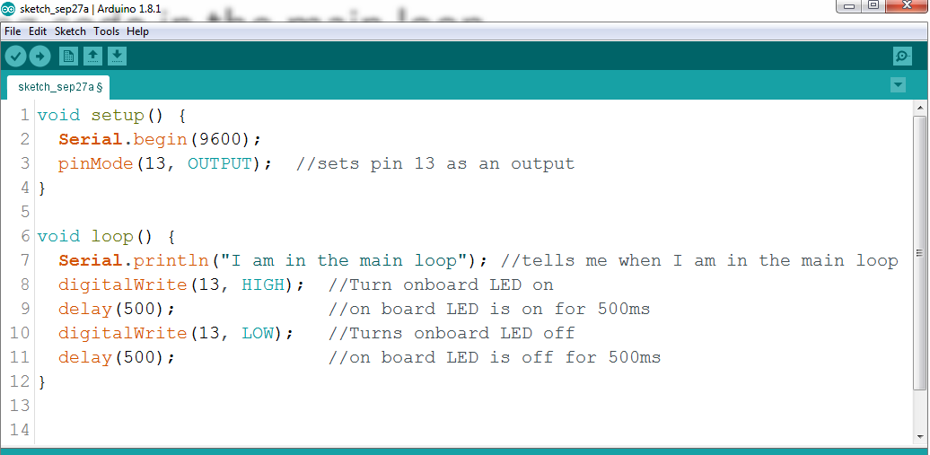
Writing code in the main loop
Code in the main loop is found within this function. Notice how all code for the main loop is within the curly brackets in the void loop() function.
Write comments to help you remember the purpose of each line of code
Sets pin 13 as an OUTPUT
Commands to make the onboard LED blink

Slide 7
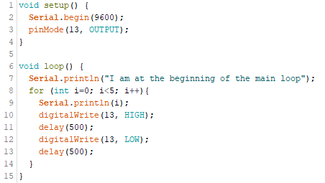
for loops
The Arduino starts in the main loop.
The for loop starts at a given value
It then checks to see if that value meets a set condition
If the condition is met, the for loop executes the commands within the curly brackets
Once the commands are executed, the given value changes according to the parameters set in the for loop
The process is repeated until the set condition is not met
for (int i=0; i<0; i++)
Each iteration of the for statement is printed and then the program goes back to the beginning of the main loop.
The commands in the for loop are inside curly brackets, and these curly brackets are inside the curly brackets of the main loop function.

Slide 8
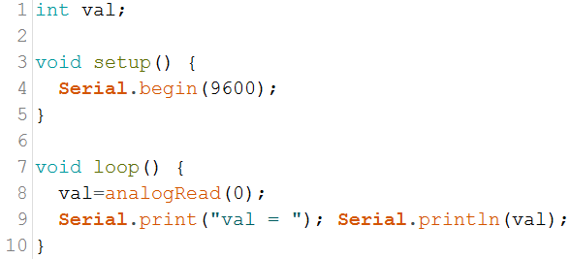
Analog input
Analog Pin 0 with ground
Use a jumper wire to connect
Analog Pin 0 with ground
Analog Pin 0 with 5V
Analog Pin 0 with 3.3V
Print the analog values to the serial monitor
How do the analog values change with each configuration?
Analog Pin 0 with 5V
Analog Pin 0 with 3.3V
$$voltage=\text{analogRead} value∙\frac{5 volts}{1023}$$

Slide 9
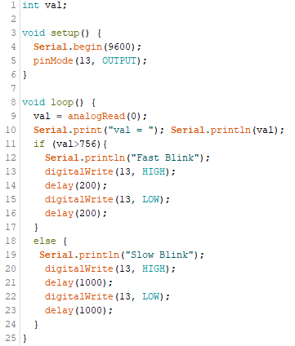
if Statements
if statements check for a given condition. If the condition is met, the Arduino executes the function following the if statement. In this case the LED_FastBlink function.
If the condition in the if statement is not met, then the else command will be executed.

Slide 10
Data Types
Data Type | # of Bits | Range | Comments
boolean | 1 | True or false | True ≠ 0 and False = 0
byte | 8 | 0 to 255 | An unsigned 8 bit number (2⁸=256)
int | 16 | -32,768 to 32,767 | Whole number, signed (+ or -), most common data type
long | 32 | -2,147,483,648 to 2,147,483,647 | Frequently used data type, number with many digits, signed
float | 32 | -3.4028235x10³⁸ to 3.4028235x10³⁸ | Includes decimal point, total precision is 6 to 7 digits
char | 8 | One 8-bit ASCII character | Alphanumeric characters, multiple characters called strings

Slide 11
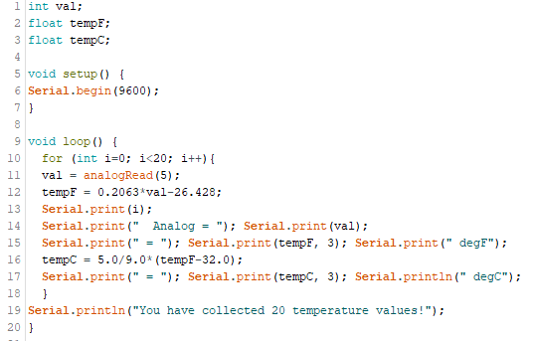
Data Types
Use a float when you can expect the variable to be a decimal value.
When dividing or multiplying and you and you want to avoid truncation, add .0 to any whole numbers.
To print more digits after the decimal, you input the desired number after the variable in your print statement.

