Slide 1
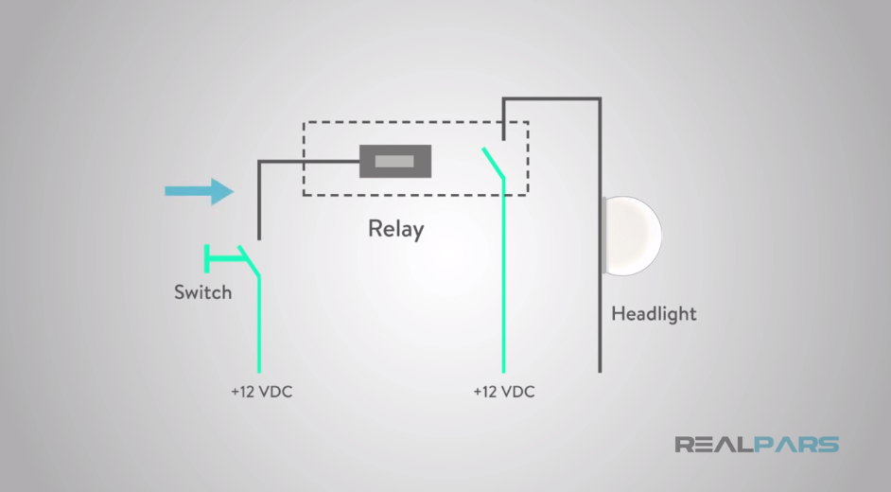
What is a Relay System?
What is a Relay System? (6:08) https://www.youtube.com/watch?v=1lbdwPfFegY

Slide 2
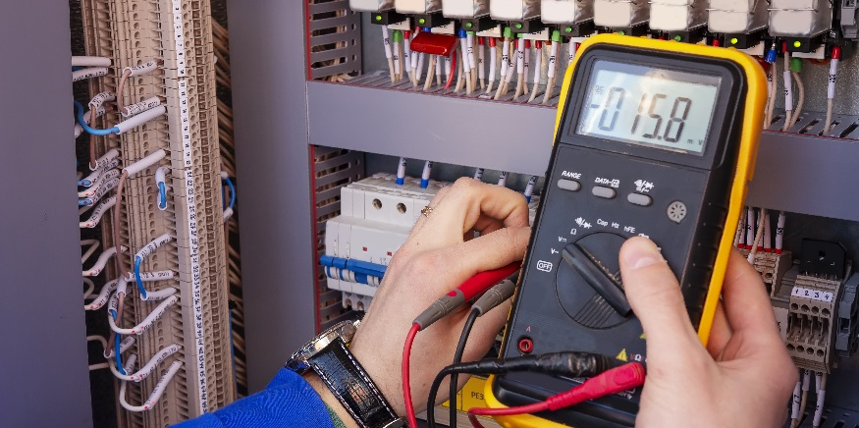
Relays

Slide 3
Relays
Describe the function of relays
Describe how a relay works
Define coil voltage, coil current and contact rating
Describe default states of relays
Describe relays in terms of poles and throws
Discuss how we can use a relay to control the Sous Vide project heater

Slide 4
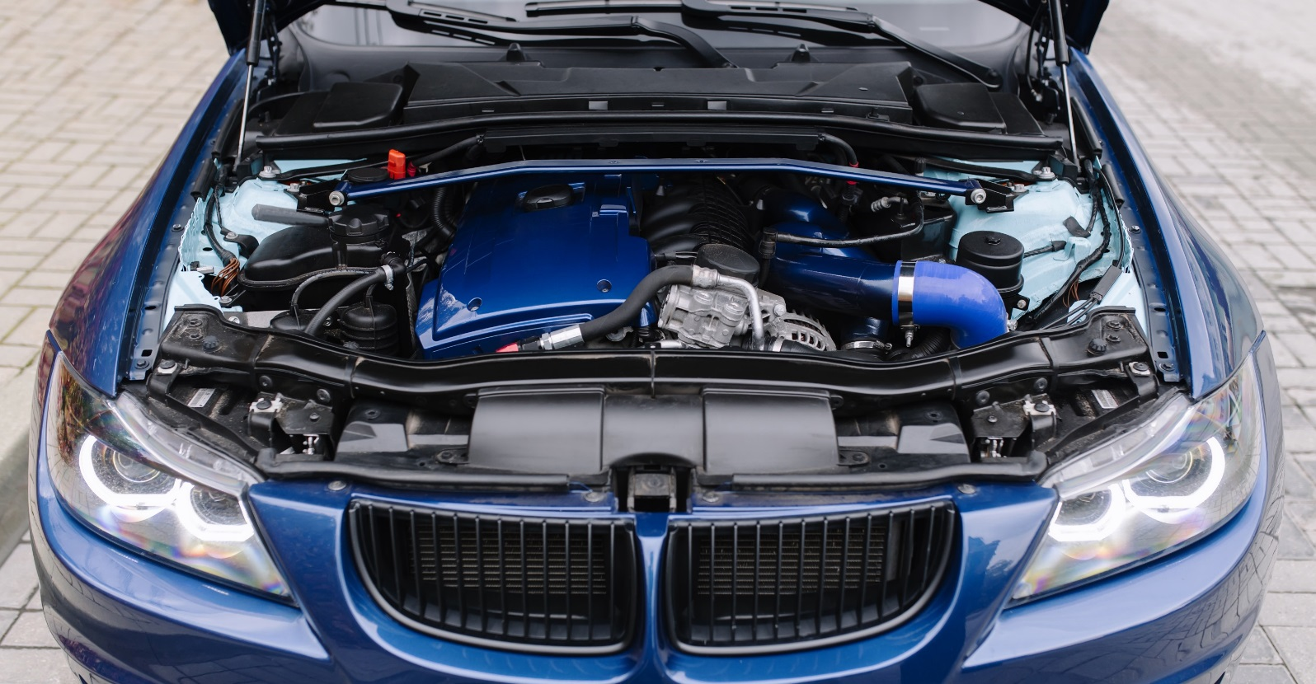
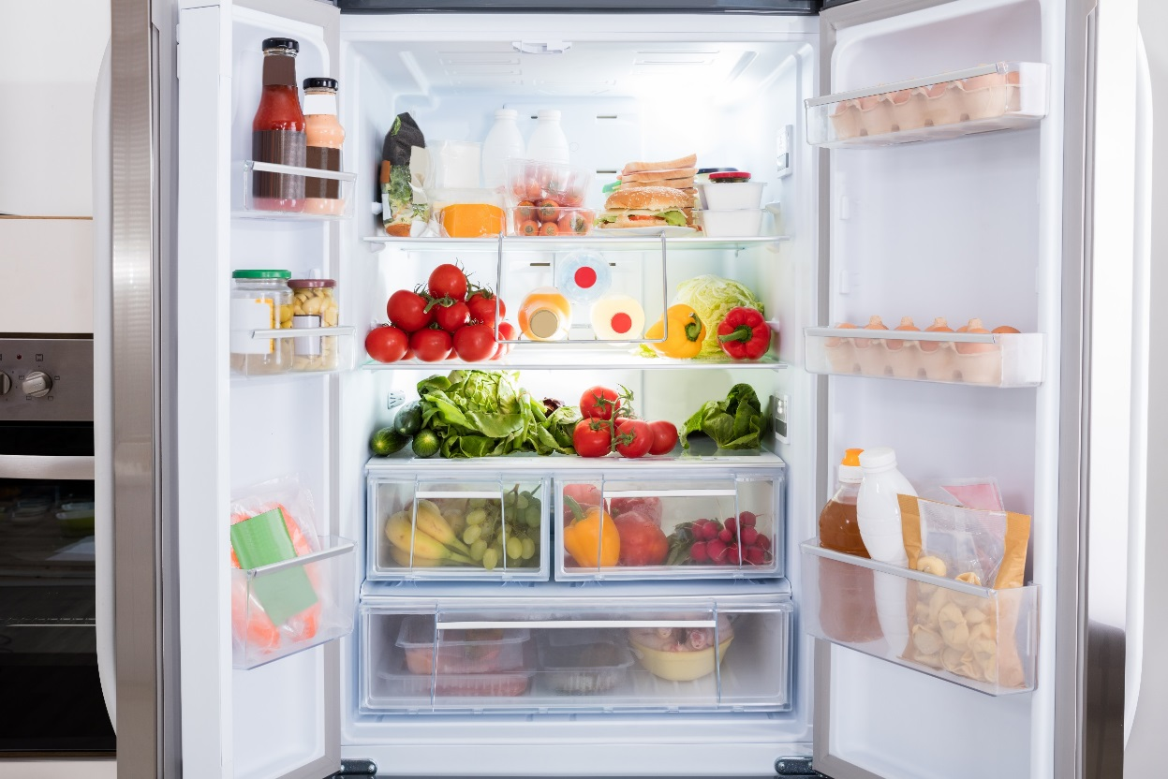
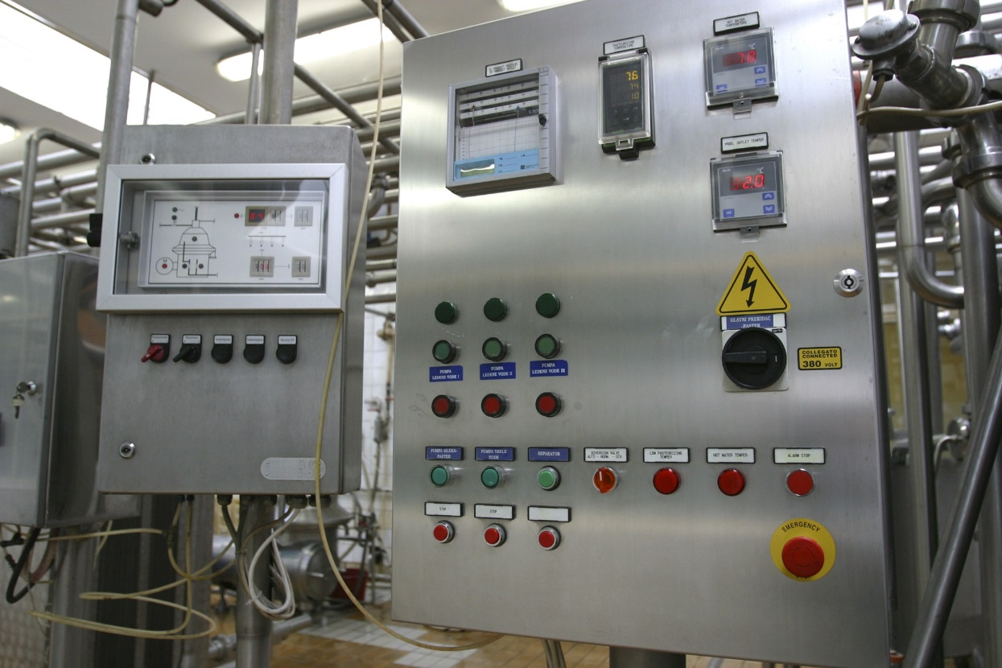
What are relays?
Relays are switches that are turned on and off using electricity.
Relays allow a low-power signal to control a large amount of power.
Relays are all around us.
Sous Vide application: Relays will be used to activate the heater.
Refrigerator - turns on compressor when temp gets low
Automobiles
Industrial Controls

Slide 5
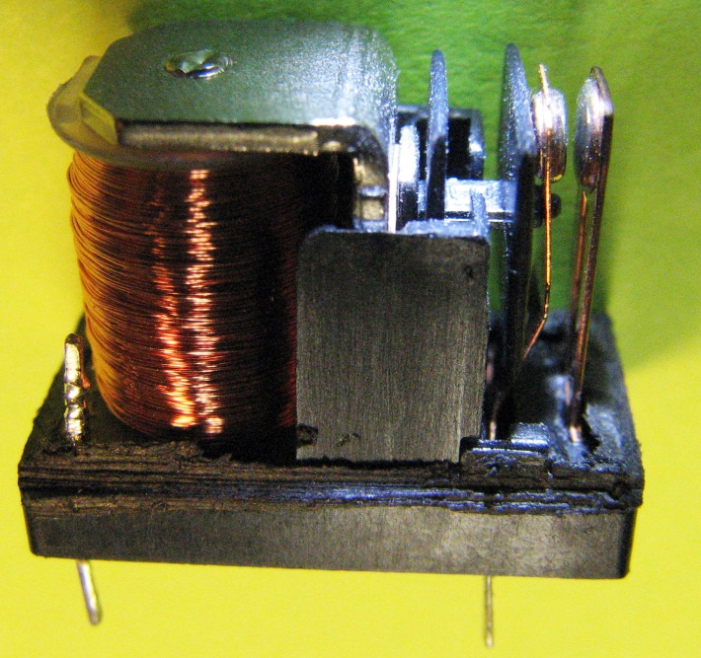
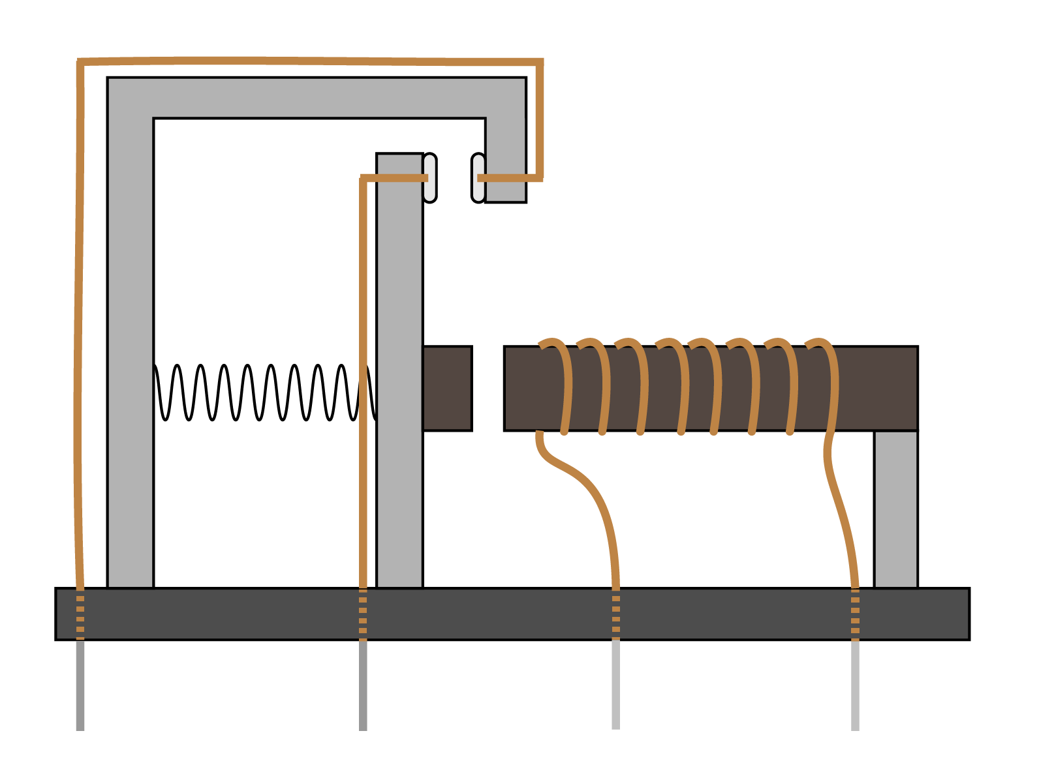
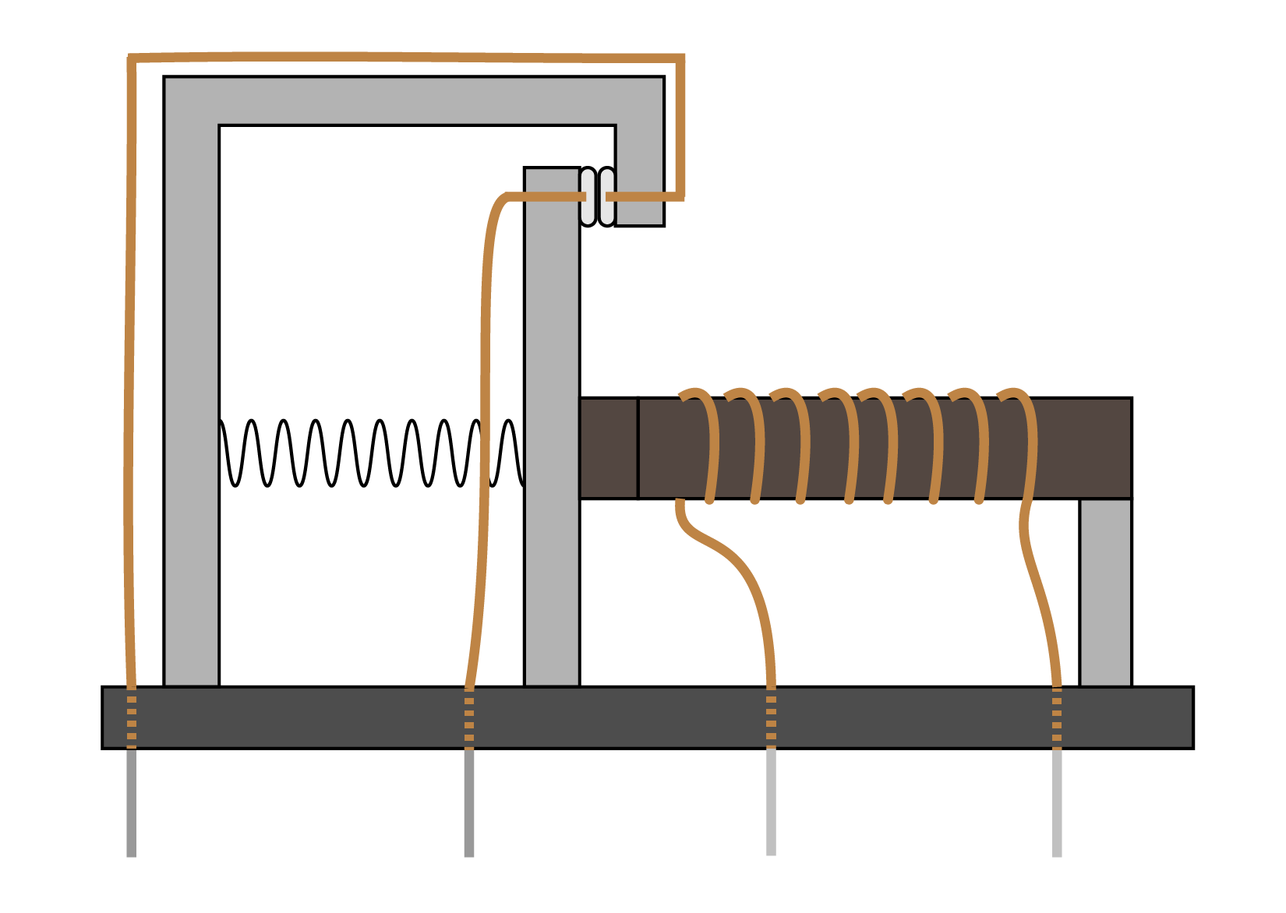
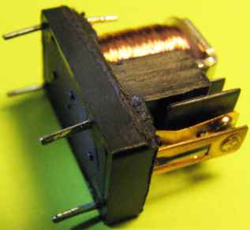
How do relays work?
Inside the relay used in this class:
Relays pass a small current through a coil which causes the iron core to become magnetized
This electromagnet attracts an iron mass on the moveable contact causing it make contact with the stationary contact
With the contacts touching, a much larger current can pass to drive the load of the circuit
contacts
coil
moveable contacts
stationary contact
moveable contacts
stationary contact
coil leads
iron mass on moveable contacts
iron mass on moveable contacts
tension spring
tension spring
iron core that becomes an electromagnet
iron core that becomes an electromagnet
contact leads
contact leads
contact leads
coil leads
coil leads

Slide 6
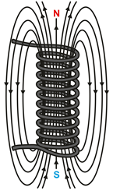
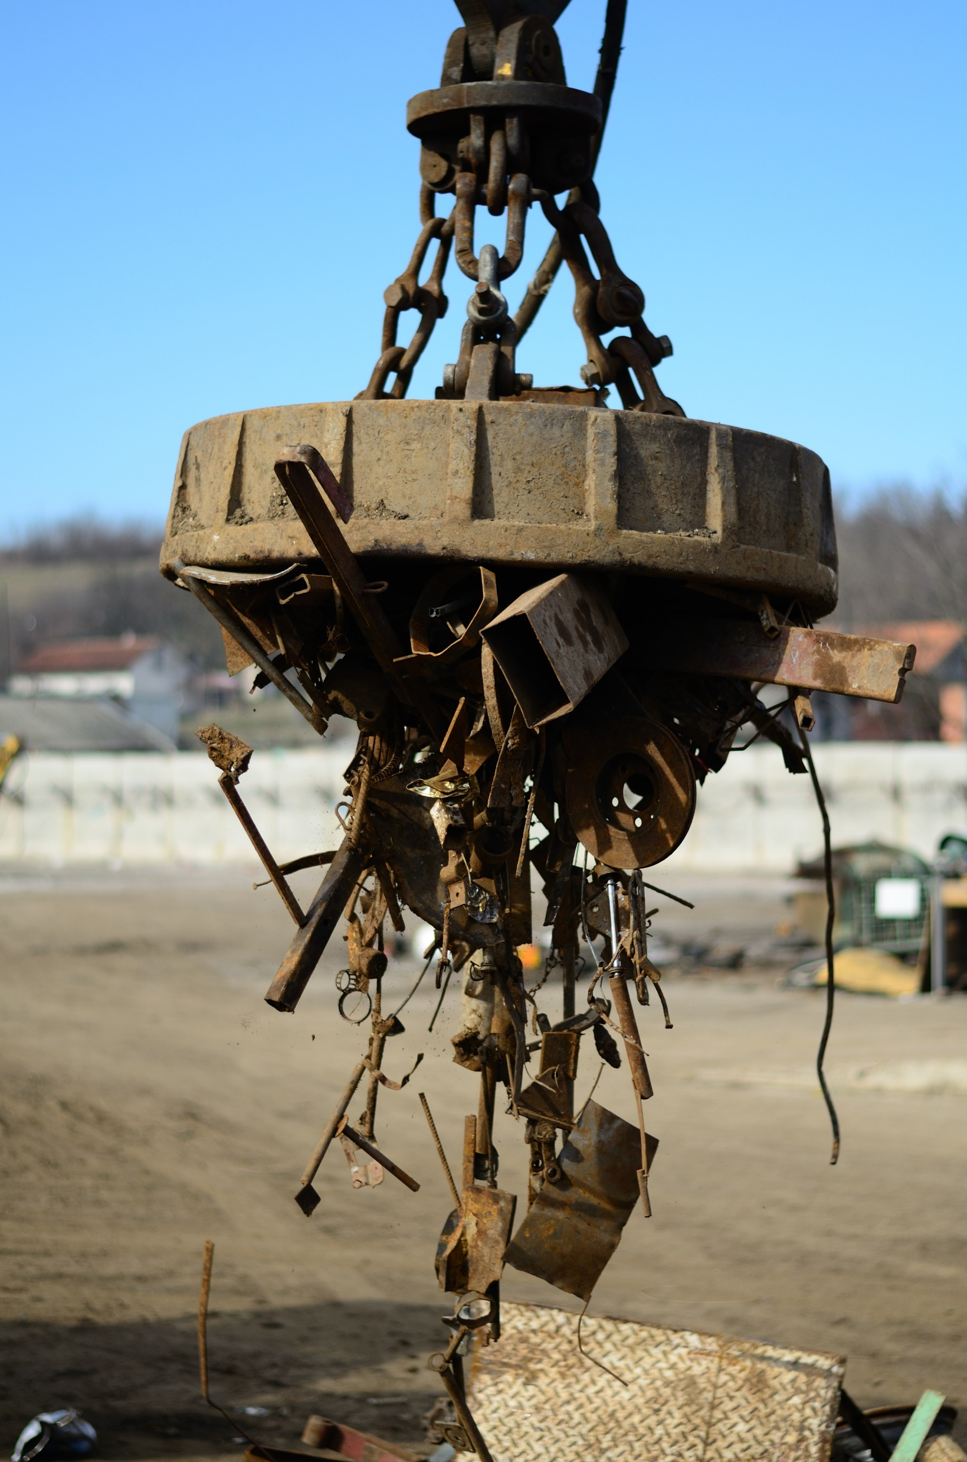
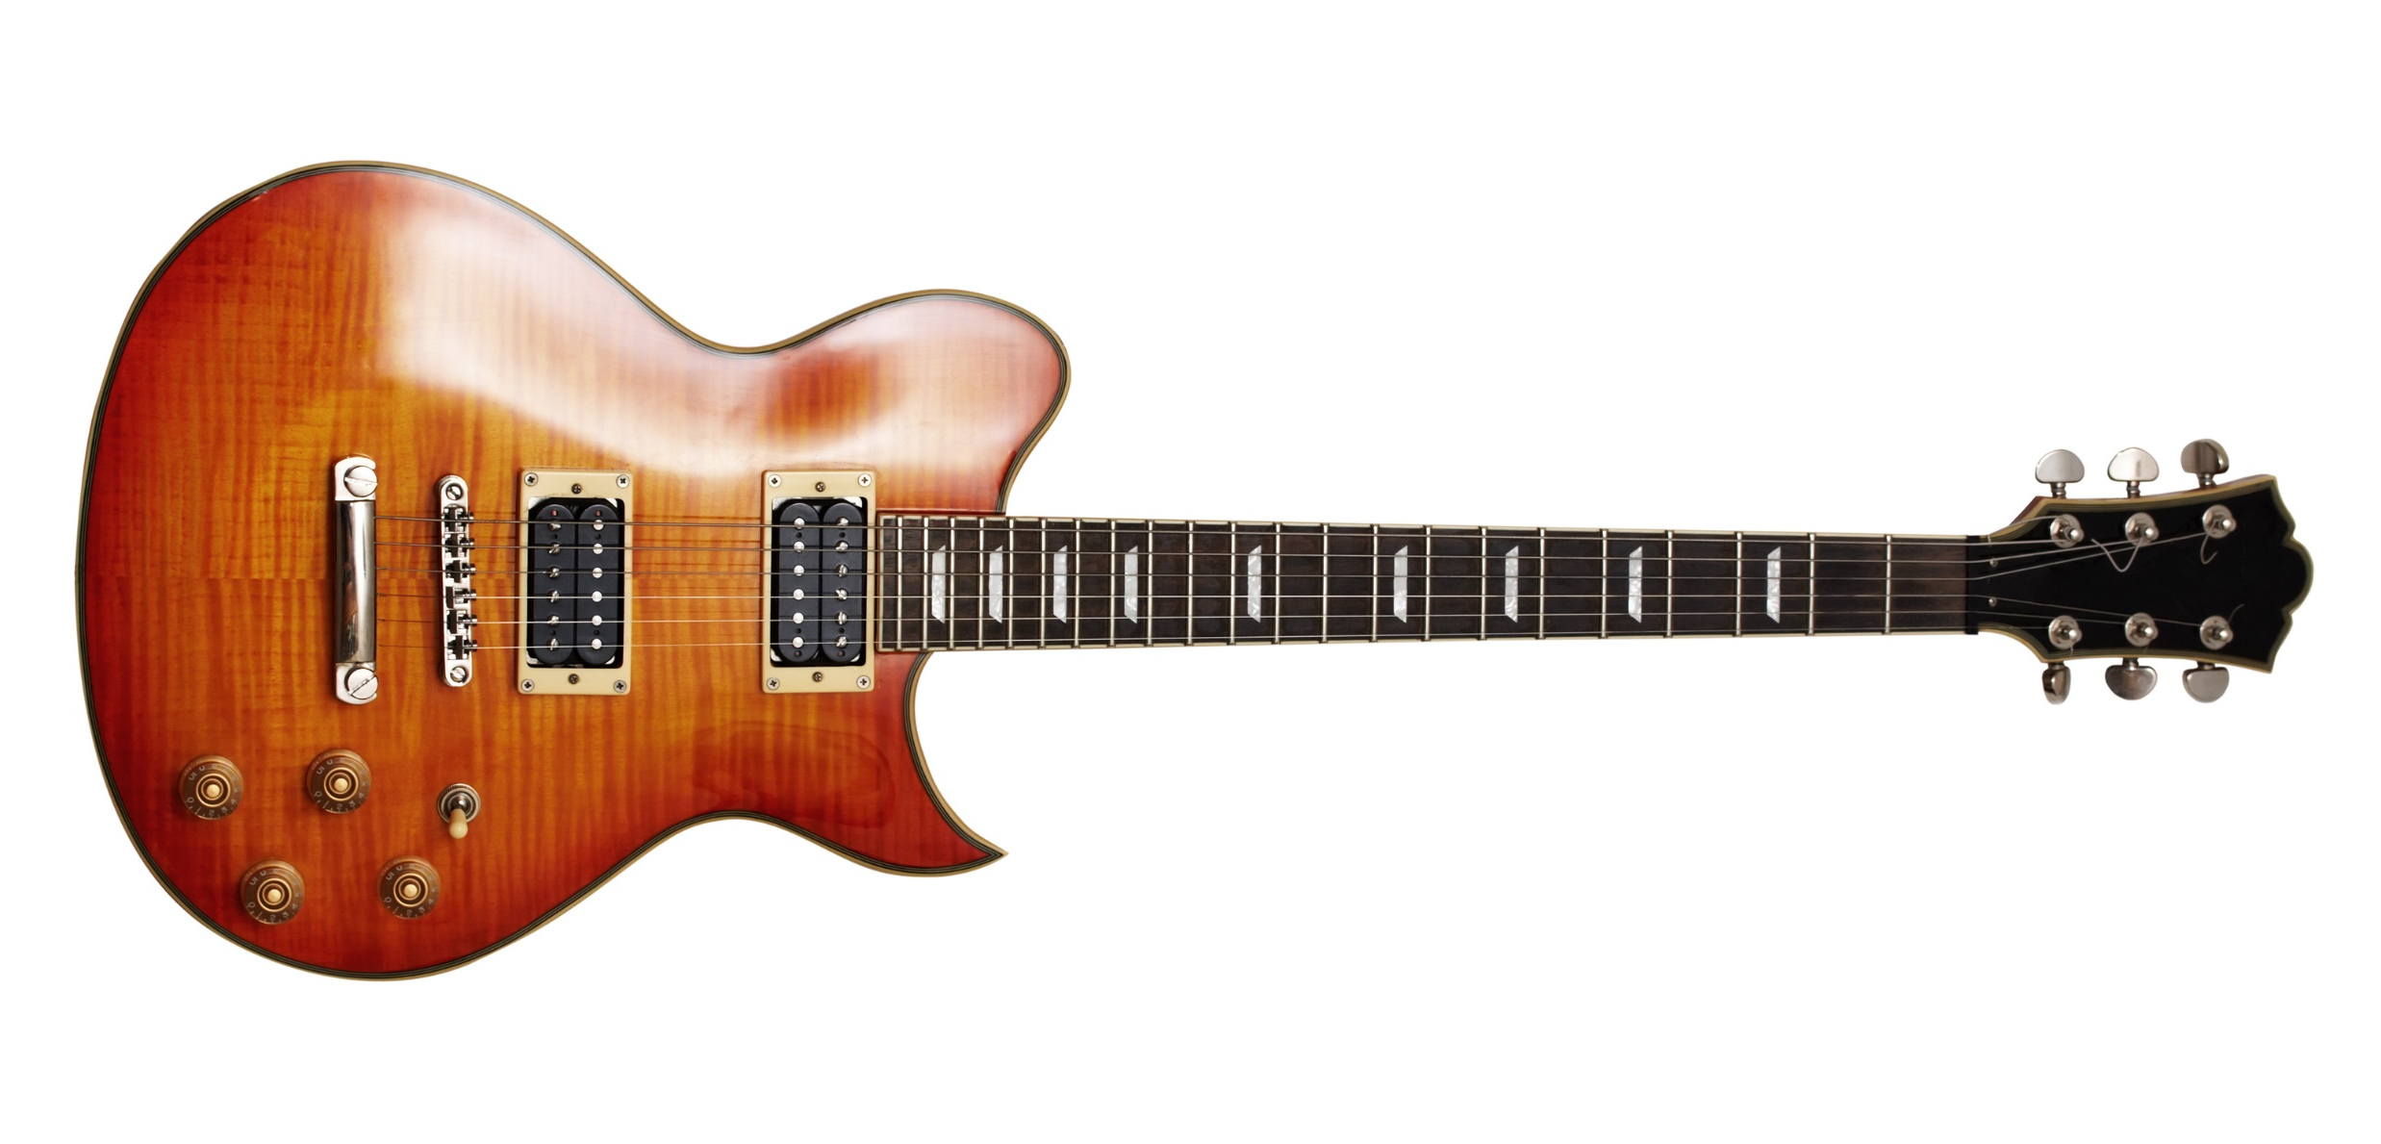
Relay Terminology
Electromagnet (Temporary Magnet)
Magnetic Field
current out
Electromagnets are temporary magnets created by sending current though metal that is coiled around iron to induce a magnetic field.
Why and how do you think a temporary magnet could be useful (not just with relays)?
Can you think of any examples of electromagnets?
coil carrying electric current
current in
coil
DC Motors
Magnetic Lifters
Scrap Yards
Electric Guitars
Doorbells
Inside of your Relay

Slide 7
Relay Terminology
moveable contacts
stationary contact
iron mass on moveable contacts
tension spring
Coil voltage – voltage that must be applied across the coil leads to open or close the contacts
Coil current – the amount of current drawn by the coil; this much current is required to close the contacts
Contact rating or contact current – the amount of current that can pass through the contact leads without damaging the relay
iron core that becomes an electromagnet
small current
contact leads
coil leads
much larger current
contacts
coil
Default state of contacts – the contacts can be either open (switch = off) or closed (switch = on) by default
Normally open (NO) relay – contacts are open when no current is passed through the coil
passing current through the coil causes the contacts to close, allowing power to flow through the contact leads
Normally closed (NC) relay – contacts are closed when no current is passed through the coil
passing current through the coil causes the contacts to open, preventing power from flowing through the contact leads
Normally Open
Is this relay NO or NC?
(assuming no current is flowing through the coil)

Slide 8
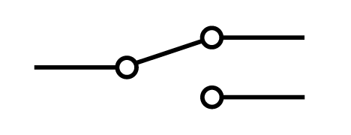
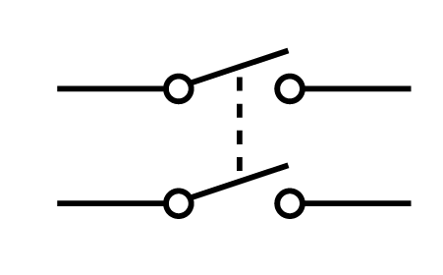
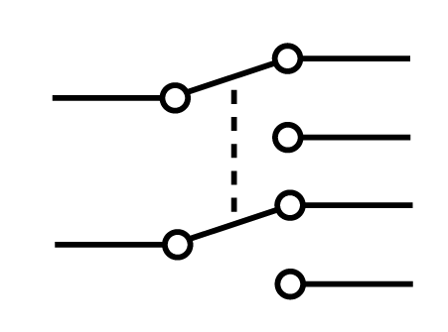
Relay Terminology
contacts
coil
Number of poles – the number of separate circuits that can be switched by energizing the coil
SP = single pole (one circuit is switched)
DP = double pole (two circuits are switched)
Throw – describes what happens to the contacts when the coil is energized
Single Throw
Energizing the coil of a single throw (ST) relay closes the contacts if it is a NO relay
Energizing the coil of a ST relay opens the contacts if it is a NC relay
Double Throw
Energizing the coil of a double throw (DT) relay can either open or close the contacts, depending on how it is wired
A DT relay can be wired to either come on or go off when the coil is energized
Single Pole
Is this relay SP or DP?
SPST
SPDT
DPST
DPDT

Slide 9
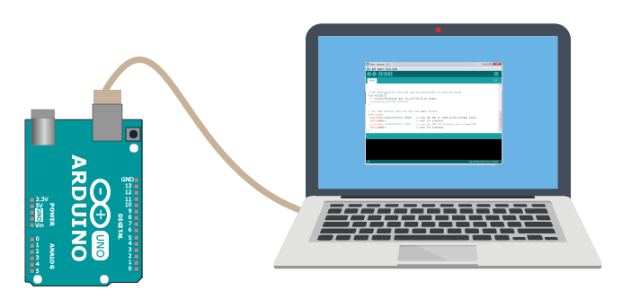
Sous Vide Application
A relay will be used to control the heater of your sous vide.
Recall, when you were learning about electricity and building circuits, you put a single resistor connected from power to ground. What happened?
You will be using the same principle for your sous vide heaters. Sous Vide heater will be a 10Ω resistor powered by the 9V power source.
Why do you think the relay will be useful for the heater?
The resistor got hot!
You can program a digital pin, which uses 5V from the Arduino, to be HIGH, to activate the relay coil. The relay will use the small current from the 5V source to close the contacts of the relay. This will allow for a second circuit connected to a larger voltage source to provide a larger current to pass through the heater.
Circuit 1: 5V from Arduino
Heater
Circuit 2: 9V from external power supply. Switched on using 5V source
9V
NOTE: This is a generalized version of the circuitry, more components will be needed for implementation.

