Slide 1
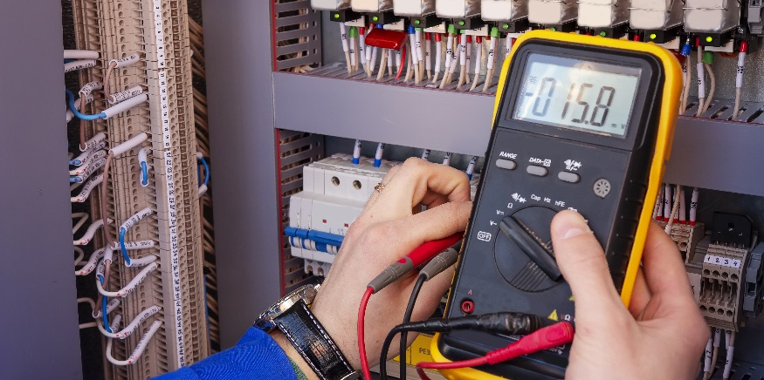
What’s In Your Kit

Slide 2
DISCLAIMER & USAGE
This material is based upon work supported by the National Science Foundation's Advanced Technological Education Program under Grant No. 1801177.
Any opinions, findings, and conclusions or recommendations expressed in this material are those of the author(s) and do not necessarily reflect the views of the National Science Foundation.
2

Slide 3
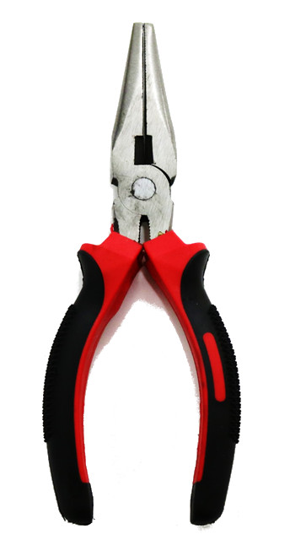
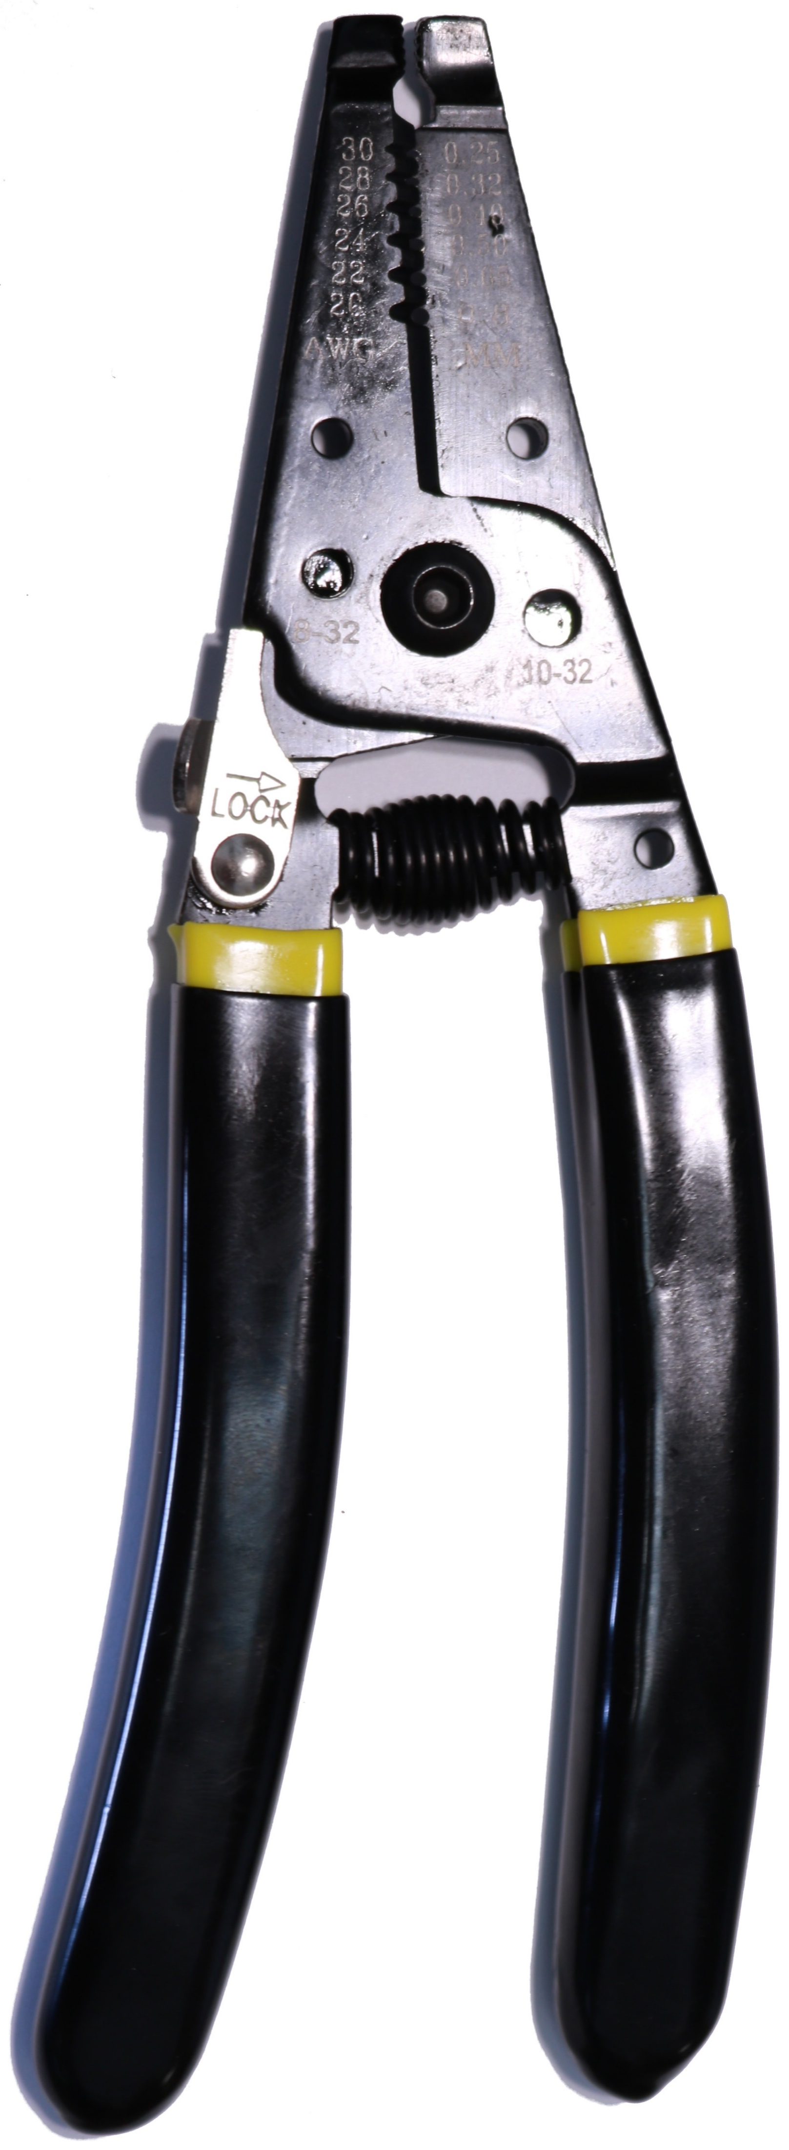
Find these in your kit…
What is different about each of the items shown?
What do you think/know each item is used for?

Slide 4
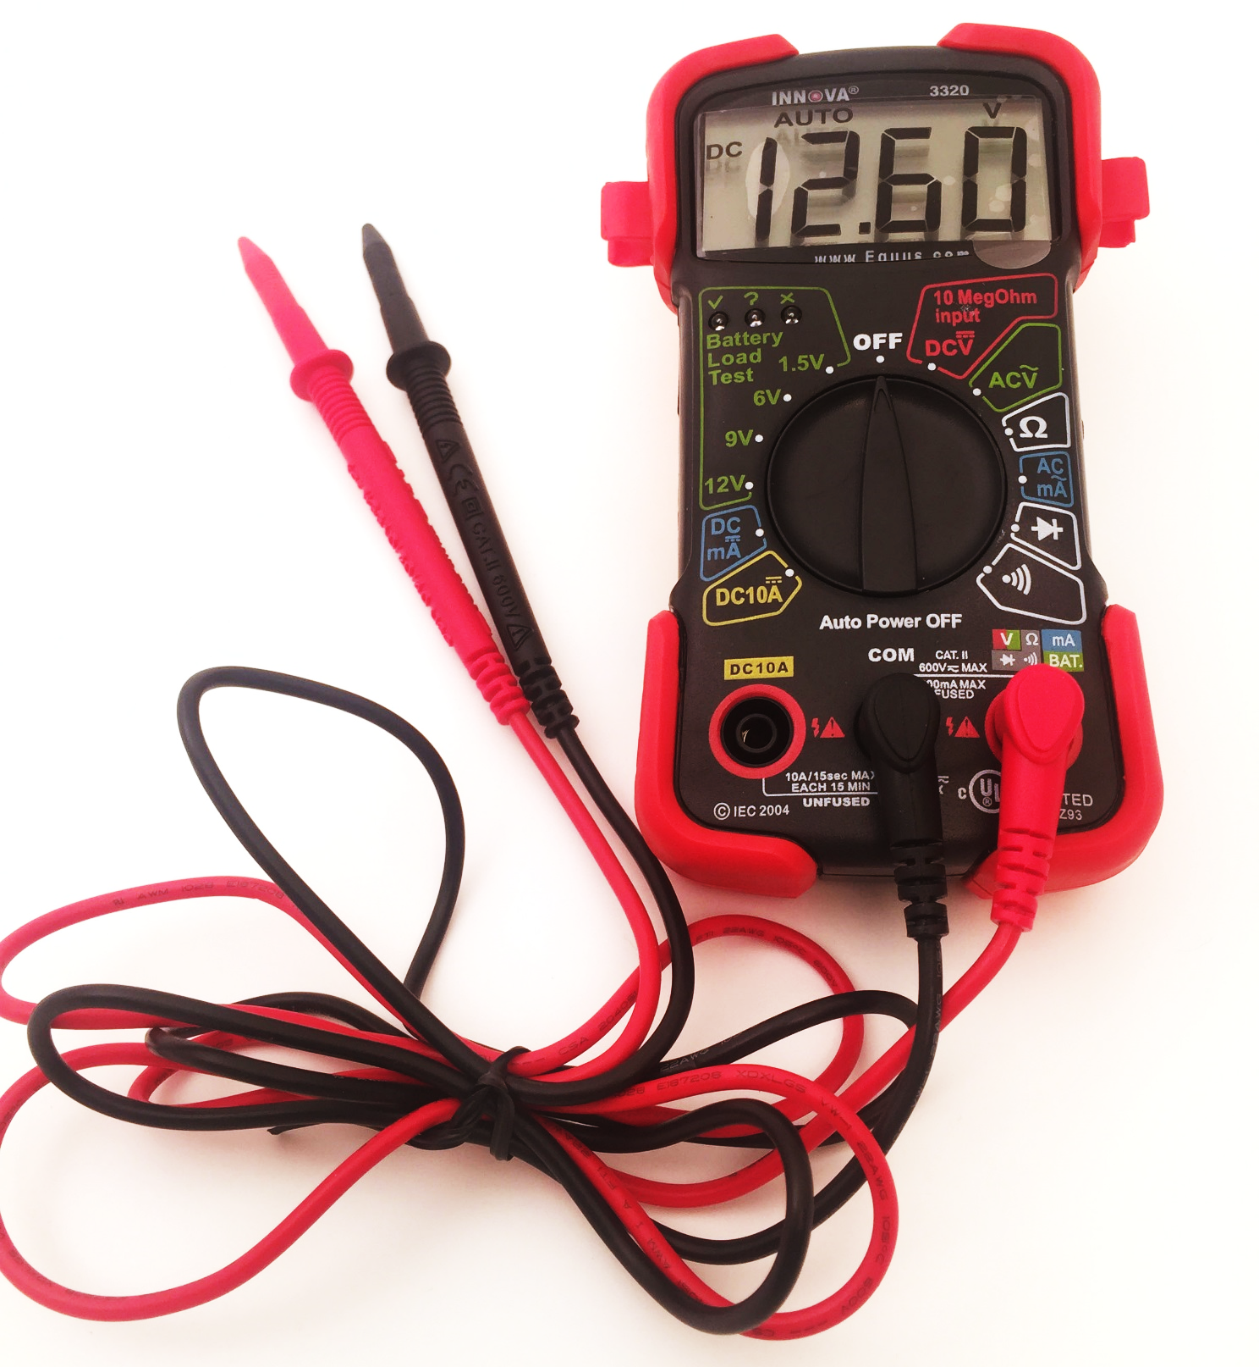
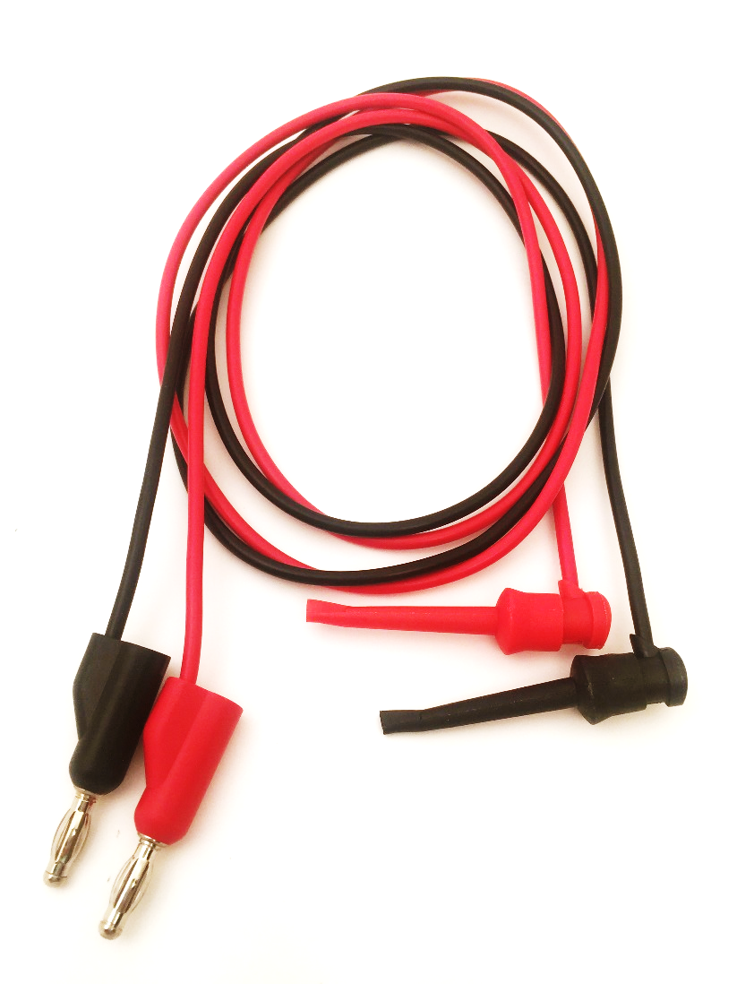
Find in your kit…
Discuss with the people at your table.
Does anyone know what is pictured?
What do you think/know it is used for?
How do you think you will use it in this class?

Slide 5
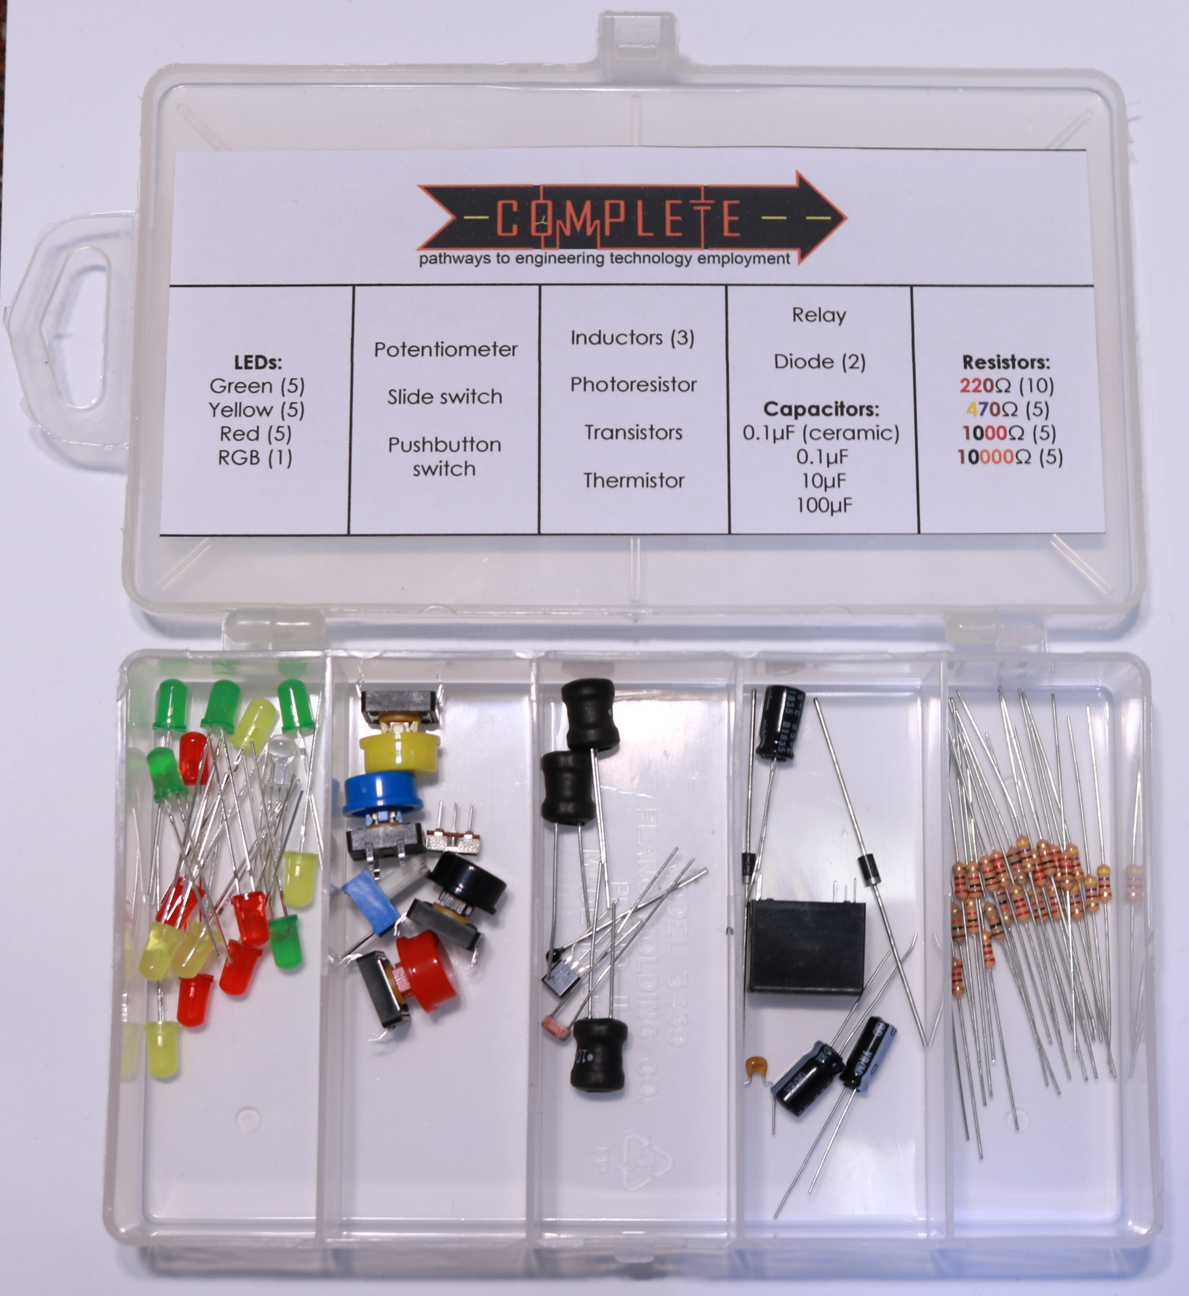
Find in your kit…
Discuss with the people at your table.
Does anyone know what any of the items pictured?
What do you think these items are used for?
How do you think you will use it in this class?

Slide 6
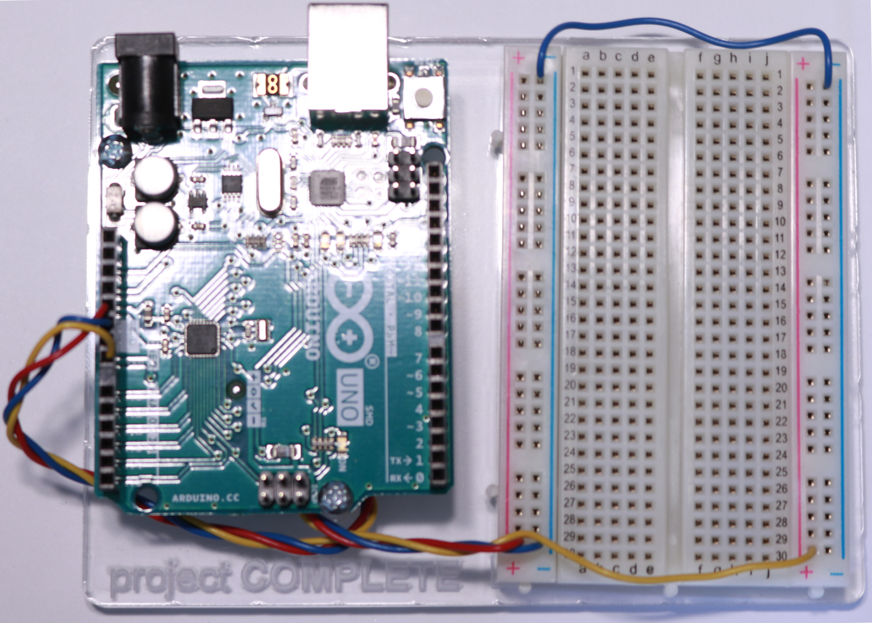
Find in your kit…
Discuss with the people at your table.
Does anyone know what is pictured?
What do you think/know it is used for?
How do you think you will use it in this class?

Slide 7
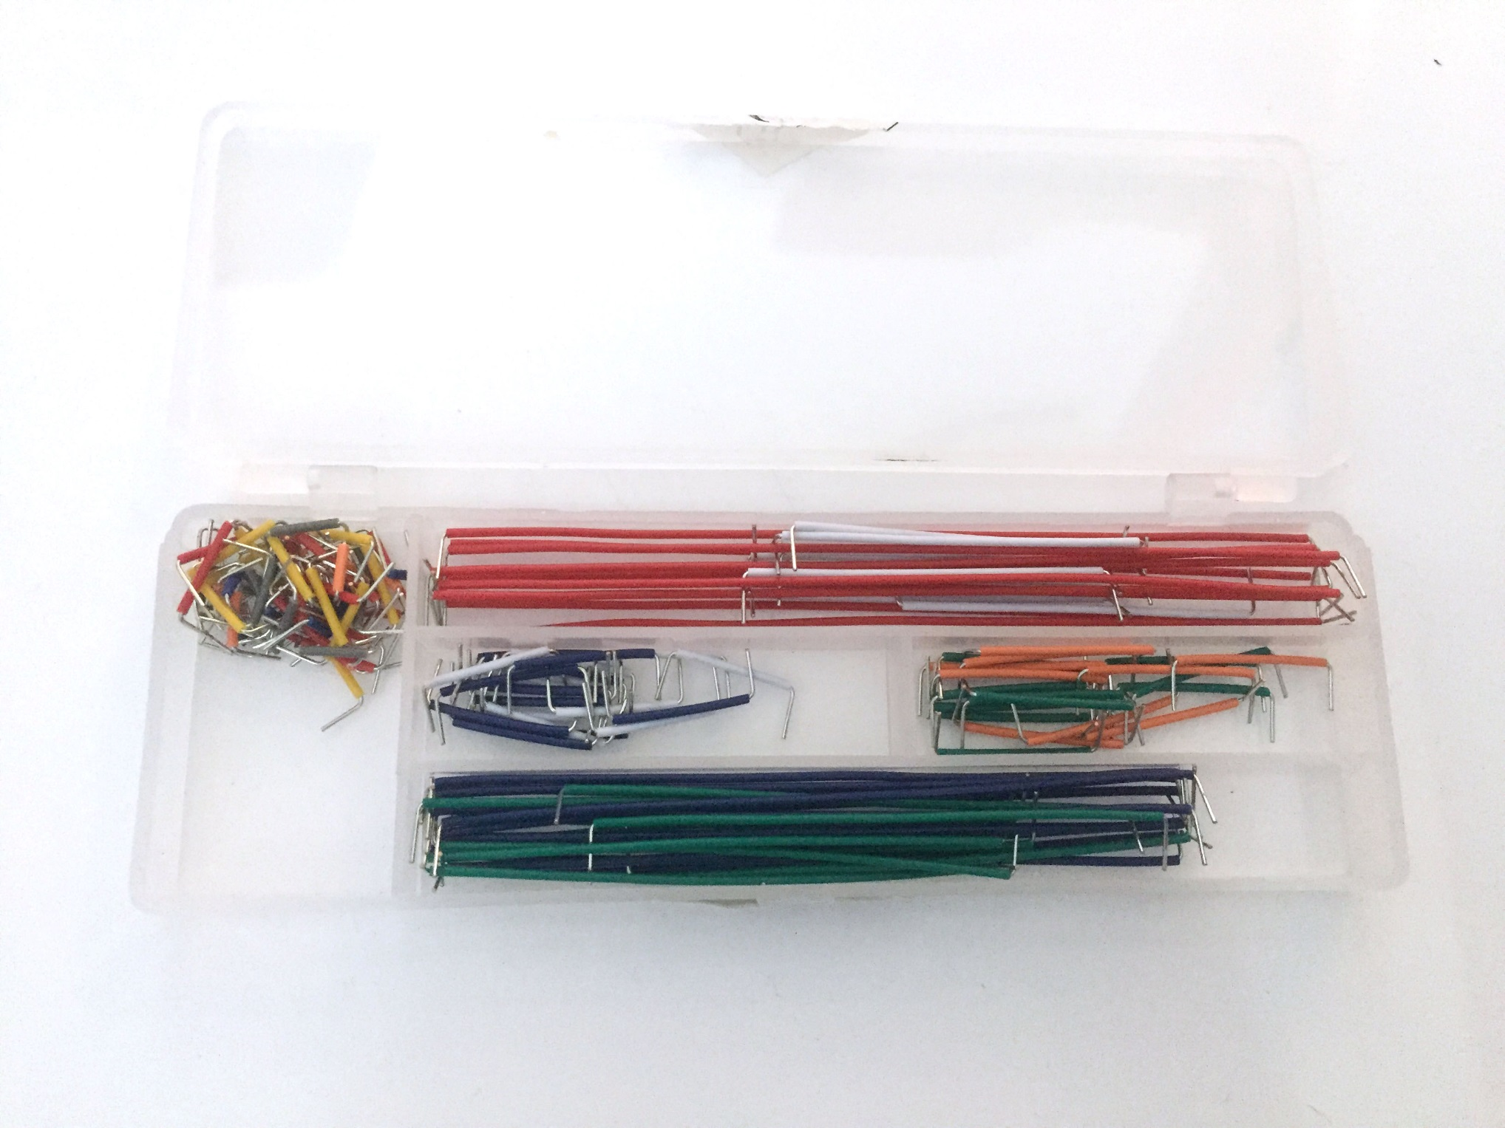
Find in your kit…
Discuss with the people at your table.
Does anyone know what is pictured?
What do you think/know it is used for?
How do you think you will use it for Living with the Lab?

Slide 8
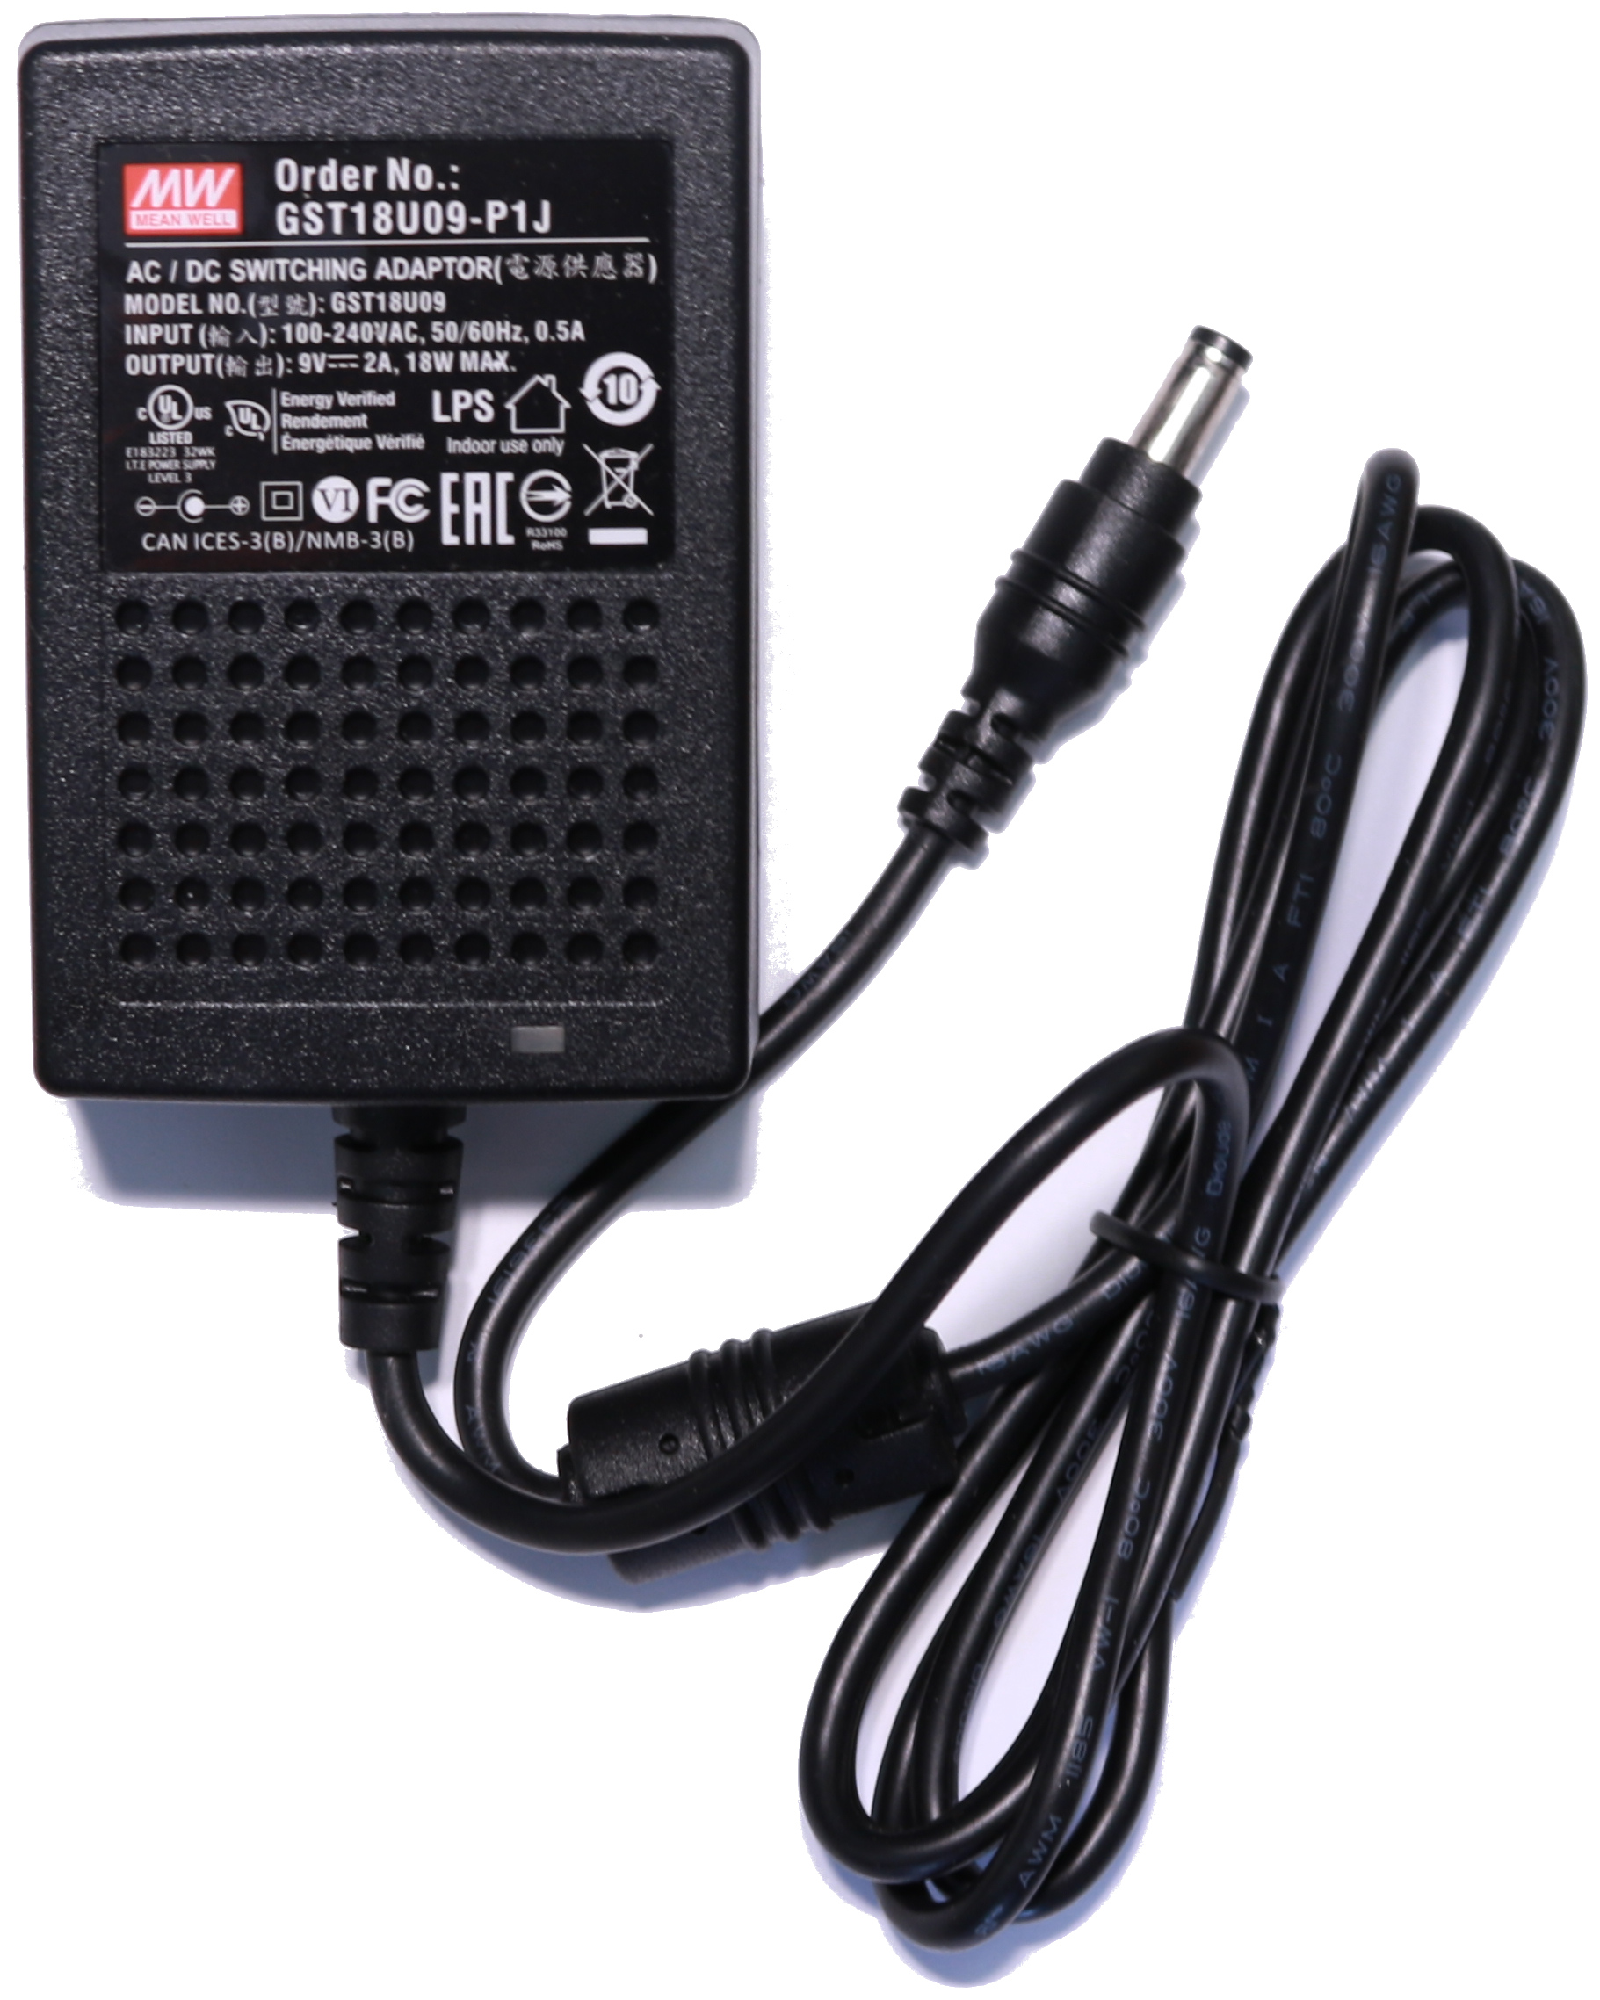
Find in your kit…
Discuss with the people at your table.
Does anyone know what is pictured?
What do you think/know it is used for?
How do you think you will use it in this class?

Slide 9
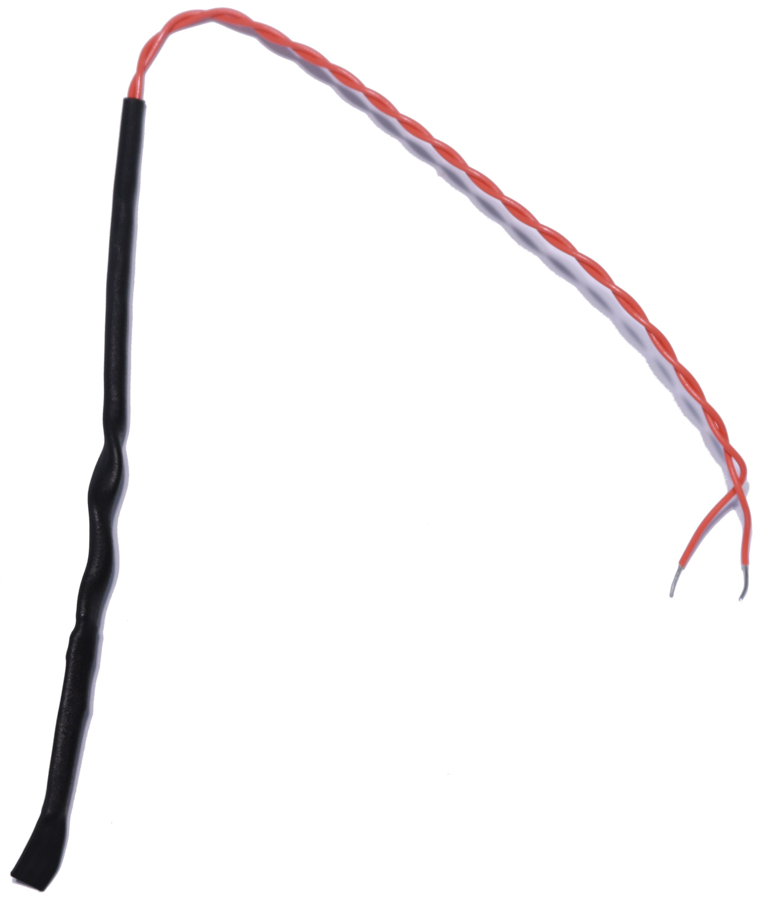
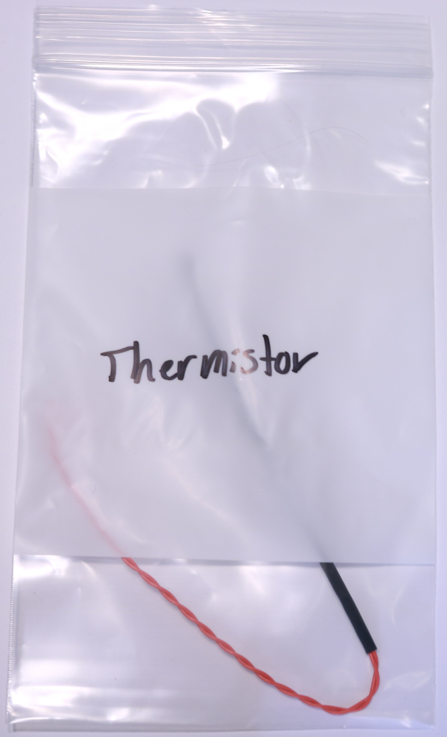
Find in your kit…
Discuss with the people at your table.
Does anyone know what is pictured?
What do you think/know it is used for?
How do you think you will use it in this class?

Slide 10
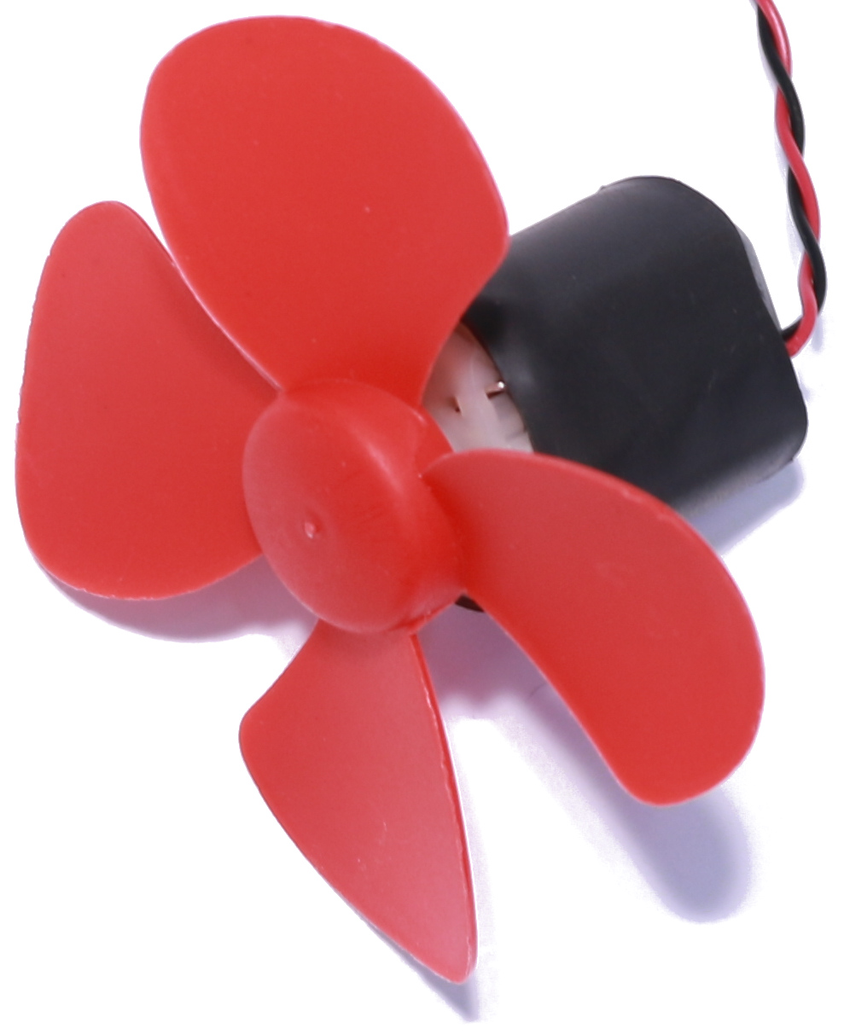
Find in your kit…
Discuss with the people at your table.
Does anyone know what is pictured?
What do you think/know it is used for?
How do you think you will use it in this class?

Slide 11
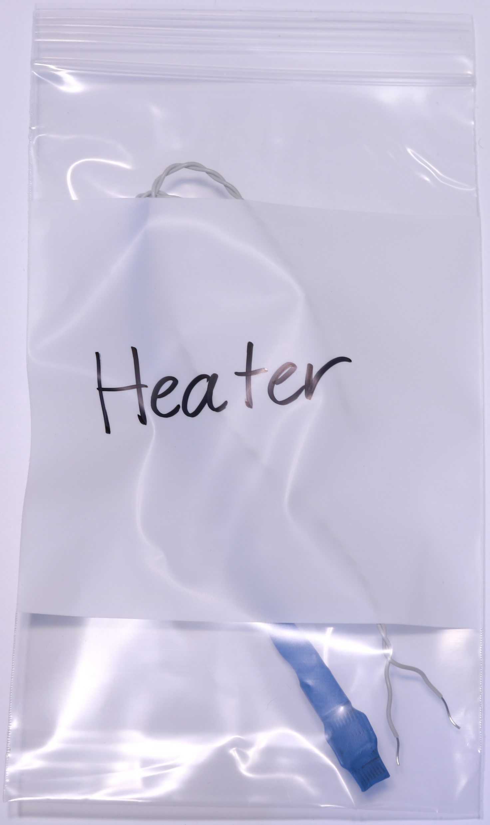
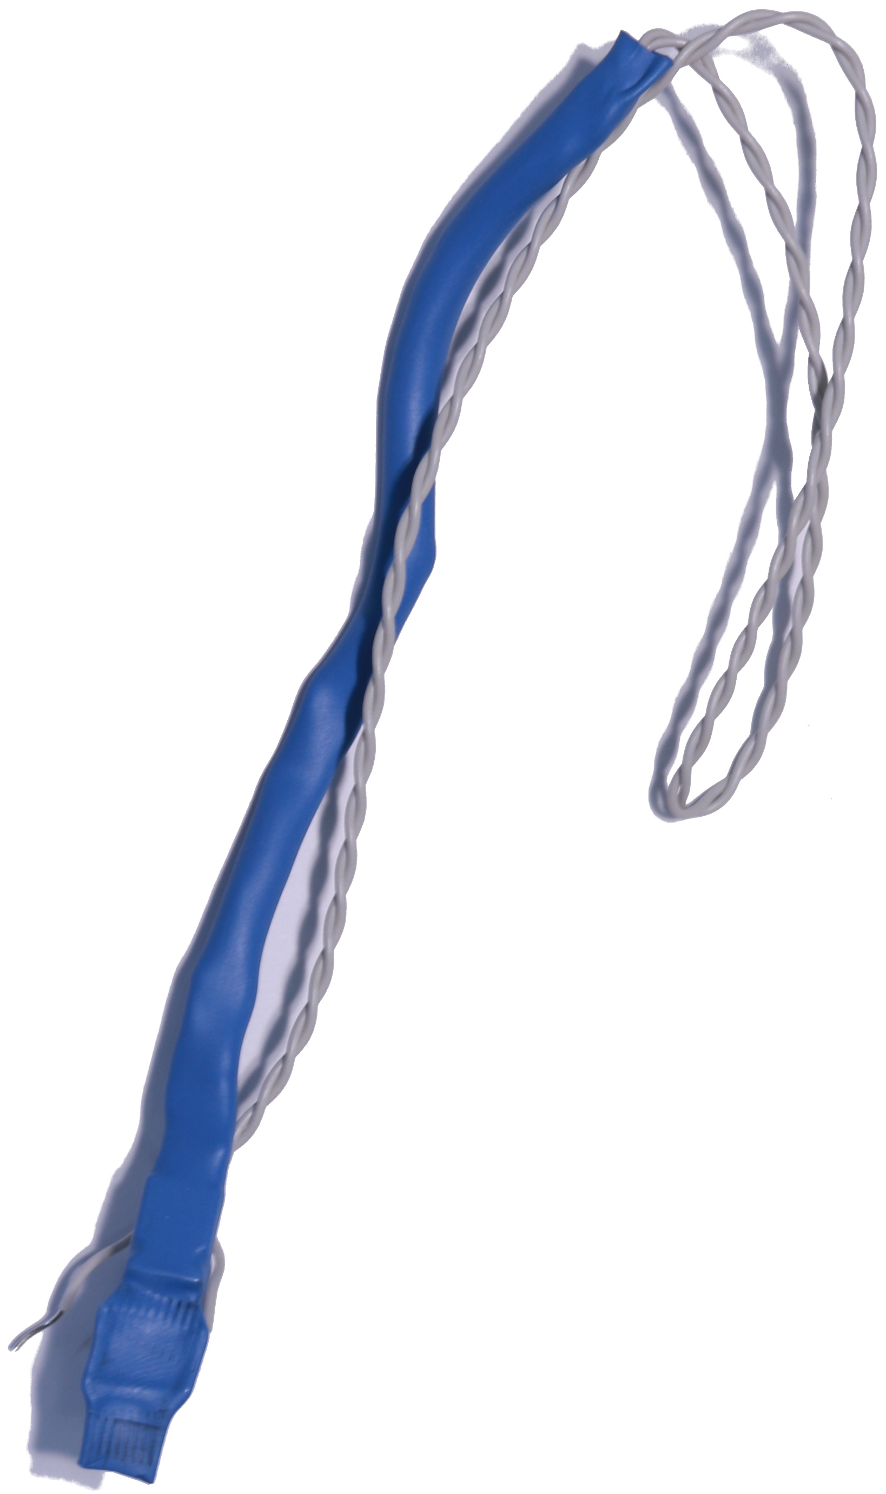
Find in your kit…
Discuss with the people at your table.
Does anyone know what is pictured?
What do you think/know it is used for?
How do you think you will use it in this class?

Slide 12
Things you should know:
You may not use everything in your kit this term
You will eventually use it all
Keep track of your kit
The cost of the kit is approximately $100
Lost items can be purchased at local/online stores

