Slide 1
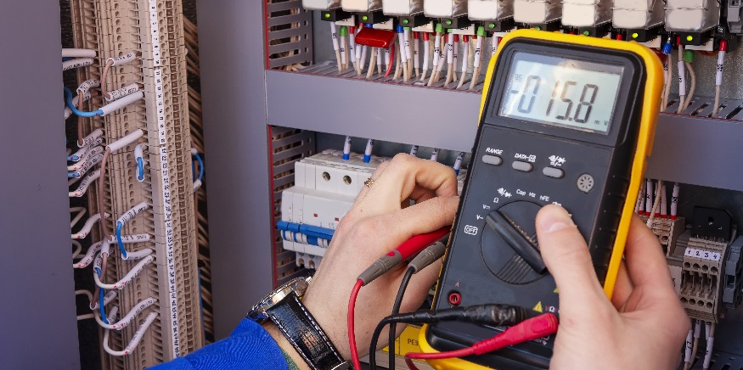
Inductors

Slide 2
DISCLAIMER & USAGE
This material is based upon work supported by the National Science Foundation's Advanced Technological Education Program under Grant No. 1801177.
Any opinions, findings, and conclusions or recommendations expressed in this material are those of the author(s) and do not necessarily reflect the views of the National Science Foundation.
2

Slide 3
The Inductor
A component that has the ability to store electrical energy in a magnetic field.
Constructed of an insulated wire coiled around a solid core
The water analogy may be used to realize how the energy is stored.
Schematic
Symbol
There are three main classifications of inductors:
Air core
Iron core
Variable
Solid Core
Coil

Slide 4
The Water Analogy
The behavior of electricity may be likened to the behavior of water.
Electric voltage is like water pressure.
Electric current is like the flow of water.
An inductor behaves like a water hose.
Does water stop flowing exactly when the water faucet is turned off? Why?
Energy is stored in the swelling of the water hose.
That energy is released when the water is turned off.

Slide 5
Inductor Behavior
When a voltage source is applied to an inductor:
Current flow produces a magnetic field in the inductor
As the current increases, the magnetic field expands
As the current decreases, the magnetic field contracts
With changing current, the expanding/contracting magnetic field creates a voltage in the inductor.
The voltage created in the inductor opposes the applied voltage.
If the current is not changing, there is no voltage created in the inductor.

Slide 6
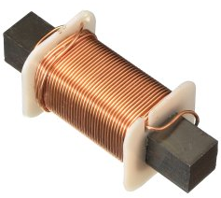
Inductor Types
Air core inductors consist of coiled wire with no core.
Often used to keep current at a constant level
Sometimes a cardboard or plastic core is used
Iron core inductors have higher inductor values.
The iron core promotes the produce of the magnetic field
Electromagnets are an example of an iron core induction type device
Variable inductors have to ability to change their inductor value.
Often used in transmitters and receivers

Slide 7
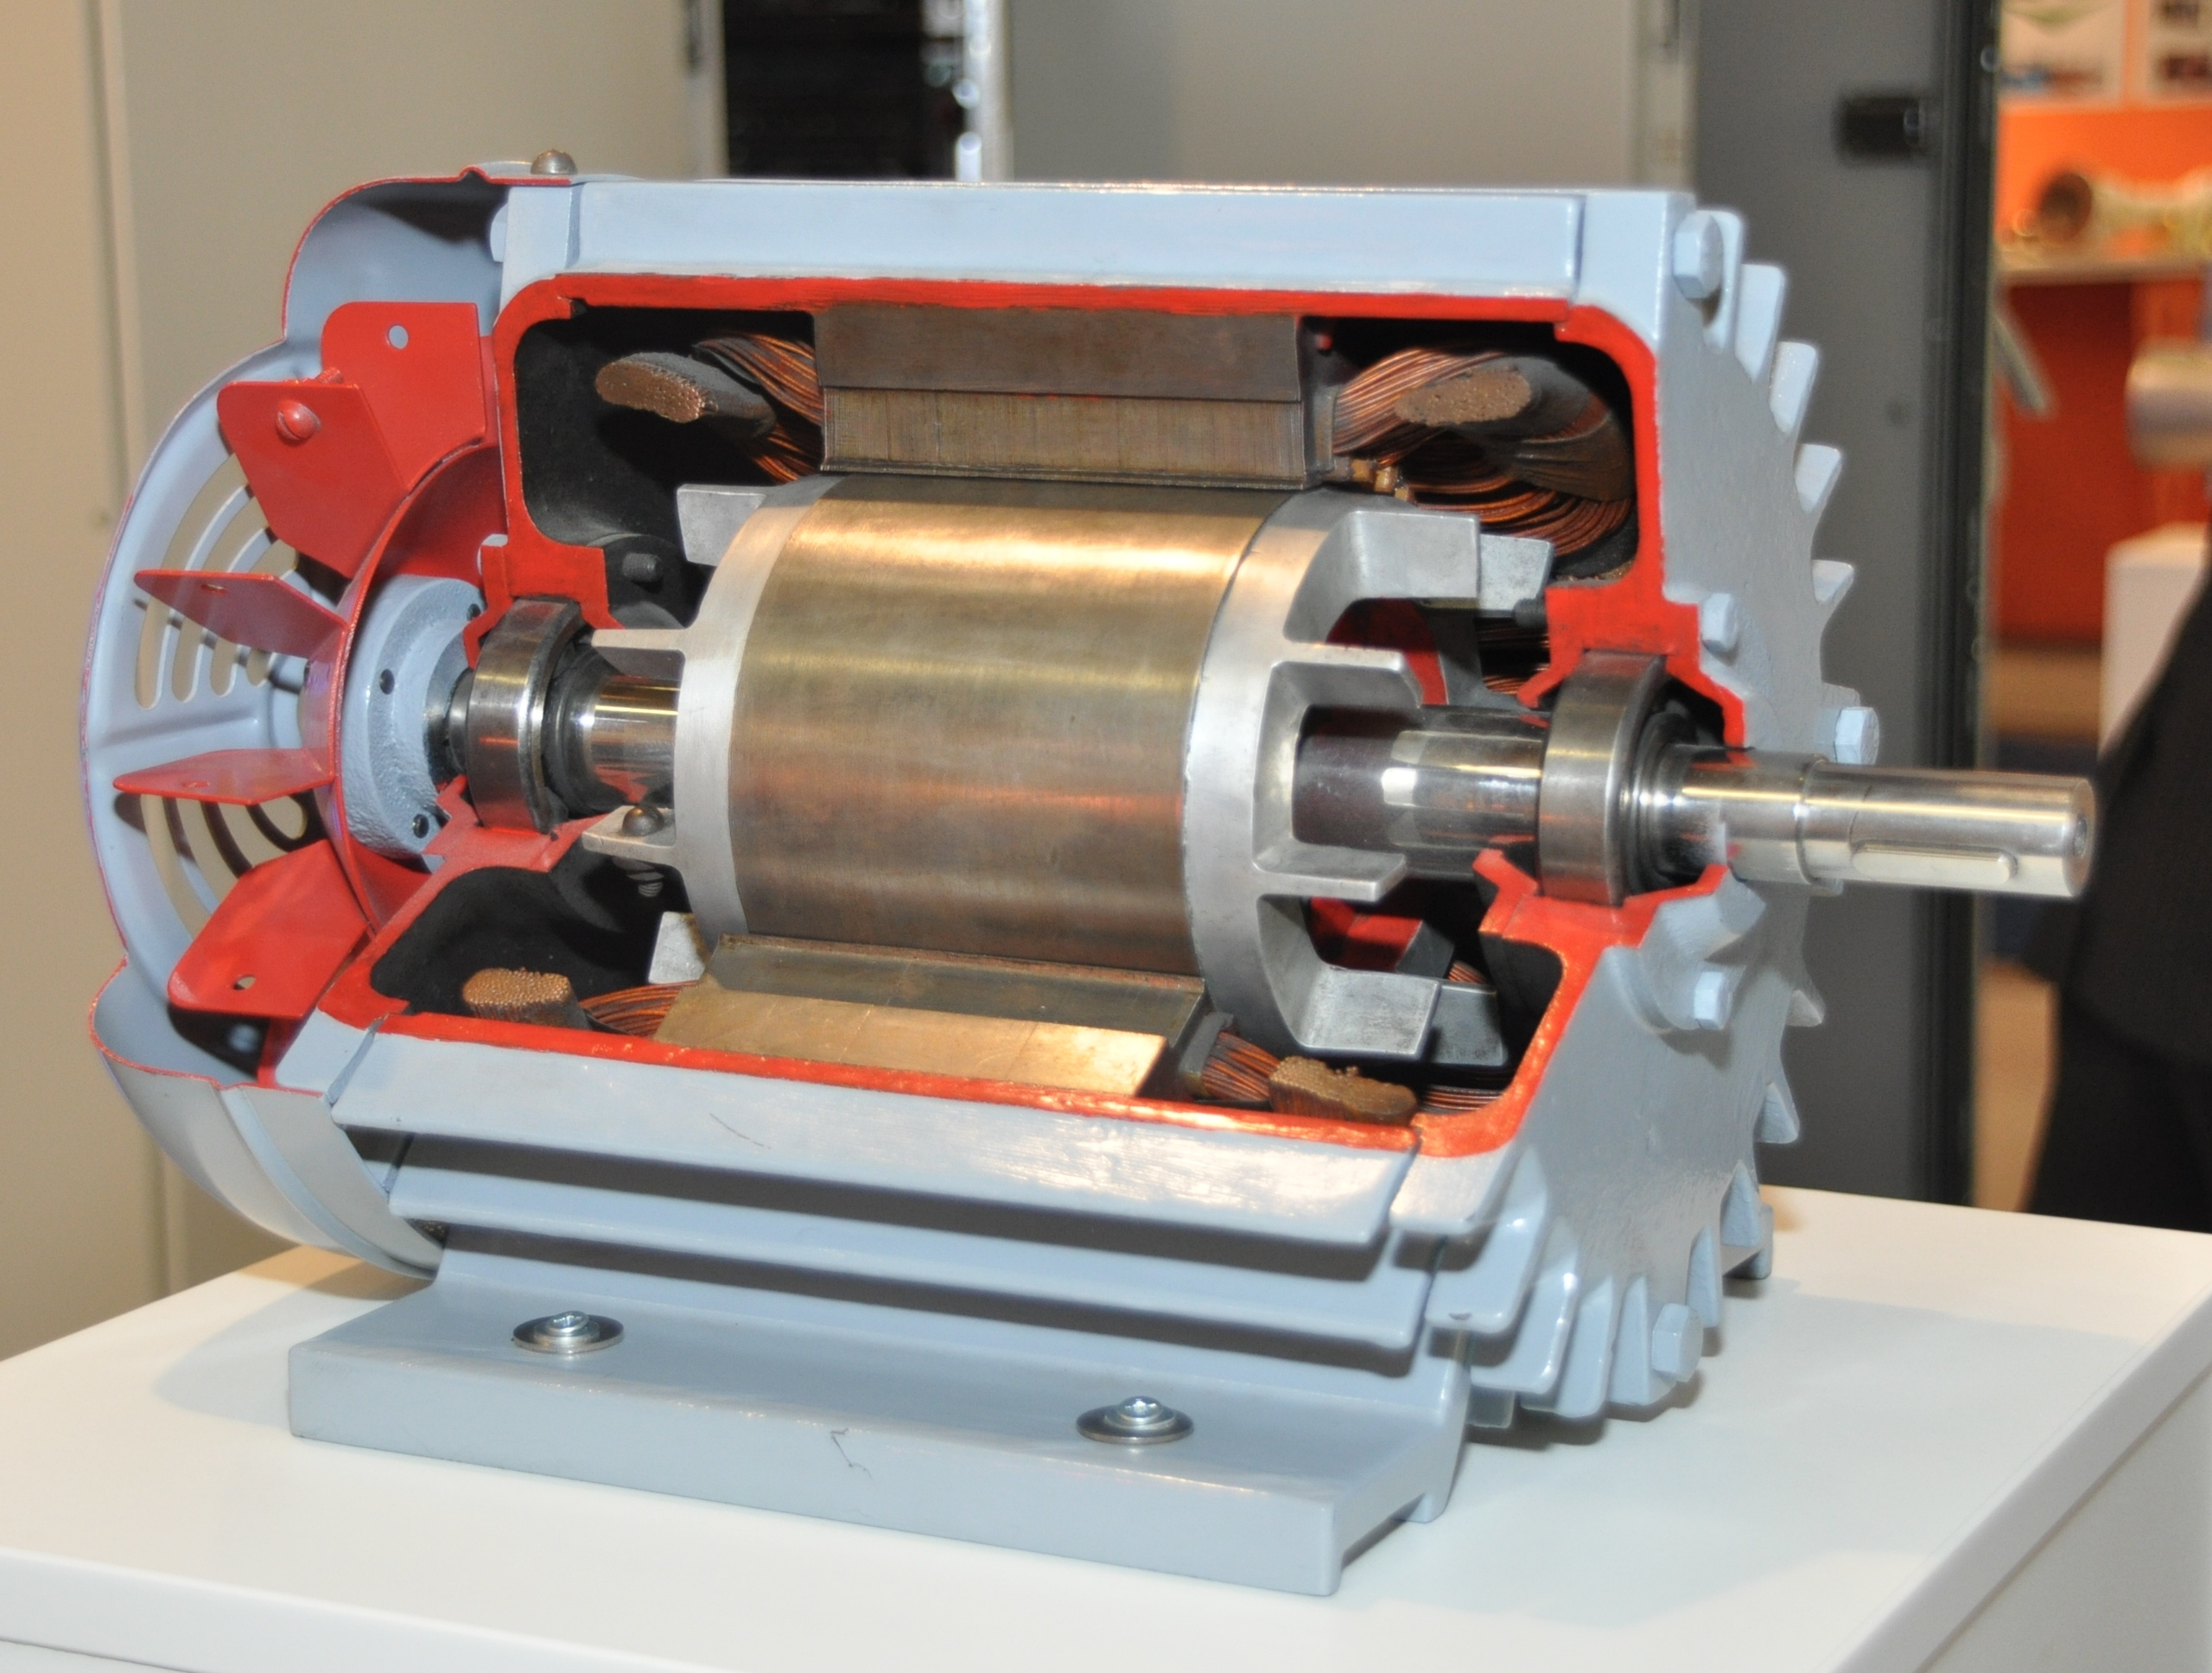
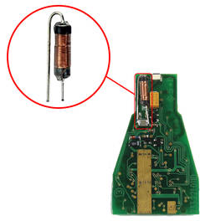
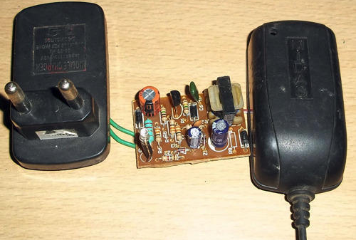
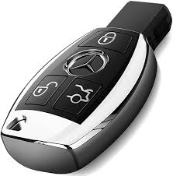
Common Inductor Applications
Voltage transformers
Certain types of phone chargers use inductors to change the voltage from the wall to the voltage of the phone.
Keyless entry
Certain types of keyless entry devices use the magnetic field created by an inductor to open doors.
In industry, induction motors
An induction motor is a common industrial motor that uses the magnetic field generated by an inductor to produce rotary motion.
Transformer cut in half

