Slide 1
Electrical Basics for Fluid Power
Created by Tom Wylie, 5/4/18

Slide 2
Electrical Basics for Fluid Power
After viewing this document, the student should be able to:
1. Determine what scale the dial should be set for on a digital multi-meter for a specific test.
2. Identify symbols for a solenoid on a pneumatic and electrical print.
3. Test a solenoid coil with a digital multi-meter, while out of circuit.
4. Test a N.O. and N.C. pushbutton with a digital multi-meter, while out of circuit.
5. Determine which control voltage is used for a specific electro-pneumatic application
6. Explain the basic operation of an electro-mechanical relay.
7. Predict the voltage that should be measured in an electrical circuit.
8. Explain what a Start/Stop hold-in circuit is in relay logic.
9. Explain the operation and symbology of a proximity sensor/switch.
10. Explain the operation of the electrical circuit of the continuous operation circuit.

Slide 3
Please Read This
This document is to overview the operation of a pneumatic system, based on the hardware the student will use in the fluid power lab.
The intent of the document is the student to get a good understanding of the hardware used in the course, as well as some basic pneumatic circuits.
The valves in the IND 134 HOA’s will be primarily Festo brands.

Slide 4
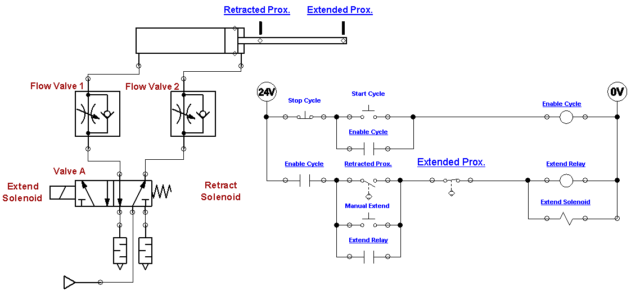
An Electro/Pneumatic Circuit:
This power point will use this electrical and pneumatic circuit to explain the electrical components, and how to troubleshoot them.

Slide 5
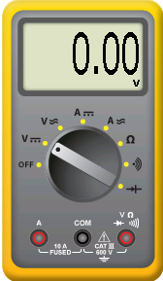
A digital multi-meter for testing:
It is important to know how to use a digital multi-meter to perform troubleshooting tasks. This example shows a digital multi-meter that is used in Automation Studio, but is also very similar to any actual digital multi-meter.
The focus will be on using the meter to measure voltage and resistance.
The dial in the center of the meter must be in the correct position.
**Warning: never use a meter in a powered circuit, if the dial is on the Resistance or Continuity setting. It can damage your meter.
The three things to measure with a digital multi-meter in this course is:
Voltage – Usually 24Vdc or 120 Vac
Resistance – Open Line, actual resistance, or continuity
Continuity – Will a contact, switch or coil pass current?
AC Volts
Resistance
Continuity
(audible)
DC Volts
Jack for measuring
Volts & Ohms

Slide 6
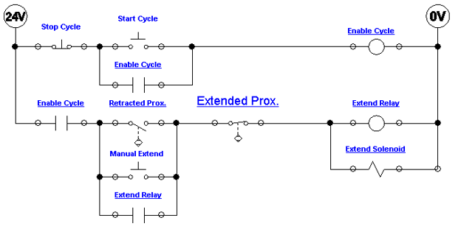
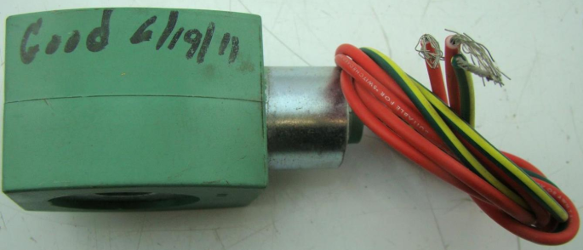
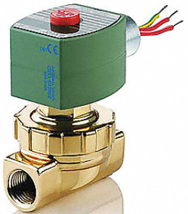
Solenoid Coil:
This slide shows the electrical circuit for the continuous operation circuit.
The most important part of this is to identify the solenoid coil symbol in the last rung of the circuit. This example shows a 2-way valve (2 ports). It is a valve that opens or closes off the flow of air, fluid, gas, etc.
The most important thing about these valves is that they have 2 parts: The valve (spring and plunger) that is actuated by the magnetic force of an electric solenoid. This type is termed an ASCO (manufacturer), red hat, due to the red cap. The cap is removed with a screwdriver, then the coil can be removed. If the device is on, you will feel the magnetism with a screwdriver. Sometimes the coil is bad (it opens), or the plunger sticks and must be replaced.
An important thing to remember is that if the coil is 120Vac, and is removed from the valve with power still on, a screwdriver must be inserted into the opening in the coil to keep the coil from burning up. No need to do this with a 24Vdc coil.
Electrical Symbol
for a Solenoid Coil
Solenoid Coil
Solenoid Valve

Slide 7
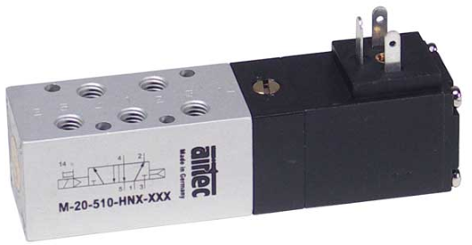
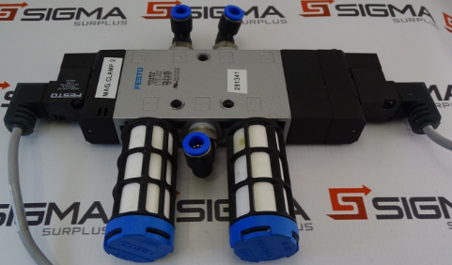
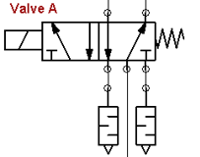
Solenoid Coil on Directional Valve:
This slide will show the solenoid actuated directional control valve. The graphic in the lower left corner will show a 5/2 valve, that is dual solenoid actuated.
This will allow the user to compare the solenoid symbol on a pneumatic print, with the solenoid symbol on an electrical print.
Electrical Symbol
for a Solenoid Coil
Solenoid Coils
on the valve
Solenoid Coil on
pneumatic print

Slide 8
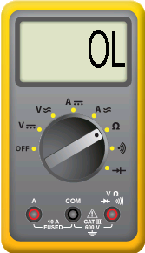
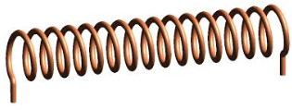
Checking the coil out of circuit:
To verify that a solenoid coil is good, the user can measure the resistance when it is not connected in a circuit.
If it is out of the circuit, and an ohmmeter (digital multi-meter on the resistance scale) is put across the coil, the coil is good if it reads a resistance. If it reads a resistance, it also has continuity.
If the meter reads OL, which means Open Line, the coil is bad and must be replaced.
Coils do not short out, they open due to overcurrent. There is also a possibility that the insulation on the wire breaks down and the solenoid coil wire could short to ground.
25 Ohms
Coil is open, so it will
display OL for Open Line

Slide 9
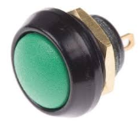
Testing a Normally-open Pushbutton:
Many times a user must test a Normally-open pushbutton when it is out of the circuit, to determine if it is faulty.
The diagram at the left shows a Normally-open (N.O. for short) pushbutton. The resistance should be OL (open line), which is also infinity ohms.
If the pushbutton is pushed, as shown in the right diagram, the switch is now closed, which should measure 0 ohms.
To remove the pushbutton from a circuit, power down the circuit (remove power), then take a wire off of one of the two terminals of the pushbutton, then put the Ohmmeter across the switch terminals.
OL
0 Ohms

Slide 10
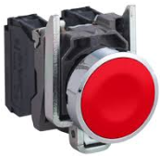
Testing a Normally-closed Pushbutton:
Many times a user must test a Normally-closed pushbutton when it is out of the circuit, to determine if it is faulty.
The diagram at the left shows a Normally-closed (N.C. for short) pushbutton. The resistance should be 0 ohms.
If the pushbutton is pushed, as shown in the right diagram, the switch is now open, which should measure a very high resistance, which should be an open line.
To remove the pushbutton from a circuit, power down the circuit (remove power), then take a wire off of one of the two terminals of the pushbutton, then put the Ohmmeter across the switch terminals.
0 Ohms
OL

Slide 11
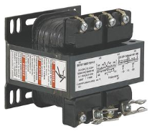
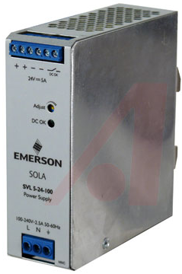
Electrical circuit voltage:
There are primarily two electrical control system voltages: 24Vdc and 120Vac.
Older, sometimes termed legacy equipment, is where 120Vac is primarily found. This means that the valve solenoids are rated at 120Vac.
Most equipment manufactured within the last 10-15 years will use 24Vdc for the control voltage. This means that the valve solenoids are rated at 24 Vdc. 24 Vdc coils are smaller in physical size than their 120 Vac counterparts.
One other important factor is that if a maintenance person is going to test the voltage in a live circuit that is higher than 50 volts, they must have high voltage gloves on as part of their PPE.
120 V outlet
Control Transformer (120VAC out)
24 Vdc Power Supply found
in most electrical panels

Slide 12
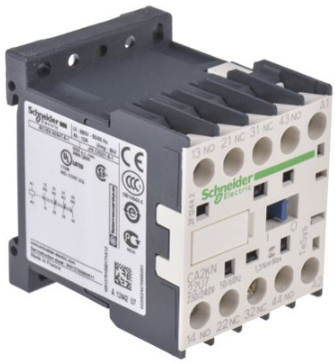
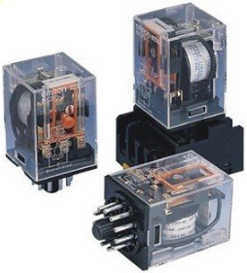
Relays:
This slide shows a basic the symbols and actual devices for an electro-mechanical relay. A relay is used as a logic device in a ladder logic circuit. The relay typically has Normally Open (N.O.) contacts that has no continuity in it’s deactivated state. It also may have Normally Closed (N.C.) contacts that should measure 0 ohms (full continuity) in it’s deactivated state.
When the relay coil pulls in (gets powered), the contacts change state. The N.O. contact now will have full continuity, and the N.C. contact will open.
The contacts of a relay will be rated at 10 amps or less.
Most contacts are rated for at least 300 volts, since the maximum control voltage by law is 250 volts.
These relay coils may be rated at either 24Vdc or 120Vac for an industrial application.
The HVAC world many times use 24Vac coils.
Relay Coil
N.O. Relay Contact
N.C. Relay Contact
Industrial IEC Relay
Industrial Ice Cube Relays

Slide 13
Relays used in a Start/Stop circuit:
24 Vdc
This slide shows what voltage will be measured across the 24Vdc power lines. It is 24Vdc, as shown in the top diagram. Notice that the dial has to be set for DC volts.
The lower diagram shows that if the user will measure between electrical nodes 3 and 2 (wire numbers), they will measure 24Vdc. The relay coil does not yet have power, but since the Stop Cycle pushbutton is wired Normally Closed, it has continuity, thus there is 24Vdc up to node 3.
Notice that the black, Common wire should be placed on node 2. If these two wires are reversed (the red is on node 2), then the meter would read -24Vdc. If the meter shows a negative voltage, just reverse the two test leads. DC (direct current) voltage has polarity (+ and -). AC does not have polarity.
24 Vdc

Slide 14
Relays used in a Start/Stop circuit cont.:
This slide shows that between nodes 4 and 2, there will be no voltage. This is due to the fact that neither the Start Cycle pushbutton, or the Enable Cycle relay are actuated.
It is important to determine what voltage that should be measured at each node.
0 Vdc

Slide 15
The Start/Stop hold-in circuit:
This slide shows the how a start/stop hold-in circuit works. The intent is that when the Start Cycle button is pressed, the Enable Cycle relay coil is energized, and when the Start Cycle button is released, the relay coil remains energized.
To make this work, a Normally Open relay contact must be wired in parallel to the Start Cycle pushbutton. When the relay coil is energized, it closes the N.O. contact as shown in step 3 of this graphic. When the Start Cycle is released, the Enable Cycle relay remains energized.
The way to shut off the Enable Cycle relay is to press the Stop Cycle pushbutton.
1. The Start Button is activated
2. The relay coil is energized
3. The N.O. relay contact is closed
4. The Start Button is released
5. The relay coil is held in
by it’s own contact

Slide 16
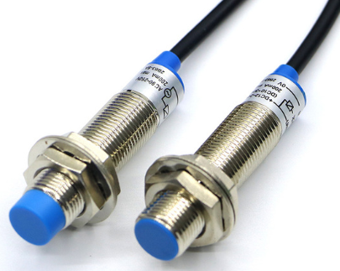
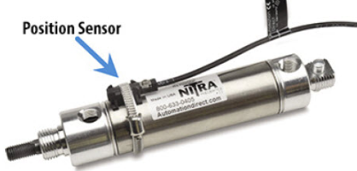
Proximity Sensors/Switches:
Proximity switches are devices that sense a part without touching it. A limit switch will touch a part, but a proximity switch senses it. The confusing part of this is that there is one symbol for a pneumatic circuit, and a different symbol for an electrical circuit. The reality is that these are the same device. In graphic A, two proximity switches are shown. They have the sensor on the head (blue part) and the switch internally.
Graphic B shows the two different electrical symbols for proximity switches.
Graphic C shows a magnetic sensor that senses a magnet that is built into the piston of the cylinder. When the cylinder is fully extended, the proximity switch will actuate. Graphic D shows something very similar with a graphic from Automation Studio. Notice that there are two symbols for the proximity sensor on the pneumatic print.
There are two types of proximity sensor: inductive and capacitive. An inductive senses metal, and a capacitive senses non-metals.
A
B
Commercial proximity
sensor/switches
Proximity Switch in an
electrical circuit
Proximity sensor mounted
on a cylinder, sensing a
magnet on the piston
C
D
Proximity Sensor in a
pneumatic circuit

Slide 17
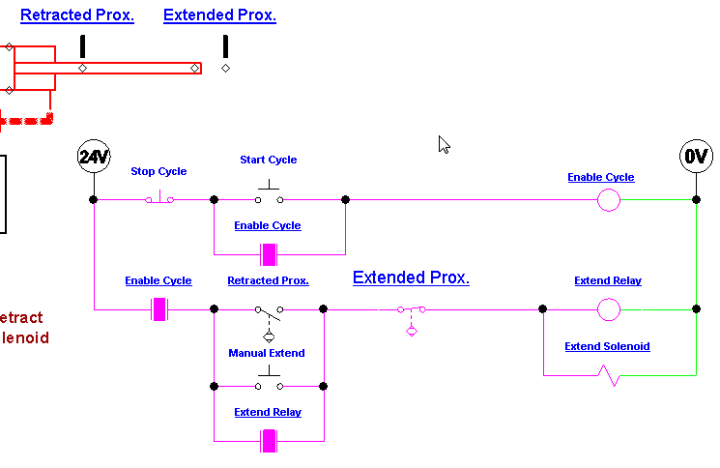
Electrical circuit operation:
This graphic will give a further in depth explanation of the electrical circuit.
When the Start Cycle pushbutton is actuated, it pulls in the Enable Cycle relay, and it will be held in after the Start Cycle is released, due to the hold-in contact in parallel with the start button.
This will enable the next rung of logic. When the Retracted Prox switch is actuated (piston is fully retracted), the Extend Relay and Extend Solenoid coils are energized. This closes the N.O. Extend Relay contact at the bottom of the circuit to act as a hold-in to keep the two coils on as the cylinder rod extends.
When the two diamonds
line up, the Extend Prox.
switch changes state
When the two diamonds above
line up, the Extend Prox.
switch will open, dropping out
the Extend Relay and Solenoid
If a contact shows a purple
block between the two contacts,
the contact is passing power

Slide 18
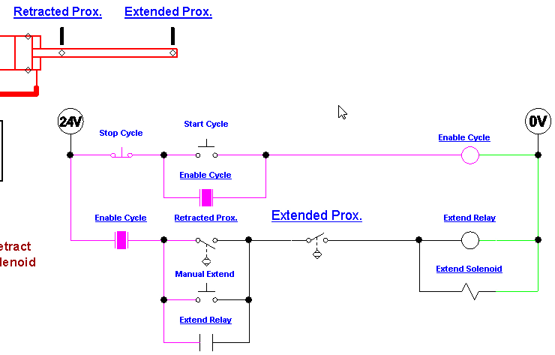
Electrical circuit operation:
This graphic will give a further in depth explanation of the electrical circuit.
This slide shows that the cylinder rod is fully extended, which actuated the Extend Prox switch. This will open the switch in the last rung of the electrical circuit, which will in turn drop out the Extend Relay and Extend Solenoid coils. This will cause the 5/2 valve to shift back to the default position (due to the spring return), which will start retracting the cylinder.
When the two diamonds
line up, the Extend Prox.
switch changes state
When the two diamonds above
line up, the Extend Prox.
switch will open, dropping out
the Extend Relay and Solenoid
If a contact shows a purple
block between the two contacts,
the contact is passing power

Slide 19
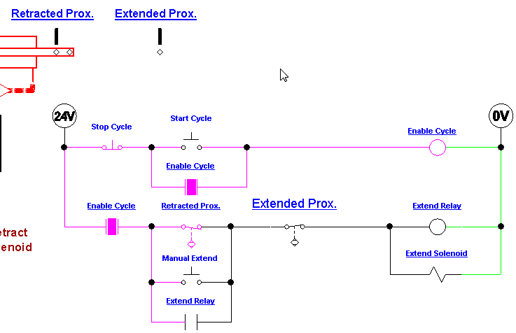
Electrical circuit operation:
This graphic will give a further in depth explanation of the electrical circuit.
When the Start Cycle pushbutton is actuated, it pulls in the Enable Cycle relay, and it will be held in after the Start Cycle is released, due to the hold-in contact in parallel with the start button.
This will enable the next rung of logic. When the Retracted Prox switch is actuated (piston is fully retracted), the Extend Relay and Extend Solenoid coils are energized. This closes the N.O. Extend Relay contact at the bottom of the circuit to act as a hold-in to keep the two coils on as the cylinder rod extends.
Due to an error in Automation
Studio, on the retraction, the
retracted Prox switch is actuated
a little earlier than it should
When the cylinder rod
is fully retracted, the Retracted
Prox switch will close, powering
the two solenoid coils, and the
cylinder rod will extend
If a contact shows a purple
block between the two contacts,
the contact is passing power

Slide 20
Electrical circuit operation:
This graphic will give a further in depth explanation of the electrical circuit.
When the cylinder rod is fully retracted, the N.O. Retracted Prox switch closes, which will energize the relay coil and solenoid, thus shifting the 5/2 valve and extending the cylinder rod.
The Extend Relay hold-in circuit will continue powering the solenoid after the Retracted Prox is no longer actuated, and will continue powering the solenoid until the Extended Prox switch is actuated, which drops out the hold-in circuit.
Due to an error in Automation
Studio, on the retraction, the
retracted Prox switch is actuated
a little earlier than it should
When the cylinder rod
is fully retracted, the Retracted
Prox switch will close, powering
the two solenoid coils, and the
cylinder rod will extend
If a contact shows a purple
block between the two contacts,
the contact is passing power

Slide 21
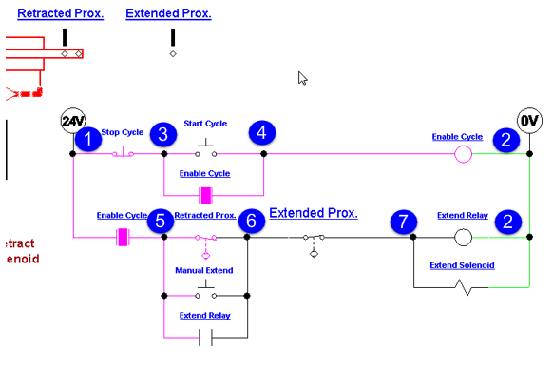
The main air supply for the lab:
24 Vdc
This slide will show the voltages that should be measured if both rungs are powered, and the solenoid is energized.
Notice that all the nodes are referenced from #2 node, which is the common side of the 24 Vdc power supply.
Volts 1 – 2 = 24Vdc
Volts 3 – 2 = 24Vdc
Volts 4 – 2 = 24Vdc
Volts 5 – 2 = 24Vdc
Volts 6 – 2 = 24Vdc
Volts 7 – 2 = 24Vdc

Slide 22
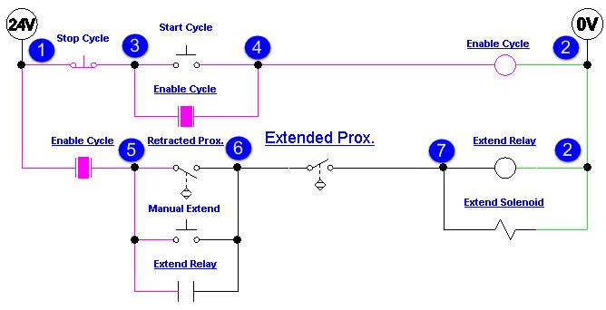
The main air supply for the lab:
24 Vdc
This slide will show the voltages that should be measured if the first rung is energized (Enable Cycle is pulled in), and the second rung does not have the relay and solenoid powered, due to the N.C. Extended Prox switch being actuated (between nodes 6 & 7).
Notice that all the nodes are referenced from #2 node, which is the common side of the 24 Vdc power supply.
Volts 1 – 2 = 24Vdc
Volts 3 – 2 = 24Vdc
Volts 4 – 2 = 24Vdc
Volts 5 – 2 = 24Vdc
Volts 6 – 2 = 0Vdc
Volts 7 – 2 = 0Vdc

Slide 23
This completes this Instructional Document

