Slide 1
General Instructions / Routine
Class Problems
When you see “Class Problem ___”, add the problem to a (continuous) sheet of paper(s).
Number the problem
Show work (including Schematic Diagrams)
Include units in your answer(s) (V, mA, Ω, W…)
Graphic Organizers
When you see terms in BOLD RED, look for the definition/term and fill in the information on the Unit Graphic Organizer.
All of the information provided is potential test material.
“Neat and Complete.”

Slide 2
Class Problem 1b
Title a clean sheet of paper: Class Problems
Convert 88 feet per second, to miles per hour.
$$\frac{88 ft}{1 s}×\frac{1 mile}{5280 ft}×\frac{3600s}{1 hr}=60 mph$$
Note: There are 5280 feet in a mile.
01 A day in the life of an instrumentation electrical technician: https://www.youtube.com/watch?v=X13Tiq3CjGo

Slide 3
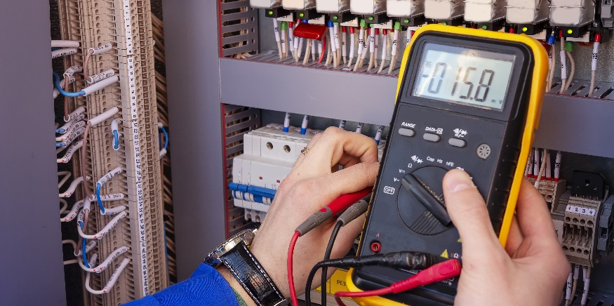
Introduction to Electricity

Slide 4
Introduction to Electricity
Use unit conversions to solve problems.
Define electricity in terms of flow of electric charge (electrons).
Identify the three types of materials used in the conduction of electric charge: conductors, insulators and semiconductors.
Recognize the atomic structures that make materials conductive.
Define electric current, resistance, and voltage.
https://www.khanacademy.org/science/electrical-engineering/introduction-to-ee

Slide 5
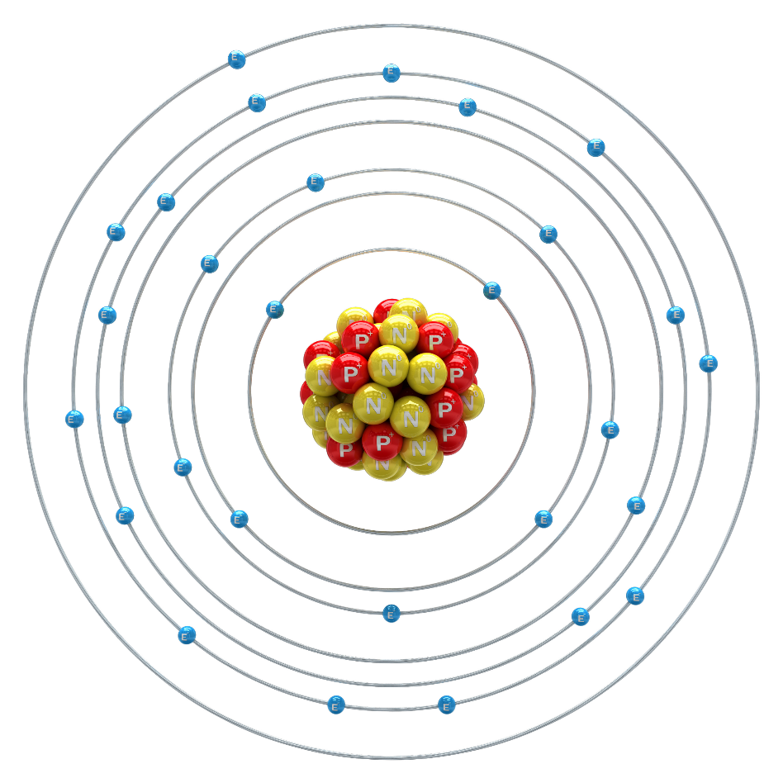
What is electricity?
Electrons:
Negatively charged particles
Flow of electric charge*
Electricity moves through some materials better than others.
Three types of materials used in conducting electricity:
Conductors – electricity can flow (or conduct) easily
NEC: Copper, Aluminum, Copper-Clad Aluminum
Insulators – electricity is prohibited from flowing easily
Semiconductors – modern materials designed to conduct only under certain conditions
* Record on organizer
What is electricity? (2:11): https://www.youtube.com/watch?v=ZAFW4zdXpbY

Slide 6
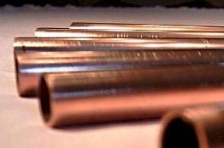
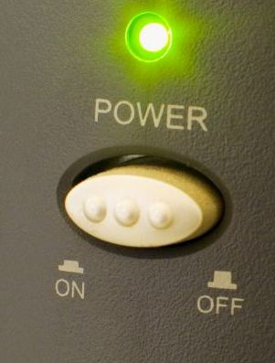
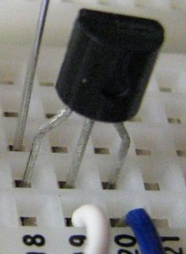
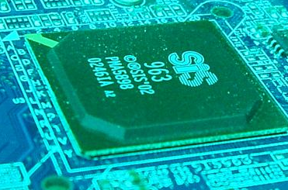
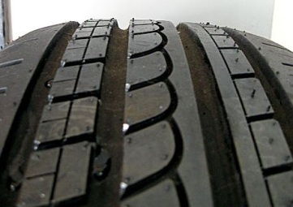
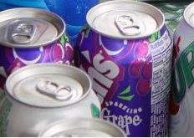
Identify the type of material: Insulator (I), Conductor (C), or Semiconductor (S)
I
C
S
C
S
glass
copper
LEDs
gold
transistors
I
S
I
C
plastic
Integrated circuits
rubber
aluminum

Slide 7
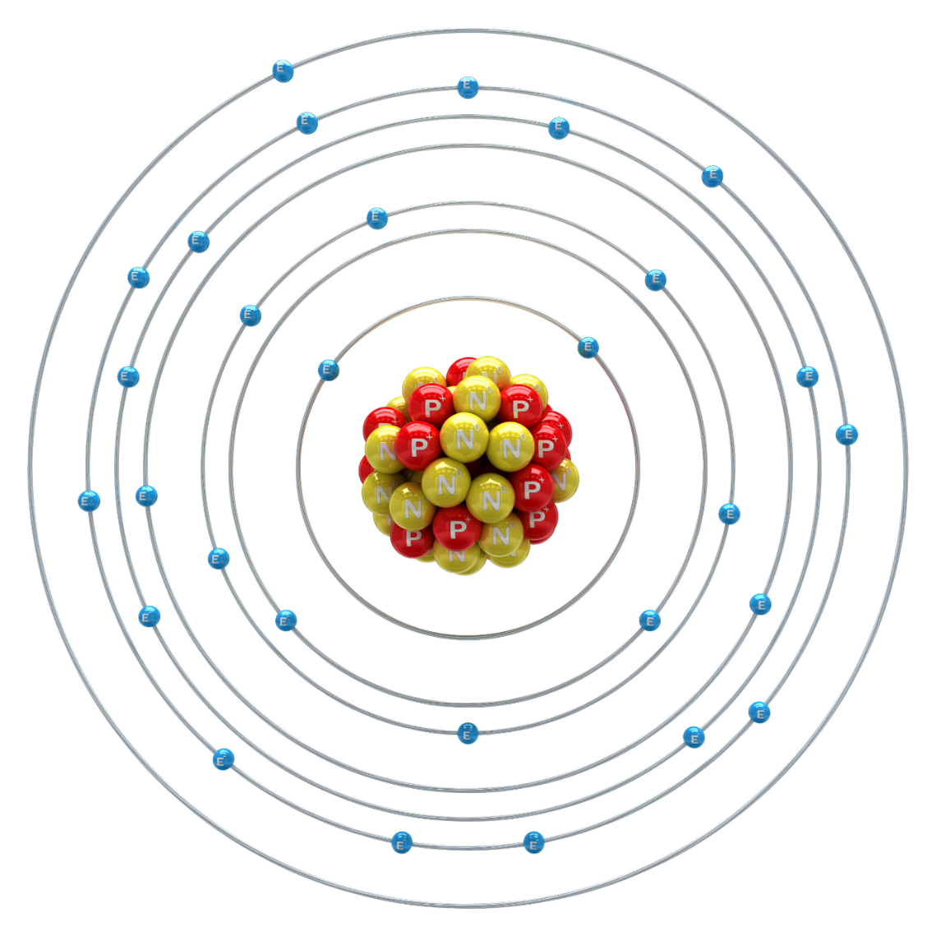
Why do some materials conduct better than others?
Bohr Model - Electrons configure themselves into shells around the nucleus of an atom (center of the atom).
The ability of a material to conduct electricity depends on the arrangement of electrons around the nucleus; specifically the electrons in the outer shell (valence electrons).
8 electrons make up a complete outer shell.
The fewer valence electrons (electrons in the outer shell), the more conductive the material.
How many valence electrons does copper have?
1
Because Copper only has one valence electrons, it will more freely give up that electron allowing for it to be a good conductor.
Copper Atom

Slide 8
How do electrons move?
Scenario: You are talking on the phone with a friend in Beijing, China.
Your voice causes the diaphragm in the microphone to move which would induce electron motion.
Would an electron that you just caused to move in the microphone somehow get to China in a fraction of a second?
Assume that your phone is directly wired to your friend’s phone in China.
electron introduced due to
chemical reaction in battery
When one electron leaves the negative terminal of the battery, another one enters the positive terminal, so that the battery remains electrically neutral overall.
6,900 miles or 11,100 km
maps.google.com

Slide 9
Electric Current
Electrons migrate from the supply to the shortage.
The actual path that electrons take is scattered mostly due to atom oscillations.
electron shortage
electron supply
+
-
+ net flow of electrons -
the net flow of electrons through a material is called electron current
+ conventional current -
$$conventional current (I)$$
Conventional current is opposite of the actual flow of electrons and goes from + to – .
We determine the conventional current when we measure or compute currents in a circuit.

Slide 10
Electrical Resistance
Consider the interaction of electrons with ions as they pass through a material.
Atoms oscillate about their equilibrium positions due to thermal energy
The amplitude of oscillation increases with temperature
The conduction of electrons through a material is interrupted due to destructive interactions with oscillating atoms
This scattering and destructive interaction cause electrical resistance as well as heat generation
Electrical resistance is a measure of a material’s opposition to the passage of electric current.
$$resistance=R$$

Slide 11
Voltage
Electrons migrate from the supply to the shortage.
electron shortage
electron supply
-
+
The potential difference between the strength of the electron supply and the electron shortage defines the voltage.
$$voltage=V$$
Voltage is a measure of how badly electrons want to cover a distance.
“Cloud to ground lightening begins within the cloud when the localized electrical potential gradient exceeds 3 million volts per meter along a path perhaps 50m long.”
Meteorology Today: An Introduction to Weather, Climate, and the Environment by C. Donald Ahrens

Slide 12
Introduction to Electricity
Define electricity in terms of flow of electric charge (electrons).
Identify the three types of materials used in the conduction of electric charge: conductors, insulators and semiconductors.
Recognize the atomic structures that make materials conductive.
Use unit conversions to solve problems.
Define electric current, resistance, and voltage.

