Slide 1
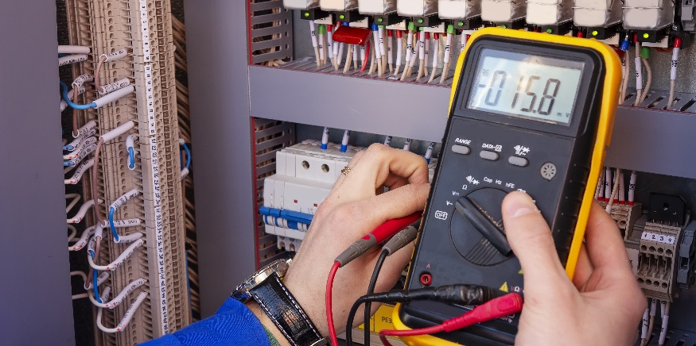
Understanding Voltage

Slide 2
Class Problem 1c
Solve $P=IV$, for $I$, if $P=50$ and $V=120$.

Slide 3
Understanding Voltage
Distinguish between AC and DC voltage.
Power an Arduino breadboard using power bus strips / columns.
Identify the basic functions of a multimeter.
Use a multimeter to measure voltage on a breadboard.
https://www.khanacademy.org/science/electrical-engineering/introduction-to-ee/intro-to-ee/v/ee-voltage-intuition?modal=1
Voltage, Current and Resistance (9:46): https://www.youtube.com/watch?v=J4Vq-xHqUo8

Slide 4
Voltage
Electrons migrate from the supply to the shortage.
electron shortage
electron supply
-
+
The potential difference between the strength of the electron supply and the electron shortage defines the voltage*.
Units of voltage: Volts, V (or E )
Two sources of voltage: AC and DC
* a.k.a Electromotive Force (EMF)

Slide 5
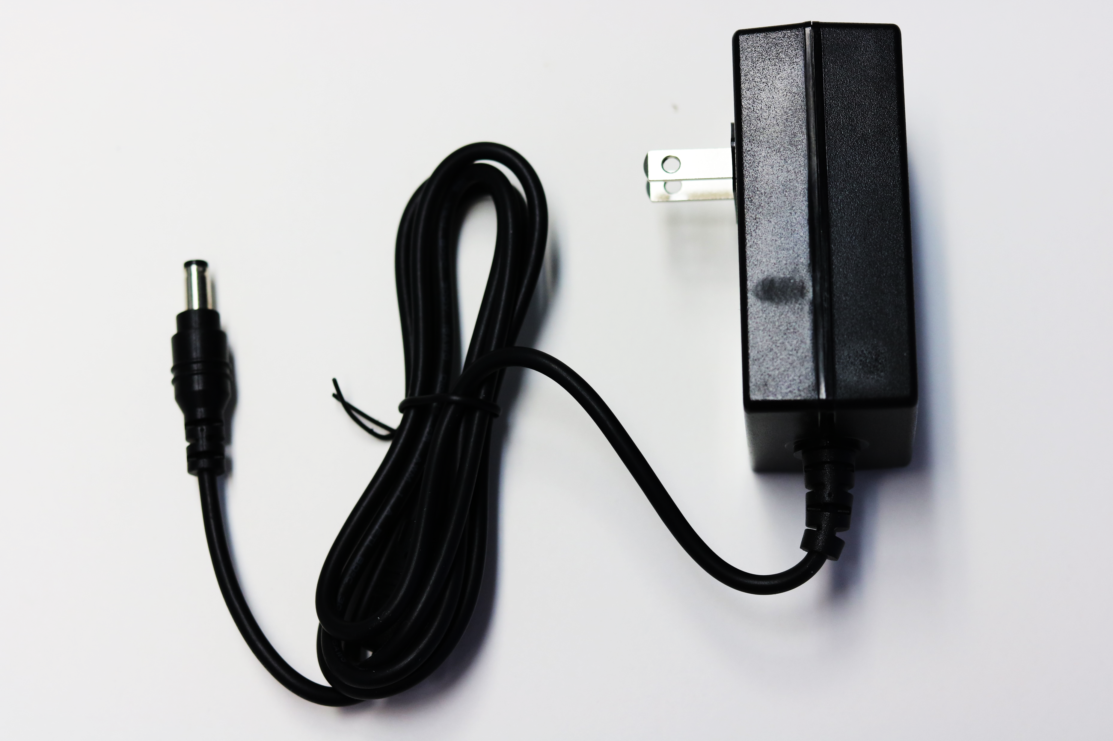
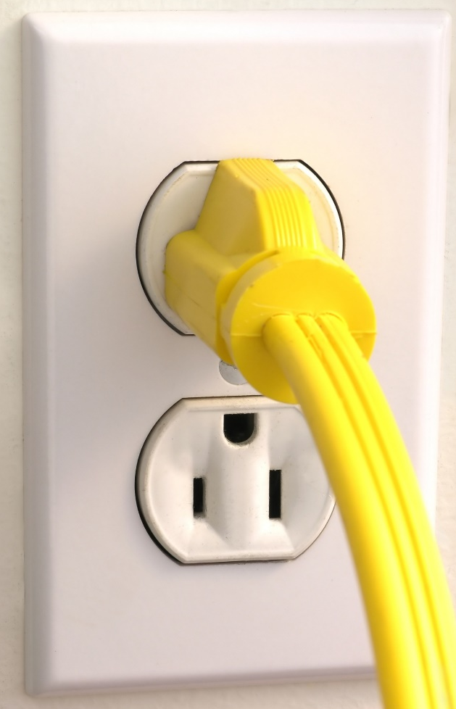
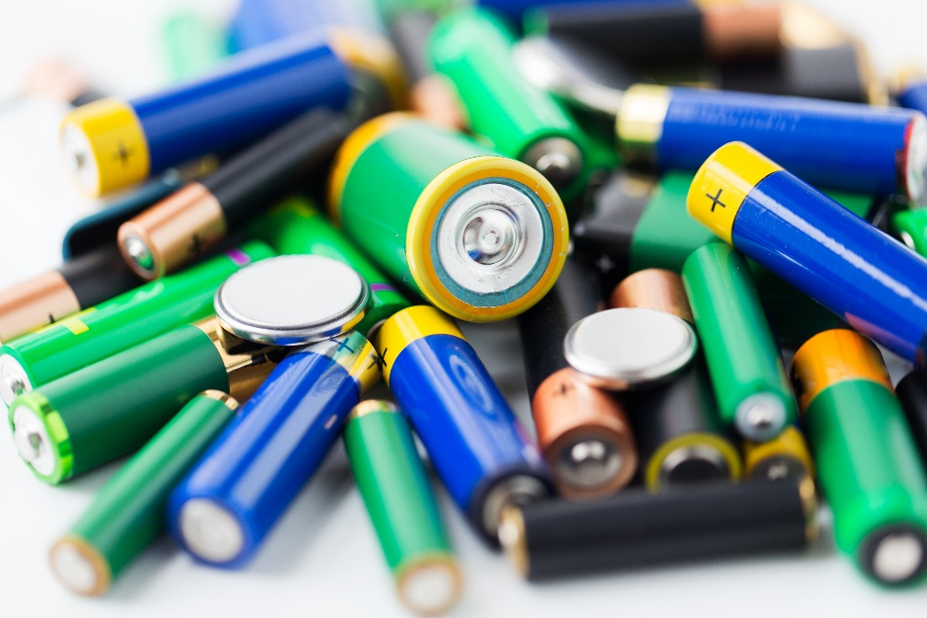
AC vs DC Voltage
Direct Current Voltage (DC Voltage)
Electric current or voltage is constant
Batteries, generators, wall adaptors
Voltage depends on the source (AA batteries are 1.5V)
Alternating Current Voltage (AC Voltage)
Electric current or voltage periodically reverses direction
Used to deliver power to houses and buildings
U.S. Power Outlet is 120V

Slide 6
Power to your Breadboards
AC/DC Switching adaptor
Converts the 120 ACV to 9 DCV
Barrel jack plugs into Arduino
Wires from Arduino brings voltage to the breadboard
What does your AC/DC Switching Adaptor say is the Input and Output? What does this mean?

Slide 7
Power to Breadboard
Three wires from the Arduino
Red – 5V, regulated down to 5V regardless of power supply
Blue – Ground, needed to complete circuits built on the breadboard
Yellow – Vin, unregulated voltage coming from power source (9V power supply)

Slide 8
Power to Breadboard
Wire jumping ground from Arduino to other blue –
Power bus – columns on the bread board that are used to provide voltage for multiple circuits built on the board.
5V wire is connected to the red + column on power bus
Ground wire is connected to blue – column on power bus
Vin wire is connected to other red + column on power bus (9V)

Slide 9
DC Electronics – Typical Wire Colors
Positive wires (hot) will be red.
Negative wires (Ground) will be black.
Grounded wires will be white or grey.

Slide 10
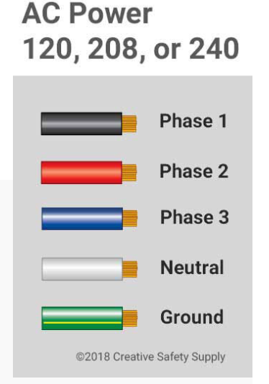
AC Power – Typical Wire Colors
}
Phase 1 – Black
Phase 2 – Red
Phase 3 – Blue
Neutral – White
Ground – Green, Green with yellow stripe, or bare wire
“Hot”

Slide 11
Basics of Using a Digital Multimeter (DMM)
What setting do you think you will use to measure voltage coming from your Arduino on your breadboard?
DCV
Battery Load Test – Tests small batteries
DCV – Measures DC Volts
ACV – Measures AC Volts
Ω – Measures Resistance
DCmA – Measures DC Current in mA (0-200mA)
ACmA – Measures AC Current in mA (0-200mA)
– Tests Diodes
DC10A – Measures DC Current in MA (0-10A)
– Tests Continuity Between Two Points
Red lead plugged in here to measure everything but DC10A
Red lead plugged in here only when measuring current larger than 200mA
Black lead plugged into COM (ground)

Slide 12
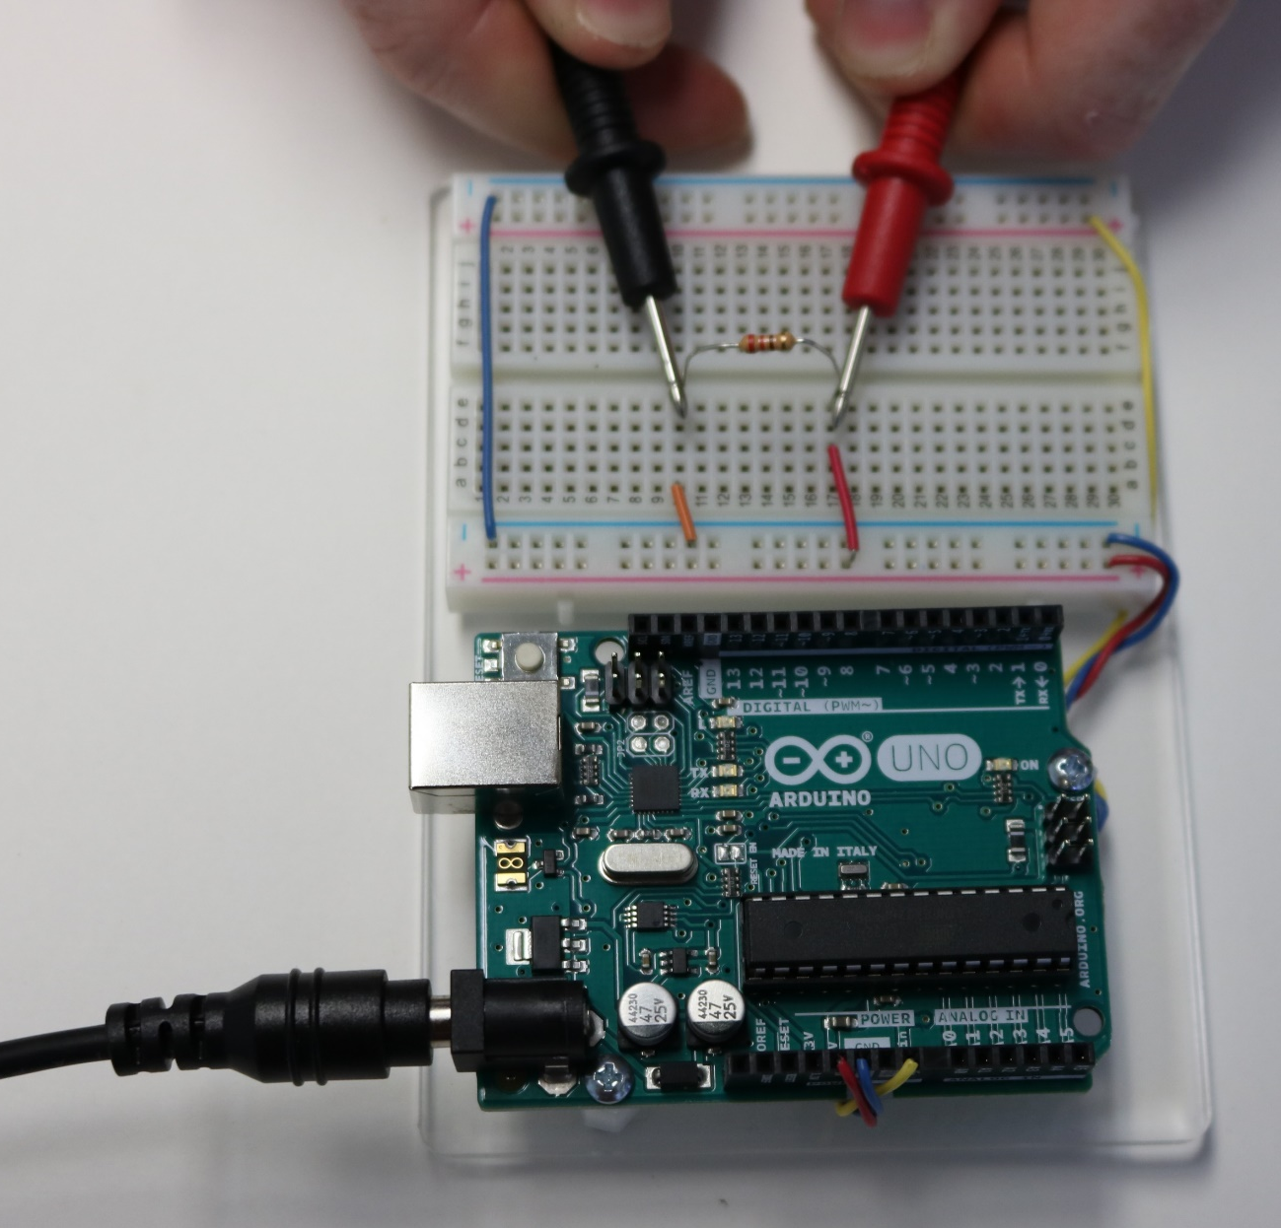
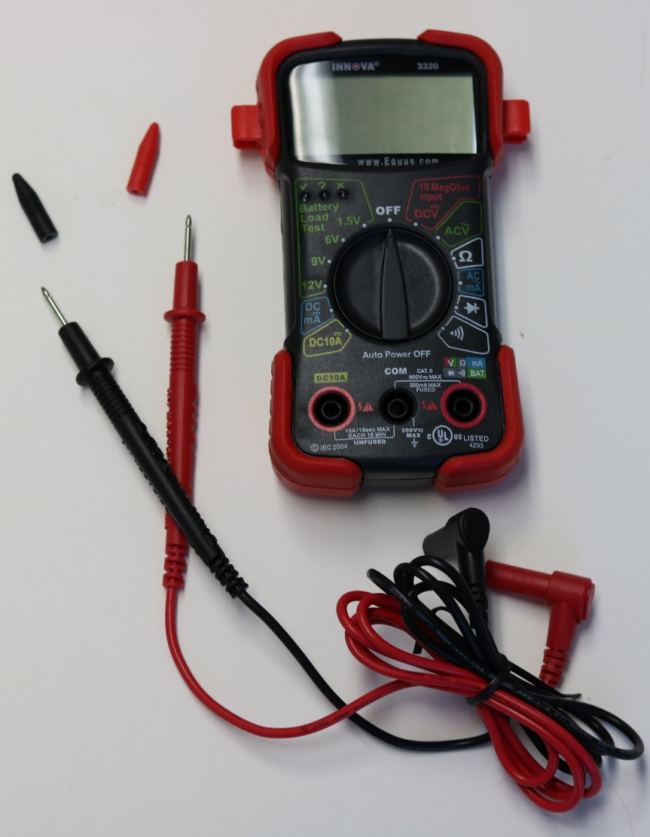
Basics of Using a Multimeter – Pinchers vs Probes
Probes
Must hold with hands
Touch end of probe on wire/metal being measured
Pinchers
Hands free
Clip end of pinchers on on wire/metal being measured
Pinchers
Probes
This is just an example; you do not need to build this circuit.

Slide 13
NEVER Connect Power + to Ground – or an I/O Connector !!!!!
5V
GND
PAY ATTENTION when you are wiring circuits.
Trace your circuit out and make sure you haven’t (inadvertently) connected power to ground.
Get an extra pair of eyes to look it over.
GND
9V

Slide 14
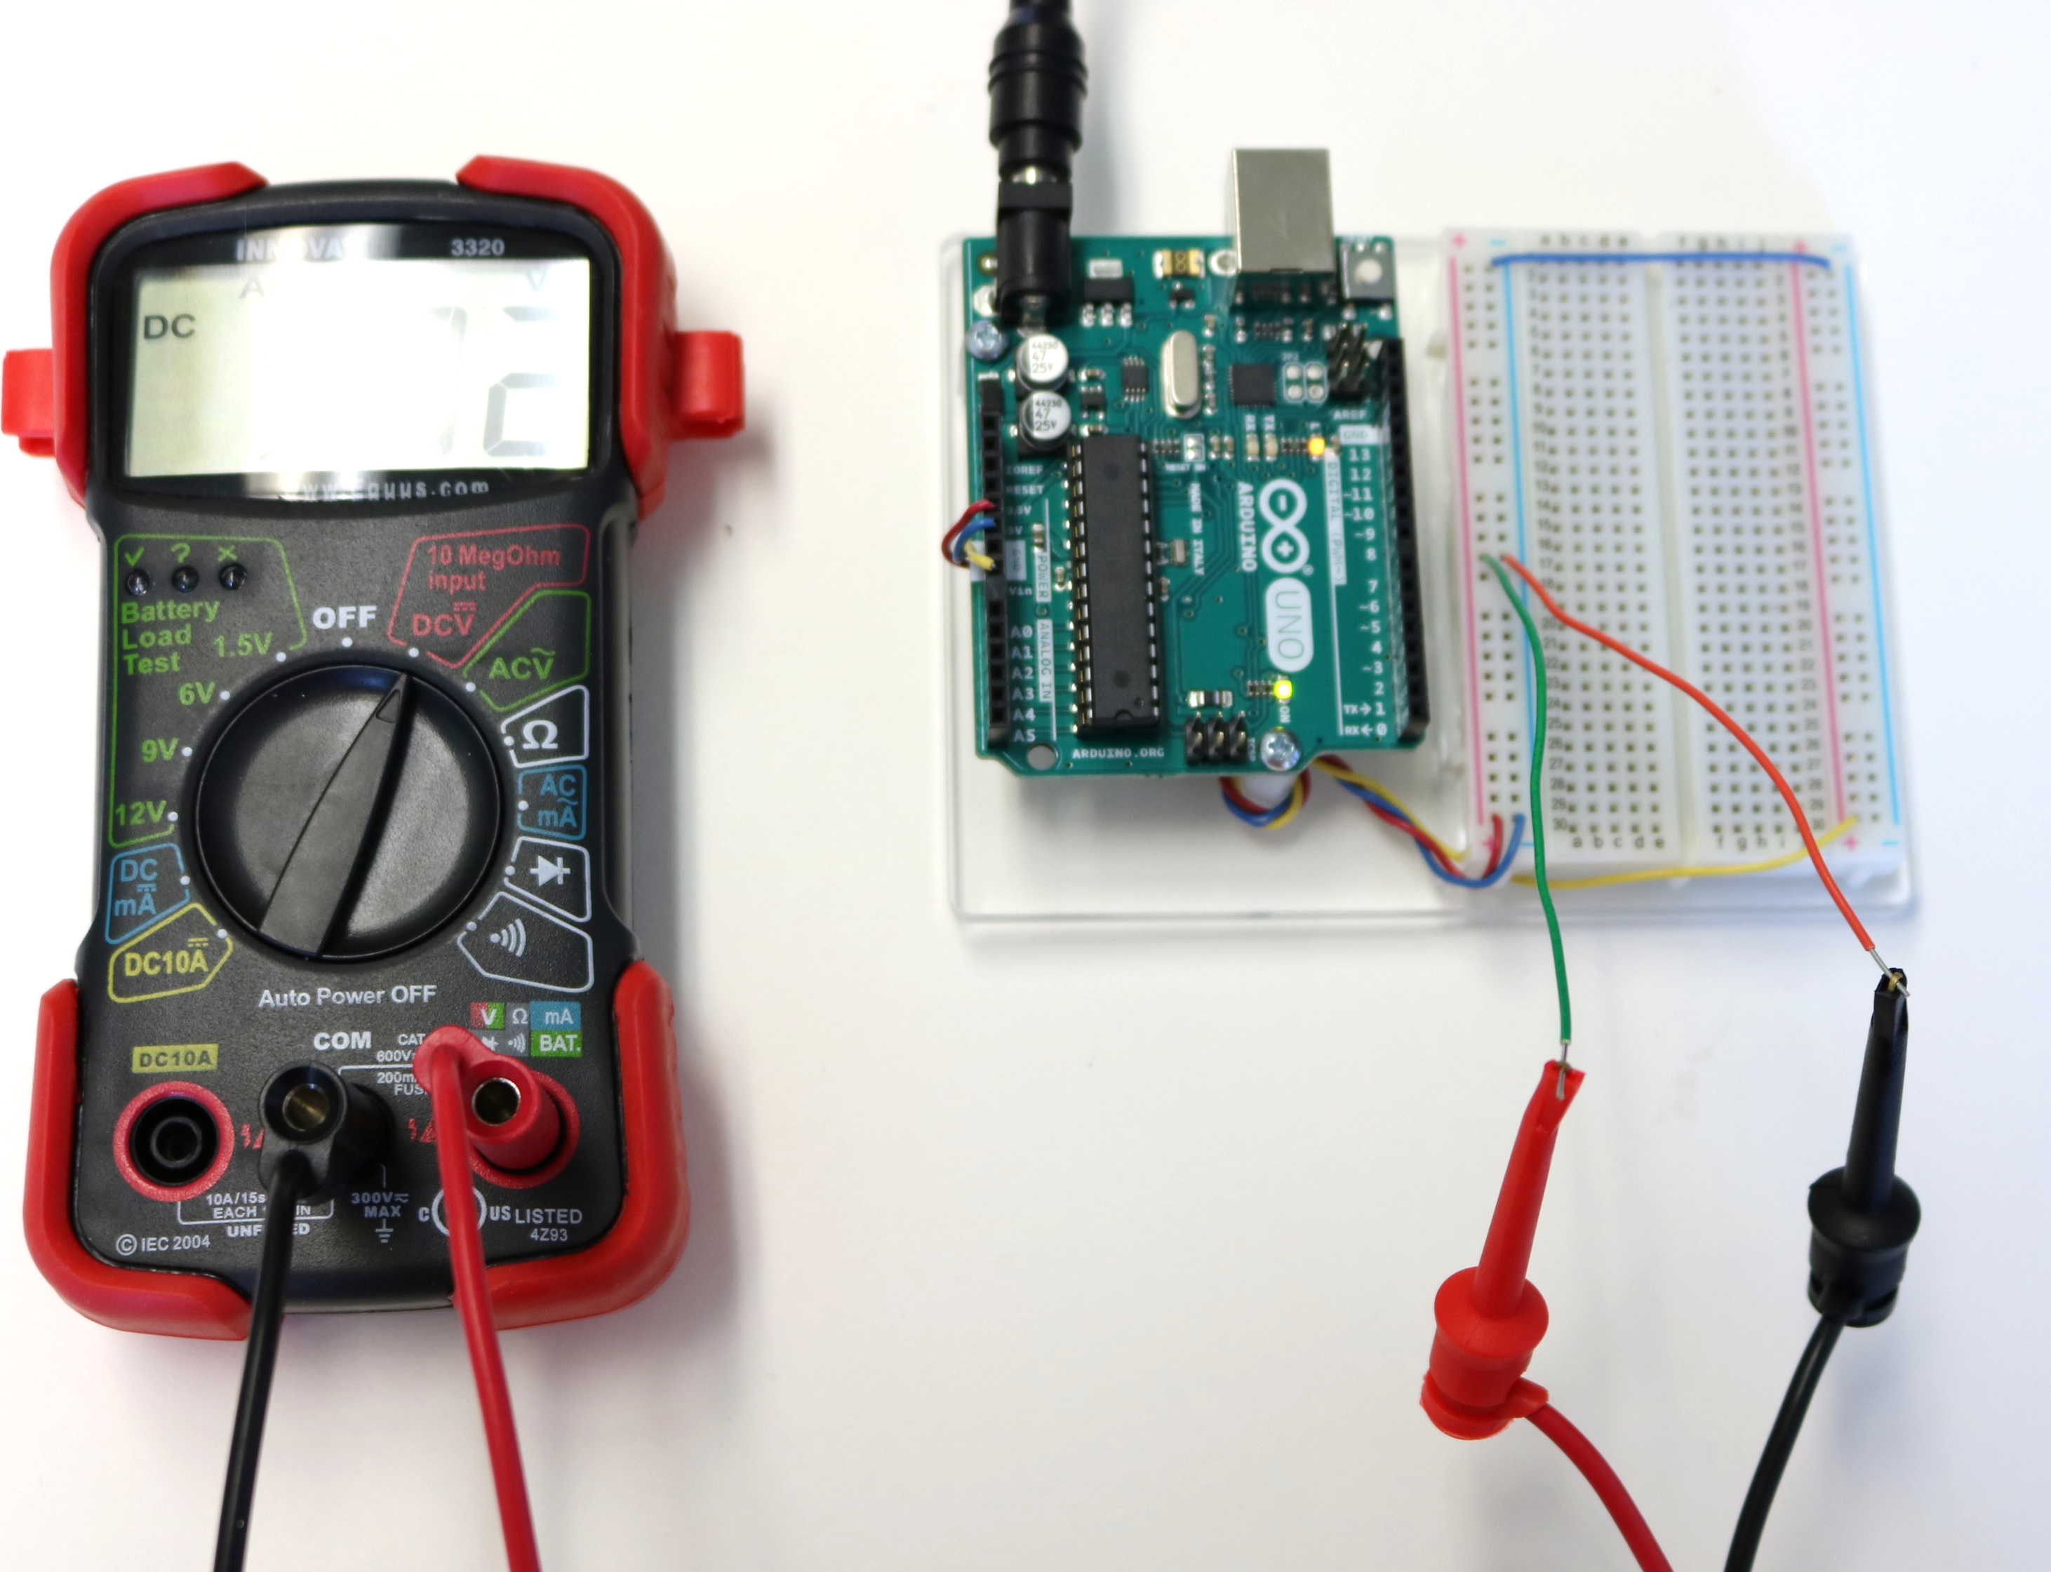
Measuring the Voltage to Breadboard
Plug a jumper wire into the column on the bus strip that is connected to the:
5V wire coming from your Arduino.
Ground wire coming from your Arduino.
Predict the voltage you will measure.
Measure the voltage using your multimeter.
Does the color of the jumper wire matter?
No, the colored part is insulation; the color of the wire has no affect on the wire itself.

Slide 15
Measuring the Voltage to Breadboard
What value do you get for voltage?
Around 5V
Did you expect the value to be exactly 5V? Why is it not exactly 5V?
Move the wires around along the column of the bus strip, what voltage do you measure?
Around 5V because the columns in the bus strip are all connected.
Swap the leads (use black to measure the 5V and Red to measure Ground). What do you measure? Why?

Slide 16
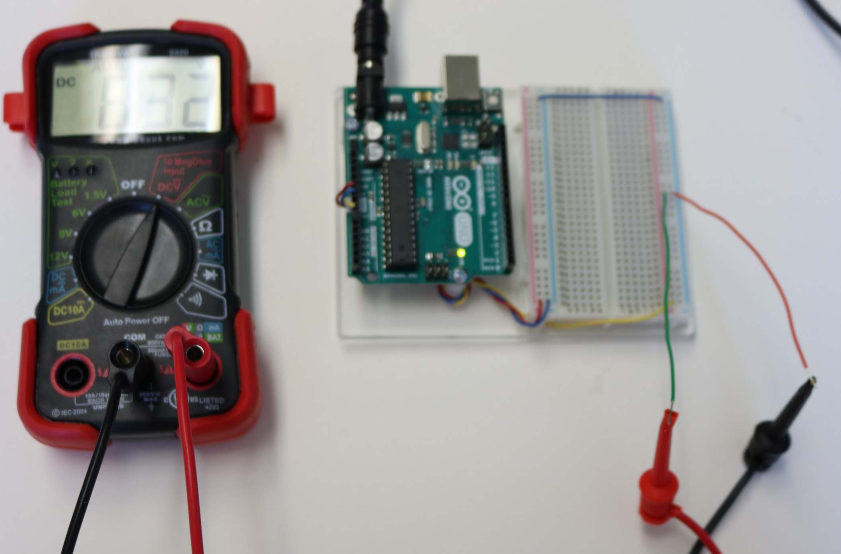
Measuring the Voltage to Breadboard
Plug a jumper wire into the column on the bus strip that is connected to the:
Vin wire coming from your Arduino
Ground wire coming from your Arduino
Predict the voltage you will measure
Measure the voltage using your multimeter
What value do you get for voltage?
Around 9V
Move the wires around along the column of the bus strip, what voltage do you measure?
Around 9V because the columns in the bus strip are all connected.

Slide 17
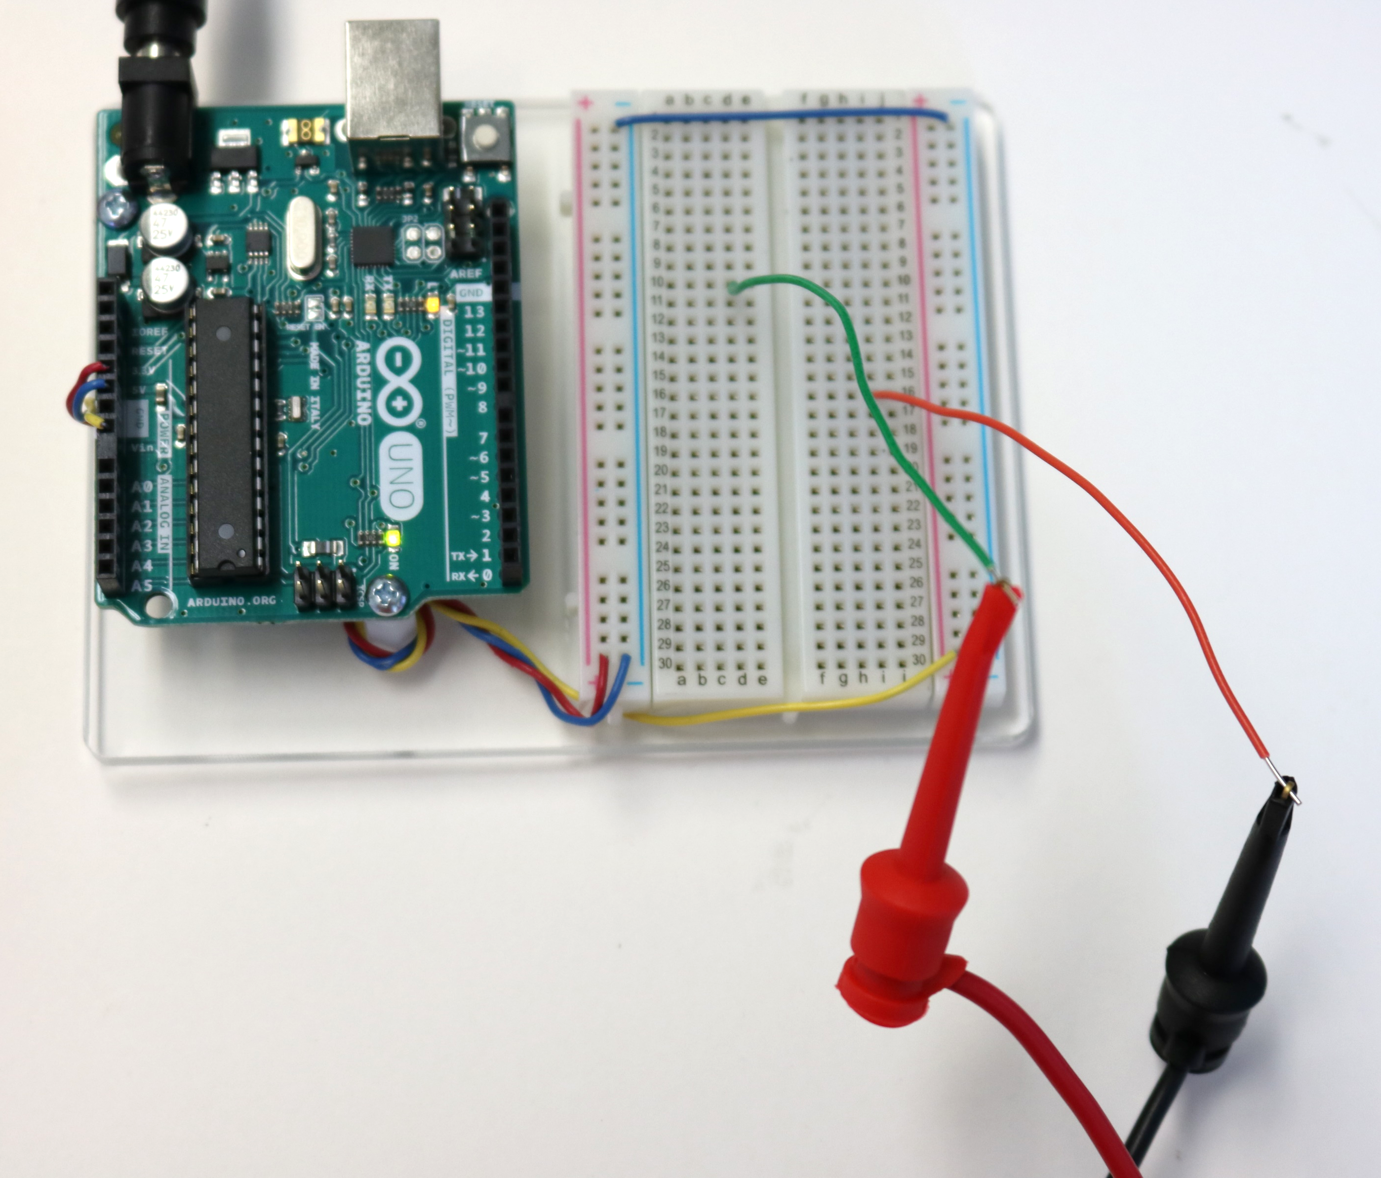
Measuring the Voltage to Breadboard
What voltage value do you measure when the wires are plugged into rows that are not connected to the bus strip?
A VERY small voltage value like 75 mV, meaning 0V
How can you bring the voltage from the bus strip to the rows?
Use jumper wires to “jump” the voltage over

Slide 18
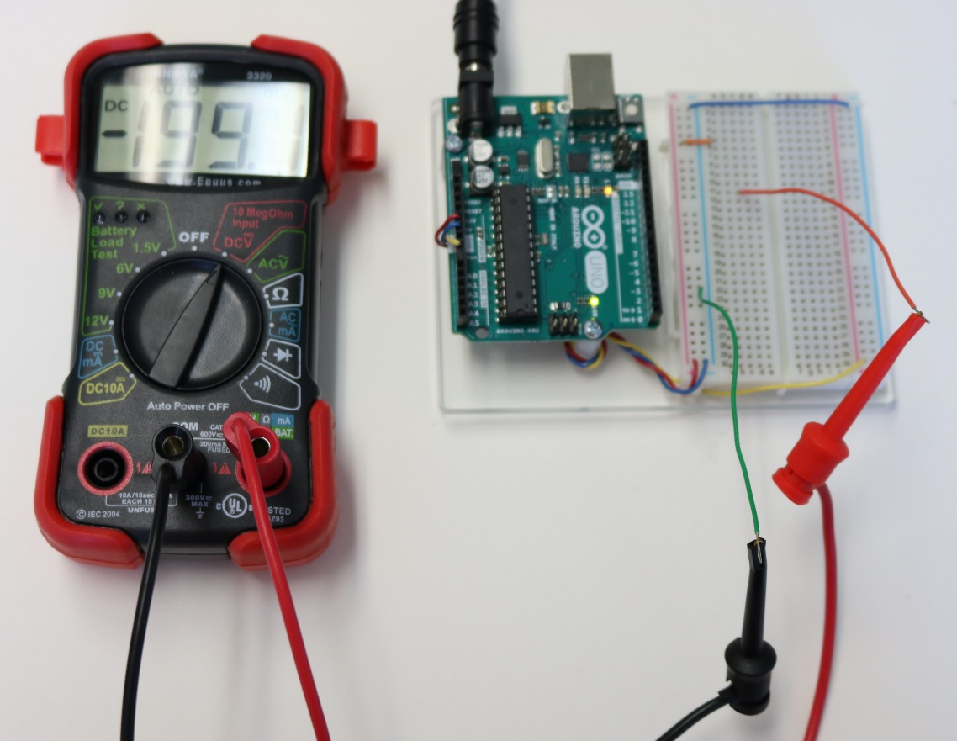
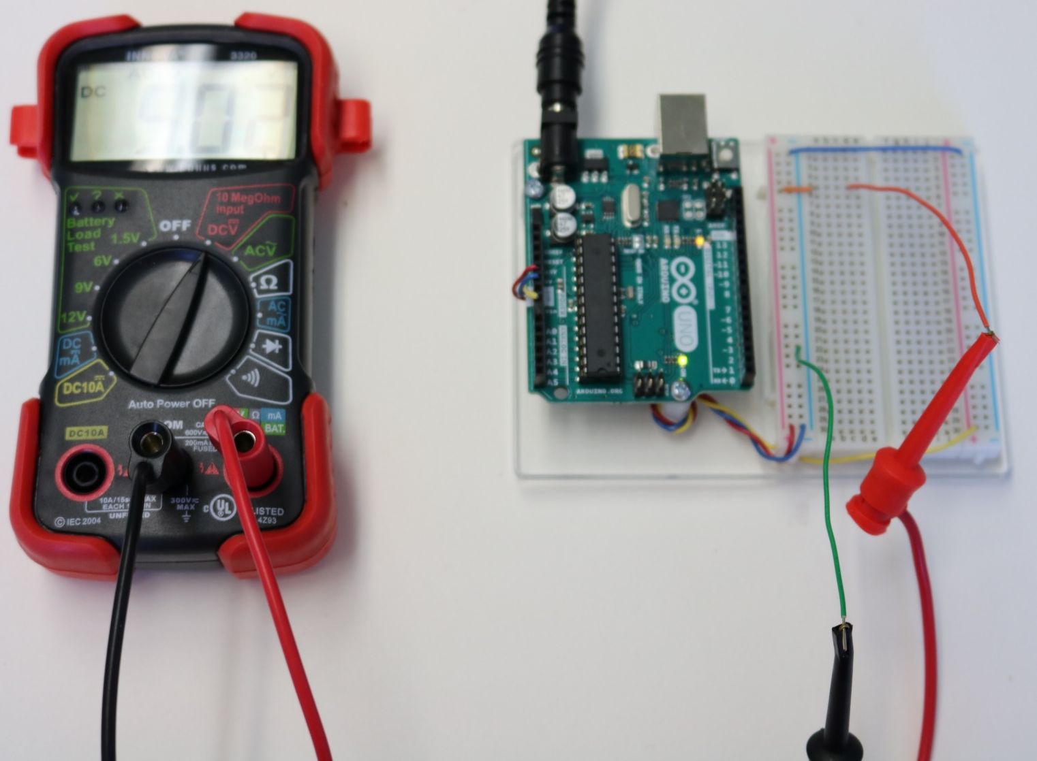
Measuring the Voltage to Breadboard
About 5V
Connect the small jumper wires as shown in the the previous slide to any row on the breadboard.
Place a jumper wire in the same row and a jumper wire in the ground.
Measure voltage.
What voltage value do you measure?
Move the wire from the row with the jumper wire coming from the bus strip to a different row.
What value do you think voltage will be? What do you measure?
0V
What can you infer about the rows of the breadboard?
Outside of the bus strip the rows are connected but not the columns.

Slide 19
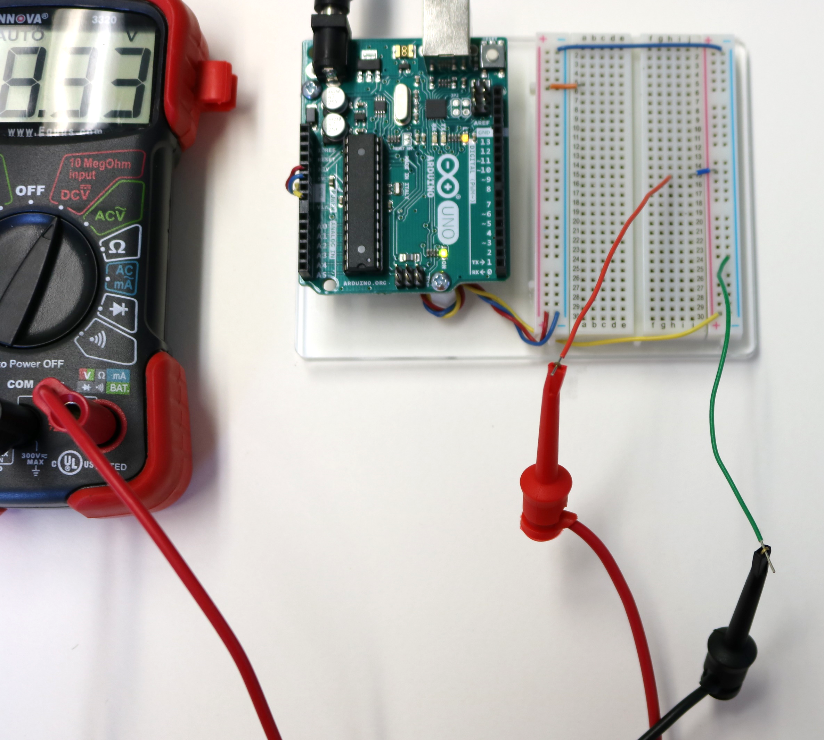
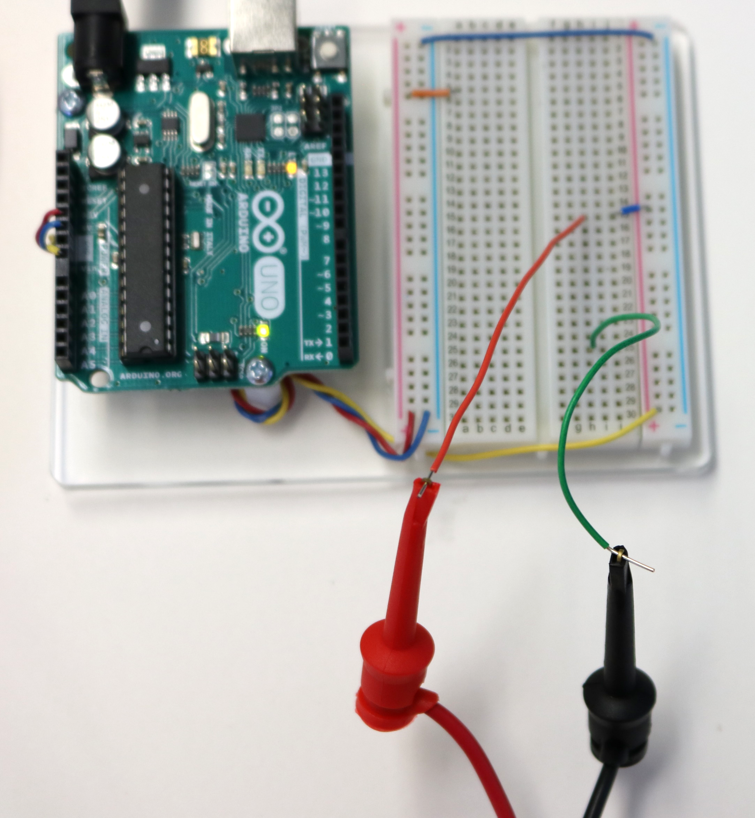
Measuring the Voltage to Breadboard
Repeat for the 9V side of the breadboard.

Slide 20
Breadboard Configuration for Inst. Projects
5V
GND
Component Wiring Area
Rows are connected.
Adjacent rows are not connected.
abcde row is not connected to fghij row.
Columns are not connected.
GND
9V

Slide 21
Understanding Voltage
Distinguish between AC and DC voltage.
Power an Arduino breadboard using power bus strips / columns.
Identify the basic functions of a multimeter.
Use a multimeter to measure voltage on a breadboard.

