Slide 1
SHOW
WORK
1. Find the equivalent resistance R_{eq} and source current I_{s}.
2. Find the equivalent resistance R_{eq} and source current I_{s}.
220Ω
+
-
+
-
5V
470Ω
5V
220Ω
470Ω
1000Ω
1000Ω
CIRCLE
ANSWERS

Slide 3
3. Find the equivalent resistance and source current.
+
-
5V
380Ω
470Ω
1KΩ
4. Find the current in the 470Ω resistor.

Slide 5
SHOW
WORK
5a. Find the equivalent resistance.
6. Current leaving voltage source is 8.35 mA. Find the voltage source.
220Ω
470Ω
470Ω
1000Ω
220Ω
+
-
5V
1000Ω
10kΩ
330Ω
220Ω
1500Ω
+
-
5b. Find the current in the 1000Ω resistor.
CIRCLE
ANSWERS

Slide 7
SHOW
WORK
7. Find the equivalent resistance.
2Ω
7Ω
14Ω
+
24Ω
10Ω
V
10Ω
12Ω
-
6Ω
1Ω
8. Given V = 24V, find the voltage drop in the 2Ω resistor.
CIRCLE
ANSWERS

Slide 9
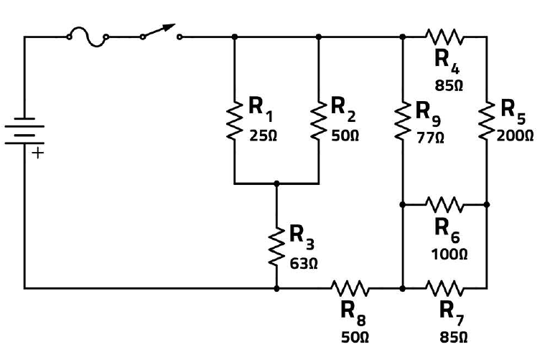
SHOW
WORK
9. Find the equivalent resistance.
10. Find the current in R₃ if the voltage source is 36 volts.
CIRCLE
ANSWERS

Slide 10
285Ω
16.67Ω
Find any parallel and/or series combinations that can be reduced.
45.9Ω

Slide 11
16.67Ω
285Ω
79.67Ω
50Ω
45.9Ω

Slide 13
SHOW
WORK
11. Find the equivalent resistance.
R1
20Ω
R2
25Ω
-
220 V
+
R3
40Ω
R4
30Ω
R5
30Ω
12. Current in R₅.
CIRCLE
ANSWERS

