Slide 1
DC Theory Solving Combination Circuits
Additional Practice

Slide 2
Combination Circuits
Find equivalent resistance in combination circuits.
Solve a combination circuit using a PIER Chart.
Using Kirchhoff’s Current and Voltage Laws

Slide 3
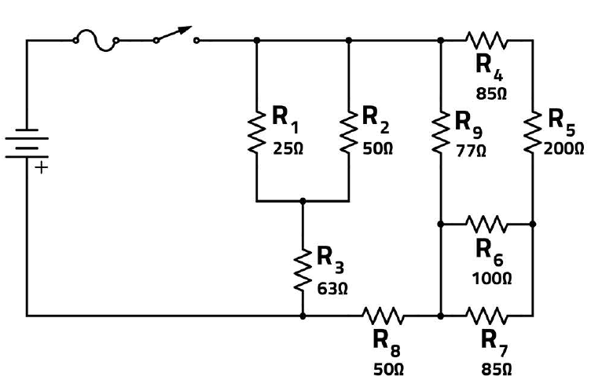
Class Problem 1
Handout

Slide 4
Handout

Slide 5
285Ω
16.67Ω
Find any parallel and/or series combinations that can be reduced.
45.9Ω

Slide 6
16.67Ω
285Ω
79.67Ω
50Ω
45.9Ω

Slide 7
General Problem-Solving Process
Draw circuit to provide space to mark node voltages and branch currents.
Place known values in PIER Chart
Source current, voltage and resistance are known, so apply KVL and KCL
KVL: All voltages around any closed loop sum to zero.
KCL: All currents entering or leaving a node sum to zero.

Slide 8
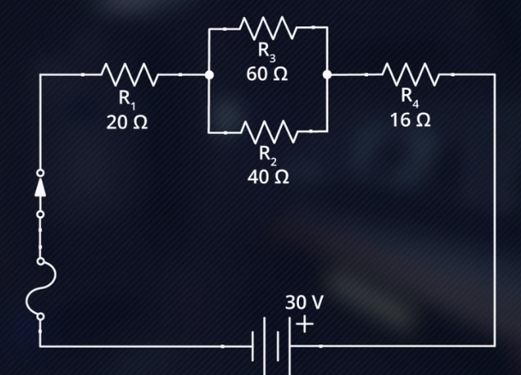
Class Problem 2
Handout
Load known values in PIER Chart
Apply rules to find total equivalent resistance.
Find total current supplied. (= I_{R1} and I_{R4})
Find voltage drops across R1 and R4
Find voltage drop across // combination of R3 and R2 (KVL: Total voltage around any closed path = 0)
Find current in R3 and R2
Find the power dissipated in each load and the total power dissipated (= supplied) in the circuit.
E
I
R
P
 | E | I | R | P
R1
R2
R3
R4
Total
I
E

Slide 9
Handout

Slide 10
Class Problem 2
E
Load known values in PIER Chart
Apply rules to find total equivalent resistance.
Find total current supplied. (= I_{R1} and I_{R4})
Find voltage drops across R1 and R4
Find voltage drop across // combination of R3 and R2 (KVL: Total voltage around any closed path = 0)
Find current in R3 and R2
Find the power dissipated in each load and the total power dissipated (= supplied) in the circuit.
I
R
P
 | E | I | R | P
R1 | 10 | .5 | 20 Ω
R2 | 12 | .3 | 40 Ω
R3 | 12 | .2 | 60 Ω
R4 | 8 | .5 | 16 Ω
Total | 30 V | .5 | 60
I
E

Slide 11
Class Problem 2
E
Load known values in PIER Chart
Apply rules to find total equivalent resistance.
Find total current supplied. (= I_{R1} and I_{R4})
Find voltage drops across R1 and R4
Find voltage drop across // combination of R3 and R2 (KVL: Total voltage around any closed path = 0)
Find current in R3 and R2
Find the power dissipated in each load and the total power dissipated (= supplied) in the circuit.
I
R
P
 | E | I | R | P
R1 | 10 V | .5 A | 20 Ω | 5 W
R2 | 12 V | .3 A | 40 Ω | 3.6 W
R3 | 12 V | .2A | 60 Ω | 2.4 W
R4 | 8 V | .5 A | 16 Ω | 4 W
Total | 30 V | .5 A | 60 Ω | 15 W
I
E

Slide 12
“PIER Chart” – Combination Circuits
E
P
I
R
 | E | I | R | P
R1 | 10 V | .5 A | 20 Ω | 5 W
R2 | 12 V | .3 A | 40 Ω | 3.6 W
R3 | 12 V | .2A | 60 Ω | 2.4 W
R4 | 8 V | .5 A | 16 Ω | 4 W
Total | 30 V | .5 A | 60 Ω | 15 W
I
E
P = IE for all loads (including source/ total load).
E = IR for all loads.
KVL: All voltages around any closed loop sum to zero.
KCL: All currents entering or leaving a node sum to zero.
Use series and parallel equations to find total resistance for combination circuits.
Power in each load sums to total power for all circuits.

Slide 13
Kirchoff’s Current Law
The algebraic sum of all currents entering/leaving a node = 0.
R1
25Ω
R2
25Ω
R3
5Ω
200V
2A
100 Ω
R4
50Ω
R5
30Ω
R6
10Ω
Kirchoff’s Voltage Law
The algebraic sum of all voltages in a closed loop = 0.
R7
50Ω
R8
10Ω
R9
15Ω

Slide 14
General Problem-Solving Process
Draw/markup circuit diagram as you work.
Load known values in PIER Chart.
Apply Series/Parallel rules to find total equivalent resistance.
Find total current supplied.
Find voltage drops across resistors and node voltages.
Apply KVL and KCL as needed.
Combination
R1
25Ω
R2
25Ω
-
220 V
+
R3
50Ω
R4
30Ω
R5
50Ω
R6
10Ω

Slide 15
Class Problem 3
R1
25Ω
R2
25Ω
R3
5Ω
200V
2A
100 Ω
R4
50Ω
R5
30Ω
R6
10Ω
R7
50Ω
R8
10Ω
R9
15Ω

Slide 16
PIER Chart
E
 | E | I | R | P
R1 |  |  | 25 Ω
R2 |  |  | 25 Ω
R3 |  |  | 5 Ω
R4 |  |  | 50 Ω
R5 |  |  | 30 Ω
R6 |  |  | 10 Ω
R7 |  |  | 50 Ω
R8 |  |  | 10 Ω
R9 |  |  | 15 Ω
Total | 200 V | 2 A | 100 Ω
50 V
2 A
100 W
I
R
25 V
1 A
25 W
2.5 V
0.5 A
1.25 W
1 A
50 W
P
50 V
15 V
0.5 A
7.5 W
I
E
5 V
0.5 A
2.5 W
100 V
2 A
200 W
10 V
1 A
10 W
7.5 V
0.5 A
3.75 W
400 W

Slide 17
Class Problem 3
Handout
R1
25Ω
R2
25Ω
R3
5Ω
200V
2A
100 Ω
R4
50Ω
R5
30Ω
R6
10Ω
R7
50Ω
R8
10Ω
R9
15Ω

Slide 18
Computations

Slide 19
PIER Chart
Handout
E
 | E | I | R | P
R1
R2
R3
R4
R5
R6
R7
R8
R9
Total
I
R
P
I
E

Slide 20



Series
Parallel
E
P
220Ω
I
R
I
E
+
-
+
-
5V
5V
470Ω
220Ω
470Ω
KVL
Voltage Rises = Voltage Drops
(around any closed path)
1000Ω
$$R_{T}=\frac{1}{\frac{1}{R_{1}}+\frac{1}{R_{2}}+\frac{1}{R_{3}}+…}$$
$$R_{s}= R_{1}+R_{2}+R_{3}+…$$
$$E_{x}=E_{T}\left(\frac{R_{x}}{R_{T}}\right)$$
KCL
Current In = Current Out
(through any node)
$$R_{T}=\frac{R_{1}×R_{2}}{R_{1}+R_{2}}$$
$$I_{x}=I_{T}\left(\frac{R_{T}}{R_{x}}\right)$$
Kilo | 1000 | .001 kA
Base | 1 | 1 A
Milli | .001 | 1000 mA
$$I_{1}=I_{T}\left(\frac{R_{2}}{R_{1}+R_{2}}\right)$$

Slide 21
Handout
Practice Combination Circuit
Draw/markup circuit diagram as you work. Show node voltages and current directions.
Load known values in PIER Chart.
Apply Series/Parallel rules to find total equivalent resistance.
Find total current supplied.
Find voltage drops across resistors and node voltages.
Apply KVL and KCL as needed.
R1
20Ω
R2
25Ω
-
220 V
+
R3
40Ω
R4
30Ω
R5
30Ω
Write equations / show work!

Slide 22
Review Problem 1
R1
20Ω
R2
25Ω
Total equivalent resistance:
Total Current:
Voltage drop across R2:
-
220 V
+
R3
60Ω
R4
50Ω
R5
30Ω

Slide 23
PIER Chart
Handout
 | E | I | R | P
R1
R2
R3
R4
R5
Total

Slide 24
Review Problem 2
Handout
R1
20Ω
R4
20Ω
R5
20Ω
R2
40Ω
-
220 V
+
R6
30Ω
R3
30Ω

Slide 25
PIER Chart
Handout
E
 | E | I | R | P
R1
R2
R3
R4
R5
R6
Total
I
R
P
I
E

Slide 26
Circuit Concepts
The equivalent resistance is substituted back into a combination circuit that represents the _______________ value as all of the resistances combined.
The current leaving the source is _______________ the current returning to the source in a combination, or series-parallel, circuit.
Any circuit in which the current is split or follows two (or more) alternative paths is called a(n) _______________ circuit.
Identify the first step necessary to allow calculation of component voltages in a combination circuit with component resistors in series and parallel.
Component currents in combination circuits are generally calculated by applying _______________ to the component voltage and the component resistance.
same
the same as
parallel
Determine the total resistance.
Ohm’s Law

