Slide 1
First Five 7a
serial monitor
The _________ prints out information from the Arduino.
_________ functions in a program (sketch) only run once.
________ functions run indefinitely.
What value should be put into the delay function to make an LED turn on for 1 second? ____________
A ________ switch contains a basic on/off function which holds the state that the switch is set to.
A ____________ resistance changes with temperature.
What does “ for(int i=0; i<80; i+=2) ” do?
void Setup
void Loop
1000
maintained
thermistor’s
Creates a for loop that counts (loops) from 0 to 78, by 2’s before ending.

Slide 2
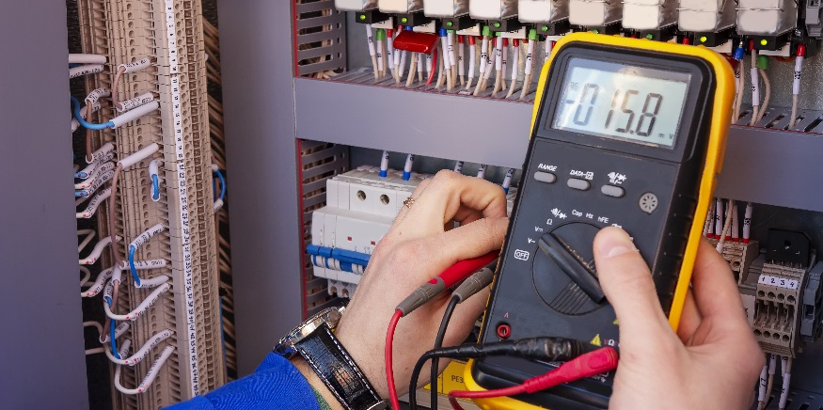
Photoresistors

Slide 3
Photoresistors
Measure the resistance of a photoresistor under different lighting inputs.
Implement a photoresistor circuit on a breadboard.
Write/edit a sketch to control an LED using a photoresistor, using an analog input pin.

Slide 4
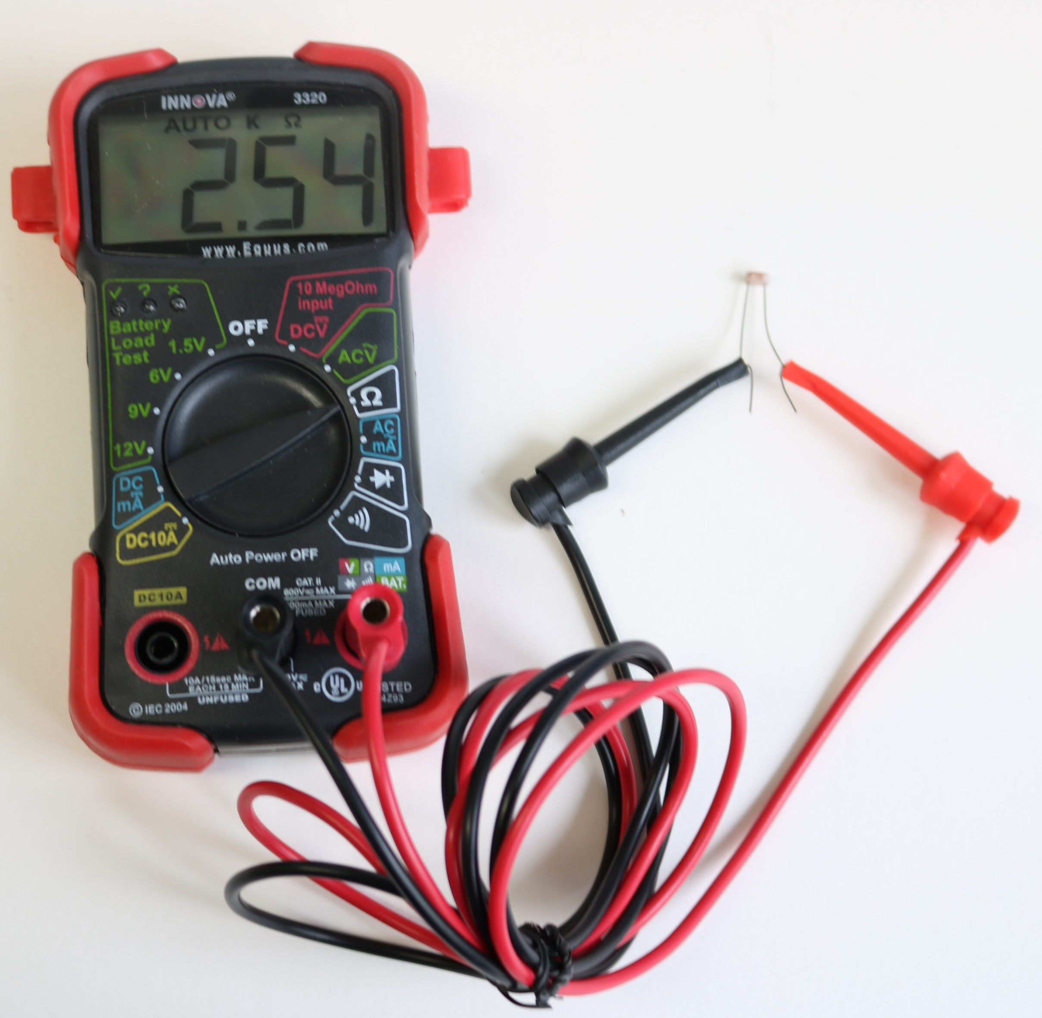
Measure Photoresistor Resistance
Connect a photoresistor to your multimeter.
Measure its resistance.
Cover the photoresistor to allow it to read less light.
Measure its resistance.
What do you observe?
Resistance Decreases as Light Increases

Slide 5
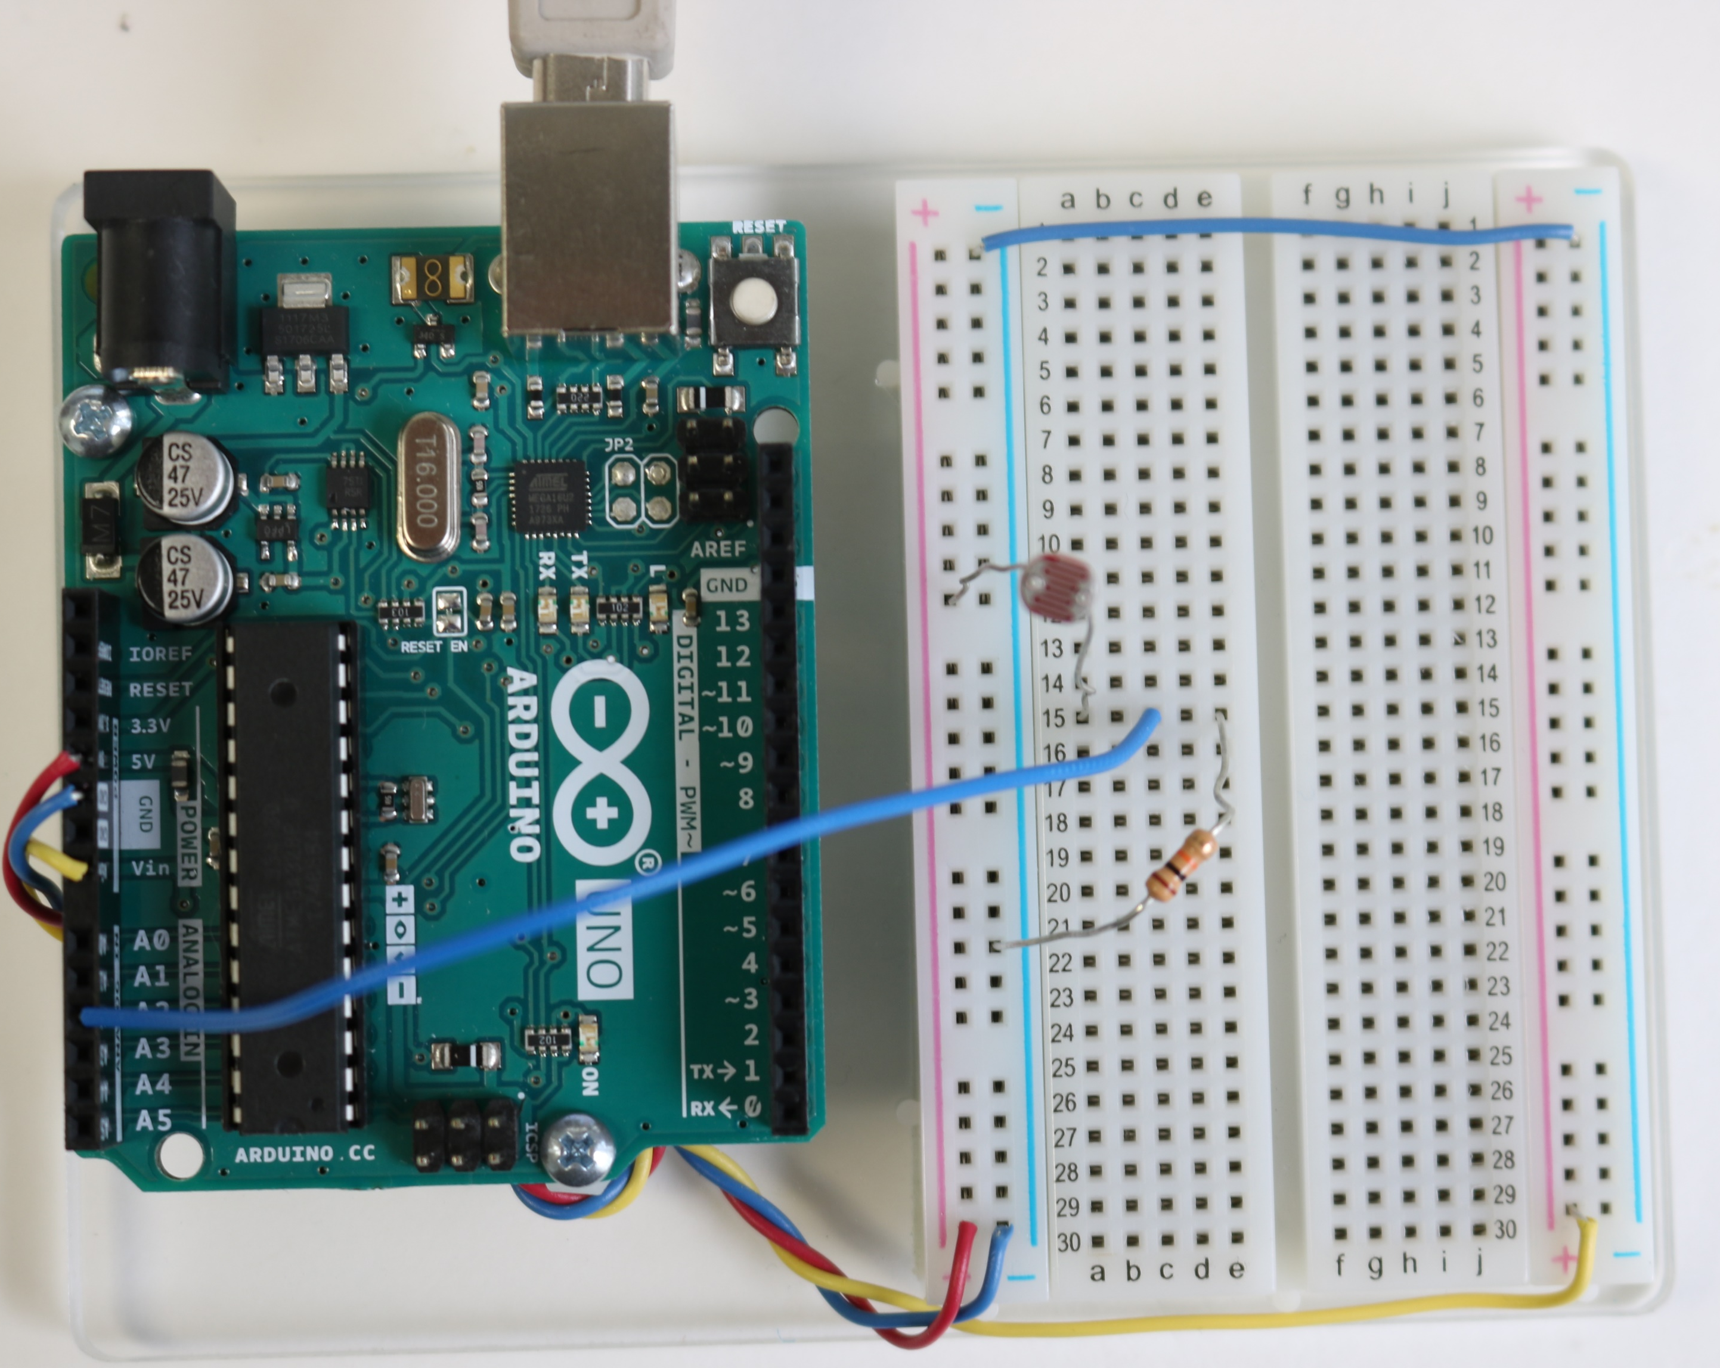
Wire this photoresistor voltage divider circuit
5V
photoresistor
analog input 2
10kΩ

Slide 6
Enter and run the following sketch
int val; // variable to store value read at analog pin 2
void setup() {
Serial.begin(9600); // set up to print out text to monitor
}
void loop() {
val = analogRead(2); // read analog input pin 2
Serial.println(val); // print value to serial monitor
}
What happens to the values on your serial monitor when you put your hand over the photoresistor?

Slide 7
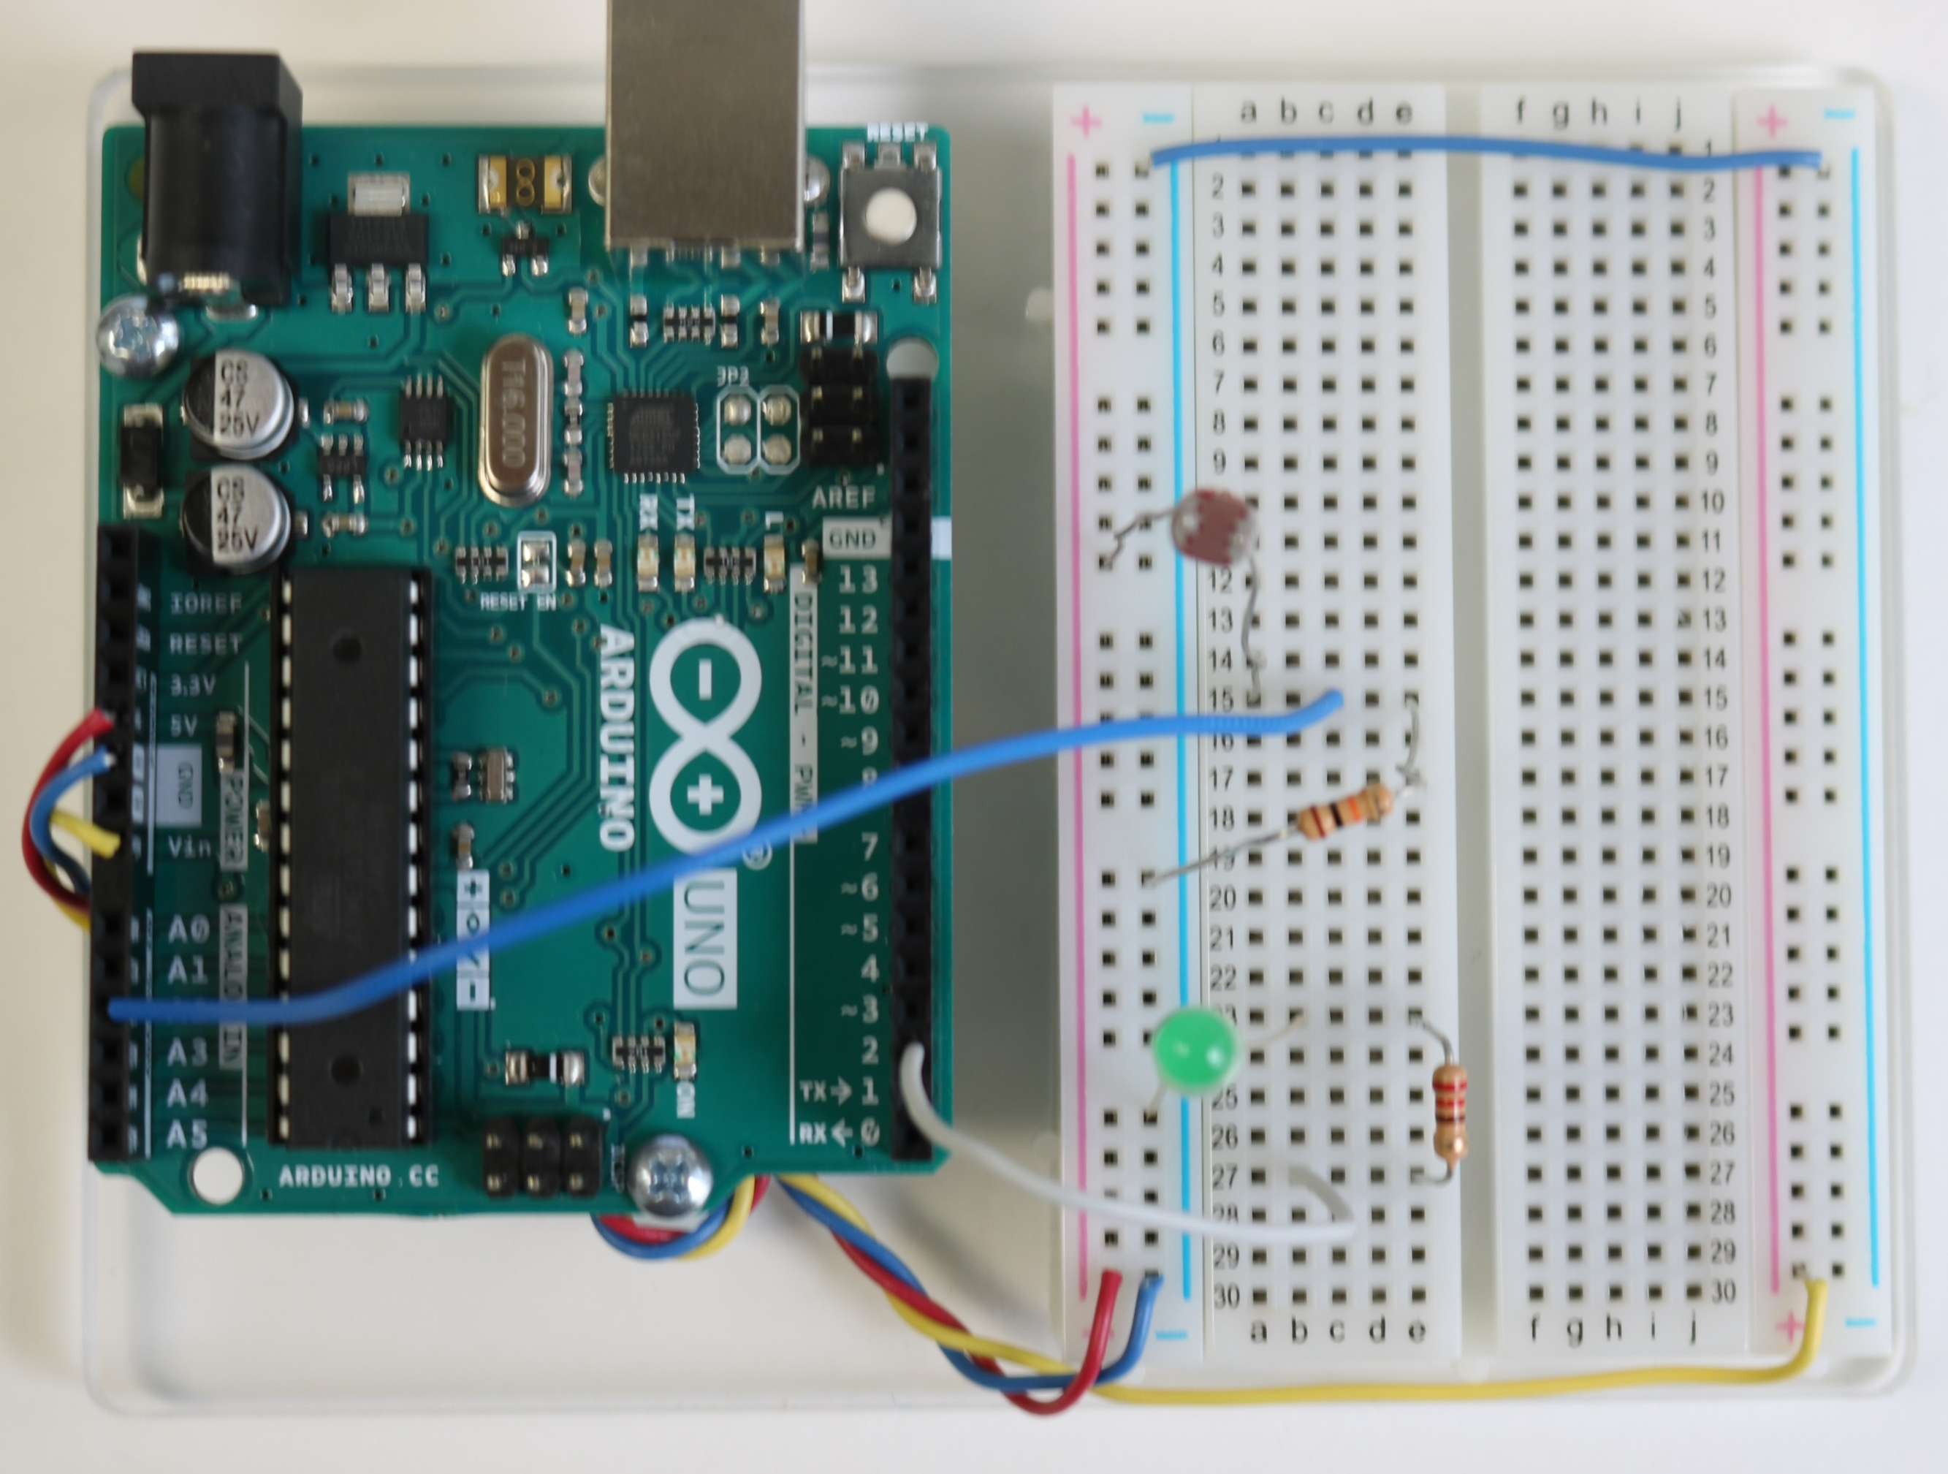
Implement photoresistor and LED circuits
5V
photoresistor
analog input 2
10kΩ
220Ω
digital pin 2

Slide 8
Enter and run the following sketch
int val; // variable to store value read at analog pin 2
void setup() {
Serial.begin(9600); // set up to print out text to monitor
pinMode(2,OUTPUT); // declare pin 2 as an output
}
void loop() {
val = analogRead(2); // read analog input pin 2
Serial.println(val); // print value to serial monitor
if(val < 300) // if statement used to control LED
{
digitalWrite(2,HIGH); delay(100);
digitalWrite(2,LOW); delay(100);
}
}
How does the photoresistor control the LED?

Slide 9
Connect a second LED Circuit
If the photoresistor value is above 750, have the LED connected to pin 12 turn on.
If the photoresistor value is below 600, have the LED connected to pin 2 blink.
All other cases the LEDs should be off.
5V
220Ω
220Ω
digital pin 2
digital pin 12
photoresistor
analog input 2
10kΩ
Getting started:
Where will the main portion of your sketch be located?
How many if statements will you need in your sketch?
Will anything be written in the setup function?
Do you need to set a pinMode for the analog pin?
You will need to turn the LEDs off (set pins LOW). Experiment with setting them LOW at the beginning, setting a range for being off, and/or using and else statement.
Loop function
2 if statements
Yes, the pinMode() commands for the digital pins
No, because analog pins are only input

Slide 10
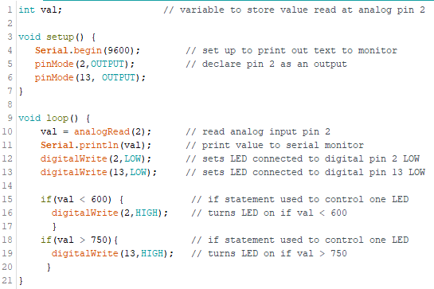

Slide 11
Solution Using else statement
int val; // variable to store value read at analog pin 2
void setup() {
Serial.begin(9600); // set up to print out text to monitor
pinMode(2,OUTPUT); // declare pin 2 as an output
pinMode(12,OUTPUT);
}
void loop() {
val = analogRead(2); // read analog input pin 2
Serial.println(val); // print value to serial monitor
if(val < 550) // if statement used to control LED
{
digitalWrite(2,HIGH); delay(100);
digitalWrite(12,LOW); delay(100);
}
if(val > 800) // if statement used to control LED
{
digitalWrite(12,HIGH); delay(100);
digitalWrite(2,LOW); delay(100);
}
else
{
digitalWrite(12,LOW);
digitalWrite (2,LOW);
}
}

Slide 12
Control LED Based on Light Input
Handout
int val; // variable to store value read at analog pin 2
void setup() {
Serial.begin(9600); // set up to print out text to monitor
pinMode(2,OUTPUT); // declare pin 2 as an output
}
void loop() {
val = analogRead(2); // read analog input pin 2
Serial.println(val); // print value to serial monitor
if(val < 600) // if statement used to control LED
{
digitalWrite(2,HIGH); delay(100);
digitalWrite(2,LOW); delay(100);
}
}

Slide 13
Beep Piezo Speaker
Handout
Piezo Speaker
+ digital pin
- ground
// Beep piezo speaker at 500 Hz
const int buzzer = 7; //buzzer to arduino pin 7
void setup(){
pinMode(buzzer, OUTPUT); // Set buzzer - pin 7 as an output
}
void loop(){
tone(buzzer, 500); // Send 500 Hz sound signal...
delay(1000); // ...for 1 sec
noTone(buzzer); // Stop sound...
delay(1000); // ...for 1sec
}
Digital
7

Slide 14
Alarm Program
If the ambient light is ON
Turn on the GREEN LED (solid)
If the ambient light goes dark
Sound an alarm
Blink the RED LED (synced with alarm)
Turn off the GREEN LED

Slide 15
Alarm Solution
int val; // variable to store value read at analog pin 2
const int buzzer = 7;
void setup() {
Serial.begin(9600); // set up to print out text to monitor
pinMode(2,OUTPUT); // declare pin 2 as an output
pinMode(buzzer, OUTPUT); // Set buzzer - pin 7 as an output
}
void loop() {
val = analogRead(2); // read analog input pin 2
Serial.println(val); // print value to serial monitor
if(val < 800) // if statement used to control LED
{
digitalWrite(2,HIGH); // turn on GREEN LED
digitalWrite(12,LOW); // turn off RED LED
}
else
{
digitalWrite(2,LOW);
digitalWrite(12,HIGH); // turn on RED LED
tone(buzzer, 500); // Send 500 Hz sound signal...
delay(1000); // ...for 1 sec
digitalWrite(12,LOW); // turn off RED LED
noTone(buzzer); // Stop sound...
delay(1000);
}
}

