Slide 1
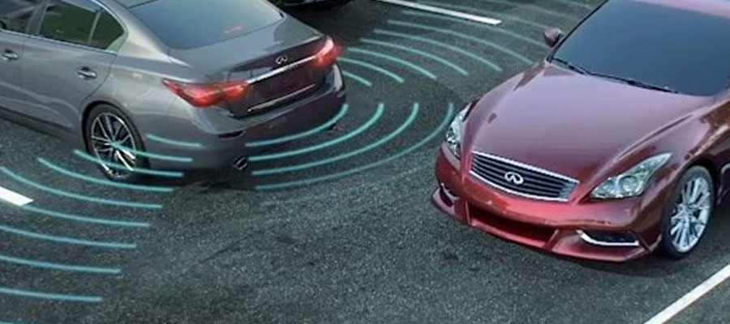
Collision Avoidance System
Code
Schematics
Distance Measurement
Application

Slide 2
Project Code (Ranging)
//Rounds to nearest inch
const int pingPin = 7;
float duration, inches, cm;
void setup() {
Serial.begin(9600);
}
void loop() {
pinMode(pingPin, OUTPUT); // Set pin to OUTPUT
digitalWrite(pingPin, LOW); // Ensure pin is low
delayMicroseconds(2);
digitalWrite(pingPin, HIGH); // Start ranging
delayMicroseconds(5); // with 5 microsecond burst
digitalWrite(pingPin, LOW); // End ranging
pinMode(pingPin, INPUT); // Set pin to INPUT
duration = pulseIn(pingPin, HIGH); // Read echo pulse
inches = duration / 74 / 2; // Convert to inches (37 = 74/2)
cm = duration / 59;
Serial.println(inches); // Display result
Serial.println(cm);
delay(2000); // Short delay
}

Slide 3
Piezo Speaker Code
// Beep piezo speaker at 500 Hz
const int buzzer = 7; //buzzer to arduino pin 7
void setup(){
pinMode(buzzer, OUTPUT); // Set buzzer - pin 7 as an output
}
void loop(){
tone(buzzer, 500); // Send 500 Hz sound signal...
delay(1000); // ...for 1 sec
noTone(buzzer); // Stop sound...
delay(1000); // ...for 1sec
}

Slide 4
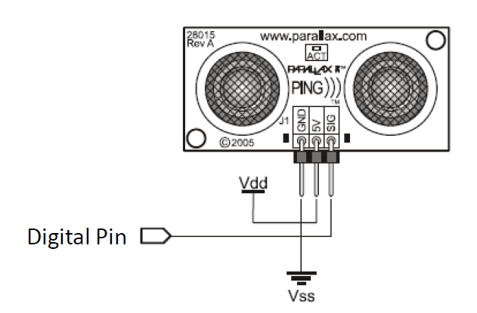
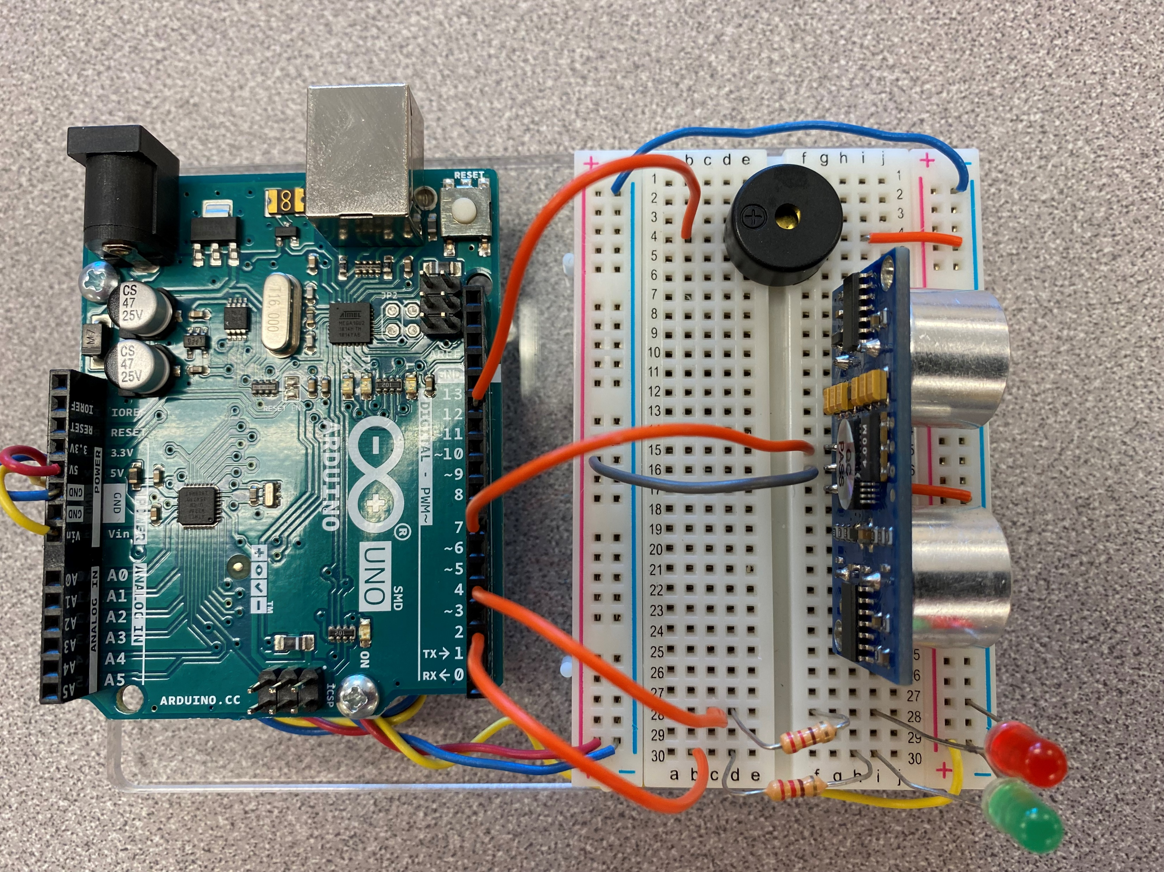
Circuit Schematics
Piezo Speaker
+ digital pin
- ground
Pin 3 Green
Pin 4 Red
Pin 8
Pin 7
7

Slide 5
Distance Measurement
Used computation for inches in given code to convert to centimeters.
“Duration” value for 7in (17.7cm) was 1042.
Use a proportion to determine Duration value per centimeter.
$$7in≈1042$$
$$7in≈17.7cm$$
$$\frac{1042s}{7in}=\frac{7 in}{17.7 cm} →$$
$$\frac{59s}{cm}$$
$$where \text{s}=increments of time for Arduino$$

Slide 6
Application: Back-Up Sensor
Enable (Sonic) Sensor when vehicle is in reverse.
Issue (audible) warning when vehicle is nearing an obstacle.
Increase frequency as vehicle gets closer to object.
Light panel light and apply brakes when object reaches minimum safe distance.
Could use to test human interface design / situational awareness in proof of concept phase.

