Slide 1
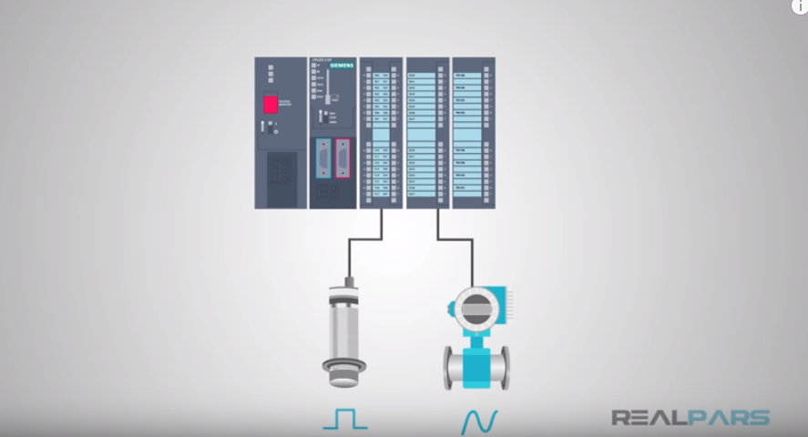
Types of Sensors
https://www.youtube.com/watch?v=J_KoRp8SnoE&list=PLln3BHg93SQ812ihcqWb9OOWbZ-09DLW6&index=5 8:28

Slide 2
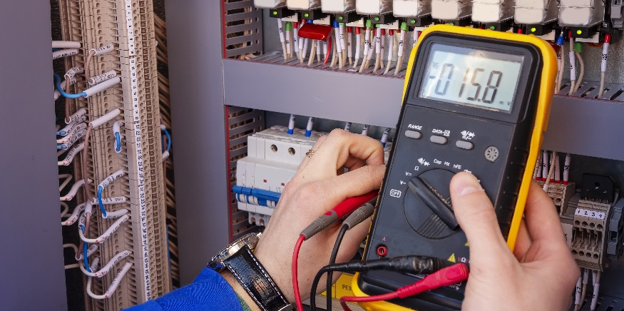
Transistors

Slide 3
Transistors
Describe the function of a transistor.
Build a transistor switching circuit.
Control a transistor switch with the Arduino.
Implement a circuit to monitor a thermistor.
Implement a set point program using a thermistor.

Slide 4
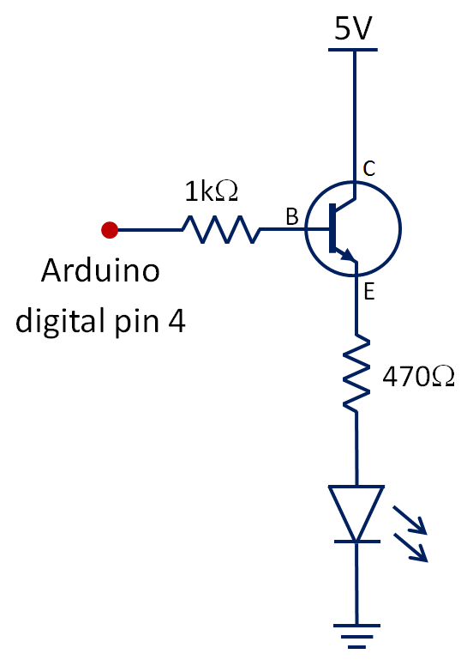
Implementation of a Transistor Circuit
A transistor is a semiconductor device that can be used as an “electrical switch” or as an amplifier
Implement the transistor circuit on your Arduino
C
B
E
Compare the pin locations of C, B and E to the circuit diagram
WARNING: The transistor will get VERY hot if connected incorrectly

Slide 5
Implementation of a Transistor Circuit
Write a simple program to make the LED blink on and off
void setup() {
pinMode(4,OUTPUT);
}
void loop() {
digitalWrite(4, HIGH);
delay(1000);
digitalWrite(4, LOW);
delay(1000);
}
What is the transistor doing?
Transistors can be used to have a small current toggle a larger one
Your Arduino can output ~40mA of current
Using transistors with your Arduino allows you to toggle a much larger amperage
We will use transistors to activate a relay for switching our sous vide heater on and off.
Switching the LED on and Off

Slide 6
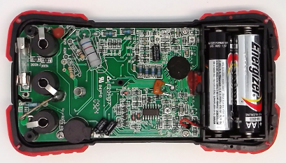
Transistors
A transistor is a semiconductor device that can be used as an “electrical switch” or as an amplifier.
Transistors are in most electronic devices
Advantages of using a transistor over a mechanical switch:
Can be very small
Works very fast
Can be controlled electrically
Inexpensive
The A8 chip in an iPhone contains 2 billion transistors
This chip in your multimeter contains multiple transistors

Slide 7
Transistors are made from Semiconductors
Semiconductors are materials that can either be a conductor or an insulator depending on the conditions
Silicon by nature is an insulator but it is also the most common semiconductor material.
Silicon can easily be bonded with other atoms to make it conduct or insulate when desired using a process called doping.
Common doping atoms are Phosphorous and Boron .
When silicon is doped with phosphorous it yields an extra electron which encourages conduction. This makes the bond more negative and is called N-Type Doping.
When silicon is doped with boron it yields a hole or missing electron which encourages conduction. This makes the bond more positive and is called P-Type Doping.
e
e
e
Si
e
Si
e
e
e
e
e
e
e
e
e
h
e
Si
e
Si
Si
e
P
e
Si
e
B
e
e
e
e
e
e
e
e
e
e
e
e
e
e
e
e
e
Si
e
Si
e
e
e
e

Slide 8
Transistors as switches
V_{BE} is the voltage from the digital pin & V_{CE} is the 5V power source
Transistors use both types of semiconductors (N-Type and P-Type) sandwiched together along with strategically applied voltages to switch between insulation and conduction.
Voltage_{BE} can be used as a switch to turn Voltage_{CE} on and off.
Think about how that relates the transistor/LED circuit you set up at the beginning of class.
You had 2 voltage sources: 5V power source and voltage supplied by digital pin 4
Which of the two would be V_{CE} and V_{BE}?
You were able to switch the LED on by supplying the second voltage (V_{BE}) from the digital pin
When you turned the pin LOW you removed the second voltage which turned switched the LED off
Emitter
Base
Collector
n++
p
n
V_{BE}
-
+
V_{CE}
-
+

Slide 9
Transistors as switches

Slide 10
Transistors with Arduino Application
5V
Goal: When the temperature read by your thermistor is higher than 77°F, use a transistor to turn on an LED.
Guiding Steps:
Implement the transistor/LED circuit and the thermistor circuit.
Determine your variables. What variables do you think you will have and what data type will each be?
thermistor
analog input 5
10kΩ
Variable to read in the analog value from the thermistor
- int val;
Variable to convert the analog value from thermistor to °F
- float tempF;
Variable for setpoint of 77°F
- float setpoint;
Programming tip: since setpoint is a constant value, you can set that value at the beginning of the sketch when you define the variable. This makes it easy to change if you need to adjust the setpoint.
float setpoint = 77.0;
C
B
Remember to put .0 with your whole numbers so the Arduino looks for the decimal values.
E
plug C, B, and E correctly

Slide 11
Transistors with Arduino Application
What do you need to put in your setup function?
What is the first thing you need to do in your main loop function?
What type of value are the thermistors points collected as?
You need to convert the analog values into temperature values. How can you do this?
Remember to print the values you collected from the thermistor and their corresponding °F values on the serial monitor. Why is it good to do this?
Initialize the serial monitor and pin Mode for digital pin connected to the transistor
Collect values from the thermistor
Analog Values
Use inverted calibration equation
Seeing the values on the serial monitor helps you to know what temperature values you are reading, lets you know where in the sketch you are, and helps you troubleshoot issues with the sketch.
$$TempF =0.2063∗AnalogValue−26.428$$
2022 Data: TempF = 0.19 * AnalogValue - 20.943

Slide 12
Transistors with Arduino Application
Compare your temperature value with your setpoint value. What type of statement do you need to use for the comparison?
What should the comparison statement be?
If the condition is met, what should the Arduino do and how?
How do you make the LED turn off when the condition is not met?
Remember it is a good practice to print to the serial monitor when the condition is met and the LED is on as well as when the condition is not met and the LED is off.
If statement
If (tempF > setpoint)
Turn on the LED by using the transistor. Turning the digital pin connected to the transistor to HIGH will turn the LED on.
Turn the digital pin connected to the transistor to LOW in an else statement.

Slide 13
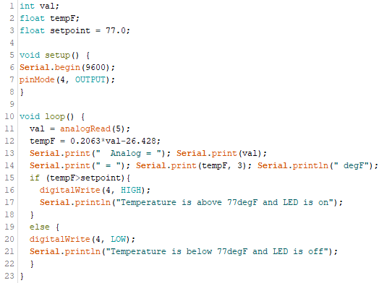
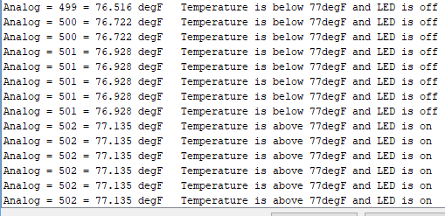
Transistors with Arduino Application
If the LED represents the heater mechanism on the sous vide, how do you think this activity is similar to the sous vide project that you are working towards?

Slide 14
int val;
float tempF;
float setpoint = 75.0;
void setup() {
Serial.begin(9600);
pinMode(4,OUTPUT);
}
void loop() {
val = analogRead(5);
tempF = 0.2063*val-26.428;
Serial.print(" Analog = "); Serial.print(val);
Serial.print(" = "); Serial.print(tempF);Serial.println(" degF");
if (tempF>setpoint){
digitalWrite(4,HIGH);
}
else {
digitalWrite(4,LOW);
}
}

Slide 15
Transistors with Arduino Project (Extension)
5V
Objectives:
When the temperature read by your thermistor is higher than 77°F, use a transistor to turn on a Green LED using a Transistor. (turn OFF bellow 77)
When a photoresistor detects “dark”, turn on a RED LED (using a digital pin).
thermistor
analog input 5
Requirements/Rubric:
Build the circuits shown on your breadboard.
Print analogRead values and actual temperature in °F to the serial monitor. “TempF = “ ____
Print analogRead value for the photoresistor voltage divider. “Photo = “ ____
Demonstrate your control system (show me it works)
Comment your code (at least 8 lines). Cut and paste your program into a Word document and upload it to the Transistors assignment on Classroom.
5V
10kΩ
16
5
photoresistor
5
analog input 2
16
8
470Ω
10kΩ
digital pin 2
C
B
E

Slide 16
Start Building Your Capstone Project Documentation “Preliminary Design Review (PDR) Presentation” (Prototype Phase)
PowerPoint
Calibration / Equation
Derivations / How we got it.
How it is used / what it does.
Circuits
Schematics: What they do/how they work
Thermistor/Analog Read
LED Status Light(s)
…
System Elements / Block Diagram
System Block Diagram
Labeled Picture of Finished System
Code
Flow Chart
Explanation of code functions
Commented Code

