Slide 1
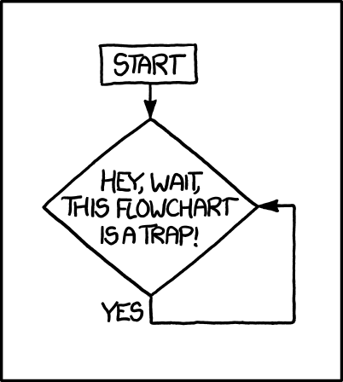
Using Flowcharts
Designing and Documenting Processes, Control Algorithms and Software

Slide 2
Flow Charts
Definition / Types of Flow Charts / Examples
Flow Charting Symbols
Working with PowerPoint (to generate Flowcharts / Project Documentation)
Flow Chart Cooling Control Program

Slide 3
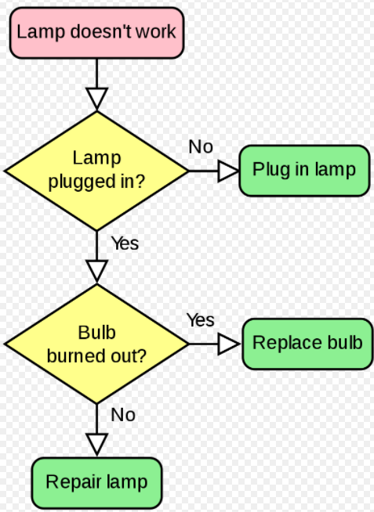
Flow Charts
A flowchart is a type of diagram that represents a workflow or process.
A flowchart can also be defined as a diagrammatic representation of an algorithm, a step-by-step approach to solving a task.
Flowcharts are used in designing and documenting simple processes or programs.
https://en.wikipedia.org/wiki/Flowchart

Slide 4
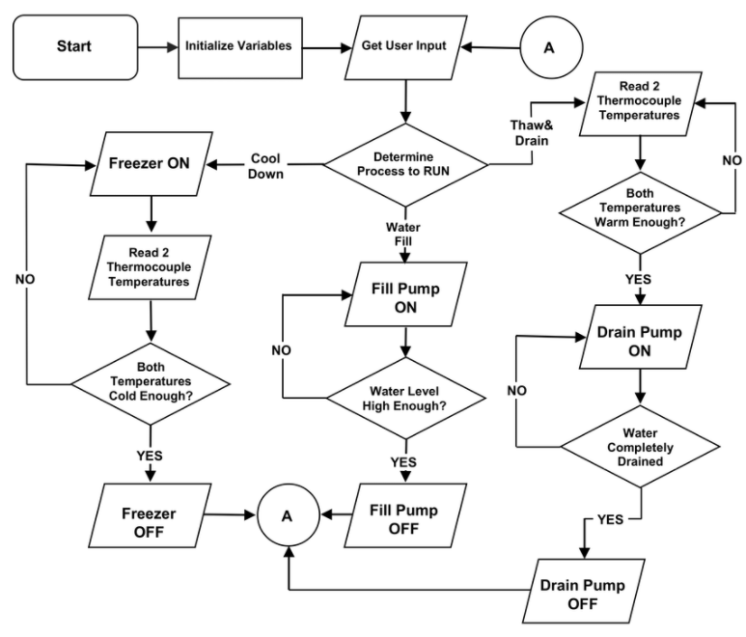
Refrigeration System Control Logic

Slide 5
Program Flow Chart Symbols / Layout
Void Loop
Start/End
Terminal
Read Thermistor
Connector/
Program Flow
Compute
Temperature
Input / Output
> Setpoint ?
Y
1
Process/
Operation
N
Turn Heater On
Decision
1
Connector
Loop
See ANSI & ISO Standards

Slide 6
Working in PowerPoint
Selecting Graphics, Text Boxes
Using Connectors
Grouping, Layering (Bring to Front, Send to Back…)
Windows Snip & Sketch Tool
Hot Links
Font Sizes
Opening, Closing, Saving, Retrieving…
Chart Types / Formatting
Slide Size
Slide Master
Views: Normal, Slide Sorter
Header/Footer

Slide 7
Flow Chart the Cooling Control Program
Setup
Initialize
Variables
int val;
float tempF;
float setpoint = 74.0;
void setup() {
Serial.begin(9600);
pinMode(7,OUTPUT);
Serial.print(setpoint);Serial.println("degf");
}
void loop() {
val = analogRead(5);
tempF = 0.2063*val-26.428;
Serial.print(" Analog = "); Serial.print(val);
Serial.print(" = "); Serial.print(tempF,3);Serial.println(" degF");
if (tempF > setpoint){
digitalWrite(7,HIGH);
Serial.println("The temperature is too hot! The fan is ON");
}
if (tempF <= setpoint) {
digitalWrite(7,LOW);
Serial.println("The temperature is comfortable. The fan is OFF");
}
}
Void Setup
Analog Read Thermistor
Compute
Temperature
tempF > Setpoint ?
Turn Fan ON
Print Fan Status

Slide 8
Rubric
Flow Chart Symbols used properly 10
Connectors indicate program flow 10
All major elements of the program captured 20
Setup
Void Setup
Void Loop
Inputs
Outputs (to Serial Monitor, to/rom circuits)
Decisions

Slide 9
Set int, tempF and setpoint variables
Void Loop
<= Setpoint ?
N
Read Thermistor
Y
Compute
Temperature
Turn Fan OFF
Void Setup
Initialize Serial Monitor
Print Temperature
Loop
> Setpoint ?
N
Set Pin 7 Output – Fan Control
Y
Turn Fan ON

