Slide 1
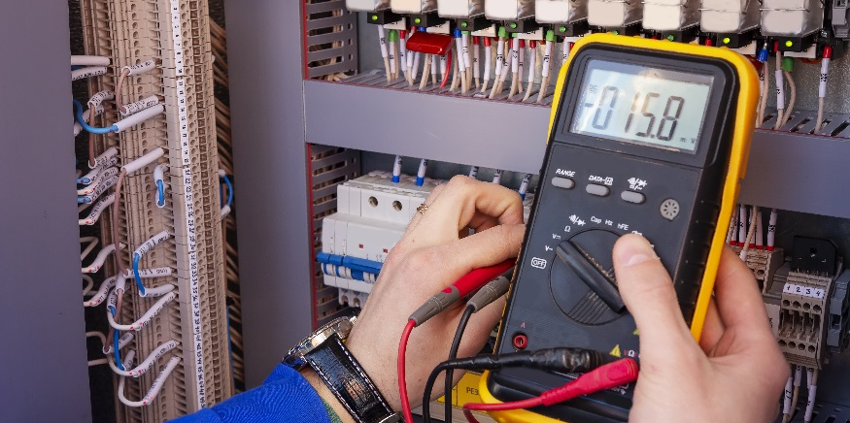
Heater Controller

Slide 2
Heater Control
A person will choose a target temperature or a setpoint for your temperature control system.
What do you think should happen with your system when the temperature of the water is below the setpoint value?
Heater should turn on
What do you think should happen with your system when the temperature of the water is above the setpoint value?
Heater should turn off

Slide 3
First Five 11c
Measure the resistance of your heater resistor.
Assuming a 9V DC power supply, find the current draw for this resistor (at room temp).
Find the power that will be dissipated by the resistor.
“there is a series polarity protection diode wired between the external power connector + to the Vin pin, this is I believe a nominal 1 amp maximum forward current rated diode.”
https://forum.arduino.cc/t/max-ampere-for-vin-pin/69865

Slide 4
First Five 11c - Solution
Measure the resistance of your heater resistor.
Assuming a 9V DC power supply, find the current draw for this resistor (at room temp).
Find the power that will be dissipated by the resistor.
$$\sim 10.2Ω$$
$$I=\frac{8.2V}{10.2Ω}≈0.8 A$$
Adapter: 2A, 18W
Arduino 9V (8.2): $\sim 1A$
$$P=0.8A ×9V≈7.2W$$

Slide 5
Heater Control Range
This would be difficult to do for one specific value
The heater would keep turning on and off rapidly
Not efficient
Setting a maximum limit and a minimum limit to what we allow the temperature to be
Maximum limit is commonly called a Upper Control Limit (UCL)
Minimum limit is commonly called a Lower Control Limit (LCL)
Too Cold
Heater turn ON
Just Right
Too Hot
Heater turns OFF
LCL
Setpoint
UCL

Slide 6
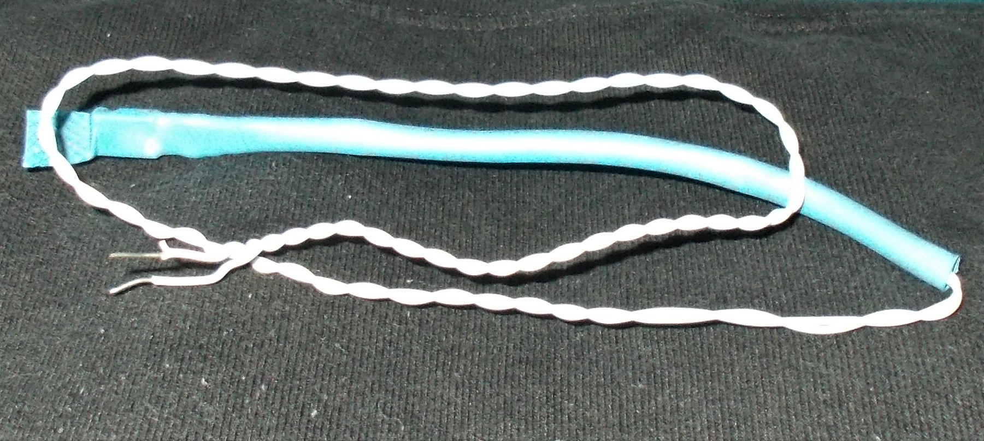
Wire the Heater
With power off and disconnected:
Connect the Heater Resistor in place of the fan in your Cooling Control System.
Can also now remove the output Flyback Diode (no magnetic field energy in heater resistor)
Do not operate without the resistor submerged in the water bath.

