Slide 1
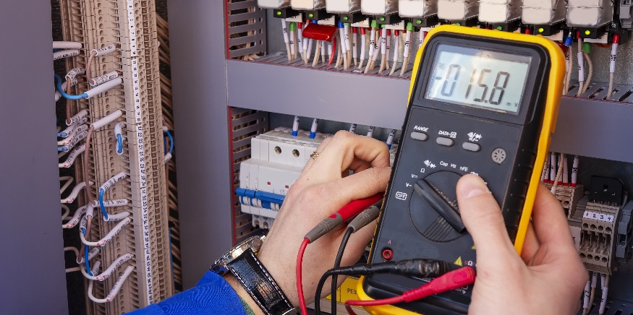
RC Circuits

Slide 2
RC Circuits
Build an RC Circuit.
Understand the relationship between capacitance and the charge and discharge times for an RC circuit.
Find the time constant for an RC circuit.
Plot the charge voltage vs charge time using RCPlot.ino
https://www.khanacademy.org/science/electrical-engineering/ee-circuit-analysis-topic/ee-natural-and-forced-response/v/ee-rc-natural-response-intuition
Schematic Diagrams & Symbols, Electrical Circuits (17:58): https://www.youtube.com/watch?v=Dl1gFBNa0Ik
Draw the symbol for each component shown in the video.

Slide 3
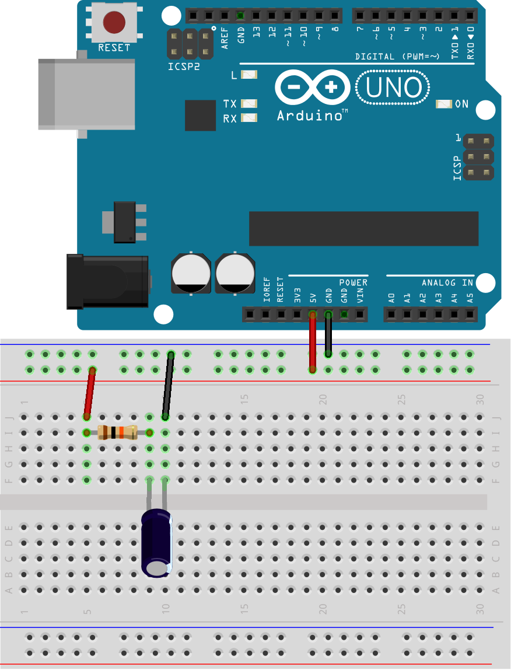
RC Circuits
Using a $10kΩ$ resistor and a $10μF$ capacitor, draw a schematic and build the circuit shown below.
Negative (striped) side to ground!
This is known as an RC circuit.
What is the voltage across the capacitor when the Arduino is on?
What happens with you turn off the Arduino (i.e. unplug it)?

Slide 4
Schematic
Negative
Side
5 V
10µF

Slide 5
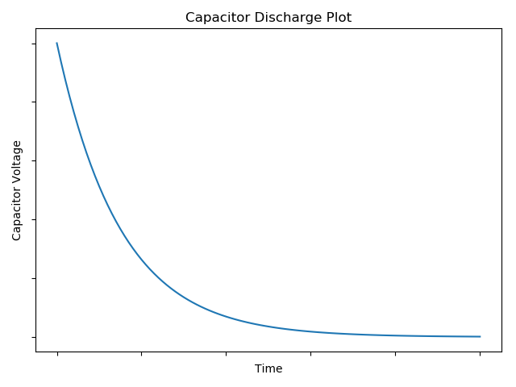
RC Circuits
If you were to plot the discharge of the capacitor (i.e. voltage vs time), the plot would look something like…
The capacitor will discharge at a rate that is dependent on the capacitance and the resistor used to discharge the voltage to ground.

Slide 6
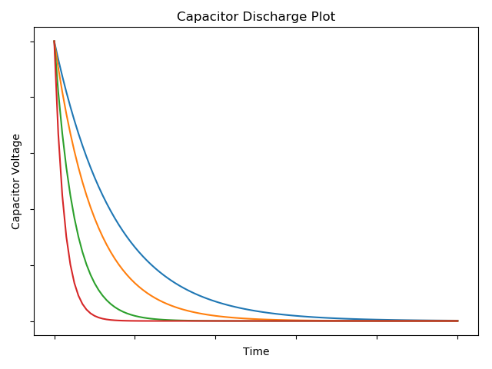
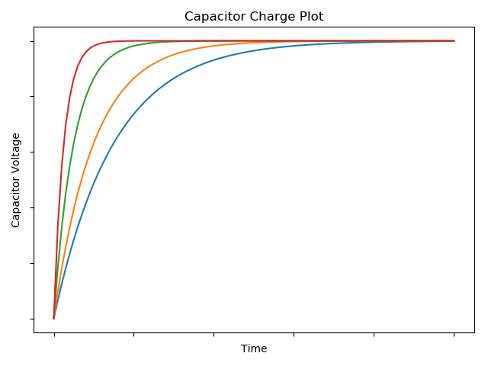
RC Circuits – Charge/Discharge Times
Here are plots for various capacitors (holding the resistance constant).
As the capacitance increases, the discharge time increases.
Which capacitor has the lowest capacitance?
The charging time of a capacitor has a similar behavior.
As the capacitance decreases, the charge time decreases.
Discharge
Plot
$$C_{p}↑$$
Time
Voltage
Charge
Plot
$$C_{p}↑$$

Slide 7
RC Circuits
For a RC circuit, if the resistor value ($R$) is known and the charge plot of the capacitor is known, the capacitance ($C_{p}$) may be determined.
The capacitance is determined by the use of a time constant.
A time constant, denoted by the Greek letter tau ($τ$), is a value that describes how well a particular circuit responds to change.
The RC circuit’s time constant is given by
$τ=RC_{p}$
Looking at the units, we see that the time constant has units of…
Recall from Ohm’s Law that $V≡ΩA$.
$$≡Ω\left(\frac{C}{V}\right)$$
$$≡Ω\frac{C}{\left(ΩA\right)}$$
$$≡\frac{C}{A}$$
$$≡\frac{C}{\frac{C}{s}}$$
$$τ≡\left(Ω\right)\left(F\right)$$
$$≡s$$

Slide 8
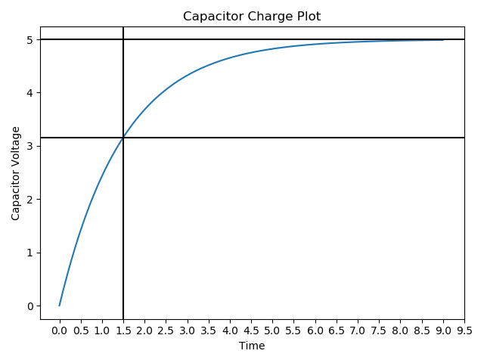
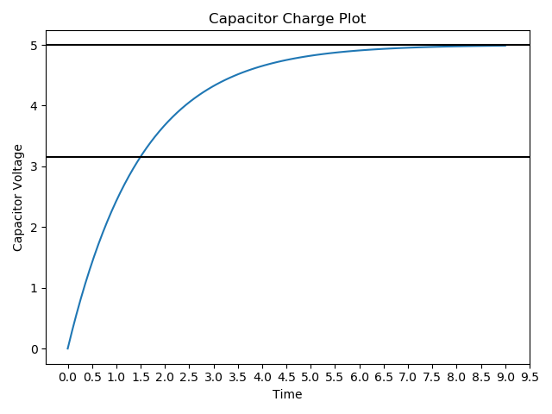
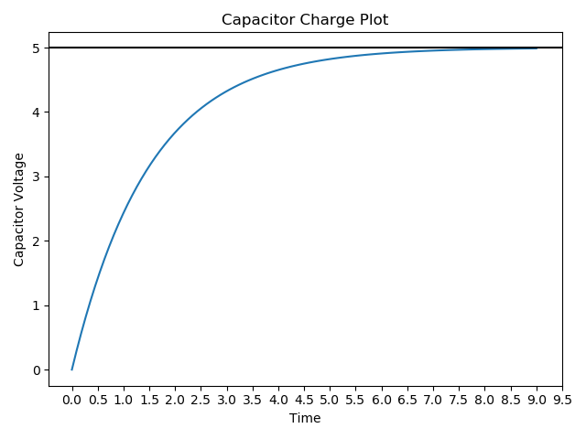
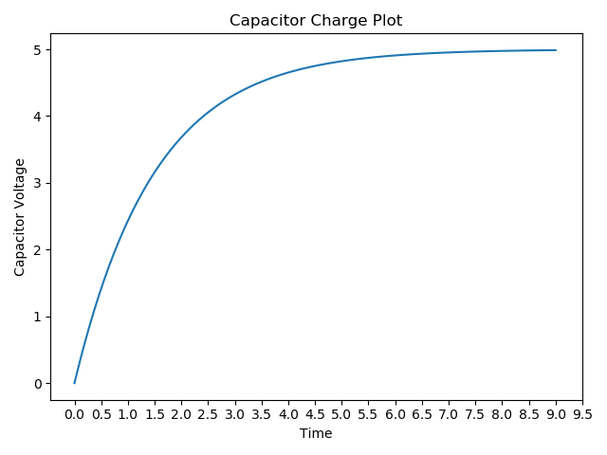
Time Constants
If the plot of a charging capacitor is inspected, the time constant can directly be determined.
Once the voltage reaches $63.2\%$ of the entire charged voltage, the amount of time that has elapsed is equal to the time constant.
For example, look at the plot below.
The charged voltage is $5V$.
$63.2\%$ of $5V$ is $3.16V$.
The time when the capacitor voltage reach $3.16V$ is approximately $1.5s$.
Thus $τ=1.5s$.

Slide 9
Time Constants
If the resistance is $10kΩ$ then the capacitance may be found by
$τ=RC_{p}$
Solving for the capacitance, $C_{p}$, shows
$C_{p}=\frac{τ}{R}$
It should be noted that whenever values are read from plots and graphs there is always error that is introduced.
This is ok. Just be aware that the capacitance found this way will not be 100% accurate.
$$=\frac{1.5s}{10kΩ}$$
$$=1.5×{10}^{−4}F$$
$$=150μF$$

Slide 10
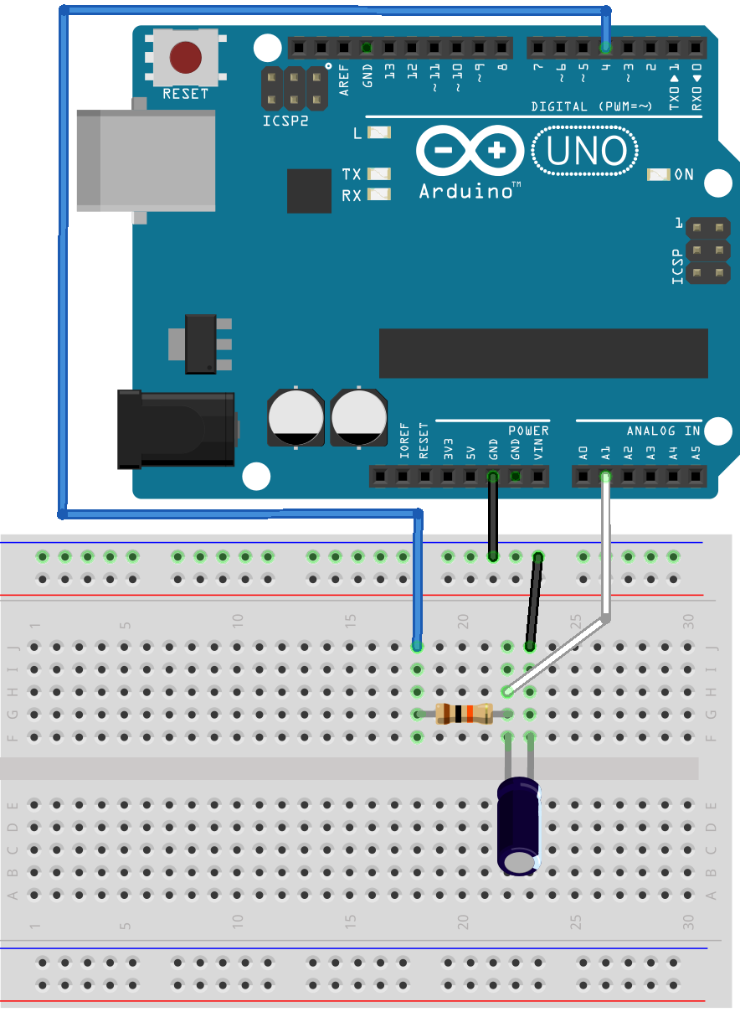
RC Circuits
We can use the Arduino to obtain the charge plot of a capacitor.
Build the circuit shown below, using a $10kΩ$ resistor and a $10μF$ capacitor.*
Digital
Pin 4
10kΩ
Analog
Pin 1
10µF
* Replace 5V with Digital Pin and add Analog Pin connection

Slide 11
RC Circuits (Class Problem 13b-1)
Find the time constant ($τ$) for this circuit.
Digital
Pin 4
10kΩ
$$τ=RC_{p}$$
Analog
Pin 1
10µF
Download RCPlot.ino and upload the sketch to your Arduino.
(Go to Classroom PowerPoint and cut & paste.)

Slide 12
// the number of times to read the capacitor voltage
int N=200;
// the amount of time (in ms) to charge the capacitor
int chargeTime=1000;
// the amount of time (in ms) to pause to initially
// discharge the capacitor
int dischargeTime=1000;
// set to false to use with serial plotter
// set to true to use with serial monitor
boolean serialMonitor=false;
//=========================================//
// No need to edit below this point =============//
//========================================//
// the pin that charges the RC circuit
int chargePin=4;
// the analog pin that reads the capacitor voltage
int capPin=1;
float capVoltage;
unsigned long t;
void setup(){
// begin serial communications
Serial.begin(115200);
// set the charging pin to an output
pinMode(chargePin, OUTPUT);
// set the charging pint to a low value
digitalWrite(chargePin, LOW);
// wait to discharge the capacitor
delay(dischargeTime);
// start charging the capacitor
digitalWrite(chargePin, HIGH);
// start collecting capacitor voltage values
for(int i=1; i<=N; i++){
// get the current time
t=millis();
// get the capacitor voltage
capVoltage=convertToVoltage(capPin);
// if the serial monitor is to be used
if(serialMonitor){
// display the time and a comma
Serial.print(t-dischargeTime);
Serial.print(',');
}
// display the capacitor voltage
Serial.println(capVoltage);
// pause for a small time interval
delay(chargeTime/N);
}
// turn the charging pin off
digitalWrite(chargePin, LOW);
}
// void loop() not needed for this sketch
void loop(){}
// convert the analogRead value to a voltage
float convertToVoltage(int analogPin){
int aR=analogRead(analogPin);
return 5.0*aR/1023.0;
}

Slide 13
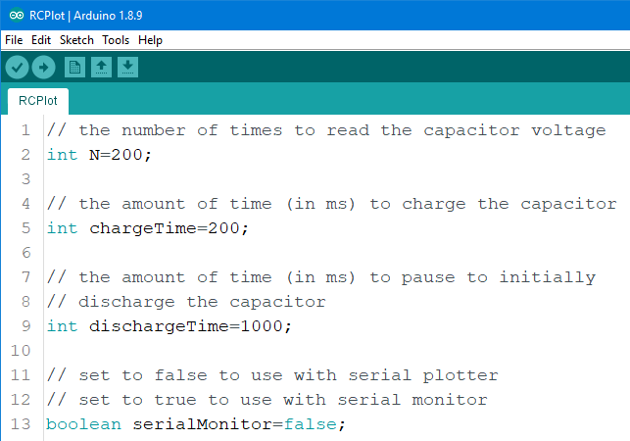
How RCPlot.ino Works
RCPlot.ino works by first discharging the RC circuit for a particular duration set by the variable dischargeTime.
The sketch then charges the RC circuit for a particular duration set by the variable chargeTime.
During the charging time, the capacitor voltage is read for a particular number of times set by the variable N.
The values that are collected are displayed either to the serial monitor or serial plotter. This is set by the serialMonitor variable.

Slide 14
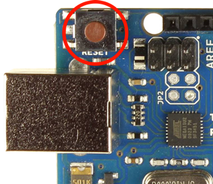
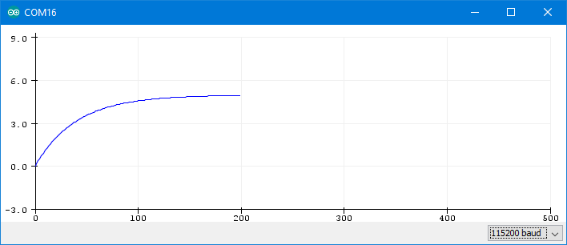
Using RCPlot.ino
With the RC circuit connected, upload the RCPlot.ino sketch with the serialMonitor variable set to false.
Once uploaded, open the serial plotter by selecting Tools>Serial Plotter or by pressing <ctrl>+<shift>+L.
The capacitor voltage should be shown on the plot.
Make sure baud rate is set to 115200.
The Arduino reset button may be used to get the serial plotter to display the plot again.

Slide 15
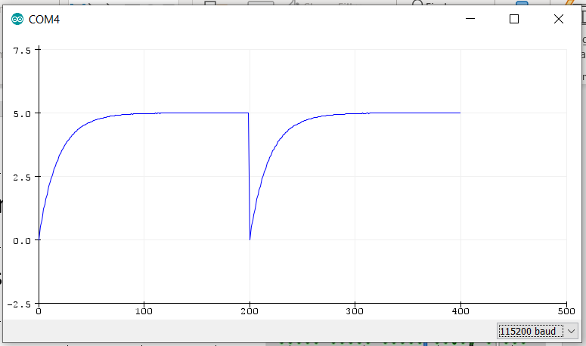
~3.16V
(63.2%)
$$τ≈10ms$$
Time (ms)

Slide 16
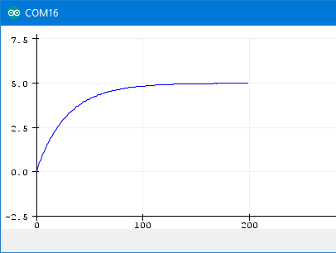
Using RCPlot.ino
Play around with the different capacitors in your kit.
What variable values work well for the $10μF$ capacitor?
N=200, chargeTime=750, and dischargeTime=1000
What variable values work well for the $100μF$ capacitor?
N=200, chargeTime=7500, and dischargeTime=10000

Slide 17
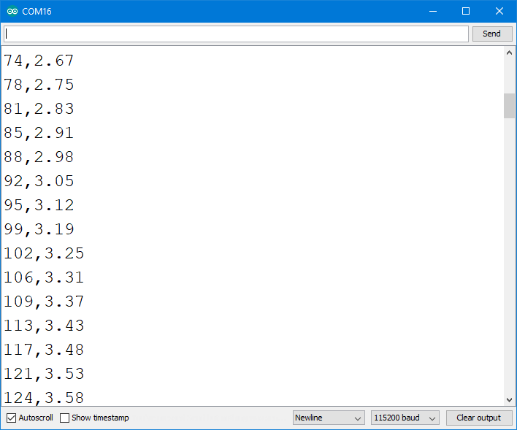
Using RCPlot.ino
Setting serialMonitor to true changes how the serial plotter works.
When serialMonitor is set to true, it is better to use the serial monitor.
With the $10μF$ capacitor in the circuit, set the RCPlot.ino variables to:
N=200
chargeTime=750
serialMonitor=true
dischargeTime=1000
Upload the sketch and open the serial monitor. What do you see?
The first column is the time in $ms$.
The second column is the capacitor voltage in $V$.

Slide 18
Using RCPlot.ino
Using RCPlot.ino when the serialMonitor variable is set to true is particular useful in determining the time constant of the RC circuit.
To use the serial monitor to determine the time constant, we first need to know when the voltage is $63.2\%$ of the fully charged voltage.
The charged voltage is $5V$ so the voltage when the time is equal to the time constant is $3.16V$.
$3.16V$ occurs between $95ms$ and $99ms$.
Interpolating shows
$$τ=\frac{3.16V−3.12V}{3.19V−3.12V}\left(99ms−95ms\right)+95ms=97.3ms$$

Slide 19
Using RCPlot.ino
Knowing that $τ=97.3ms$, the capacitor value may be determined.
Knowing that the resistance is $10kΩ$, the capacitance is
$C_{p}=\frac{τ}{R}$
Why isn’t it exactly $10μF$?
We interpolated for $τ$.
The resistance isn’t exactly $10kΩ$.
The reported value of the capacitance isn’t actually $10μF$.
$$=\frac{97.3ms}{10kΩ}$$
$$=9.73μF$$

Slide 20
Capacitors and RC Circuits
As the capacitance increases, the discharge time increases.
As the capacitance decreases, the charge time decreases.
$$C_{p}=\frac{q}{V}$$
$$C_{p}↑$$
$$C_{p}=\left(8.854×{10}^{−12}F/m\right)\left(\frac{εA}{d}\right)$$
$$C_{p}↑$$
$$τ=RC_{p}$$
$$τ=RC_{p}$$
Time elapsed to reach $63.2\%$ of charged voltage.

Slide 21
My Plot Looks Wrong…
My voltage isn’t fully charging.
Increase chargeTime
My voltage reaches fully charged early on.
Decrease chargeTime

Slide 22
My Plot Looks Wrong…
My starting voltage is not zero.
Increase dischargeTime
My plot doesn’t look smooth or is too short.
Increase N

Slide 23
Class Problem 13b-1
Find the time constant ($τ),$knowing that the resistance is $20kΩ$, and the capacitance is $150 μF$

