Slide 1
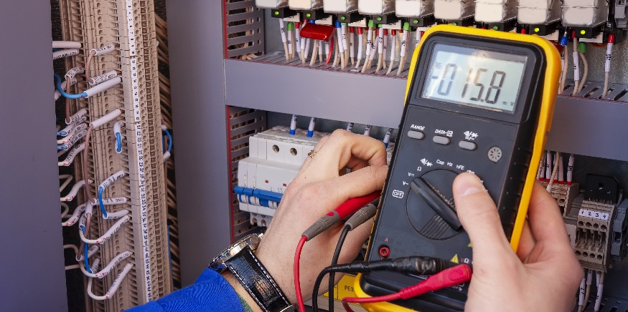
RL Circuits

Slide 2
DISCLAIMER & USAGE
This material is based upon work supported by the National Science Foundation's Advanced Technological Education Program under Grant No. 1801177.
Any opinions, findings, and conclusions or recommendations expressed in this material are those of the author(s) and do not necessarily reflect the views of the National Science Foundation.
2

Slide 3
RL Circuits
Build an RL circuit
Plot charge and Discharge vs time curves for an RL circuit
Understand the relationship between inductance and the charge and discharge times for an RL circuit.
Determine the time constant for an RL circuit
https://www.khanacademy.org/science/electrical-engineering/ee-circuit-analysis-topic/ee-natural-and-forced-response/a/ee-rl-natural-response

Slide 4
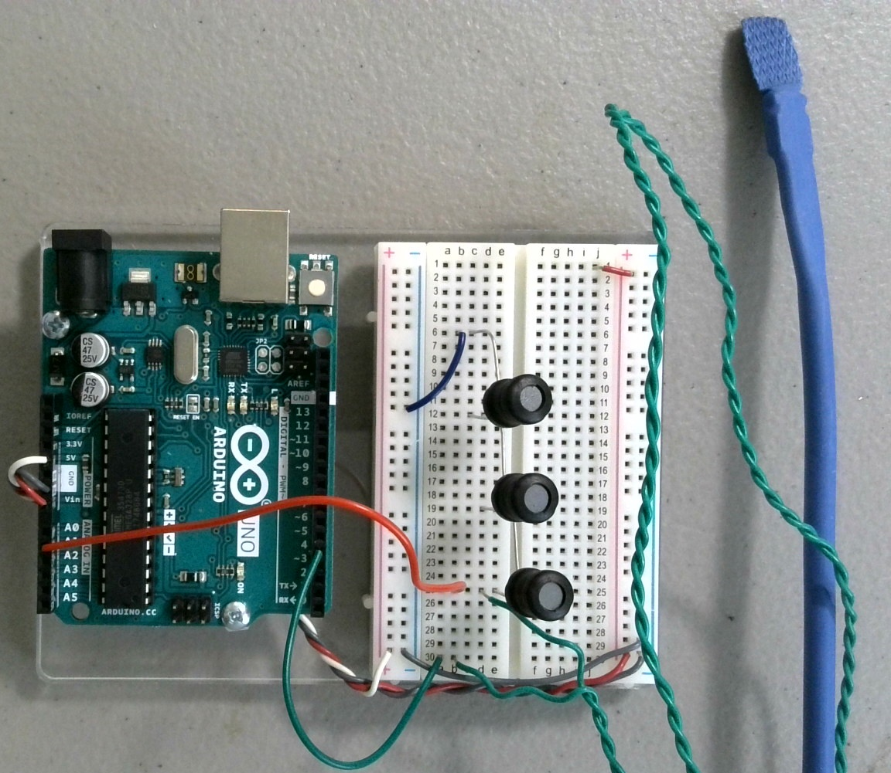
RL Circuits
Using a 1KΩ resistor and three $100mH$ inductors, build the circuit shown.
5V
1KΩ
$$Analog 2$$
$100mH$
$100mH$
$100mH$

Slide 5
RL Circuits
At steady state, what voltage would you expect across an inductor?
What is the voltage across an inductor when the Arduino is on? (5V ON)
What is going on?
5V
0 V
1KΩ
$$Analog 2$$
$100mH$
$100mH$
~ 0.7 V
$100mH$

Slide 6
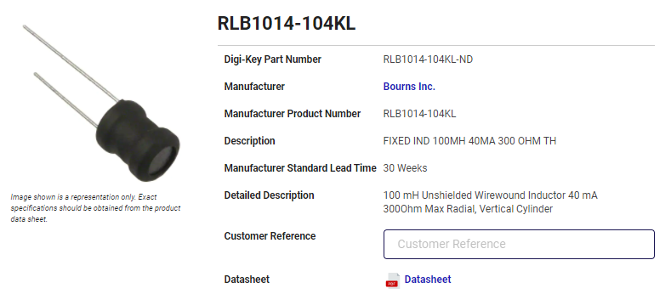
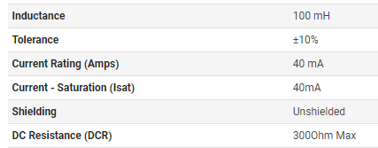
DCR – DC Resistance in Inductors
The amount of resistance an inductor exhibits when a DC signal (0 Hz) is passed through it.
Measure the DCR of one of your inductors with a DMM.
~ 230Ω

Slide 7
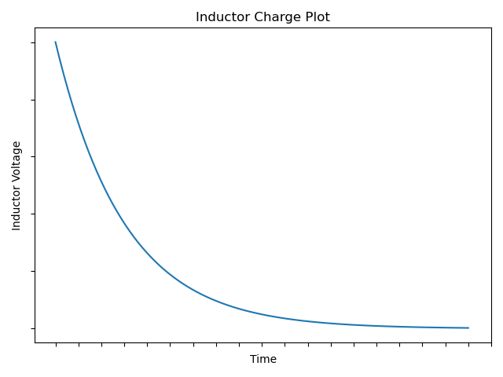
RL Circuits
If you were to plot the charge of the inductor (i.e. voltage vs time), the plot would look something like…
Does this remind you of anything?
It is similar to how a capacitor charges and discharges.

Slide 8
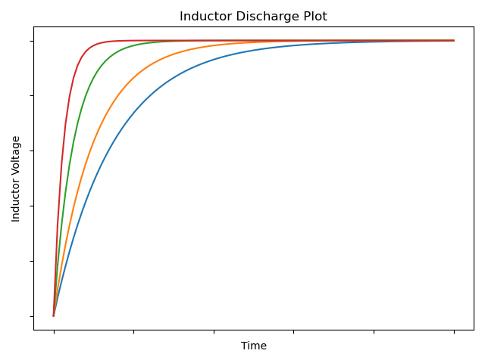
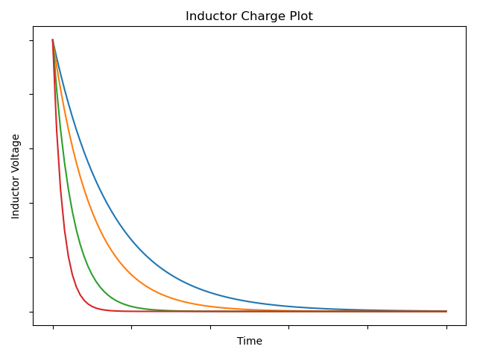
RL Circuits
Here’s a plot of various inductors.
As the inductance increases, the discharge time increases.
Which inductor has the lowest inductance?
The charging time of an inductor has a similar behavior.
A plot of charging times of various inductors is shown to the right.
As the inductance decreases, the charge time decreases.
$$L_{i}↑$$
$$L_{i}↑$$

Slide 9
RL Circuits
For a RL circuit, if the resistor value ($R$) is known and the charge plot of the inductor is known, the inductance ($L_{i}$) may be determined.
The inductance is determined using a time constant.
A time constant, denoted by the Greek letter tau ($τ$), is a value that describes how well a circuit responds to change.
The RL circuit’s time constant is given by
$τ=\frac{L_{i}}{R}$
Looking at the units, we see that the time constant has units of…
Recall from Ohm’s Law that $Ω≡V/A$.
$$≡\frac{\frac{Wb}{A}}{Ω}$$
$$≡\frac{\frac{Vs}{A}}{Ω}$$
$$τ≡\frac{H}{Ω}$$
$$≡\frac{Ωs}{Ω}$$
$$≡s$$

Slide 10
RL Circuits
Notice how the discharge plot of the inductor increases while the charge plot of the decreases.
Inductors always oppose the flow of current resulting in a change in voltage opposite of the applied voltage.
The charge of three inductor circuit may be seen using the Arduino.
Download RLPlot.ino and upload the sketch to your Arduino.
$$L_{i}↑$$
$$L_{i}↑$$

Slide 11
Using RLPlot.ino
The charging/discharging of the inductors happens much faster than that of the capacitors used before.
For this reason, a special Arduino sketch must be used to capture the inductor behavior.
Unlike the RCPlot.ino sketch no variables need to be adjusted to use the RLPlot.ino sketch.
Running the sketch with the serial plotter shows
The charge plot curve may be seen here

Slide 12
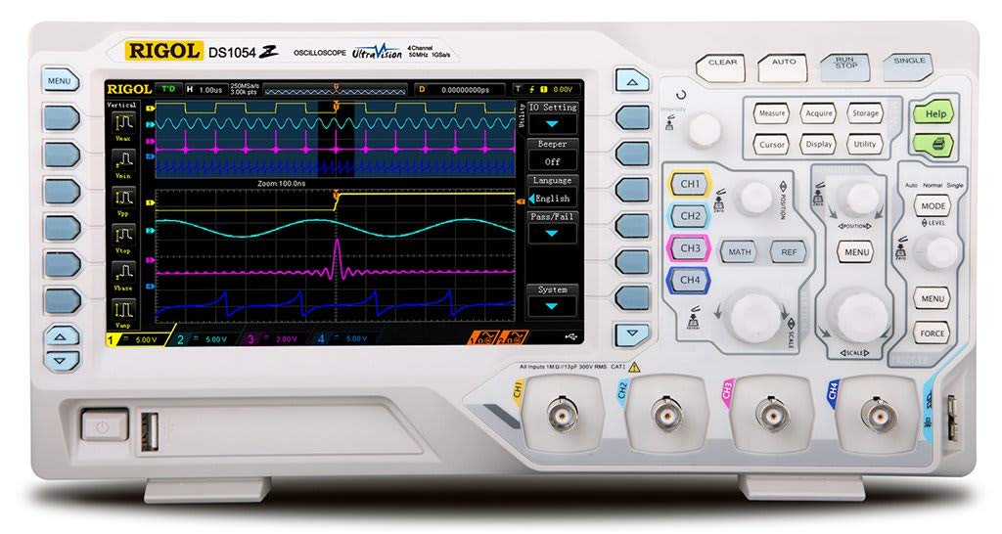
Why Doesn’t It Look Right?
The charging of the inductor is happening so quickly the Arduino is having a difficult time measuring the change.
The Arduino is not well suited for this type of task.
An oscilloscope is much better at measuring this sort of quick change.

Slide 13
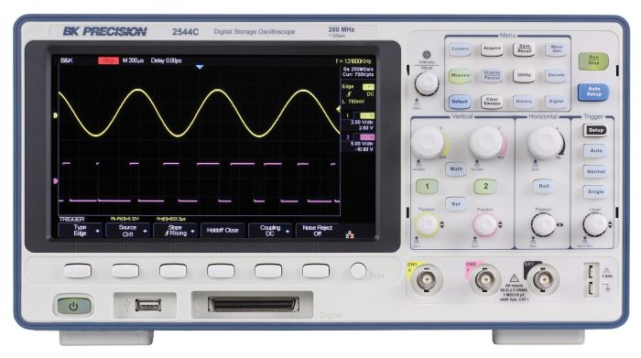
What’s An Oscilloscope?
Sample Rate – 200 MHz
An oscilloscope is a piece of lab equipment that is capable of quickly measuring voltage changes.
With the right know how, the Arduino is capable of reading 50,000 samples per second (50 kHz).
An oscilloscope is capable of reading 100 million samples per second (100 MHz).
That’s 2,000 times quicker!
That’s a sample ever 10 nanosecond!
Sample Rate – 1 GHz

Slide 14
Oscilloscopes: Digging Deeper
https://learn.sparkfun.com/tutorials/how-to-use-an-oscilloscope?_ga=1.171970599.529458105.1355161158

