Slide 1
Control
Loops

Slide 2
Control Loops
Define Instrument Control Loop and give examples.
Identify the three major elements of a control loop.
Define On/Off and Proportional Control and give examples.
Identify the role and importance of Calibration.

Slide 3
Instrument and Control Loops
The arrangement of instruments designed to measure and control a process is called an Instrument (Control) Loop.
Temperature Sensor
(Thermistor)
Controller/PLC
(Arduino Microcontroller)
Heater
(Relay/Power Resistor)

Slide 4
The 3 Major Elements of a Control Loop
The primary element is typically an electrical device (e.g. a level measuring instrument/transmitter) that measures the process variable and converts the measurement into an electrical signal.
The control element (Controller/PLC) receives the 4-20 mA signal from the primary element, compares it to a set point, and sends a signal (manipulated variable / corrective action) to the final element to keep the process variable at the set point.
The final element receives the control signal and regulates the amount of material or energy in the process in order to keep the process set point.

Slide 5
Instrument and Control Loops – Sous Vide
Primary Element
Control Element
Final Element
Temperature Sensor
(Thermistor)
Controller/PLC
(Arduino Microcontroller)
Heater
(Relay/Power Resistor)
Heater
ON/OFF
Control
Measures
and Transmits
Process
Variable
Compares to
Setpoint
Regulates
Energy
Input to Hold Setpoint
(adjusts the manipulated variable)
Manipulated
Variable
(Heat)

Slide 6
Two Types of Control
On/Off Control: the final control element is either on or off depending on whether the process variable is above or below set point. (tends to overshoot or undershoot the set point)
Proportional Control: the final control element changes proportionally to the amount of deviation from the setpoint (more precise).
Calibration ensures that the output of the transmitter is proportional to the process variable.
e.g. Turn heater resistor ON or OFF
e.g. Vary the power input to the heater based on the variance.

Slide 7
Process Instrumentation Instruments measure and control process variables.
Primary Element
Measures PV
Converts to a proportional value
Transmits to control element.
Control Element
Receives signal/value from primary element.
Compares to a setpoint
Sends (corrective) signal to final element to maintain PV at setpoint
Final Element
Receives signal from control element
Adjusts the manipulated variable to keep process at setpoint
Temperature (PV) Sensor/Transmitter
(Thermistor)
Controller/PLC
(Arduino Microcontroller)
Heater
(Relay/Power Resistor)
Manipulated
Variable
(Heat)
Used to control the PV
Process Variable: Quantity to measure and control (temperature)
Heater
ON/OFF Control
or
Proportional Control
Setpoint: Desired value of the process variable.
Too Low
Setpoint
To High
Min: 75°
Max: 80°
Range: 75° to 80°
Span: Max – Min = 5°
M. Nelson 2022

Slide 8
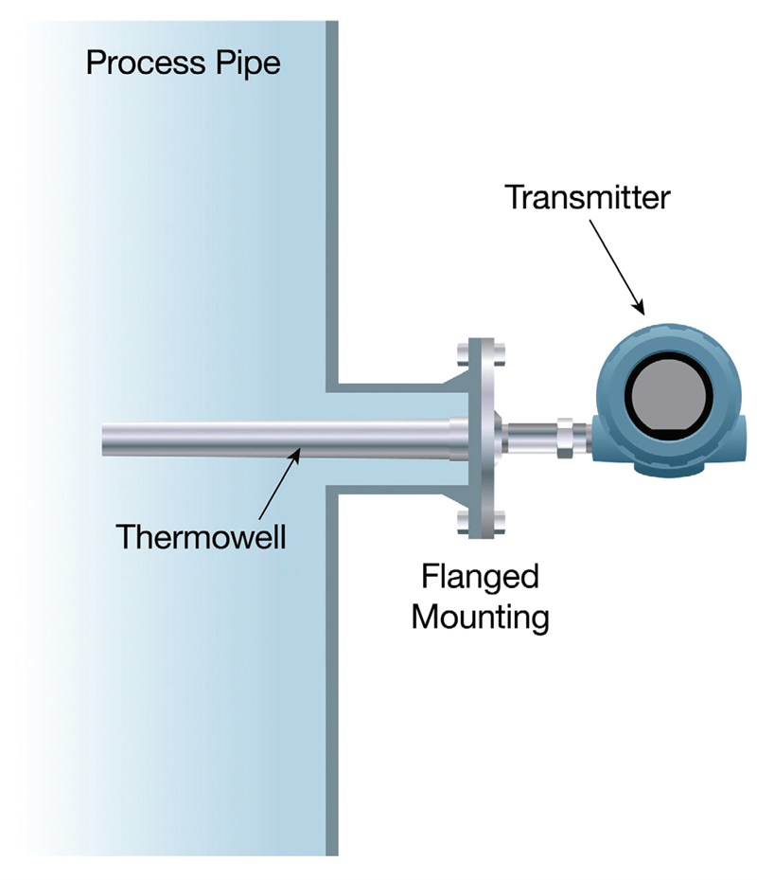
Accuracy: Degree to which measured value matches actual process value.
(e.g. temperature readout versus actual temperature in the pipe)
Sensitivity: Smallest change in a variable that can be detected by a sensor.
(e.g. +/- 0.5°)
Repeatability: Ability of sensor to provide same result under same conditions.
(e.g. temperature remains constant at 200° and sensor continues to read 200° +/- 0.5°)
Temperature Sensor / Transmitter

Slide 9
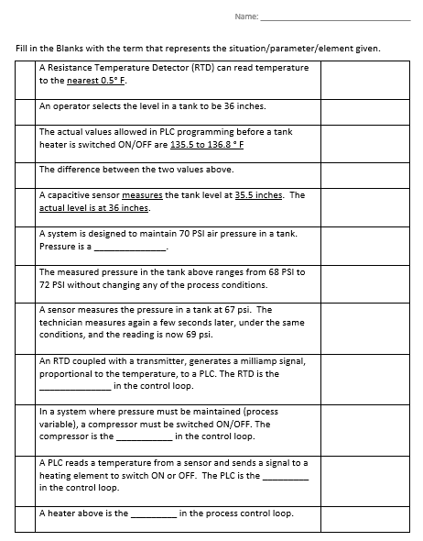
Assignment
Fill in blanks with correct term for each situation / parameter / element in a process control system.

