Slide 1
Steps & Lessons on Converting
to a Competency-Based
Hybrid Model Part 1
Presented by:
Tom Wylie, PI for HOME4TECHS & Scaling CBE Elements
Northwest State CC, Archbold, OH

Slide 2
Topics this training will cover:
Overview of the CREATE project
Traditional Educations versus Competency-Based
Overview of the HOME4TECHS project
Aligning the curriculum to employer needs
What is an assessment model?
Creating Hand-on Assessments & lab exercises
Backward Design of a Course

Slide 3
Workshop Materials Available for Download:
https://ate.is/Scaling_CBE

Slide 4
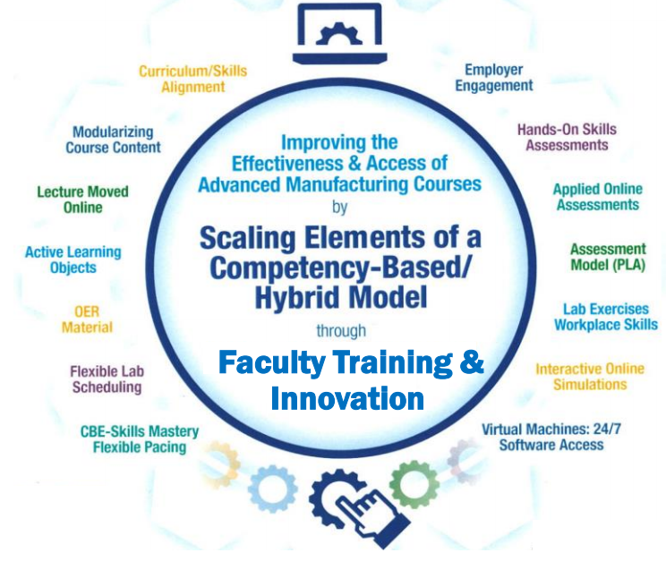
Instructional Elements to Improve Technical Courses

Slide 5
New NSF ATE Funded Project: CREATE
Creating Relevant, Effective & Accessible Technical Education

Slide 6
CREATE: Goal #1

Slide 7
CREATE: Goal #2

Slide 8
A few things on the CREATE Project:
Project is funded for 3 years
Create, Implement & Evaluate (There is accountability)
Mike H. is the project Principle Investigator
Program Officer is assigned to the Project
Rucks Group is the Project Evaluators
Big advantage is the conversion has been started
Build on what others have done – Do not start from scratch

Slide 9
A few more things on the CREATE Project:
Get your Micro-site setup at ATE Central
Use this site as a communication hub to stakeholders
Get a logo and project look designed
Get showcase booth materials designed
Will need to have a booth at the Showcase – PI Conf. in late October 2022

Slide 11
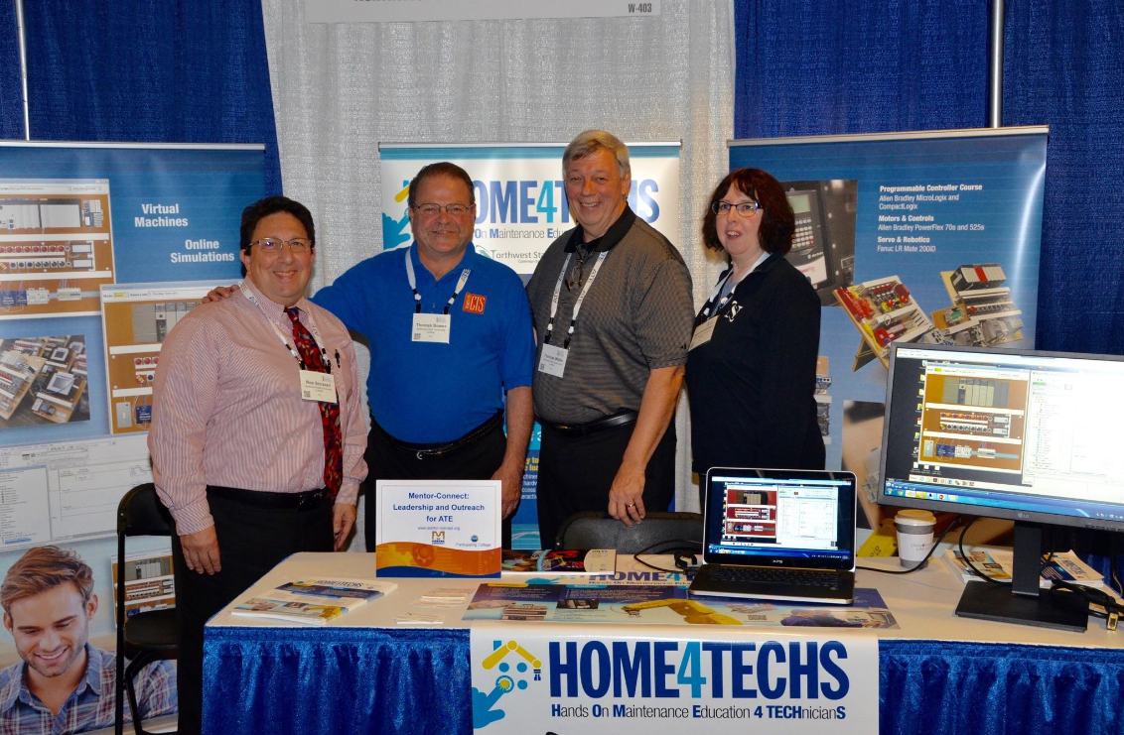
2017 PI Conference
Washington DC

Slide 12
Traditional Technical Course at NSCC, 8 years ago
Syllabus
Textbook
Lecture
Handful of labs
3 P/P Tests
Grade (ABCDF)

Slide 13
Competency-Based/Hybrid Instructional Model
LMS Canvas
On-campus class time
*Readings
*Videos
*PDFs
*Lec Cap
*Objects
Lab Exercises
Hands-On Assessment
Student 1
Lab Packs sold in Bookstore (required)
Student 2
*Study
*Practice
*KAAs
Student 3
Faculty facilitates learning
*Labs
*Simulations
*HOAs
Faculty
Faculty assesses student skill/knowledge
Self-proctored Online Assessments

Slide 14
Traditional Education vs. Competency-Based
Topic Outcomes:
Explain the differences between traditional education, and a competency-based model.
Differentiate between direct assessment CBE, and hybrid CBE models
List the positive attributes of a CBE model
Identify the Champions that support the CREATE project.
Compare assessments between traditional and CB
Create an elevator speech to advocate for CREATE (Why are we doing this project)

Slide 15
Competency-Based Education (CBE)
Across the country there is a trend to transition away from seat-time and move towards a flexible structure that allows students to progress in their learning after they have demonstrated mastery, which is often time at their own pace. This trend is known as competency-based education (CBE). Good article by Janice Walton.
https://www.gettingsmart.com/2017/12/12/competency-based-education-definitions-and-difference-makers/#:~:text=Competency%2Dbased%20education%20is%20defined,to%20more%20efficient%20student%20outcomes.%E2%80%9D

Slide 16
Traditional Education vs. Competency-Based
Traditional education has a set time (16 weeks), and variable education (5 possible grades, and how much was actually learned).
Competency-based education has set level of education/learning (mastery), and variable time (students progress based on their learning), where some students can finish early, but some may take a little longer.

Slide 17
What is Competency-based Education (CBE)?
Competency-based Education consists of two important element:
Mastery of Skills - The CBE course is typically parsed into modules, with assessments in each module that must be passed at the mastery level.
Flexible Pacing - Student will progress through a course at their pace of learning (and of course mastery). Some students will finish early, and some will take a little longer.

Slide 18
Apprentices attending a CBE hybrid course
Apprentices base progress on seat time (lecture and lab).
Get ahead of this by discussing it with the Educational Representative form their joint committee
Create a cross walk from the traditional course to the CBE hybrid course
A learning sequence sheet will help in justifying the competency to contact hours

Slide 19
Traditional Education vs. Competency-Based
In a traditional model, the faculty does primarily teaching, and some assessment.
In a competency-based model, the faculty does primarily assessment, and less teaching than in the traditional model. The faculty becomes a learning facilitator.

Slide 20
What is a Competency?
A competency is defined as observable and measurable statements that describe the specific skills, knowledge or abilities demonstrated by a learner (Salt Lake CC).
Competencies are often focused at an overarching level, rather than a more granular level.
Competencies are many times derived from a job description

Slide 21
Sources/Resources for Developing Competencies:
Employers, advisory committees, roundtables, trade unions
Department of Labor has competency models and support documents for many occupations
Professional associations

Slide 22
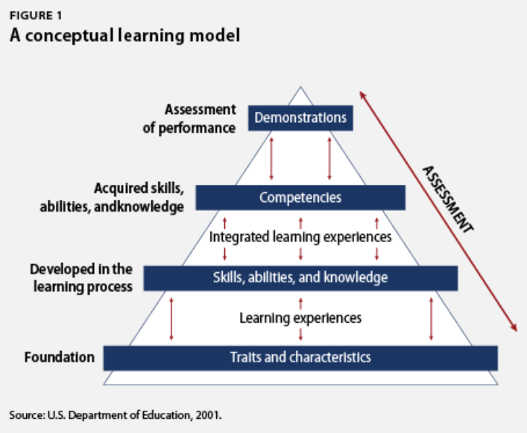
A traditional model has typically 2-3 written or online assessments.
A CBE model has many more assessments so the faculty can determine mastery of the knowledge/skill of each student in each module.

Slide 23
DACUM Competencies
Develop A CUrriculuM
5-7 Industry SMEs meet for 2-3 days to identify all the duties and tasks required for a technology or a job
At least part of your competencies should be obtained from a DACUM, which you can then say are validated.
VET all competencies through the Industry SME group

Slide 24
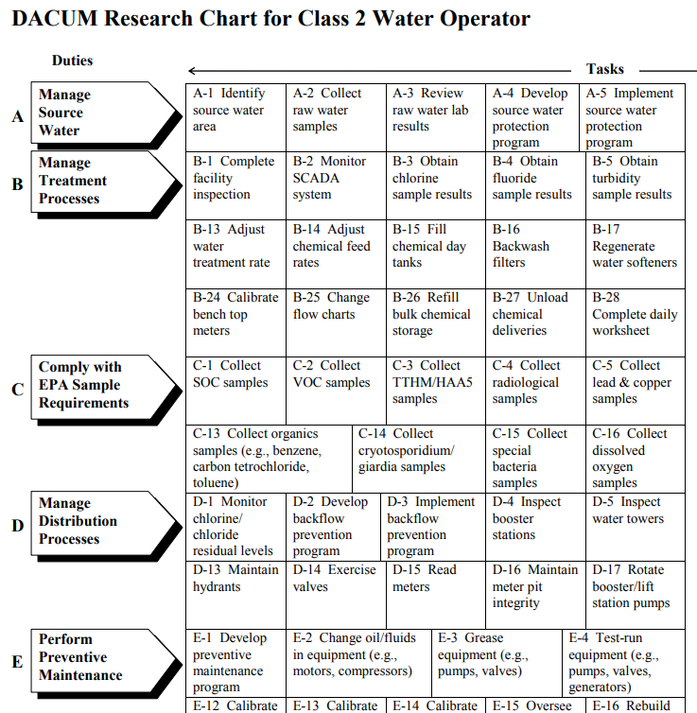
DACUM results for a Class 2 Water Operator in Ohio.
DACUM is an Ohio State format

Slide 25
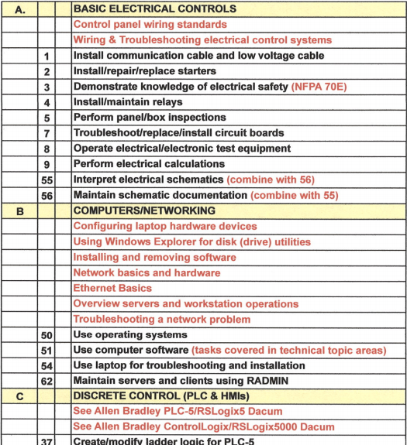
DACUM format for Control Technicians
DACUM format by NOCTI group in MI

Slide 26
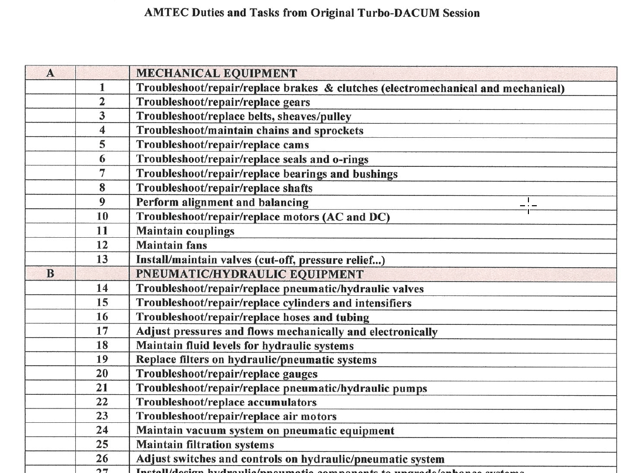
DACUM format for Control Technicians
DACUM format by NOCTI group in MI

Slide 27
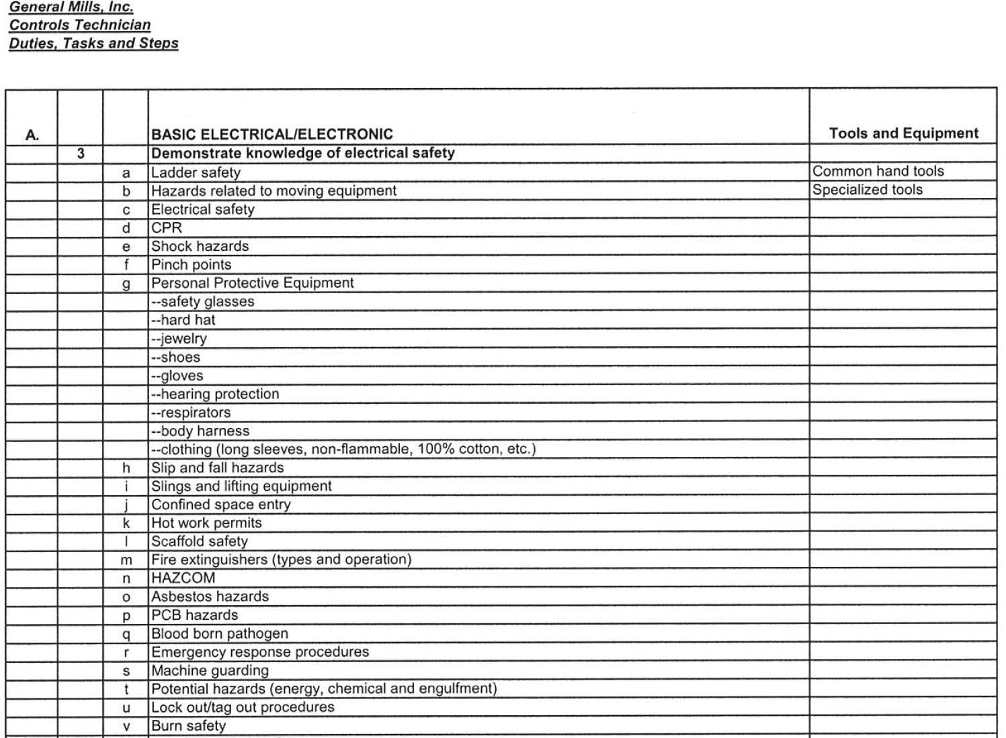
DACUM format for Control Technicians
DACUM format by NOCTI group in MI

Slide 28
Universal Terms
Universally, the terms Competency, Learning Objective, and Learning Outcome are often used interchangeably.
A competency is a broader statement than an objective
Outcomes make up a competency
VET all competencies and outcomes through the Industry SME group

Slide 29
Overview of the HOME4TECHS Project
Won in 2015. Ran from 8/1/15 to 7/31/18.
Amount was approximately $200K
Focus was to build a model to convert lecture/lab technical courses to a competency-based/hybrid model
3 courses were converted:
IND223: Motors & Motor Controls
PLC200: Programmable Controller I
PLC230: Servo & Robotics

Slide 30
Overview of the HOME4TECHS Project, cont.
3 faculty were PI & Co-PIs
Assessment model changed everything
Lecture moved online, scheduled & open lab model
Project results (2 yrs previous to 2 yrs of the new model):
44% increase in enrollment (of the 3 courses)
10% increase in retention
7% increase in grade level attainment

Slide 31
Overview of the HOME4TECHS Project
Why did NSCC pursue funds for this project?
New LEAN initiative at NSCC
The college had to get the voice of the customer
60 employers met in groups of 6 for roundtables
Employers expressed their needs for training
Employers gave a gradecard to NSCC
The college had to make some changes

Slide 32
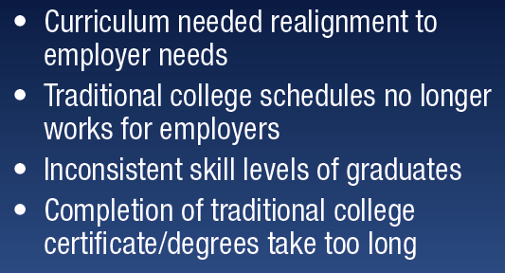

Slide 34
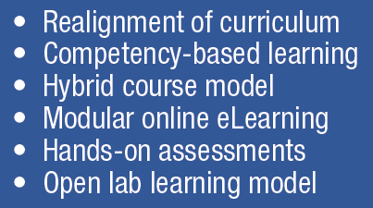

Slide 35
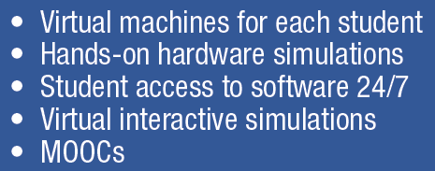

Slide 36
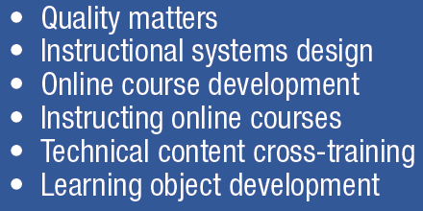

Slide 38
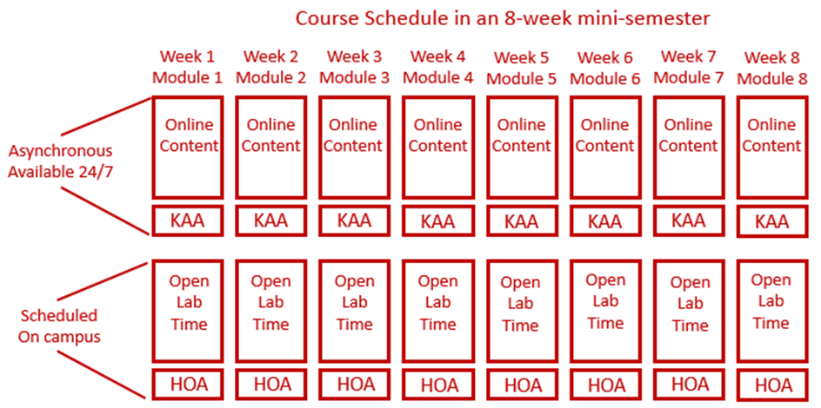

Slide 39
Student Grades in the NSCC model:
The grades the students are awarded in the NSCC Ind. Tech hybrid courses are: A, B or F.
The hands-on assessment (HOA) must have 100% mastery, so students have to get 100. This is not averaged into the grade. It is required.
The knowledge & application assessment (KAA for short) is the cognitive, online assessment. Student have to get at least an 80% on this assessment to pass the module. They have two tries at taking KAA in each module.
16 assessments in each course (8 online, 8 hands-on)

Slide 40
What’s in it for Me? The Stakeholders Perspective:
Students: Students like the 24/7 access to the course materials, and knowing what is expected of them for the assessments.
Faculty: Faculty like the consistency in the curriculum, and that all materials are developed, so they do not have to spend time preparing for a class. They also like the flexibility of time on campus.
Employers: Employers like the more accessible classes for their employees, and better prepared graduates. They really like the assessment model of student accountability.
College: Increase in enrollment, increase in retention (SSI), and knowing that the other 3 stakeholders are happy.

Slide 41
A Few Lessons Learned:
This is a team effort. Support each other and have a common cause with the end goal in mind. Don’t be critical of each other.
Student learning behavior will follow the assessment model. The employers wanted more hands-on learning. By requiring HOAs, students wanted more lab time.
Online was new for us, so we had to change the faculty culture. We also had to change the student culture.
We learned not to use the CBE term, but how the elements of CBE are embedded in the model

Slide 42
A Few Lessons Learned cont.:
This model has moved the student learning off the shoulders of the faculty, to the student. Students are responsible for their learning, and when they take their assessments.
Employers really like this model since all of the curriculum is developed. A positive thing for the companies was if they sponsored students into a course that had two sections with two different instructors, the students get the same learning experience. Reducing the variance.

Slide 43
A Few Lessons Learned cont.:
CBE type of technical courses must have a solid structure. How we did technical courses before did not need as much structure.
Until our Ind. Tech. hybrid courses, online courses were a wild west rodeo. 10 different courses, and they may all look different. Huge negative for the students.
Our faculty needed to become more literate in the digital world (not just computer literate), due to the moving online, and they needed a support structure.

Slide 44
A Few Lessons Learned cont.:
Faculty and developers had to become more literate in the digital world, such as:
Cloud based applications and storage
Internet/browser basics
Networking basics (Ethernet, WiFi, 4/5G)
Portable devices (phones, phablets & tablets)
Powerpoint for a graphics container
Using a camera for photos and videos
Snagit for capturing portions of computer screen
Capture video, produce and upload to YouTube

Slide 45
Aligning the Curriculum to Employer Needs
Topic Outcomes:
How does Terra currently engages employers
Explain the three types of employer engagement
Explain the purpose of an Industry SME group
Determine how to obtain and validate competencies

Slide 46
Engaging Employers
How does the Technology division at TSCC engage employers?
Accrediting bodies like a comprehensive employer engagement strategy.
Purpose of an Advisory Board
Purpose of an Industry Roundtable
Purpose of a Focused Industry Visit

Slide 47
Importance of an External SME group
SME stands for Subject Matter Expert
4-6 of these SMEs should be identified to vet information through as part of the development process for CREATE
It is important to have all knowledge and skills development, align to the workplace
This will be done through validated competencies, and measurable outcomes

Slide 48
Building Measurable Outcomes
Topic Outcomes:
Explain the difference between a competency and an outcome.
Explain the term of “alignment” when working with competencies and outcomes
Show how to find the correct action verb for an outcome
Create 3 skills based outcomes
Create 3 knowledge based outcomes

Slide 49
Building Measurable Outcomes
Outcomes must be aligned to a competency, which should align to to the workplace
A Quality Matters alignment table is used to align the outcomes to the competencies
Outcomes must be measurable
Students must know what is expected of them. The term “Understanding” is not measurable

Slide 50
What is an Assessment Model?
Topic Outcomes:
Compare the assessment for traditional education, and for competency-based
Explain why there are more assessments in a competency-based than in traditional education
Compare the CAEL portfolio model to the competency-based assessment for PLA
Explain the faculty role for assessment within the CB/H model

Slide 51
What is an Assessment Model?
Traditional technical courses typically uses a written/online assessment for the course.
In a Competency-based course, the faculty must verify the student learning (both knowledge & skills) through a demonstration (HOA).
The assessment model verifies that a student get credit for a course, either by taking the course, or by a PLA. The assessment should be the same.

Slide 52
Competency-Based Assessment
The term CBA stands for Competency-Based Assessments. This assessment must be in place to assess mastery in a CBE model.
Since the course content is parsed into multiple modules (8 modules for the NSCC model), there will need to be an assessment for each module, to prove mastery, so the student can move to the next module.
There will be more assessments for students to take (and for faculty to create) in a CBE model

Slide 53
Proficiency by Portfolio
CAEL is an organization that started as an effort to build a model where student were awarded college credit for experiential learning.
Portfolio is a common method for getting college credit by documenting the learning and the experience of the student. The challenge is that many times this method of review is not objective. An assessment model will give an accurate assessment of a student.

Slide 54
Assessment by Faculty
Assessment is the responsibility of the faculty.
Student skills and knowledge are both assessed by the faculty in the HOA process.
Knowledge is also assessed through an online assessment for each module that faculty developed, which consists of M.C. and T.F. questions
LMS efficiency saves faculty valuable time
The assigned instructor objectively determines if a student passes a module, and the course.

Slide 55
A Few Lessons Learned cont.:
Student engagement by the faculty is very important. There is a direct correlation between student engagement and retention.
The CBA model with 8 Hands-On Assessments naturally creates the student engagement environment.
Lecture is not engagement. Lab activities is a little closer to student engagement, but assessment is the key.
Also giving individual feedback through the LMS activities creates a great engagement model.

Slide 56
The End of the Presentation

