Slide 1
Steps & Lessons on Converting
to a Competency-Based
Hybrid Model Part 2
Presented by:
Tom Wylie, PI for HOME4TECHS & Scaling CBE Elements
Northwest State CC, Archbold, OH

Slide 2
Topics this training will cover:
A few review questions for everyone
Stakeholders in the CREATE Project
Backward Design of a Course
Aligning the curriculum to employer needs
What is an assessment model in a course and PLA?
Examples of Hand-on Assessments & lab exercises
Examples of Practice Quiz & KAA
Course Blueprint & managing tasks to do on the Project

Slide 3
Review Question 1
What does CBE stand for?

Slide 4
Review Question 2
What are the two elements of CBE?
Element 1: _____________________
Element 2: _____________________

Slide 5
Review Question 3
What is an HOA as it pertains to CREATE?
Explain!!

Slide 6
Review Question 4
What is a KAA as it pertains to CREATE?
Explain!!

Slide 7
Review Question 5
What does the term Hybrid mean as it pertains to the CREATE Project?
Explain!!

Slide 8
Review Question 6
Which Instructional Model focuses on seat time?
Traditional or CBE
Explain!!

Slide 9
Review Question 7
Which Instructional Model will have more assessments?
Traditional or CBE
Explain!!

Slide 10
Review Question 8
Why load a PDF of a PowerPoint into Canvas for the students to view, instead of the PowerPoint?
Explain!!

Slide 11
Competency-Based/Hybrid Instructional Model
LMS Canvas
On-campus class time
*Readings
*Videos
*PDFs
*Lec Cap
*Objects
Lab Exercises
Hands-On Assessment
Student 1
Lab Packs sold in Bookstore (required)
Student 2
*Study
*Practice
*KAAs
Student 3
Faculty facilitates learning
*Labs
*Simulations
*HOAs
Faculty
Faculty assesses student skill/knowledge
Self-proctored Online Assessments

Slide 12
What’s in it for Me? The Stakeholders Perspective:
Students: Students like the 24/7 access to the course materials, and knowing what is expected of them for the assessments.
Faculty: Faculty like the consistency in the curriculum, and that all materials are developed, so they do not have to spend time preparing for a class. They also like the flexibility of time on campus.
Employers: Employers like the more accessible classes for their employees, and better prepared graduates. They really like the assessment model of student accountability.
College: Increase in enrollment, increase in retention (SSI), and knowing that the other 3 stakeholders are happy.

Slide 13
A Few Lessons Learned cont.:
Faculty and developers had to become more literate in the digital world, such as:
Cloud based applications and storage
Internet/browser basics
Networking basics (Ethernet, WiFi, 4/5G)
Portable devices (phones, phablets & tablets)
Powerpoint for a graphics container
Using a camera for photos and videos
Snagit for capturing portions of computer screen
Capture video, produce and upload to YouTube

Slide 14
Aligning the Curriculum to Employer Needs
Topic Outcomes:
How does Terra currently engages employers
Explain the three types of employer engagement
Explain the purpose of an Industry SME group
Determine how to obtain and validate competencies

Slide 15
Engaging Employers
How does the Technology division at TSCC engage employers?
Accrediting bodies like a comprehensive employer engagement strategy.
Purpose of an Advisory Board
Purpose of an Industry Roundtable
Purpose of a Focused Industry Visit

Slide 16
Importance of an External SME group
SME stands for Subject Matter Expert
4-6 of these SMEs should be identified to vet information through as part of the development process for CREATE
It is important to have all knowledge and skills development, align to the workplace
This will be done through validated competencies, and measurable outcomes

Slide 17
Meet with the SME group:
Send information 3-4 days ahead of time in email
Plan on meeting no more than 45-60 minutes
Do not give them a blank piece of paper
Do not give them more than 2-3 pages of information to review
Give them immediate feedback on the meeting – within 1-2 days
Make sure you communicate the next steps

Slide 18
What is an Assessment Model?
Traditional technical courses typically uses a written/online assessment for the course.
In a Competency-based course, the faculty must verify the student learning (both knowledge & skills) through a KAAs and HOAs
The assessment model verifies that a student get credit for a course, either by taking the course, or by a PLA. The assessment should be the same.

Slide 19
What is Prior Learning Assessment?
A PLA process should be in place in your division, so students with prior learning can get credit without taking a course.
Portfolios were popular for quite a while, but could be somewhat subjective.
A credit by examination could be created based on the assessment model of the course the students want credit for.
Faculty should be the evaluators in a PLA process

Slide 20
Backward Design
Topic Outcomes:
Explain the reverse design process of a course, and the employer engagement during this process
Explain why it is important to start at the end of the course, and build it backwards
Explain how the competencies and outcomes are created through the reverse design process

Slide 21
Understanding by Design, 2nd edition, by Grant Wiggins & Jay McTighe is the book and process that everyone working within the CB realm references.
The focus of the book is to start with what the student must be able to do at the end of the course, and build from there.

Slide 22
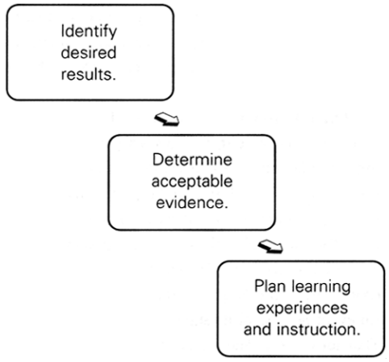
What should they be able to do/know when they are done with the module?
How will I measure or assess what they can do or know?
How do I prepare the student?
Readings, Labs, PPT/PDFs, Videos, Simulations, etc.?

Slide 23
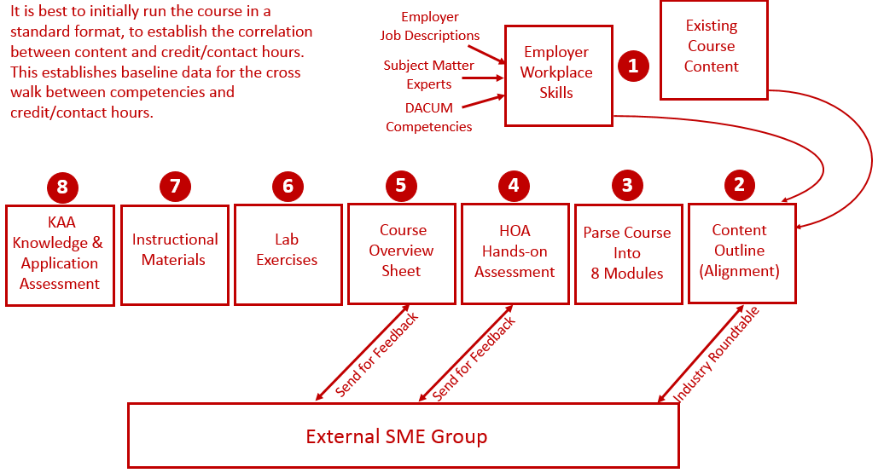
Reverse Design

Slide 24
Creating Hands-On Assessments & Lab Exercises
Topic Outcomes:
Explain the purpose of a Hands-On Assessment
Describe the elements that go into an HOA
Create an HOA for a module
Explain the purpose of a Lab Exercise/Procedure
Describe what elements go into a Lab Exercise

Slide 25
Purpose of the Hands-On Assessment
The purpose of the HOA is so a student can demonstrate mastery of a learning module to the faculty.
An HOA is much more than just putting something together, or adjusting a machine. The faculty will ask the student questions on the topic, similar to what a student will experience in an interview.

Slide 26
Elements of a Hands-On Assessment
The does a task specified by the HOA for the faculty. This task must be related to the tasks performed in the workplace.
Interpret workplace documentation (P&ID diagrams)
Faculty asks student questions from the lab exercises and the KAA
Many times the student must also troubleshoot a circuit, or a machine

Slide 27
Workshop Participant Exercise #1
Identify a course that you teach at Terra State
Create a short Hands-On Assessment (3-5 tasks)
How will you prepare the students to pass this Hands-On Assessment?

Slide 28
The purpose of Lab Exercises:
The purpose of a lab exercise is to guide the student through a learning process that will develop their knowledge & skills for the workplace.
Lab exercises are performed in teams of 2-3 students (though they are assessed individually), for the purpose of developing small group communication skills, and teamwork. Students have to solve problems together, and practice the HOA on each other, thus developing actual skills they need in the workplace.

Slide 29
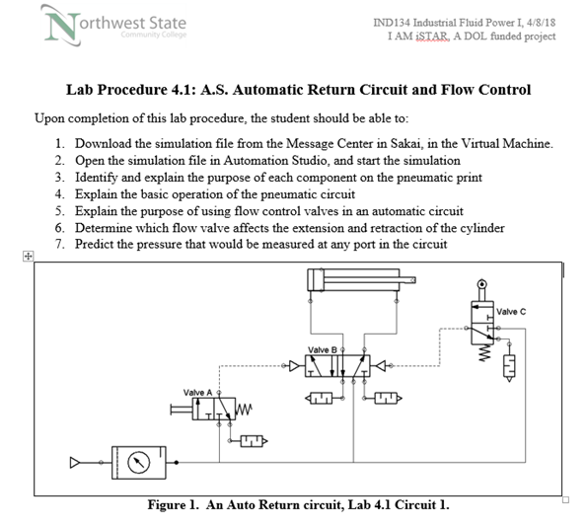
A student lab exercise, or lab procedure (same thing) is a directed/guided learning experience for the student.
Questions about the learning within the lab exercise, should be asked in the Hands-On Assessment (HOA)

Slide 30
A student lab exercise, or lab procedure (same thing) is a directed/guided learning experience for the student.
Questions about the learning within the lab exercise, should be asked in the Hands-On Assessment (HOA)

Slide 31
The purpose of Lab Exercises:
The purpose of a lab exercise is to guide the student through a learning process that will develop their knowledge & skills for the workplace.
Lab exercises are performed in teams of 2-3 students (though they are assessed individually), for the purpose of developing small group communication skills, and teamwork. Students have to solve problems together, and practice the HOA on each other, thus developing actual skills they need in the workplace.

Slide 32
Hands-On Assessments (HOA)
Example of an HOA
Build an operational circuit from an electrical print
Explain the operation of the circuit to the instructor
Demonstrate the knowledge on an electrical print
Predict the operation of a circuit based on certain criteria
Troubleshoot a faulty circuit

Slide 33
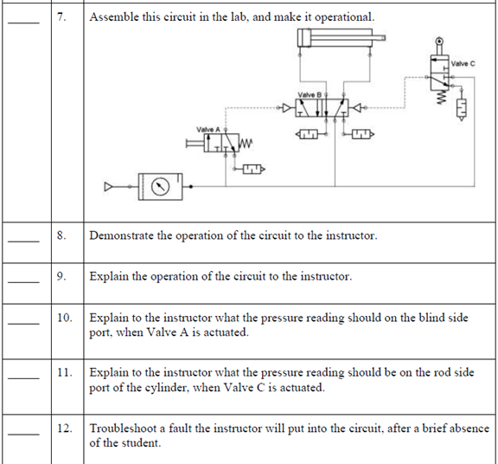
A Hands-On
Assessment in a Fluid Power course

Slide 34
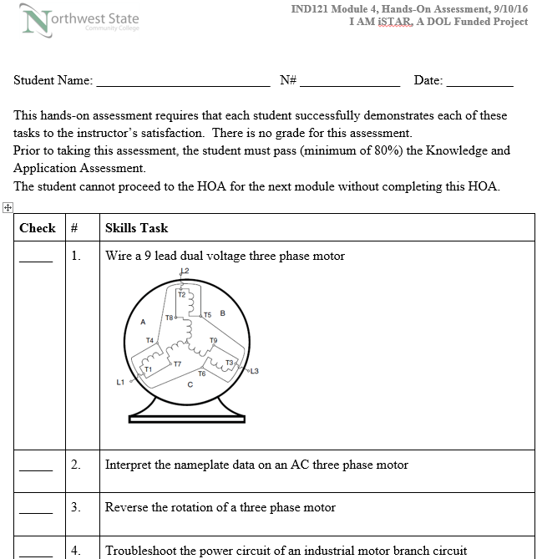
A Hands-On
Assessment from Industrial Electrical II

Slide 35
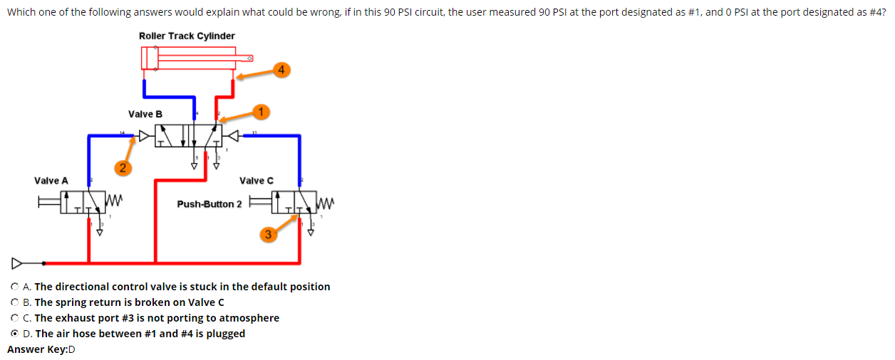
A sample question in a KAA for Fluid Power

Slide 36
A sample question in a KAA for Fluid Power

Slide 37
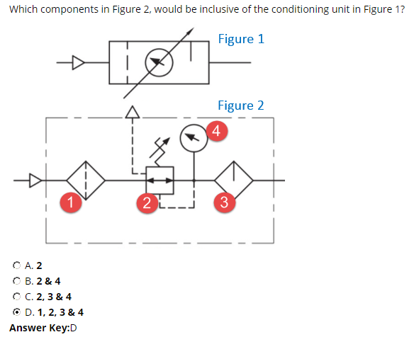
A sample question in a KAA for Fluid Power

Slide 38
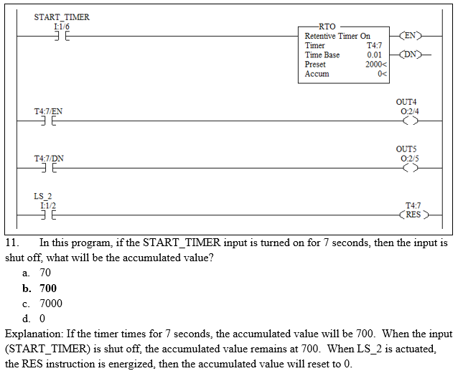
Practice Quizzes are a Formative Assessment & Learning Tool

Slide 39
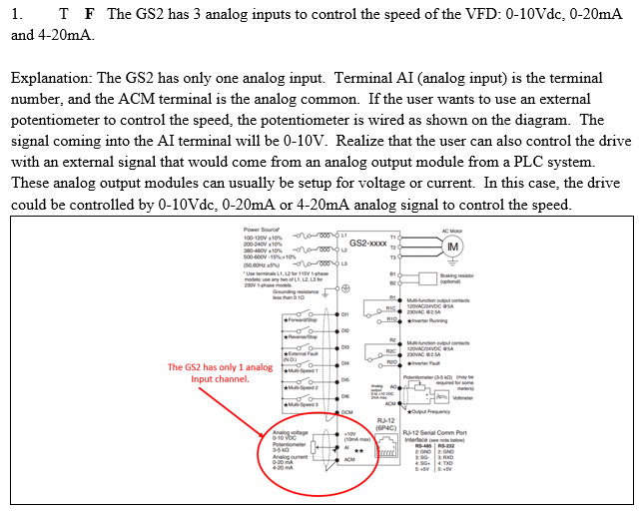
Practice Quizzes are a Formative Assessment & Learning Tool

Slide 40
A Few Lessons Learned cont.:
When I designed the HOME4TECHS, the plan was to have the 3 faculty develop their own course. This will not work (too many inconsistencies)
Online Conference in Madison, WI
We brought in an Instructional Designer for support
What does this support person do?

Slide 41
The South Arkansas CC Project:
New Intro to Technology Course
South Ark uses Blackboard Ultra for their LMS
TW Project Lead (Task Master)
Dean wanted more hands-on in the course
Blueprint for the course based on input from the faculty
Roadmap to completion

Slide 42
The End of the Presentation

