Slide 1
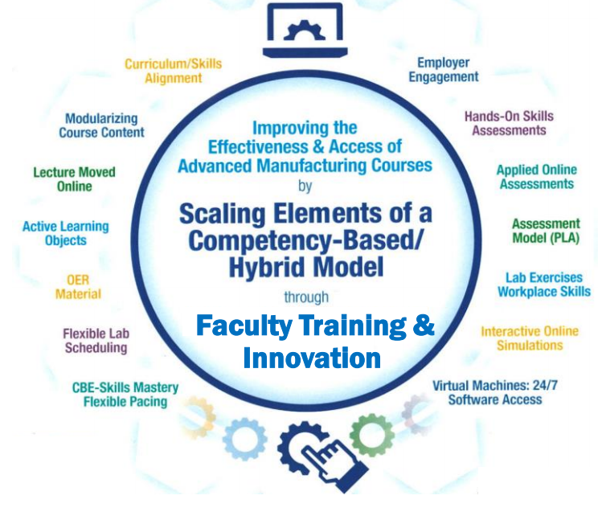
Creating Learning Objects
For the NSF Project: “Scaling Elements of a Competency-based/
Hybrid Instructional Model in Adv. Mfg. Courses”
Presented by:
Tom Wylie, Northwest State CC, Archbold, OH
(twylie@northweststate.edu)

Slide 2
What are Learning Objects:
1. Learning Objects are housed in the course within the LMS
2. Common objects are the textbook and PDFs
3. Videos and voice over PPT are the most effective objects
4. Interactive simulations will be covered next session
5. Study guides and quizzes/tests are also learning object
6. A very effective object is formative assessments with feedback
7. Example 1 of formative assessment with feedback

Slide 3
Learning Objects that Navigate the User
Some learning objects will navigate the user through the learning object. This object paces the student through a lesson and may include some formative assessment questions along the way.
This example is a learning object on hand tools from Wisc-online.
These objects are typically created either of these two software packages:
Articulate Storyline
Adobe Captivate
This software is typically used by an instructional designer. Seldom do faculty use this software.

Slide 4
Navigating in Wisc-Online:
In the Wisc-Online learning object, the user must navigate to the next screen by clicking the Next button in the lower right of the screen.
The user can also repeat a slide by clicking the Back button.

Slide 5
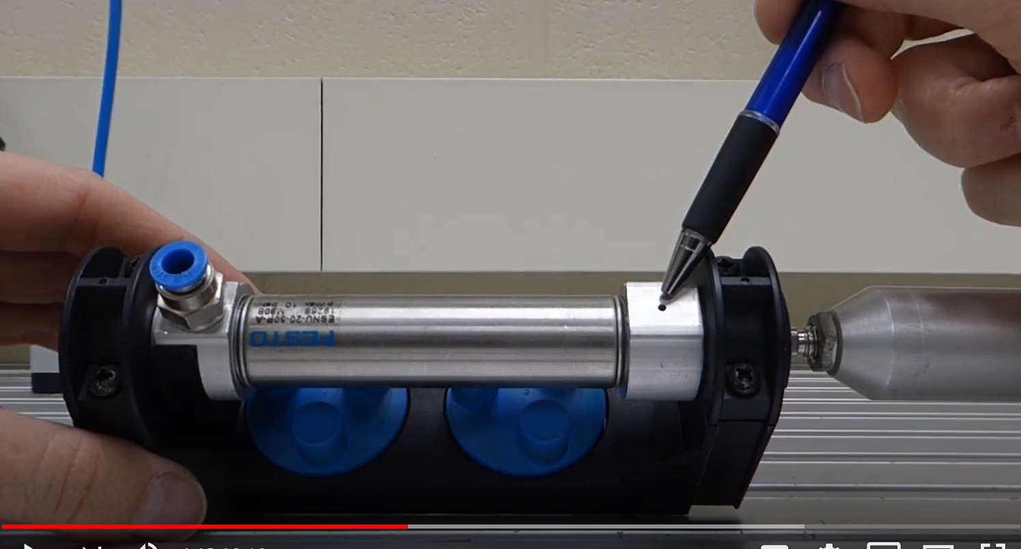
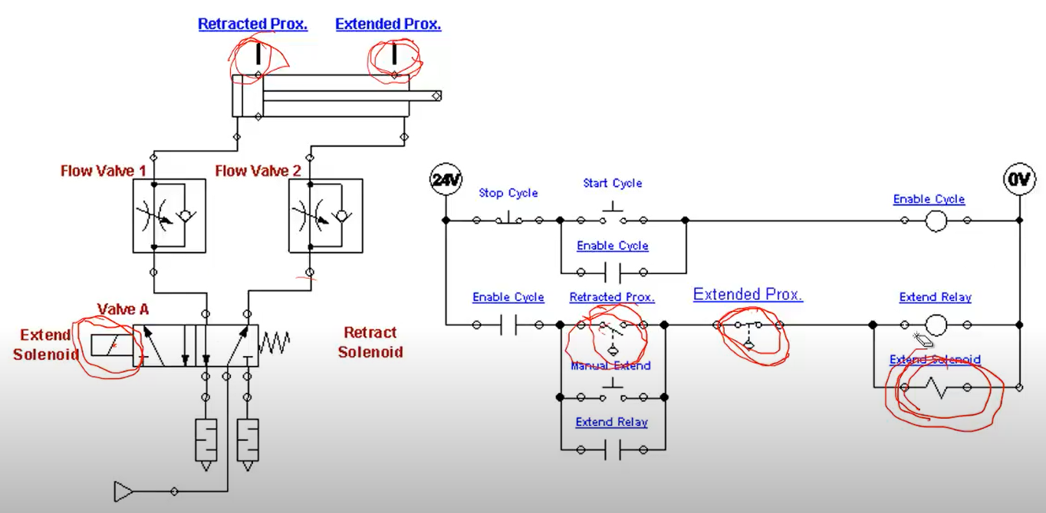
Learning Objects the User Navigates
Videos
Independent Learning Objects are posted in an LMS for student access. These objects can be viewed in any sequence. The upper left graphic shows a video that was shot with a camera, explaining a single acting pneumatic cylinder.
The middle graphic is a PPT that will be converted to a PDF, then posted in the LMS.
The bottom graphic is a voice over PPT, where the graphic was put into PPT, then annotated with a stylus on the computer touch screen.
All of these objects can be viewed on a smart phone, phablet, tablet or computer screen.
PPT/PDFs
Voice over PPT Video

Slide 6
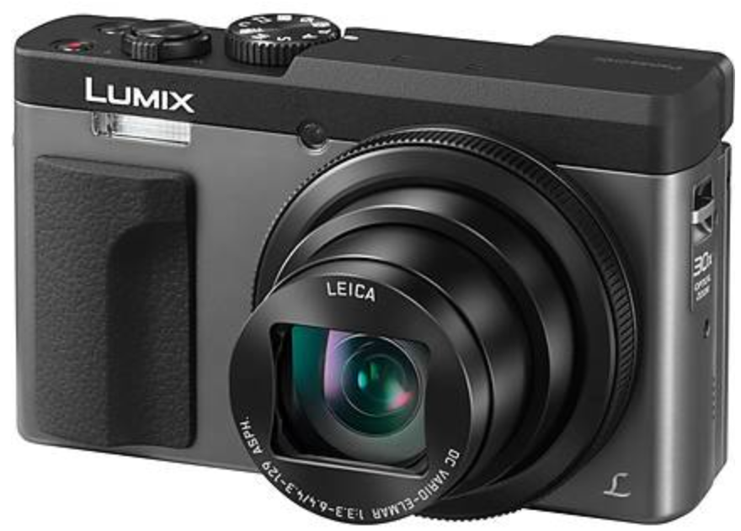
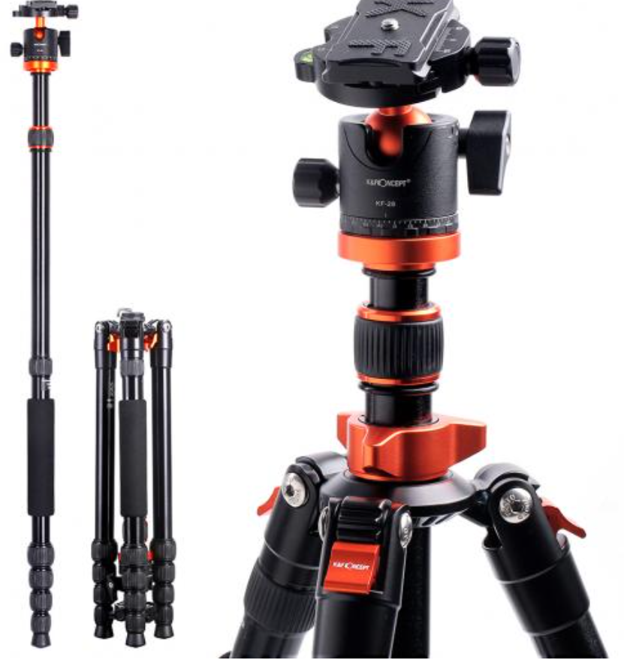
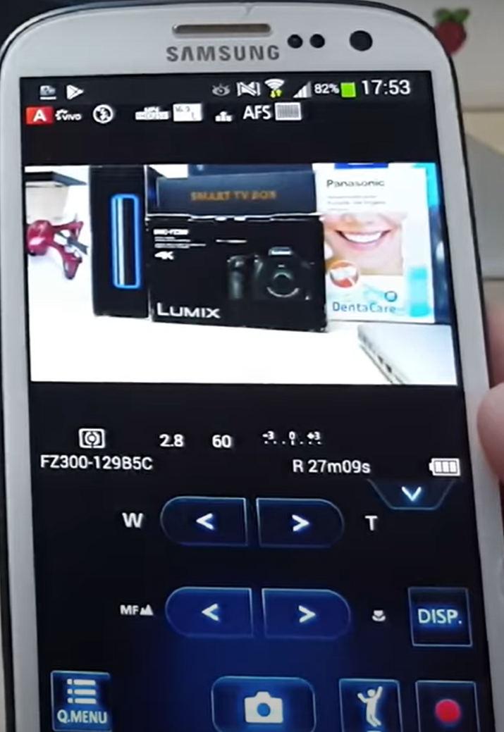
Cameras for Creating Videos:
One of the common tools that our Industrial Technology Instructors use is a simple Panasonic Point and Shoot camera. It is small with a zooming lens, with a removeable SD card, and a very sensitive internal microphone. The inverting tripod allows us to position the camera upside down to shoot onto an object or whiteboard (laying on a desktop). One of the most powerful features is the Panasonic Image app that runs on the smartphone. The camera has its own WiFi portal, thus the phone connects to it, then the image app controls the camera zooming, taking photos and taking videos. The SD card is removed then put into a port on the computer where it is then transferred to the HD, and produced with the Camtasia Producer software.
Panasonic Lumix Point & Shoot
Inverting Tri-Pod
Panasonic Image Smart Phone App

Slide 7
Cameras for Creating Videos:
I also use a high end camera when I need to use different lenses, use different lighting filters and want higher quality images and videos. This is primarily if I am doing something for a vendor who needs a little higher quality than for instruction. I can get UHD 4K video quality. Usually $700+. It also has a removeable SD.
Olympus E-M10 Mark III

Slide 8
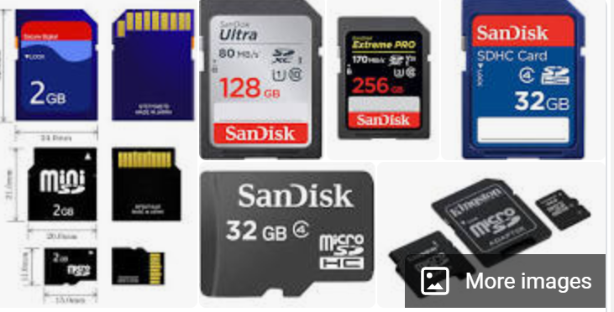
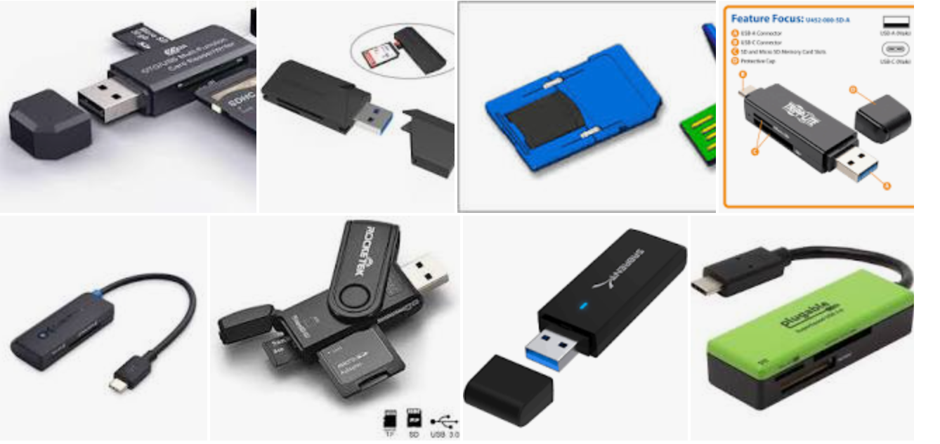
SD Cards for Recording Videos and Images:
The SD cards will be used in most cameras to store the videos and pictures that are taken with the camera. I seldom use an SD less than 128GB in size, because they will fill up quickly. Remove the SD from the camera and connect it to the computer, to load the videos and images, so you can use the software tools to develop the learning objects
SD to USB Interface
SD Cards: GigaBytes

Slide 9
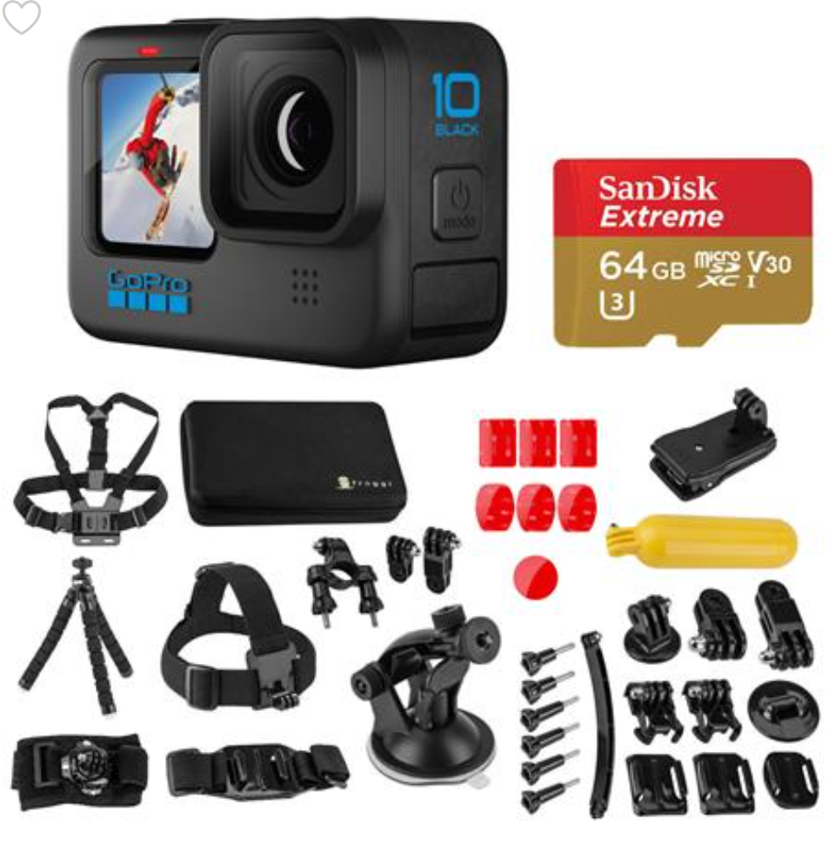
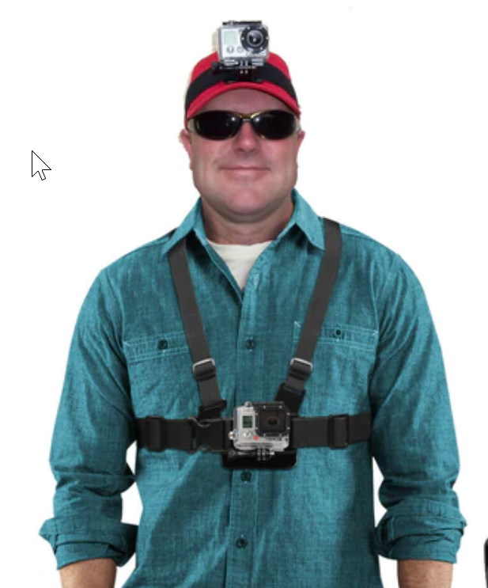
GoPro Cameras:

Slide 10
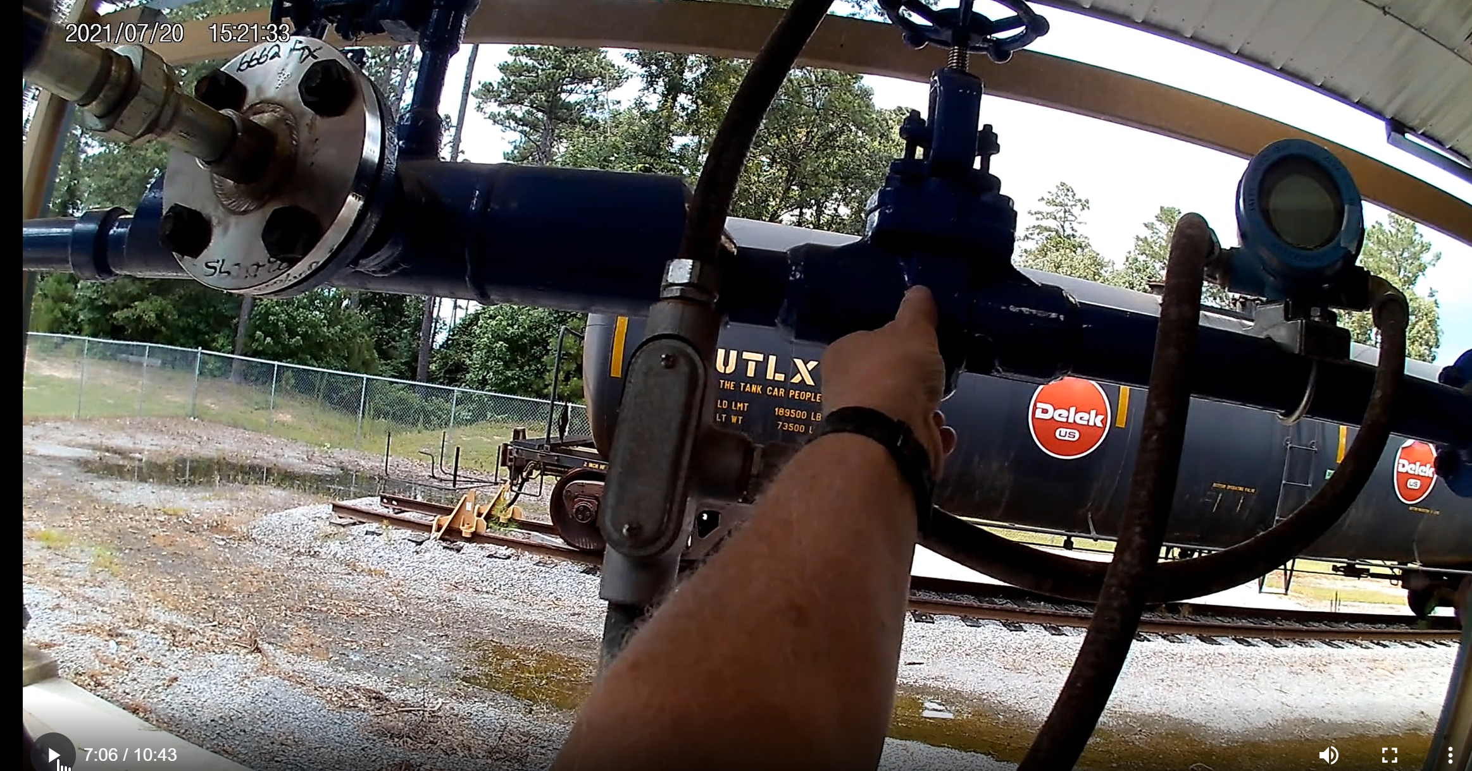
GoPro Recording of Video:

Slide 11
Software used to Create Objects
TechSmith (Techsmith.com), located in Michigan, developed and distributes Snagit and Camtasia. These products are targeted toward Faculty. They are simple to use and give immediate results. Snagit is an image or video capture software, and Camtasia is a product with multiple uses, but in the end it produces high quality videos. MP4 is the preferred video format for creating instructional videos. MS PowerPoint is the other key software that is needed to create illustrated graphics and animations. Google Slides does not have all of the features that MS PowerPoint has.
Snagit 2019
Camtasia 2019 Recorder
Microsoft PPT
Snagit 2019 Editor
Camtasia 2019

Slide 12
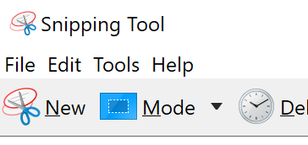
TechSmith Snagit 2019 (Capture):
This is the interface for Snagit capture. The user can designate a hot key such as the “PrtSc” key (Print Screen), which will bring up the cross hairs for capture.
Olympus E-M10 Mark III
Windows 10 Snipping Tools

Slide 13
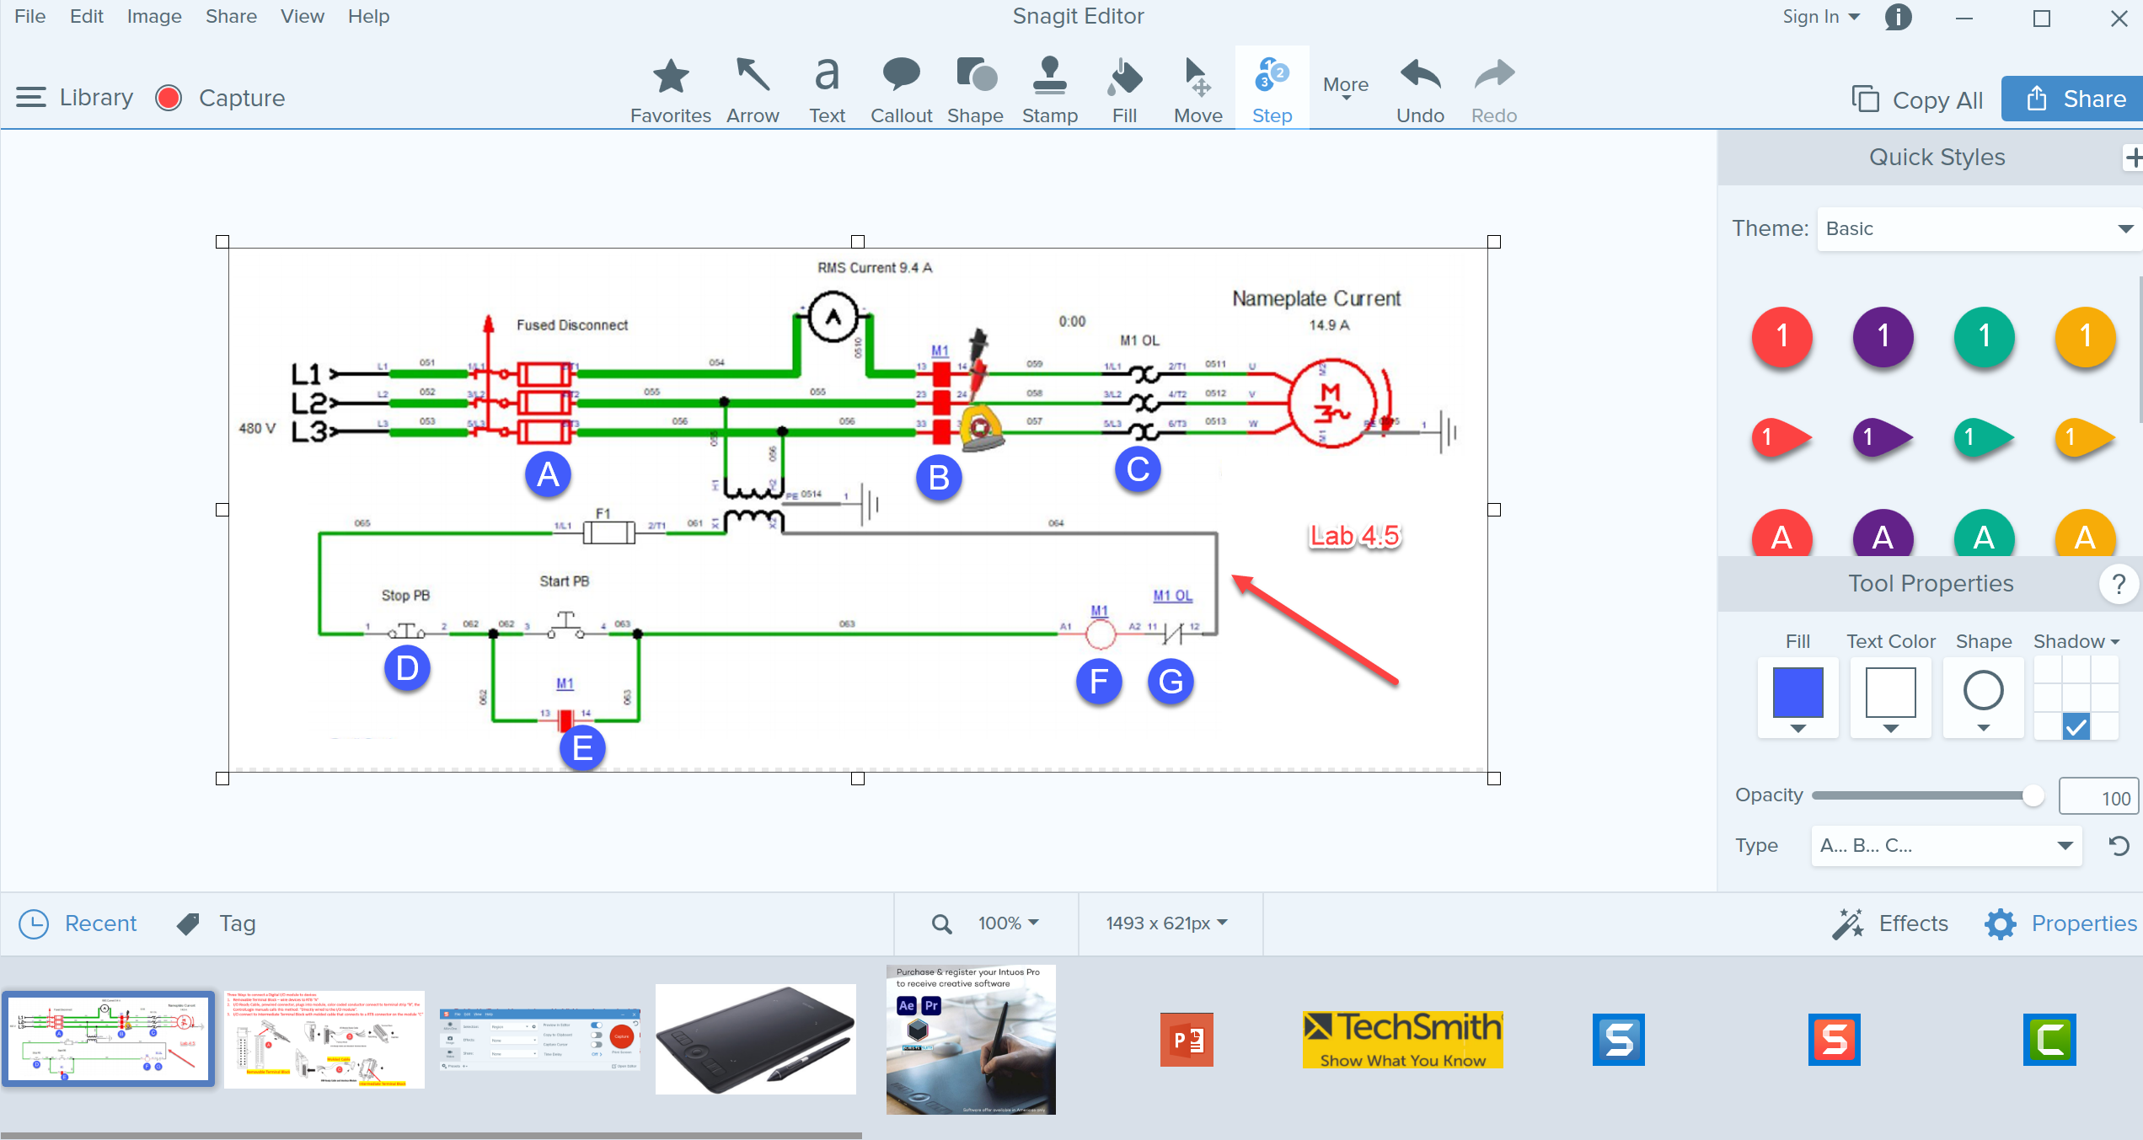
TechSmith Snagit 2019 Editor:
Tools to modify the image
Olympus E-M10 Mark III
Shows recently captured images

Slide 14
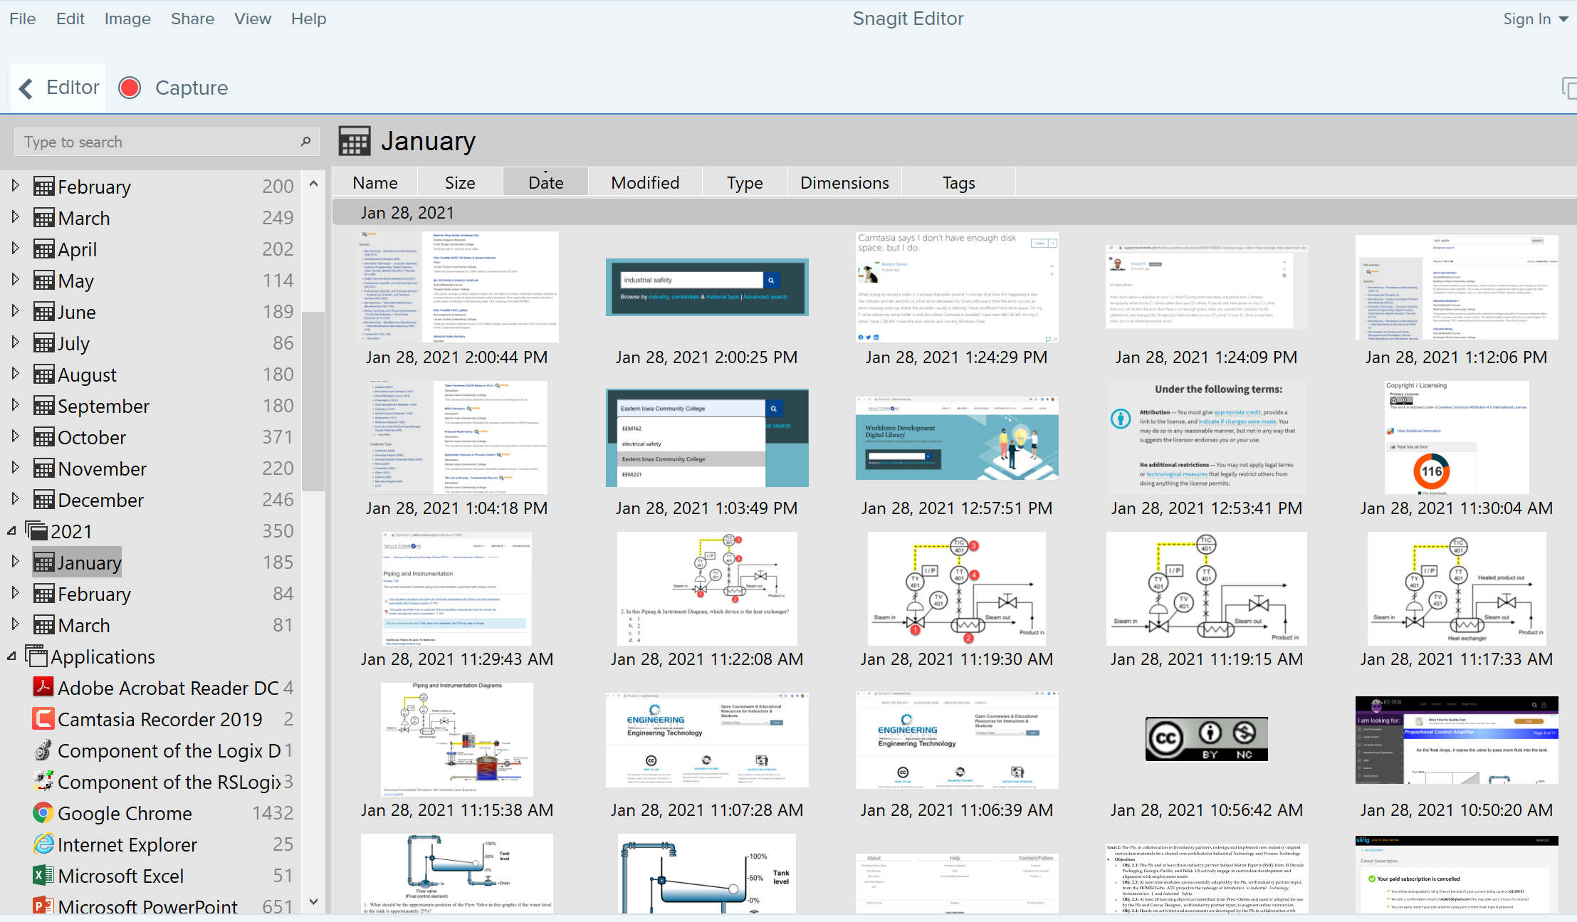
TechSmith Snagit Editor Library
User can go to any Month & Day for images

Slide 15
Creating a PDF Focused Learning Object:

Slide 16
Creating a PDF Focused Learning Object:

Slide 17
Creating a PDF Focused Learning Object:

Slide 18
TechSmith Camtasia Recorder
This software is used to capture the screen of the computer, as well as the voice of the faculty that is creating the video. This can be used to create a video on how to use software that a student will have to learn to use. Camtasia recorder can also be used to do a voice over PowerPoint video, using a stylus on the computer screen, or on a Wacom Tablet to annotate on the screen.
F9 Starts the Recording, and can be used to pause the recording
F10 is used to stop the recording, then it automatically starts Camtasia 2019 (Producer) with the recording

Slide 19
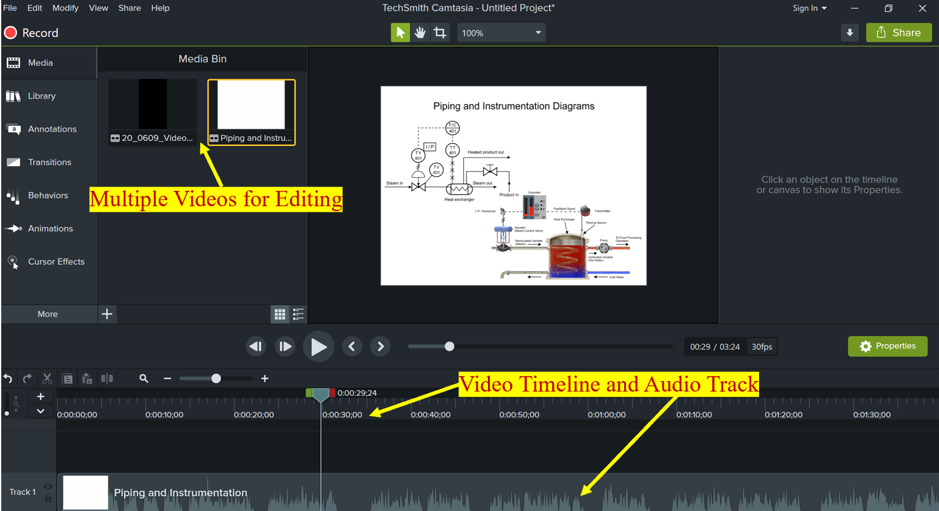
TechSmith Camtasia Producer
Camtasia (Producer) is used to add effects to an MP4 video, edit (or splice) videos, and most of all, to compress the video into a smaller file that can be uploaded to YouTube, or loaded into an LMS for students to download. A smaller file in the LMS minimizes delays for the student, and smaller files take less time for YouTube videos.

Slide 20
Three types of Video Learning Objects:
______________________
Created with a camera: (Example: How to do something in the lab)
______________________
Computer Screen CAM: (Example: How to use CAD or PLC Software)
______________________
Voice Over PowerPoint: (Example: Explaining the symbols on a schematic)
Camtasia 2019 Recorder
Camtasia 2019 Recorder
Camtasia Producer 2019
Camtasia Producer 2019
Camtasia Producer 2019
Explaining 5/2 Valves.MP4
Moving RSLinx in Virtual Backplane.MP4
Explanation of Lab 6.2 circuit.MP4
Load the MP4 into the LMS for students to download and view:
OR
Upload the MP4 to YouTube, then insert Link into the LMS for students to view:
**Camtasia Producer compresses the MP4 to a smaller file size, making uploading and downloading more efficient.

Slide 21
Informational Learning Objects (PDFs)
Informational PDF, which are sometimes termed Targeted Learning Objects are usually created in either Word or PPT. The examples I have are with PPT. These will many times have a graphic, then an explanation.
Here are a few examples of Informational Learning Objects:
IND134 Module 5 Intro to Electrical circuits 050318
IND223 Module 2 Motor Branch Circuits ver B
IND220 Module 7 VFDs Basics

Slide 22
Instructional Videos:
Camtasia will be used to create instructional videos. If Camtasia Recorder is started, I can start a video of my screen and add voice and even annotation to the video. The videos are then produced in Camtasia 2019, then saved as an MP4 file. Camtasia condenses the video. The video is then loaded onto a YouTube channel, then the YouTube link is put into the LMS.
IND134 Lab 4.1 Auto Return circuit in lab with print overlays 3
IND220 Explanation of Lab 2.3 Circuit 1 082420
IND220 Explanation of Lab 3.3 Circuit 1 091620

Slide 23
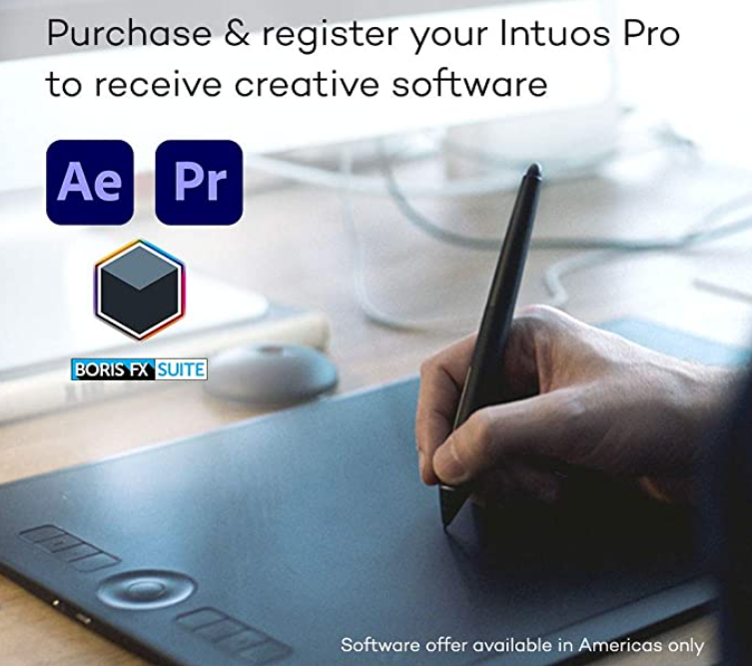
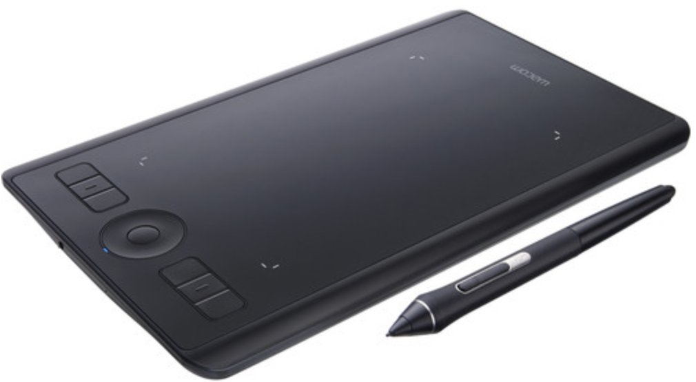
Annotating on the Screen in Camtasia
WACOM is a company that makes a digitizing tablet that connects to the computer via USB or Bluetooth. The tablet allows the user to draw on the screen of a computer that is not a touchscreen. Many touchscreen computers come with a stylus for drawing on the screen, instead of using a Wacom Tablet.

Slide 24
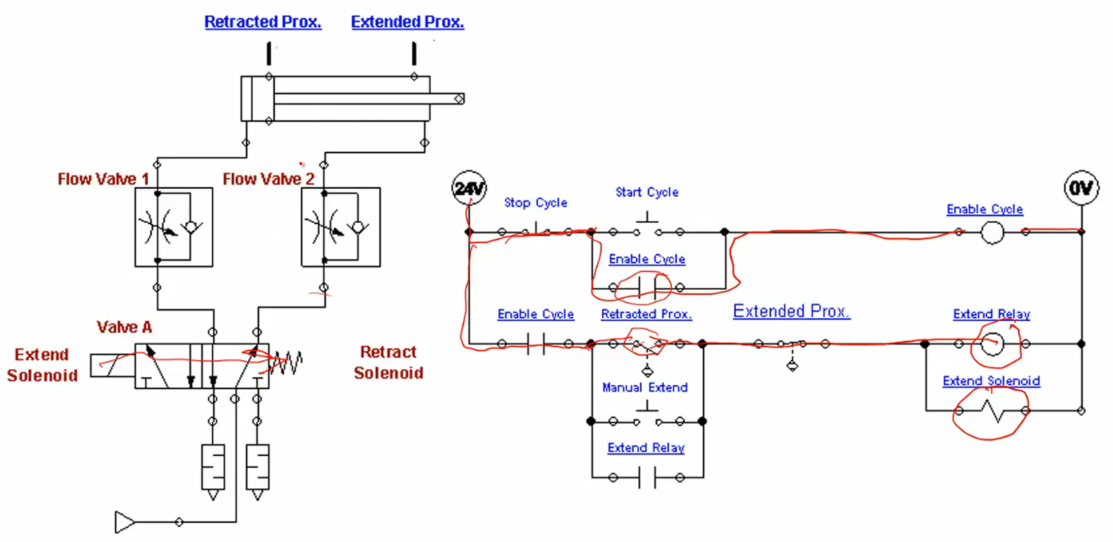
Annotating on the Screen in Camtasia Recorder
The WACOM tablet, or stylus on a touchscreen will allow the Faculty to draw on a picture, similar to drawing on a whiteboard.

Slide 25
Video Links in the LMS:
Video Links (or MP4 videos) are loaded into your LMS so students can view the videos from the computer or portable devices. Where do these links originate?
Faculty finds a video on YouTube for students to view
2. Faculty finds a video on Skillscommons.org or Vimeo
3. Faculty creates their own video, then loads it into YouTube, or loads the MP4 into the LMS

Slide 26
Storing Videos on YouTube:
If you create your own videos, you may decide to upload them to YouTube, and use the link in the LMS for students to view.
Your IT department should create a YouTube channel for you
Always have a way of documenting your video uploads
3. A Gmail account can give you a YouTube channel
4. Updating captions are important for ADA compliancy

Slide 27
Linking to YouTube Videos:
YouTube is a great source for finding videos for the students to view, but also as a place for the faculty to store their videos. A link from the video within the LMS, will allow the students to stream the video to their computer or portable devices. Each video on YouTube has a unique Video Identifier.
YouTube Video: T. Wylie, Video on setting RSLinx and FTLinx on virtual backplane, 12/4/20
https://youtu.be/POSmMFjfajg
Video Identifier
YouTube Video URL that will have the video start at a specific time:
https://www.youtube.com/watch?v=1K0YF1foxVk&t=3m10s
YouTube Video URL that will have the video start at a specific time, and end at a specific time:
https://www.youtube.com/embed/SMsYHbtYnK8?start=50&end=60

Slide 28
Demonstration on Creating Objects:
1. Capturing with Snagit
2. An Informational PDF
3. Recording a video with Camtasia Recorder
3. Voice over PowerPoint Video
4. Editing a video with Camtasia
5. Adding a video to another video
6. Uploading to YouTube

Slide 29
How-To Videos for Session 2:
YouTube Video: T. Wylie, Video on Finding OER Videos and Simulations 042221
https://youtu.be/uo934NaFoxs
YouTube Video: T. Wylie, Video Searching for OER in Skillscommons 042221
https://youtu.be/ep4Erjg46bs
YouTube Video: T. Wylie, How to produce an MP4 with camtasia producer 042421
https://youtu.be/2iZCLMnSDhk
YouTube Video: T. Wylie, 21_0425_Example of a voice over PPT video
https://youtu.be/KXi-iqFUohU
YouTube Video: T. Wylie, 21_0425_Creating a video and uploading to Youtube
https://youtu.be/ZG4jEiF2Wgw
YouTube Video: T. Wylie, 21_0425_Edit closed captions in Youtube
https://youtu.be/eNdX1RrBf5U

Slide 30
The End of the Presentation
Please email the presenter with
Any questions you may have, as
well as any feedback on the session
(twylie@northweststate.edu)

