Slide 1
CREATE Faculty Training on CBE Learning
Created by Tom Wylie, 12/20/22

Slide 2

CREATE Faculty Training on CBE Learning
Training topics for this training session:
Traditional courses versus Competency-based hybrid courses
Process of converting a traditional course to a hybrid format
Traditional and competency-based assessment models
Performance Assessments: Examples and Execution
Knowledge & Application Assessments: Examples
Grading Model – Standards set by Dean and Grant Personnel
Overview of Module 1 of the PLC1 Course:
a. Module description and Outcomes, Learning Sequence Sheet
b. Learning objects, Lab Exercises, KAA study guides
c. Practice quizzes, Assessments

Slide 3
CREATE Faculty Training on CBE Learning
Training topics continued:
8. Introduction to creating Learning Objects
a. PowerPoint
b. Converting PPT to PDF
c. Voice over PPT
d. Creating videos with a camera
e. Creating a screen CAM video to show how to use software

Slide 4
Please Read This
Handouts for the Workshop is available at the Project Website:
https://ate.is/Scaling_CBE

Slide 5
Why is Terra doing the CREATE Project?
C R E A T E
Creating Relevant, Effective and Accessible Technical Education
Students to develop more applicable Hands-On Technical Skills than in previous courses
NSF uses the phrase: Developing a More Qualified Technician
Reduce the Product Variance: Which means that all students in the PLC courses will have the same learning experience, no matter who the Instructor is. All the base level material is found in the LMS.

Slide 6
What is Competency-Based Education (CBE)?
Competency-based Education consists of two components:
  *Mastery of Skills - The CBE course is typically parsed into modules, with knowledge assessments in each module that must be passed at an acceptable level, and Performance Assessments that must be passed at 100% (mastery).
  *Flexible Pacing - Student will progress through a course at their pace of learning (and of course mastery). Some students will finish early, and some will take a little longer.

Slide 7
Traditional PLC Course:
Wk. 1
Wk. 2
Wk. 3
Wk. 4
Wk. 5
Wk. 6
Wk. 7
Wk. 8
Wk. 9
Wk. 10
Wk. 11
Wk. 12
Wk. 13
Wk. 14
Wk. 15
Wk. 16
Mon
Mon
Mon
Mon
Mon
Mon
Mon
Mon
Mon
Mon
Mon
Mon
Mon
Mon
Mon
Mon
Lecture
Lecture
Lecture
Lecture
Lecture
Lecture
Lecture
Lecture
Lecture
Lecture
Lecture
Lecture
Lecture
Lecture
Lecture
Lecture
5-8pm
5-8pm
5-8pm
5-8pm
5-8pm
5-8pm
5-8pm
5-8pm
5-8pm
5-8pm
5-8pm
5-8pm
5-8pm
5-8pm
5-8pm
5-8pm
Wed
Wed
Wed
Wed
Wed
Wed
Wed
Wed
Wed
Wed
Wed
Wed
Wed
Wed
Wed
Wed
Lab
Lab
Lab
Lab
Lab
Lab
Lab
Lab
Lab
Lab
Lab
Lab
Lab
Lab
Lab
Lab
5-8pm
5-8pm
5-8pm
5-8pm
5-8pm
5-8pm
5-8pm
5-8pm
5-8pm
5-8pm
5-8pm
5-8pm
5-8pm
5-8pm
5-8pm
5-8pm
Test #1
Test #2
Final
EET 2440, 4 Cr. Hr., 96 contact hours (6 hrs./week for 16 weeks)
Students & Faculty make 32 trips to campus for this semester course
3 Written or Online Knowledge-based Assessments, and possibly projects
Pace is set by the Instructor

Slide 8
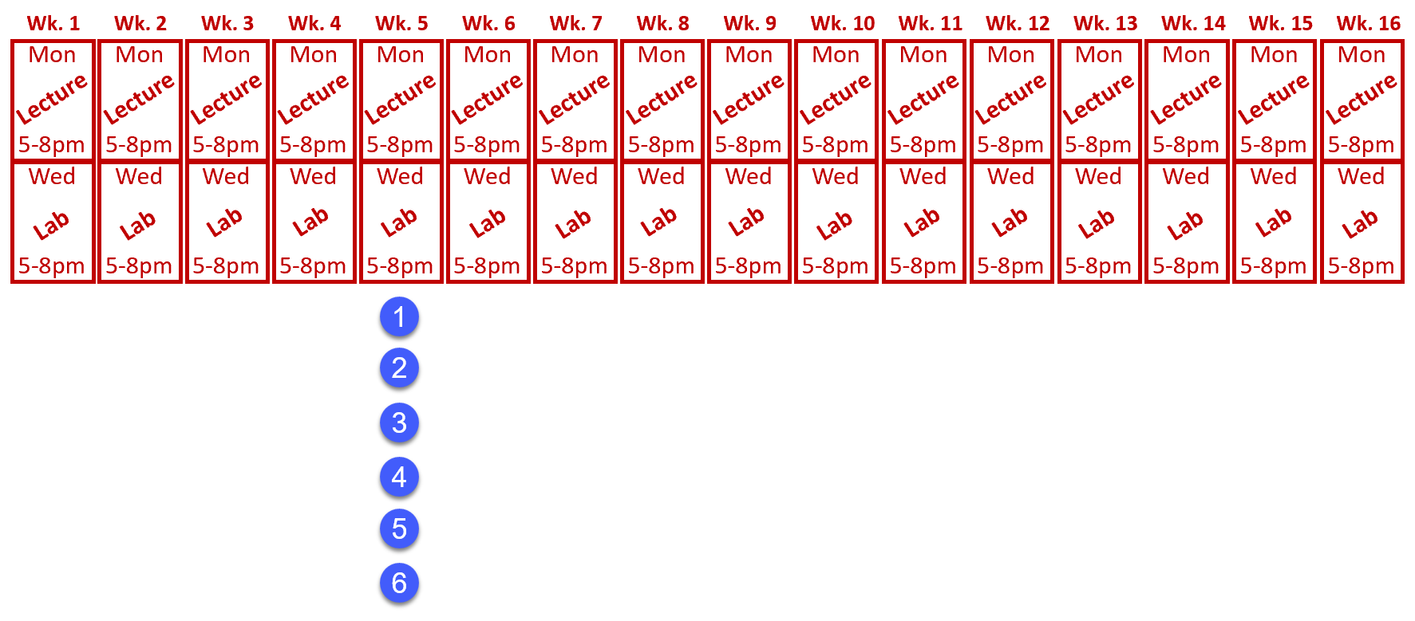
Traditional Course Pacing:
Pace is set by the Instructor
Pace is the same with all students
Learning/Grade is variable

Slide 9
Competency-based Hybrid PLC Course:
Wk. 1
Wk. 2
Wk. 3
Wk. 4
Wk. 5
Wk. 6
Wk. 7
Wk. 8
Wk. 9
Wk. 10
Wk. 11
Wk. 12
Wk. 13
Wk. 14
Wk. 15
Wk. 16
Module 1
Module 2
Module 3
Module 4
Module 5
Module 6
Module 7
Module 8
Canvas
Canvas
Canvas
Canvas
Canvas
Canvas
Canvas
Canvas
M1 KAA
M2 KAA
M3 KAA
M4 KAA
M5 KAA
M6 KAA
M7 KAA
M8 KAA
Wed
Wed
Wed
Wed
Wed
Wed
Wed
Wed
Wed
Wed
Wed
Wed
Wed
Wed
Wed
Wed
Lab
Lab
Lab
Lab
Lab
Lab
Lab
Lab
Lab
Lab
Lab
Lab
Lab
Lab
Lab
Lab
5-8pm
5-8pm
5-8pm
5-8pm
5-8pm
5-8pm
5-8pm
5-8pm
5-8pm
5-8pm
5-8pm
5-8pm
5-8pm
5-8pm
5-8pm
5-8pm
Performance
Assessment #1
Performance
Assessment #2
Performance
Assessment #3
Performance
Assessment #4
Students & Faculty make 16 trips to campus for this semester course
Pace is set by student learning and completion

Slide 10
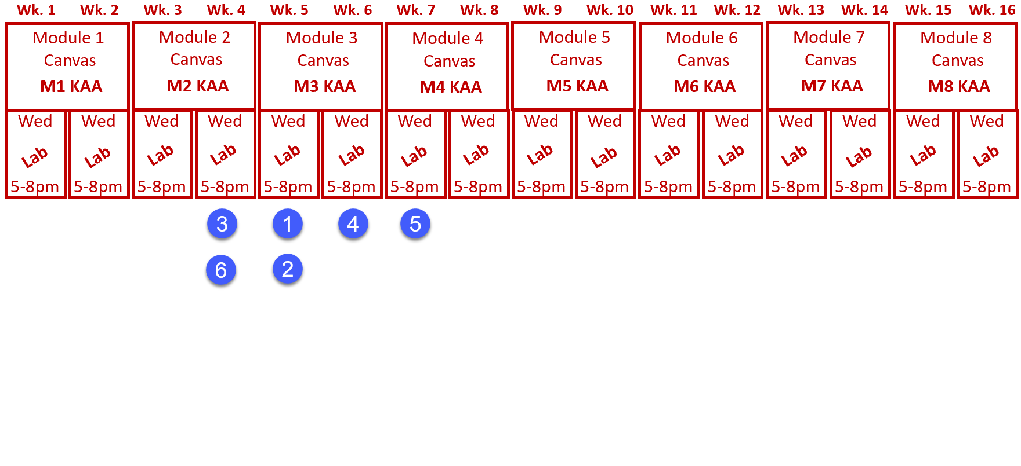
Competency-based Hybrid PLC Course:
Pace is set by student learning and completion
All students finish with the same level of learning

Slide 11
Assessment Models:
Traditional Assessment Model:
Competency-based Assessment Model:
Test #1
M1 KAA
Performance
Assessment #1
Test #2
M2 KAA
Test #3
M3 KAA
M4 KAA
Performance
Assessment #2
Knowledge
Paper or
Online
10 Point Sys.
A-F Grade
M5 KAA
M6 KAA
Performance
Assessment #3
M7 KAA
M8 KAA
Performance
Assessment #4
Knowledge
Paper or
Online
80% min.
A, B, or F
Skills
Hands-on
100% min.

Slide 12
Consistency in Instructional Materials:
Consistency is an important thing to the students at NSCC. Not only are all the documents built in a standard format, but also the LMS course layout is an important standard.
LMS formatting is especially critical. At NSCC, many students did not have great experience taking online courses (primarily Gen Ed), since every Instructor would setup a course differently. The standardization in our LMS was a best practice in our student focus groups.
Learning Objects have a specific format in PPT and Word, with text colors, margins, headers, etc.

Slide 13
Learning Objects:
Textbooks typically take a scatter gun approach to learning, covering multiple types of hardware and software. Textbooks are expensive (sold by the pound), but if you can find a good book, adopt it.
Textbooks Vendors have really stepped up their game with course packs that include PowerPoints and test banks.
Learning Objects take a more focused approach to learning, where faculty can customize to match hardware and software in the lab environment.

Slide 14
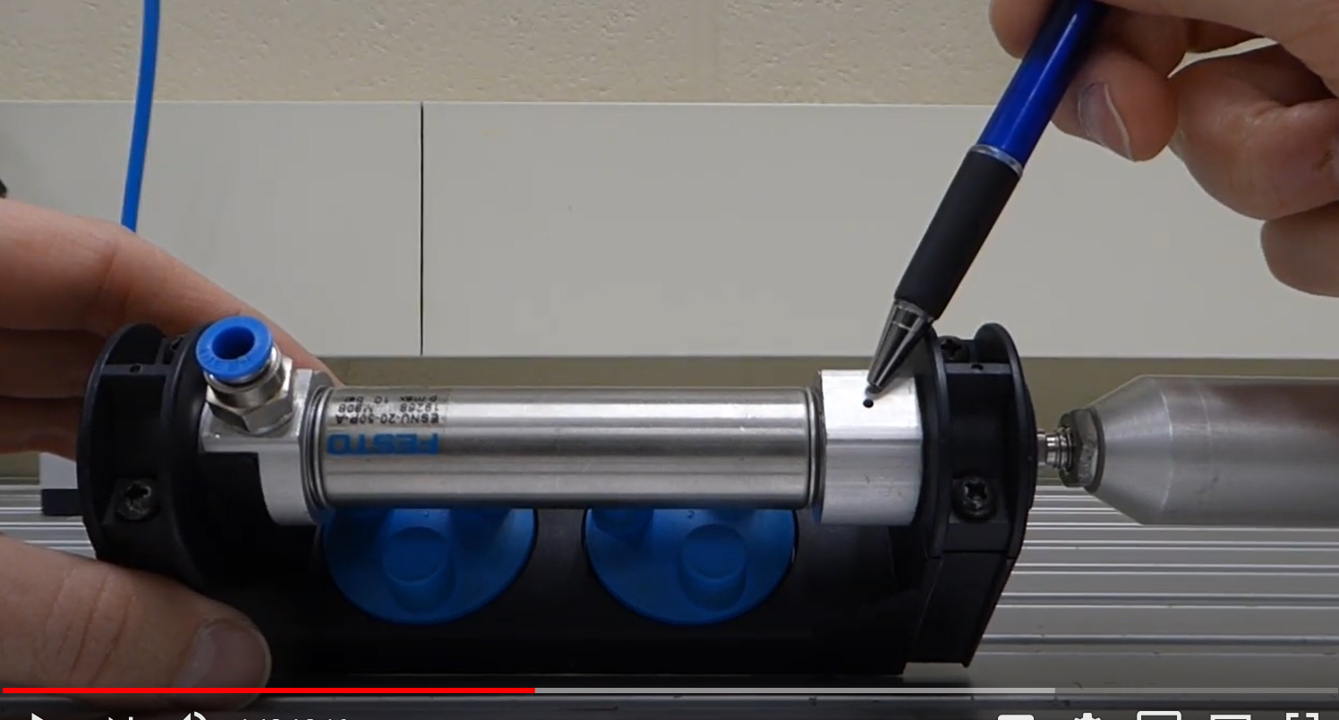
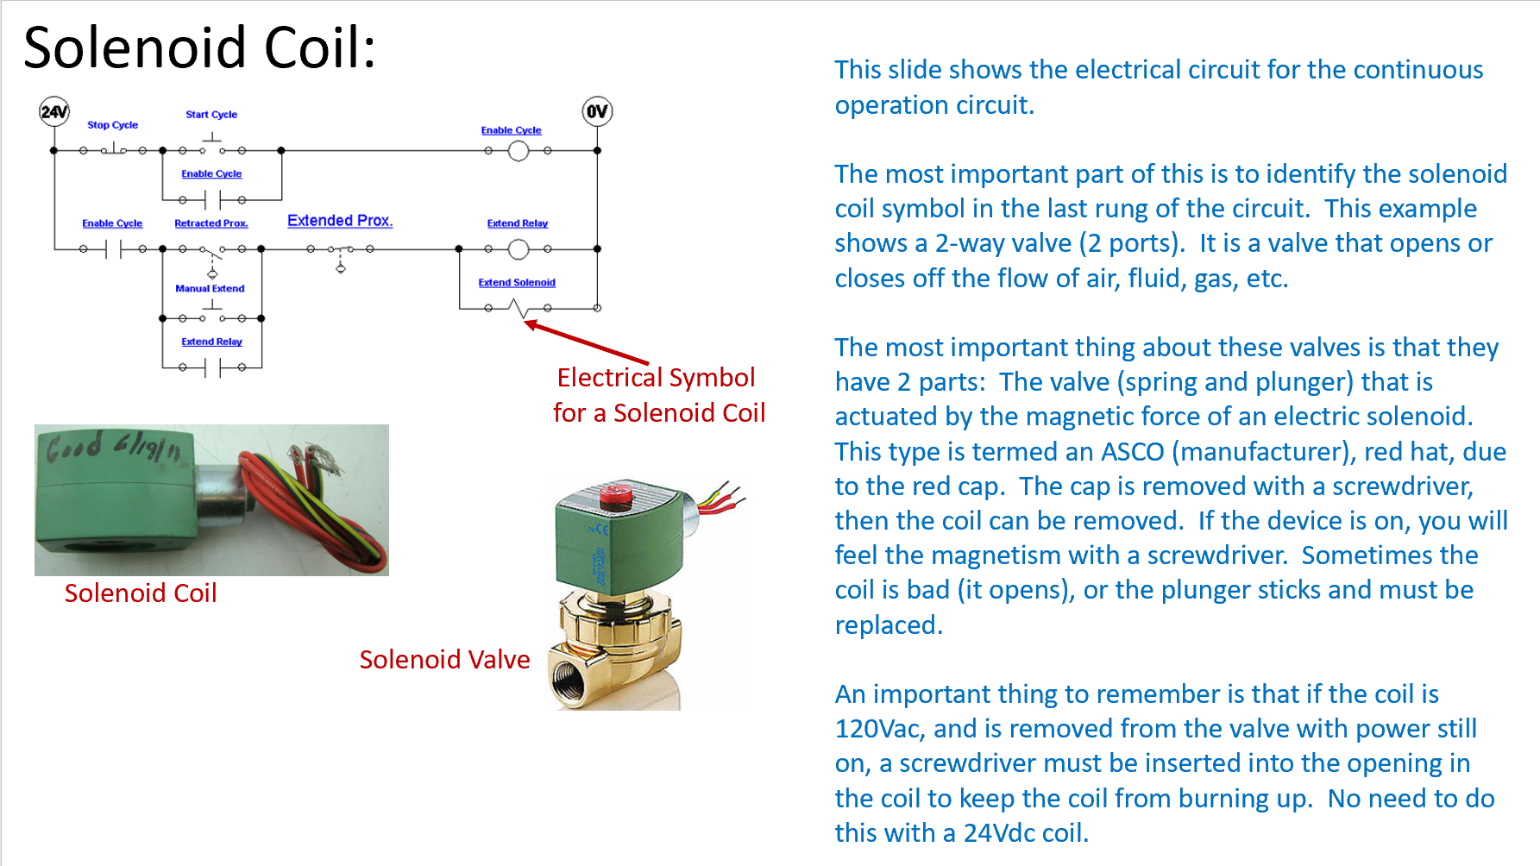
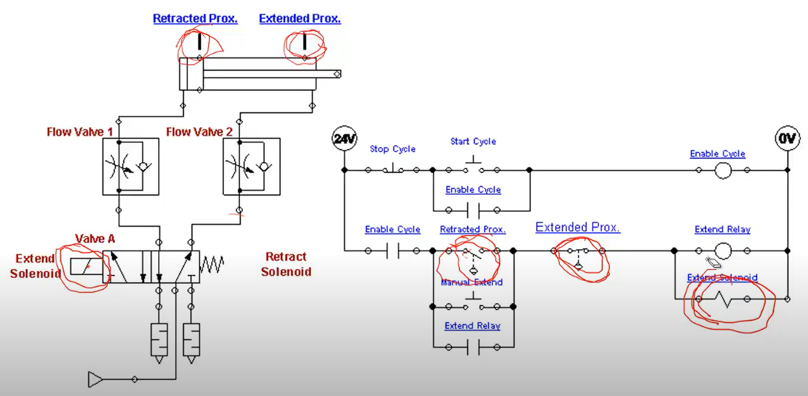
Learning Objects the User Navigates
Videos
Independent Learning Objects are posted in an LMS for student access. These objects can be viewed in any sequence. The upper left graphic shows a video that was shot with a camera, explaining a single acting pneumatic cylinder.
The middle graphic is a PPT that will be converted to a PDF, then posted in the LMS.
The bottom graphic is a voice over PPT, where the graphic was put into PPT, then annotated with a stylus on the computer touch screen.
All of these objects can be viewed on a smart phone, phablet, tablet or computer screen.
PPT/PDFs
Voice over PPT Video

Slide 15
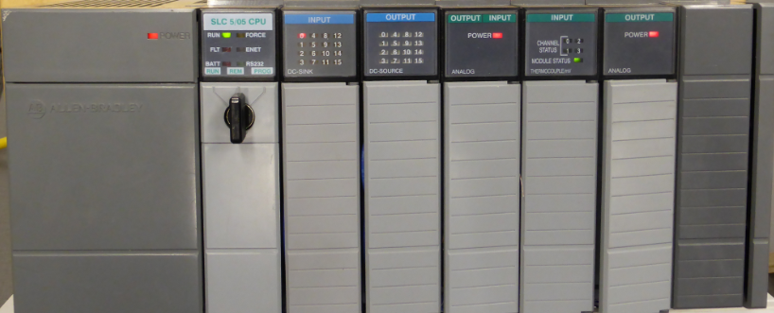
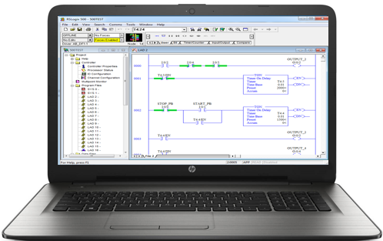
Overview of PLC Software:
Rockwell Software created a Windows-based software application (RSLinx) that will be used to communicate with Allen Bradley PLCs, as well as PLC programming software for all Allen Bradley PLCs:
RSLogix 500 – MicroLogix and SLC-500s
RSLogix 5 – PLC-5s
Studio 5000 – CompactLogix & ControlLogix
In an industrial environment these software packages are typically installed on a laptop, so the computer can be taken out to machine to connect to a PLC for troubleshooting a system.
All of these software packages will be installed on the computers in the Terra PLC lab. It is important to understand how to use the software to communicate, program and troubleshoot a PLC system. These software packages are expensive for companies to purchase ($1,000-$2,000 per package) and are copy protected, so students will need to come to campus to use this software. The Terra licensing agreement does not allow students to install this software on their computers at home.
RSLogix 500 PLC Programming Software is installed on the computer
Ethernet Connectivity between the SLC-5/05 processor and the computer
A Windows based computer with the Rockwell Software loaded becomes a PLC Programming Panel

Slide 16
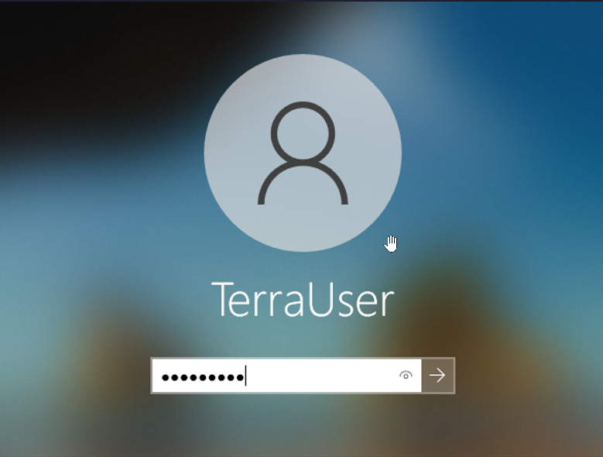
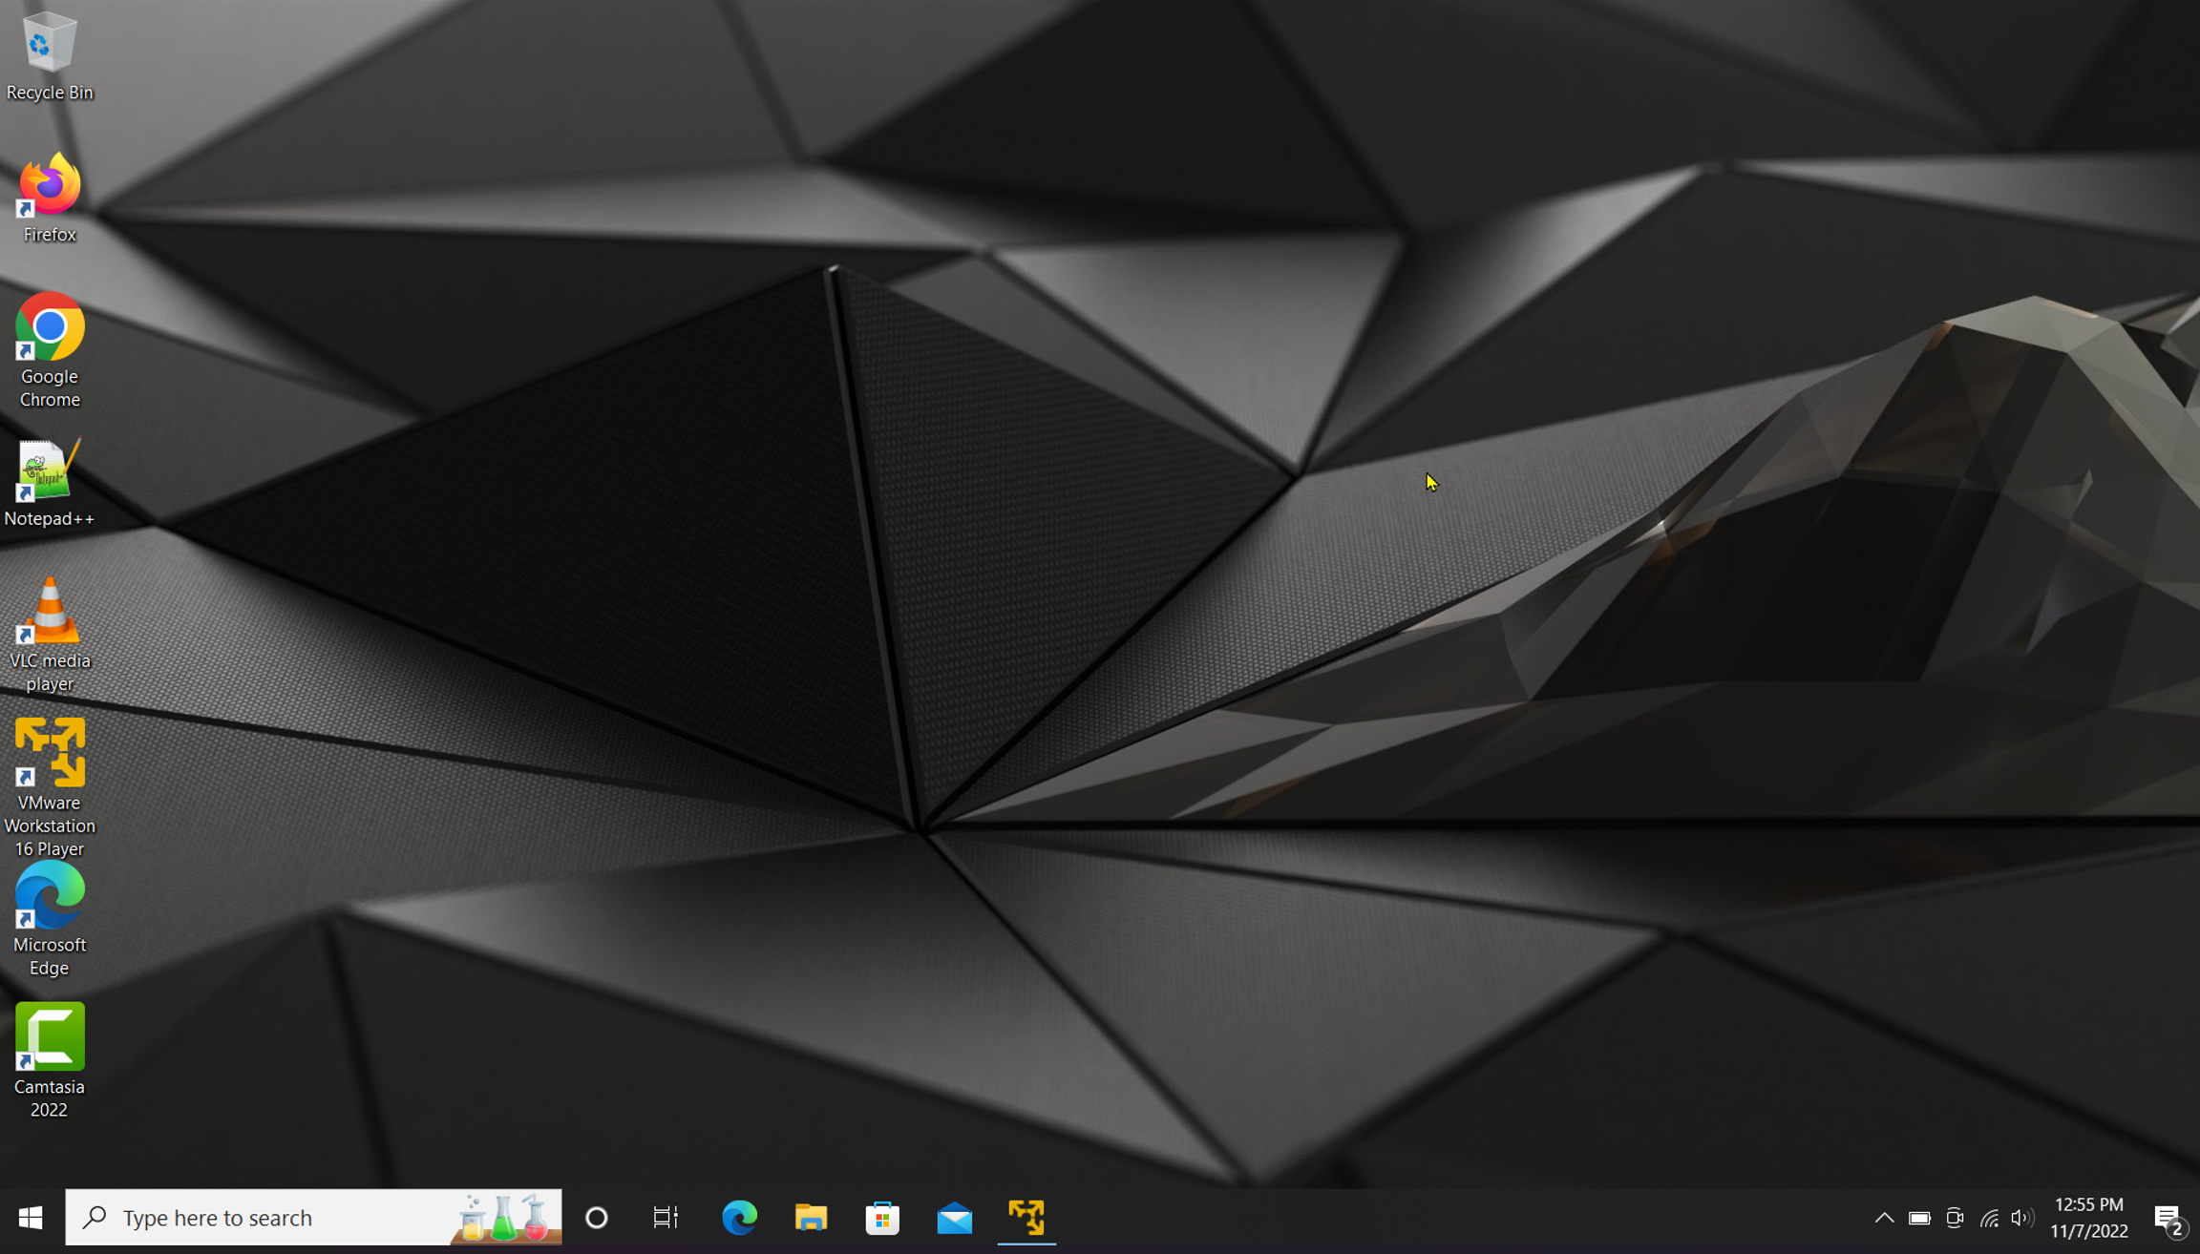
Terra Virtual Machines (VMs):
When working in the Terra PLC lab, it important to understand that the college has the Rockwell Software PLC applications loaded on a virtual machine (virtual computer) that is actually inside of the physical (host) computer that is on desks in the PLC lab. This practice allows the Terra IT department to load the Rockwell Software on a VM, then copy it to the computers in the PLC lab, versus loading all the applications on each machine. The operation is the same using the applications on a VM, as it is using the applications that were installed on a computer.
The important thing to remember is that there are two logins, which are both the same.
The student must first log into the physical computer with the username and password as shown in the upper right of this graphics (also on the white board in the PLC lab).
After logging into the physical computer, the student will then need to double click on the virtual machine icon (lower graphic), which is named: VMWare Workstation 16 Player.
User: TerraUser
Pwd: T3rra@User
Desktop of Host (Physical) Computer
Terra Virtual Machine (VM) icon

Slide 17
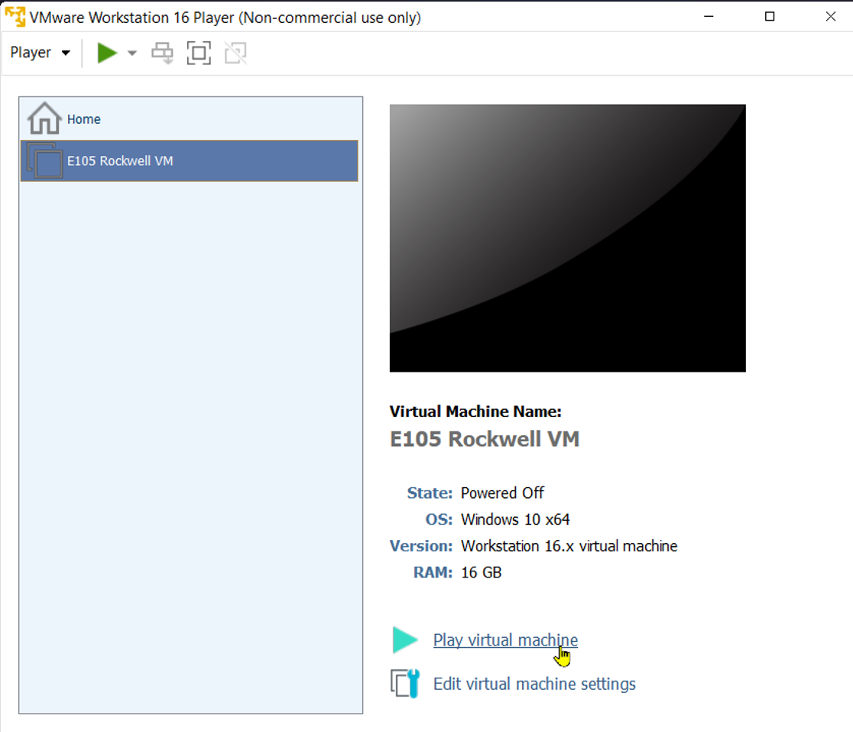
Terra Virtual Machines (VMs) cont.:
The next step is to login to the virtual machine. It will take some time before the VM fills the desktop. A Windows screen will appear. Click on the desktop and a login box will show up as shown in the upper left of this graphic. Use the same login credentials for the VM that you did for the physical computer login.
The VM Workstation 16 Player application opens.
Click on the E105 Rockwell VM
Then click the “Play virtual machine” link (shown in the lower portion of the graphic).
User: TerraUser
Pwd: T3rra@User
Click on the E105 Rockwell VM
Click on the Play virtual machine

Slide 18
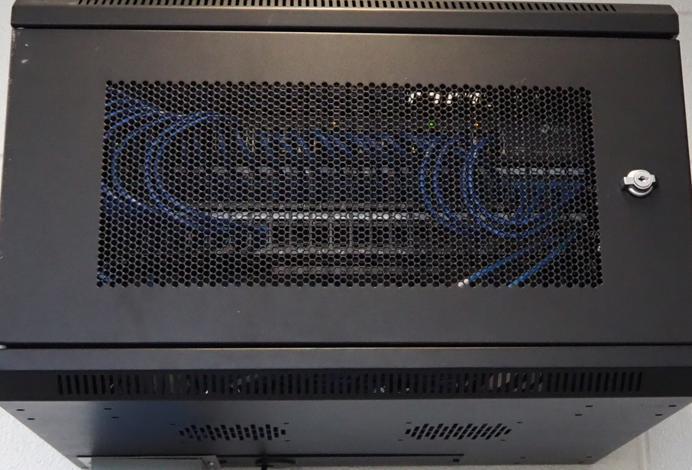
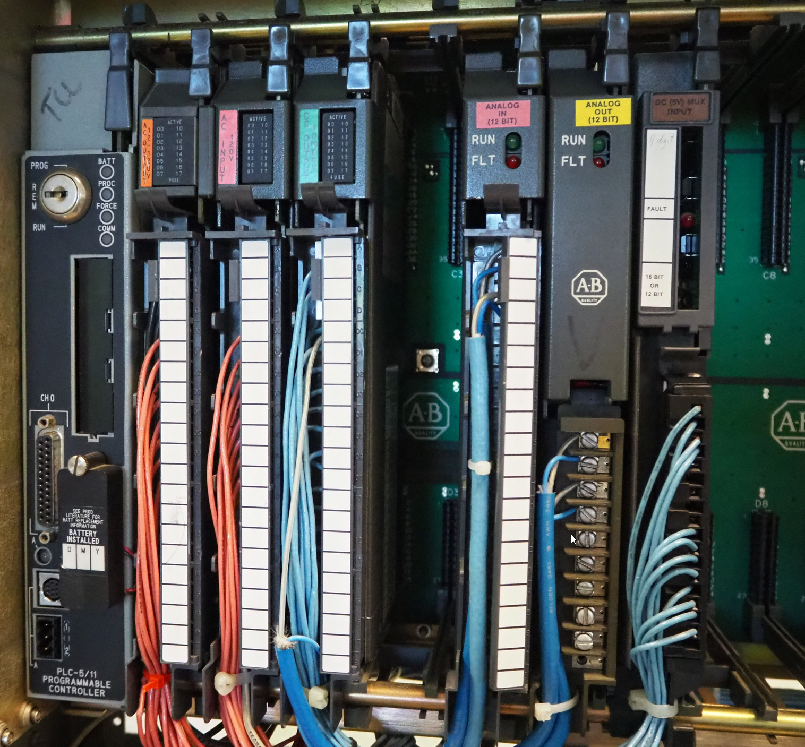
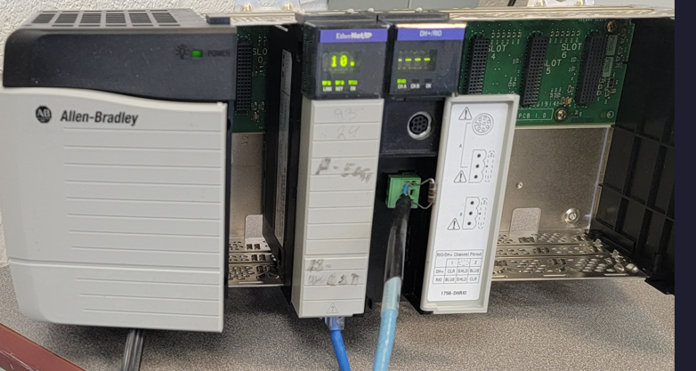
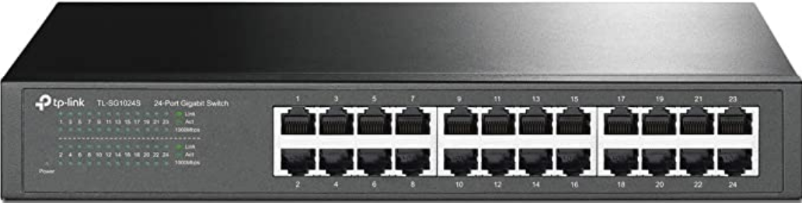
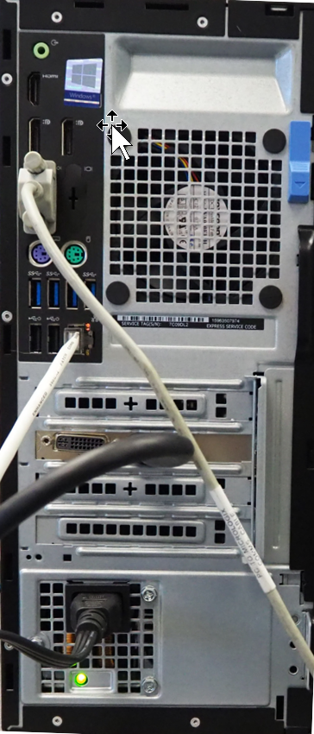
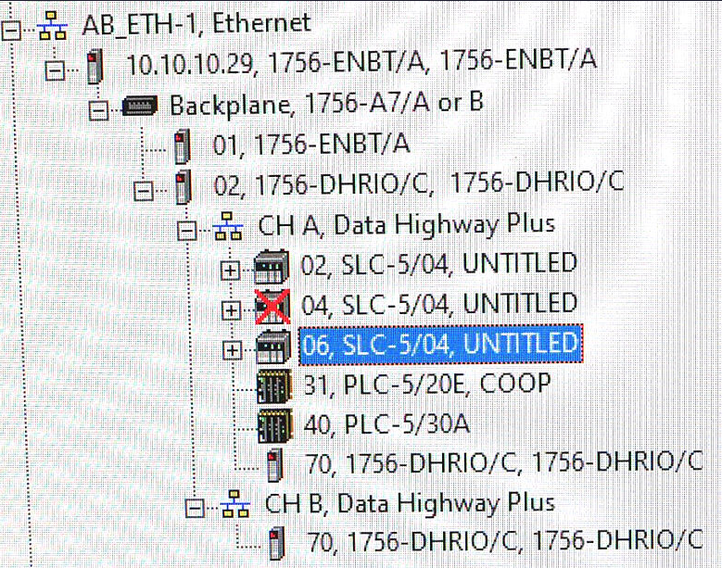
ControlLogix Gateway:
Ethernet Module
10.10.10.29
DH+/RIO Module
Ch A, DH+ Sta. 70
Ethernet Switch
DH+
Ethernet
DH+ Sta. 40
Ethernet
10.10.10.5
RSLinx
Computer in PLC Lab

Slide 19
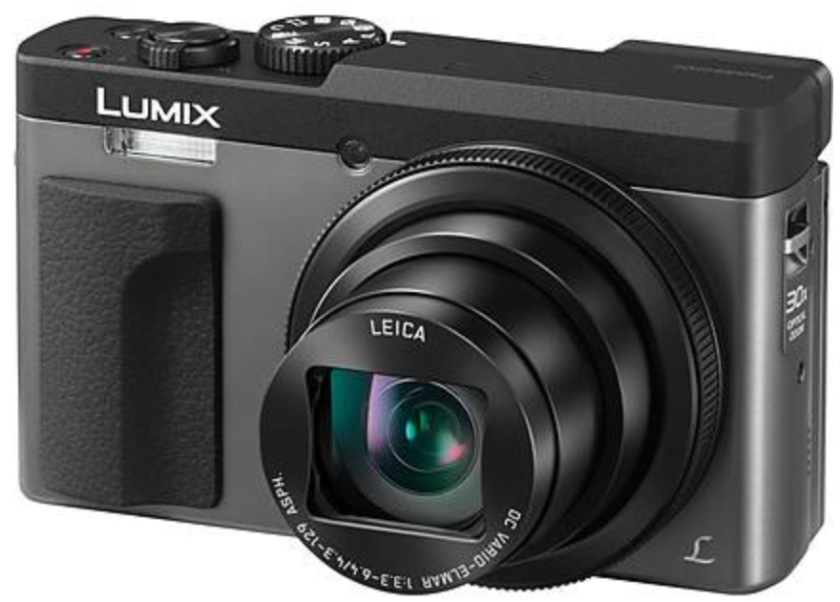
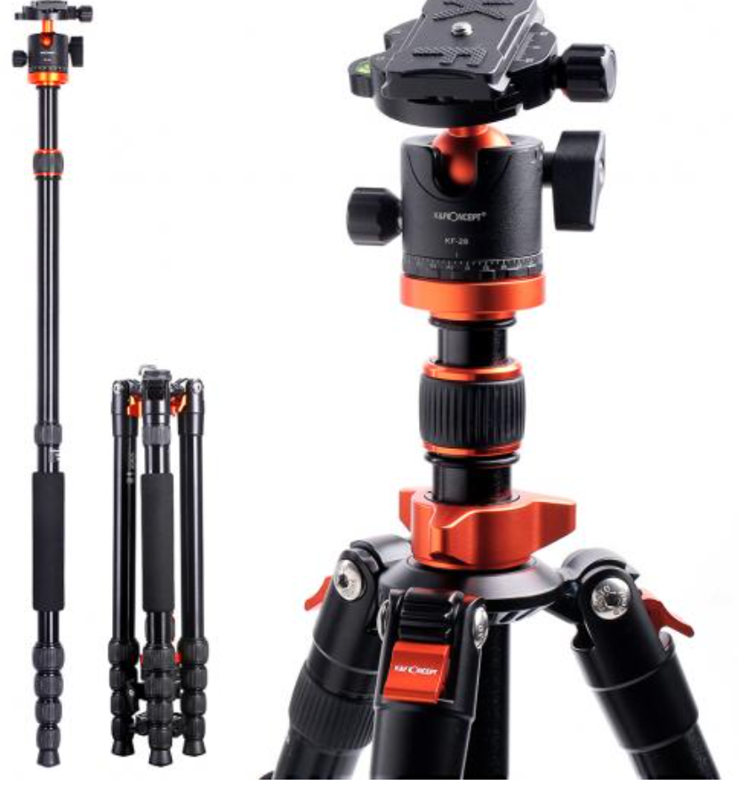
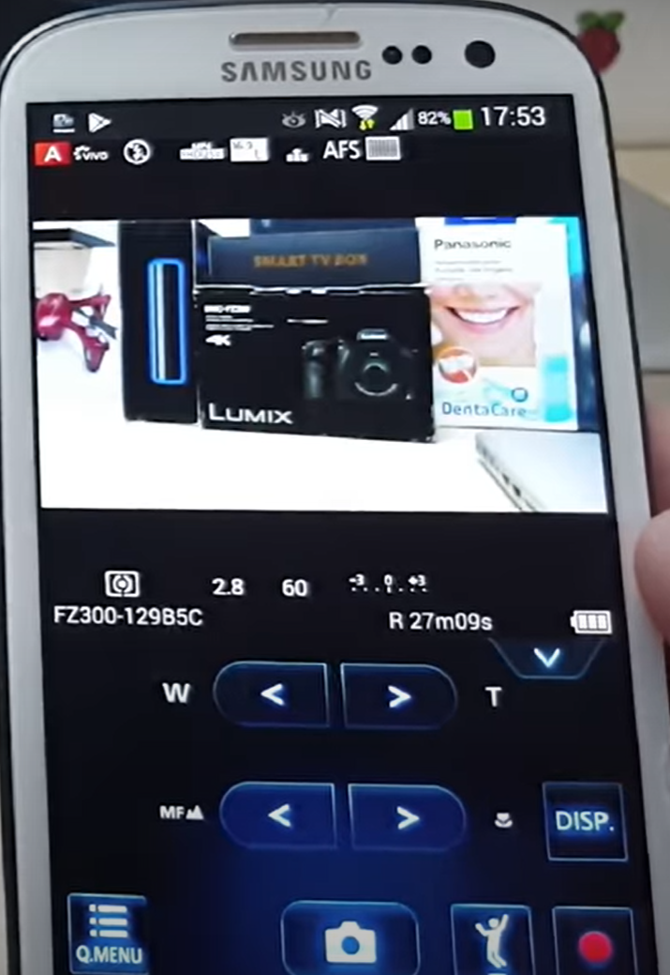
Cameras for Creating Videos:
One of the common tools that our Industrial Technology Instructors use is a simple Panasonic Point and Shoot camera. It is small with a zooming lens, with a removeable SD card, and a very sensitive internal microphone. The inverting tripod allows us to position the camera upside down to shoot onto an object or whiteboard (laying on a desktop). One of the most powerful features is the Panasonic Image app that runs on the smartphone. The camera has its own WiFi portal, thus the phone connects to it, then the image app controls the camera zooming, taking photos and taking videos. The SD card is removed then put into a port on the computer where it is then transferred to the HD, and produced with the Camtasia Producer software.
Panasonic Lumix Point & Shoot
Inverting Tri-Pod
Panasonic Image Smart Phone App

Slide 20
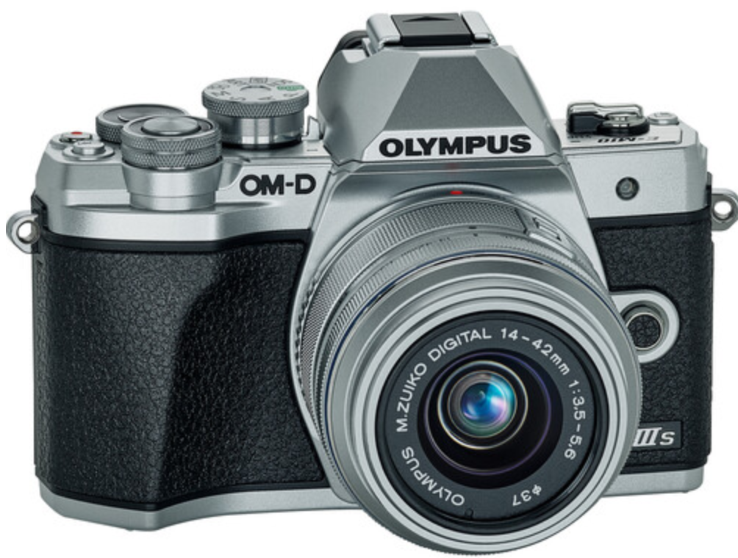
Cameras for Creating Videos:
I also use a high-end camera when I need to use different lenses, use different lighting filters and want higher quality images and videos. This is primarily if I am doing something for a vendor who needs a little higher quality than for instruction. I can get UHD 4K video quality. Usually, $700+. It also has a removeable SD.
Olympus E-M10 Mark III

Slide 21
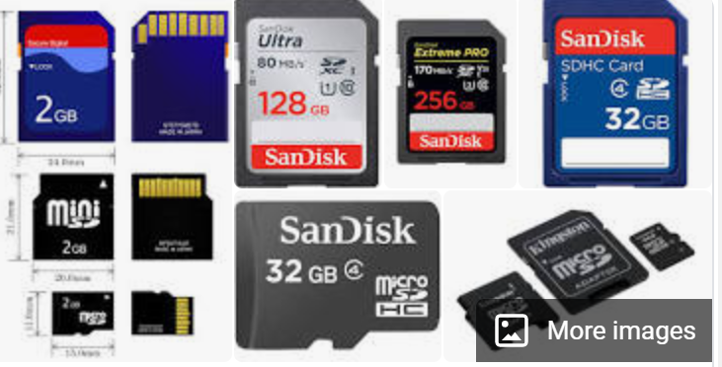
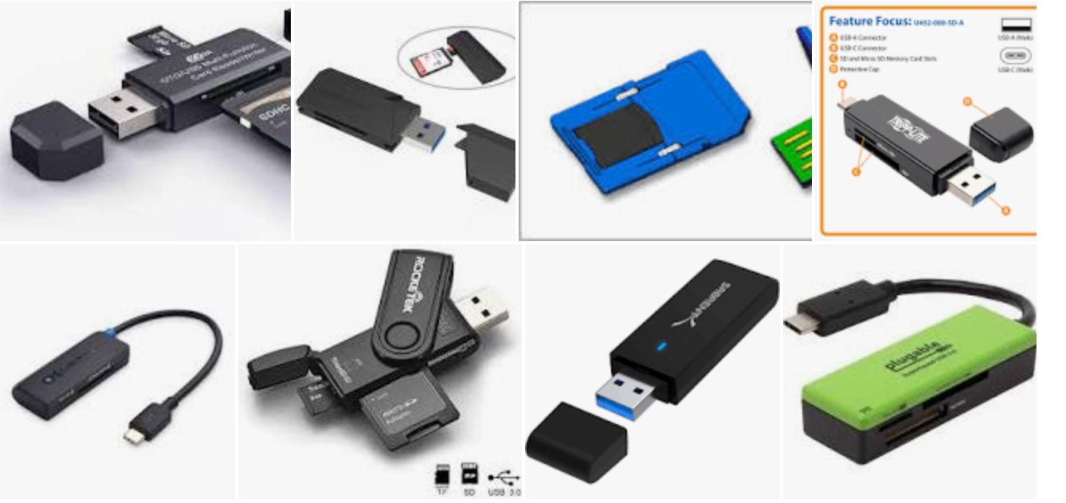

SD Cards for Recording Videos and Images:
The SD cards will be used in most cameras to store the videos and pictures that are taken with the camera. I seldom use an SD less than 128GB in size, because they will fill up quickly. Remove the SD from the camera and connect it to the computer, to load the videos and images, so you can use the software tools to develop the learning objects
SD to USB Interface
SD Cards: GigaBytes

Slide 22
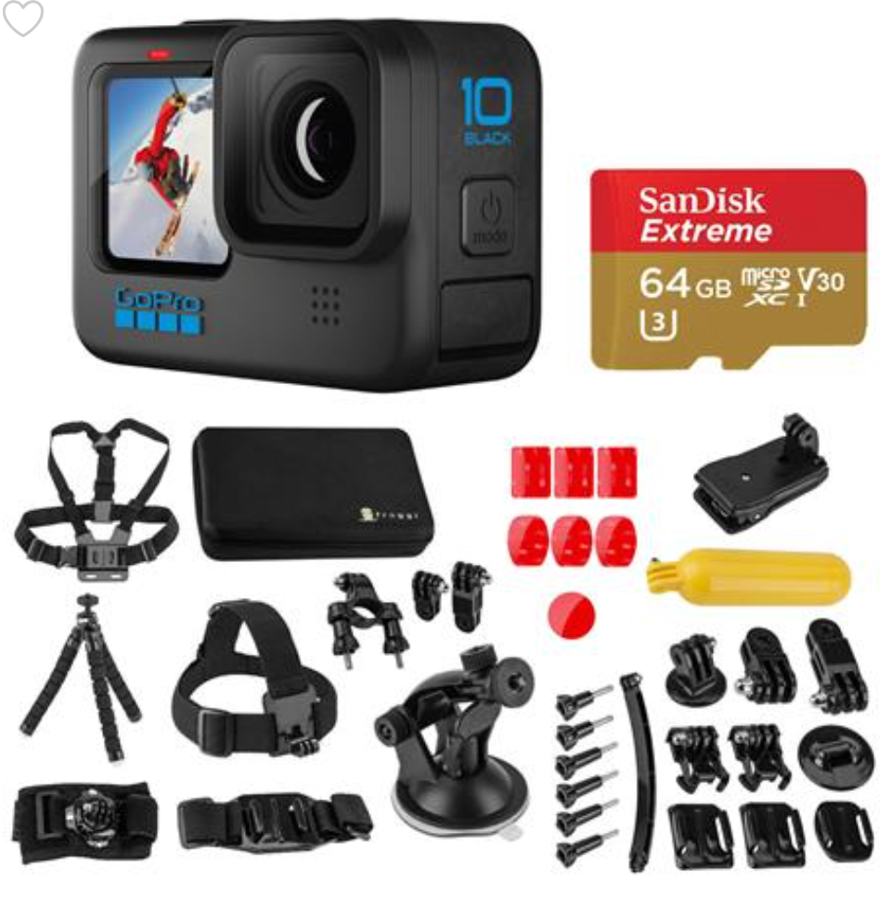
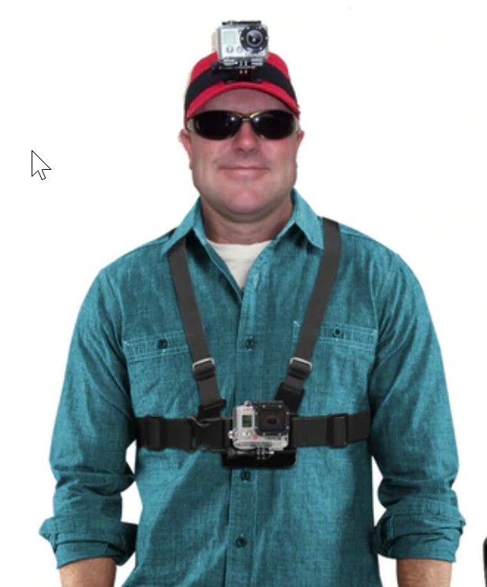
GoPro Cameras:

Slide 23
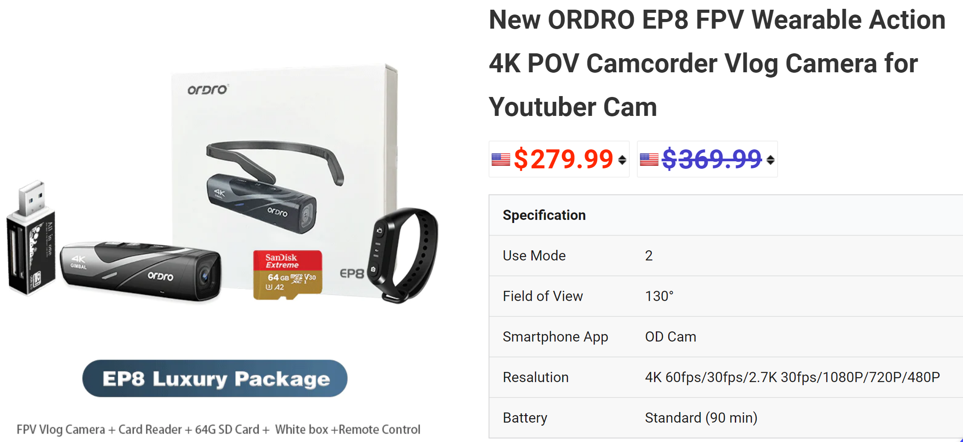
ORDRO Cameras:

Slide 24
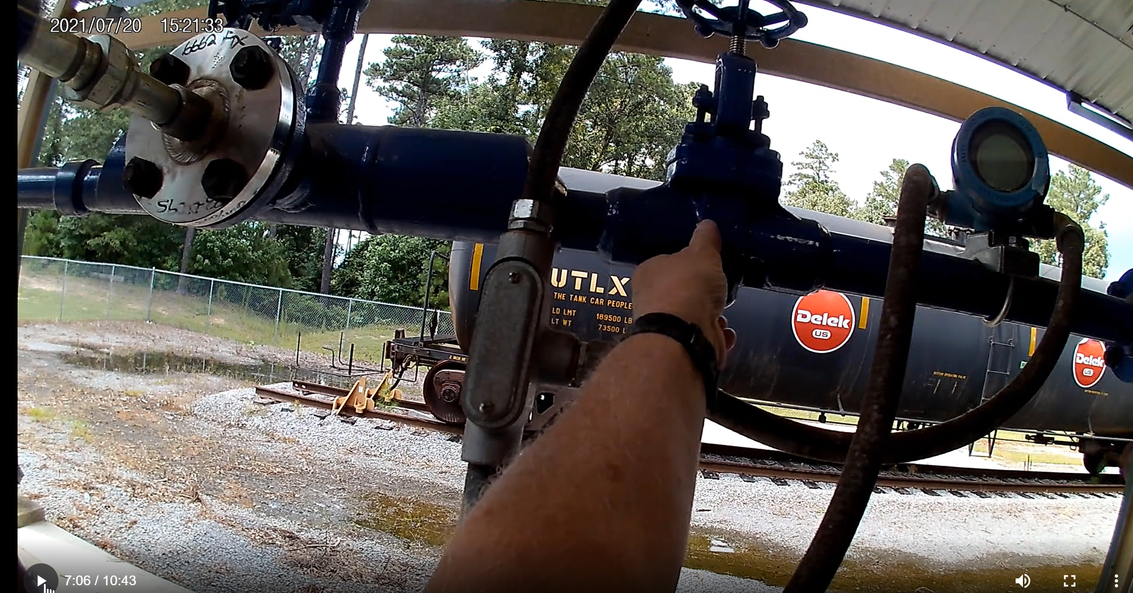
GoPro Recording of Video:

Slide 25






Software used to Create Objects
TechSmith (Techsmith.com), located in Michigan, developed and distributes Snagit and Camtasia. These products are targeted toward Faculty. They are simple to use and give immediate results. Snagit is an image or video capture software, and Camtasia is a product with multiple uses, but in the end it produces high quality videos. MP4 is the preferred video format for creating instructional videos. MS PowerPoint is the other key software that is needed to create illustrated graphics and animations. Google Slides does not have all of the features that MS PowerPoint has.
Snagit 2019
Camtasia 2019 Recorder
Microsoft PPT
Snagit 2019 Editor
Camtasia 2019

Slide 26
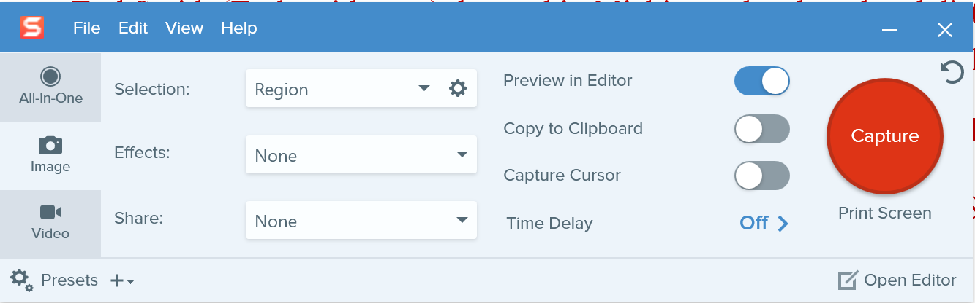
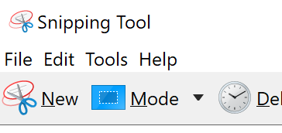
TechSmith Snagit 2019 (Capture):
This is the interface for Snagit capture. The user can designate a hot key such as the “PrtSc” key (Print Screen), which will bring up the cross hairs for capture.
Olympus E-M10 Mark III
Windows 10 Snipping Tools

Slide 27
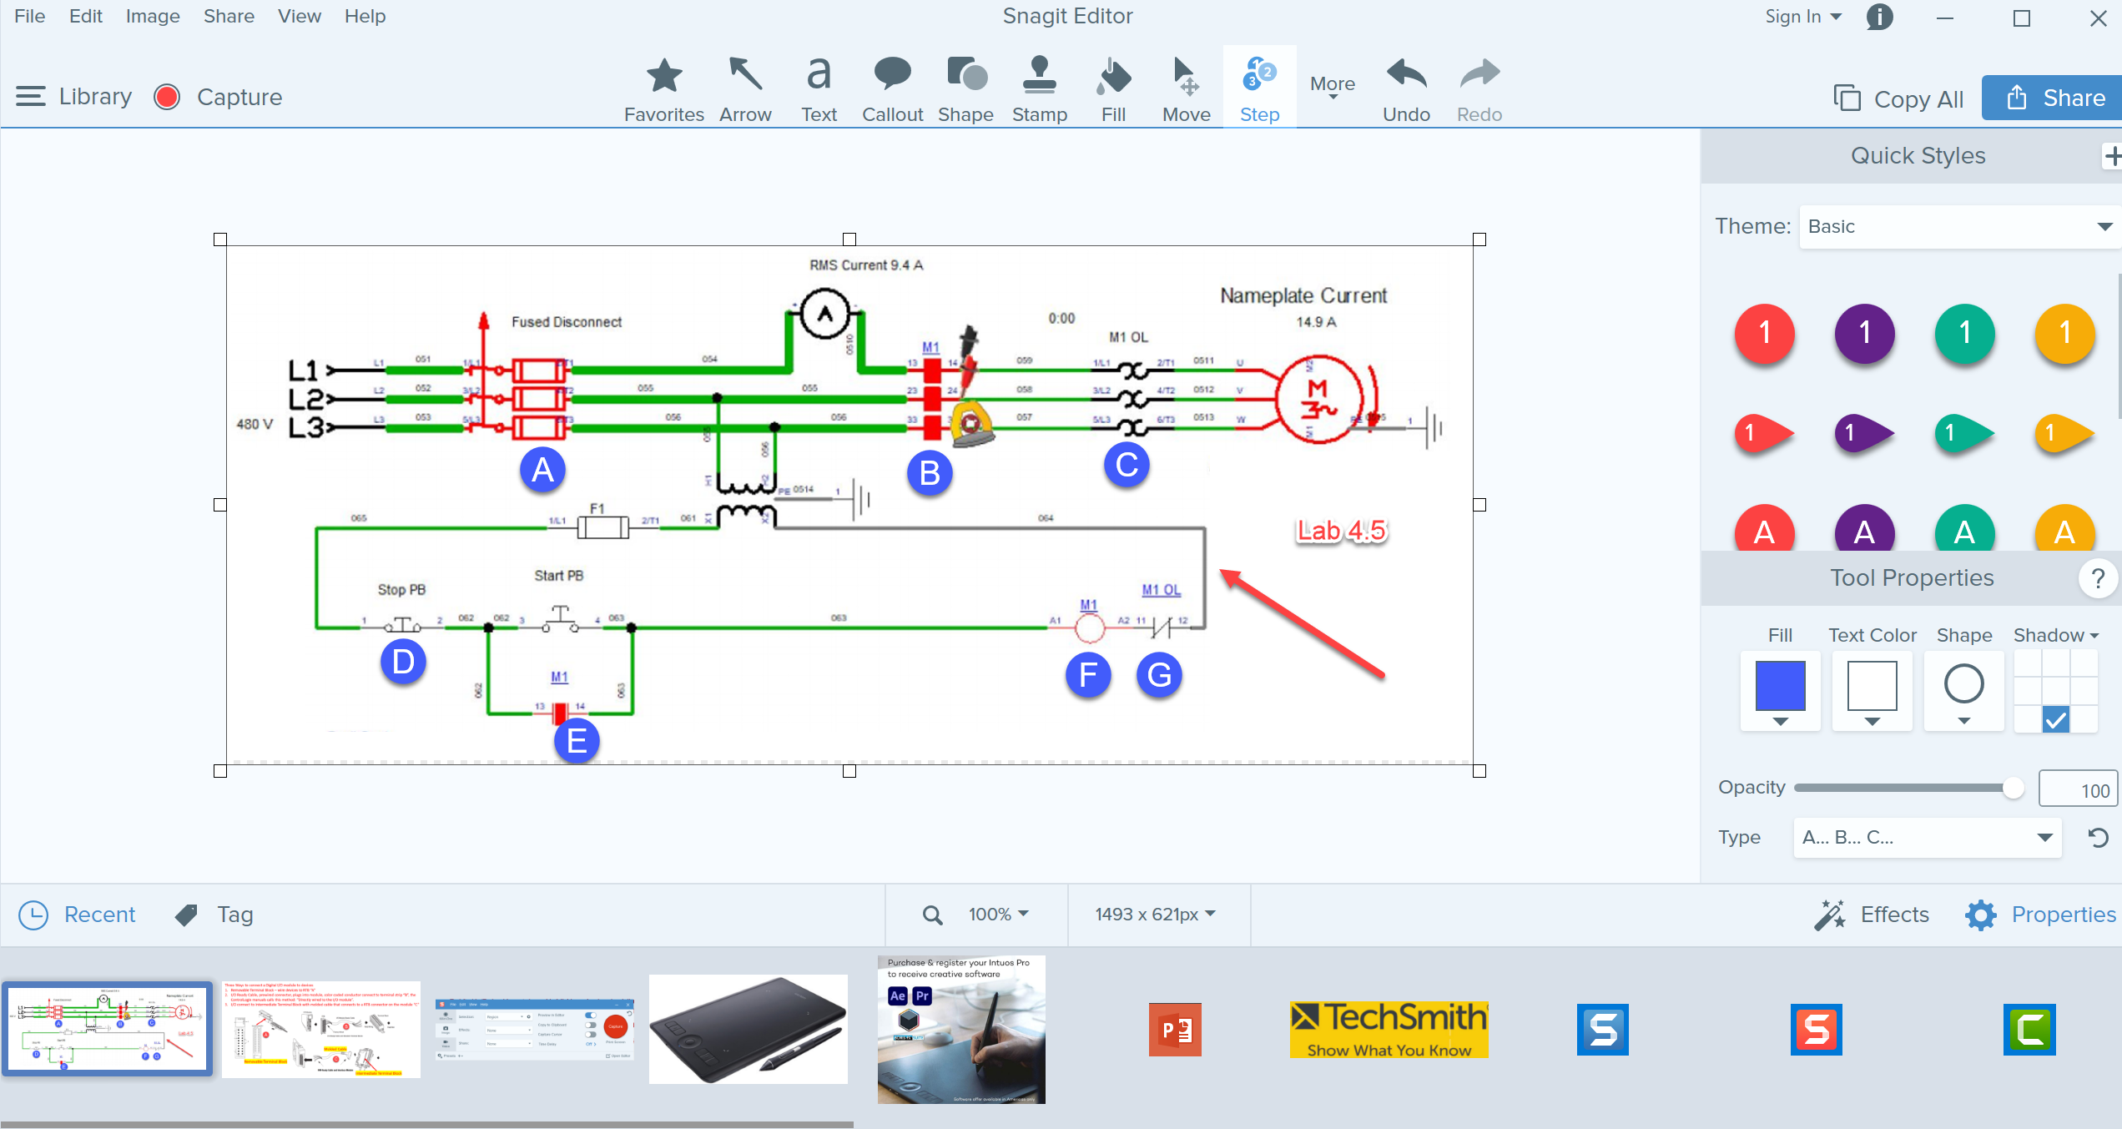
TechSmith Snagit 2019 Editor:
Tools to modify the image
Olympus E-M10 Mark III
Shows recently captured images

Slide 28
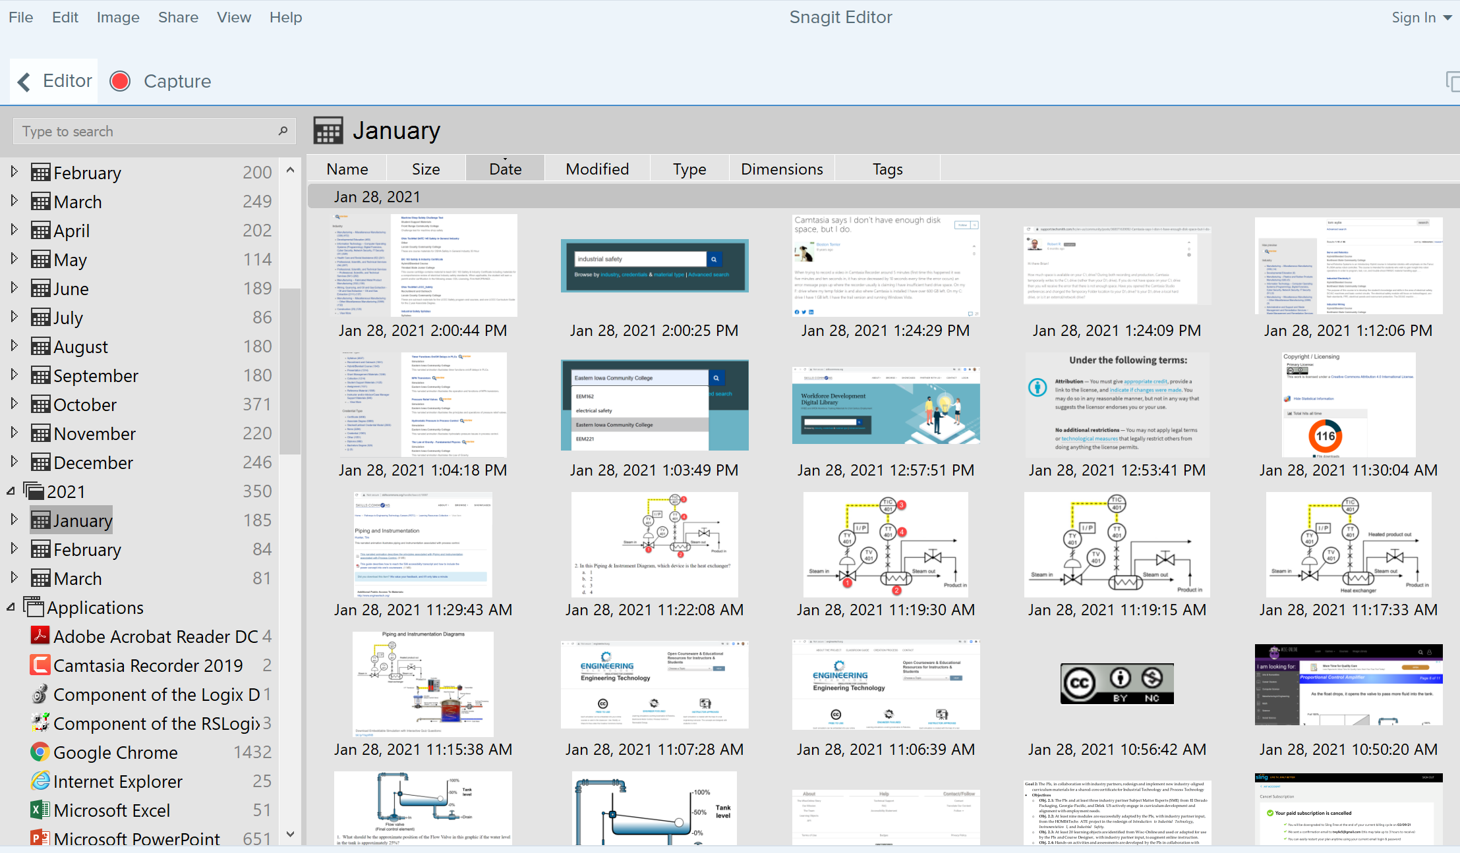
TechSmith Snagit Editor Library
User can go to any Month & Day for images

Slide 29
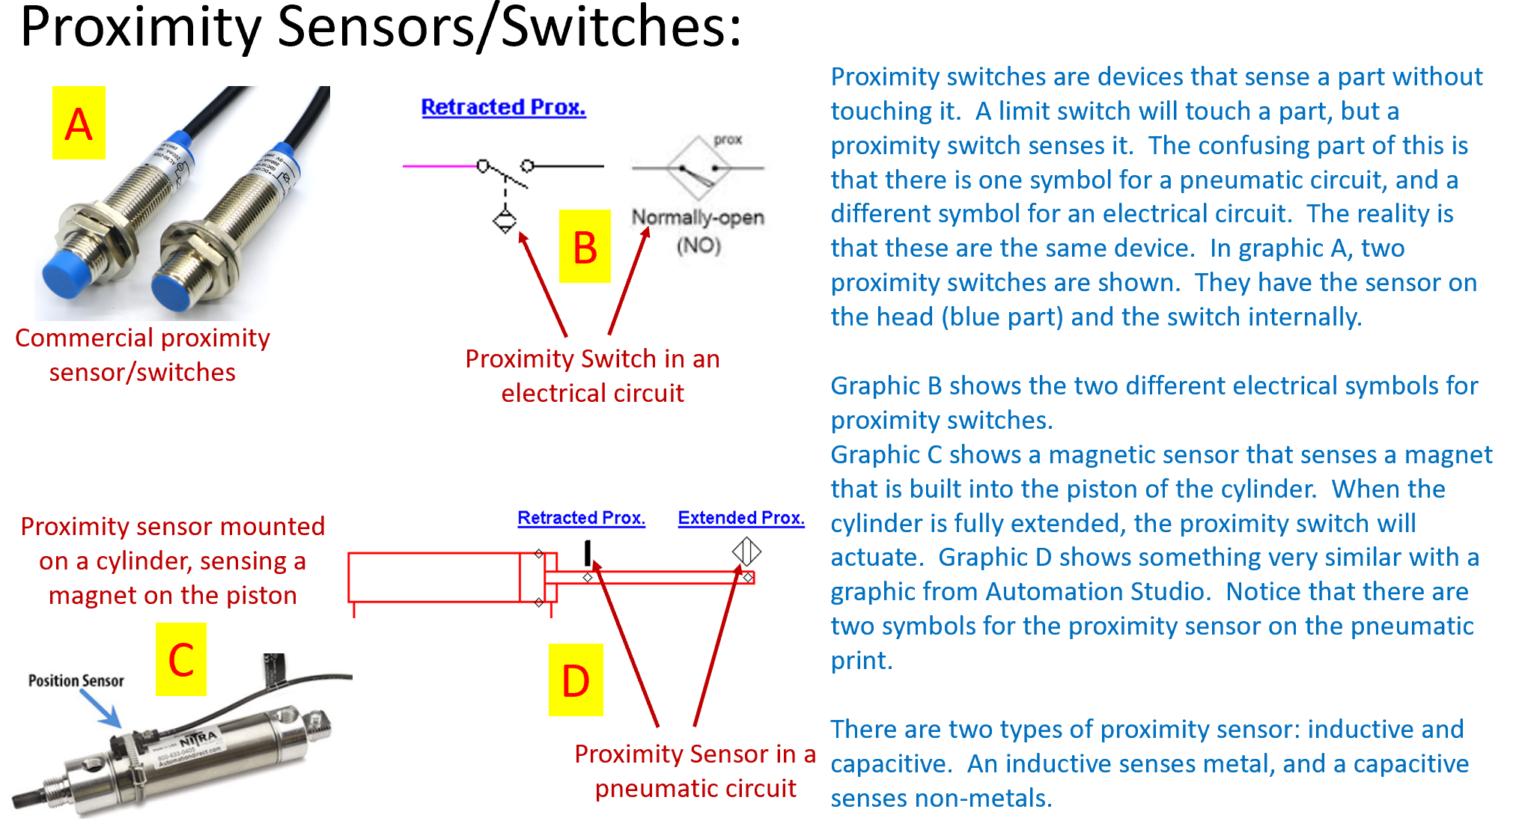
Creating a PDF Focused Learning Object:

Slide 30
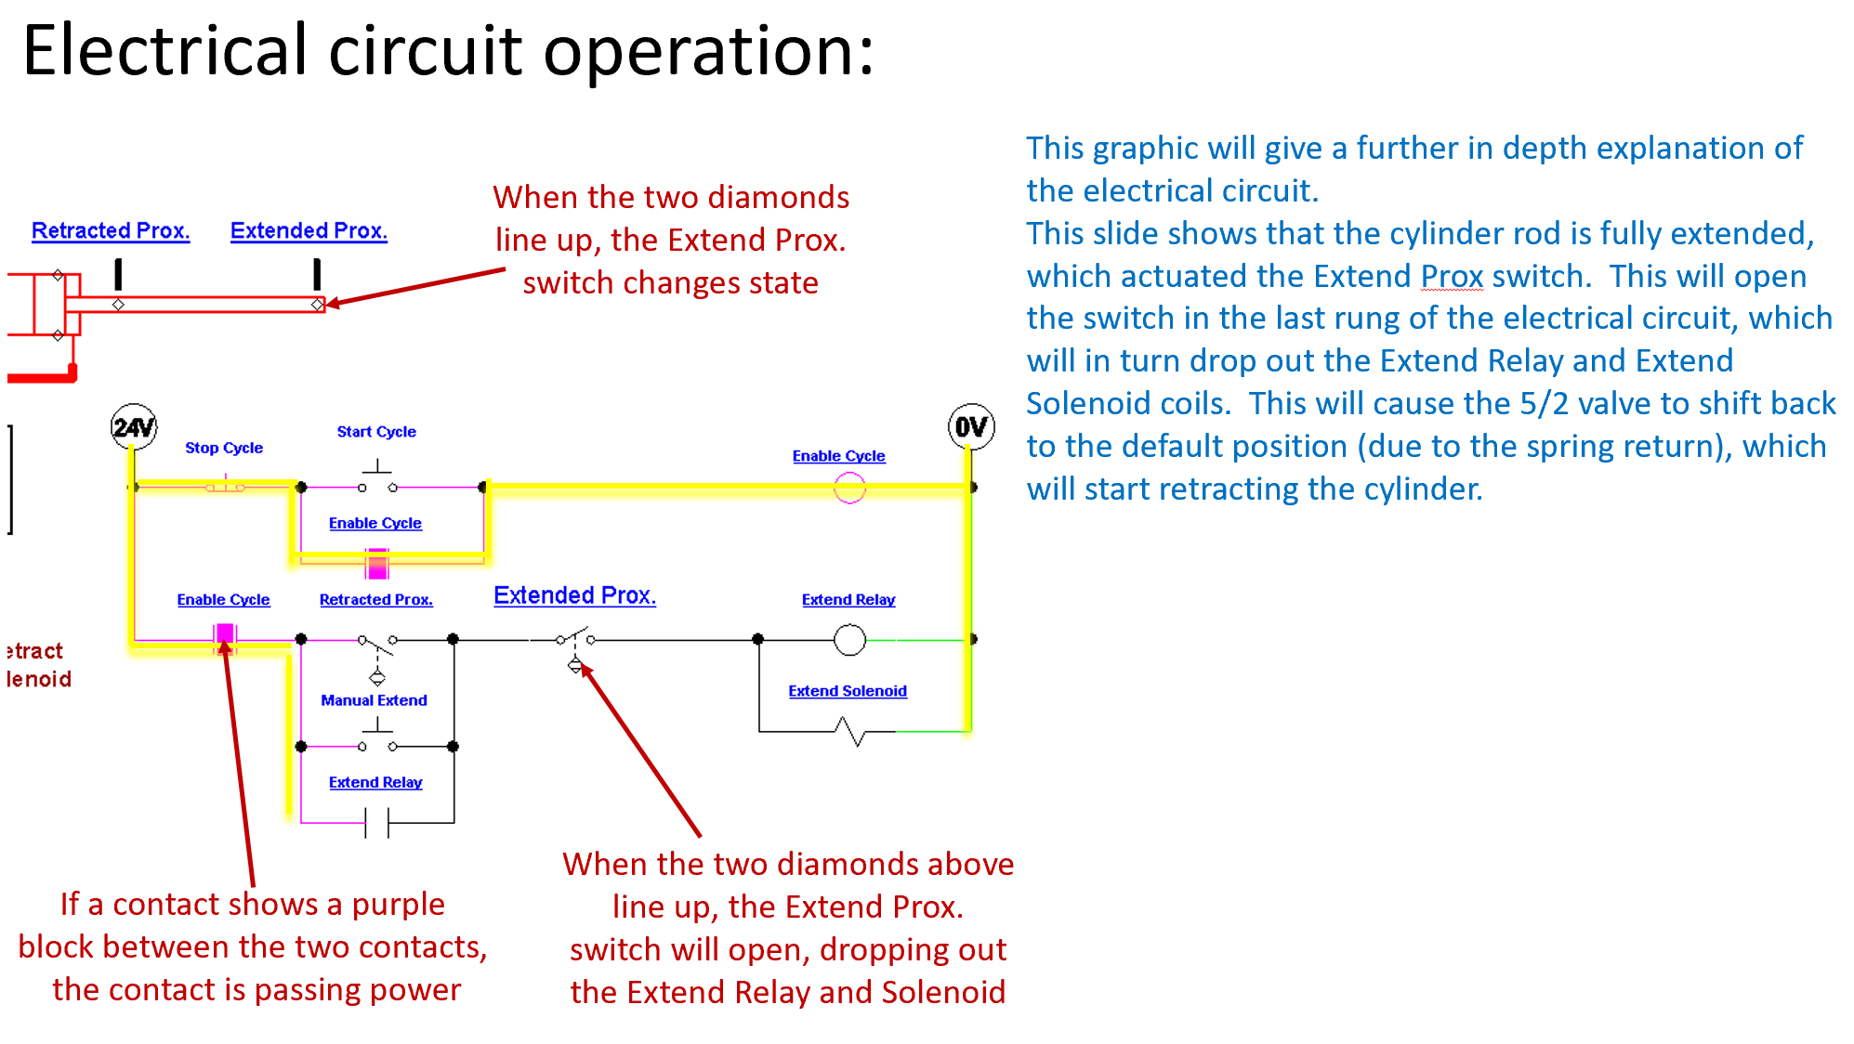
Creating a PDF Focused Learning Object:

Slide 31
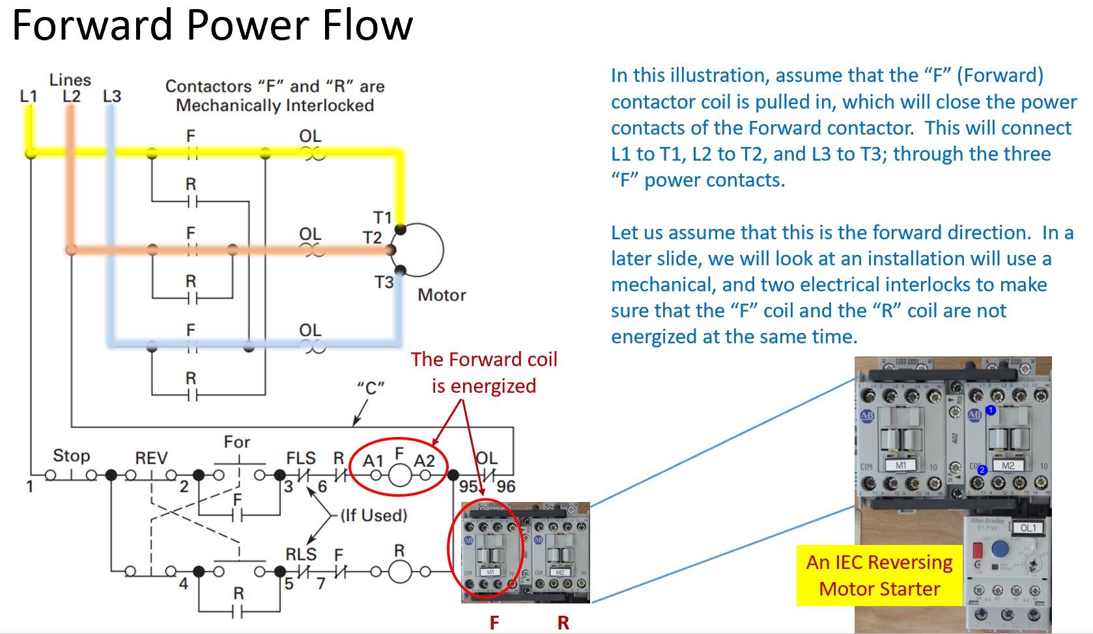
Creating a PDF Focused Learning Object:

Slide 32
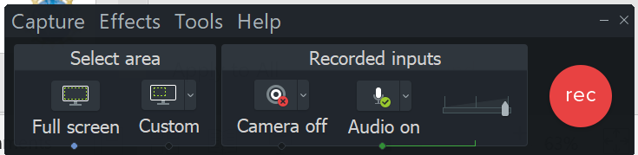
TechSmith Camtasia Recorder
This software is used to capture the screen of the computer, as well as the voice of the faculty that is creating the video. This can be used to create a video on how to use software that a student will have to learn to use. Camtasia recorder can also be used to do a voice over PowerPoint video, using a stylus on the computer screen, or on a Wacom Tablet to annotate on the screen.
F9 Starts the Recording, and can be used to pause the recording
F10 is used to stop the recording, then it automatically starts Camtasia 2019 (Producer) with the recording

Slide 33
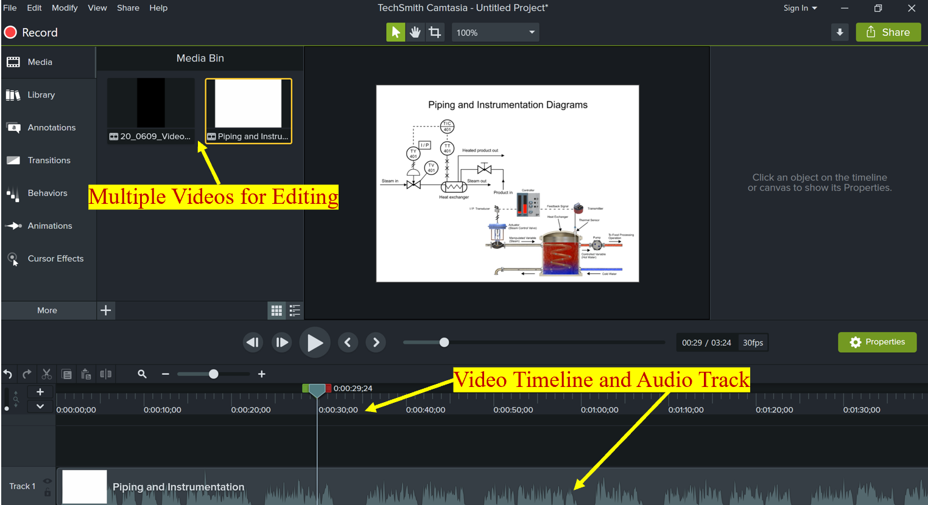
TechSmith Camtasia Producer
Camtasia (Producer) is used to add effects to an MP4 video, edit (or splice) videos, and most of all, to compress the video into a smaller file that can be uploaded to YouTube, or loaded into an LMS for students to download. A smaller file in the LMS minimizes delays for the student, and smaller files take less time for YouTube videos.

Slide 34
Three types of Video Learning Objects:
______________________
Created with a camera: (Example: How to do something in the lab)
______________________
Computer Screen CAM: (Example: How to use CAD or PLC Software)
______________________
Voice Over PowerPoint: (Example: Explaining the symbols on a schematic)
Camtasia 2019 Recorder
Camtasia 2019 Recorder
Camtasia Producer 2019
Camtasia Producer 2019
Camtasia Producer 2019
Explaining 5/2 Valves.MP4
Moving RSLinx in Virtual Backplane.MP4
Explanation of Lab 6.2 circuit.MP4
Load the MP4 into the LMS for students to download and view:
OR
Upload the MP4 to YouTube, then insert Link into the LMS for students to view:
**Camtasia Producer compresses the MP4 to a smaller file size, making uploading and downloading more efficient.

Slide 35
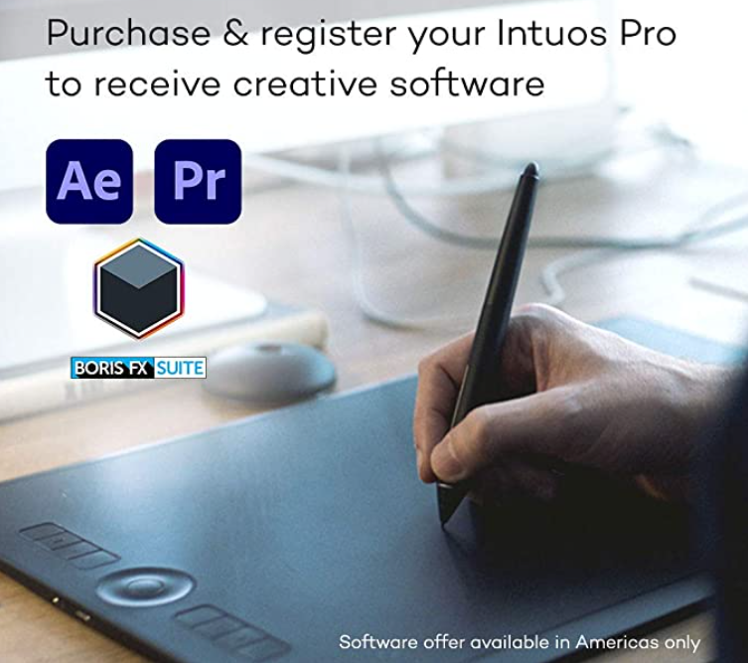
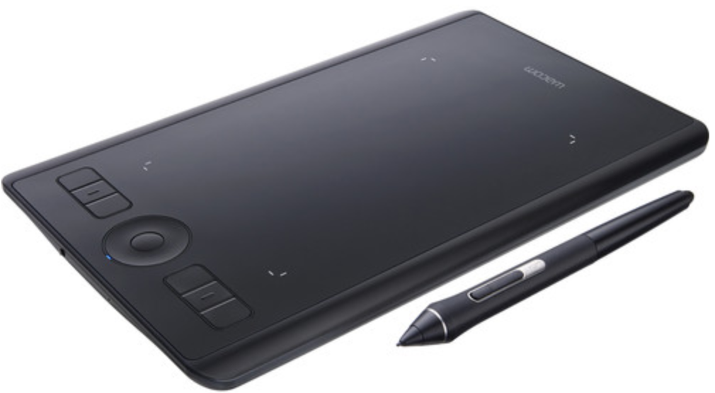
Annotating on the Screen in Camtasia
WACOM is a company that makes a digitizing tablet that connects to the computer via USB or Bluetooth. The tablet allows the user to draw on the screen of a computer that is not a touchscreen. Many touchscreen computers come with a stylus for drawing on the screen, instead of using a Wacom Tablet.

Slide 36
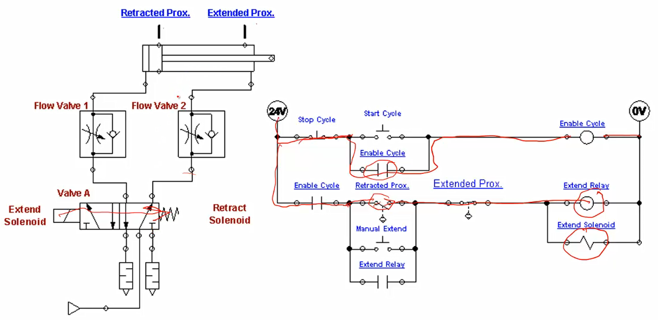
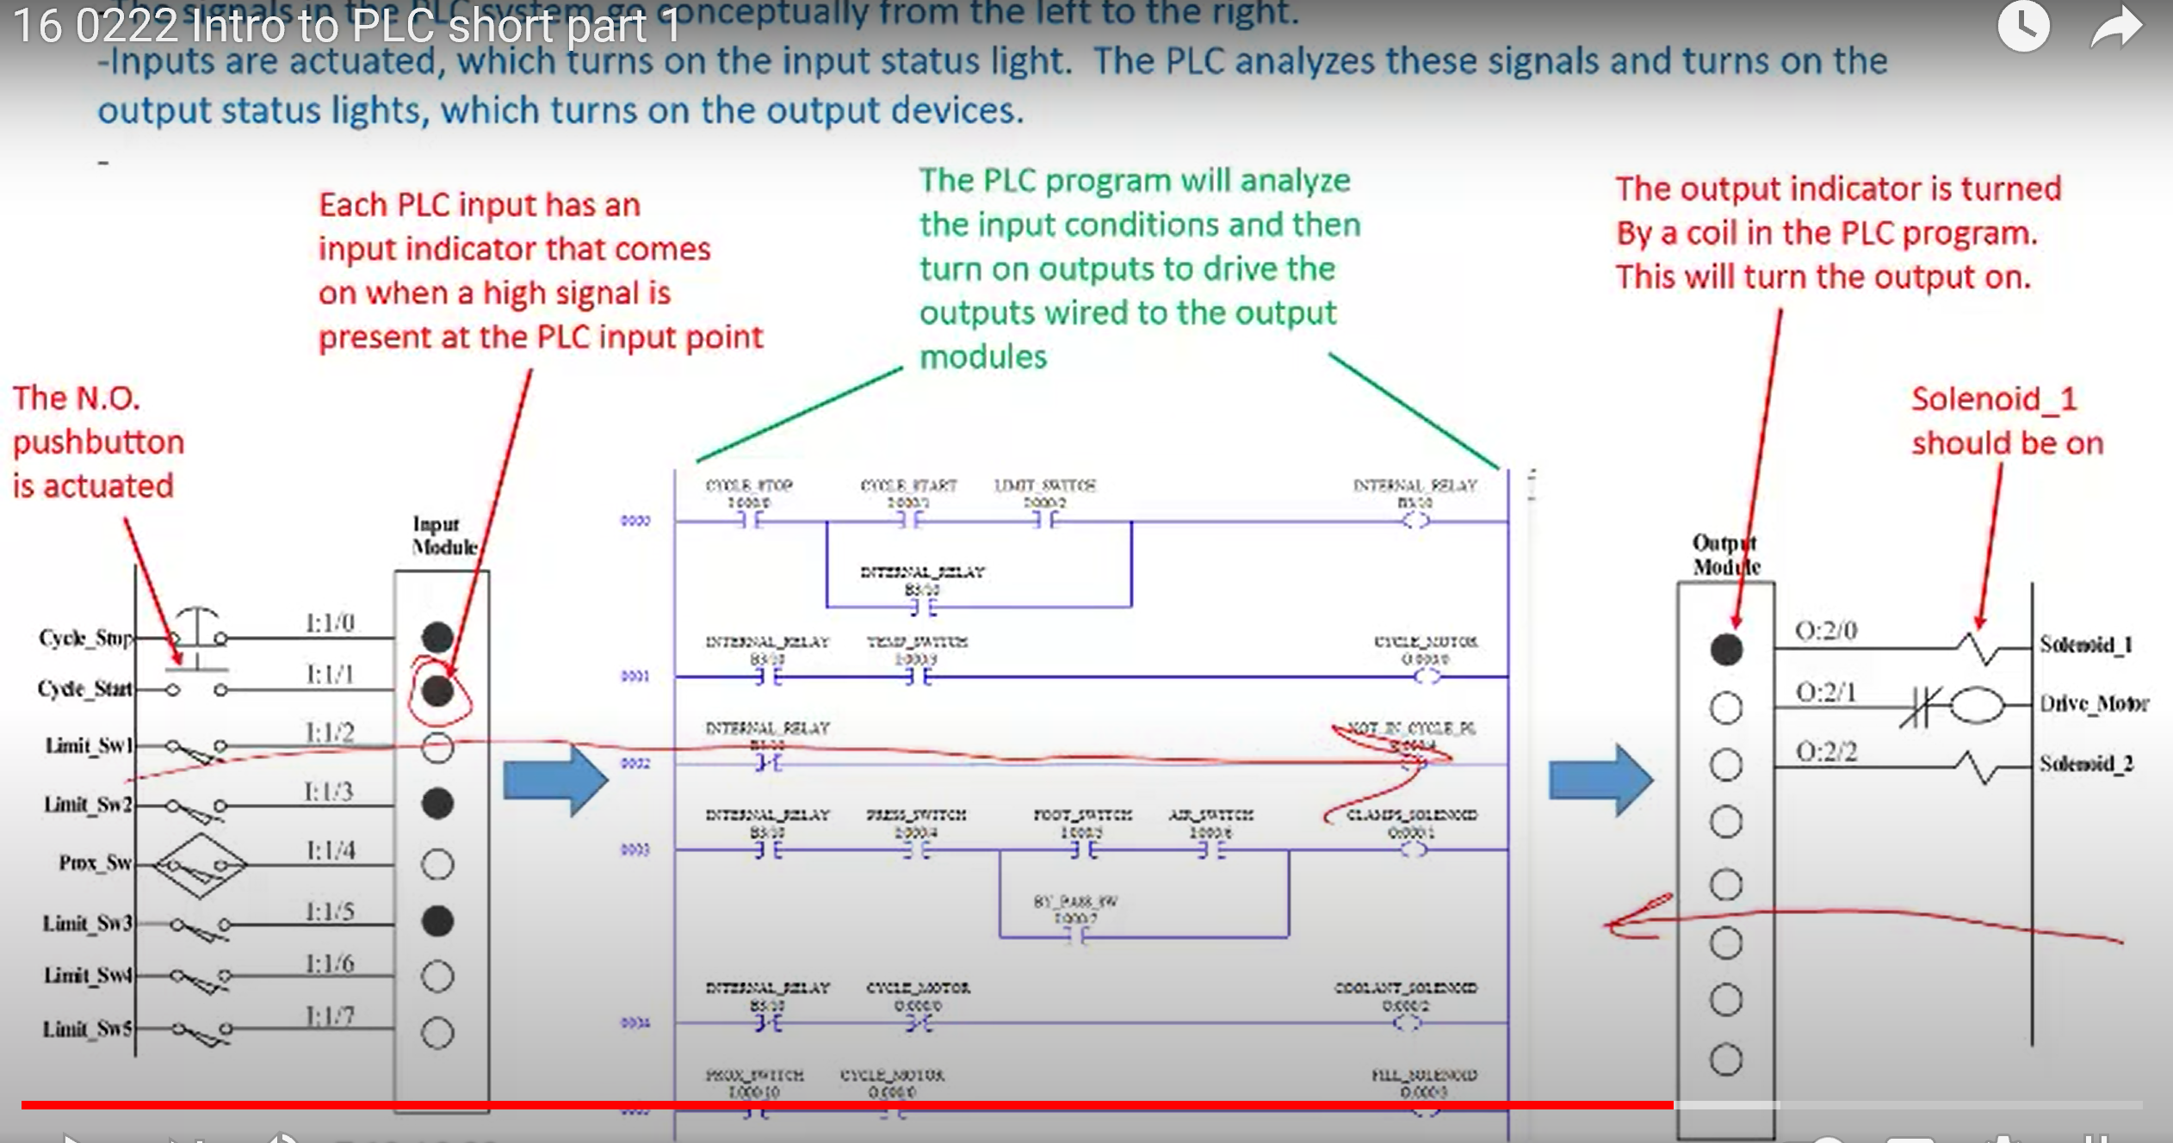
Annotating on the Screen in Camtasia Recorder
The WACOM tablet, or stylus on a touchscreen will allow the Faculty to draw on a picture, similar to drawing on a whiteboard.

Slide 37
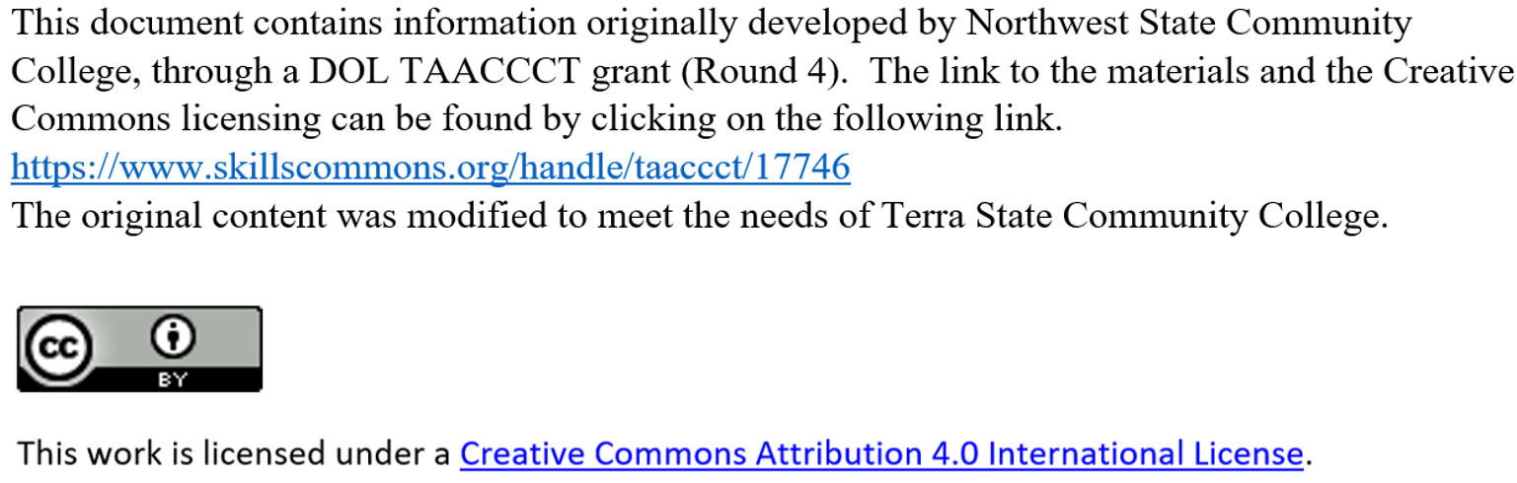
This Concludes this Instructional Document

