Slide 1
CREATE Faculty Training on CBE Learning
Created by Tom Wylie, 6/20/23

Slide 2

CREATE Faculty Training on CBE Learning
Training topics for this training session:
Review the CREATE Project Goals
Electrical Prints and Troubleshooting Course
Review the Planning Documents for the PLC1 conversion
Progress so far on the 3 courses
Learning Thread
Faculty Professional Development
Increasing effectiveness, access and efficiency of technical courses
a. What are different learning objects
b. What is Open Educational Resources
c. Practice quizzes, Assessments

Slide 3
CREATE Faculty Training on CBE Learning
Training topics continued:
8. Introduction to creating Learning Objects
a. PowerPoint
b. Converting PPT to PDF
c. Voice over PPT
d. Creating videos with a camera
e. Creating a screen CAM video to show how to use software

Slide 4
Website to get Sample Documents:
Handouts for the Workshop is available at the Project Website:
https://ate.is/Scaling_CBE

Slide 5
Questions on Project Videos:
How does Terra want to handle videos in Canvas?
a. YouTube link and/or Raw MP4 in LMS?
2. Do you want to have a YouTube channel for project videos?
3. How do you want to handle Closed Caption?
4. What support can the IT department give the project?

Slide 6
Why is Terra doing the CREATE Project?
C R E A T E
Creating Relevant, Effective and Accessible Technical Education
Students to develop more applicable Hands-On Technical Skills than in previous courses
NSF uses the phrase: Developing a More Qualified Technician
Reduce the Product Variance: Which means that all students in the PLC courses will have the same learning experience, no matter who the Instructor is. All the base level material is found in the LMS.

Slide 7
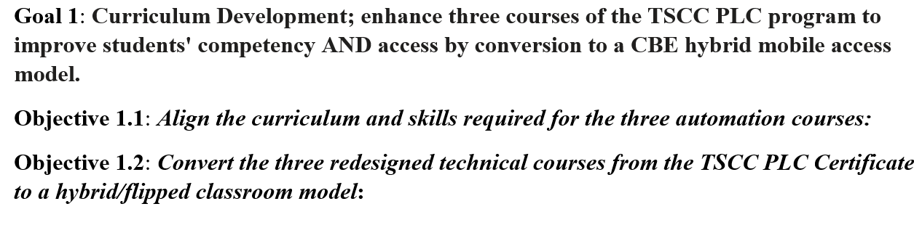

CREATE: Goal #1

Slide 8
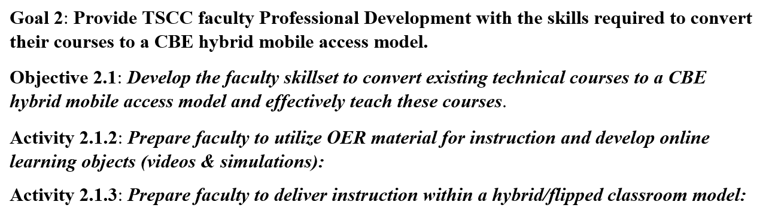
CREATE: Goal #2

Slide 9
What is Competency-Based Education (CBE)?
Competency-based Education consists of two components:
  *Mastery of Skills - The CBE course is typically parsed into modules, with knowledge assessments in each module that must be passed at an acceptable level, and Performance Assessments that must be passed at 100% (mastery).
  *Flexible Pacing - Student will progress through a course at their pace of learning (and of course mastery). Some students will finish early, and some will take a little longer.

Slide 10
Competency-based Hybrid PLC Course:
Wk. 1
Wk. 2
Wk. 3
Wk. 4
Wk. 5
Wk. 6
Wk. 7
Wk. 8
Wk. 9
Wk. 10
Wk. 11
Wk. 12
Wk. 13
Wk. 14
Wk. 15
Wk. 16
Module 1
Module 2
Module 3
Module 4
Module 5
Module 6
Module 7
Module 8
Canvas
Canvas
Canvas
Canvas
Canvas
Canvas
Canvas
Canvas
M1 KAA
M2 KAA
M3 KAA
M4 KAA
M5 KAA
M6 KAA
M7 KAA
M8 KAA
Wed
Wed
Wed
Wed
Wed
Wed
Wed
Wed
Wed
Wed
Wed
Wed
Wed
Wed
Wed
Wed
Lab
Lab
Lab
Lab
Lab
Lab
Lab
Lab
Lab
Lab
Lab
Lab
Lab
Lab
Lab
Lab
5-8pm
5-8pm
5-8pm
5-8pm
5-8pm
5-8pm
5-8pm
5-8pm
5-8pm
5-8pm
5-8pm
5-8pm
5-8pm
5-8pm
5-8pm
5-8pm
Performance
Assessment #1
Performance
Assessment #2
Performance
Assessment #3
Performance
Assessment #4
Students & Faculty make 16 trips to campus for this semester course
Pace is set by student learning and completion

Slide 11
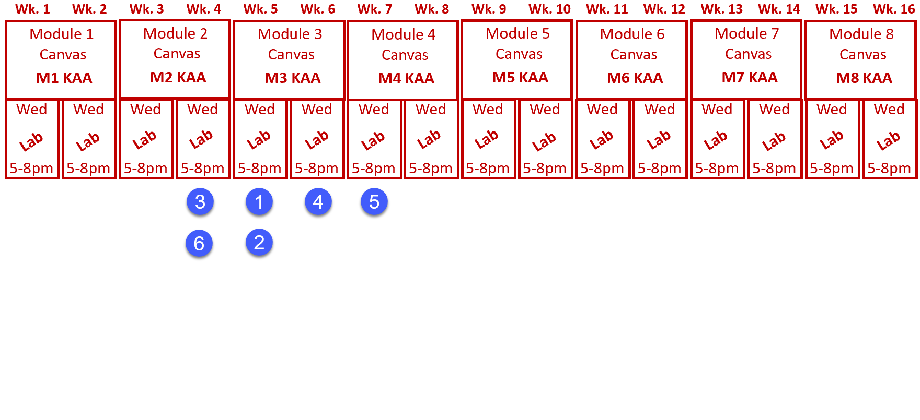
Competency-based Hybrid PLC Course:
Pace is set by student learning and completion
All students finish with the same level of learning

Slide 12
2 Parts to the CREATE Project
Faculty Prof. Dev.
Prog. Controller 1
Mike &
Scott
Develop Faculty Skillset:
*Convert technical courses to a CB/Hybrid model
*Effectively teach the CB/Hybrid courses
Prepare the Faculty to:
*Utilize OER material for teaching
*Develop online learning objects:
*Videos, simulations & PPT/PDF
*Deliver instruction in a CB/Hybrid model
Prog. Controller 2
Mike &
Scott
Elect. Troubleshoot
Course Conversion:
*Re-Align the Curriculum
*Convert the courses to a competency-based/hybrid model

Slide 13
NSCC Electrical Prints & Troubleshooting
Module 0 – Overview of Industrial Technologies Hybrid Course Model
Module 1 – Troubleshooting Electrical Circuits I (Festo AC/DC Training Units)
Module 2 – Troubleshooting Electrical Circuits II (Festo AC/DC Training Units)
Module 3 – Pneumatic Symbols and Circuits (Festo didactic pneumatics equipment)
Module 4 – PLC Operation & Troubleshooting (AB CompactLogix & ControlLogix)
Module 5 – Pneumatic Circuits Controlled by Electrical/PLC Circuits
Module 6 – Robotic Operations & Troubleshooting (Fanuc)
Module 7 – Variable Frequency Drives: Operation and Troubleshooting (PF525)
Module 8 – Safety Circuits and Devices (Safety relays, Safety Controllers & Safety PLCs)

Slide 14
Silos and Systems
*Most colleges put their technical topics into silos, teaching one technology in a technical course: CAD, Electronics, Motors Control, PLC1, PLC2, Pneumatics and Hydraulics, to name just a few.
*Most colleges do this, sometimes to meet transfer requirements. It has been this way from the beginning.
*Our students get a job as a Maintenance Technician, and they must work on systems, combining PLC, Electrical, HMI, Pneumatics, Instrumentation, etc. Most companies have moved to multi-craft Technicians, so they must work on many technologies that work together to make a system.
*A few colleges are purchasing systems for students to learn from. These are great to show students how signals flow, and to enhance troubleshooting skills.

Slide 15
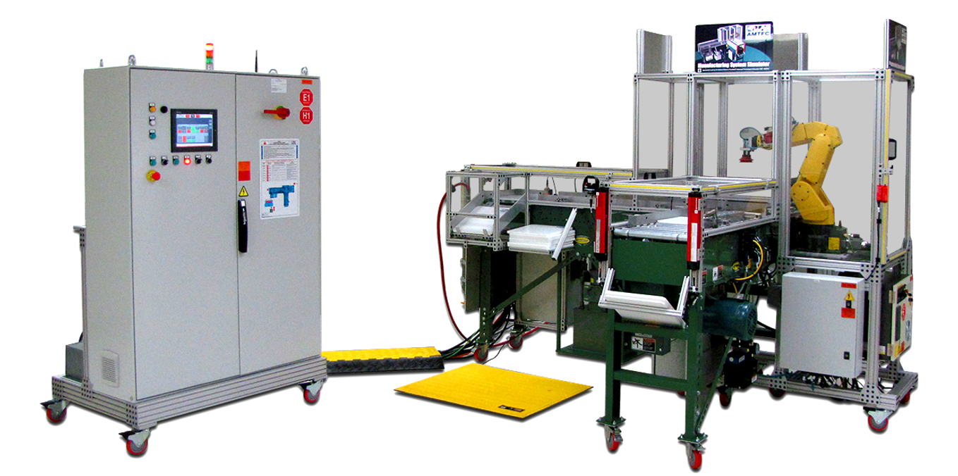
The AMTEC Training Unit at HFCC:

Slide 16
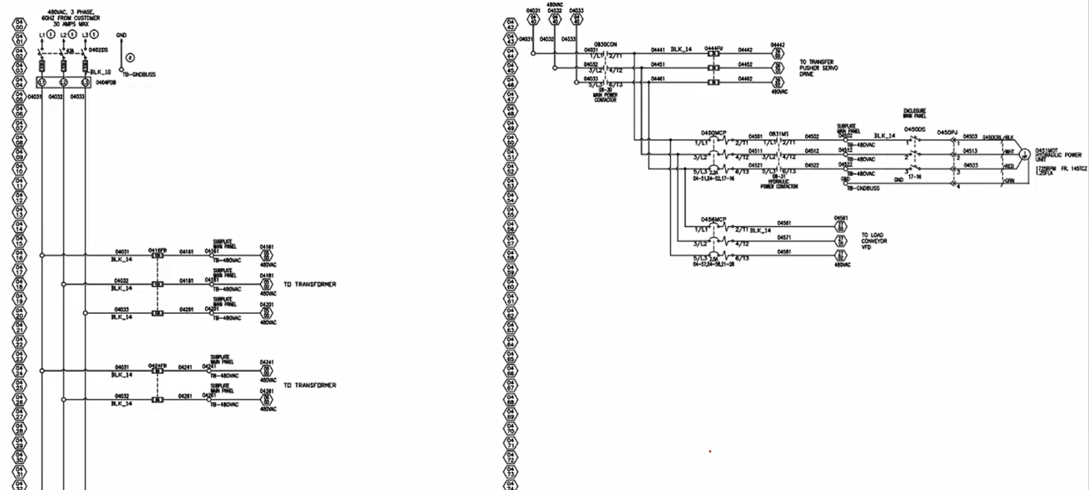
The AMTEC Training Unit Electrical Prints:

Slide 17
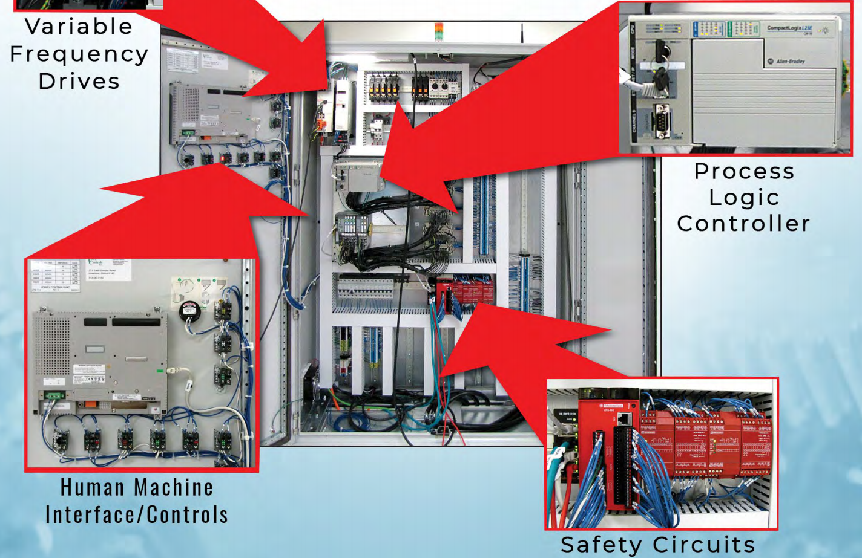

Slide 18
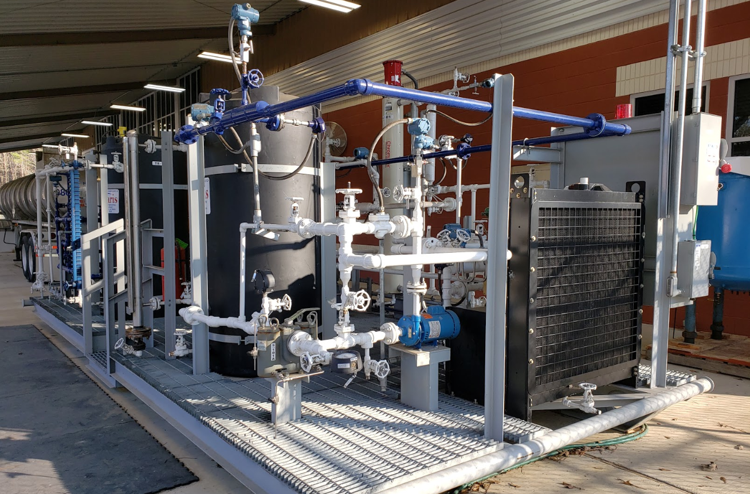
Polaris HOT Skid Training Unit South Ark CC:

Slide 19
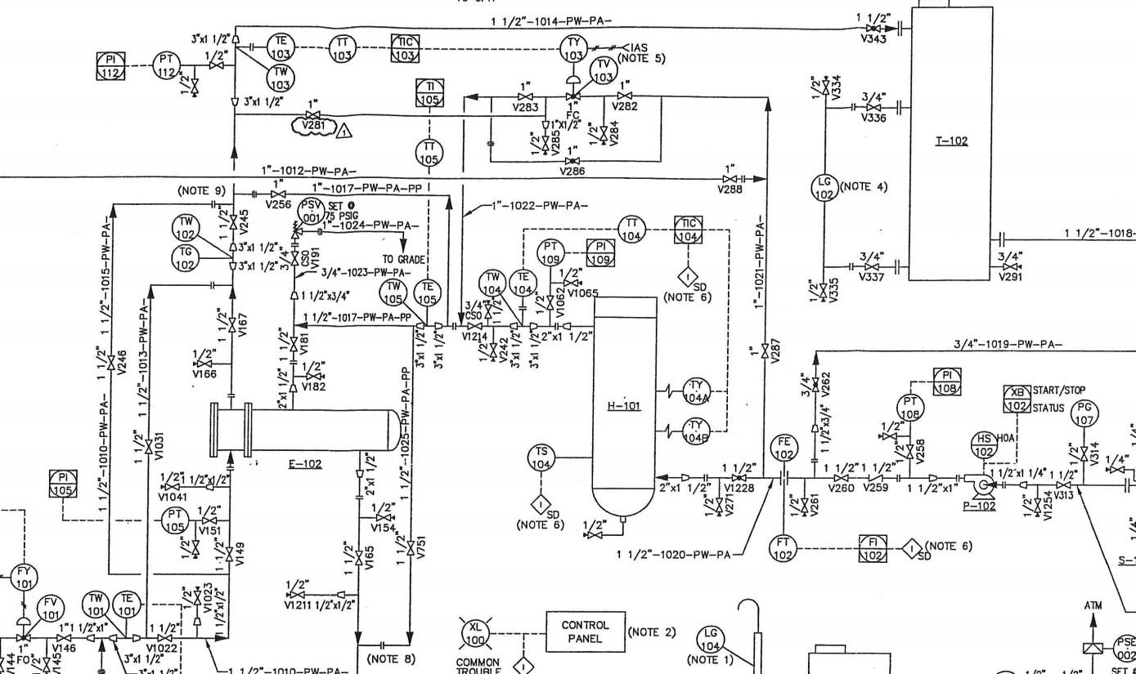
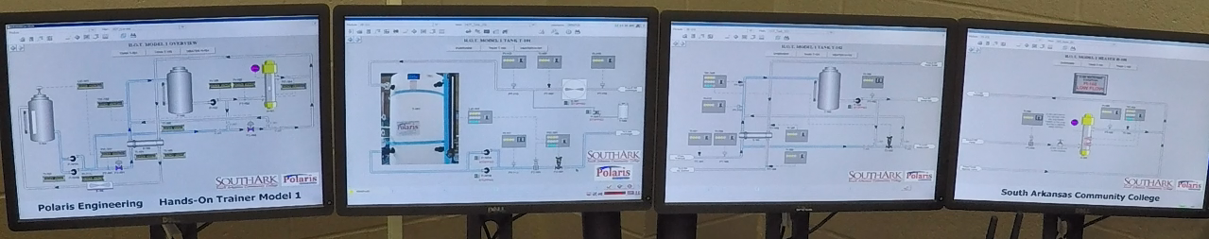
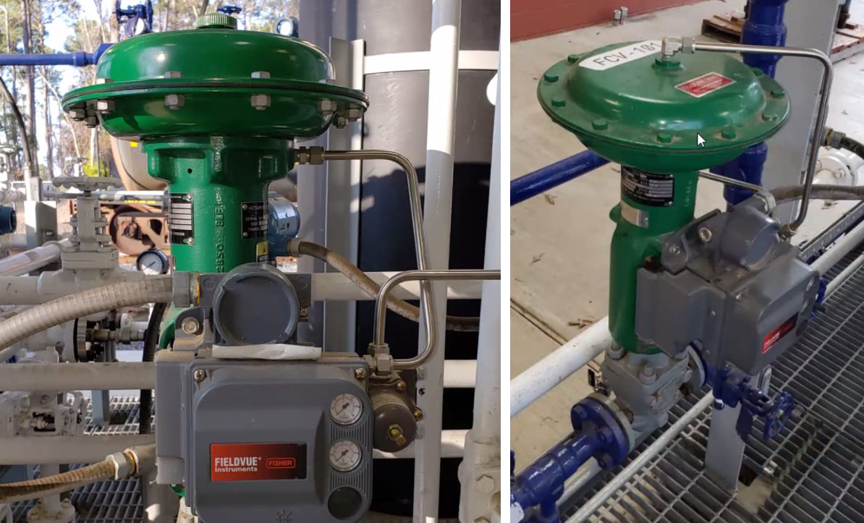

Slide 20
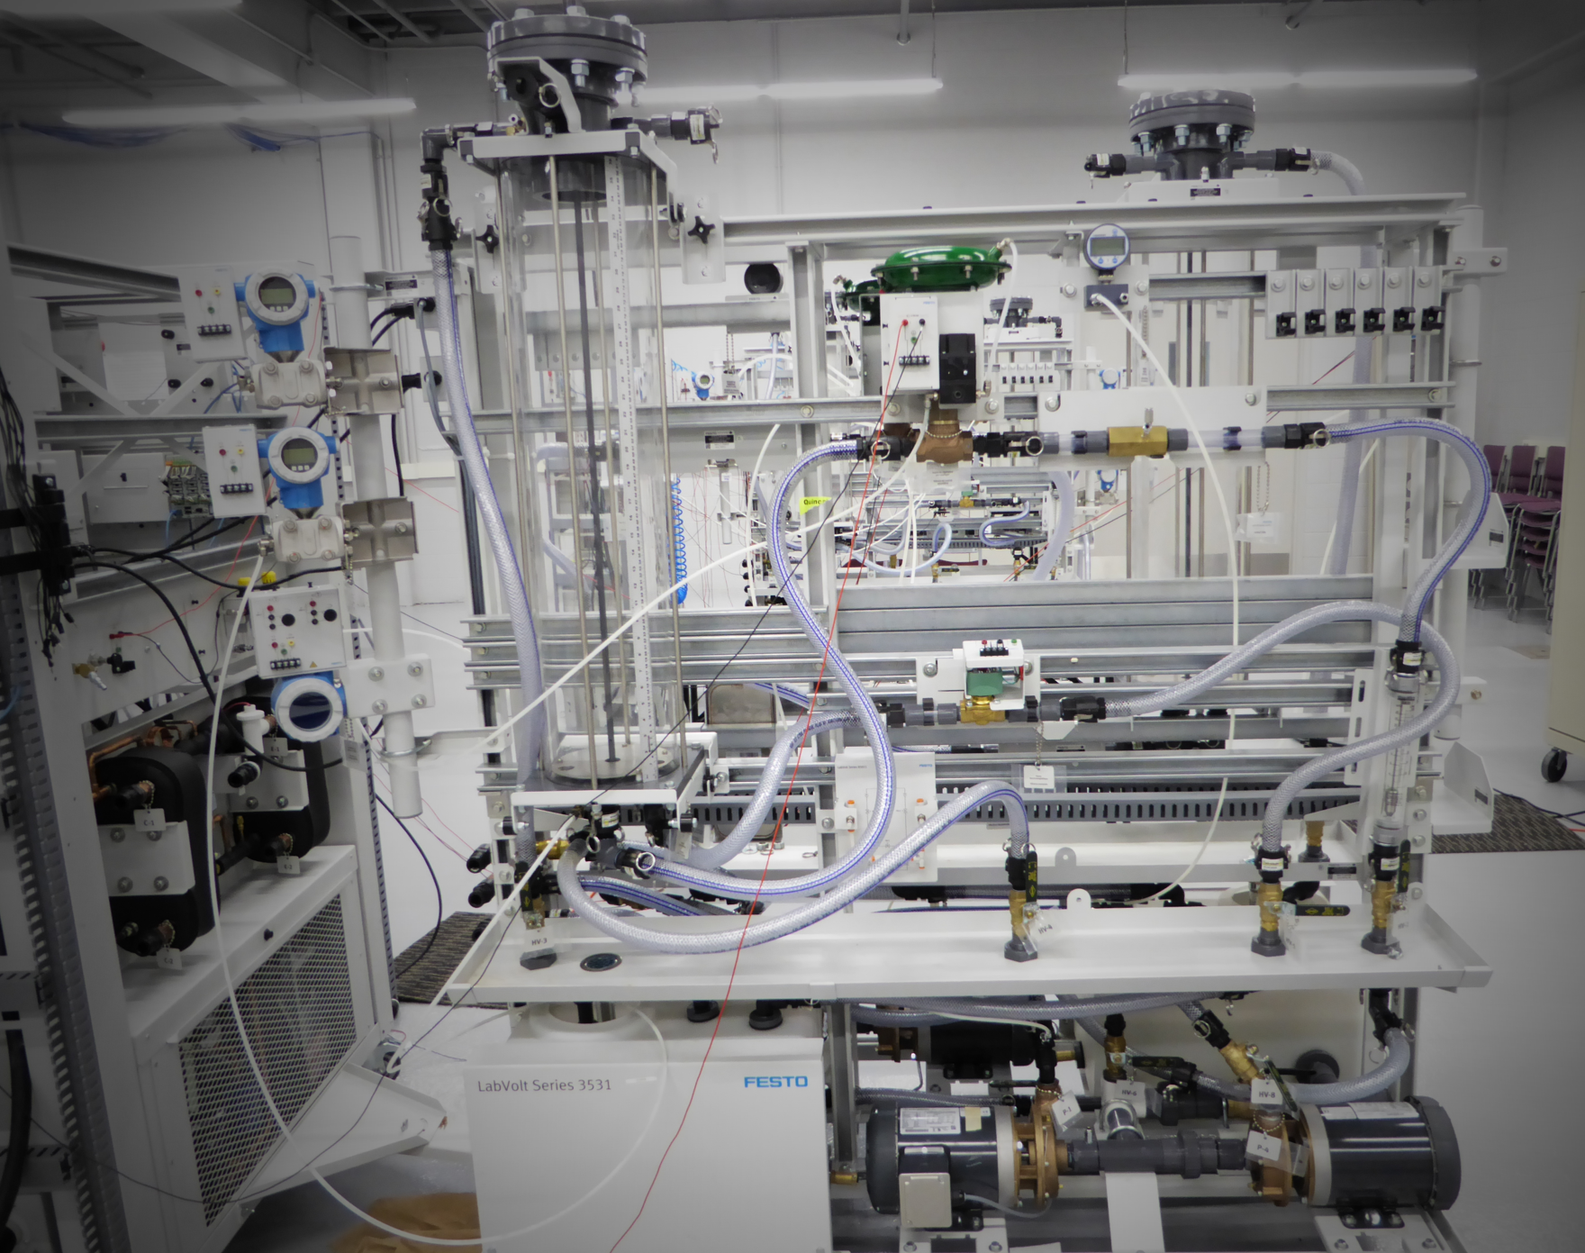

Slide 21
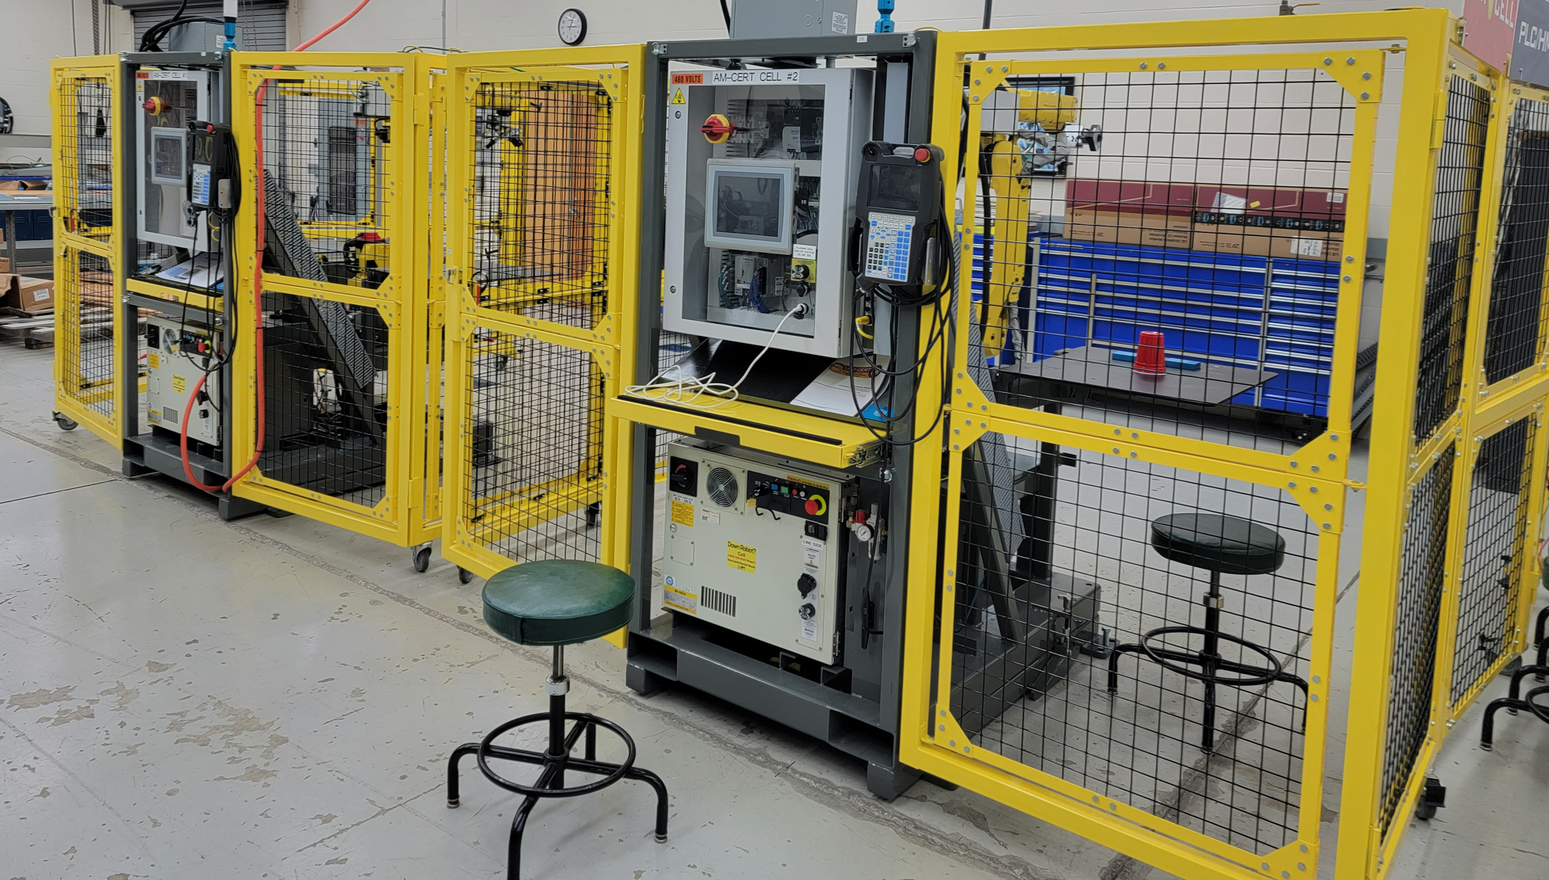

Slide 22
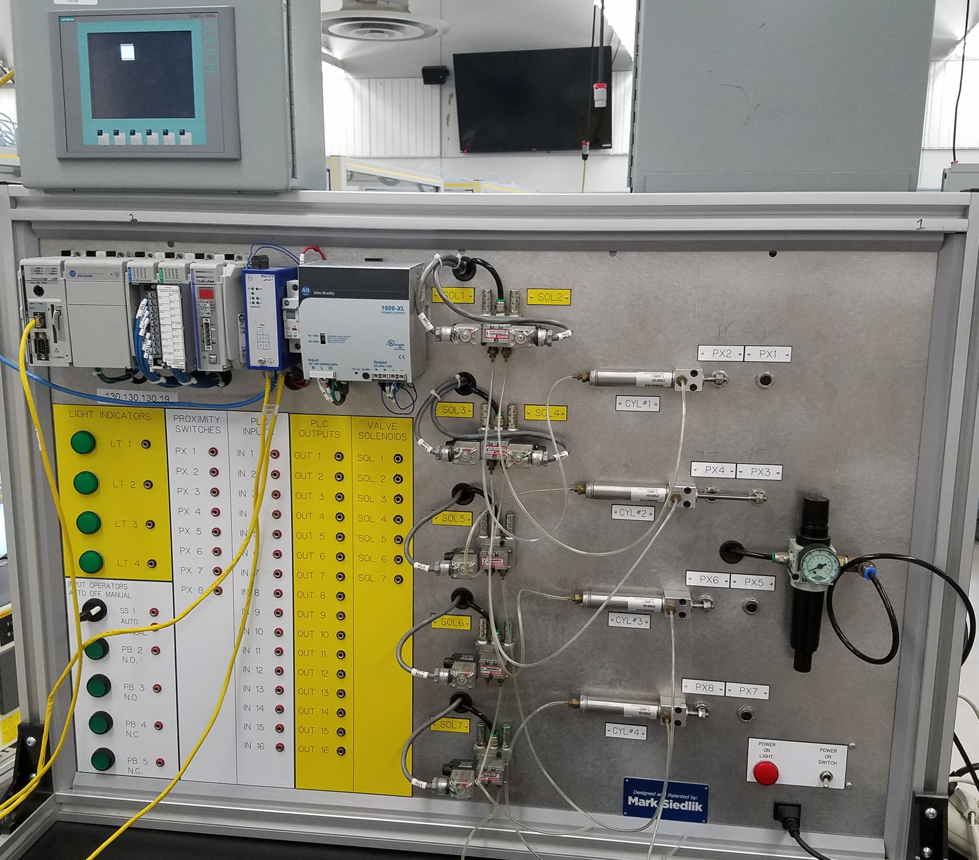

Slide 23
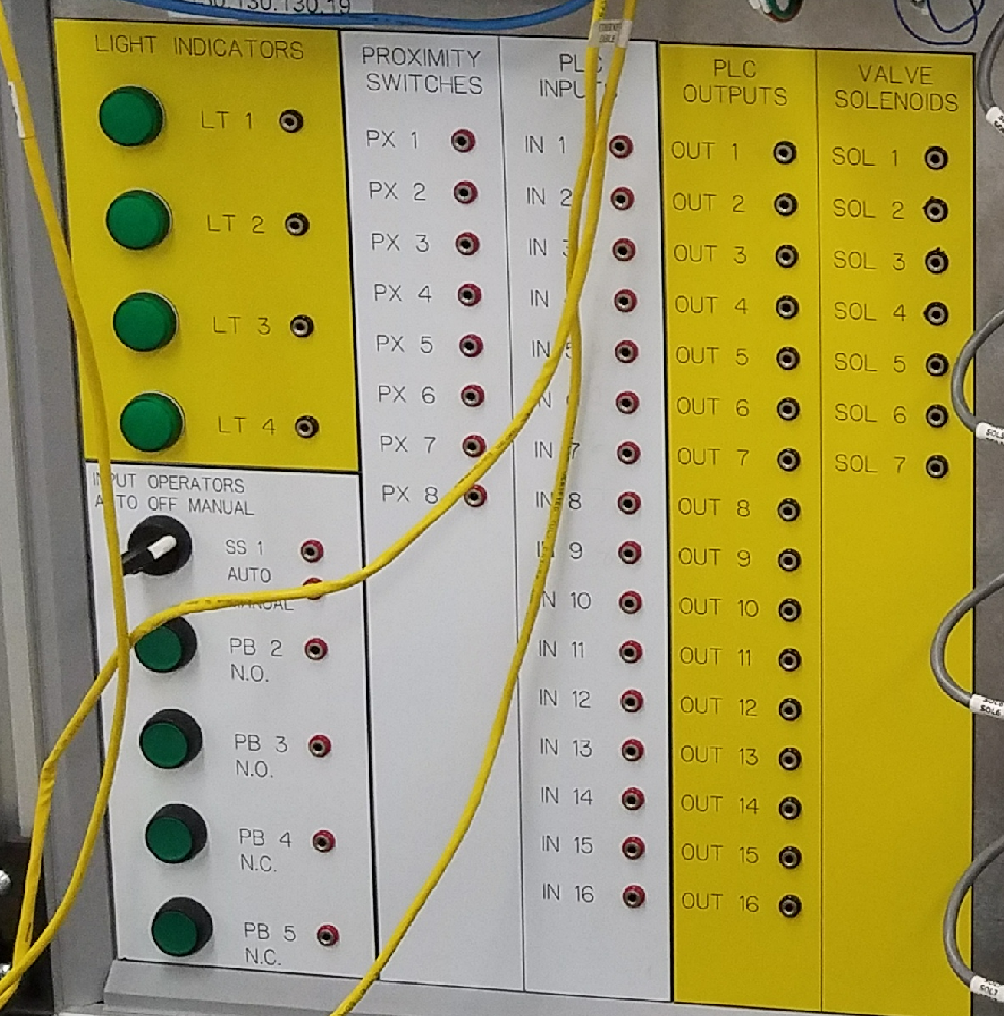

Slide 24
What are topics/technologies that Terra should have in
their troubleshooting course?
?????
?????
?????
?????
?????
?????
?????
?????
?????
?????
?????
?????

Slide 25
2 Parts to the CREATE Project
Faculty Prof. Dev.
Prog. Controller 1
Mike &
Scott
Develop Faculty Skillset:
*Convert technical courses to a CB/Hybrid model
*Effectively teach the CB/Hybrid courses
Prepare the Faculty to:
*Utilize OER material for teaching
*Develop online learning objects:
*Videos, simulations & PPT/PDF
*Deliver instruction in a CB/Hybrid model
Prog. Controller 2
Mike &
Scott
Elect. Troubleshoot
Course Conversion:
*Re-Align the Curriculum
*Convert the courses to a competency-based/hybrid model

Slide 26
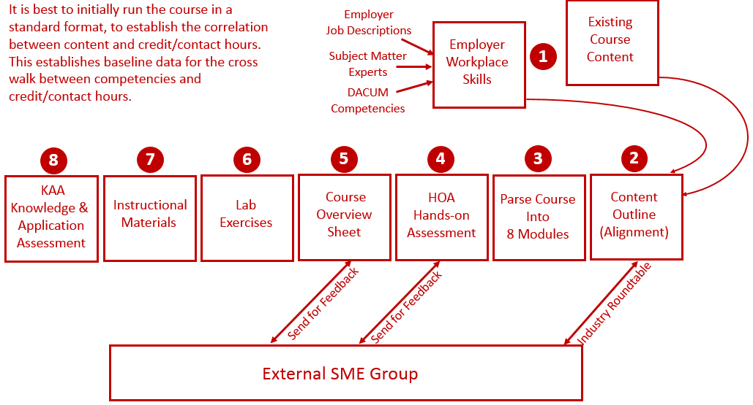
Reverse Design:

Slide 27
Thread of Learning:
Course Topics
Design
Course Outcomes
Design
Hands-On
Performance Assess.
Assessment
Lab Exercises
Preparation
PPT/PDF
Reading
Videos
Instructional Mat.
Preparation
Online Assessment
Assessment
Practice Quizzes
Preparation

Slide 28
2 Parts to the CREATE Project
Faculty Prof. Dev.
Prog. Controller 1
Mike &
Scott
Develop Faculty Skillset:
*Convert technical courses to a CB/Hybrid model
*Effectively teach the CB/Hybrid courses
Prepare the Faculty to:
*Utilize OER material for teaching
*Develop online learning objects:
*Videos, simulations & PPT/PDF
*Deliver instruction in a CB/Hybrid model
Prog. Controller 2
Mike &
Scott
Elect. Troubleshoot
Course Conversion:
*Re-Align the Curriculum
*Convert the courses to a competency-based/hybrid model

Slide 29
Why Make a Change in your Course(s)?
Course Improvements: Effectiveness, Access & Efficiency
Questions every Faculty should ask themselves:
*What takes most of my time in the Classroom?
*What takes most of my time in the Lab?
*What concepts do students have trouble grasping?
*How do I know that each student really know and can do what they say they know/can do?

Slide 30
What have other Faculty answered?
Over the past 3 years I have taught/consulted with about 140 technical faculty from around the country (2 & 4 year faculty), Apprenticeship Program faculty, and private company trainers. Here are a few of their answer:
Grading tests
Grading labs
5-6 groups of students, and repeating showing each group how to do something
Trying to write down the steps to putting parameters into a PF70 drive
4 types of relays, contactors, starters and always getting questions on hold-in contact, auxiliary contacts, coil connectors
Showing the class how to create a project with Logix Designer, then them forgetting by the time they do it and I have to repeat myself 20 times a night
Having to repeat numerous times how the product flows in a Piping & Instrument Diagram, and then the students forget after they leave class. I have to go through it again during the next class.
Hard to teach troubleshooting in a course

Slide 31
What consumes most of the Terra Faculty time?
?????
?????
?????
?????
?????
?????
?????
?????
?????
?????
?????
?????

Slide 32
What could be implemented to improve a Course?
1. Videos
2. Lab Exercises
3. Tests in Canvas (versus P/P tests)
4. Support material (vendor manuals)
5. Informational documents (PPT/PDF or Word/PDF)
6. Simulation
7. Formative assessments with feedback
8. Performance Tests (Lab Tests)

Slide 33
Building a Learning Object:
In the next week, could each of you identify a course that could be improved on, and sketch out what type of learning object you would like to create, and Mike or myself can work with you to create it. No presentations, no pressure; just a way of better learning how to apply this information into a curricular change.

Slide 34
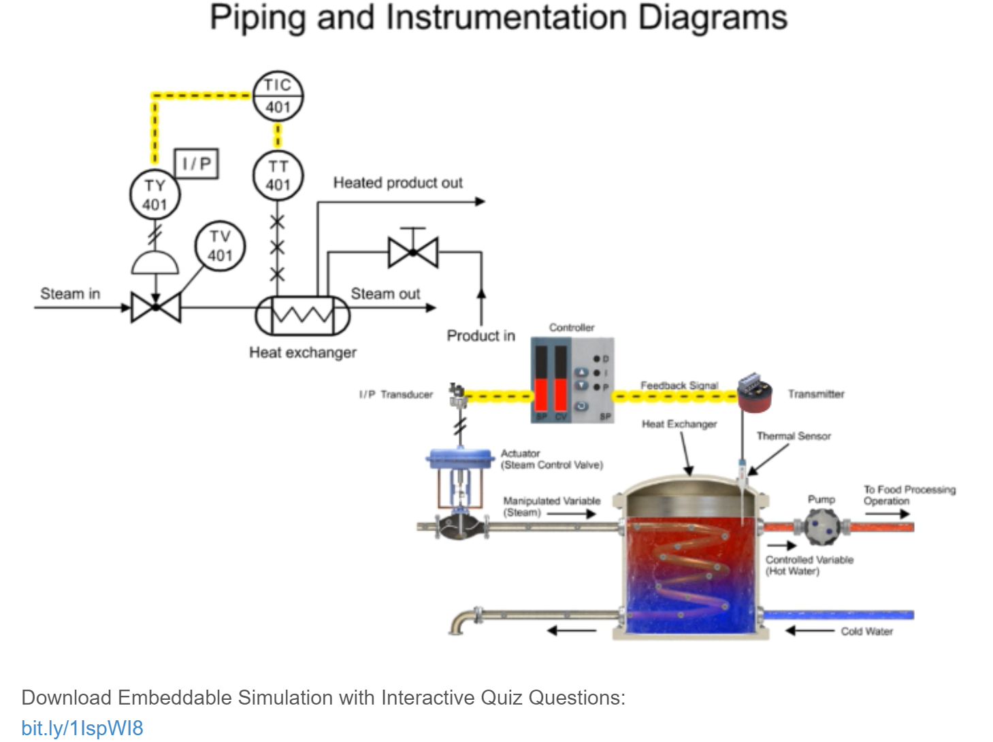
Many good Videos at EngineerTech.Org

Slide 35
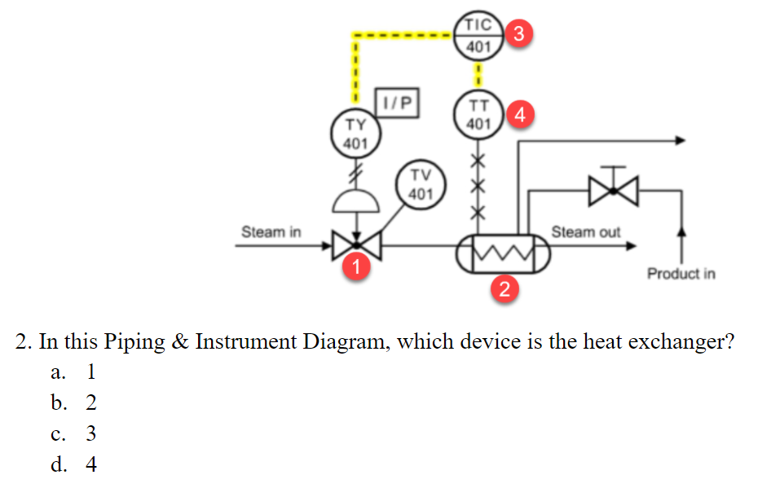
Assess the students on information within Learning Object

Slide 36
Sample Videos:
Video on YouTube: Tom Wylie, Explanation of Lab 2.3 Circuit 1 082420, 8/26/20: https://youtu.be/2JBei-qTphY
Video on YouTube: Tom Wylie, Explanation of Lab 2.3 Circuit 2 082420, 8/26/20: https://youtu.be/cmM_Ao7VlG8
Video on YouTube: Tom Wylie: Video_PF525 taking the unit apart, 3/11/17: https://youtu.be/ljyYZv3n6r8
Video on YouTube: Tom Wylie: PF525_how to disable the reverse button 031617, https://youtu.be/p1J0-9CDUyg
Video on YouTube: Tom Wylie: PF525 _Navigating and Resetting the Drive, 2/13/17: https://youtu.be/tfBWFKO5nlo
Video on YouTube: Jim Boone, Roboguide demo of PLC230 Lab 7 with audio, 11/5/20: https://youtu.be/8T2yVps2TXg

Slide 37






Software used to Create Objects
TechSmith (Techsmith.com), located in Michigan, developed and distributes Snagit and Camtasia. These products are targeted toward Faculty. They are simple to use and give immediate results. Snagit is an image or video capture software, and Camtasia is a product with multiple uses, but in the end it produces high quality videos. MP4 is the preferred video format for creating instructional videos. MS PowerPoint is the other key software that is needed to create illustrated graphics and animations. Google Slides does not have all of the features that MS PowerPoint has.
Snagit 2019
Camtasia 2019 Recorder
Microsoft PPT
Snagit 2019 Editor
Camtasia 2019

Slide 38
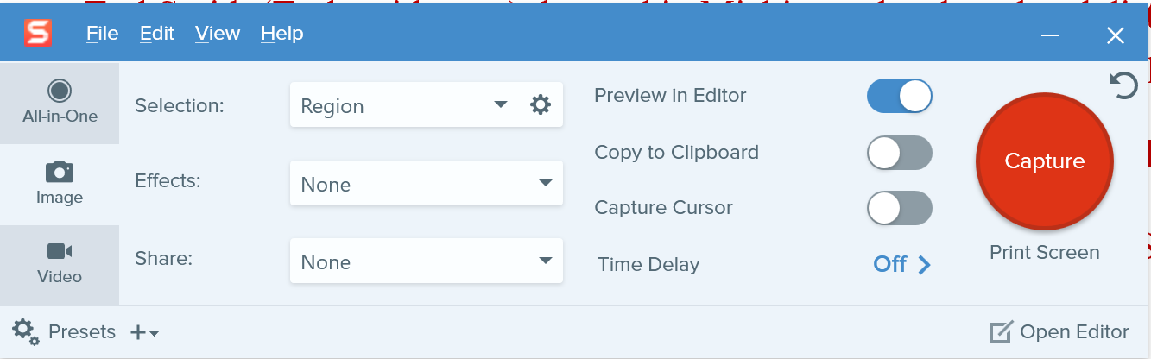
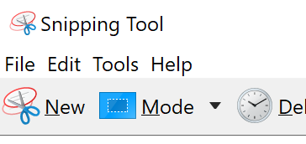
TechSmith Snagit 2019 (Capture):
This is the interface for Snagit capture. The user can designate a hot key such as the “PrtSc” key (Print Screen), which will bring up the cross hairs for capture.
Olympus E-M10 Mark III
Windows 10 Snipping Tools

Slide 39
Four Primary Applications for Snagit
1. Capture a portion of a screen and save as a .PNG file or to clipboard
2. Record video from an existing video. I sometimes use this if I am recording something from a recording on a website that I want to save, or I am capturing an important video on YouTube, just as a backup in case they pull it down and I need to create one from scratch.
3. Capture a panoramic scrolling image. This is if I have a PDF that I want to backup, but the properties will not allow a download or to print it. I will scroll down through the document and save as a PDF. Always follow good legal practices.
4. Capture a block of text from the screen and “grab text” which will use OCR (Optical Character Recognition) and copy all and paste into a document so I can edit the text. I find old labs I created 10 years ago and I do not have the original files. Instead of re-typing them in, I use Snagit to capture the text as an object and convert it to editable text.

Slide 40
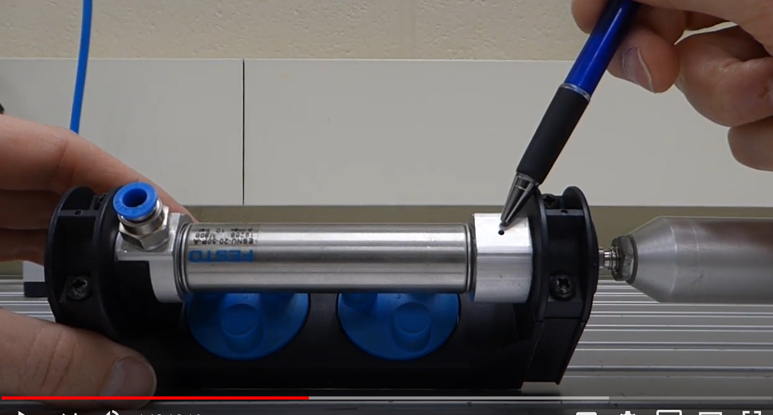
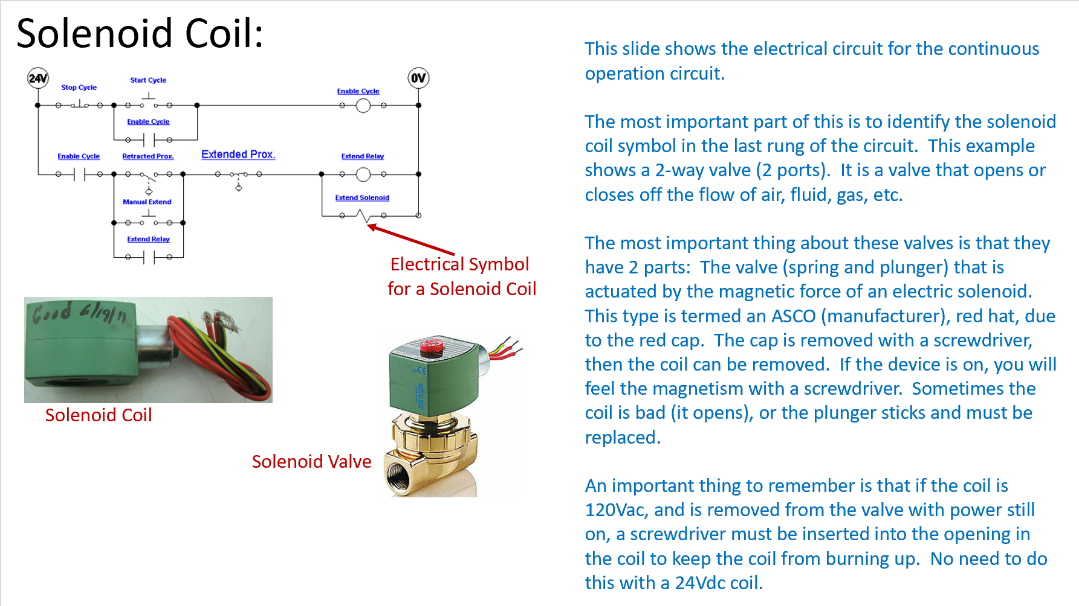
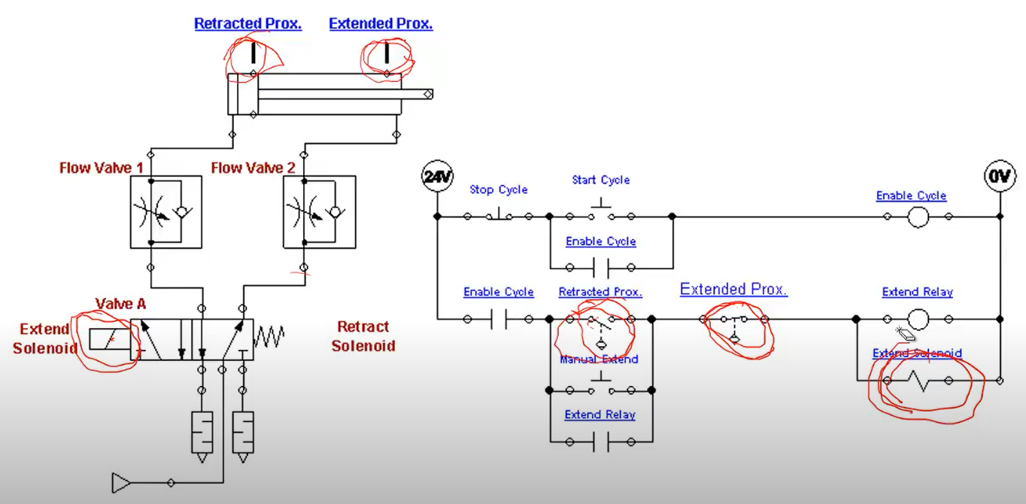
Learning Objects the User Navigates
Videos
Independent Learning Objects are posted in an LMS for student access. These objects can be viewed in any sequence. The upper left graphic shows a video that was shot with a camera, explaining a single acting pneumatic cylinder.
The middle graphic is a PPT that will be converted to a PDF, then posted in the LMS.
The bottom graphic is a voice over PPT, where the graphic was put into PPT, then annotated with a stylus on the computer touch screen.
All of these objects can be viewed on a smart phone, phablet, tablet or computer screen.
PPT/PDFs
Voice over PPT Video

Slide 41
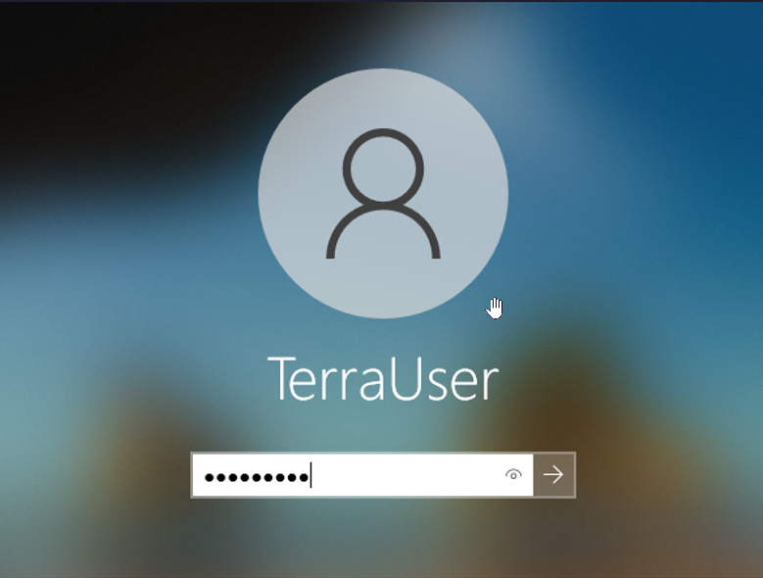
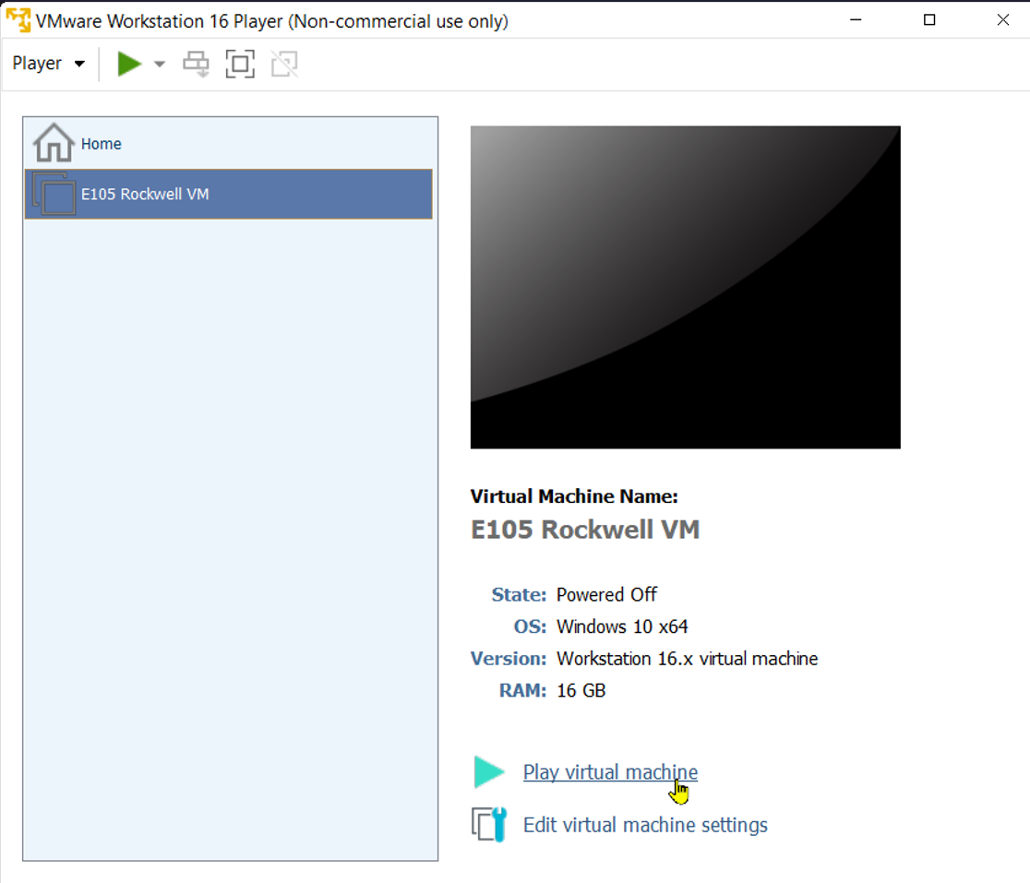
Terra Virtual Machines (VMs) cont.:
The next step is to login to the virtual machine. It will take some time before the VM fills the desktop. A Windows screen will appear. Click on the desktop and a login box will show up as shown in the upper left of this graphic. Use the same login credentials for the VM that you did for the physical computer login.
The VM Workstation 16 Player application opens.
Click on the E105 Rockwell VM
Then click the “Play virtual machine” link (shown in the lower portion of the graphic).
User: TerraUser
Pwd: T3rra@User
Click on the E105 Rockwell VM
Click on the Play virtual machine

Slide 42
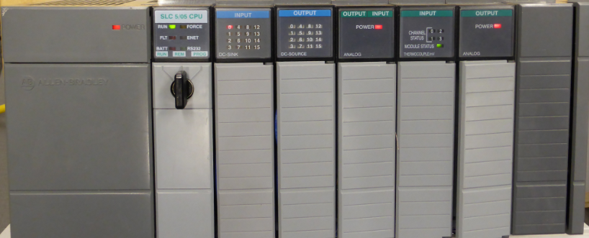
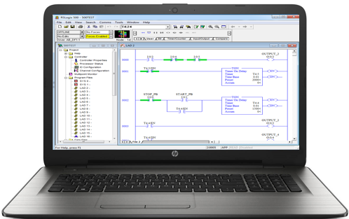
Overview of PLC Software:
Rockwell Software created a Windows-based software application (RSLinx) that will be used to communicate with Allen Bradley PLCs, as well as PLC programming software for all Allen Bradley PLCs:
RSLogix 500 – MicroLogix and SLC-500s
RSLogix 5 – PLC-5s
Studio 5000 – CompactLogix & ControlLogix
In an industrial environment these software packages are typically installed on a laptop, so the computer can be taken out to machine to connect to a PLC for troubleshooting a system.
All of these software packages will be installed on the computers in the Terra PLC lab. It is important to understand how to use the software to communicate, program and troubleshoot a PLC system. These software packages are expensive for companies to purchase ($1,000-$2,000 per package) and are copy protected, so students will need to come to campus to use this software. The Terra licensing agreement does not allow students to install this software on their computers at home.
RSLogix 500 PLC Programming Software is installed on the computer
Ethernet Connectivity between the SLC-5/05 processor and the computer
A Windows based computer with the Rockwell Software loaded becomes a PLC Programming Panel

Slide 43
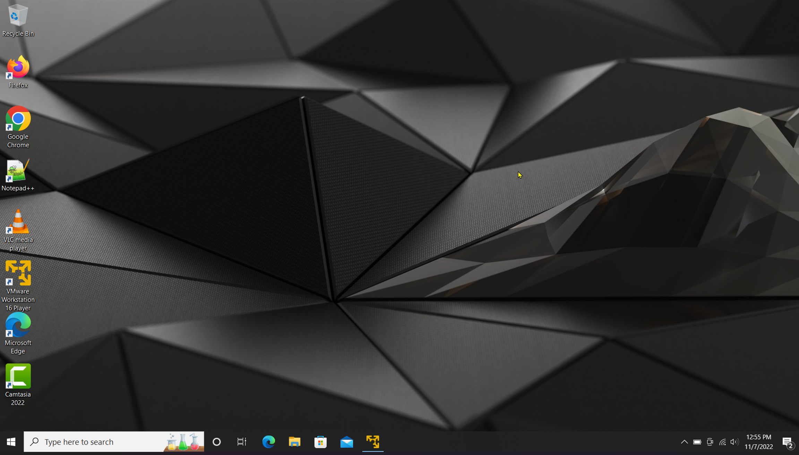
Terra Virtual Machines (VMs):
When working in the Terra PLC lab, it important to understand that the college has the Rockwell Software PLC applications loaded on a virtual machine (virtual computer) that is actually inside of the physical (host) computer that is on desks in the PLC lab. This practice allows the Terra IT department to load the Rockwell Software on a VM, then copy it to the computers in the PLC lab, versus loading all the applications on each machine. The operation is the same using the applications on a VM, as it is using the applications that were installed on a computer.
The important thing to remember is that there are two logins, which are both the same.
The student must first log into the physical computer with the username and password as shown in the upper right of this graphics (also on the white board in the PLC lab).
After logging into the physical computer, the student will then need to double click on the virtual machine icon (lower graphic), which is named: VMWare Workstation 16 Player.
User: TerraUser
Pwd: T3rra@User
Desktop of Host (Physical) Computer
Terra Virtual Machine (VM) icon

Slide 44
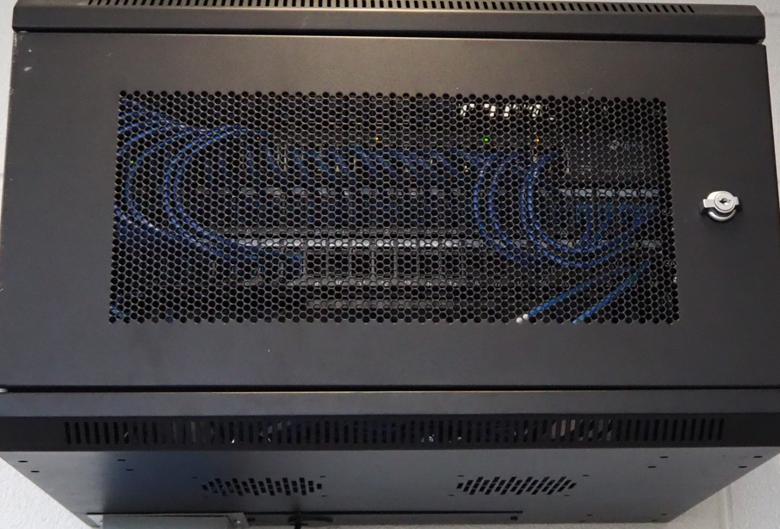
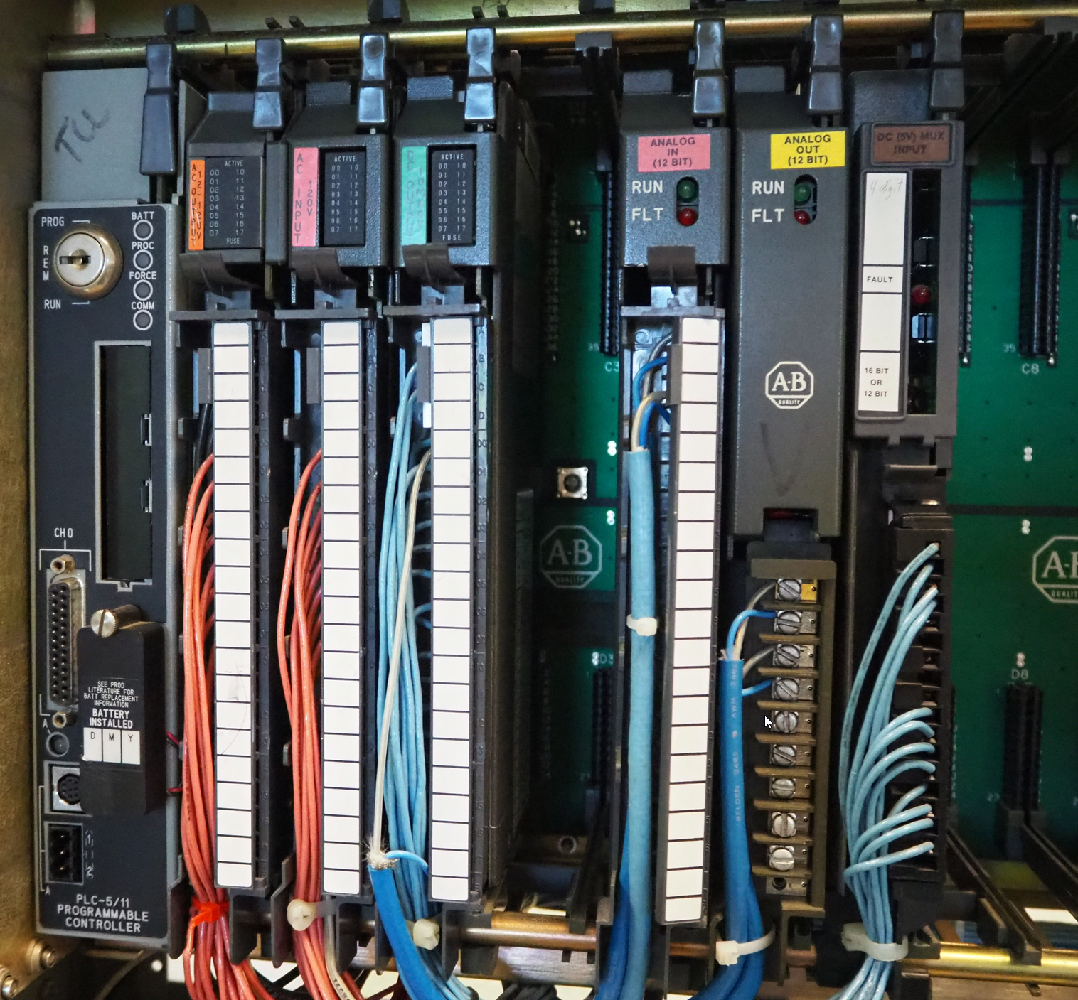
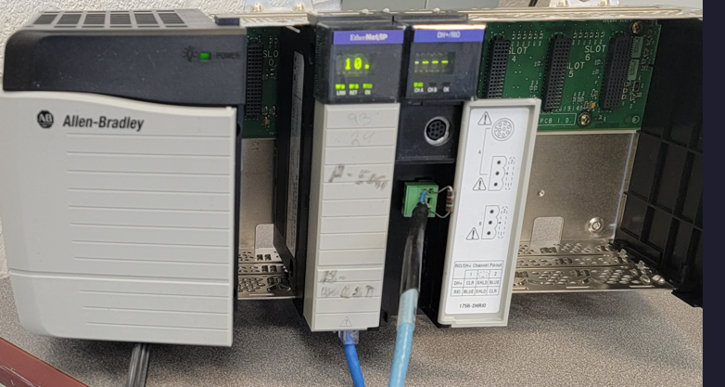
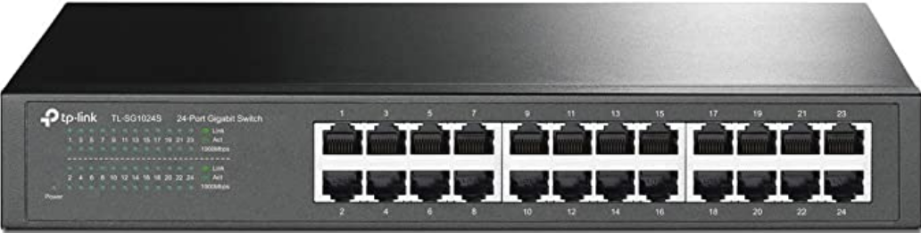
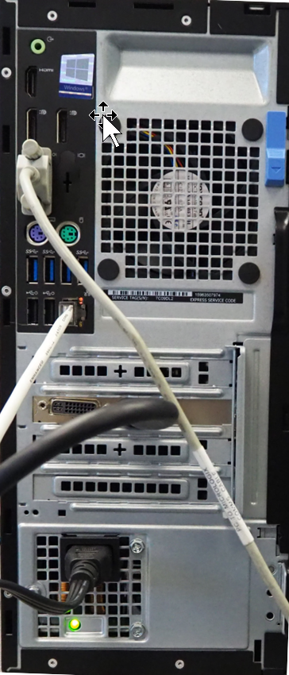
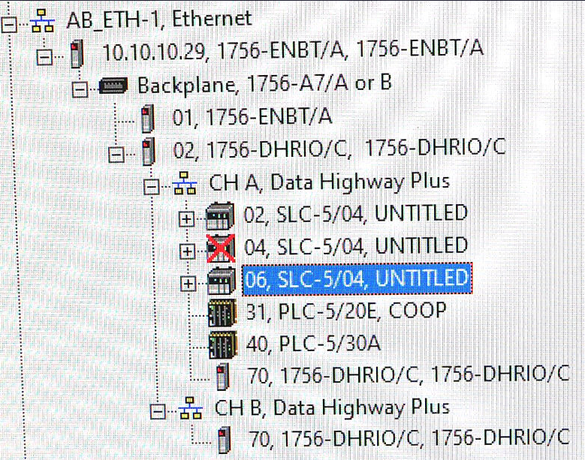
ControlLogix Gateway:
Ethernet Module
10.10.10.29
DH+/RIO Module
Ch A, DH+ Sta. 70
Ethernet Switch
DH+
Ethernet
DH+ Sta. 40
Ethernet
10.10.10.5
RSLinx
Computer in PLC Lab

Slide 45
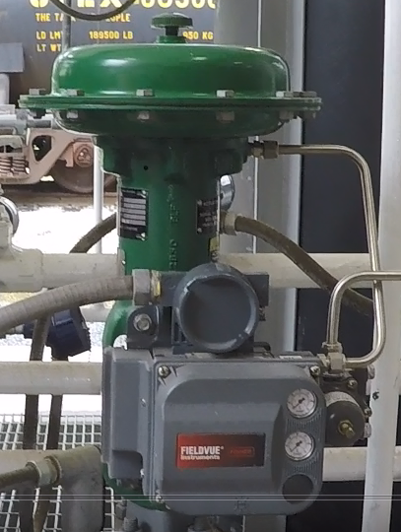
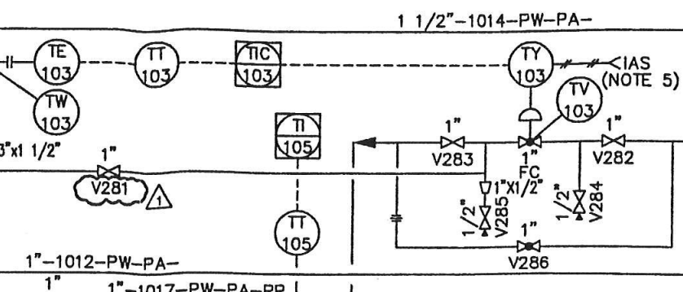
Interpreting a P&ID to the actual hardware:
Digital Valve Controller (I/P)
TCV-103 Control Valve

Slide 46
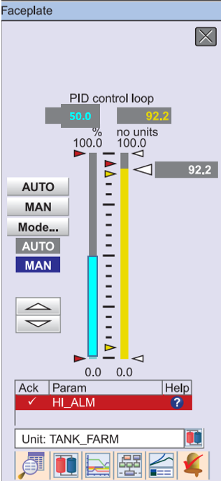
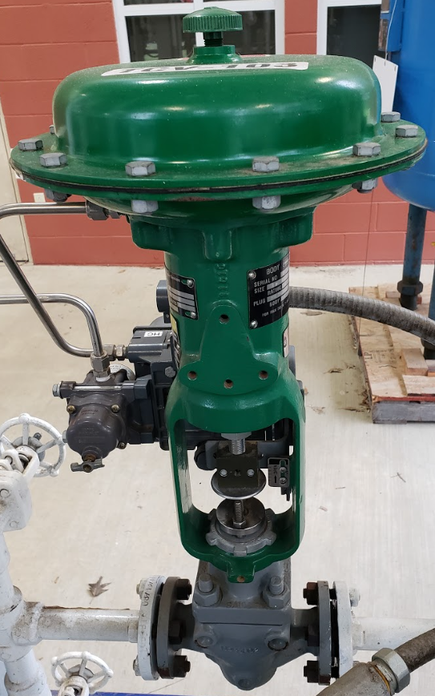
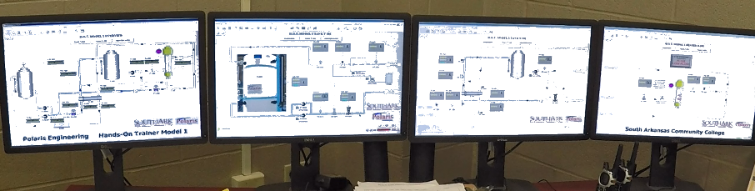
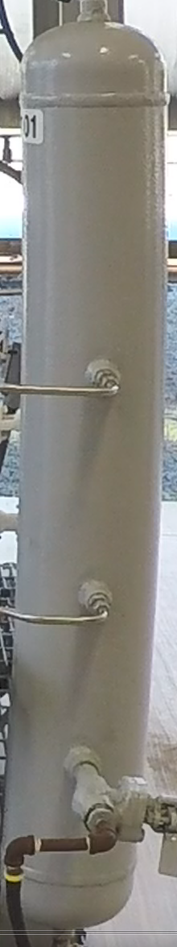
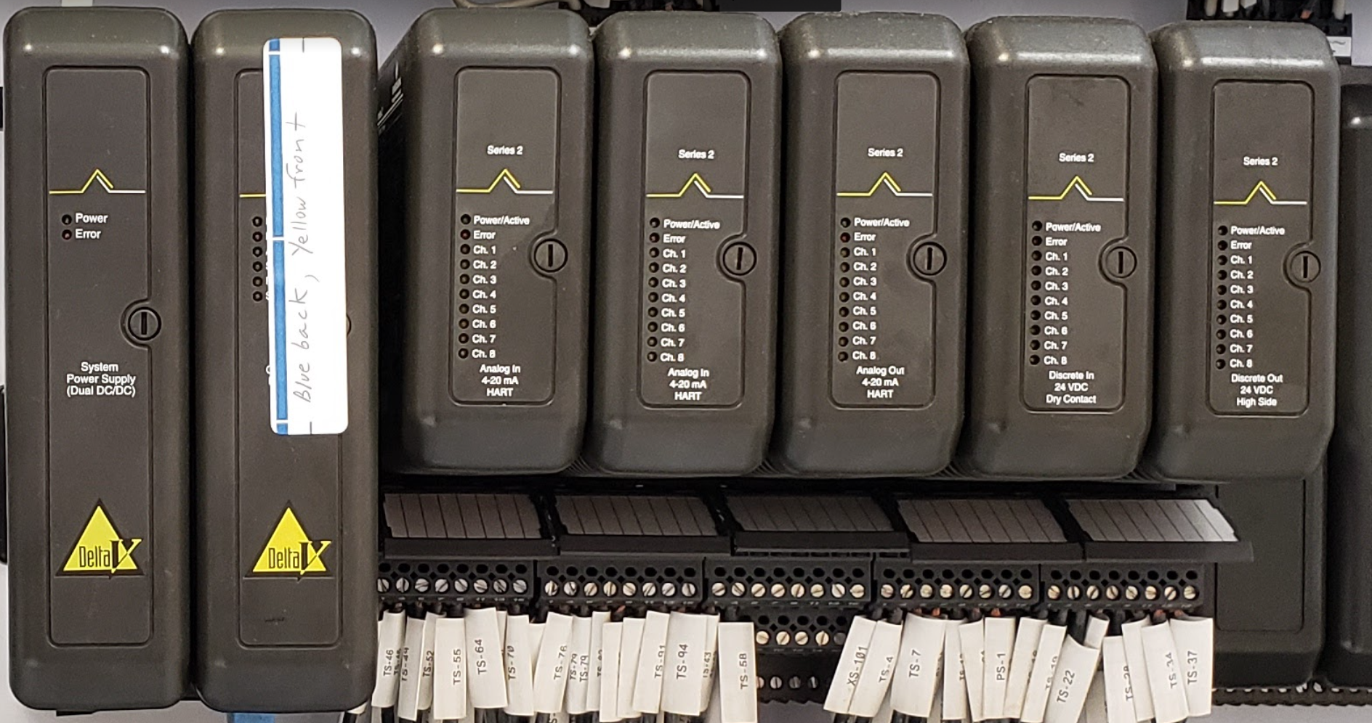
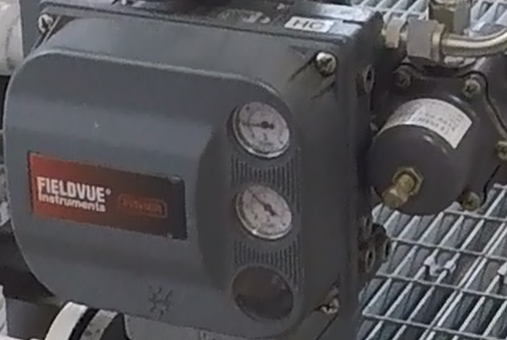
Signal Flow in a Distributed Control System:
Controller
Faceplate
50%
1/2 Open
9 psi
Control Console
50%
12 mA
70 psi
Delta V DCS System
DVC6200 (I/P)
Charge Tank

Slide 47
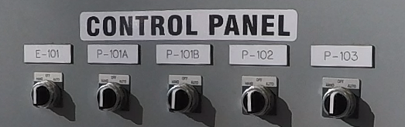
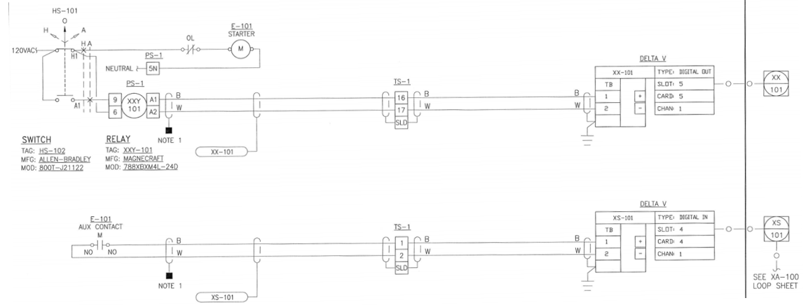
Prints to Hardware:
Card Slot: 1 2 3 4 5

Slide 48
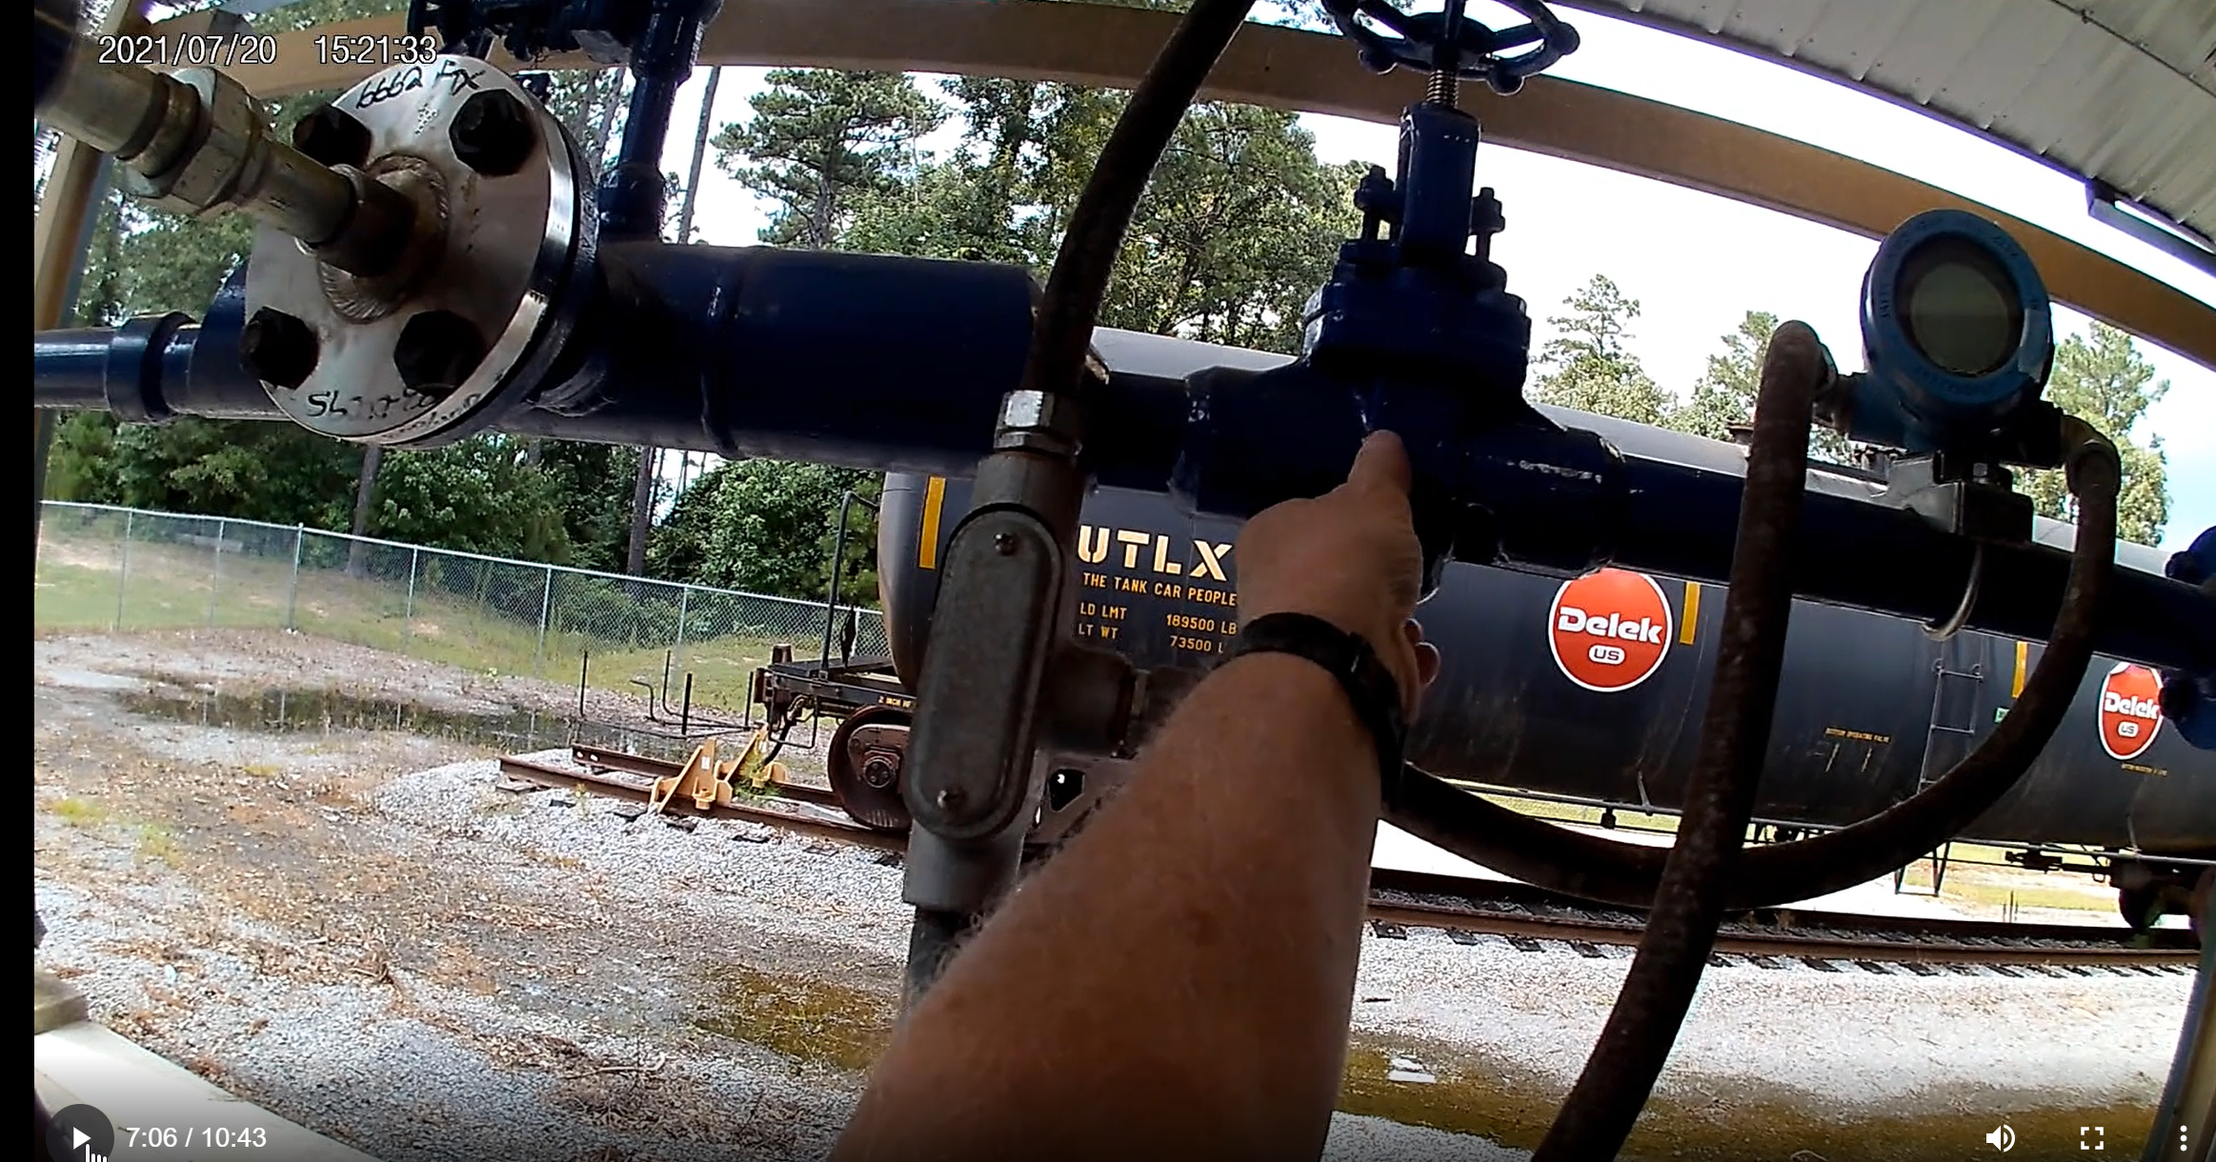
GoPro Recording of Video:

Slide 49
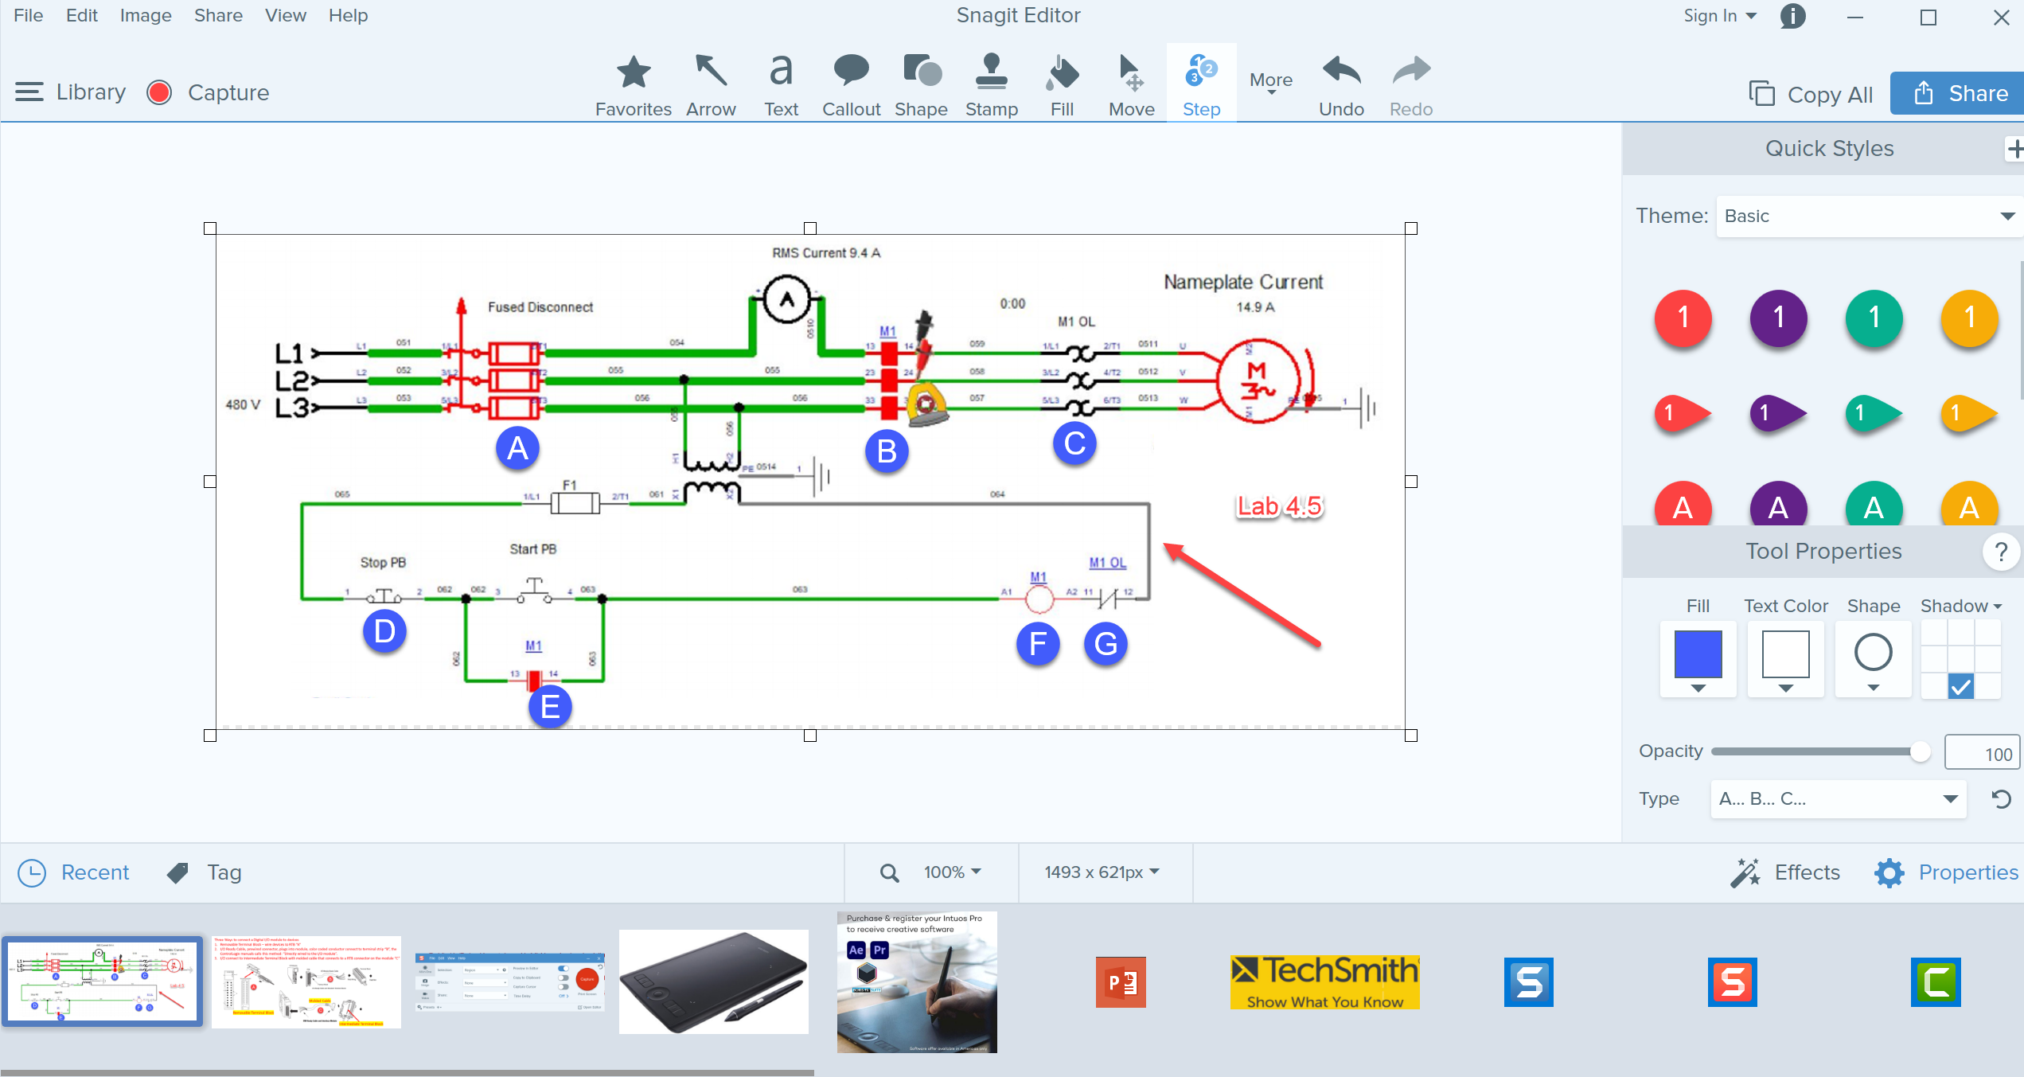
TechSmith Snagit 2019 Editor:
Tools to modify the image
Olympus E-M10 Mark III
Shows recently captured images

Slide 50
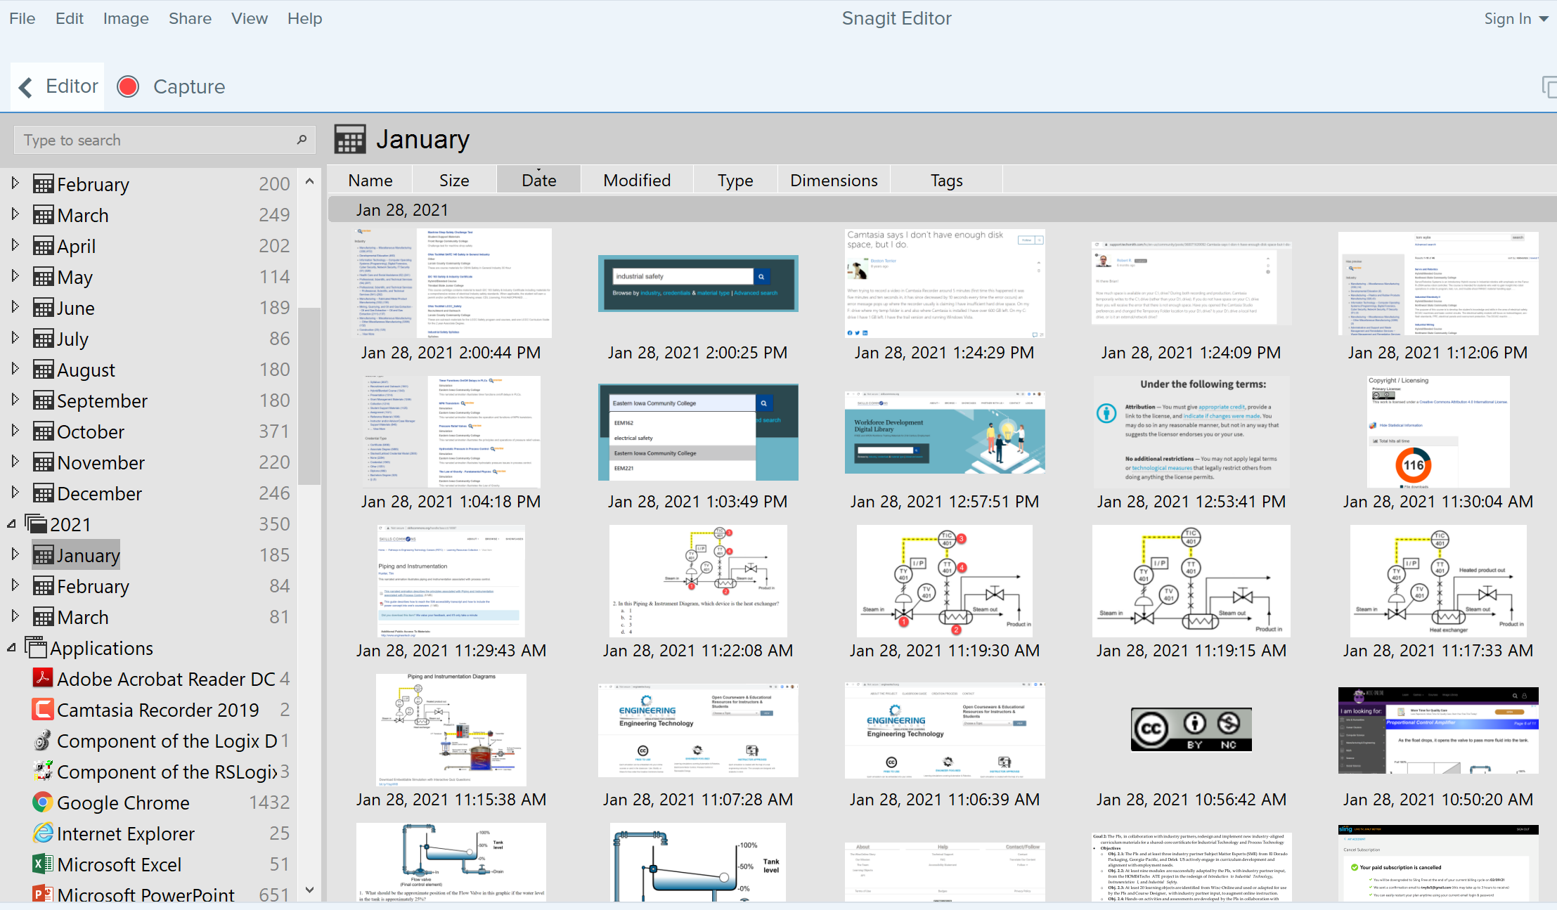
TechSmith Snagit Editor Library
User can go to any Month & Day for images

Slide 51
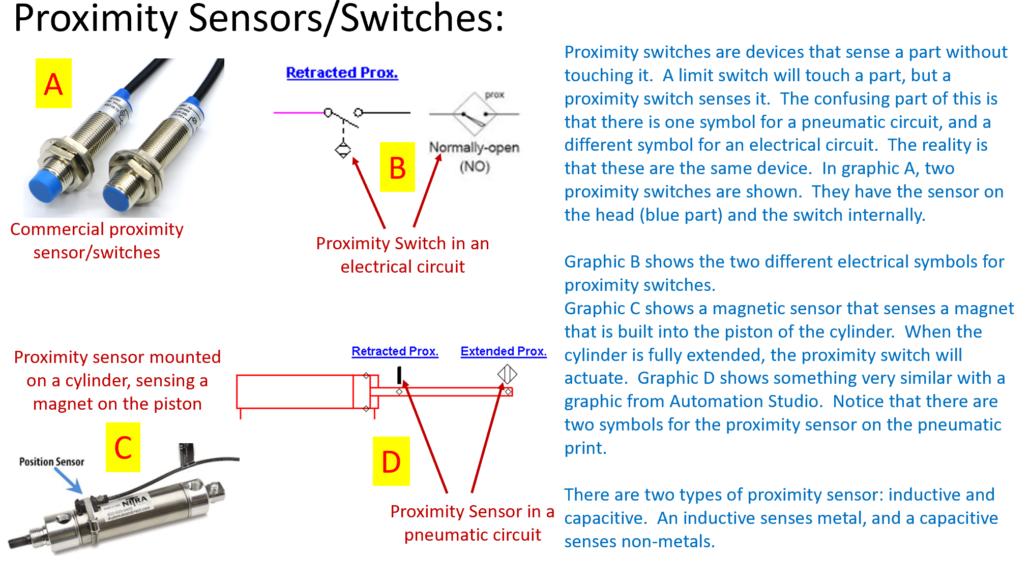
Creating a PDF Focused Learning Object:

Slide 52
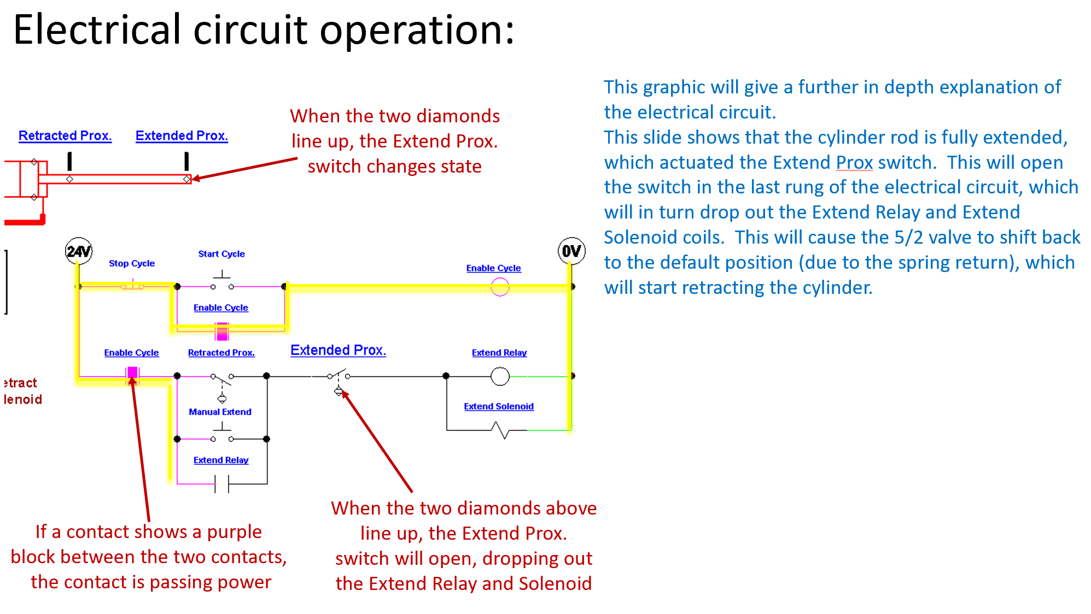
Creating a PDF Focused Learning Object:

Slide 53
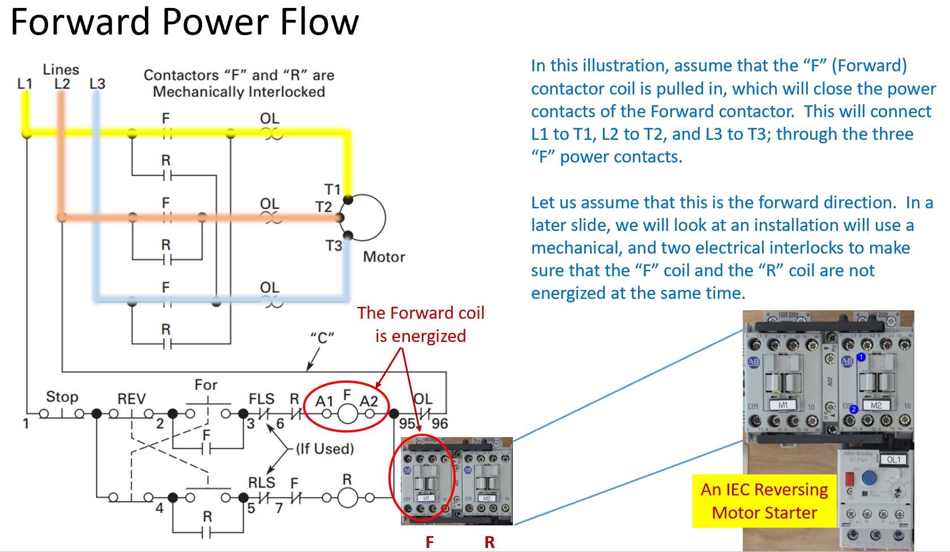
Creating a PDF Focused Learning Object:

Slide 54
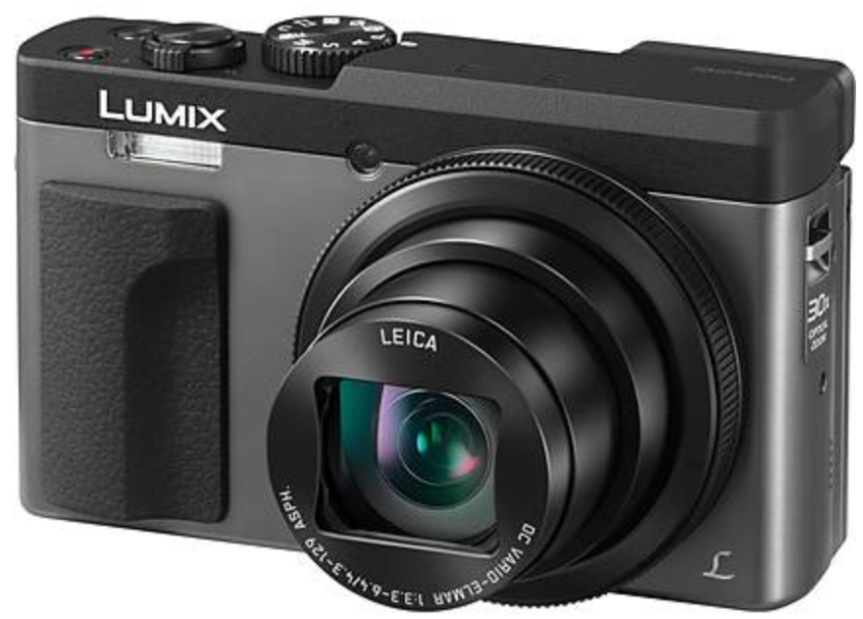


Cameras for Creating Videos:
One of the common tools that our Industrial Technology Instructors use is a simple Panasonic Point and Shoot camera. It is small with a zooming lens, with a removeable SD card, and a very sensitive internal microphone. The inverting tripod allows us to position the camera upside down to shoot onto an object or whiteboard (laying on a desktop). One of the most powerful features is the Panasonic Image app that runs on the smartphone. The camera has its own WiFi portal, thus the phone connects to it, then the image app controls the camera zooming, taking photos and taking videos. The SD card is removed then put into a port on the computer where it is then transferred to the HD, and produced with the Camtasia Producer software.
Panasonic Lumix Point & Shoot
Inverting Tri-Pod
Panasonic Image Smart Phone App

Slide 55

Cameras for Creating Videos:
I also use a high-end camera when I need to use different lenses, use different lighting filters and want higher quality images and videos. This is primarily if I am doing something for a vendor who needs a little higher quality than for instruction. I can get UHD 4K video quality. Usually, $700+. It also has a removeable SD.
Olympus E-M10 Mark III

Slide 56


SD Cards for Recording Videos and Images:
The SD cards will be used in most cameras to store the videos and pictures that are taken with the camera. I seldom use an SD less than 128GB in size, because they will fill up quickly. Remove the SD from the camera and connect it to the computer, to load the videos and images, so you can use the software tools to develop the learning objects
SD to USB Interface
SD Cards: GigaBytes

Slide 57


GoPro Cameras:

Slide 58

ORDRO Cameras:

Slide 59

This Concludes this Instructional Document

