Slide 1
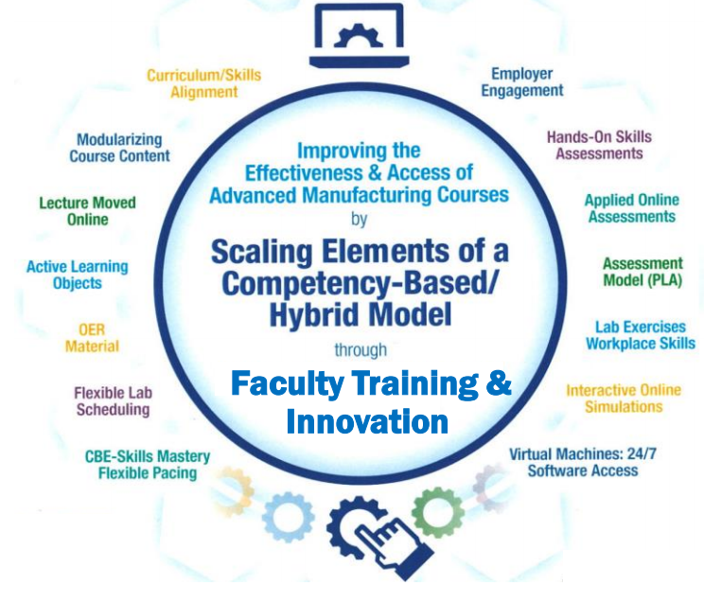
Open Educational Resources
Terra CREATE Project Team
Presented by:
Tom Wylie, Northwest State CC, Archbold, OH
(twylie@northweststate.edu)

Slide 2
What is OER?
1. Open Educational Resources
2. Free material that can be used for instruction
3. Some Faculty replace textbooks with OER
4. Some Faculty use OER in addition to the textbook
5. Most OER can be modified and reused
6. All materials funded through federal agencies (DOL, NSF, DOE) is considered OER and can be used based on the licensing

Slide 3
What are Learning Objects
1. Passive Learning versus Active Learning
2. Active Learning Objects are: Video, Voice over PPT, & Simulations
3. Targeted Learning Objects are PDFs to focus on a topic area, or even a video on how to do something
4. Hands-on students learn best with videos or a simulations, but also learn with a targeted learning object
5. Study guides and quizzes/tests are learning object

Slide 4
URLs Used in OER Workshop:
Engineertech.org: Eastern Iowa CC Videos on Technical Topics
http://engineertech.org/
Wisconsin Online Learning Object:
https://www.wisc-online.com/
The DOL document repository:
www.skillscommons.org
The NSF ATE document repository:
www.atecentral.net
Jim Pytel, Big Bad Tech, Video Lectures with Graphics
https://www.youtube.com/user/bigbadtech

Slide 5
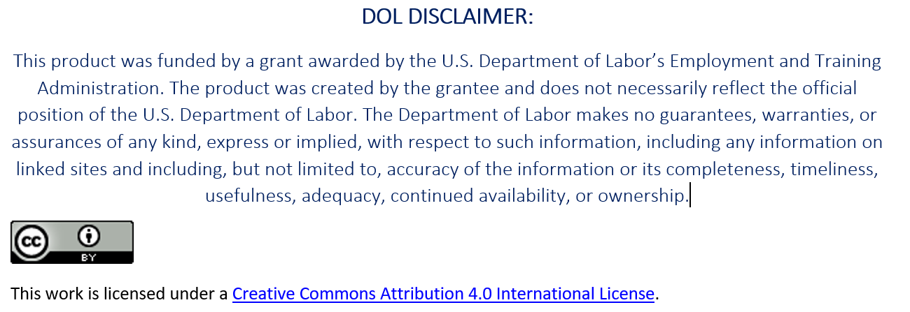
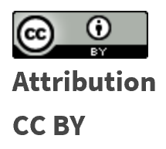
Creative Commons Licensing
Creative Commons is a nonprofit organization that provides a licensing structure that allows individuals and organizations in the world, a free, simple, and standardized way to grant copyright permissions for creative and academic work.
Material is not registered at Creative Commons. The author chooses a license, then attaches it to the material, then puts it in a repository for open access.
To learn more about each type of CC License, go to this link:
https://creativecommons.org/licenses/

Slide 6
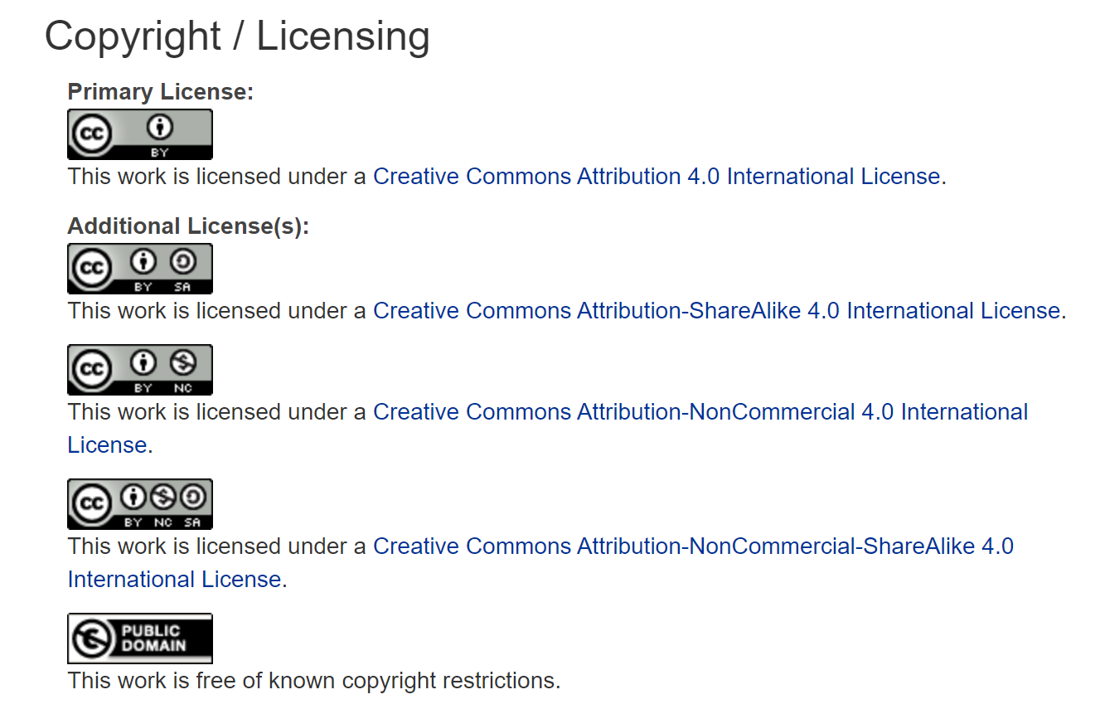
To learn more about each type of CC License, go to this link:
https://creativecommons.org/licenses/

Slide 7
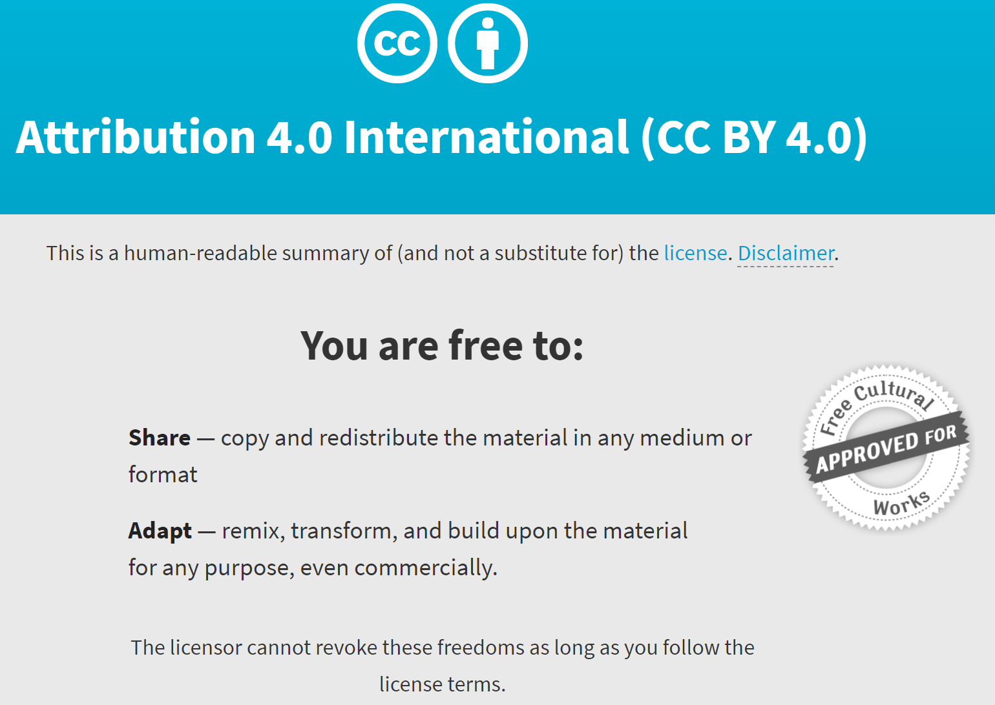
https://creativecommons.org/licenses/by/4.0/

Slide 8
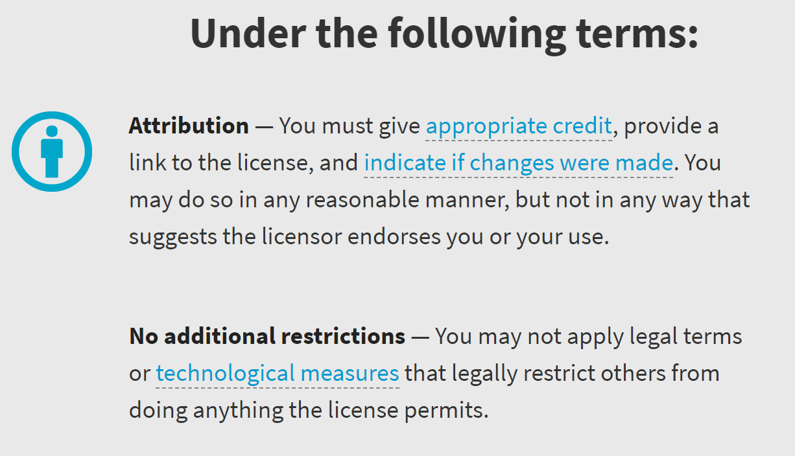

Slide 9
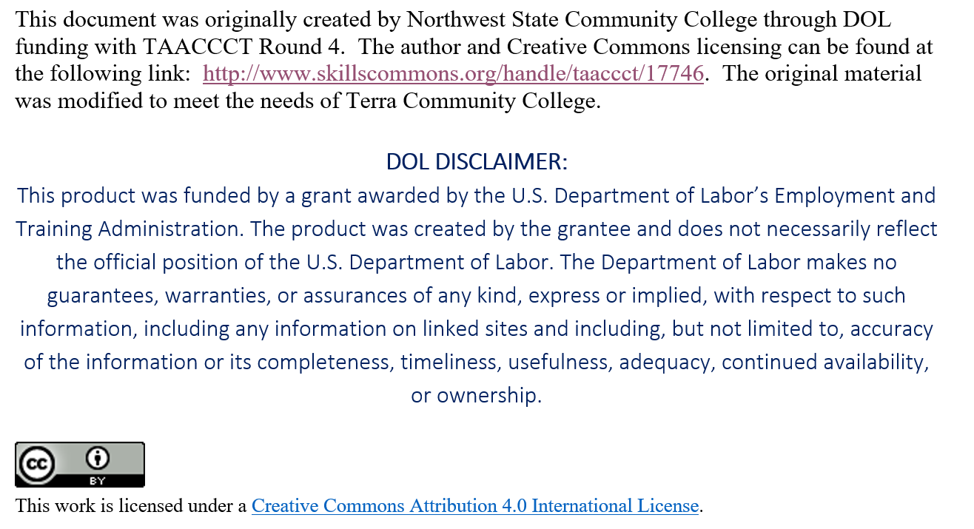
Attribution: Giving Appropriate Credit

Slide 10
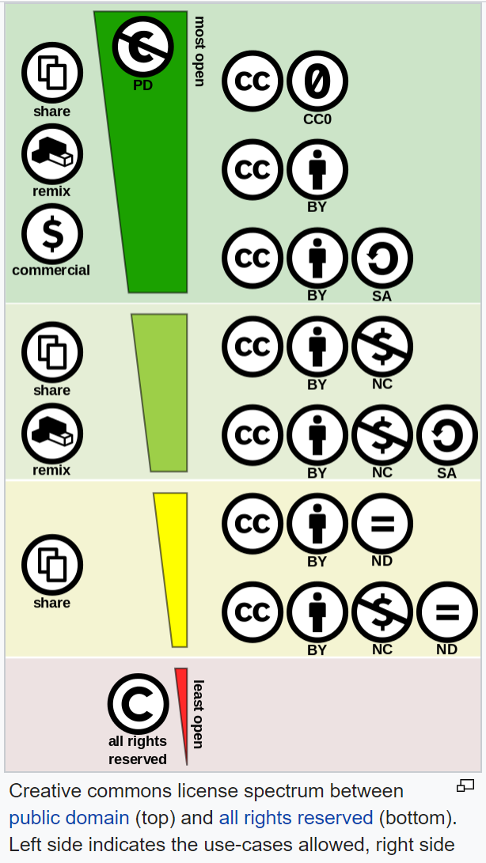
All Creative Common Licenses:
Remix: means to add, delete, modify
the original OER for reuse:
A Commercial license does allow a user to remix
and modify, but they can also resell it.
Non-Commercial license does not allow
a user to resell the OER, but they can still
use it, modify it, and share it.
This link explains all the licenses:
https://creativecommons.org/about/cclicenses/

Slide 11
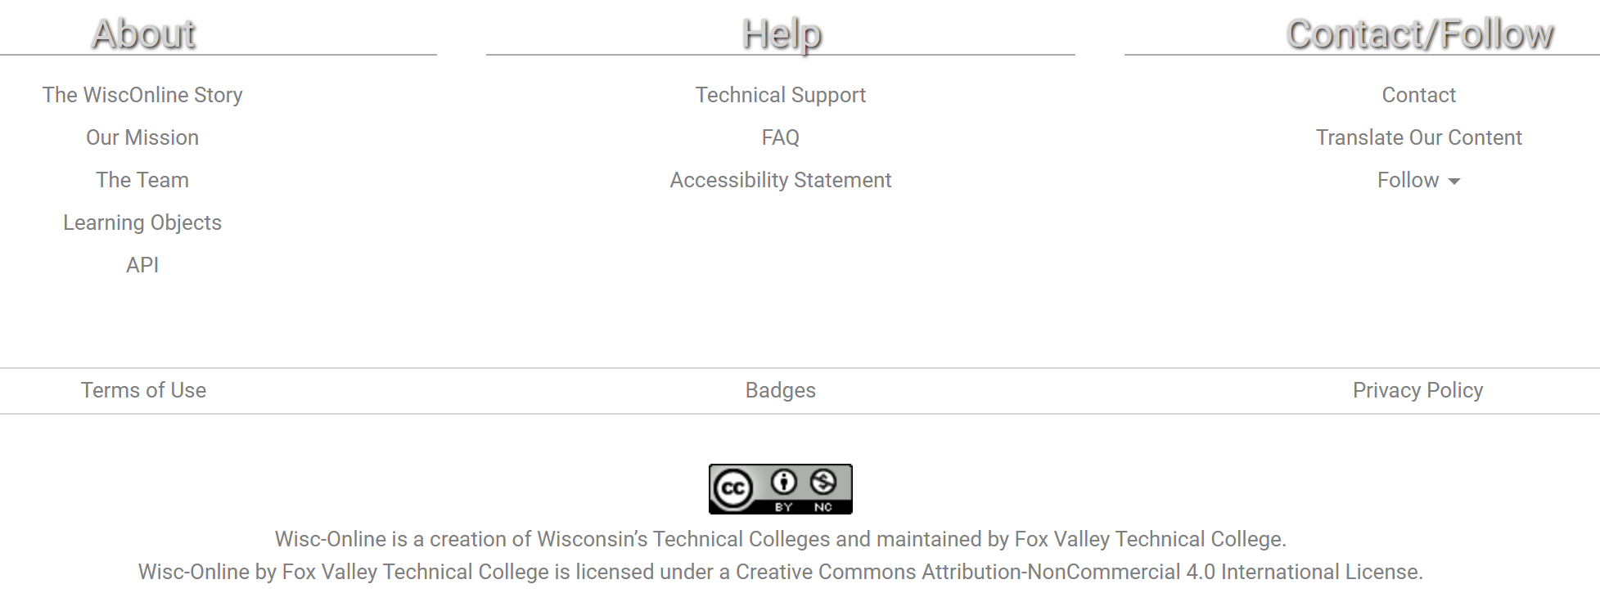
WiscOnline Licensing

Slide 12
Referencing Original Work in OER

Slide 13
URLs Used in OER Workshop:
Engineertech.org: Eastern Iowa CC Videos on Technical Topics
http://engineertech.org/
Wisconsin Online Learning Object:
https://www.wisc-online.com/
The DOL document repository:
www.skillscommons.org
The NSF ATE document repository:
www.atecentral.net
Jim Pytel, Big Bad Tech, Video Lectures with Graphics
https://www.youtube.com/user/bigbadtech

Slide 14
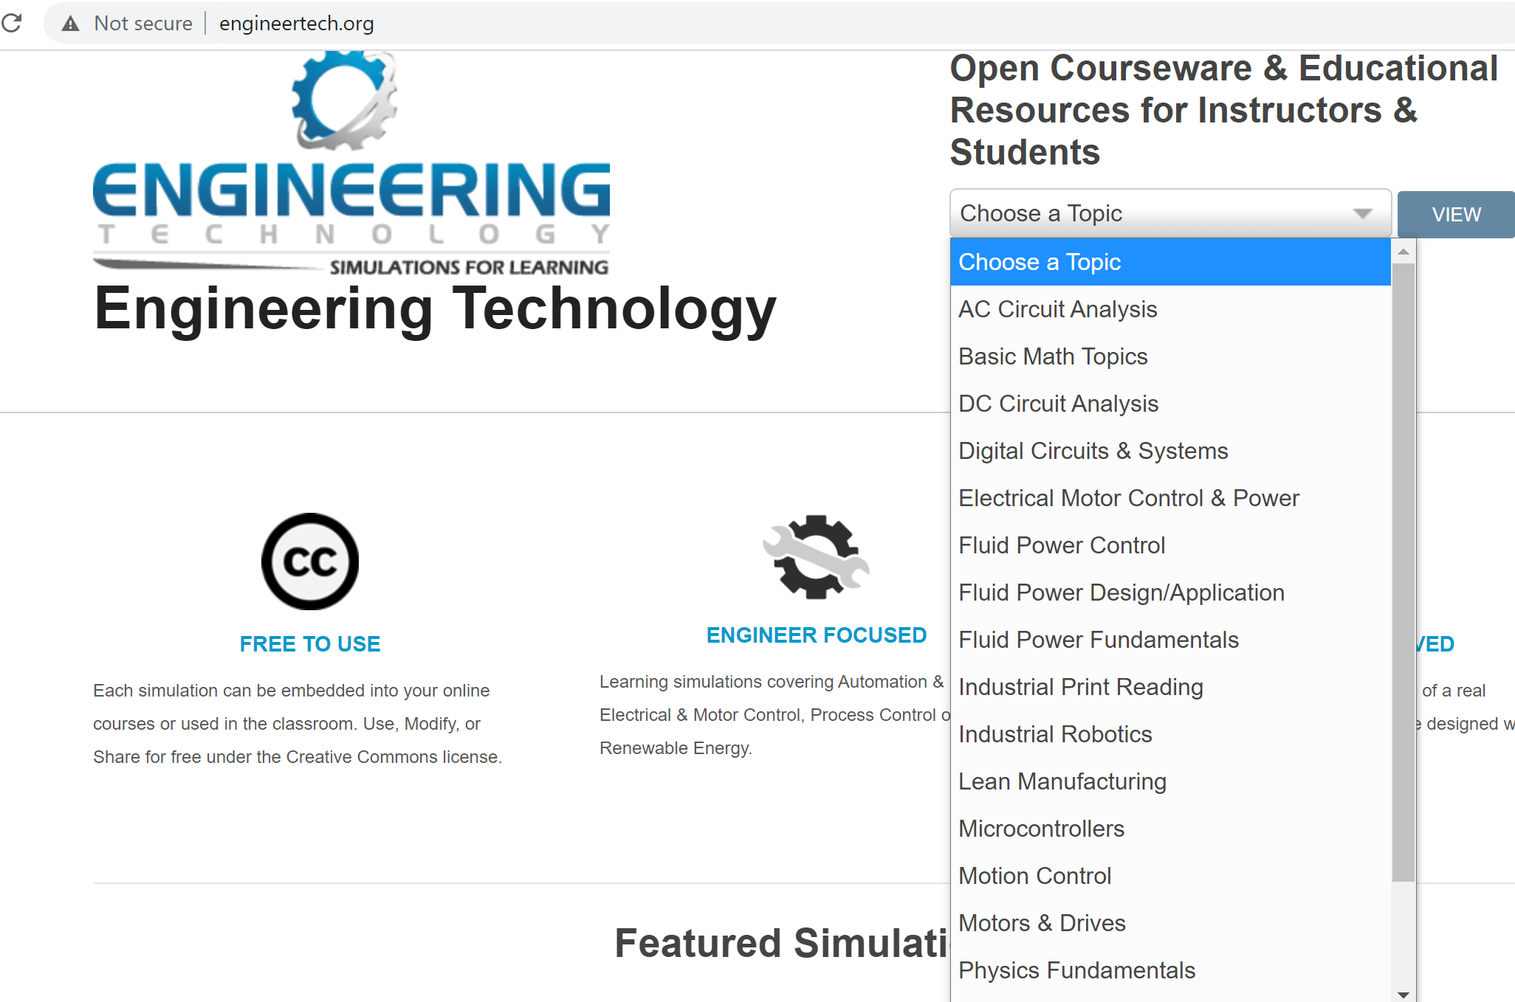
ENGINEERTECH.ORG:
ENGINEERTECH.ORG is a website created to house videos created by Eastern Iowa Community College with funds from TAACCCT Round 2 grant. This is the user interface to the videos that are housed at VIMEO.COM (instead of YouTube). A college LMS can link to each video. The MP4 videos can also be downloaded from Skillscommons. The link to the CC license can also be found at Skillscommons.

Slide 16
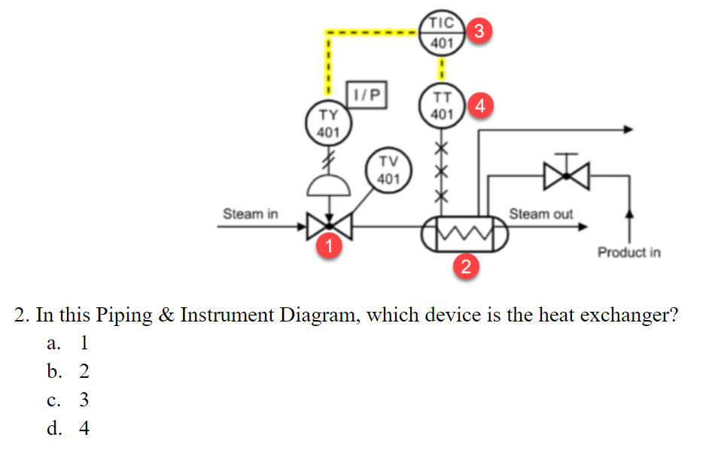
Assess the students on information within Learning Object

Slide 17
URLs Used in OER Workshop:
Engineertech.org: Eastern Iowa CC Videos on Technical Topics
http://engineertech.org/
Wisconsin Online Learning Object:
https://www.wisc-online.com/
The DOL document repository:
www.skillscommons.org
The NSF ATE document repository:
www.atecentral.net
Jim Pytel, Big Bad Tech, Video Lectures with Graphics
https://www.youtube.com/user/bigbadtech

Slide 18
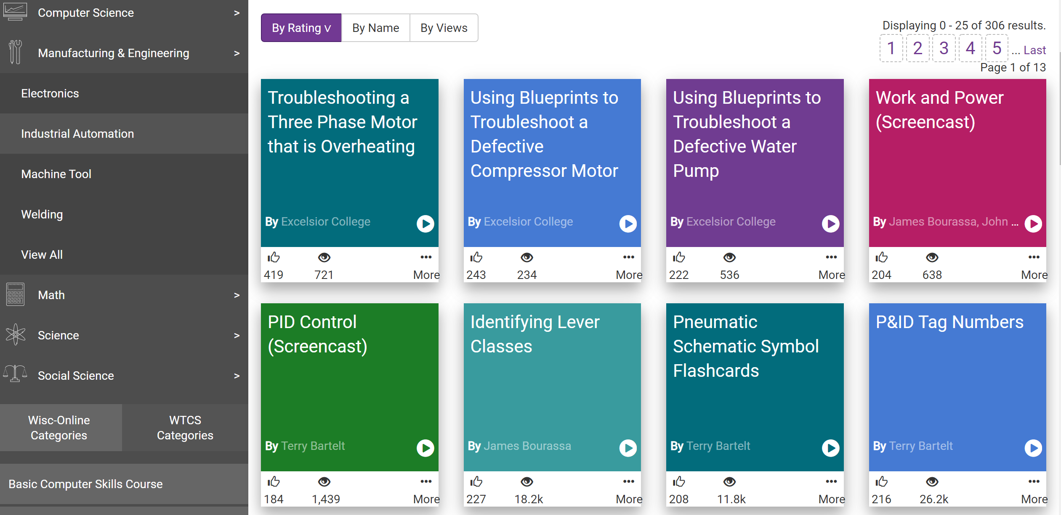
WISC-ONLINE:
WISC-ONLINE is an online repository for active learning objects that is accessible by going to their website:
https://www.wisc-online.com/, and searching for a topic, or look into categories. These links can be posted
in an LMS system for students to view on a computer or on their portable devices.

Slide 19
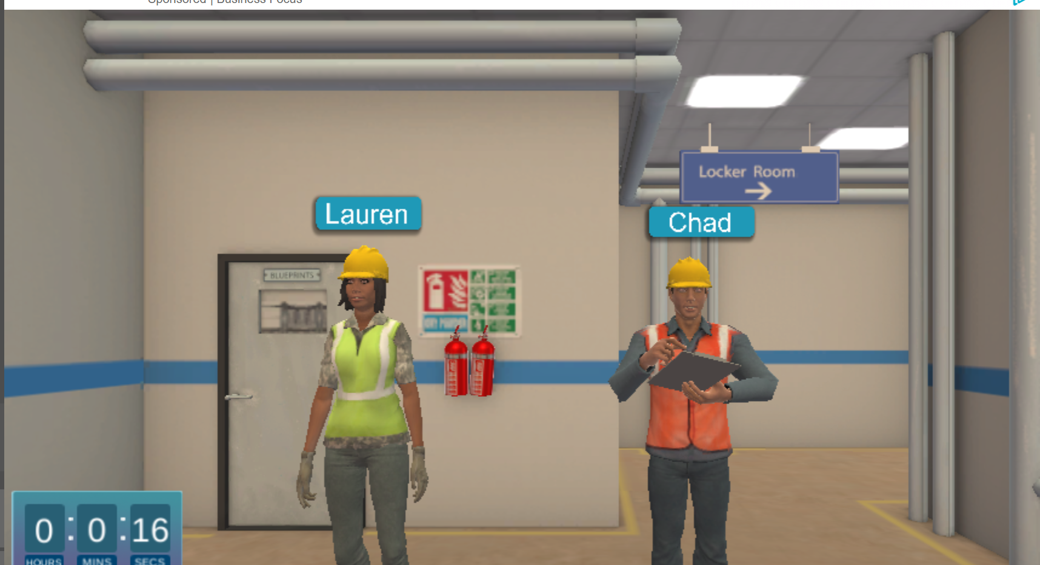
WISC-ONLINE:

Slide 20
WISC-ONLINE:

Slide 21
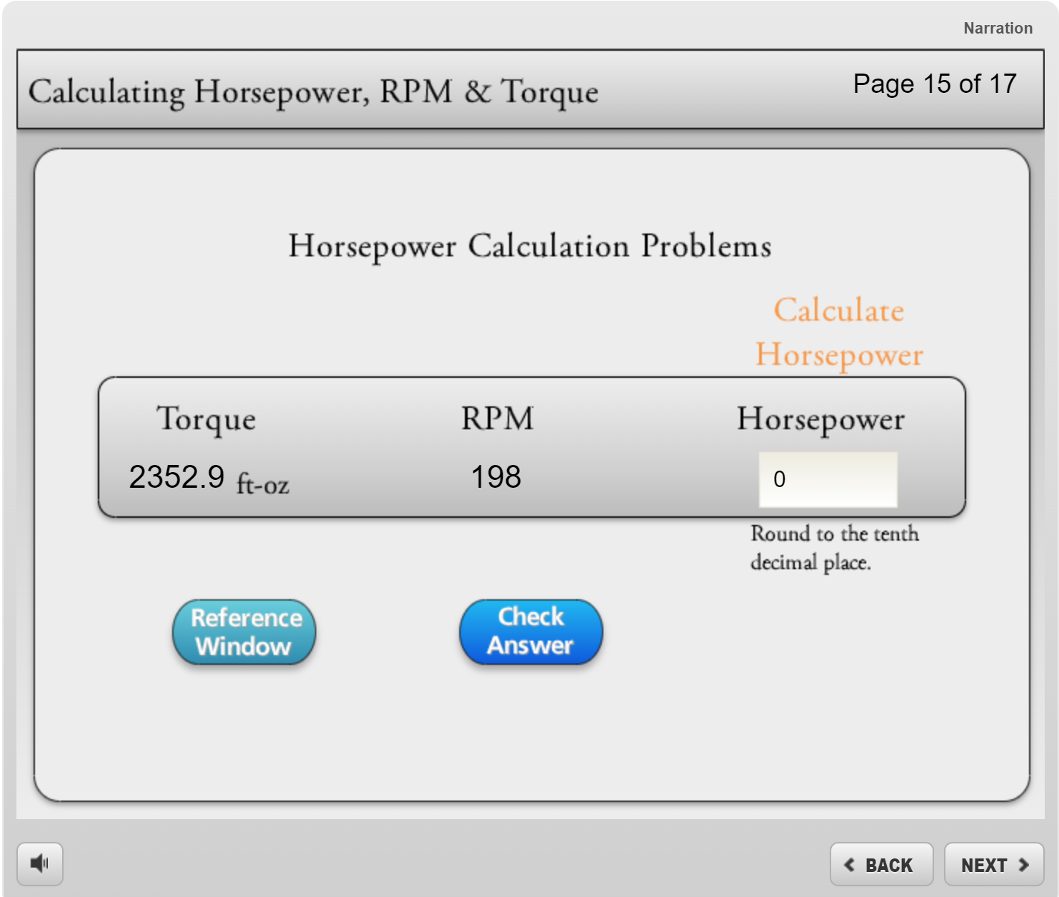
WISC-ONLINE:

Slide 22
URLs Used in OER Workshop:
Engineertech.org: Eastern Iowa CC Videos on Technical Topics
http://engineertech.org/
Wisconsin Online Learning Object:
https://www.wisc-online.com/
The DOL document repository:
www.skillscommons.org
The NSF ATE document repository:
www.atecentral.net
Jim Pytel, Big Bad Tech, Video Lectures with Graphics
https://www.youtube.com/user/bigbadtech

Slide 23
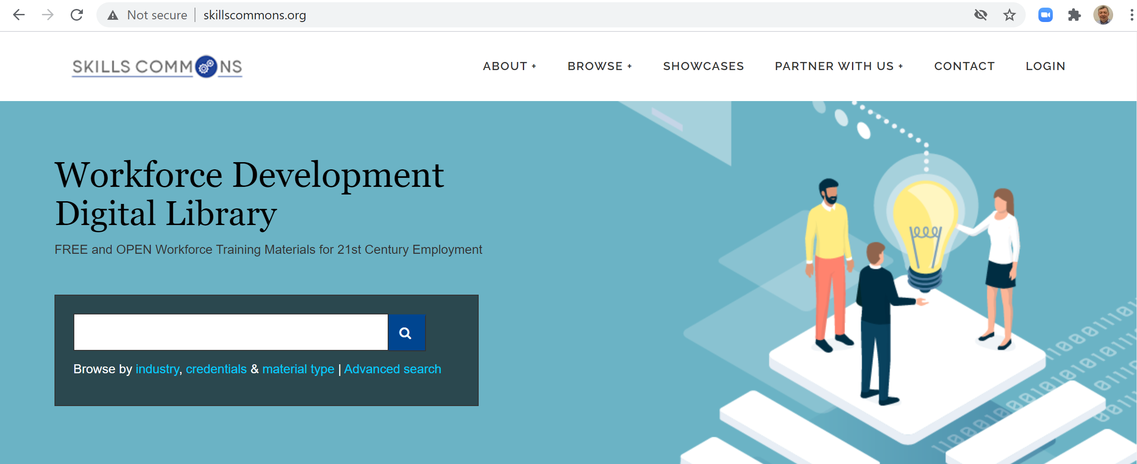
SKILLSCOMMONS.ORG:
SKILLSCOMMONS.ORG is a website created to house the instructional content that was developed with DOL dollars, especially materials developed in the TAACCCT grant project. There are thousands of learning objects that are stored there. A person can spend hours searching within their site. A search can be done on a person, college or technical content topic. All of the licensing information is stored with the object.

Slide 24
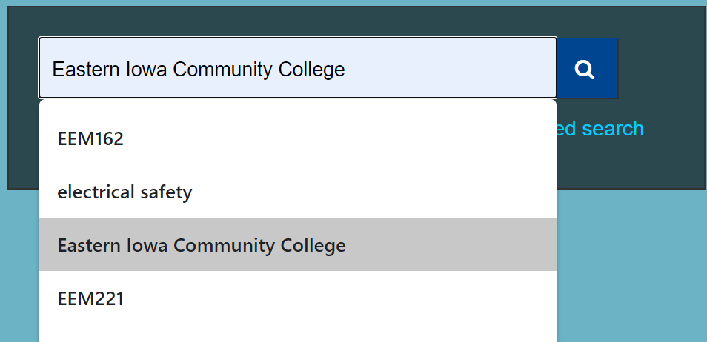
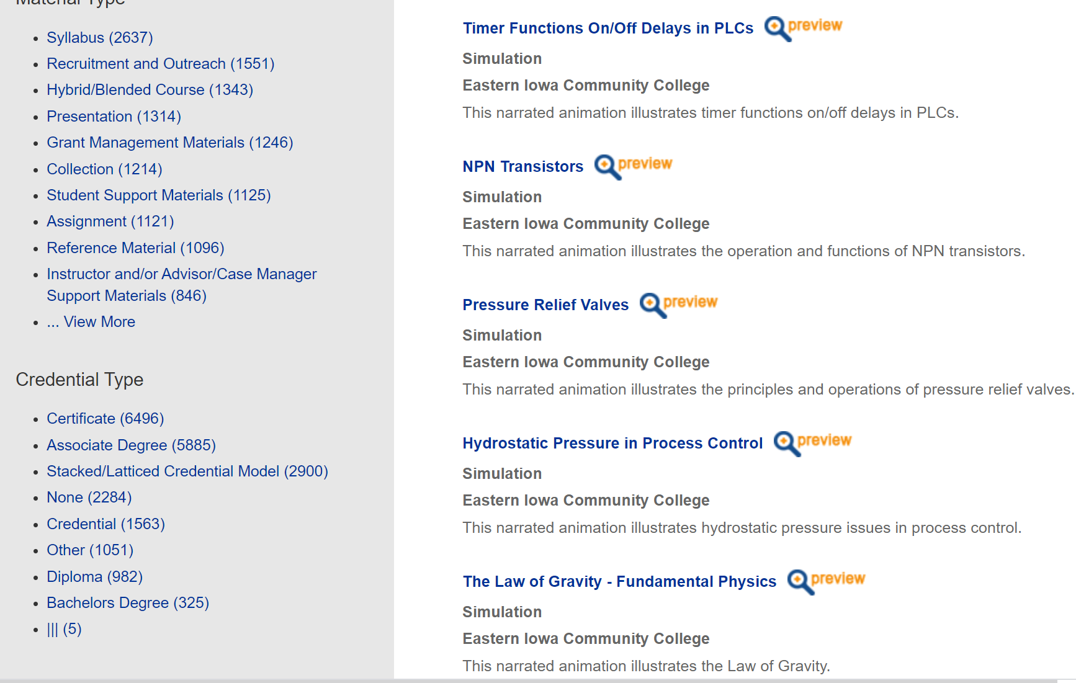
All the videos Eastern Iowa Community College has at ENGINEERTECH.ORG, housed by VIMEO, is stored as MP4s in Skillscommons.
These MP4 videos can be uploaded to an LMS system, or could be put on YouTube.
Some colleges are loading MP4s into the LMS, stored on their own servers so they can monitor when a student opens the learning object, and to assure that only their registered students can get to it.
These MP4s can also be edited in Camtasia to add or move content.

Slide 25
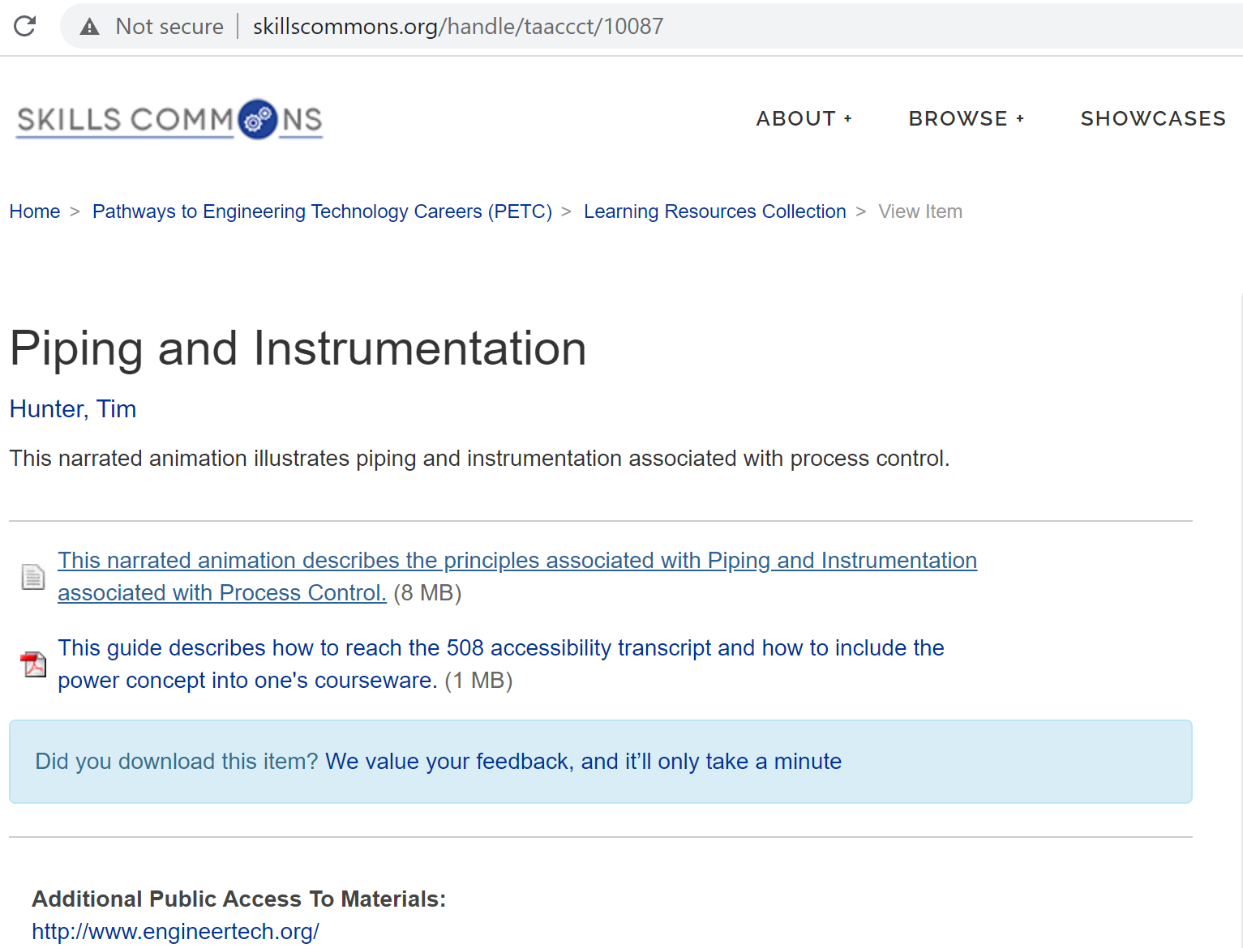
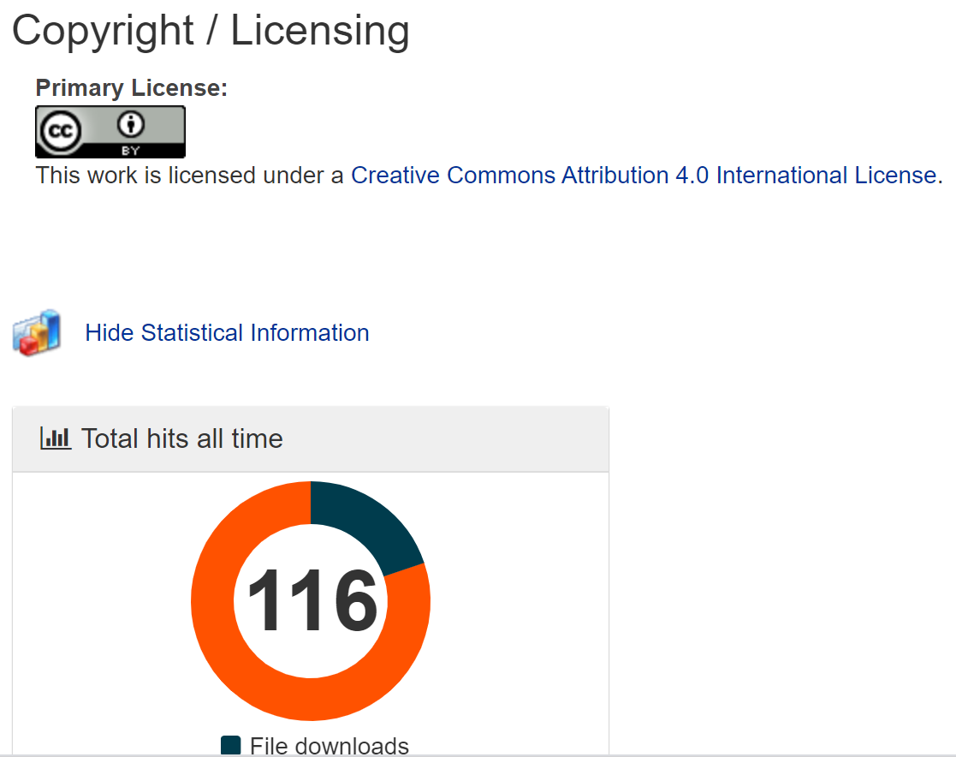
Link to video in EngineerTech.org
Raw MP4 that can be edited
Creative Commons License
Website for links to all of the Eastern Iowa CC videos

Slide 26
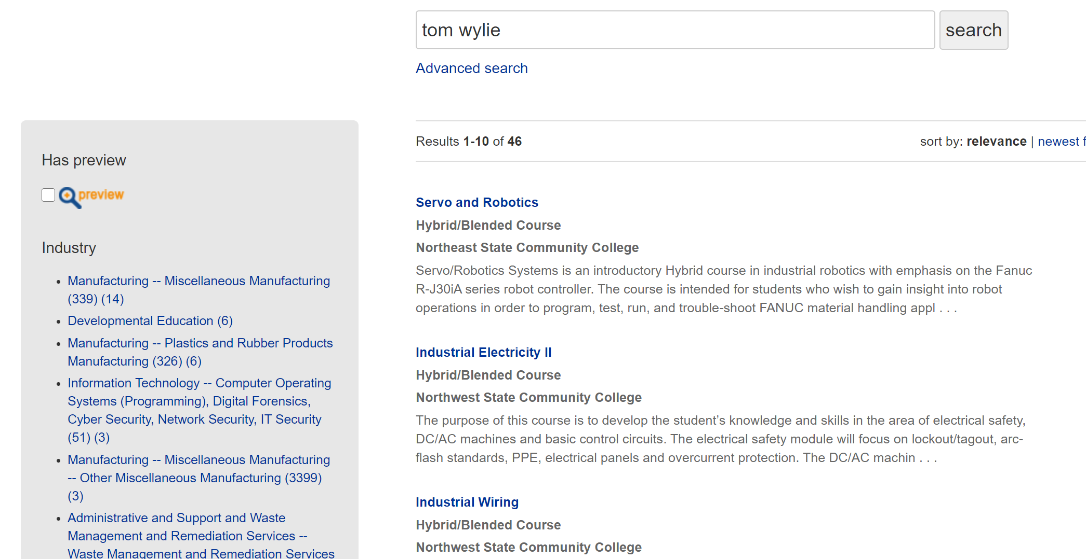
The user can search by the Author of the materials in Skillscommons, or the organization, or the topic area.

Slide 27
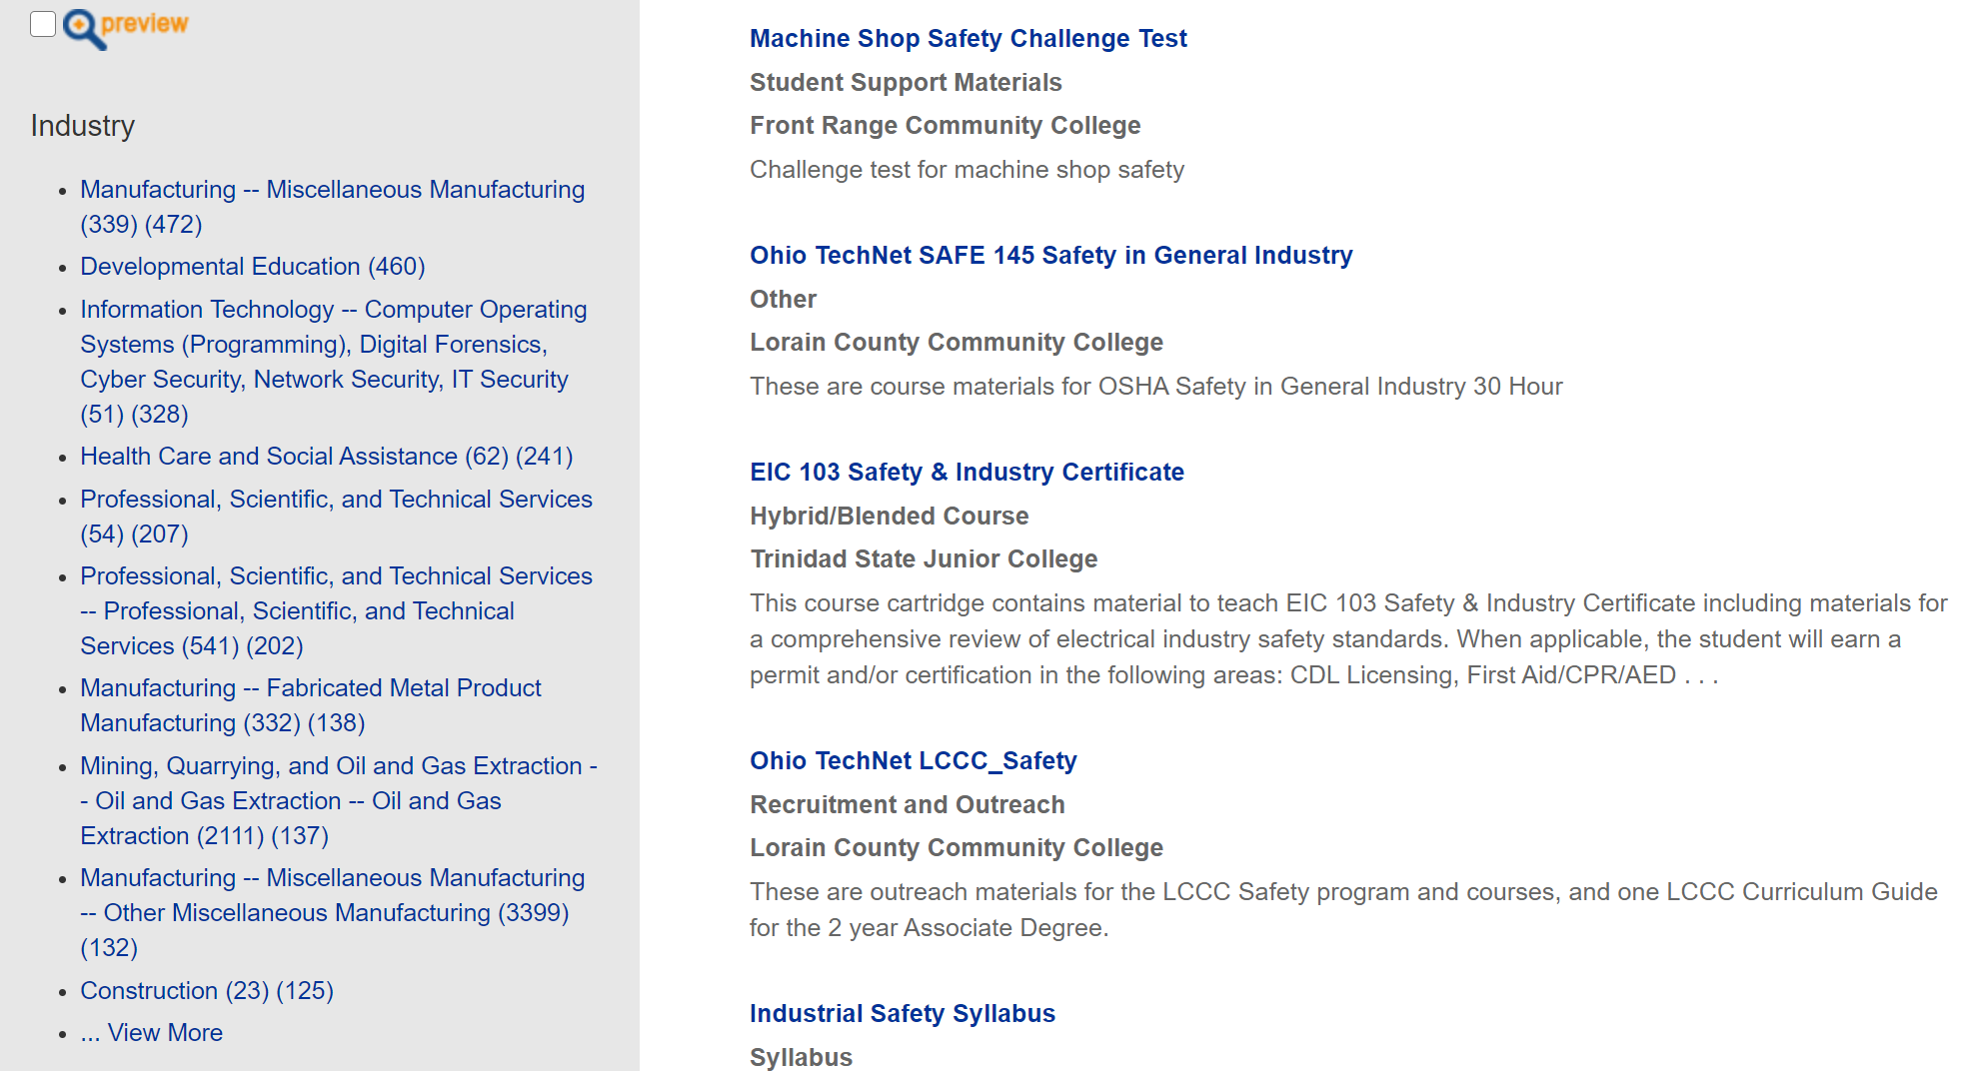
In this example the user can search for any topic on Industrial Safety.

Slide 28
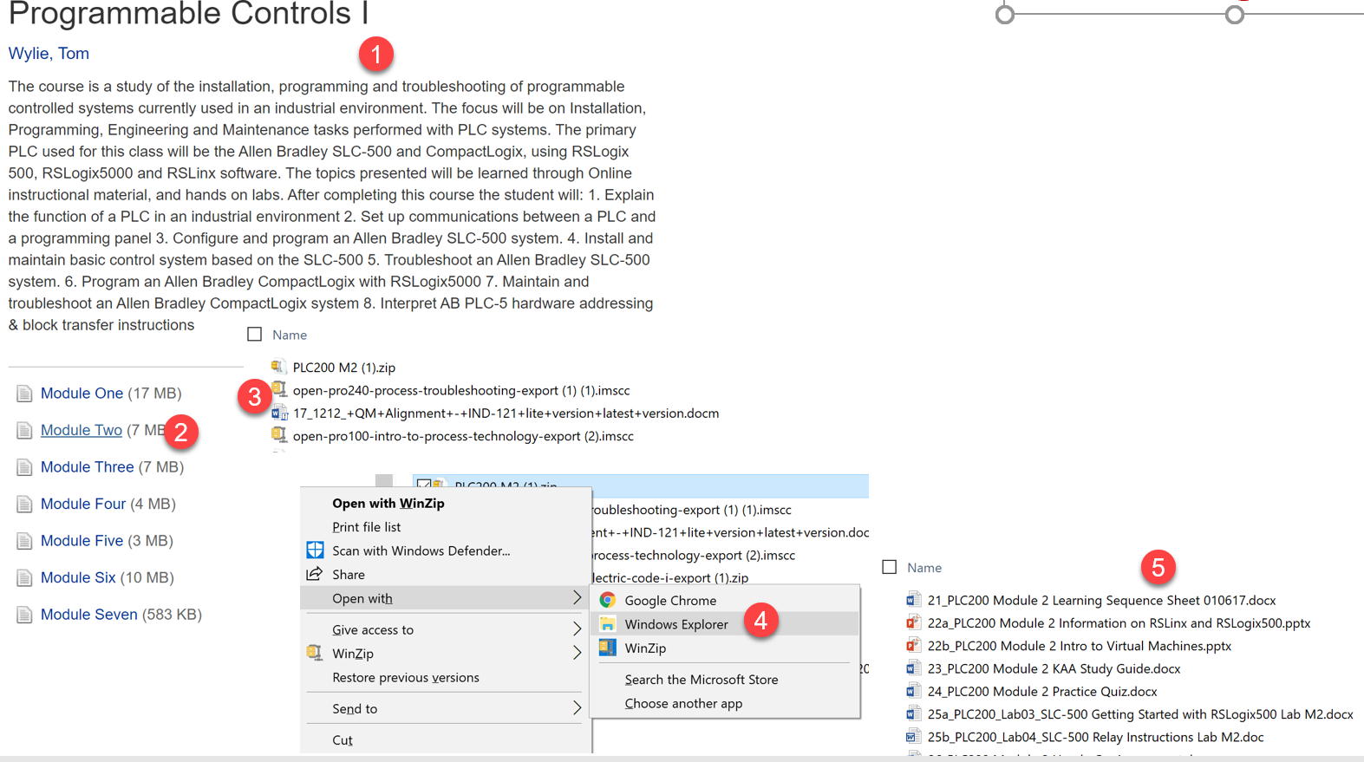
ZIPPED Files in Skillcommons.org
Many objects (files) are zipped within Skills Commons, thus they can be retrieved easily and added to a course within your unique LMS.
NSCC objects are all in their native format: Word, PPT, MP4.

Slide 29
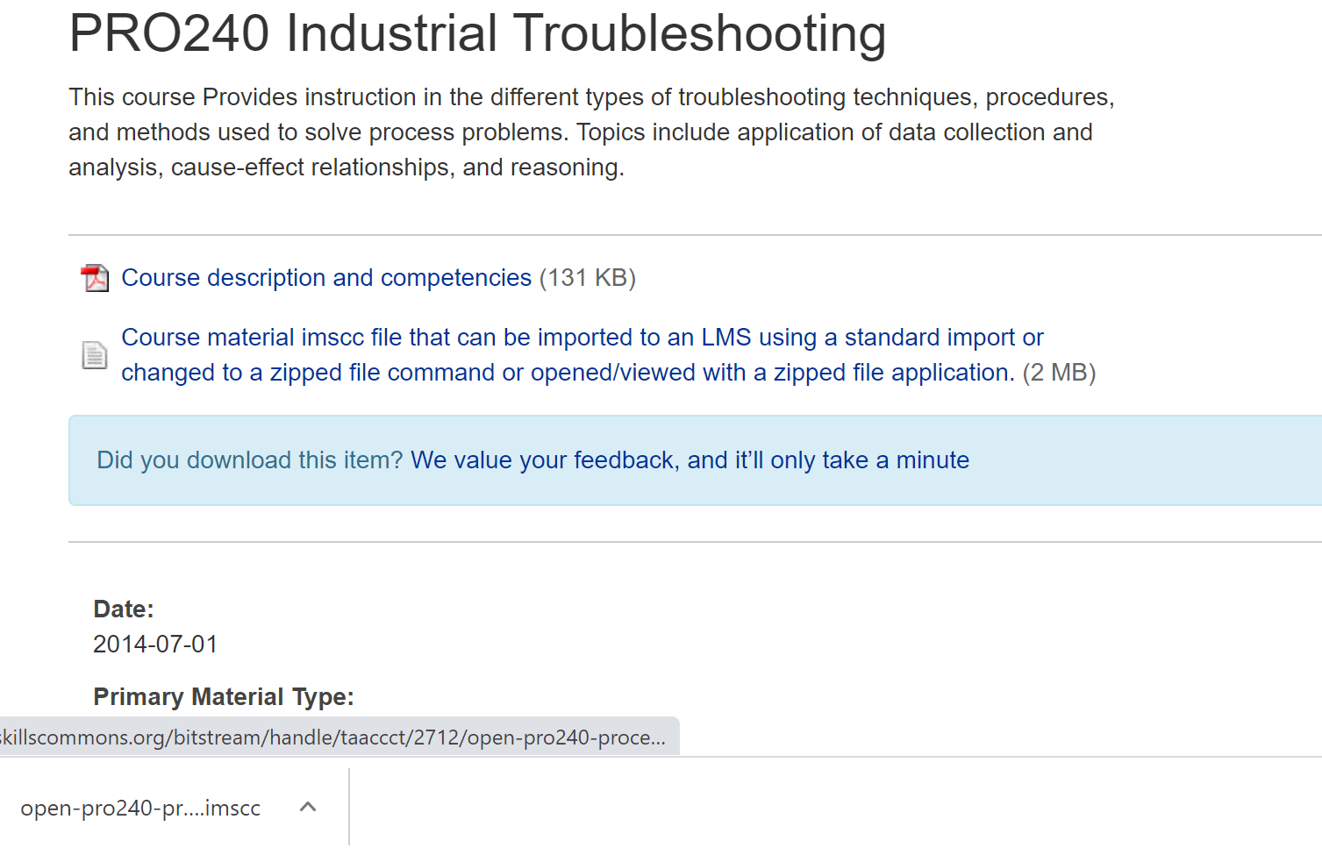
Common Cartridge Files found on Skills Commons
Some authors do not want to license all of their objects, so they export their online course with all of the object as a “.imscc” type of file. This way they can license only the online course. The .imscc file can be imported into the LMS.
A Canvas exported courses (as a .imscc file can import into Canvas at another institution, but some objects are removed if imported into Blackboard or Sakai.

Slide 30
Some of my Favorites on Skills Commons Site
MTE247 Strength of Materials Course Pikes Peak CC
http://www.skillscommons.org/handle/taaccct/3914
EEM151 Motors and Controls I, Midlands CC, SC
http://www.skillscommons.org/handle/taaccct/741
OPT1100 Tooling & Machining Metrology, Stark State College, OH
http://www.skillscommons.org/handle/taaccct/16107
Mechanical Components, Purdue University Northwest, IN
http://www.skillscommons.org/handle/taaccct/10929
Introduction to Electrical Circuit Simulation, Colorado Mountain College, CO
http://www.skillscommons.org/handle/taaccct/18698

Slide 31
URLs Used in OER Workshop:
Engineertech.org: Eastern Iowa CC Videos on Technical Topics
http://engineertech.org/
Wisconsin Online Learning Object:
https://www.wisc-online.com/
The DOL document repository:
www.skillscommons.org
The NSF ATE document repository:
www.atecentral.net
Jim Pytel, Big Bad Tech, Video Lectures with Graphics
https://www.youtube.com/user/bigbadtech

Slide 32
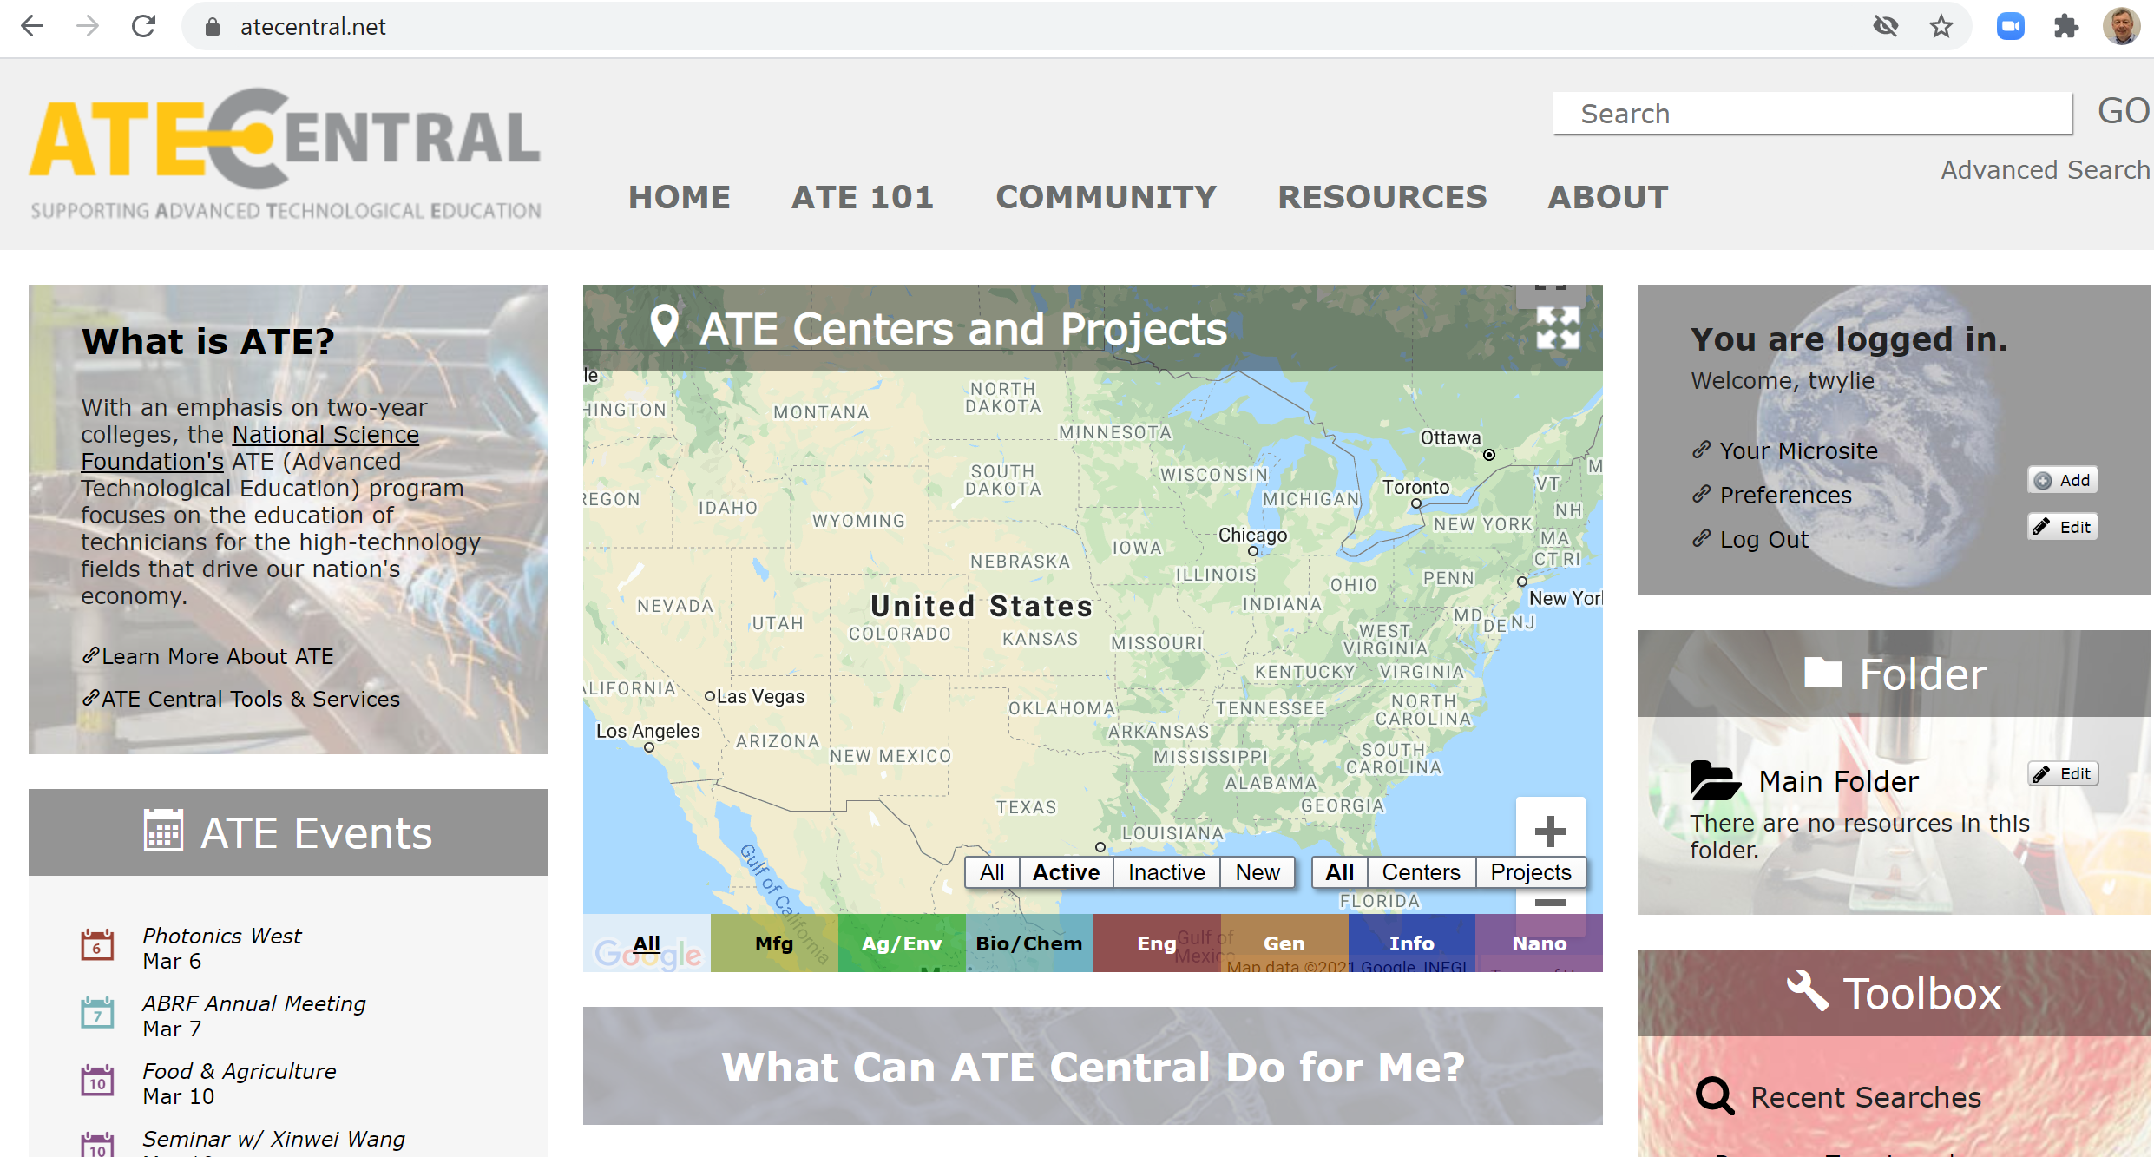
ATECENTRAL.NET:
ATECentral.net is a website that houses all the information about NSF Projects and NSF Centers throughout the nation. It also holds all of the resources that were developed with NSF funds.

Slide 33
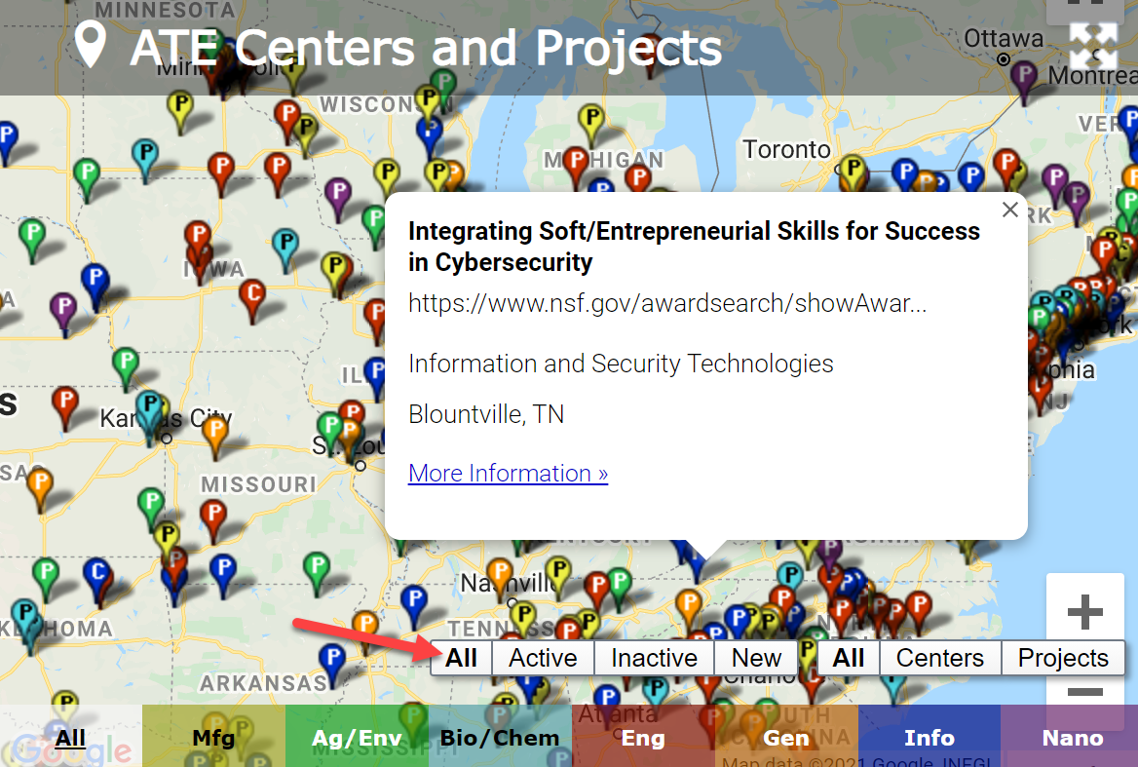
ATECENTRAL.NET:
If the user clicks on the “All” option on the map (shown by the red arrow), it will display all of the active NSF ATE Projects and Centers within the country. The user can click on any of the pins, and it will show the name of the award, as shown below.

Slide 34
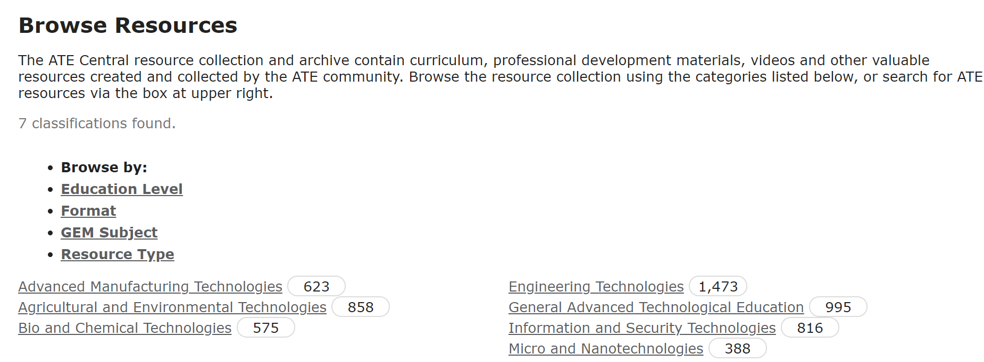
ATECENTRAL.NET:
Click on Resources, then choose ATE Resource Collection. The user can choose any of the categories at the bottom of the page.

Slide 35
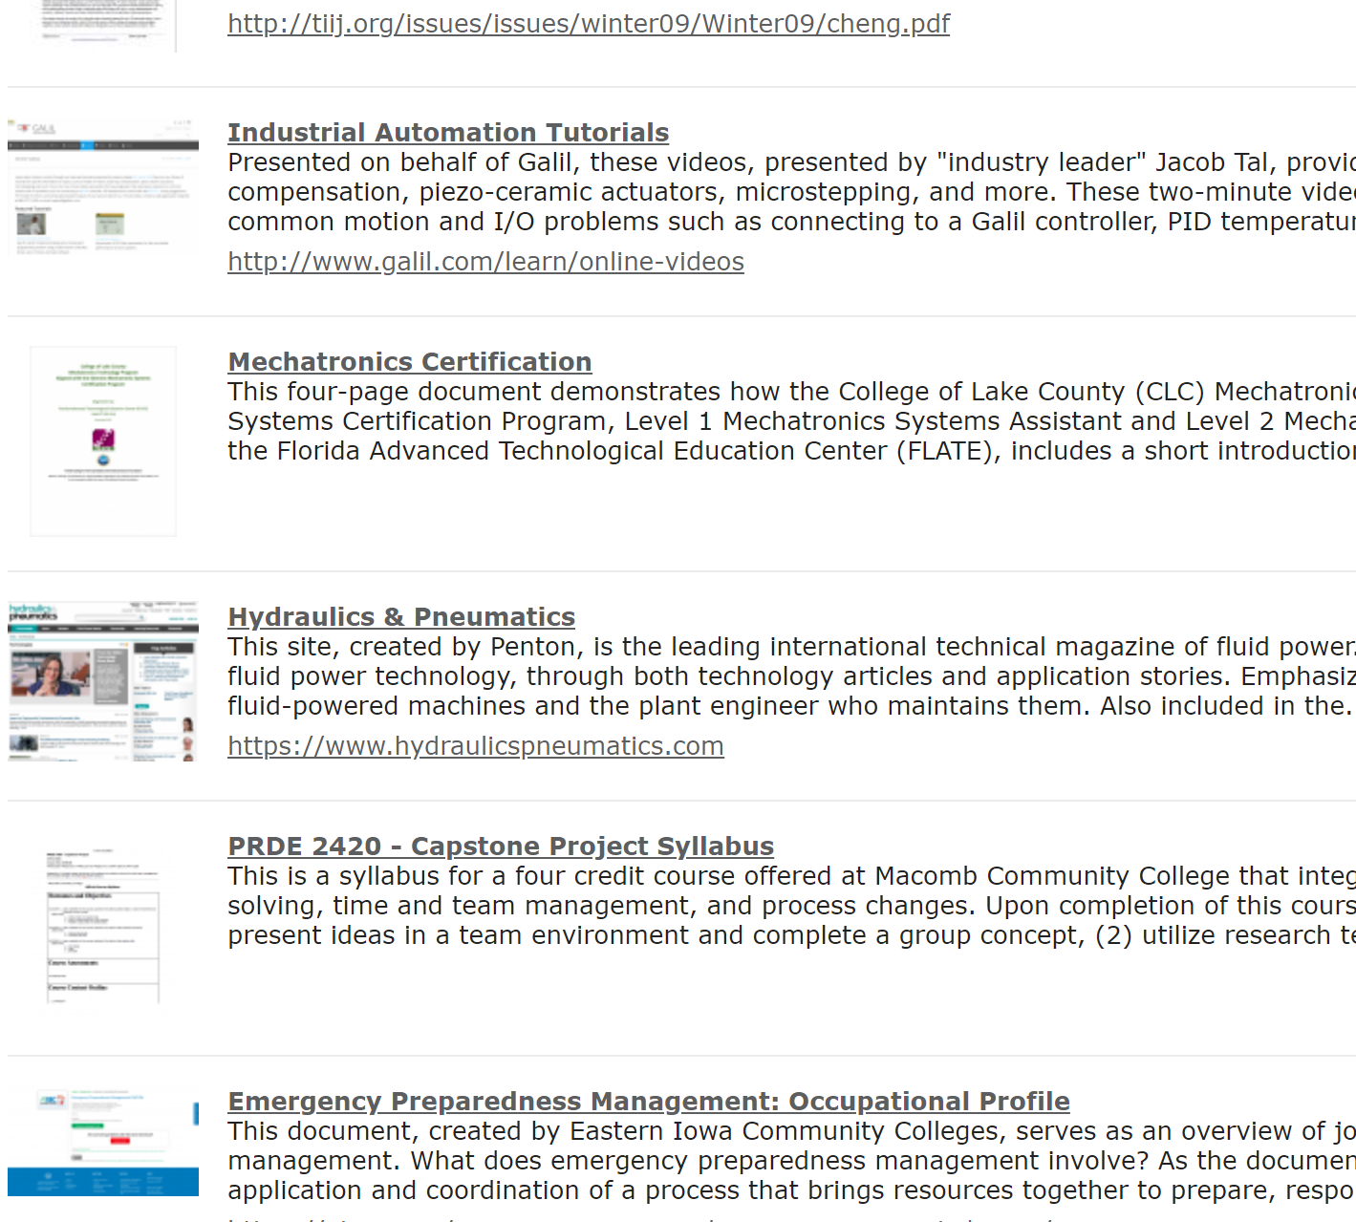
ATECENTRAL.NET:

Slide 36
URLs Used in OER Workshop:
Engineertech.org: Eastern Iowa CC Videos on Technical Topics
http://engineertech.org/
Wisconsin Online Learning Object:
https://www.wisc-online.com/
The DOL document repository:
www.skillscommons.org
The NSF ATE document repository:
www.atecentral.net
Jim Pytel, Big Bad Tech, Video Lectures with Graphics
https://www.youtube.com/user/bigbadtech

Slide 37
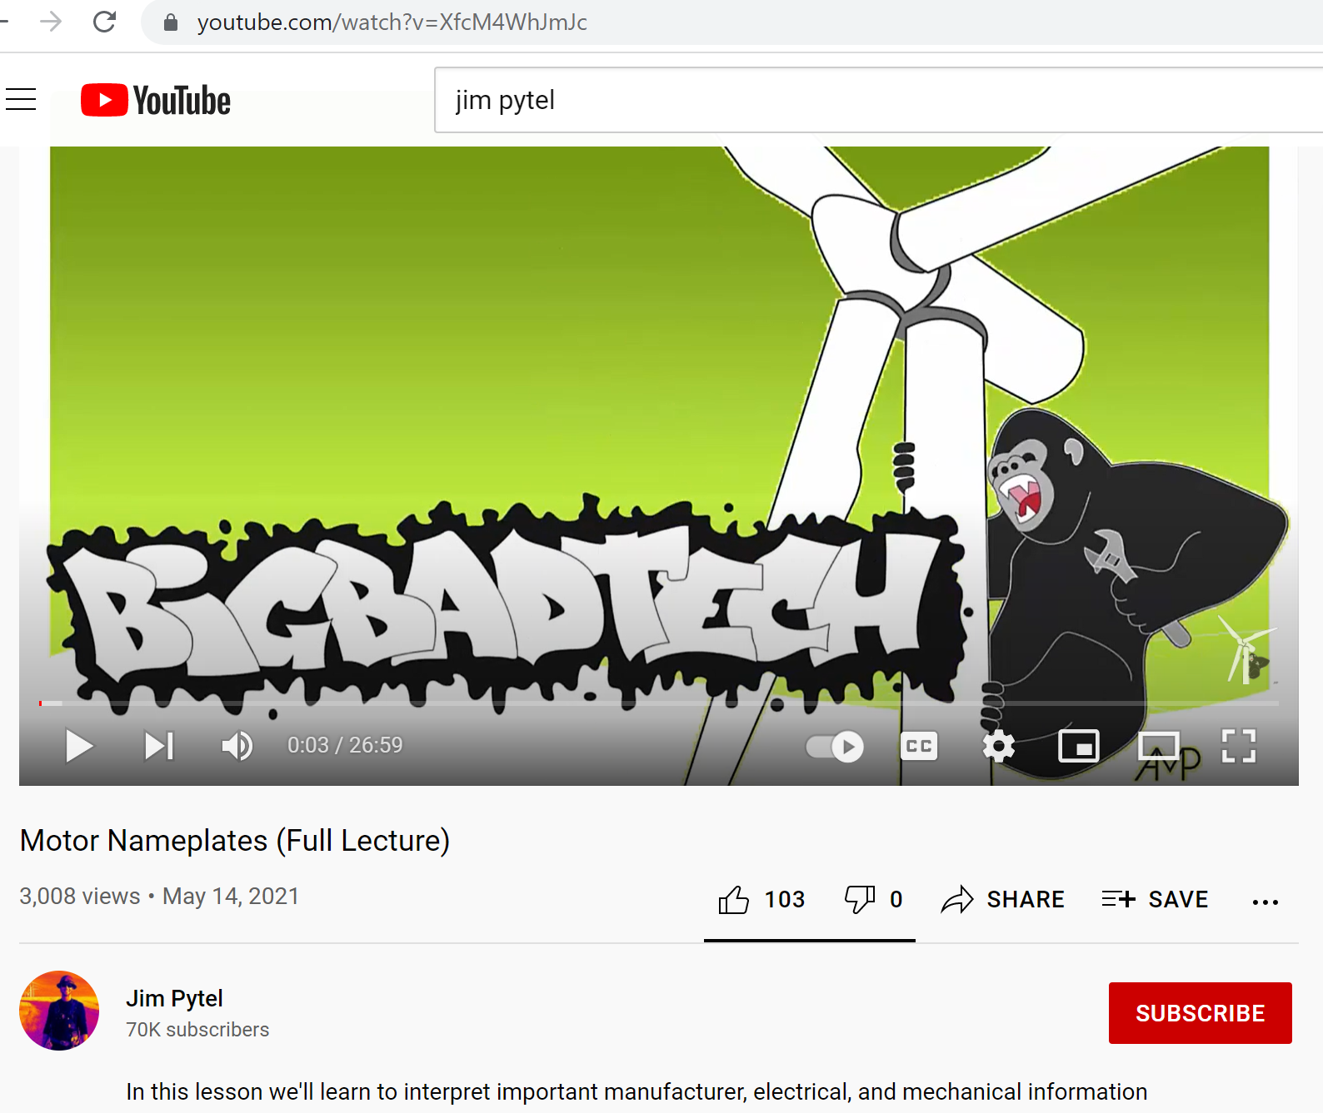
Jim Pytel YouTube Channel:

Slide 38
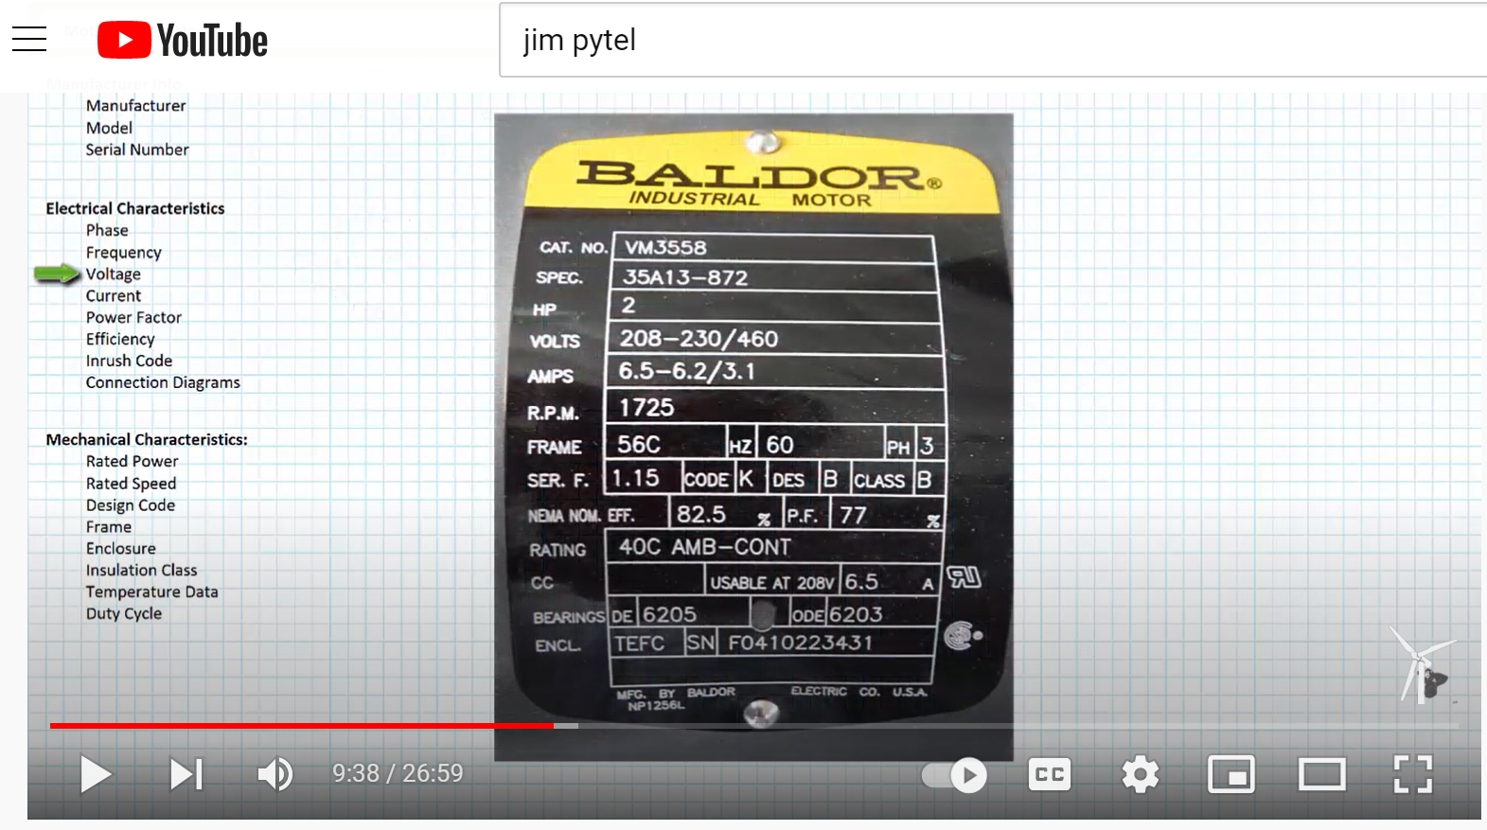
Jim Pytel YouTube Channel:

Slide 39
How-To Videos for Session 1:
YouTube Video: T. Wylie, Video on Finding OER Videos and Simulations 042221
https://youtu.be/uo934NaFoxs
YouTube Video: T. Wylie, Video Searching for OER in Skillscommons 042221
https://youtu.be/ep4Erjg46bs

Slide 40
The End of the Presentation
Please email the presenter with
Any questions you may have, as
well as any feedback on the session
(twylie@northweststate.edu)

