Slide 1
CREATE Faculty Training on CBE Learning
Created by Tom Wylie, 6/27/23

Slide 2
CREATE Faculty Training on CBE Learning
Training topics for this training session:
Review the steps to developing a module
Review a Learning Thread
Open Education Resources
Simulations
Review the development of a learning object
6. Introduction to creating Learning Objects
a. PowerPoint
b. Converting PPT to PDF
c. Voice over PPT
d. Creating videos with a camera
e. Creating a screen CAM video to show how to use software

Slide 3
Website to get Sample Documents:
Handouts for the Workshop is available at the Project Website:
https://ate.is/Scaling_CBE

Slide 4
2 Parts to the CREATE Project
Faculty Prof. Dev.
Prog. Controller 1
Mike &
Scott
Develop Faculty Skillset:
*Convert technical courses to a CB/Hybrid model
*Effectively teach the CB/Hybrid courses
Prepare the Faculty to:
*Utilize OER material for teaching
*Develop online learning objects:
*Videos, simulations & PPT/PDF
*Deliver instruction in a CB/Hybrid model
Prog. Controller 2
Mike &
Scott
Elect. Troubleshoot
Course Conversion:
*Re-Align the Curriculum
*Convert the courses to a competency-based/hybrid model

Slide 5
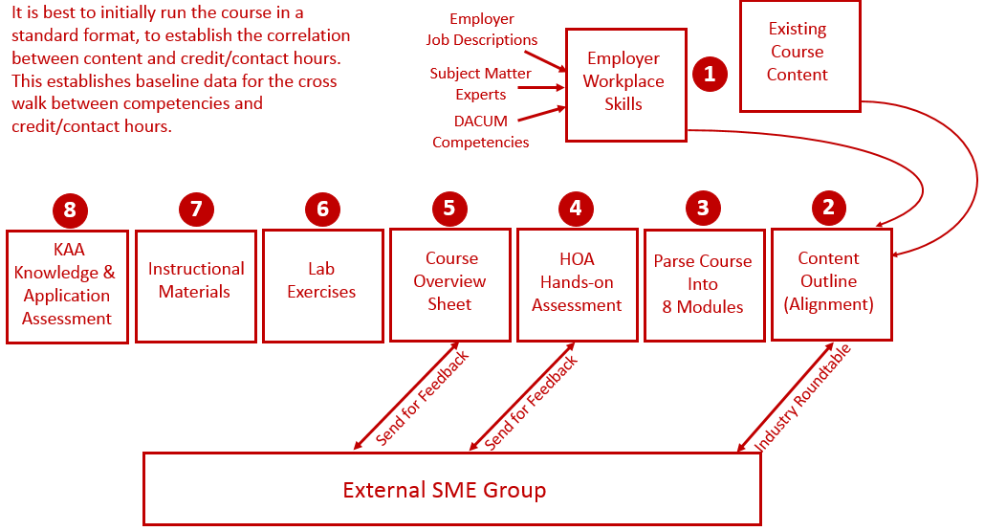
Reverse Design:

Slide 6
Thread of Learning:
Course Topics
Design
Course Outcomes
Design
Hands-On
Performance Assess.
Assessment
Lab Exercises
Preparation
PPT/PDF
Reading
Videos
Instructional Mat.
Preparation
Online Assessment
Assessment
Practice Quizzes
Preparation

Slide 7
Many good Videos at EngineerTech.Org

Slide 8
OER Material
Open Educational Resource Material
*Open for anyone to use in their courses
*Any material developed with funds from a federal grant is OER
*View the OER PowerPoint

Slide 9
Simulations using Automation Studio:
Used to prepare students for the Hands-On Lab Exercises:
*Electrical
*Motor Control
*VFD
*Pneumatics
*Hydraulics
*PLCs
Simulations do not replace Hands-On Learning
View the Examples of Simulations on the Project Site:

Slide 10
Building a Learning Object:
In the next week, could each of you identify a course that could be improved on, and sketch out what type of learning object you would like to create, and Mike or myself can work with you to create it. No presentations, no pressure; just a way of better learning how to apply this information into a curricular change.

Slide 11
Software used to Create Objects
TechSmith (Techsmith.com), located in Michigan, developed and distributes Snagit and Camtasia. These products are targeted toward Faculty. They are simple to use and give immediate results. Snagit is an image or video capture software, and Camtasia is a product with multiple uses, but in the end it produces high quality videos. MP4 is the preferred video format for creating instructional videos. MS PowerPoint is the other key software that is needed to create illustrated graphics and animations. Google Slides does not have all of the features that MS PowerPoint has.
Snagit 2019
Camtasia 2019 Recorder
Microsoft PPT
Snagit 2019 Editor
Camtasia 2019

Slide 12
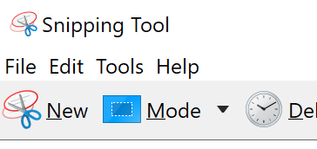
TechSmith Snagit 2019 (Capture):
This is the interface for Snagit capture. The user can designate a hot key such as the “PrtSc” key (Print Screen), which will bring up the cross hairs for capture.
Olympus E-M10 Mark III
Windows 10 Snipping Tools

Slide 13
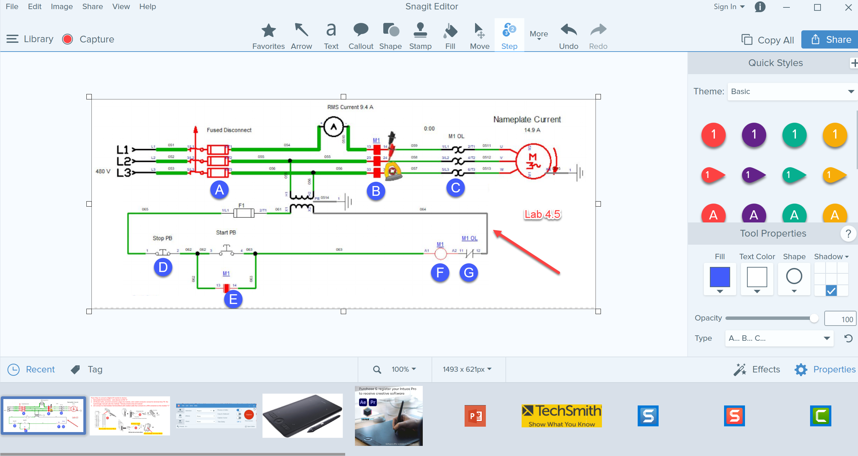
TechSmith Snagit 2019 Editor:
Tools to modify the image
Olympus E-M10 Mark III
Shows recently captured images

Slide 14
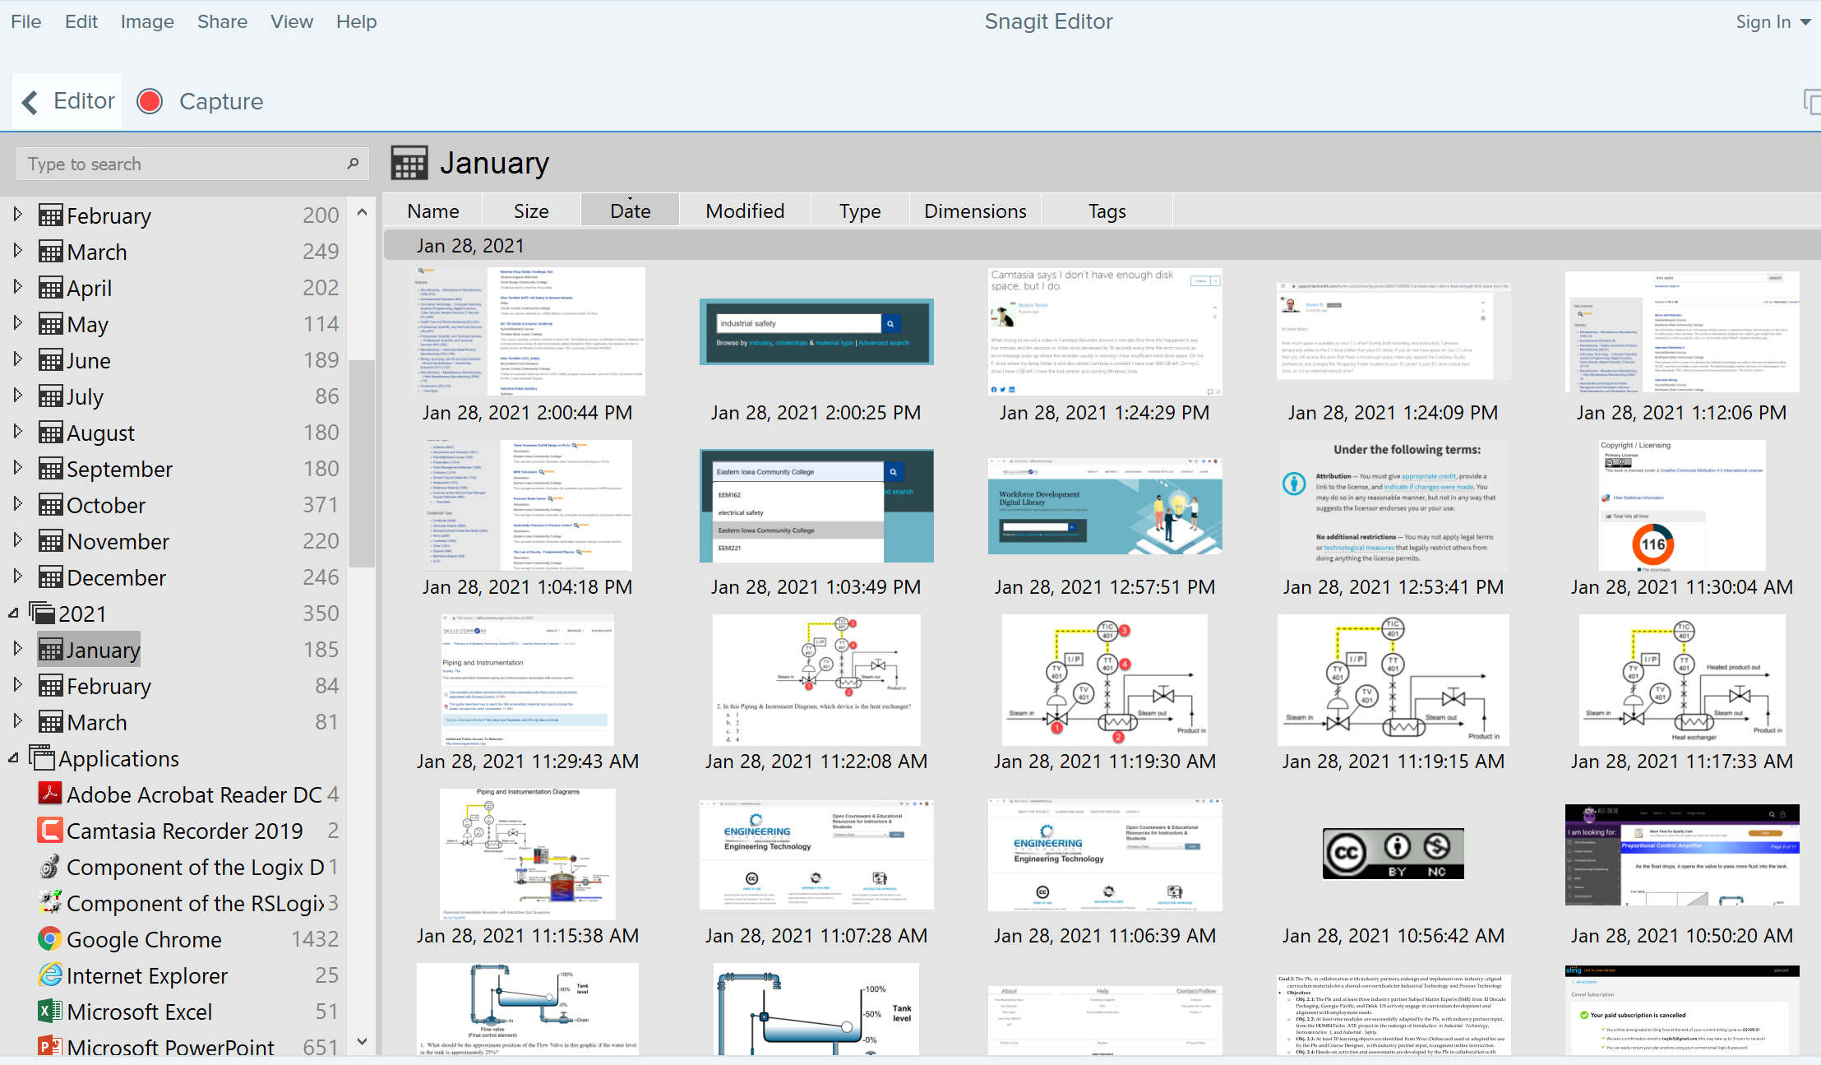
TechSmith Snagit Editor Library
User can go to any Month & Day for images

Slide 15
Four Primary Applications for Snagit
1. Capture a portion of a screen and save as a .PNG file or to clipboard
2. Record video from an existing video. I sometimes use this if I am recording something from a recording on a website that I want to save, or I am capturing an important video on YouTube, just as a backup in case they pull it down and I need to create one from scratch.
3. Capture a panoramic scrolling image. This is if I have a PDF that I want to backup, but the properties will not allow a download or to print it. I will scroll down through the document and save as a PDF. Always follow good legal practices.
4. Capture a block of text from the screen and “grab text” which will use OCR (Optical Character Recognition) and copy all and paste into a document so I can edit the text. I find old labs I created 10 years ago and I do not have the original files. Instead of re-typing them in, I use Snagit to capture the text as an object and convert it to editable text.

Slide 16
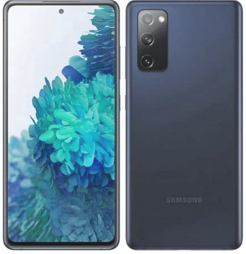
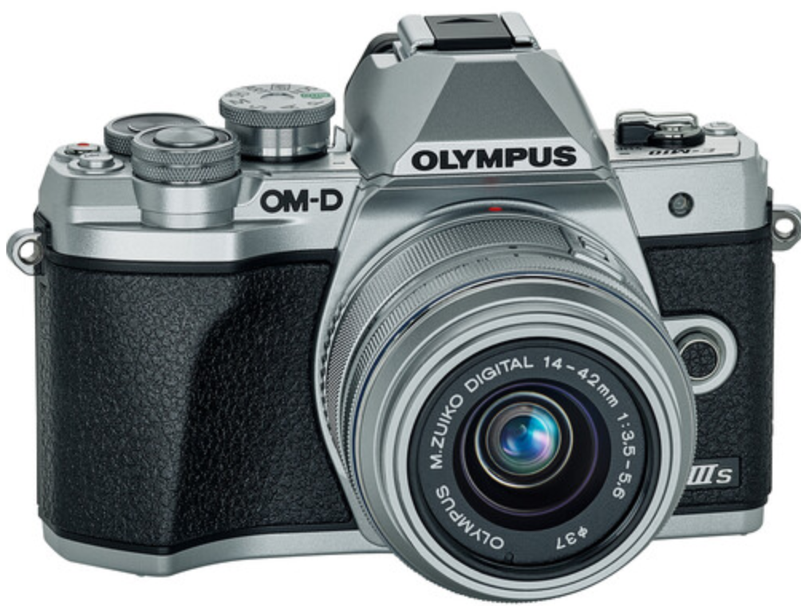
How to Create Videos
Video on how to Setup RSLinx
Recording Computer Screen
Video of how to Operate a CNC Controller
.MP4 or .MOV File
.MP4 File
.MP4 File
Video Quiz
Video Quiz

Slide 17
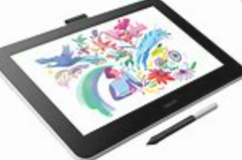
How to Create Videos
Voice over PPT Video of a Print
Recording Computer Screen
Recording voice as you annotate
(Wacom tablet or mouse)
Video Quiz
.MP4 File
Video Quiz

Slide 18
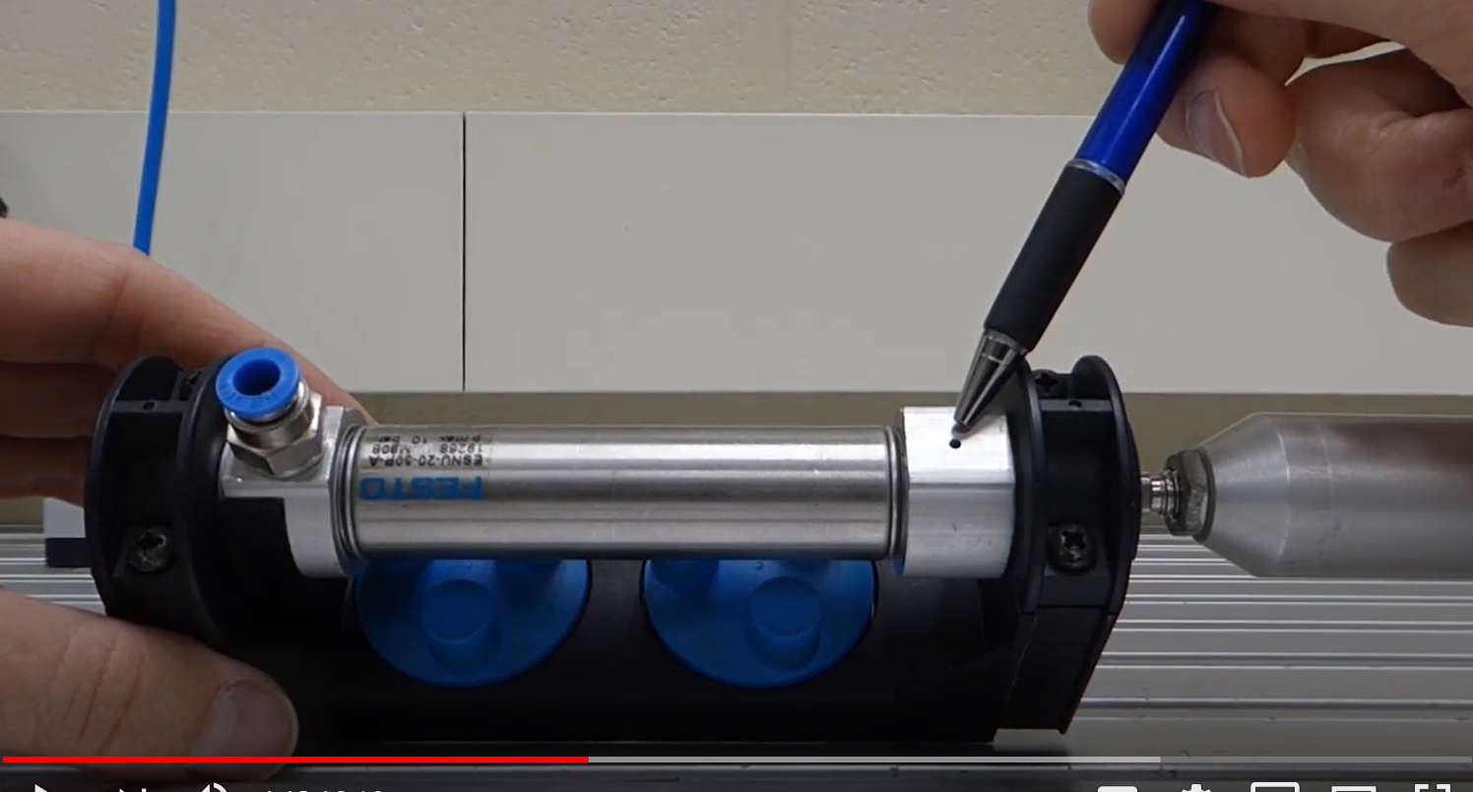
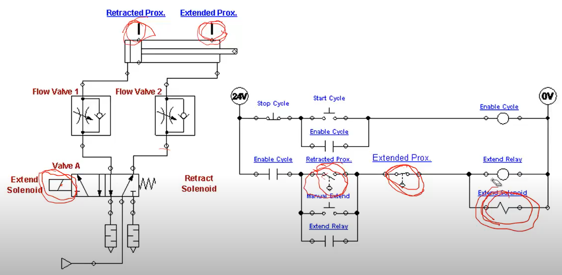
Learning Objects the User Navigates
Videos
Independent Learning Objects are posted in an LMS for student access. These objects can be viewed in any sequence. The upper left graphic shows a video that was shot with a camera, explaining a single acting pneumatic cylinder.
The middle graphic is a PPT that will be converted to a PDF, then posted in the LMS.
The bottom graphic is a voice over PPT, where the graphic was put into PPT, then annotated with a stylus on the computer touch screen.
All of these objects can be viewed on a smart phone, phablet, tablet or computer screen.
PPT/PDFs
Voice over PPT Video

Slide 19
Example Videos:
A video shot in the lab showing how to do something
(Video Links on Scaling Project site, Josh Coupling)
2. A screen cam video (22_0614 AS Basic Electrical Simulation)
3. A voice over PPT in Canvas (Voice over PPT with Wacom)

Slide 20
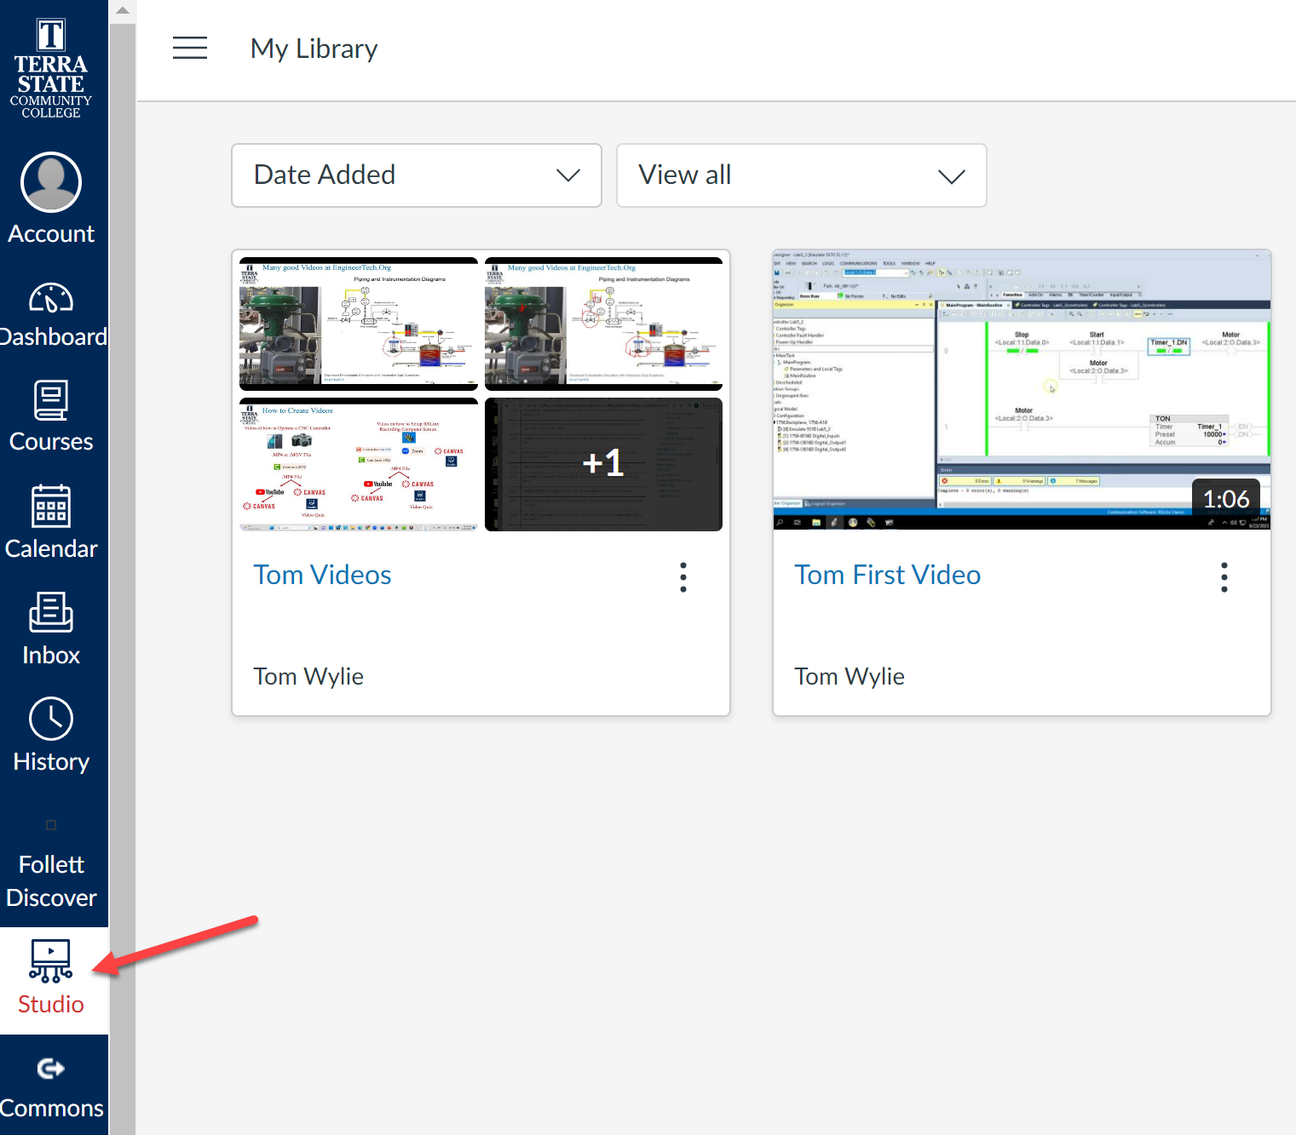
Videos in Canvas:
Collection

Slide 21
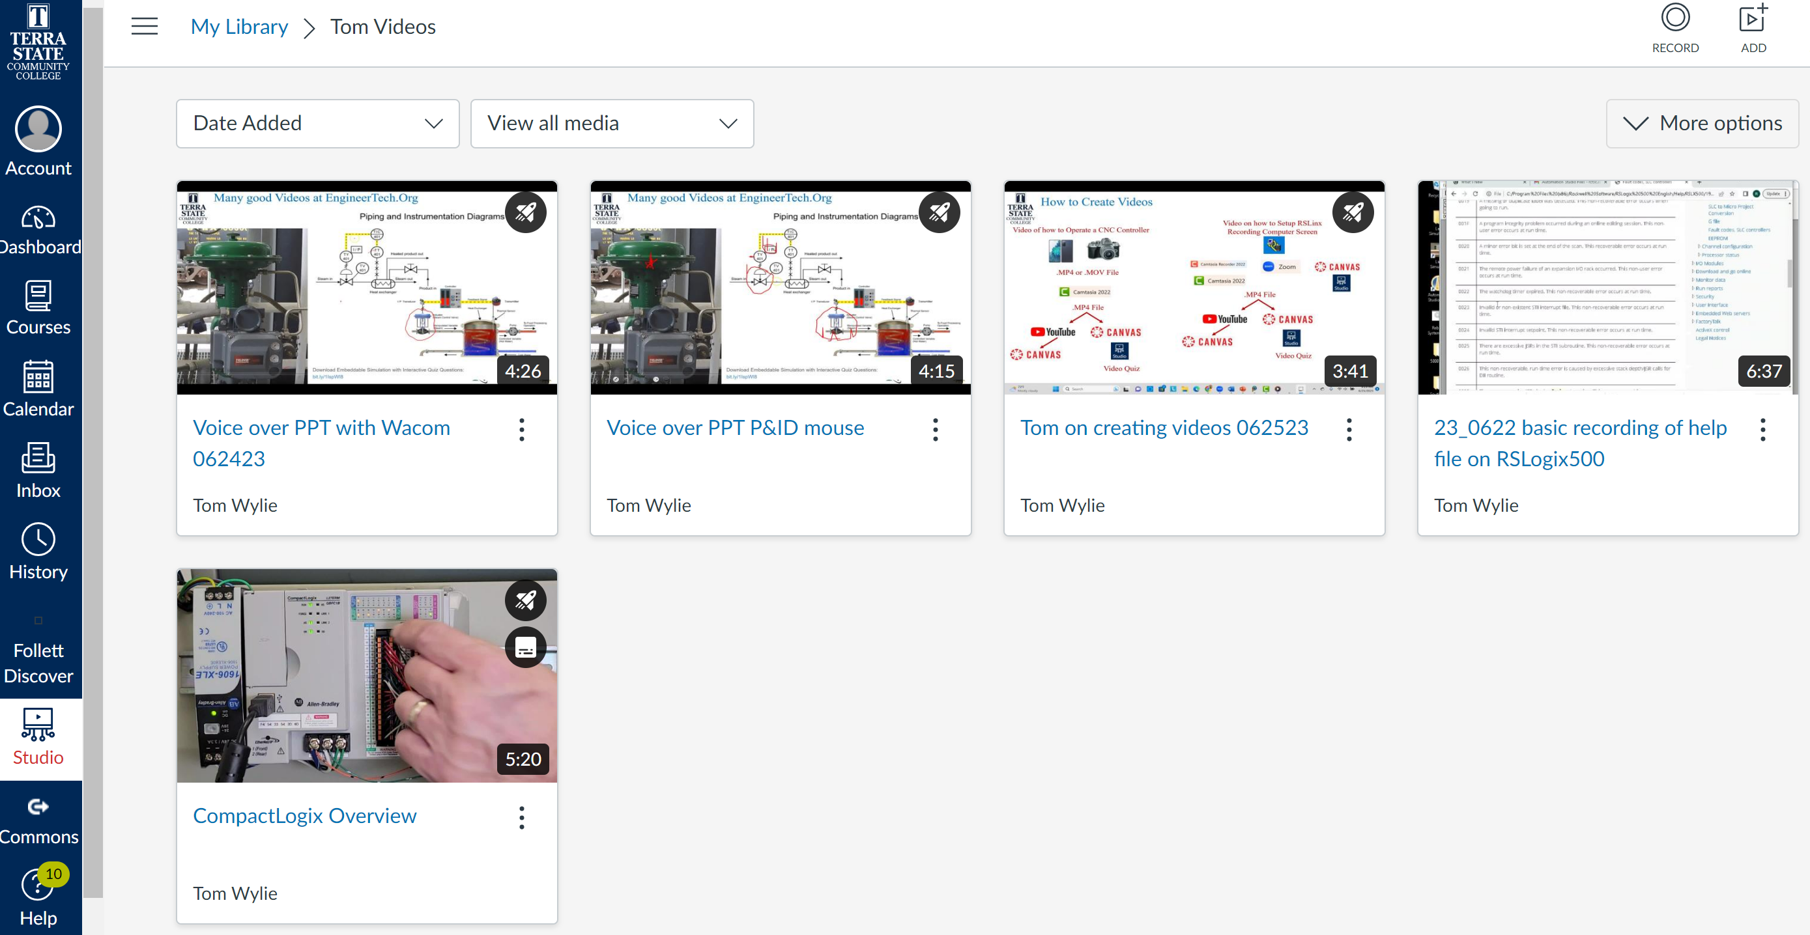
Collection of Videos in Canvas:
Airplane Icon means a Quiz was created for the Video

Slide 22
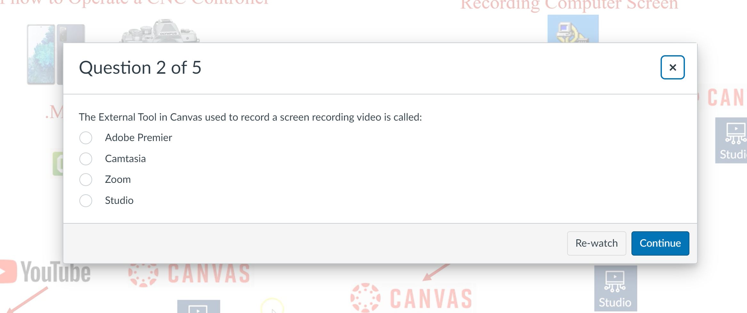
Collection of Videos in Canvas:
Questions in the Video
Studio Quiz Question
Re-watch since last question

Slide 23
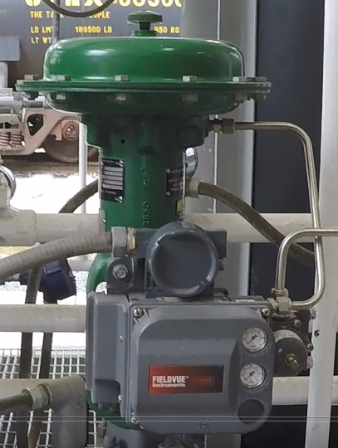
Many good Videos at EngineerTech.Org

Slide 24
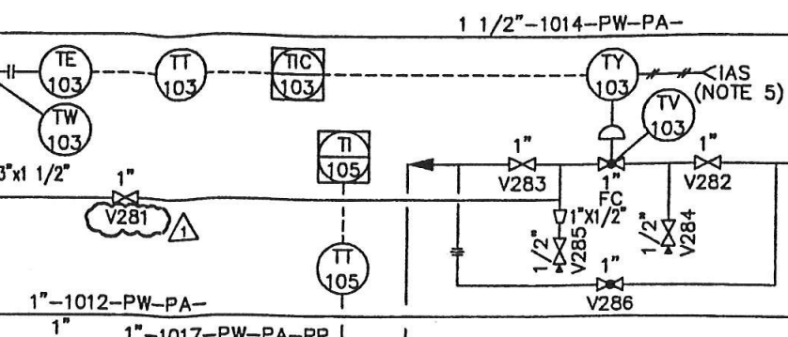
Interpreting a P&ID to the actual hardware:
Digital Valve Controller (I/P)
TCV-103 Control Valve

Slide 25
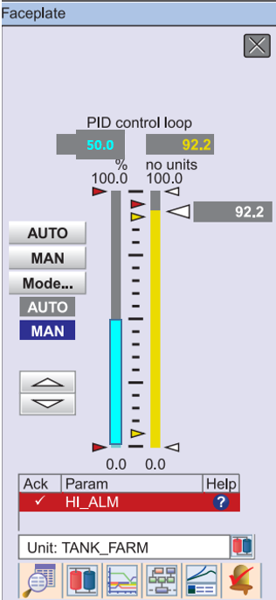
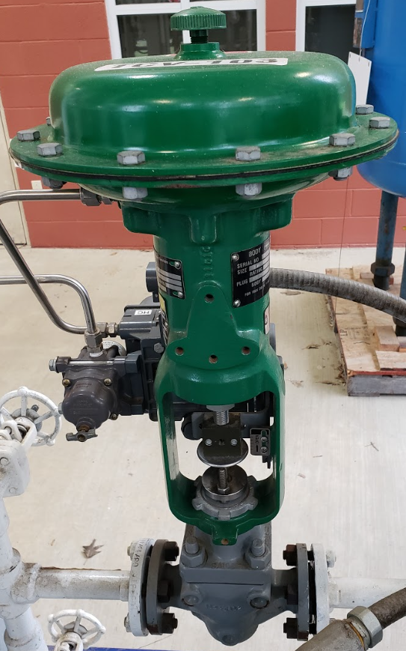
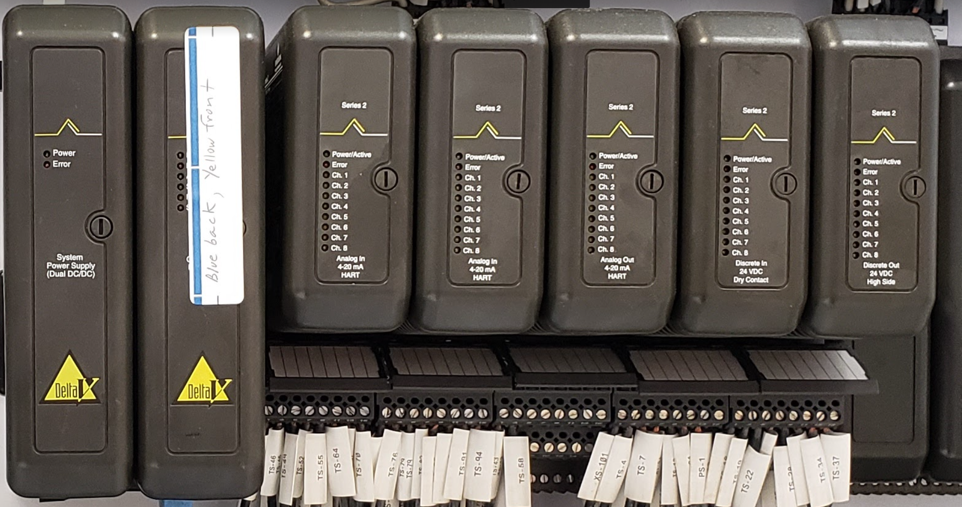
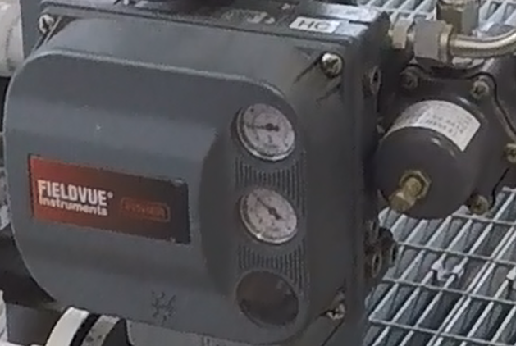
Signal Flow in a Distributed Control System:
Controller
Faceplate
50%
1/2 Open
9 psi
Control Console
50%
12 mA
70 psi
Delta V DCS System
DVC6200 (I/P)
Charge Tank

Slide 26
This Concludes this Instructional Document

