Slide 1
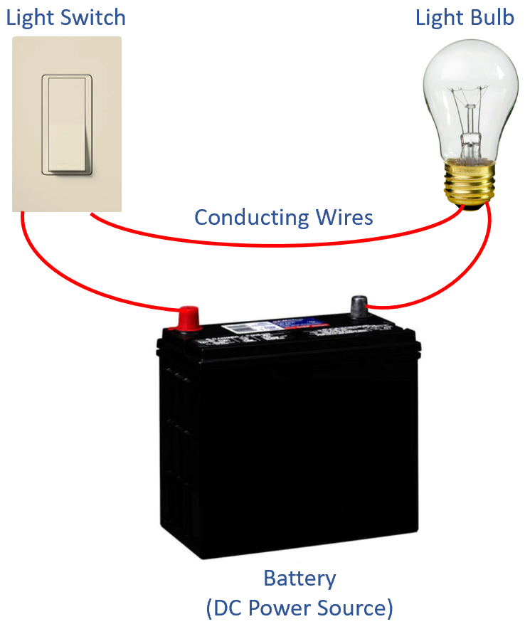
M2: Electrical & Motor Basics
Created by Tom Wylie, 6/8/22

Slide 2
Electrical & Motor Basics
After viewing this document, the student should be able to:
1. Determine what scale the dial should be set for on a digital multi-meter for a specific test.
2. Explain the different AC and DC voltage sources
3. Test a solenoid coil with a digital multi-meter, while out of circuit.
4. Test a N.O. and N.C. pushbutton with a digital multi-meter, while out of circuit.
5. Measure the resistance of N.O. and N.C. pushbutton and relay contacts
6. Explain the basic operation of an electro-mechanical relay.
7. Explain how a N.O. and N.C. relay contact operates in a relay circuit
8. Explain what a Start/Stop hold-in circuit is in relay logic.
9. Check the continuity of an open and a closed switch, using an ohmmeter
10. x

Slide 3
Course Disclaimer - Please Read:
This document is to overview the basics of electricity for the South Arkansas Community College students that are enrolled in the Intro to Technology course.
The intent of teaching electrical basics in the Intro to Technology course is to introduce the students to how electricity is used in a process and manufacturing environment. This course only introduces the students to the basic concepts and should not be used to replace a full electricity course.

Slide 4
Electrical Basics I
A typical electric circuit is made up of 4 parts:
The power source, in this case is a battery.
The load, in this circuit is the light bulb.
A switch for turning the circuit on and off.
Wires (or conductors) that connects the components together, and give a path for current flow.
When the switch is turn on (or closed) voltage is applied across the load, and current will flow through the circuit, which should turn on the light bulb.

Slide 5
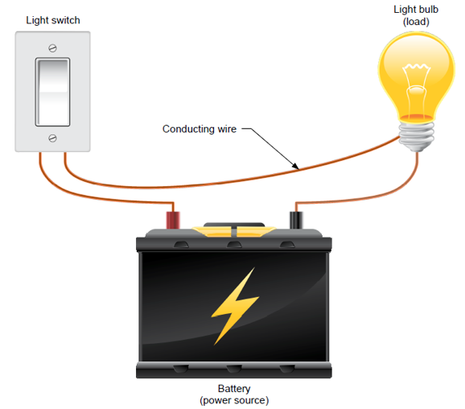
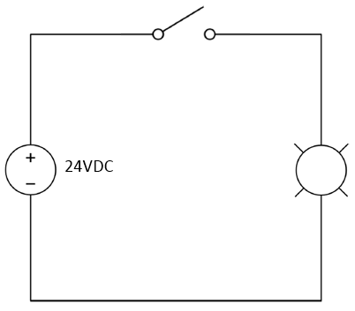
Electrical Terminology
A few terms that are important that will be expanded on later in the course:
Voltage: This is a force or potential that is put on a circuit to create current flow. It is many times termed EMF, for Electro-Motive Force. The letters “V” or “E” represent voltage. Voltage is measured in the units of Volts.
Current: This is the flow of electrons through the circuit (through the wires and the load). Current is measured Amperes, or Amps for short.
Resistance: This is the opposition to current flow. All loads (lights, coils, heating elements and motors) have a resistance. Switches are usually either zero resistance or infinity resistance. Resistance is measured in Ohms.
This illustration shows the physical components in a circuit, as well as an electrical circuit diagram.
Current flowing when
The light switch is on (closed)
Physical View of
Electrical Circuit
Electrical Circuit
Diagram
Light Switch
Power
Source
Light bulb
(load)
Voltage

Slide 6
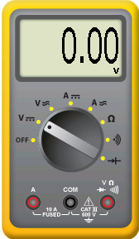
A virtual digital multi-meter for testing:
Since electricity is invisible, we need to use test equipment to measure the different things in an electrical circuit. This example shows a virtual digital multi-meter that is used in Automation Studio, but is also very similar to any actual digital multi-meter.
The focus will be on using the meter to measure voltage and resistance.
The dial in the center of the meter must be in the correct position.
**Warning: never use a meter in a powered circuit, if the dial is on the Resistance or Continuity setting. It can damage your meter.
The two things to measure with a digital multi-meter in this course is:
Voltage – Usually 24Vdc,
Resistance – Open Line, actual resistance
AC Volts
Resistance
Continuity
(audible)
DC Volts
Jack for measuring
Volts & Ohms
Adjustable
Dial

Slide 7
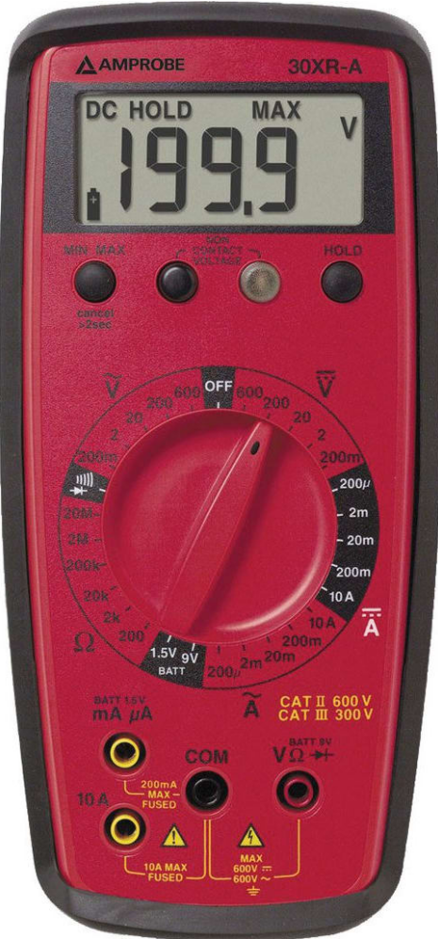
A digital multi-meter used in the lab:
Since electricity is invisible, we need to use test equipment to measure the different things in an electrical circuit. This example shows an Amprobe multi-meter that is used in the South Arkansas CC Advanced Manufacturing Lab.
The focus will be on using the meter to measure voltage and resistance.
The dial in the center of the meter must be in the correct position.
**Warning: never use a meter in a powered circuit, if the dial is on the Resistance or Continuity setting. It can damage your meter.
The two things to measure with a digital multi-meter in this course is:
Voltage – Usually 24Vdc
Resistance – Open Line or actual resistance.
AC Volts
DC Volts
Continuity
(audible)
Adjustable
Dial
Resistance
Jack for measuring
Volts & Ohms

Slide 8
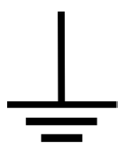
Electrical Symbols found on Multimeters
The electrical field uses many types of designations and symbols to represent devices and voltages.
This is just a few of the designations and symbols that will be found primarily on multimeters.
Continuity means that a device will allow current to flow. An open contact does not have continuity.
This is a designation on many DMMS to represent AC Volts
This is a designation on many DMMS to represent DC Volts
This is the Omega symbol, which in the electrical field is used to designate Ohms, which is resistance
This is a designation on many Digital Multimeters to represent an audible tone. Primarily to determine if a device has continuity.
This symbol is used to designate earth ground, or equipment ground

Slide 9
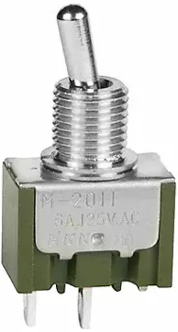
Basics of continuity & resistance
Continuity is a term used to explain that current can flow through a device. There is a path for current flow. Either a device has continuity or it does not.
Resistance is the opposition to current flow. Resistance is measured in Ohms. The device used to measure resistance is a Digital Multi-Meter, that is set up to measure resistance.
This course will discuss many types of switches. The most basic switch is a toggle switch. The user can toggle the switch on (up position), or off (down position). This is the same as a light switch in your home.
When the light switch is closed, it has continuity, which will allow current to flow, and the light will come on.
When the light switch is open (off), it has no continuity and the light will shut off.
Switch is open
Switch has no continuity
Resistance is infinite resistance
Standard
Toggle Switch
Switch is closed
Switch has continuity
Resistance is zero ohms

Slide 10
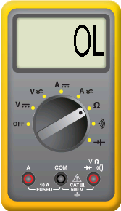
Testing the Continuity of a Switch
OL
In this illustration An Ohmmeter will be used to measure the resistance of a basic toggle switch. The switch will be either “on” or closed, or it is “off” or open.
In the top image the Ohmmeter is across an open switch. The switch has no continuity and measures infinite resistance. The meter display will show an OL, which means open line. Current will not flow through an open switch.
In the lower image the Ohmmeter is across a closed switch. The switch has continuity and measures zero resistance. Current will flow through a closed switch.
Switch is open
Switch has no continuity
Resistance is infinite resistance
Switch is closed
Switch has continuity
Resistance is zero ohms
0.0

Slide 11
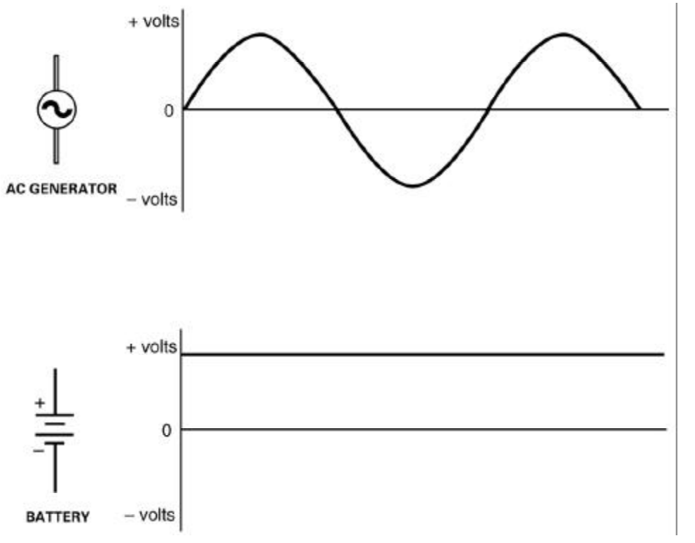
AC power versus DC power:
This slide compares the waveforms for both AC and DC power waveforms.
The top graphic is an AC (Alternating Current) waveform, that is many times called a Sine Wave. Notice that it alternates from positive to negative continuously (thus called alternating). AC power is predominately used in residential, commercial and industrial environments.
The lower graphic is DC (Direct Current), which does not alternate, it stays a steady voltage. A flashlight or smoke alarm battery is DC. In an industrial environment, DC will be used to power the control systems of a machine, and will also be used within a variable frequency drive.
We will cover and compare the basics on both DC and AC electricity in the following slides.
AC
DC

Slide 12
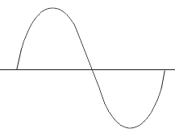
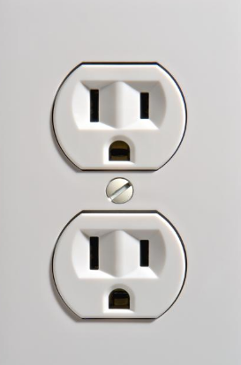
AC Single Phase Power
The AC sine wave is the waveform a student would see if an oscilloscope was connected to AC power. This waveform is created by a generator at a power company, and is transformed along the way to a useful voltage to power electrical equipment.
This AC waveform is measured in cycle (or Hertz). One AC waveform as shown is a cycle. 60 of these cycle occur in 1 second, which is called 60 hertz. All power companies in the United States generate and distribute AC electricity at 60 Hertz (HZ.) to their customers.
This waveform would also be called single phase. This is the power found on outlets and lighting circuits.
1 cycle or hertz
60 hertz means that 60 cycles
occur in one second
A standard wall outlet
In a home or in industry
is 120Vac, at 60 Hz

Slide 13
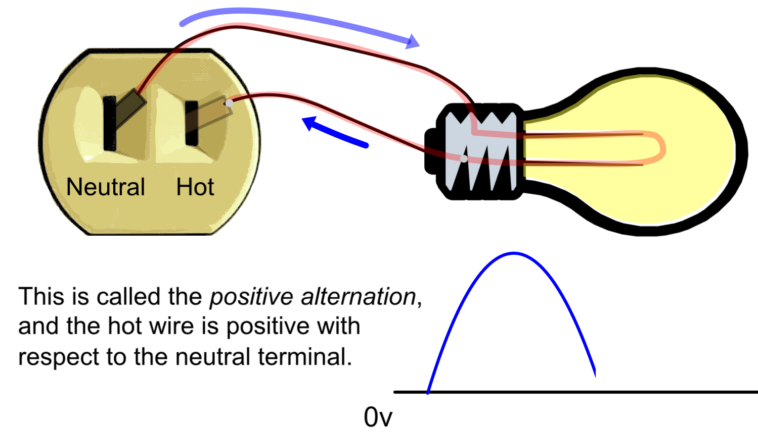
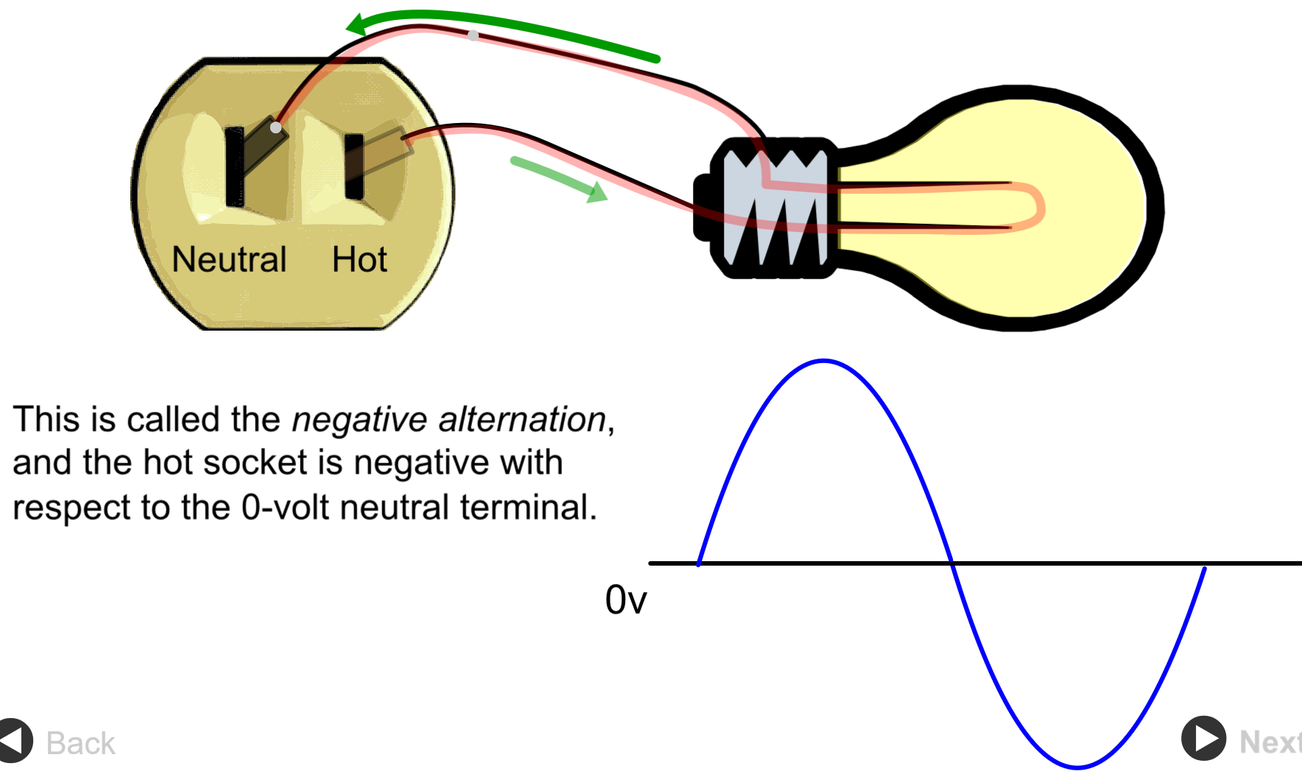
Alternating current flow:
This slide shows a light bulb that is powered with AC (120 VAC) power from a standard residential power outlet.
The current flows in one direction during the positive portion of the AC sine wave. Notice that it flows from the Neutral portion of the plug, through the light, then back to the hot side of the outlet.
The current flows in the other direction on the negative portion of the AC sine wave, thus in the lower portion of the graphic, current flows from the Hot portion of the outlet, through the light, then back to the Neutral side of the outlet.
Realize that this is why they term “Alternating Current” (AC) is used, the current changes direction every half cycle.
Positive portion
of the waveform
Negative portion
of the waveform

Slide 14
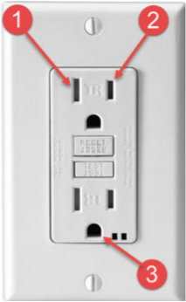
GFCI Outlet Wiring
This graphic shows the wiring of a Ground Fault Circuit Interrupter. These devices will be in the form of an outlet, or as a breaker in the power panel. The purpose of these devices is to protect an individual from electrocution by sensing the current difference between the hot and neutral wires. If there is a difference of more than 5mA (which is enough current to electrocute someone), the device will trip, shutting off the power.
These are required in outside outlets, or in bathrooms; primarily anywhere that there is a lot of moisture.
Notice the wiring is the same as a standard outlet for the hot, neutral and grounding conductor.
The Test button, when pushed will create a 5mA difference between the hot wire and the neutral wire, which will shut off the device.
The Reset button will power the GFI outlet.
White wire,
Neutral
Black, Hot
Wire
Reset
Button
Test
Button
Green or bare
grounding wire

Slide 15
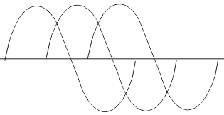
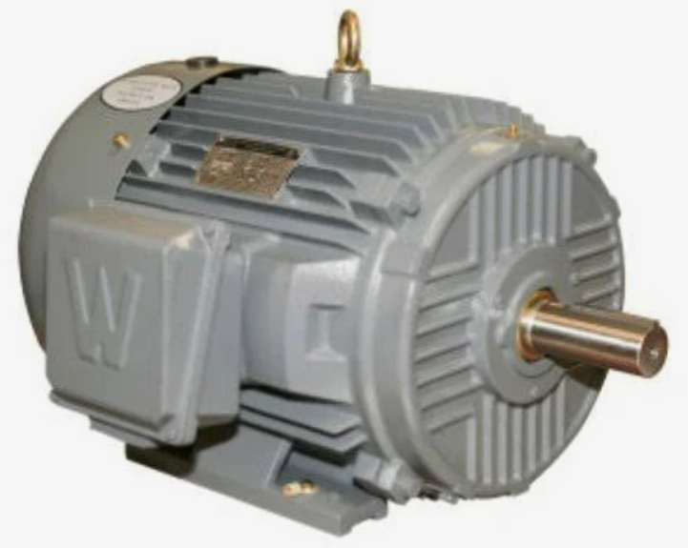
AC Three Phase Power
A three phase power waveform would look like this graphic. Notice that this is made up of three single phase waveforms. There is a 120 degrees phase shift with three phase. This means that 120 degrees into the first sine wave, the next single phase sine wave starts. Then 120 degrees later, the next sine wave starts.
Three phase is more powerful than single phase. This is why most industrial motors are three phase. The three phase motors are smaller than the same horsepower single phase motor.
240Vac three phase is a common motor voltage, as well at 480Vac three phase. Many motors are dual voltage rated, so they could be wired for either 240 Vac or 480 Vac. In most cases the motor is wired for 480 Vac, which will require smaller size power wires to carry the current, thus a lower cost installation.
L1
L2
L3
120 degrees
Three Phase
AC Motor

Slide 16
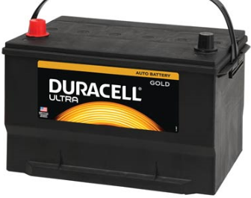
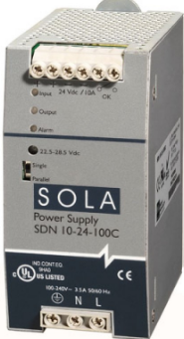
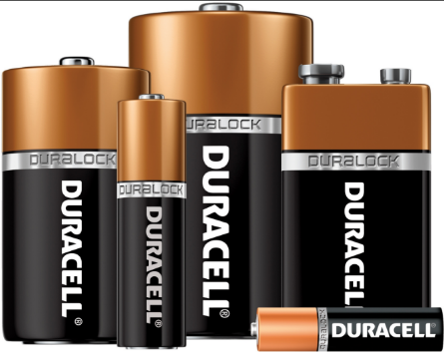
Direct Current (DC) Sources
There are typically two types of direct current power sources: Batteries & DC power supplies.
Batteries are manufactured from certain materials that create a DC voltage. Some batteries are rechargeable, and others are disposable.
Larger batteries are found in cars, tow motors and automatic guided vehicles.
Smaller batteries are found in hand tools, smoke detectors and many other small devices.
DC power supplies are devices that take AC electricity and converts it to DC. The most common DC voltage found in industry is 24Vdc. Many control circuits are 24Vdc, which controls machinery.
DC has polarity, so there is a “+” and “-” connections on each DC source.
12 Vdc Car Battery
Small DC Batteries
24 Vdc Industrial
Power Supply

Slide 17
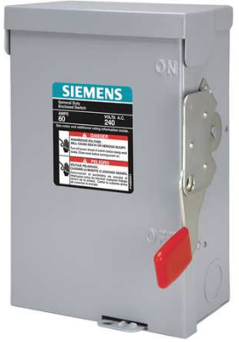
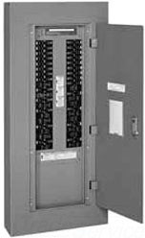
Alternating Current (AC) Sources
Alternating Current (AC) is the most used type of electricity in an industrial environment.
AC will be used to run motors, power lights, and power heating elements in a manufacturing environment.
AC power is generated at a power plant and distributed to customers through an electrical distribution network, which is beyond the focus of this course.
Users will get their AC power from a number of sources such as duplex receptacles (outlets), electrical disconnects, and electrical power panels. We will discuss a few more sources in later courses.
AC can also be single phase, or three phase.
In this course the user will be using 24Vac or 120Vac.
120 Vac outlet
AC electrical disconnect
AC electrical power panel

Slide 18
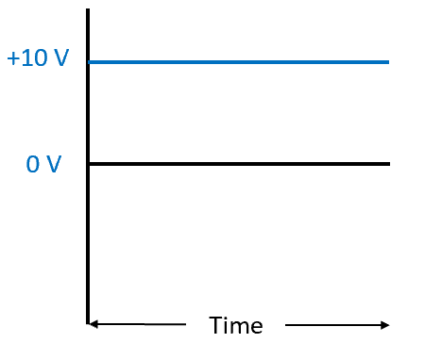
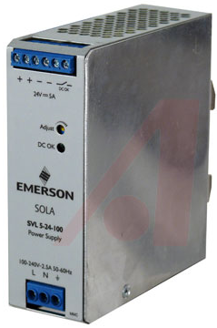
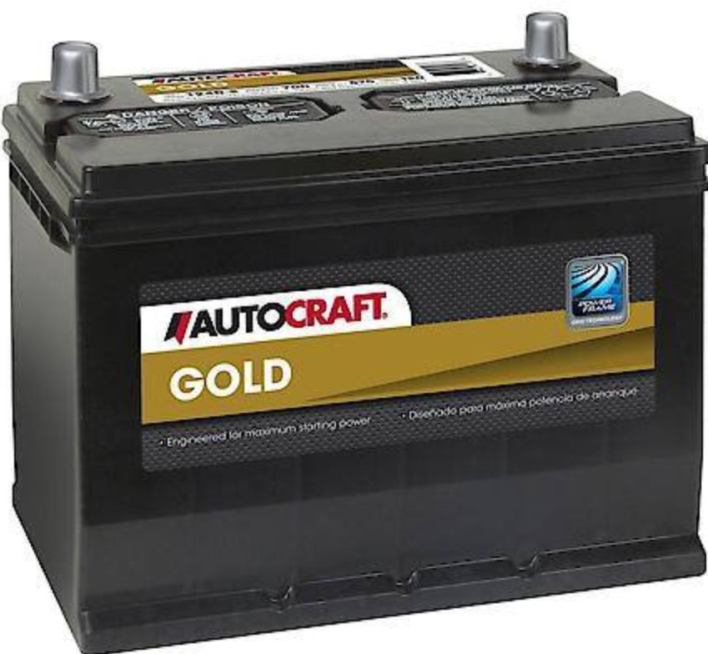
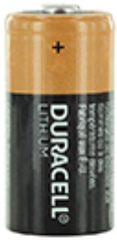
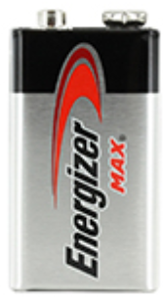
DC Basics:
DC stands for Direct Current, which is typically low voltage type of electricity. The most basic form of DC is a battery.
An important characteristic of DC power is that current only flows in one direction, and it is constant with time, as shown in the top graphic. The primary sources for DC power is batteries and DC power supplies.
Another important characteristic of DC is that I cannot transform it through a transformer. In the following slides, we will discuss AC power, and its advantage of being able to transform to different voltage level.
There are a number of applications for DC power in an industrial environment. Tow motors (lift trucks) is one of our more common applications. The track has a bank of batteries that will run a DC motor. DC is very common on industrial machinery to power the control circuit of a production machine. The most common control voltage is 24 Vdc, which will come from a DC power supply, as shown in the lower graphic.
DC stays at a consistent
voltage over time, and does
not alternate or change direction
Symbol for a DC
Power Source, 2
batteries in series
Symbol for a DC
Power Source
24 Vdc Power Supply found
in most electrical panels
Various Batteries

Slide 19
Practice Question #1
What are the two power sources for DC voltage?
a. Wall outlet
b. DC Power Supplies
c. Batteries
d. All of the above
5 Ohm
Load

Slide 20
The Answer to Practice Question #1
What are the two power sources for DC voltage?
a. Wall outlet
b. DC Power Supplies
c. Batteries
d. All of the above
Explanation: The two sources for DC power is batteries and power supplies. Many devices have their own internal power supplies such as variable frequency drives. Incoming AC power is converted to DC power within a VFD. Batteries are used in many industrial applications.
5 Ohm
Load

Slide 21
Practice Question #2
What would be the voltage measured on a standard outlet used at home?
a. 60 VAC
b. 120 VAC
c. 120VDC
d. 208 VAC
5 Ohm
Load

Slide 22
Answer to Practice Question #2
What would be the voltage measured on a standard outlet used at home?
a. 60 VAC
b. 120 VAC
c. 120VDC
d. 208 VAC
Explanation: A standard outlet (also called a duplex receptacle) found in your home, office or industrial environment is 120Vac. The outlet shown is also rated at 15 amps.
5 Ohm
Load

Slide 23
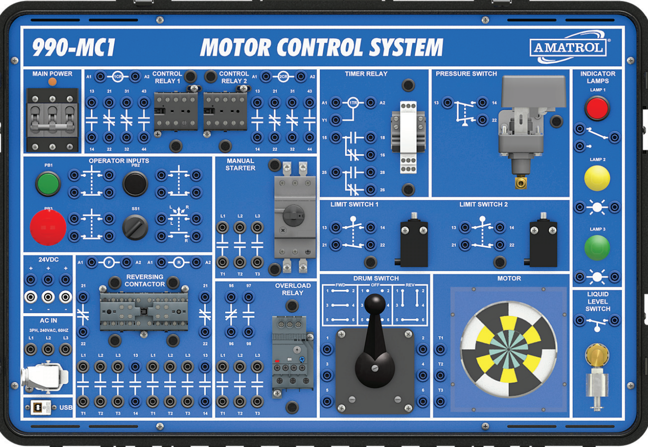
Motor Control System Training Unit:
This is the Amatrol Motor Control training unit found in the Advanced Manufacturing lab at South Ark CC. The students will use this training unit to perform their lab exercises and their practical (hands-on) assessments for the course.
This unit is powered with a 208Vac three phase power feed, which is used to power a 24 Vdc power supply on the unit. This course will focus on using only the 24 Vdc power.
It is important when working in the lab to wear safety glasses even if the circuit is not powered.

Slide 24
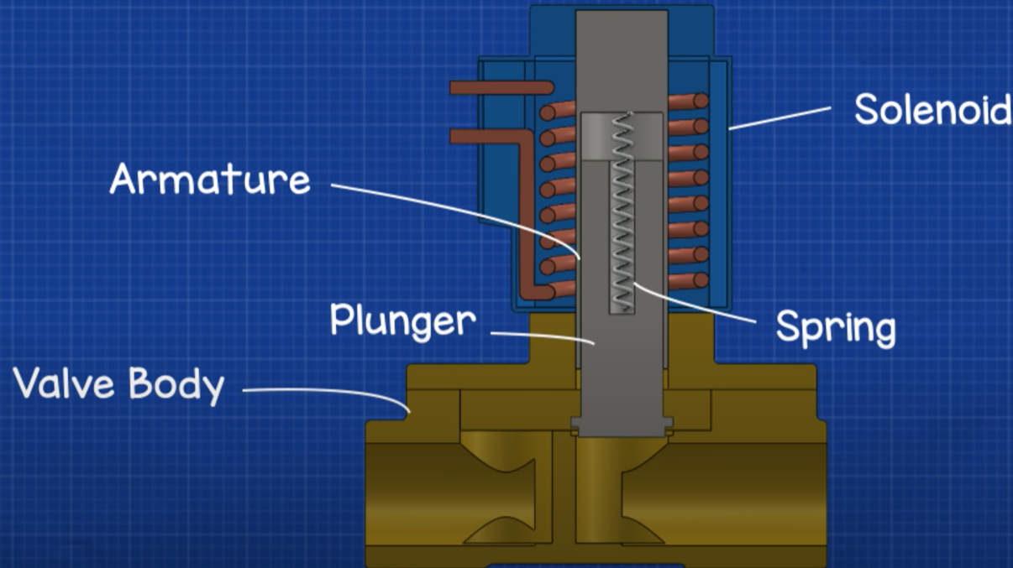
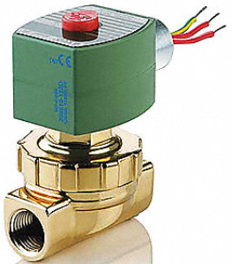
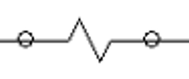
Solenoid Coil:
The lower left graphic shows the symbol for a solenoid coil on an electrical print.
This example shows a 2-way valve (2 ports). It is a valve that opens or closes off the flow of air, fluid, gas, etc.
The most important thing about these valves is that they have 2 parts: The valve (spring and plunger) that is actuated by the magnetic force of an electric solenoid. This type is termed an ASCO (manufacturer), red hat, due to the red cap. The cap is removed with a screwdriver, then the coil can be removed. If the device is on, you will feel the magnetism with a screwdriver. Sometimes the coil is bad (it opens), or the plunger sticks and must be replaced.
An important thing to remember is that if the coil is 120Vac, is removed from the valve with power still on, a screwdriver must be inserted into the opening in the coil to keep the coil from burning up. No need to do this with a 24Vdc coil.
Solenoid Coil
Electrical Symbol
for a Solenoid Coil
Solenoid Valve

Slide 25
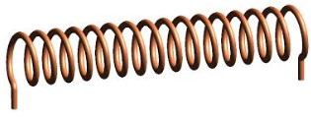
Checking the coil out of circuit:
To verify that a solenoid coil is good, the user can measure the resistance when it is not connected in a circuit.
If it is out of the circuit, and an ohmmeter (digital multi-meter on the resistance scale) is put across the coil, the coil is good if it reads a resistance. If it reads a resistance, it also has continuity.
If the meter reads OL, which means Open Line, the coil is bad and must be replaced.
Coils do not typically short out, they open due to overcurrent. There is also a possibility that the insulation on the wire breaks down and the solenoid coil wire could short to ground.
125 Ohms
Coil is open, so it will
display OL for Open Line

Slide 26
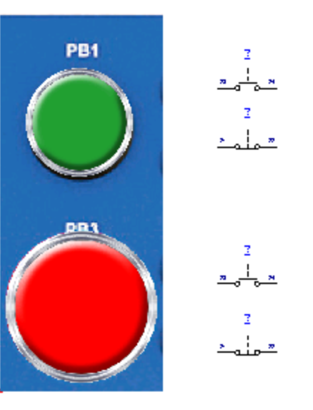
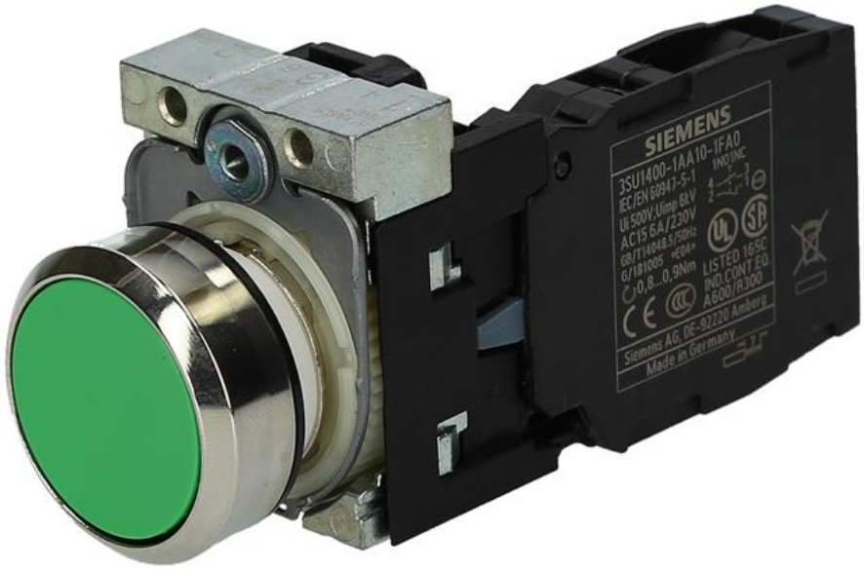
Pushbutton Contacts:
This slide shows a pushbutton, and the contacts attached to the pushbutton (pushbutton contacts). The top graphic shows a pushbutton assembly (pushbutton operator, and the contact block).
The lower graphic shows what would be termed a start/stop pushbutton station (has both a start and stop pushbutton). Each pushbutton has a normally open and a normally closed contact connected to it. This will be illustrated in the Automation Studio software, and also on the Amatrol Motor Control trainer.
Pushbutton
Contact Block
Normally Open
Contacts
Normally Closed
Contacts

Slide 27
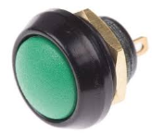
Testing a Normally-open Pushbutton:
Many times a user must test a Normally-open pushbutton contact when it is out of the circuit, to determine if it is faulty.
The diagram at the left shows a Normally-open (N.O. for short) pushbutton. The resistance should be OL (open line), which is also infinity ohms.
If the pushbutton is pushed, as shown in the right diagram, the switch is now closed, which should measure 0 ohms.
To remove the pushbutton from a circuit, power down the circuit (remove power), then take a wire off of one of the two terminals of the pushbutton, then put the Ohmmeter across the switch terminals.
OL
0.0

Slide 28
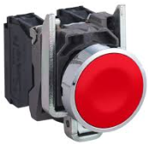
Testing a Normally-closed Pushbutton:
Many times a user must test a Normally-closed pushbutton contact when it is out of the circuit, to determine if it is faulty.
The diagram at the left shows a Normally-closed (N.C. for short) pushbutton. The resistance should be 0 ohms.
If the pushbutton is pushed, as shown in the right diagram, the switch is now open, which should measure a very high resistance, which should be an open line.
To remove the pushbutton from a circuit, power down the circuit (remove power), then take a wire off of one of the two terminals of the pushbutton, then put the Ohmmeter across the switch terminals.
0 Ohms
OL

Slide 29
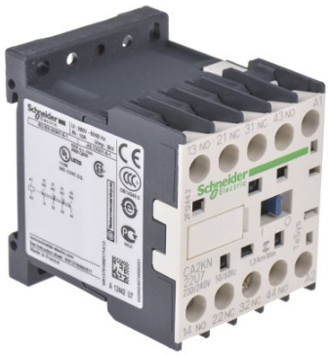
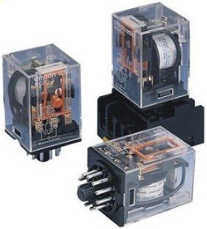
Relays:
This slide shows a basic the symbols and actual devices for an electro-mechanical relay. A relay is used as a logic device in a ladder logic circuit. The relay typically has Normally Open (N.O.) contacts that has no continuity in it’s deactivated state. It also may have Normally Closed (N.C.) contacts that should measure 0 ohms (full continuity) in it’s deactivated state.
When the relay coil pulls in (gets powered), the contacts change state. The N.O. contact now will have full continuity, and the N.C. contact will open.
The contacts of a relay will be rated at 10 amps or less.
Most contacts are rated for at least 300 volts, since the maximum control voltage by law is 250 volts.
These relay coils may be rated at either 24Vdc or 120Vac for an industrial application.
The HVAC world many times use 24Vac coils.
Relay Coil
N.O. Relay Contact
N.C. Relay Contact
Industrial IEC Relay
Industrial Ice Cube Relays

Slide 30
Practice Question #3
A
B
The symbol marked with a “B” would be a:
a. Normally-open relay contact
b. Normally-closed relay contact
c. Relay coil
5 Ohm
Load

Slide 31
Answer to Practice Question #3
A
B
The symbol marked with a “B” would be a:
a. Normally-open relay contact
b. Normally-closed relay contact
c. Relay coil
Explanation: The electrical symbol marked with an “A” is a normally-open relay contact. The electrical symbol marked with a “B” is a normally-closed relay contact.
5 Ohm
Load

Slide 32
Measuring relay contact resistance 1:
It is important to understand how the Normally-Open (N.O.) and Normally-closed (N.C.) contacts work on a basic relay.
The top graphic shows a 24Vdc power supply powering a circuit with a N.O. pushbutton contact in series with a relay coil (CR1). To the right of the coil is a N.O. and N.C. relay contact.
The lower graphic shows a multimeter, that is being used as an ohmmeter to measure the resistance of the relay contacts.
Notice the dial position on the multimeter is on the Omega symbol, which means resistance. The multimeter probes are put across the N.O. contact to monitor the resistance. OL on the multimeter display means Open Line, or infinite resistance, which will not allow current to flow.
The resistance range marked
with an Omega symbol Ω

Slide 33
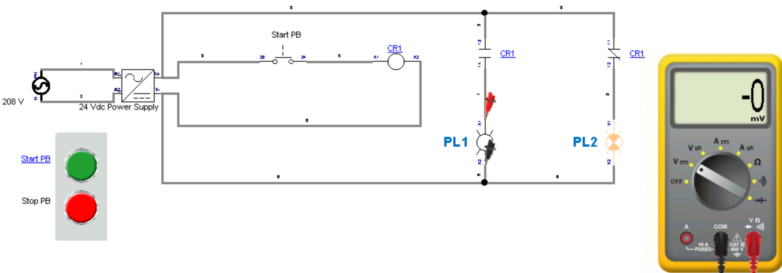
Operation of Normally-Open Relay Contacts 1:
The top graphic shows that the Normally-Open relay contact measures an open line (OL) resistance, which is infinity ohms. This means that current cannot flow through this contact. Notice that the relay coil is not actuated, which means the StartPB is not pushed (actuated).
In the lower graphic, the circuit shows the N.O. relay contact in series with PL1. Since the contact is open, no current will flow to the pilot light, thus there will be no voltage across the pilot light, and it will be off.
Relay coil is not actuated

Slide 34
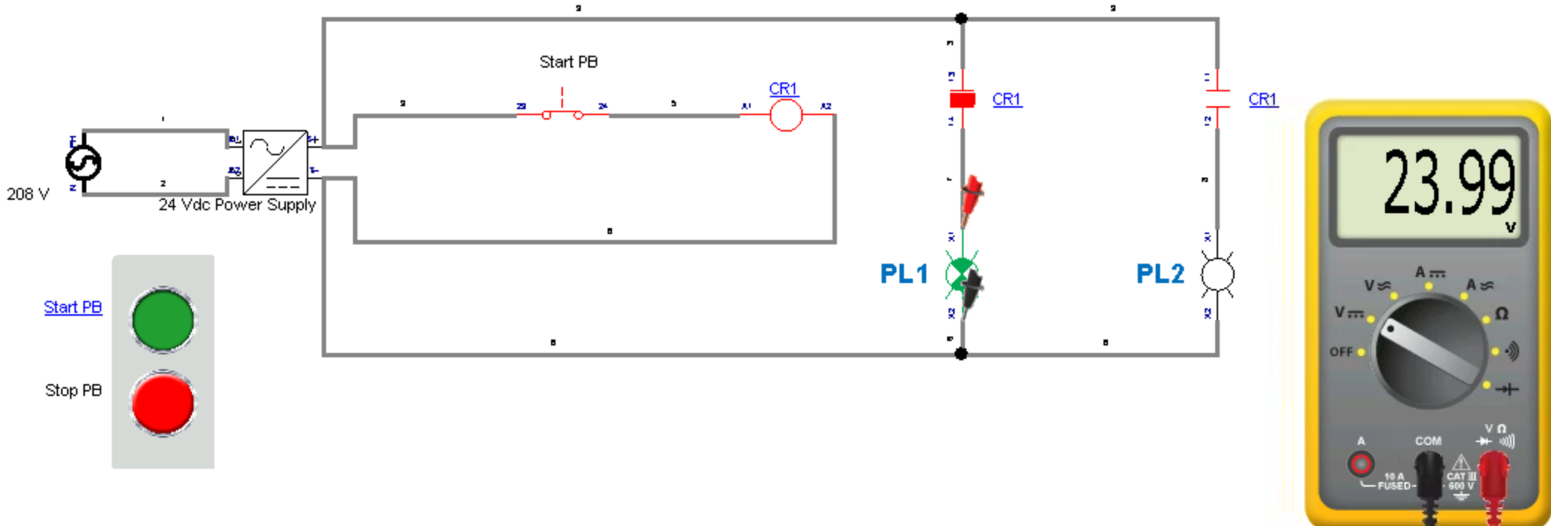
Operation of Normally-Open Relay Contacts 2:
The top graphic shows that the Normally-Open relay contact measures zero resistance. This means that current can flow through this contact. Notice that the relay coil is actuated, which means the StartPB is pushed (actuated).
In the lower graphic, the circuit shows the N.O. relay contact in series with PL1. Since the contact is closed, current will flow to the pilot light, thus there will be approximately 24 Vdc measured across the pilot light, and it will be on.
Relay coil is actuated
Pilot light is on

Slide 35
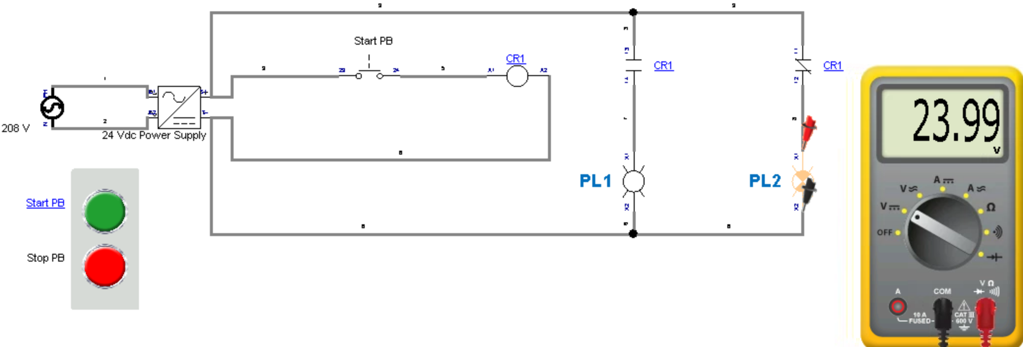
Operation of Normally-Closed Relay Contacts 1:
The top graphic shows that the Normally-Closed relay contact measures zero resistance. This means that current can flow through this contact. Notice that the relay coil is not actuated, which means the StartPB is not pushed (actuated).
In the lower graphic, the circuit shows the N.C. relay contact in series with PL2. Since the contact is closed, current will flow to the pilot light, thus there will be approximately 24 Vdc measured across the pilot light, and it will be on.

Slide 36
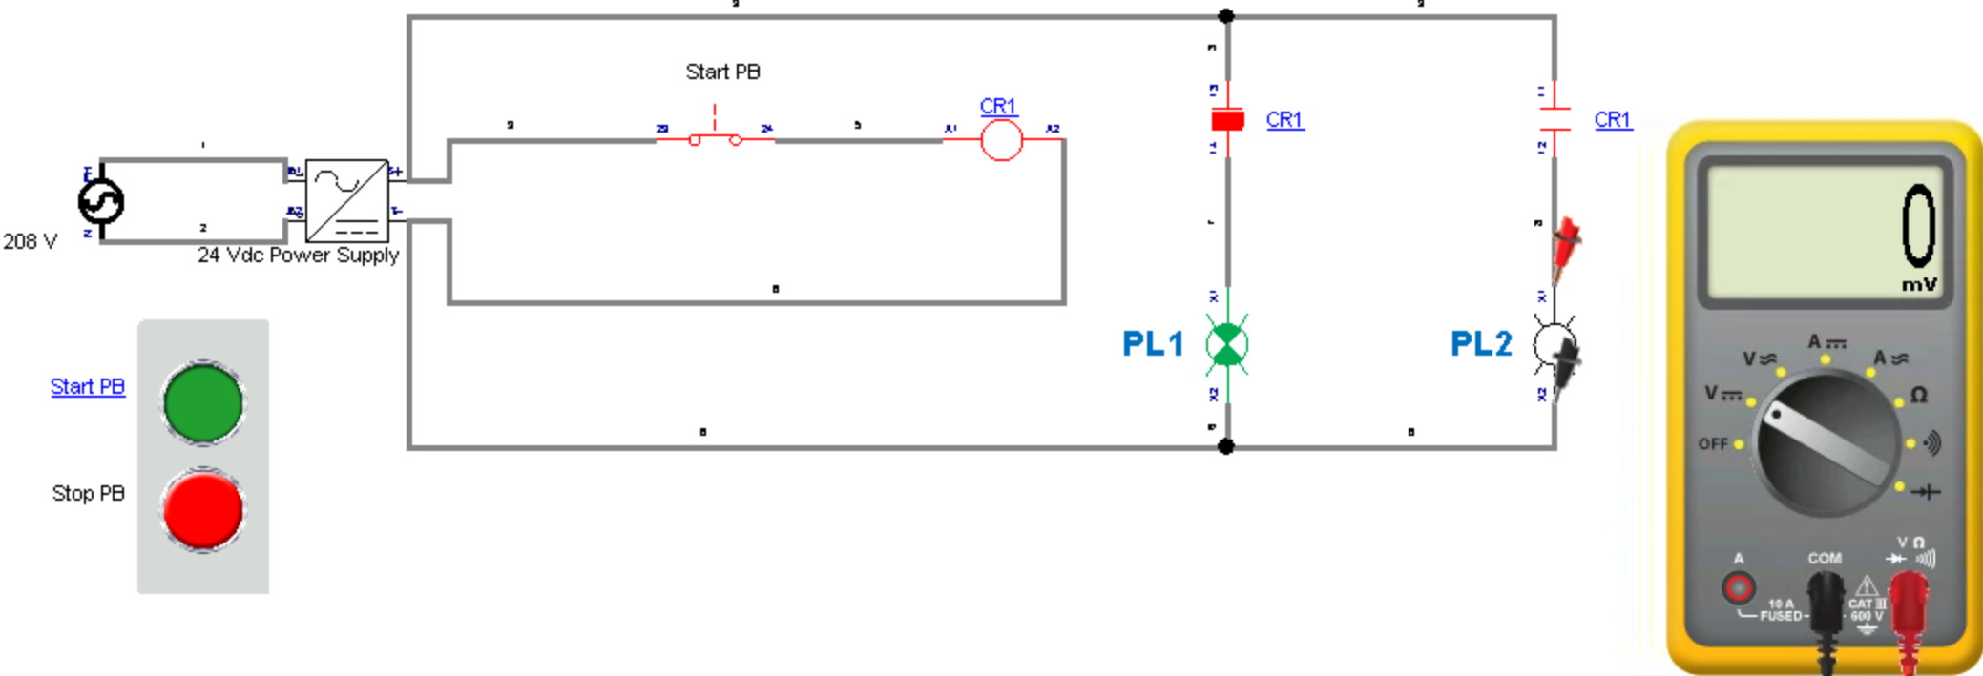
Operation of Normally-Closed Relay Contacts 2:
The top graphic shows that the Normally-Closed relay contact measures Open Line (OL), which is infinite resistance. This means that current cannot flow through this contact. Notice that the relay coil is actuated, which means the StartPB is pushed (actuated).
In the lower graphic, the circuit shows the N.C. relay contact in series with PL2. Since the contact is open (due to CR1 relay coil being energized), current will not flow to the pilot light, thus there will be no voltage measured across the pilot light, and it will be off.

Slide 37
Practice Question #4
What should the voltmeter read in the above circuit?
a. 24Vdc
b. 0 V
c. 24 Vac
OL

Slide 38
Answer to Practice Question #4
What should the voltmeter read in the above circuit?
a. 24Vdc
b. 0 V
c. 24 Vac
OL
Explanation: The voltmeter is measuring the voltage across PL1. Since the N.O. contact is controlling the current to PL1, and the contact is open, due the relay coil not being actuated, there will be no voltage drop across PL1.

Slide 39
Relays used in a Start/Stop circuit:
This circuit shows a relay (Enable_Cycle) that is used in a Start/Stop configuration, with a hold-in contact used from the relay. The purpose of the hold-in contact is that when the start button is pushed, the relay coil is energized, which closes the hold-in contact, then when the start button is released, the relay coil remains energized.
Pressing the stop button will shut off power to the relay coil, which will open the hold-in contact.
This is a common configuration in both relay circuits, and motor control circuits.
Hold-in contact

Slide 40
The Start/Stop hold-in circuit:
This slide shows the how a start/stop hold-in circuit works. The intent is that when the Start Cycle button is pressed, the Enable Cycle relay coil is energized, and when the Start Cycle button is released, the relay coil remains energized.
To make this work, a Normally Open relay contact must be wired in parallel to the Start Cycle pushbutton. When the relay coil is energized, it closes the N.O. contact as shown in step 3 of this graphic. When the Start Cycle is released, the Enable Cycle relay remains energized.
The way to shut off the Enable Cycle relay is to press the Stop Cycle pushbutton.
1. The Start Button is activated
2. The relay coil is energized
3. The N.O. relay contact is closed
4. The Start Button is released
5. The relay coil is held in
by it’s own contact

Slide 41
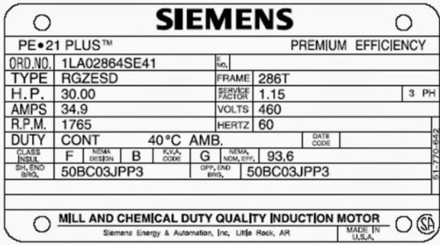
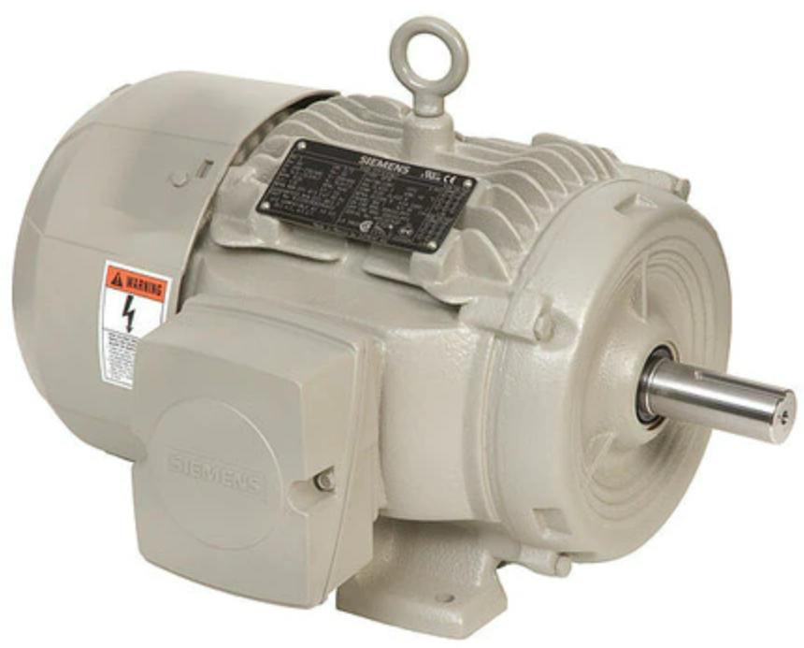
AC Electric Motor and Motor Nameplate
AC electric motors are very common in the industrial or process industries. Many of the motors are powered with three phase electricity. Common 3 phase motor voltages are 240 Vac three phase, and 480 Vac three phase. The higher voltage requires smaller wires to carry the current, so most of the time, motors are wired for 480 Vac three phase.
This diagram shows a three phase motor in the lower graphic, and the nameplate on the motor in the upper graphic. A few of the very important parameters on the nameplate are:
HP – Horsepower, which is the mechanical power the motor can put out to turn a load. This example shows a 30 HP motor
Volts – Rated voltage, in this case is 460 Vac, 3 phase
RPM – Revolutions per minute, or the motor speed. In this example is 1765 rpm.
It is important that only qualified electrical maintenance personnel install and maintain these electric motors.

Slide 42
This completes this Instructional Document
This document contains information originally developed by Northwest State Community College, through a
DOL TAACCCT grant (Round 4). The link to the materials and the Creative Commons licensing can be found
by clicking on the following link. https://www.skillscommons.org/handle/taaccct/17719
The original document was modified to meet the needs of South Arkansas Community College.

