Slide 1
Instrumentation and Analog Control Basics
Created by Tom Wylie, 8/22/23

Slide 2
Instrumentation and Analog Control Basics
After viewing this document, the student should be able to:
Explain the difference between a digital control signal and an analog control signal
Explain the basics of the various types of analog signals and how to measure them
Explain the difference between open loop and closed loop control
Explain the terms: process variable (PV), manipulated variable, and setpoint (SP)
Explain what a sensor and transmitter does in an analog circuit
Calculate the analog signal level from a percentage, and vice versa
Convert a current signal to a voltage signal given a resistance or impedance
Explain the grounding requirements for a cable transmitting a 4-20 mA signal
Explain the calibration process for a transmitter

Slide 3
Please Read This:
This document does not replace the textbook, but instead supplements it and focuses on equipment that the students will use in the lab environment. Information for skills and knowledge assessments will be created from all of the instructional materials.
Also, it is important to understand that much of this course is based on process control systems versus discrete manufacturing. Process systems are predominant in food plants, power plants, refineries, chemical plants, etc. Also, most of our manufacturing plants in Northwest Ohio will have process systems as part of their manufacturing process.

Slide 4
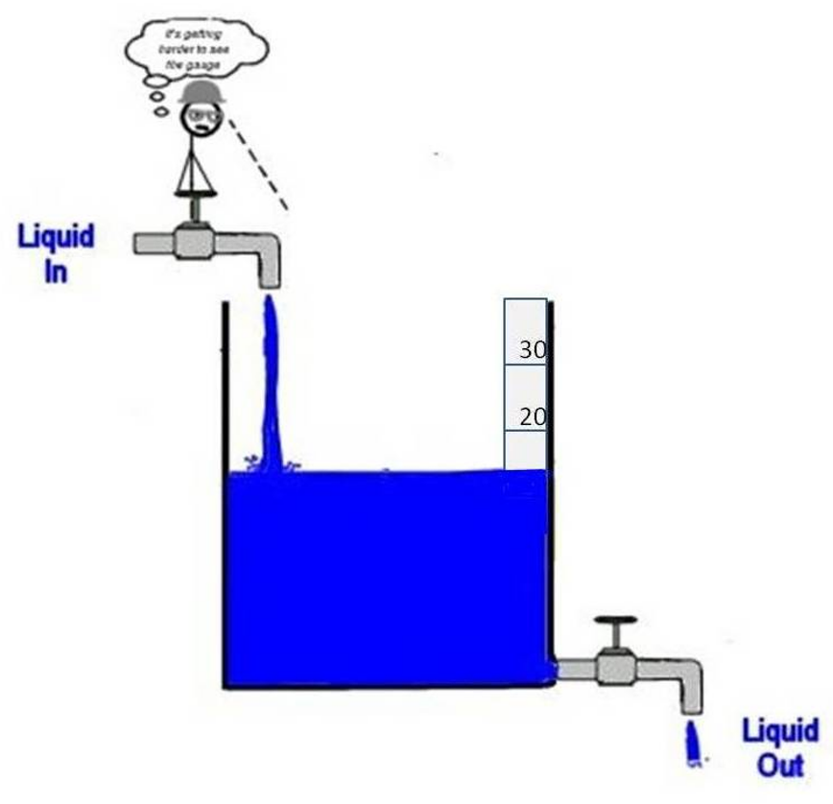
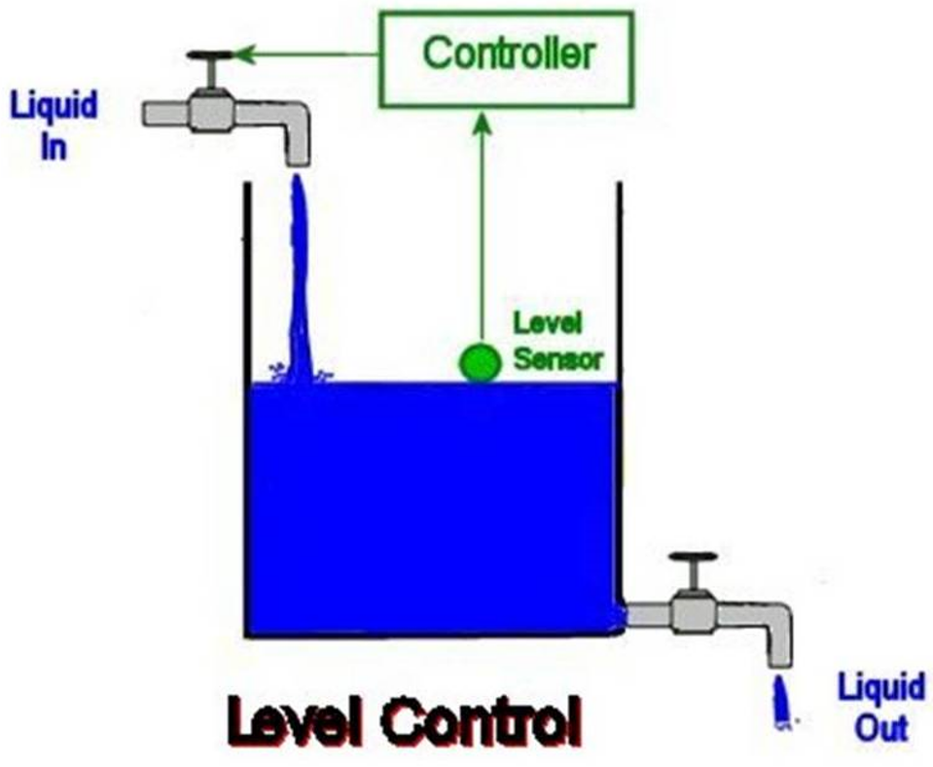
Manual versus Automatic Control
The upper graphic shows Manual Control, where the level of water should be 20 feet, in order to have the fluid feed a process at the liquid outlet for 2 hours. Ideally an operator would manually fill the tank to the 20-foot level every 2 hours. Though this is archaic and unacceptable in today’s automated world, it is a comparison to using Automatic Control, which is shown the lower graphic.
In an Automatic Control system, there is a controller that will compare the level of the water, measured by a level sensor (level is the Process Variable). The controller also has a setpoint programmed into it, and it compares the process variable to the setpoint, then will respond with an output signal, which will control a water valve that will either allow more water to flow into the tank or stop the water from flowing into the tank. The incoming water is the manipulated variable in the system, that will control the process variable.
It is important to realize that in manual control, the human did the same function as the controller does in automatic control. Process systems have become very sophisticated with programmable types of controllers. In this document we will use both discrete and analog type of control and sensing components.
Manual Control
Automatic Control
Graphics courtesy of Aiken Technical College, in the ASSIST to WORK
DOL Project, 2013, CCby 3.0.

Slide 5
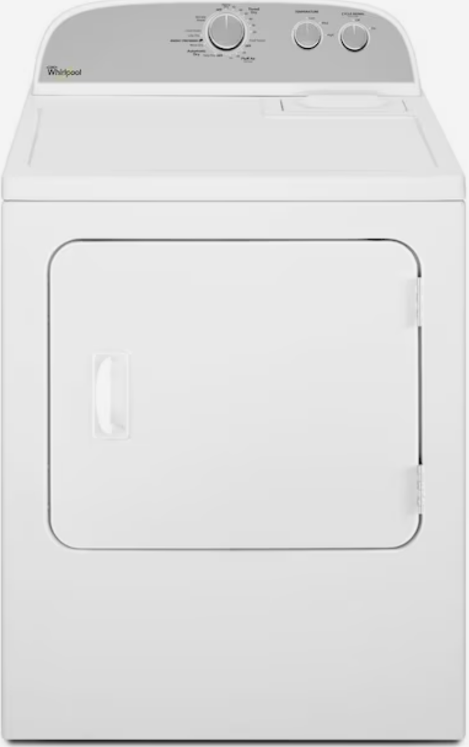
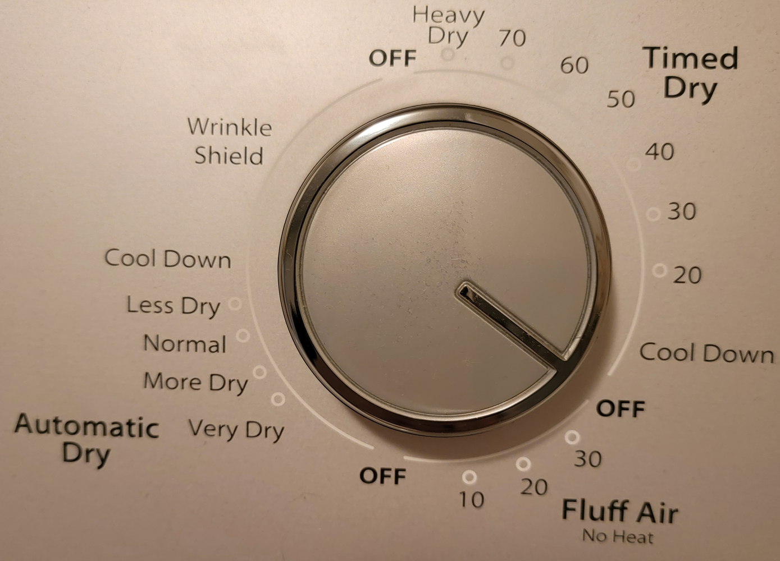
Open Loop Control versus Closed Loop Control
Timed
Dry
Open Loop control systems have no feedback to monitor if an action has taken place. The challenge with open loop is that with no feedback, variables can change (such as water pressure) which can throw off a system.
A simple open loop control found in most homes is a simple clothes dryer. The wet clothes are loaded in. If the user chooses to use time to dry the clothes, the clothes may or may not be dry when the timer times out. The variable here is the type of fabric and the amount of moisture in the fabric from the clothes washer.
In the upper graphic, there is no feedback to determine if the clothes are dry, thus this open loop control.
In the lower graphic, By moving the dial to the Automatic Dry, the clothes dryer goes into closed loop control. Now there is feedback. Most dryers have a moisture sensor that senses the moisture in the exhaust, in order to determine if the clothes are dry. The dryer is no longer controlled by time, but instead will sense when the moisture level is low enough and then shut off. Notice that the user can control the level of dryness.
The feedback in this diagram is the moisture sensor. When it senses the proper dryness level, it will shut off the motor and heating element.
Open Loop Control
Drying based
on moisture in
the exhaust
Closed Loop Control

Slide 6
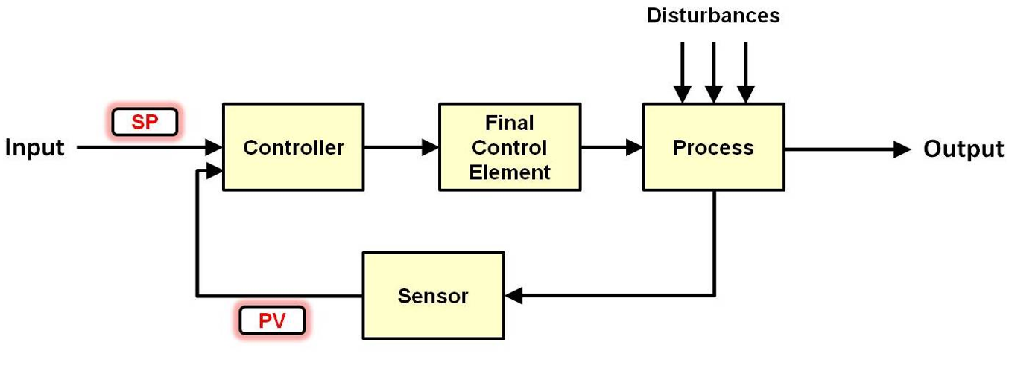
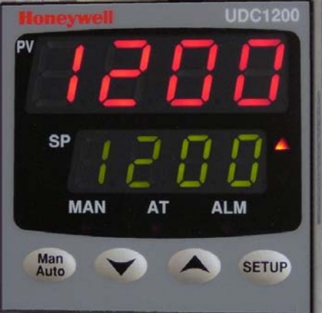
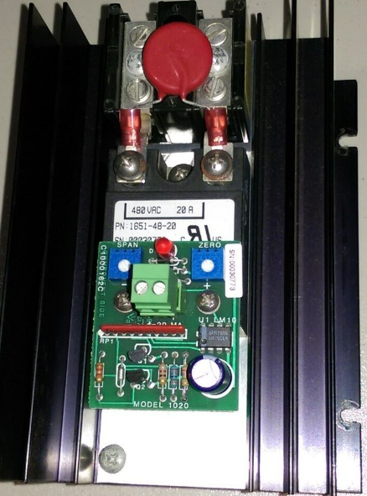
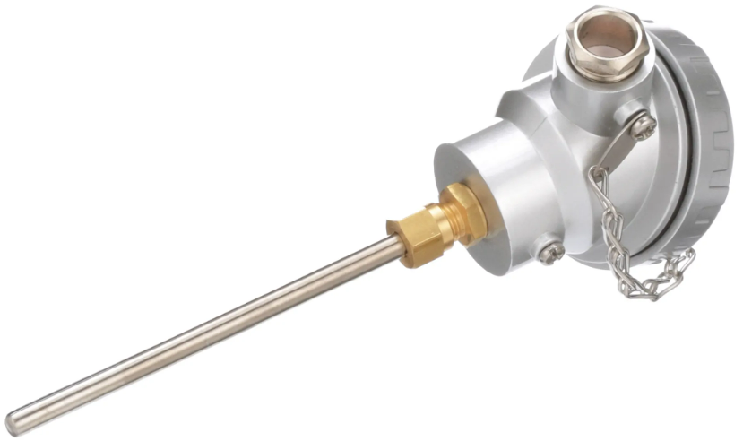
Open Loop versus Closed Loop
Open Loop control systems have no feedback to monitor if an action has taken place. The challenge with open loop is that with no feedback, variables can change (such as water pressure) which can throw off a system.
Closed Loop control systems have a feedback loop, that will let the controller know what the process is doing. A switch is a discrete device, and a sensor is an analog device. Both types of devices can give feedback.
In the upper diagram: SP is setpoint, and PV is Process Variable.
In the lower graphic, a controller is used to control the process. A setpoint for the oven is entered (example, 250 degrees). The thermocouple senses the temperature in the oven and feeds it back to the controller, then the controller sends an output signal to a heating element controller, which will vary the amount of current into a heating element, which will control the temperature of the oven.
The programming in the controller should keep the temperature of the oven right at 250 degrees, since it is closed loop.
Closed Loop Control
Graphic courtesy of Aiken Technical College, in the ASSIST to WORK
DOL Project, 2013, CCby 3.0.
Closed Loop Control
Heating
Element
Controller
Heating Element
Oven
Controller
Thermocouple
Feedback

Slide 7
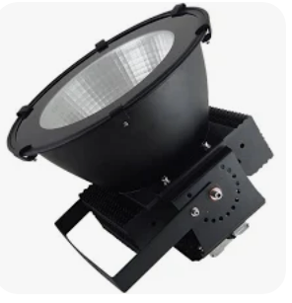
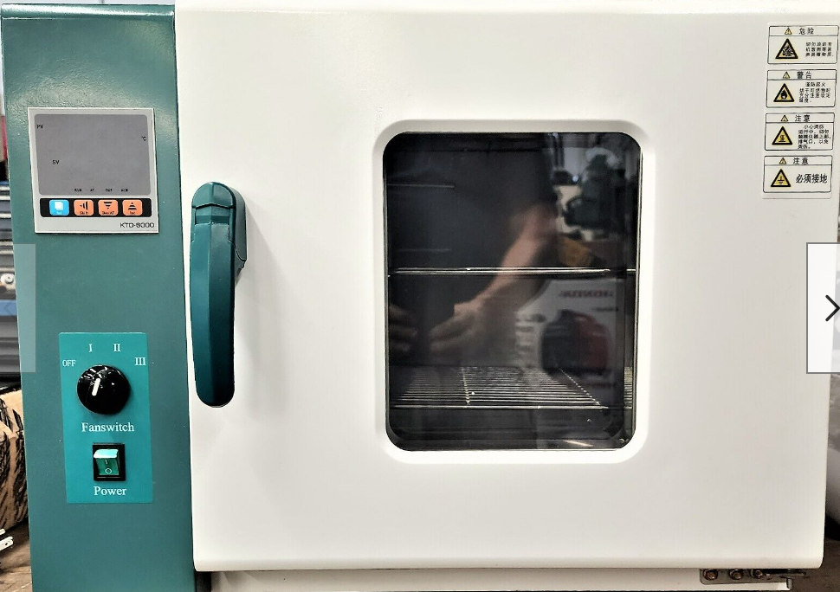
Example of Closed Loop Control of an Oven:
To give an example of a closed loop control system in an industrial environment, we will use an industrial oven that is used to cement on high intensity LED lights that have a reflector.
The maximum temperature the oven can reach is 300 degrees Fahrenheit, which is determined by the oven size and the heating element parameters.
The Temperature Controller is the brains of the systems and is programmable. The user will enter the desired setpoint on the front of the controller, which is the temperature the user wants the oven heat up to and stay at.
Notice that the Controller is mounted in an enclosure on the side of the oven. A sensor will be used to sense the heat in the oven. In this case it will be a device called a thermocouple. The thermocouple will be mounted in the oven chamber and will tell the controller what the temperature is in the oven. The controller will compare the setpoint and the oven temperature (process variable) and send a signal out to the heating element controller to give more/less current into the heating element.
LED Light with Reflector
Temperature Controller
Temperature is the:
Process Variable
Current going into the
Heating Element is the:
Manipulated Variable

Slide 8
Industrial Oven Control System:
This graphic shows more components in the control system. A temperature sensor called a thermocouple will be used to sense the temperature. The thermocouple outputs a milli-volt signal that will increase as the temperature increases.
The controller can be configured to have the input be a thermocouple. The controller then compares the temperature of the thermocouple (process variable) to the setpoint, which the operator inputs on the front of the controller and is also shown on the front of the controller.
If the temperature of the oven is lower than the setpoint, the controller sends out an output signal (4-20mA) to a heating element controller. The heating element controller will vary the amount of current going to the heating element (based on the signal coming from the controller), which will in turn change the temperature in the oven.
The Process Variable is the oven temperature that is measured by the thermocouple sensor.
The Manipulated Variable is the amount of heat the heating element is putting out, which is determined by the heating element controller, based on the signal from the controller.
All components will be covered in depth later in module.
Sensor
Thermocouple
Industrial Oven
Heating Element
Thermocouple
Symbol
0-240 Vac
Loop
Controller
Heating
Element
Controller
4-20 mA Output Signal
240 VAC Power Feed

Slide 9
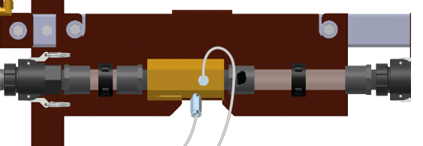
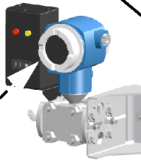
Sensors and Transmitters
Sensors are devices that sense a process (process variable): temperature, flow, pressure, level, rpm, pH, distance weight, etc.
The sensor marked with a “B” is a thermocouple housing, with the thermocouple mounted in the extended tube. This sensor senses temperature. The sensor marked with an “A” is a venturi tube that has a low-pressure port and a high-pressure port. The actual sensor is built into the transmitter right below it. This sensor senses the difference of pressure. This senses flow. The more flow the greater the pressure difference.
Transmitters are devices that convert a sensor signal into an electrical signal (DC current, or DC voltage). Which will then be transmitted (thus the name transmitter) to a controller or indicating device. The electrical signal is an analog signal, and is proportional to the sensor signal. The most common analog signal that is transmitted is a 4-20 mA signal.
The transmitter marked with a “C” is a differential transmitter (with the sensor built into it). It will sense the difference in pressure between the two H & L ports and send out a proportional 4-20 mA signal. The device marked with a “D” is an Acromag 250T temperature transmitter. It will convert the signal from a thermocouple and convert to a 4-20 mA signal.
Sensors
A.
B.
Flow Sensor
Delta P
Temperature Sensor
Thermocouple
Transmitters
C.
D.
Pressure Transmitter
Temperature Transmitter

Slide 10
Practice Question #1
What type of output signal will a thermocouple sensor create
A. milli-amps
B. milli-volts
C. A resistance that changes as the temperature changes
D. a change in capacitance

Slide 11
Answer to Practice Question #1
What type of output signal will a thermocouple sensor create
A. milli-amps
B. milli-volts
C. A resistance that changes as the temperature changes
D. a change in capacitance
Explanation: A thermocouple will output a milli-volt signal. As the temperature goes up, there will be more milli-volts created by the T/C. There are at least 6 different types of thermocouples. The most popular are J and K types. There are mV output charts on the internet that can be found that will list the amount of mV output per temperature for each type of thermocouple. This milli-volt output from a thermocouple can be checked by a digital multimeter.

Slide 12
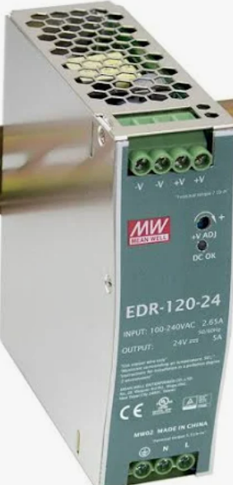
Industrial Oven Control System cont.:
120 VAC Power Feed
The UDC1200 controller input channel can be programmed to directly connect a thermocouple to it, or it can be setup to have a 4-20 mA input signal coming into it. Both methods are very common.
In this example, the thermocouple is connected to a transmitter, which will convert the mV output of the thermocouple to a 4-20 mA signal. Notice that the transmitter, the 24 Vdc power supply, and the controller input channel are all connected in series.
When using this configuration, the transmitter will have to be calibrated for a particular temperature range. On the front of the transmitter there are two screw adjustments that set the zero and span (more on this later). So if the temperature range is 100-300 degrees Fahrenheit, then the transmitter will have to be calibrated to send out 4 mA at 100 degrees, and 20 mA when the temperature is 300 degrees.
T/C Transmitter
Industrial Oven
4-20 mA Input Signal
Heating Element
Thermo-
couple
24 Vdc P/S
0-240 Vac
Loop
Controller
Heating
Element
Controller
4-20 mA Output Signal
240 VAC Power Feed

Slide 13
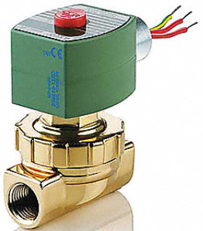
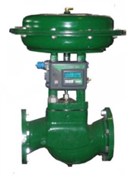
Digital Signals versus Analog Signals
DC Output Module
Discrete I/O (sometimes called Digital I/O) are either on or off. When working with industrial controls systems the I/O are usually 120 Vac (legacy equipment) or 24 Vdc.
Electrical analog signals are either DC voltage or current. The most common electrical analog signal is 4-20 mA. These signals control analog devices that can vary operation proportional to the signal. There is also a standard pneumatic analog signal (3-15 psi) which will be used on primarily proportional (analog) control valves.
A common comparison between digital and analog would be a valve that would control the flow of fluid. In the upper graphic is a 120Vac PLC output module that would send a signal out to a solenoid valve. If the valve gets a signal (120V) it will open (allowing full flow). If the output is off (0V) the valve is closed.
In the lower graphic is a proportional valve that is controlled by a 4-20 mA signal (we will skip the pneumatic signal conversion until later). This signal can vary the amount that the valve is open. With an air to close acting valve (signal to close) the valve will be open at 4 ma, ½ open at 12 mA, and fully closed at 20 mA. The PLC program will send the data to the analog module that will convert to an analog signal.
Output Signal
0 or 120 Vac Signal
Digital (on or off)
On – fully open – full flow
Off – fully closed – no flow
Output Signal
4 – 20 mA Signal
Analog Value
4 mA – open(full flow)
8 mA – 75% open
12 mA – 50% open
16 mA – 25% open
20 mA – Closed (no flow)
This would be on a signal to close type
Analog I/O Module

Slide 14
Electrical and Pneumatic Analog Signals
Electrical analog signals in an industrial or process environment are DC electricity. The most common analog signal is 4-20 mA. The reason for its popularity is that it has minimal signal loss on a long signal cable run (as compared to voltage), and it is less effected by electrical interference, since the cable used will be a shielded, twisted pair type of cable. 0-20 mA is used on some analog output modules to get a 0-10V signal by terminating across a 500-ohm resistor (20mA * 500 = 10V). -20mA to +20mA was used on old systems and will not be on modern equipment.
0-10Vdc voltage signal is common primarily within a control panel. Once outside of a control panel, the voltage signal can be affected by electrical noise and potentially has signal loss on long runs of signal cable. 1-5 Vdc is used quite often for troubleshooting, since many PLC analog input modules has an input impedance of 250 ohms, which is used to convert a 4-20mA signal to a 1-5Vdc signal.
-5Vdc to +5Vdc, and -10Vdc to +10Vdc are sometimes seen on legacy data acquisition systems and on legacy servo systems.
3-15 psi is a pneumatic signal that will be used to control a proportional control valve. An I/P (current to pressure) converter is used to convert the 4-20mA signal to a 3-15 psi signal that will control the position of a control valve.
Current Analog Signals
4 - 20 mA
0 – 20 mA
-20 mA to +20 mA
Voltage Analog Signals
0 – 10 Vdc
1 – 5 Vdc
0 – 5 Vdc
-5 Vdc - +5 Vdc
-10 Vdc - +10 Vdc
Pneumatic Analog Signals
3 – 15 psi

Slide 15
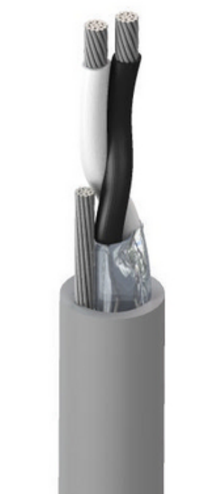
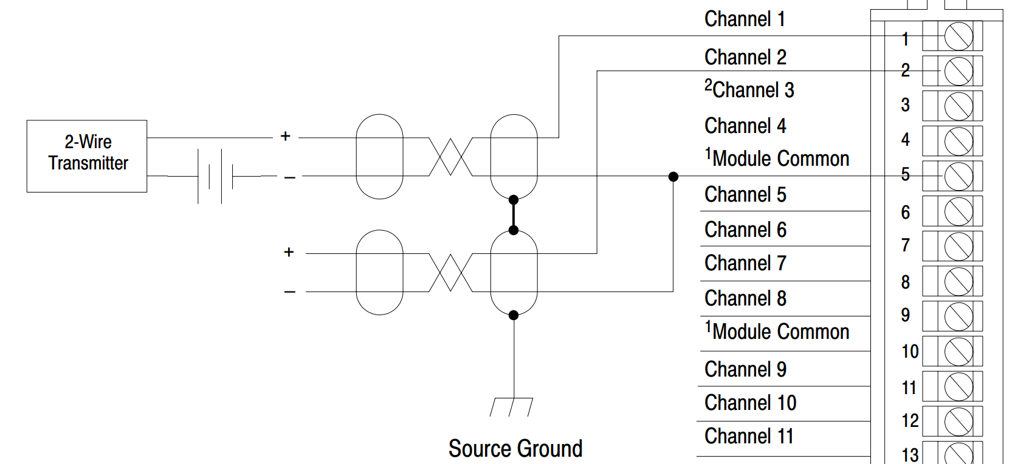
Cable for 4-20mA Signal Transmission
The signal cable shown in this graphic is a Belden 8762 cable, which has a PVC jacket, a foil shield, and 20 AWG (wire size). The 20 AWG wire is stranded wire (conductors). The two signal conductors are twisted together within the foil shield, and within the jacket.
This would be termed twisted pair, shielded signal cable.
The most common instrument signal that this cable would transmit would be a 4-20 mA (DC) type of analog signal. The twisting of the wires and the shield gives the 4-20 mA signal a lot of immunity from electrical noise, bot RFI (Radio Frequency Interference) and EMI (Electro-Mechanical Interference). A drain (ground) wire, the same size as the signal conductors is run outside of the foil shield, but is connected to the shield within the jacket. It is important to understand that the drain wire should be grounded on just one end of the cable. If both ends of the drain wire are connected to ground, a ground loop can be created which will induce unwanted electrical noise into the signal cables.
The lower graphic show the wiring terminal diagram for an analog input module on a PLC. Notice the analog cable shows the wires twisted and shielded, with the shield grounded on one end
Signal Conductors
Drain Wire
PVC Jacket
Foil Shield
Shield Symbol
Twisted Pair
Shield is grounded

Slide 16
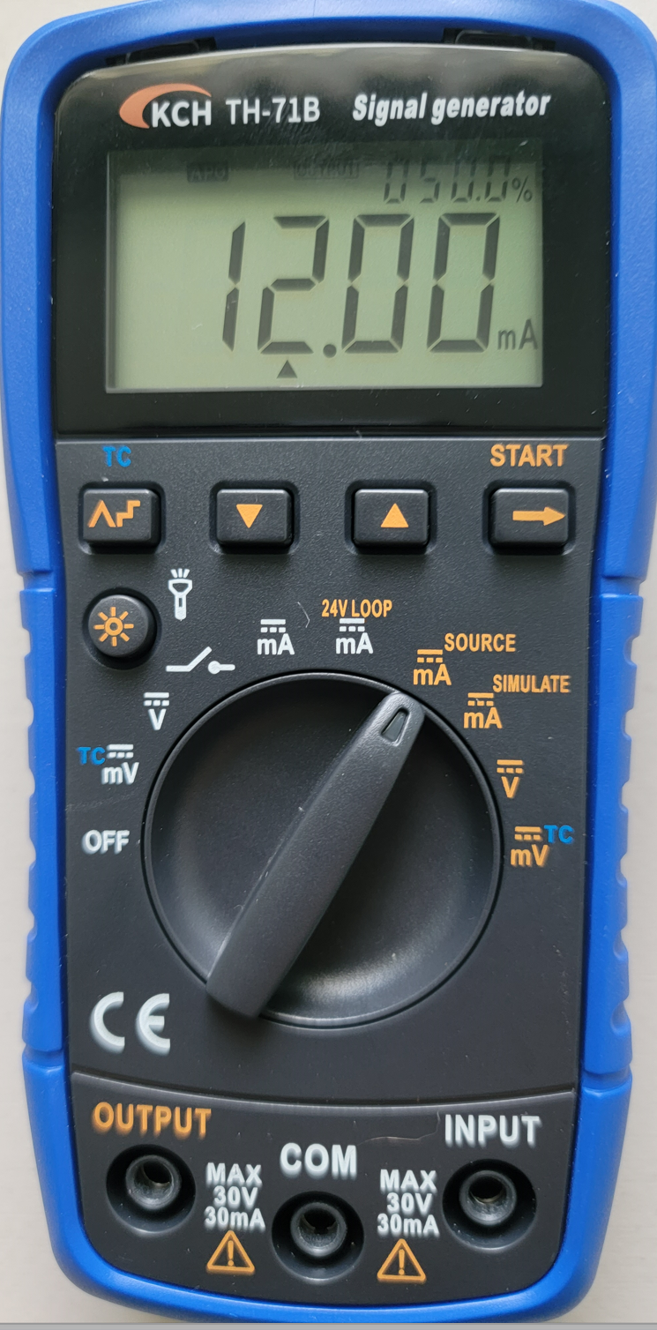
Analog Signal Generator
The students at NSCC will use the KCH TH-71B Signal Generator to create an analog signal source (for testing and calibration), and also can be used to measure analog signals. This device will measure signals and also source signals out to circuits for testing and calibration.
On the dial scale, the parameters in white are input, so use these to measure volts and milliamps. The light brown parameters are for output signals. The user must also make sure the probes are in the correct jacks.
If a user wished to measure the signal in a 4-20 mA loop, the dial setting should be set on the white mA position and the probes put in the COM and INPUT slots.
If a user wished to send a 4-20 mA signal from the signal generator to test the operation of a variable frequency drive they would put the dial on the brown mA Source setting and the probes in the COM and OUTPUT slots.
A video will be created explaining how to operate the signal generator.
Output Signals
Input Signals
Input Signal Jacks
Output Signal Jacks

Slide 17
Practice Question #2
What is the advantage of using a 4-20mA analog signal compared to a 0-10 Vdc signal? (choose all that apply)
A. 4-20 mA is less effected by electrical noise than a voltage signal
B. 4-20 mA is more accurate than a 0-10 V signal
C. 4-20 mA has less signal loss on a long run than a 0-10 V signal
D. 4-20 mA is easier to measure than a 0-10 V signal

Slide 18
Answer to Practice Question #2
What is the advantage of using a 4-20mA analog signal compared to a 0-10 Vdc signal? (choose all that apply)
A. 4-20 mA is less effected by electrical noise than a voltage signal
B. 4-20 mA is more accurate with sensors than a 0-10 V signal
C. 4-20 mA has less signal loss on a long run than a 0-10 V signal
D. 4-20 mA is easier to measure than a 0-10 V signal
Explanation: Current signals are less effected by electrical noise than a voltage signal is. Since voltage has amplitude, the electrical noise can induce a signal change on voltage. 4-20 mA is no less accurate than 0-10V, besides that the analog signals will be sent from a transmitter, not a sensor (more on this later). Long voltage signal runs of cable will create a loss of signal, which is the voltage dropped on the wire (wire has a resistance). 4-20 mA is a little tougher to measure than voltage. A DVM can be used to measure a voltage signal (in parallel). Current is measured in series, so ideally a circuit will have to be opened to insert a current tester.

Slide 19
Why start at 4mA instead of 0mA
A common question when student learn instrument systems is: Why did they start with 4mA instead of 0mA on the most popular analog signal? It was for troubleshooting. If there is 0mA the Technician knows that there is an open circuit (possibly a broken wire). This is sometime called Live Zero.
Another concept that is very important is the percentage of the control signal. The reason for this is sometimes controllers will work in percentage than in milli-amps.
Signal based on Percentage = Range * Percentage + 4mA
50% Signal = 16mA * .50 + 4mA = 12 mA
75% Signal = 16mA * .75 + 4mA = 16 mA
Percentage of a Signal=(Signal – 4mA)/Range * 100
8ma Signal = (8mA – 4mA)/16mA * 100 = 25%

Slide 20
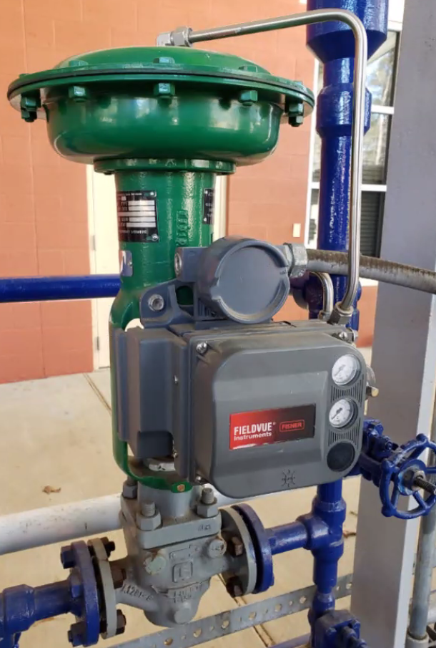
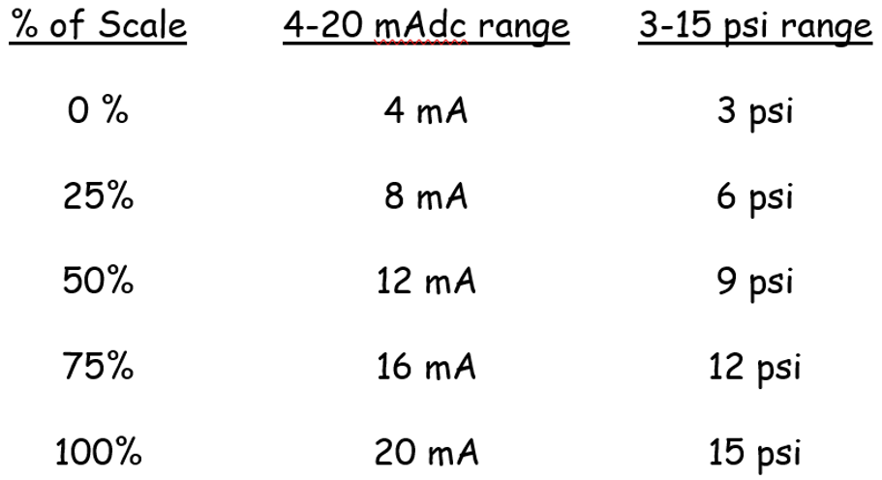
Air is also used for control signals
3-15 psi air signal that controls the position of the valve
A 3-15 psi analog signal is primarily used to control a proportional (analog) flow control valve. The position of the valve stem (which controls the flow of fluid through the valve) is proportional to the analog air signal. In this graphic, since the air line if fed to the top of the valve, the valve is help open with a spring. The air signal will close the valve. At 15 psi, the valve will be fully closed (no flow). At 3 psi, the valve is fully open (full flow).
A current to pressure converter (I/P) is used to convert a 4-20 mA signal to a 3-15 psi signal. One example is shown in the lower portion of this graphic. Typically the I/P must be calibrated to make sure that at 20 mA, it is putting out 15 psi. See the table below for the correlations.
Analog Flow Control Valve
Current to Pressure (I/P) Converter

Slide 21
Practice Question #3
What would be the analog signal for a 60% output on a 4-20 mA signal range?
A. 9.6 mA
B. 12 mA
C. 13.6 mA
D. 16 mA

Slide 22
Answer to Practice Question #3
What would be the analog signal for a 60% output on a 4-20 mA signal range?
A. 9.6 mA
B. 12 mA
C. 13.6 mA
D. 16 mA
Explanation: The calculation will be: Range * Percentage + 4 mA, which will be 16 mA * .6 + 4 mA, which will equal 13.6 mA.

Slide 23
Practice Question #4
What would be the percentage of the range, for an analog signal that measured 14.5 mA?
A. 14%
B. 66%
C. 72%
D. 90%

Slide 24
Answer to Practice Question #4
What would be the percentage of the range, for an analog signal that measured 14.5 mA?
A. 14%
B. 66%
C. 72%
D. 90%
Explanation: The calculation will be: (Signal – 4mA) / Range * 100, So:
14.5 mA – 4 mA = 10.5 / 16 mA * 100 = 65.6%, rounded to 66%

Slide 25
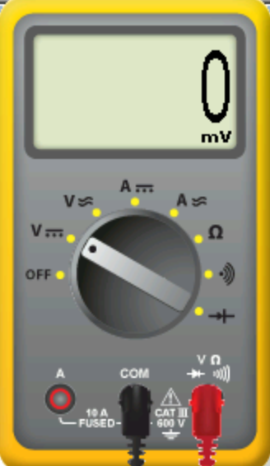
Current to Voltage Conversion
3 Vdc Signal
It is important to use Ohms Law when working with analog signals. First, all voltage and current is Direct Current (DC). A resistor can be used to convert a current signal to a voltage signal.
Only use precision resistors when working with analog or instrument signals. They cost a little more, but they have a very low tolerance, or variation from the state resistance. This would not be a resistor that has color bands on them.
A 250 ohm resistor would be used to convert a 4-20 mA signal to a 1-5 Vdc signal. Also, a 500 ohm resistor is used to convert a 0-20 mA signal to a 0-10 Vdc signal.
V = Current * Resistance.
Most PLC analog input modules have a 250 ohm resistor across their input channel, so when a current signal is applied, it converts to a voltage so the module can process it. This can also be a handy way of troubleshooting. If 3 Vdc is measured at the input channel, then the user can determine that there must be 12 mA flowing into the analog input channel. This is shown in this slide. Signal Generator putting out 12 mA across a 250 ohm resistor. The DVM is measuring 3 Vdc.
12 mA Signal
3.00V
250 ohms
Volts = Current * Resistance
3 Vdc = 12 mA * 250 ohms

Slide 26
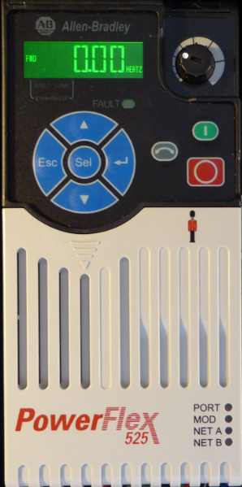
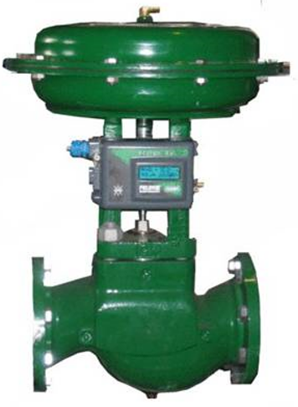
Final Control Devices
This slide show 3 common final control devices, or devices that will control and affect the process variable. All of these devices can be controlled by an analog signal (4-20 mA most common). Though many of the VFDs are now using Ethernet for speed control, there are still many systems that will control the speed of the VFD with an analog signal. These are very common in process control for controlling the speed of a pump.
A proportional valve will control the flow of fluid going through a pipe. The valve shown is a pneumatic operated (3-15 psi), so we will still need and I/P converter in order to convert a 4-20 mA signal to a 3-15 psi signal.
The lower graphic shows a proportional controller, which is used to vary the current in a resistive load (typically a heating element). Some people term these as SCR Power Controllers. Basically the 4-20 mA signal will vary the conductional angle of the AC sine wave that is going to the heating element, which will vary the current, thus varying the heat the element puts out.
AC Motor Drive
Proportional Valve
Proportional Controller
SCR Power Control

Slide 27
Calibration of a Transmitter
It is important to understand what it means to calibrate a transmitter. A temperature transmitter must be calibrated to work in the range of the process variable. So, if an oven operates between 100 degrees C and 300 degrees C, the unit must be calibrated that at 100 degrees it sends out a 4 mA signal, and when the temperature is 300 degrees it sends out a 20 mA signal. A signal generators will be needed to simulate the temperature of a thermocouple.
On the Acromag 250T transmitters there are two, multi-turn potentiometers that are the Zero and Span adjustment. So if the thermocouple is going to be a “K” type, the signal generator will be set 100 degrees C for a type K thermocouple and put across the input of the transmitter. The Zero adjustment is used to set the transmitter output to 4 mA. Then change the signal generator to 300 degrees, then adjust Span adjustment until the transmitter puts out 20 mA. Here is the tricky part: when the signal generator is set back to 100 degrees, the current may change to 8 mA, thus readjust the Zero to take it back to 4 mA. You will have to go back and forth a few time, because these units have interactive zero and span, which means changing one, will change the other.
SPAN
ZERO

Slide 28
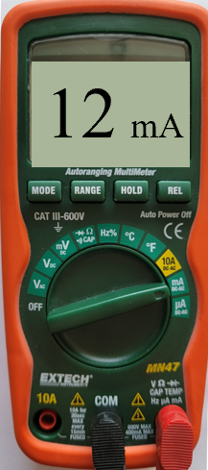
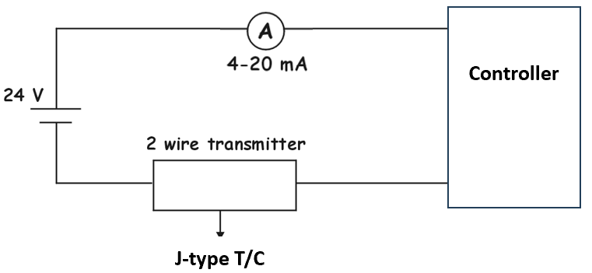
Ammeters connect in Series
DMM measuring
milli-amps
It is important to understand how to measure current in an analog circuit. The current should be a small DC current (4-20 mA).
Ammeter connect in series, in a series circuit, which is what we have in this graphic. The lower graphic shows the circuit diagram, and the upper graphic shows the components. Since current is always the same in a series circuit, the ammeter could connect anywhere in the series circuit and it should read the same. The downside to measuring current is that you will have to open the circuit in order to insert the ammeter (a Digital Multimeter on the DC mA scale).
Voltmeters connect in parallel.
Controller
24 Vdc P/S
Transmitter

Slide 29
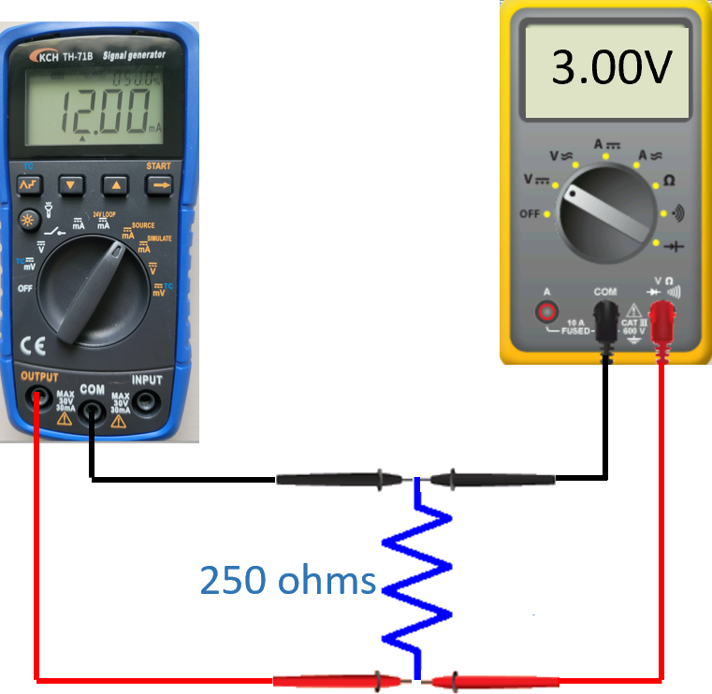
Voltmeter connect in Parallel
Always connect a voltmeter in parallel to the device that the voltage is to be measured on.
In this graphic, a signal generator is sourcing out a 4-20 mA signal across a 250-ohm precision resistor. This will create a 3 V drop across the 250Ω resistor (ohms law: V=I*R, so 0.020 A * 250Ω will equal 3 V.
The digital multimeter on the right is set for DC volts, so it will read the 3 volts on the display. If the test probes are reversed, the voltage reading would be -3 volts.
Always important to remember:
Voltmeters connect in parallel
Ammeters connect in series
Ohmmeters (to measure resistance) should be connected in parallel with what they are measuring, but only after the component is removed from a powered electrical circuit. Never use an ohmmeter in a powered circuit.

Slide 30
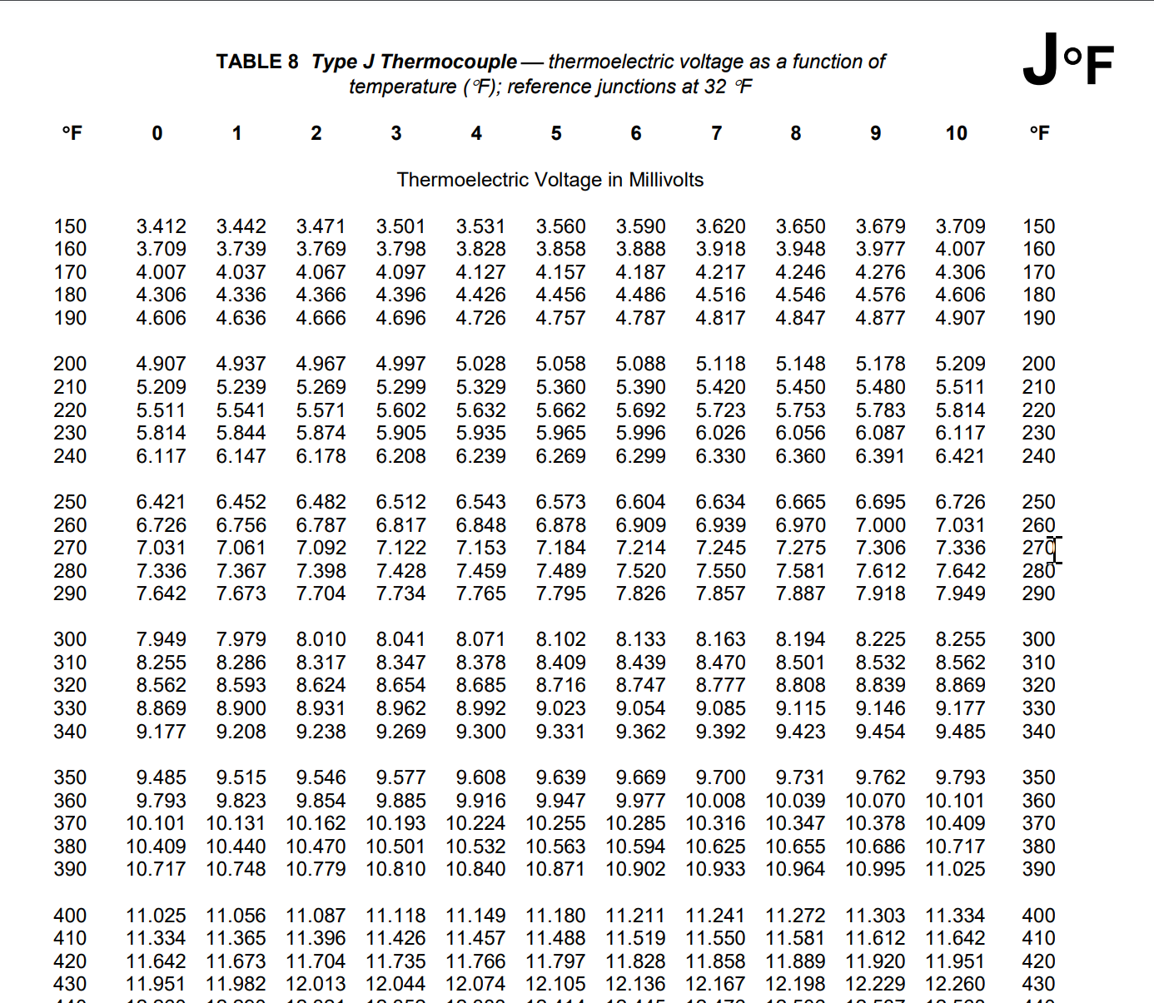
Thermocouples generate Milli-Volts
Thermocouple create a milli-volt output. The higher the temperature, the more milli-volt output.
The associated diagram shows the chart for a “J” type of thermocouple, with the temperature listed in Fahrenheit.
Notice by the arrows how the chart is laid out, left column is the temperature for every 10 degrees, then work across the column headings to find the individual temperature within that 10 degrees.
The red box is around the milli-volt output for a temperature of 405° Fahrenheit.
This shows that the milli-volt output of a J type of thermocouple at 405 degrees will be 11.180 degrees.
To Convert Fahrenheit to Celsius:
C = (F-32) * 5/9, So:
405-32 = 373 * 5 = 1865 / 9 = 207° C

Slide 31
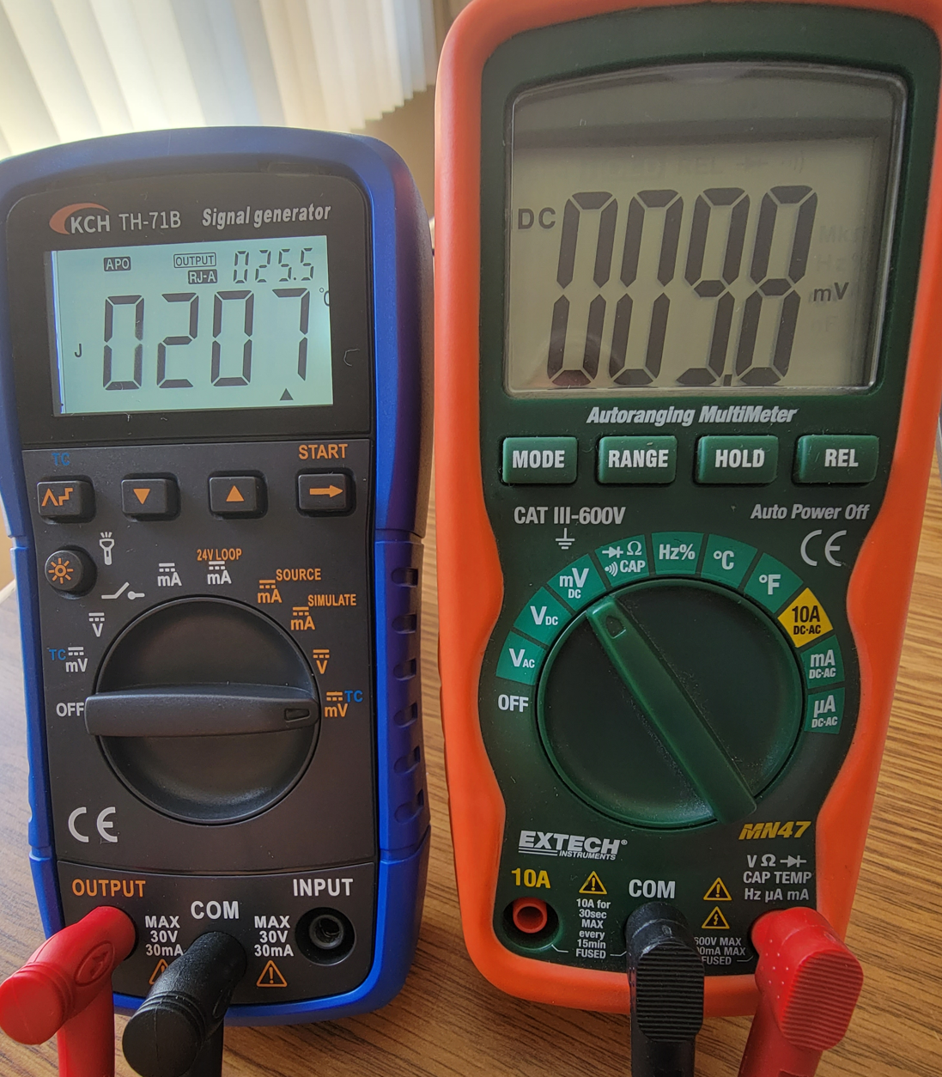
Simulate a Thermocouple with the Signal Generator
The Signal generator will be used to simulate a thermocouple. The unit will output a mV signal based on the type of thermocouple and the temperature that it is programmed for.
Based on the chart in the last slide, the mV output for 405° was 11.18 mV.
In the previous slide, we calculated that 405° F is 207° C.
In the graphic, you can see that signal generator on the left, and the temperature can only be Celsius on the signal generator.
The Digital Multimeter on the right is measuring DC mV and is showing only 9.8 mV. One of the reasons for this inaccuracy is the ice point reference, which is something that will be covered in a later module. With the ambient temp in the room at about 77° F, there will be an error since we need to have the ice point junction 32° F temp in order to get more accurate reading.
405° F – J-type thermocouple output is 11.18 mV (from chart)
77° F – Ambient temp (reference junction) is 1.277 mV (from chart)
11.18 mV – 1.277 mV is 9.9 mV, DMM reads 9.8 mV (pretty close)
Celsius only
207° C
J Type T/C

Slide 32
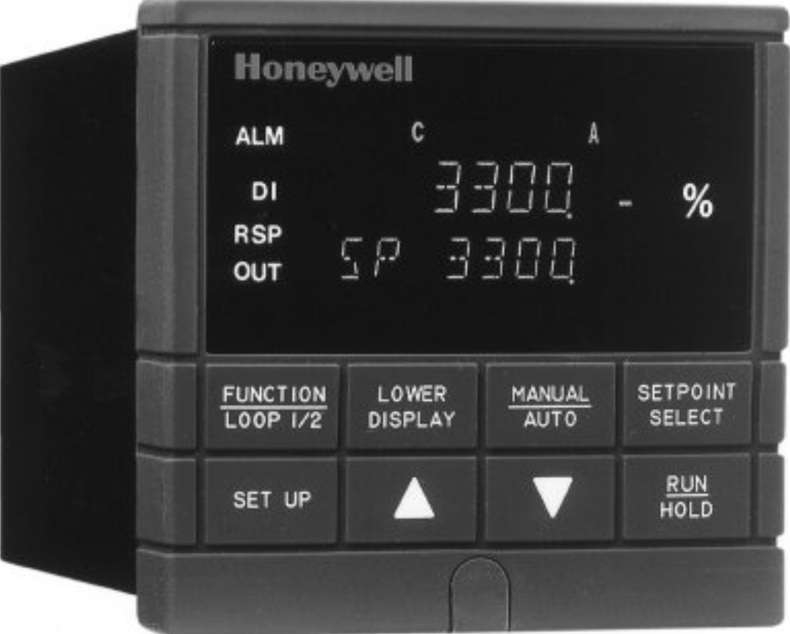
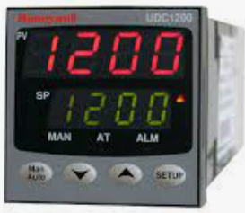
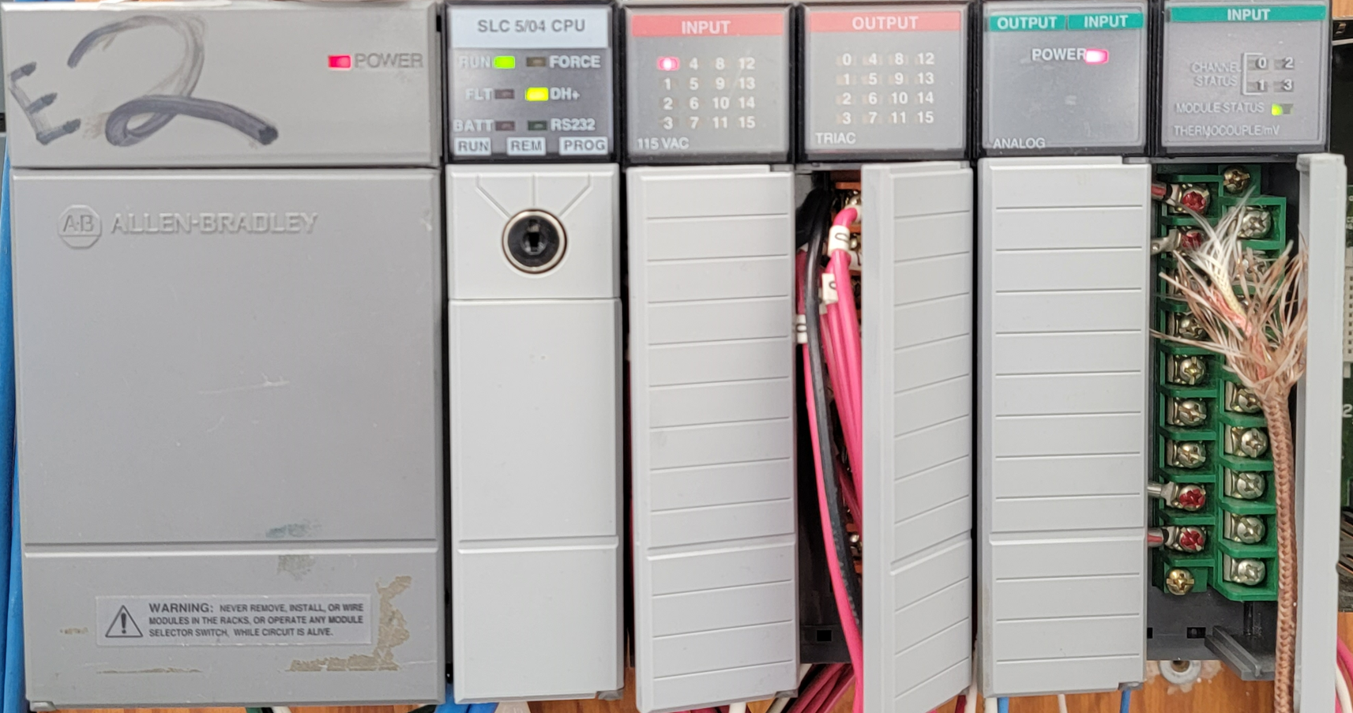
Controller used in this Course
In this course, the students will be exposed to two types of controllers: Stand Alone type (UDC1200 and UDC3300) and PLC based (Allen Bradley SLC-500 and ControlLogix).
The stand-alone controllers have at least 1 analog input channel and one analog output channel. All configuration is done through the front of the unit. These are typically designed for simple process loops. Most stand-alone controllers have a universal input channel, which means the input can be configured for a thermocouple input, RTD input (also a temperature sensor), and also a 4-20 mA input from a transmitter.
PLC based systems have analog input and analog output modules, as well as thermocouple modules. There will have to be a PLC program created for the processor that will monitor and control the process.
A third type that will be in multiple documents and literature are DCS (Distributed Control Systems). These are proprietary systems designed for a process usually in a process plant (chemical, refinery, etc.). These systems are similar to a PLC system, but typically has a server and touch screen graphic monitors for operators to run a process. The programming is proprietary and cannot be changed by plant personnel.
UDC 1200
UDC 3300
AB SLC-500
AB ControlLogix

Slide 33
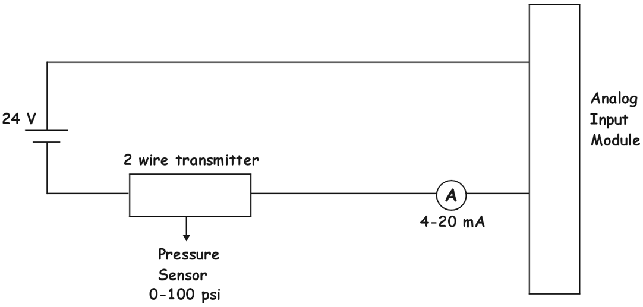
2-Wire Transmitters
A 2-wire transmitter is a very simple series circuit with 3 components: Power Supply, Transmitter and Analog Input Channel (on a module). Twisted pair shielded cable is used to connect the devices. Notice there are only 2 wires running to the transmitter (not counting the sensor). Where are the power wires to power the electronics inside the transmitter? Here is the trick. The one cable that runs to the transmitter serves as the power source and the signal wires. The power supply has 24 volts. The transmitter requires at least 12 Vdc dropped across it in order to regulate the proper signal current. If 4 mA is flowing, 1 volt will be dropped across the analog input resistor, and 23 volts is across the transmitter. If 20 mA is flowing, 5 volts is across the analog input resistor (20mA * 250 ohms = 5V), then 19 volts is dropped across the transmitter. So in this circuit there is plenty of voltage to run the transmitter.
The lower graphic shows the Acromag 250T wiring diagram. Notice that the IN side is where the thermocouple connects, and the OUT side is the analog signal side. These two circuits are the same, just drawn a little differently.
250Ω
Thermocouple
250Ω
PLC Input

Slide 34
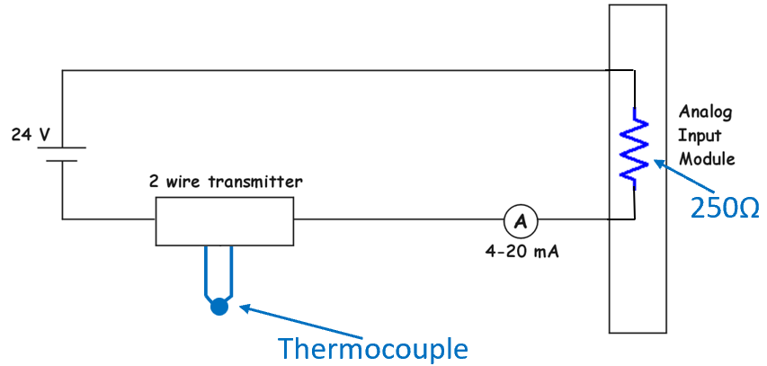
Observe the polarity of the Devices in a DC Circuit
It is very important to observe polarity of the devices that connect together. This diagram shows the polarity at the various connection points. The transmitter, the ammeter, the analog input channel and the power supply all have a “+” and a “-” connection.
Notice that coming from the power supply, the first component connection will be with the same polarity, but after that, it most go to the opposite polarity so there is no series opposing.
Positive side of P/S connects to the positive side of the analog input channel. Negative side of analog input channel to the positive side of the ammeter, negative side of ammeter to positive terminal of the transmitter, and finally, the negative side of the transmitter connects to the negative side of the P/S.
+
+
-
-
+
-
+
-
+
-

Slide 35
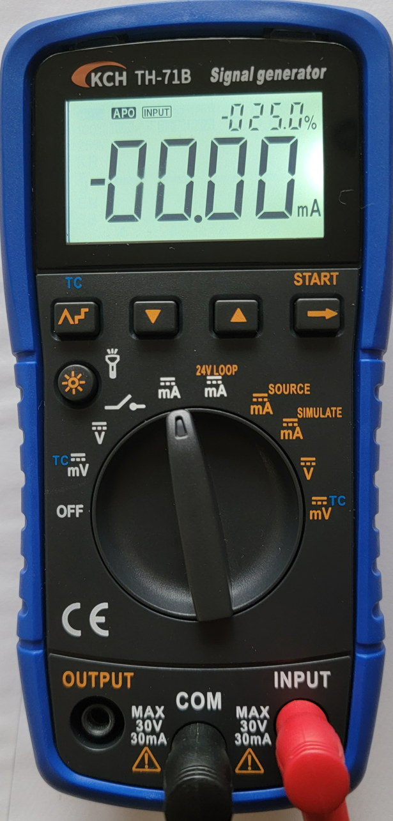
Using toggle switch to connect an Ammeter
This example shows the Technician connecting an ammeter (signal generator measuring the mA in the circuit).
It is not uncommon to use a simple toggle switch that is permanently mounted near the control loop that a Technician can quickly check the milli-amps in a circuit without disconnecting a wire and putting the ammeter in the circuit.
In normal operation the switch is closed allowing current to flow. The Tech can put the ammeter across the switch, then open the switch and the ammeter is in the circuit measuring the current.
Close the switch, then pull the ammeter. To the circuit, an ammeter looks like a very low resistance, so the circuit is never interrupted.
A digital multimeter can also be used for this. Very important to observe the polarity of the meter. Black connected to COM is the negative lead.
+
-
-
+
Important: It is important
to understand that though
this ammeter is in parallel
with the switch, it is in series
with the transmitter.
Ammeter connect in series
within the circuit.
12 mA

Slide 36
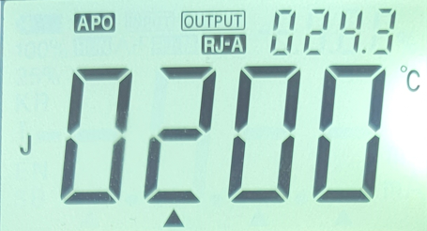
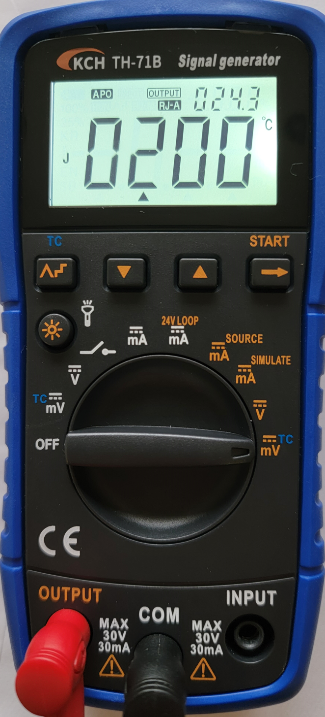
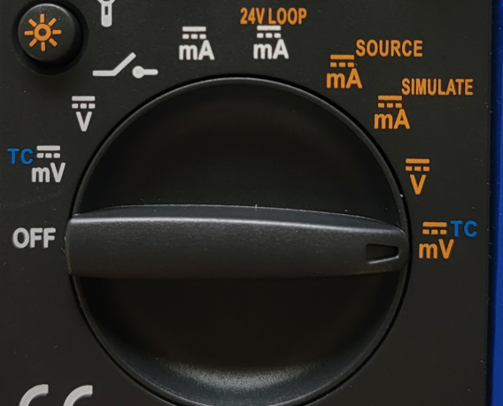
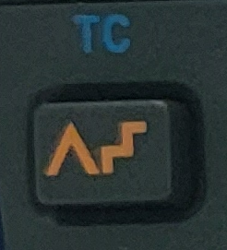
Simulate a Thermocouple with the Signal Generator
The Signal generator will be used to simulate a thermocouple. It is important to understand that a transmitter must be calibrated for a specific temperature range. As an example, the oven would run between 200° and 300°. Since the user will need to do a calibration before the transmitter is used in the circuit, they will use the signal generator in place of the thermocouple. Since the mV output charts for a specific thermocouple has the mV output, the signal generator can be put into output mode, then the scale moved mVTC position. Put in the temperature and it should put out the milli-volts.
Notice on the display, the thermocouple type is shown (J), and the temperature is displayed in Celsius. This is the temperature the user will put in; thus the signal generator will create the mV signal for that temperature, then the user will adjust the Zero potentiometer until the ammeter shows 4 mA (first step of the calibration process).
+
-
Button on the signal generator to
choose the thermocouple type

Slide 37
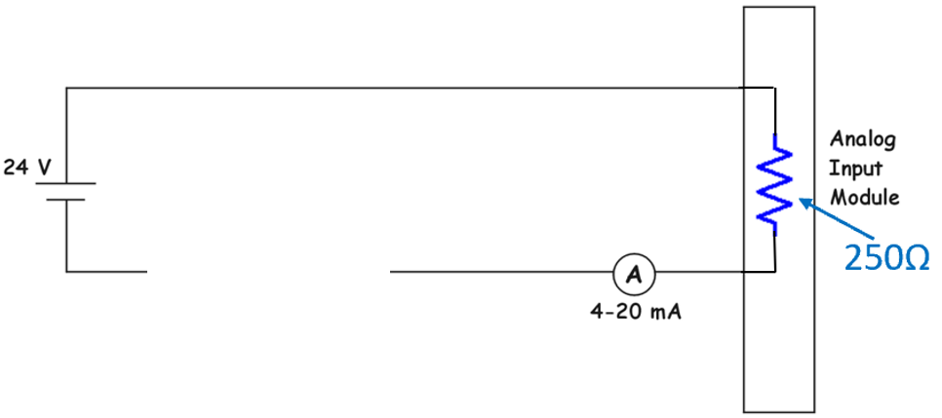
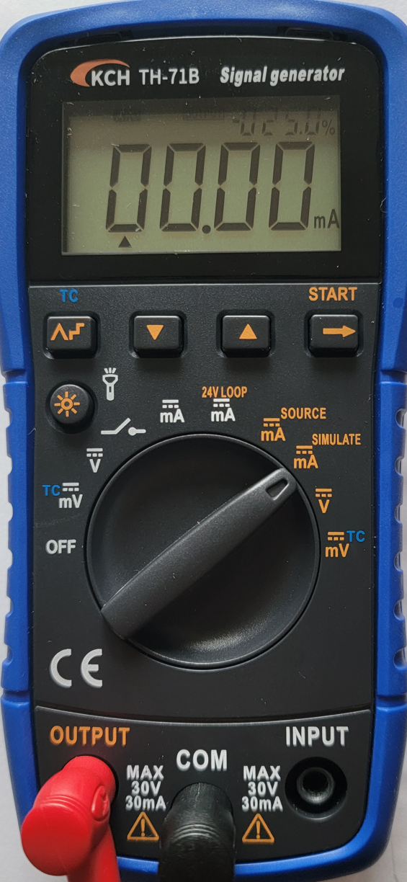
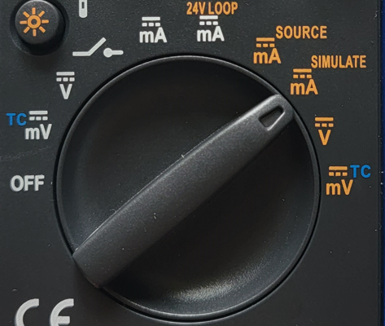
Simulate a Transmitter with the Signal Generator
The Signal generator will be used to simulate a transmitter in this graphic. Notice that the signal generator is used in place of the transmitter. The dial setting must be on the position of the brown text marked as mA Simulate.
In the simulate mode the signal generator will regulate the current in the circuit. There is no sensor with this setup. The signal generator replaces the sensor and the transmitter. The primary purpose of this simulation is that the user can test the signal that is going into the analog input channel (either on a stand-alone controller, or a PLC analog input module). The user can test the voltage drop across the input terminals but would probably also check the data inside the PLC or stand-alone controller that this signal would create. This way they know that the complete circuit and analog input channel is working properly.
16 mA

Slide 38
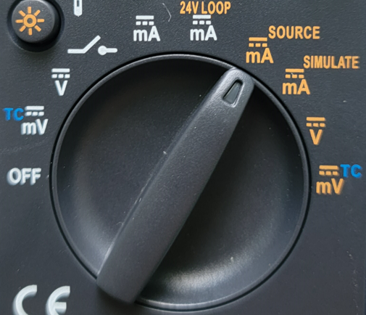
4-Wire Transmitter
A 4-wire has 4 wires running to it: 2 wires for the power supply input to run the internal electronic circuit of the transmitter, and 2 wires that will carry the signal to the analog input channel.
These transmitters are more expensive than the 2-wire type. These transmitters will also have to be calibrated through the same process as the 2-wire types.
The signal generator can also perform the same function as a 4 wire transmitter. The dial position must be on the mA SOURCE position as shown in this graphic. This is a very valuable setting since the signal generator can inject a signal directly into an analog input on a stand-alone controller, PLC input channel, on a VFD analog input, etc.
24 Vdc P/S
4-Wire Transmitter
Analog In
250Ω
8 mA

Slide 39
Correlating Temperature to Current/Voltage
It is important to understand the correlation between temperature, current and voltage. If the transmitter was calibrated for between 200-300 degree (C or F), the current should be proportional. If the temperature is 200 degrees, then the current in the loop is 4 mA. The voltage dropped across the analog input resistor (which is usually internal) will be 1 volt.
So, if a Technician is troubleshooting a system, and they know the temperature range, they could do a voltage measurement across the analog input channel and then determine the current and the temperature. If 3 volts is measure, the temperature measured should be 250°, and there should be 12 mA flowing in the circuit (3V/250Ω is 12 mA).
If 5 volts is measured across the analog input channel, 20 mA should be flowing in the circuit, and the thermocouple is sensing 300°.
200° - 300°
mA
4mA
8 mA
12 mA
16 mA
20 mA
Temp
200°
225°
250°
275°
300°
mA
4mA
8 mA
12 mA
16 mA
20 mA
Volts
1 Vdc
2 Vdc
3 Vdc
4 Vdc
5 Vdc

Slide 40
Practice Question #5
How much current would be flowing in this circuit if the temperature on the thermocouple is 275 degrees?
A. 12 mA
B. 14 mA
C. 16 mA
D. 18 mA
200° - 300°

Slide 41
Answer to Practice Question #5
How much current would be flowing in this circuit if the temperature on the thermocouple is 275 degrees?
A. 12 mA
B. 14 mA
C. 16 mA
D. 18 mA
200° - 300°
Explanation: Since 275° is 75% of the temperature range for the transmitter (200° to 300°, the current signal will be 75% of the 4-20 mA range, which will be 16 mA.

Slide 42
Calculating F to C, and C to F
It is extremely important to understand how to convert between Celsius and Fahrenheit when working with temperature in process control. Sometimes the test equipment and actual instrumentation equipment uses only one temperature system, but possibly look up information is in the other temperature system.
This graphic shows the formulas which should be committed to memory for this course and whenever working in an industrial or process environment.
Realize that the boiling point for water is 212°F and 100°C (see the top formula and calculation. The freezing temperature for water is 32°F and 0°C. These are simply points of reference that should also be committed to memory so as to estimate if a temperature calculation is correct.
If the calibration of a temperature transmitter is 300°C, but the mV output table is in Fahrenheit, a conversion must occur:
300°C * 9/5 + 32 = 572°F
Converting from Celsius to Fahrenheit
F = C * 9/5 + 32
100°C * 9 ÷ 5 + 32 = 212°F
Converting from Fahrenheit to Celsius
C = (F – 32) * 5/9
32°F - 32 x 5 ÷ 9 = 0°C

Slide 43
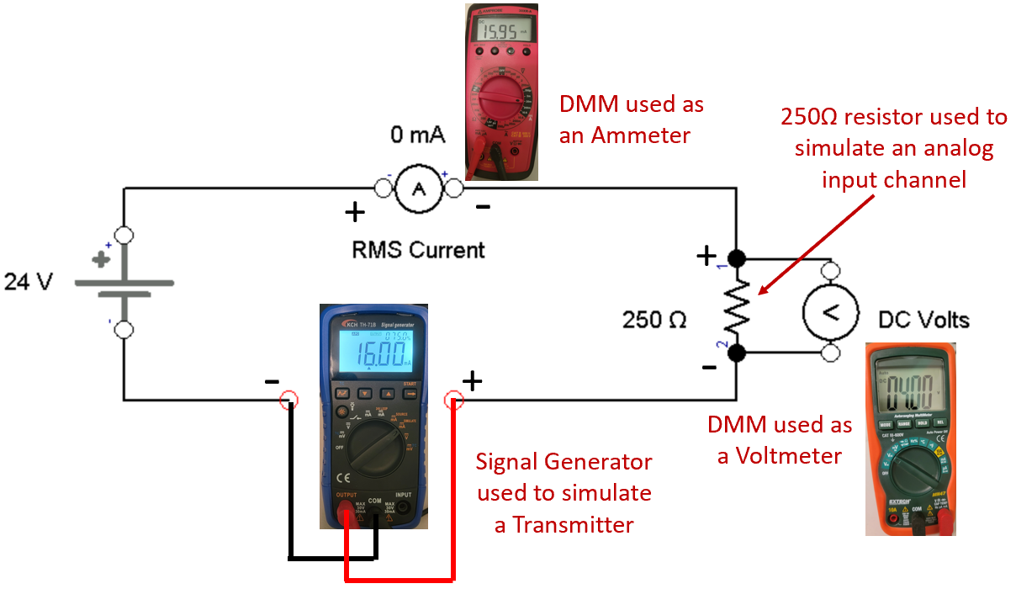
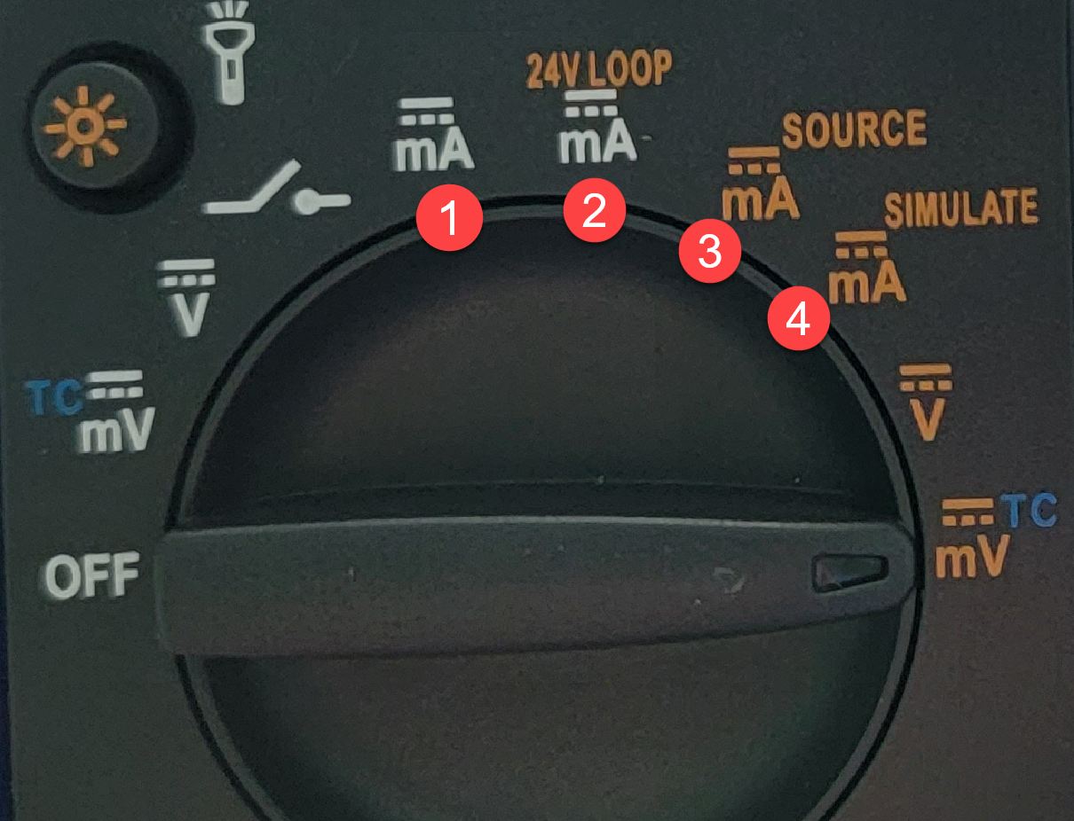
Simulating a Transmitter
Sometimes a Technician needs to test an analog current controlled system to verify that everything is working correctly, once the transmitter is correctly calibrated. To test the circuit without the actual transmitter, the user could use the signal generator to simulate a 2-wire transmitter. Notice that it is used in series with the 24 Vdc power supply and the 250 ohm resistor. Also notice that the dial setting is on the mA SIMULATE setting (the mA SOURCE setting simulates a 4-wire transmitter).
The user can dial in the different current loop settings (4-20mA) then see how the circuit responds.
At 8 mA, the ammeter will show 8 mA and there should be 2Vdc dropped across the 250Ω resistor.
At 12 mA, the ammeter will show 12 mA and there should be 3 Vdc dropped across the 250Ω resistor.
Acromag 250T Thermocouple Transmitter
Signal generator dial setting should be on mA SIMULATE (4)

Slide 44
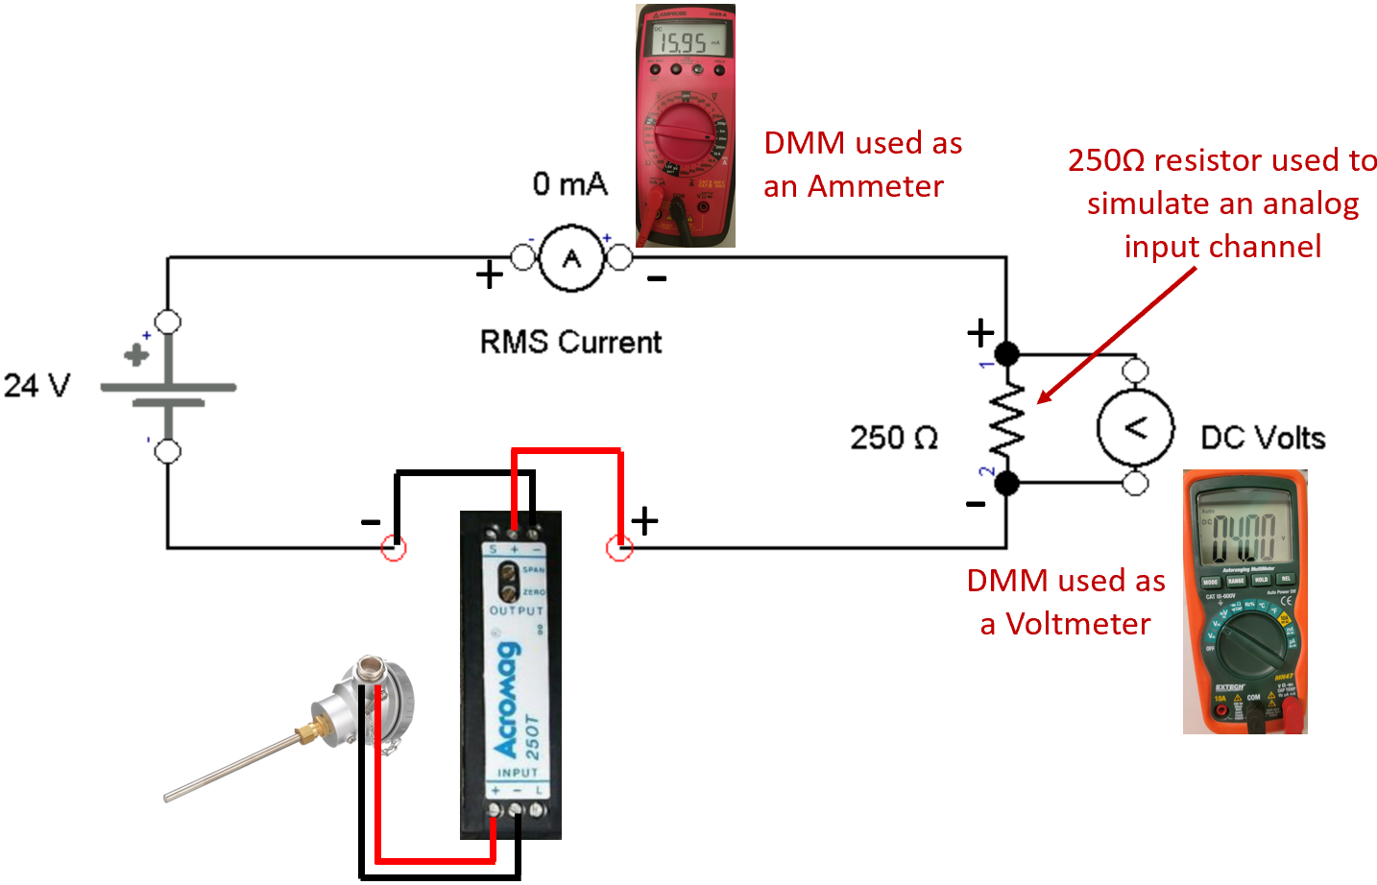
Temperature Transmitter to control Loop Current
The temperature transmitter takes the sensor (thermocouple) reading and converts it to a 4-20 mA signal that is proportional to the temperature range that the transmitter was calibrated to. So if the transmitter is calibrated for a 100° to 200° range and the thermocouple is reading 125°, the transmitter will set the loop current to 8mA (25% of the 4-20mA range), since 125° is 25% of the 100-200 degree range.
Though the J-type thermocouple has a wide temperature range it can work in, the value in using a transmitter is that the range can be narrowed down to fit the process variable range, such as the temperature range of an oven.
It is important to understand that the transmitter must be calibrated for a specific temperature range for this circuit to work correctly.

Slide 45
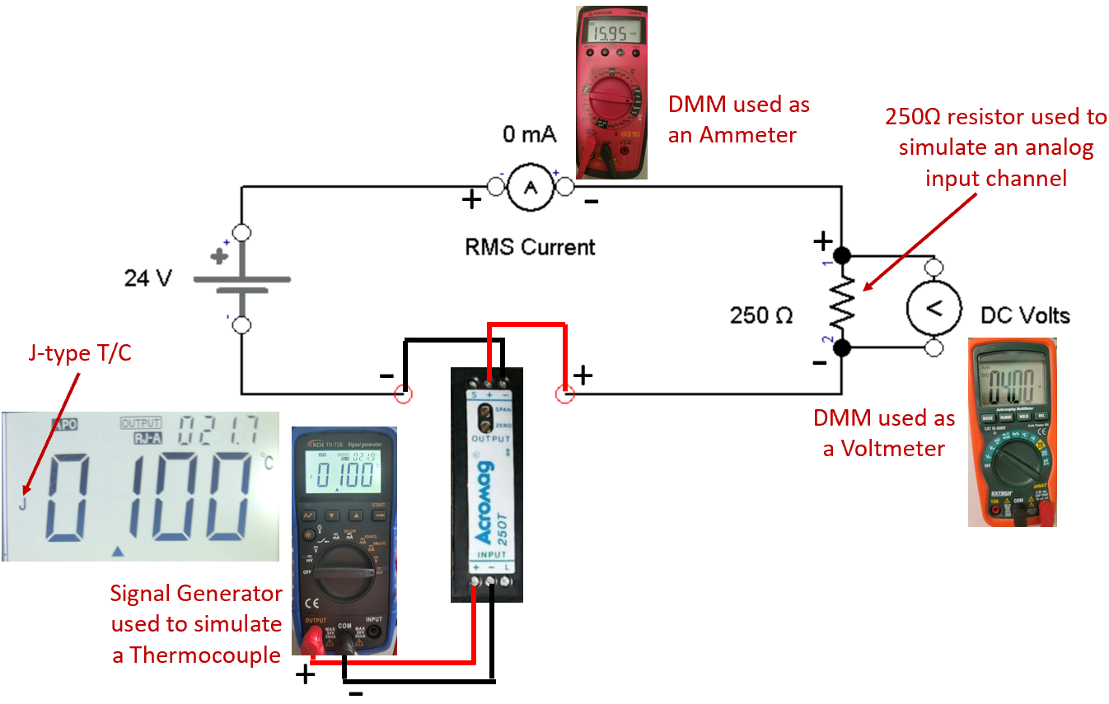
Calibrating a Transmitter
When calibrating a transmitter, the device should be removed from the actual circuit in the field and calibrated in a lab environment. The typical circuit to calibrate a 2-wire transmitter is shown in this graphic. A 250Ω resistor is used in place of an analog input channel, since this would be the typical input impedance of an input channel.
The transmitter has a zero and span adjustment that will allow calibration. The zero will set the low end of the range (100° sets 4 mA in the circuit), and the span sets the high end of the range (200° sets 20 mA in the circuit).
A thermocouple simulator is used to simulate the mV input into the transmitter for a specific temperature. The lower temperature 100° is setup on the T/C simulator then the zero potentiometer is adjusted to set 4mA in the circuit, then the T/C simulator is set for 200° and the span potentiometer is adjusted to set 20mA in the circuit. This process is repeated until the calibration process requires no more adjustments.

Slide 46
This Concludes this Instructional Document

