Slide 1
Faculty Professional Development Day 1
Converting to CB/H Model
Presented by:
Tom Wylie, PI for HOME4TECHS & Scaling CBE Elements
Northwest State CC, Archbold, OH

Slide 2
Workshop Materials Available for Download:
https://ate.is/Scaling_CBE

Slide 3
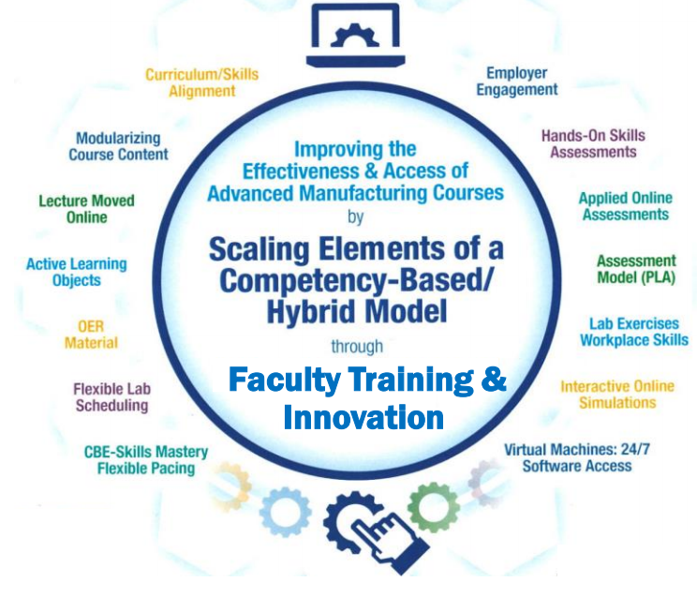
Instructional Elements to Improve Technical Courses

Slide 4
The Competency-Based/Hybrid Model:
Overview of the CB/H Model: Lecture is moved online, more hands-on learning, performance assessment (one-on-one with faculty), plenty of digital assets (learning objects) used in the LMS.
This Model was used in the Private Sector: The General Mills corporations, based in Minneapolis used a similar model to assess the knowledge and skills of their skilled trades employees starting in the late 1990s. Tom Wylie took DACUM results and created their training manuals, knowledge assessments and skills assessments.
Moodle: Online LMS systems were in their infant stages, and GMI used Moodle for their LMS to house all the instructional materials and record the assessments.
Nocti Testing Services: Knowledge assessments were stored at Nocti so information from all 62 domestic plants could be retrieved by GMI training personnel.
DOA: GMI termed their skills assessment as Demonstration Of Abilities (DOA), and had a Maintenance Team Leader at each plant who tested the maintenance personnel individually.

Slide 5
Why North Ark is moving to a new model?
More Hands-On Skills Development: Moving the lecture online makes more time for hands-on learning. Skills Assessment drives students to develop Hands-On Skills.
Faculty assured of Skillset of each Student: One-on-one skills assessment for each student by the Faculty assures the required skills and knowledge. No students can skirt the system.
Student Access: Students have the flexibility of attending any of the scheduled lab times, or scheduled open lab times. Some faculty take attendance in the lab times to identify students' procrastination.
Realignment of Technical Curriculum to meet employer needs: Some of the curriculum had not been changed for 10-20 years. Technology had changed and employers drove us to change.
Adaptive Learners: Employers need to continually update the skills of their workforce. Employees need to be adaptive learners who can learn from multiple methods of delivery (online materials, videos, etc.). Employers do not typically deliver information through a lecture. It simply is not efficient.

Slide 6
Traditional Education Model
Versus
Competency-Based/Hybrid

Slide 7
Competency Based Learning:
Competency-based Education (CBE)
The competency-based education (CBE) approach allows students to advance based on their ability to master a skill or competency at their own pace regardless of environment. This method is tailored to meet different learning abilities and can lead to more efficient student outcomes. (Educause)

Slide 8
Competency Based Learning:
Competency-based learning refers to systems of instruction, assessment, grading, and academic reporting that are based on students demonstrating that they have learned the knowledge and skills they are expected to learn as they progress through their education.
Some synonyms to CBL include: Proficiency-based, mastery-based, outcome-based, performance-based, and standards-based instruction.
Reference: https://www.edglossary.org/competency-based-learning/
Achieving the Dream movement fully supports CBE, since it is more effective instruction, and offers more access to the under served population.

Slide 9
Competency-Based Education (CBE)
Across the country there is a trend to transition away from seat-time and move towards a flexible structure that allows students to progress in their learning after they have demonstrated mastery, which is often time at their own pace. This trend is known as competency-based education (CBE). Good article by Janice Walton (below is the link to it).
https://www.gettingsmart.com/2017/12/12/competency-based-education-definitions-and-difference-makers/#:~:text=Competency%2Dbased%20education%20is%20defined,to%20more%20efficient%20student%20outcomes.%E2%80%9D

Slide 10
What is Competency-based Education (CBE)?
Competency-based Education consists of the following unique elements:
Mastery of Skills - The CBE course is typically parsed into modules, with assessments in each module that must be passed at the mastery level.
Flexible Pacing - Student will progress through a course at their pace of learning (and of course mastery). Some students will finish early, and some will take a little longer.
Fixed Learning- Ideally, every student has the same knowledge and skills assessments that require mastery, thus all students should be at the same level when they complete a course.
Variable Time – This refers back to flexible pacing. Student progress through a course at their own pace. Some students finish sooner and can start the next course prior to the start date if they are registered (assessments cannot be open until the start date of the next semester). Some student take a little longer, thus they may need more time than what is in the course (incomplete). Incompletes are awarded by the Dean based on Faculty input. Procrastination is not tolerated.

Slide 11
Traditional Technical Course
Traditional Technical Course at NSCC, 8 years ago
Syllabus
Textbook
Lecture
Handful of labs
3 P/P Tests
Grade (ABCDF)
The challenge is: How does an Instructor know that all students have the skills required by the employers?

Slide 12
Traditional PLC Course Schedule:
Wk. 1
Wk. 2
Wk. 3
Wk. 4
Wk. 5
Wk. 6
Wk. 7
Wk. 8
Wk. 9
Wk. 10
Wk. 11
Wk. 12
Wk. 13
Wk. 14
Wk. 15
Wk. 16
Mon
Mon
Mon
Mon
Mon
Mon
Mon
Mon
Mon
Mon
Mon
Mon
Mon
Mon
Mon
Mon
Lecture
Lecture
Lecture
Lecture
Lecture
Lecture
Lecture
Lecture
Lecture
Lecture
Lecture
Lecture
Lecture
Lecture
Lecture
Lecture
8a-12p
8a-12p
8a-12p
8a-12p
8a-12p
8a-12p
8a-12p
8a-12p
8a-12p
8a-12p
8a-12p
8a-12p
8a-12p
8a-12p
8a-12p
8a-12p
Wed
Wed
Wed
Wed
Wed
Wed
Wed
Wed
Wed
Wed
Wed
Wed
Wed
Wed
Wed
Wed
Lab
Lab
Lab
Lab
Lab
Lab
Lab
Lab
Lab
Lab
Lab
Lab
Lab
Lab
Lab
Lab
8a-12p
8a-12p
8a-12p
8a-12p
8a-12p
8a-12p
8a-12p
8a-12p
8a-12p
8a-12p
8a-12p
8a-12p
8a-12p
8a-12p
8a-12p
8a-12p
Test #1
Test #2
Final
ET 2440 Industrial Control Systems
4 Cr. Hr., 128 contact hours (2 hrs. Lec. & 6 hrs. Lab/week for 16 weeks)
Students & Faculty make 32 trips to campus for this semester course
3 Written or Online Knowledge-based Assessments, and possibly projects
Pace is set by the Instructor

Slide 13
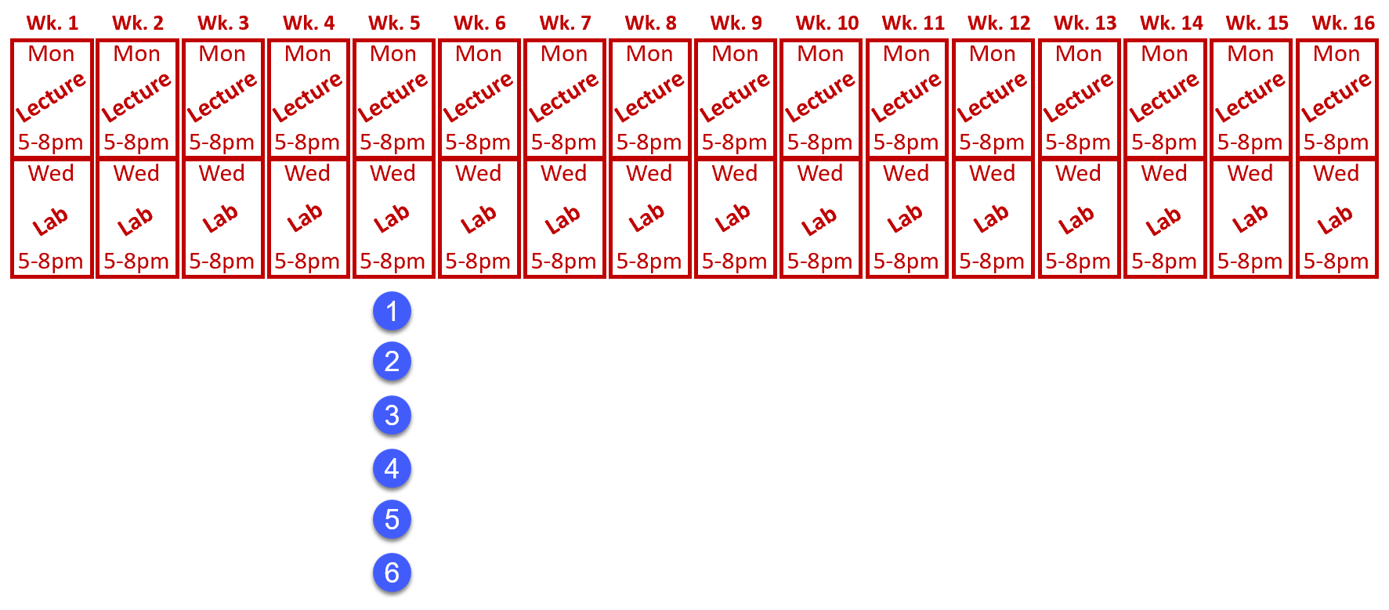
Traditional PLC Course Pacing:
Wk. 1
Wk. 2
Wk. 3
Wk. 4
Wk. 5
Wk. 6
Wk. 7
Wk. 8
Wk. 9
Wk. 10
Wk. 11
Wk. 12
Wk. 13
Wk. 14
Wk. 15
Wk. 16
Mon
Mon
Mon
Mon
Mon
Mon
Mon
Mon
Mon
Mon
Mon
Mon
Mon
Mon
Mon
Mon
Lecture
Lecture
Lecture
Lecture
Lecture
Lecture
Lecture
Lecture
Lecture
Lecture
Lecture
Lecture
Lecture
Lecture
Lecture
Lecture
8a-12p
8a-12p
8a-12p
8a-12p
8a-12p
8a-12p
8a-12p
8a-12p
8a-12p
8a-12p
8a-12p
8a-12p
8a-12p
8a-12p
8a-12p
8a-12p
Wed
Wed
Wed
Wed
Wed
Wed
Wed
Wed
Wed
Wed
Wed
Wed
Wed
Wed
Wed
Wed
Lab
Lab
Lab
Lab
Lab
Lab
Lab
Lab
Lab
Lab
Lab
Lab
Lab
Lab
Lab
Lab
8a-12p
8a-12p
8a-12p
8a-12p
8a-12p
8a-12p
8a-12p
8a-12p
8a-12p
8a-12p
8a-12p
8a-12p
8a-12p
8a-12p
8a-12p
8a-12p
Pace is set by the Instructor
Pace is the same with all students
Learning/Grade is variable

Slide 14
Competency-Based/Hybrid Instructional Model
LMS Canvas
On-campus class time
*Readings
*Videos
*PDFs
*Lec Cap
*Objects
Lab Exercises
Hands-On Assessment
Student 1
Lab Packs sold in Bookstore (required)
Student 2
*Study Guide
*Practice Quiz
*KAAs
Student 3
Faculty facilitates learning
*Lab Exercises
*Simulations
*Performance
Faculty
Faculty assesses student skill/knowledge
Self-proctored Online Assessments

Slide 15
Competency-based Hybrid PLC Course Schedule:
Wk. 1
Wk. 2
Wk. 3
Wk. 4
Wk. 5
Wk. 6
Wk. 7
Wk. 8
Wk. 9
Wk. 10
Wk. 11
Wk. 12
Wk. 13
Wk. 14
Wk. 15
Wk. 16
Module 1
Module 2
Module 3
Module 4
Module 5
Module 6
Module 7
Module 8
Canvas
Canvas
Canvas
Canvas
Canvas
Canvas
Canvas
Canvas
M1 KAA
M2 KAA
M3 KAA
M4 KAA
M5 KAA
M6 KAA
M7 KAA
M8 KAA
Wed
Wed
Wed
Wed
Wed
Wed
Wed
Wed
Wed
Wed
Wed
Wed
Wed
Wed
Wed
Wed
Lab
Lab
Lab
Lab
Lab
Lab
Lab
Lab
Lab
Lab
Lab
Lab
Lab
Lab
Lab
Lab
8a-12p
8a-12p
8a-12p
8a-12p
8a-12p
8a-12p
8a-12p
8a-12p
8a-12p
8a-12p
8a-12p
8a-12p
8a-12p
8a-12p
8a-12p
8a-12p
Performance
Assessment #1
Performance
Assessment #2
Performance
Assessment #3
Performance
Assessment #4
Students & Faculty make 16 trips to campus for this semester course
Pace is set by student learning and completion

Slide 16
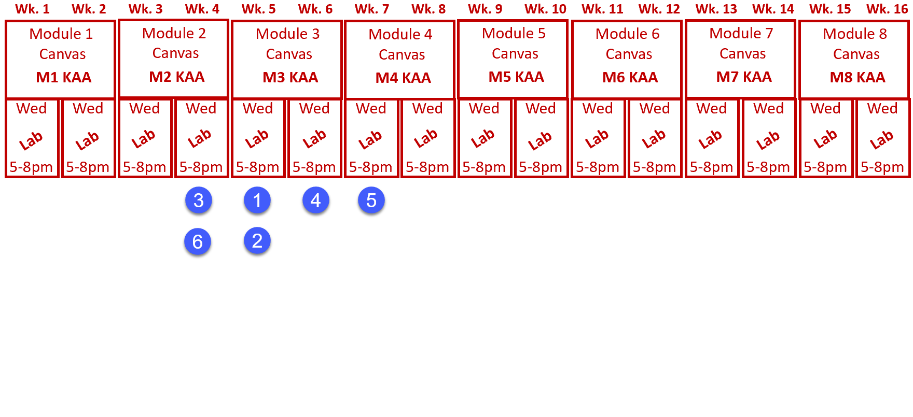
Flexible Pacing of Student Learning:
Pace is set by student learning and completion
All students finish with the same level of learning

Slide 17
Assessment Models:
Traditional Assessment Model:
Competency-based Assessment Model:
Test #1
M1 KAA
Performance
Assessment #1
Test #2
M2 KAA
Test #3
M3 KAA
M4 KAA
Performance
Assessment #2
Knowledge
Paper or
Online
10 Point Sys.
A-F Grade
M5 KAA
M6 KAA
Performance
Assessment #3
M7 KAA
M8 KAA
Performance
Assessment #4
Knowledge
Paper or
Online
80% min.
A, B, or F
Skills
Hands-on
100% min.

Slide 18
Grading in the NSCC Assessment Model:
The grades the students are awarded in the NSCC Ind. Tech hybrid courses are: A, B or F.
The hands-on assessment (HOA) must have 100% mastery, so students have to get 100. This is not averaged into the grade. It is required.
The knowledge & application assessment (KAA for short) is the cognitive, online assessment. Student have to get at least an 80% on this assessment to pass the module. They have two tries at taking KAA in each module.
16 assessments in each course (8 online, 8 hands-on)

Slide 19
Traditional Education vs. Competency-Based
In a traditional model, the faculty does primarily teaching (Sage on the Stage), and some assessment.
In a competency-based model, the faculty does primarily assessment, and less teaching than in the traditional model.
The faculty becomes a learning facilitator, both in the Lab (still teaching the hands-on skills), and also within the LMS (Canvas).

Slide 20
Lessons Learned
And
Recommendations

Slide 21
What’s in it for Me? The Stakeholders Perspective
Students: Students like the 24/7 access to the course materials, and knowing what is expected of them for the assessments.
Faculty: Faculty like the consistency in the curriculum, and that all materials are developed, so they do not have to spend time preparing for a class. They also like the flexibility of time on campus.
Employers: Employers like the more accessible classes for their employees, and better prepared graduates. They really like the assessment model of student accountability.
College: Increase in enrollment, increase in retention (SSI), and knowing that the other 3 stakeholders are happy.

Slide 22
Advantages to a Competency-Based Approach:
Focus on Learning Outcomes: In a traditional environment, learners may progress through the material even if they haven’t fully mastered it. CBE is different. It relies on students showing that they’ve learned the skills and acquired the knowledge before they can continue. This helps ensure everyone can move forward in their studies, albeit at different speeds, and no one is left behind.
Use Resources in the most Efficient, Effective Ways: CBE models may require less classroom time than traditional models since people are able to review the content independently.
Become More Flexible and Accessible: One of the significant benefits of CBE is that it allows learners to study when and where it suits them best. This can be particularly beneficial for working adults or those with other commitments who might not be able to attend traditional classes. Also, CBE programs often use online learning tools, helping them reach more nontraditional students.
Improve Retention Rates: CBE programs are generally associated with higher student retention rates than occur with traditional models. This is likely because students in a CBE program are only progressing once they have fully mastered the material, meaning they are less likely to become frustrated and give up on their studies.
Foster a More Positive Student Experience: CBE programs tend to lead to a more positive overall student experience because they focus more on learning outcomes and individualized attention. In fact, many students who have participated in CBE programs report feeling more engaged with their studies. Receiving targeted support based on their individual needs helps them feel more confident in their abilities and achieve a statistically higher GPA.
Great Article by D2L: https://www.d2l.com/blog/the-complete-guide-to-competency-based-education/

Slide 23
Challenges with Competency-Based Learning:
Instructors Must Fundamentally Change: CBE requires a change of mindset among educators. Instead of teaching to a set plan, educators need to be prepared to teach what each student is ready to learn and adapt, considering individual behaviors and outcomes.
Preparation Is Critical: Creating measurable learning objectives that show competency isn’t easy. For instructors, the change in teaching styles that comes from implementing CBE may require a top-to-bottom overhaul of course materials. This includes re-creating lessons and learning materials, developing appropriate assessments, and ensuring all students have access to the resources they need.
Students Need to Learn Differently: Students enrolled in CBE programs need to be ready to adjust to a different learning style. For some, it’s a matter of staying motivated and balancing the demands of their personal, professional and academic lives. For others, it’s a social shift. Depending on the speed at which learners move through the material, they may not stay with the same cohort the whole time.
Great Article by D2L: https://www.d2l.com/blog/the-complete-guide-to-competency-based-education/

Slide 24
Consistency in Instructional Materials:
Consistency is an important thing to the students at NSCC. Not only are all the documents built in a standard format, but also the LMS course layout is an important standard.
LMS formatting is especially critical. At NSCC, many students did not have great experience taking online courses (primarily Gen Ed), since every Instructor would setup a course differently. The standardization in our LMS was a best practice in our student focus groups.
Learning Objects have a specific format in PPT and Word, with text colors, margins, headers, etc.

Slide 25
A Few Lessons Learned cont.:
This model has moved the student learning off the shoulders of the faculty, to the student. Students are responsible for their learning, and when they take their assessments.
Employers really like this model since all of the curriculum is developed. A positive thing for the companies was if they sponsored students into a course that had two sections with two different instructors, the students get the same learning experience. Reducing the variance.

Slide 26
A Few Lessons Learned cont.:
CBE type of technical courses must have a solid structure. How we did technical courses before did not need as much structure.
Until our Ind. Tech. hybrid courses, online courses were a wild west rodeo. 10 different courses, and they may all look different. Huge negative for the students.
Our faculty needed to become more literate in the digital world (not just computer literate), due to the moving online, and they needed a support structure.

Slide 27
Academic
Standards

Slide 28
Define the Terms used in the Curriculum:
Competencies: Competency is a set of demonstratable characteristics and skills that enable, and improve the efficiency of, performance on a job. Competencies are not skills, but they are similar to skills. A competency is an over arching statement on a job description, which is many times not measurable. Outcomes are measurable, and thus outcomes are used to build a competency.
Knowledge: Knowledge is the theoretical or practical understanding of a subject. It is important to understand that a student cannot develop skills without first having knowledge.
Skills: Skill is the actual performance or demonstration of a technical task. Skills are the proficiencies developed through training or experience.
Abilities: Ability is defined as the capacity to perform. We are preparing the students to have the ability to transfer their learned skills in an industrial setting.

Slide 29
An example of Competencies & Outcomes:
Competency: Use RSLinx to establish communications between a computer (with PLC programming software) and Allen Bradley PLCs (L5000, SLC-500, PLC-5 & ML1000).
Module Outcomes:
1. Configure RSLinx to communication with a ControlLogix 5571 controller.
2. Identify all the hardware components on a L5571 controller
Skills Assessment:
Create an Ethernet driver in RSLinx to communicate with a 1756-ENET module.
Create an Ethernet/IP driver in RSLinx to communicate with 1756-ENET module.
Create a USB driver in RSLinx to communicate with the controller.
Knowledge Required:
What is an IP address? What is a subnet mask? How does an Ethernet port get an IP address?
How to determine the IP address of a 1756-ENET module
How to drill down to a controller from a driver in RSLinx
How to use RSWho to view the drivers and communications within a ControlLogix system
How to create a driver in RSLinx

Slide 30
Building Measurable Outcomes
Outcomes must be aligned to a competency, which should align to the workplace
A Quality Matters alignment table is used to align the outcomes to the competencies
Outcomes must be measurable
Students must know what is expected of them. The term “Understanding” is not measurable

Slide 31
Assessment
Model

Slide 32
Assessment by Faculty
Assessment is the responsibility of the faculty.
Student skills and knowledge are both assessed by the faculty in the Skills Assessment (Knowledge is required, to develop Skills)
Knowledge is also assessed through an online assessment for each module that faculty developed, which consists of M.C., Matching and T.F. questions. LMS is used to assure students cannot cheat. Use questions the LMS will grade, to make Faculty more efficient.
LMS efficiency saves faculty valuable time
The assigned instructor objectively determines if a student passes a module, and the course.
Create a PLA (Prior Learning Assessment) for the course, based on a combination of the Knowledge and Skills Assessments. This process of testing out of a course has tremendous academic integrity.

Slide 33
What is an Open Lab model?
NSCC initially tried an open lab model, but students were confused when they did not see a scheduled time on the semester schedule.
Lab time was schedule one day per week, with extra lab time scheduled on an “as needed” basis. Instructors found that the extra lab time schedule either right before, or right after the scheduled lab time was the most popular.
The set lab time assured the student that the Instructor would be available during this time to get assistance and to perform the skills assessment.
Only the Instructor of record can perform the skills assessment (Hands-On Assessment)

Slide 34
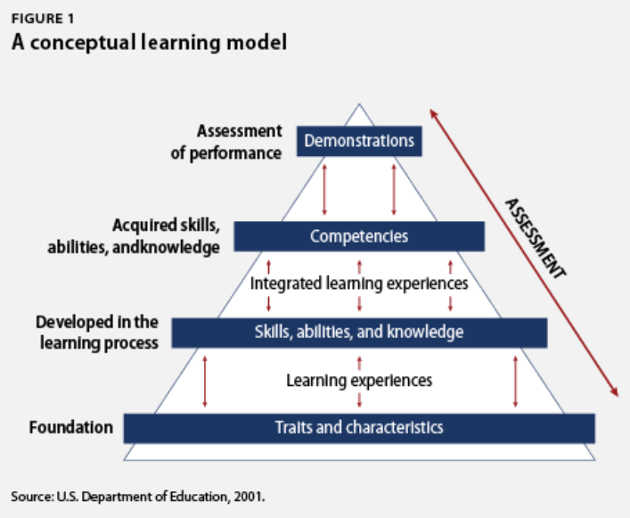
A traditional model has typically 2-3 written or online assessments.
A CBE model has many more assessments so the faculty can determine mastery of the knowledge/skill of each student in each module.

Slide 35
Develops KSA
Competencies
Assessment of
Performance
Skills Demonstration
Integrated Learning Experiences
Knowledge Assessment
Developed in the
Learning Process
Develop Knowledge, Skills & Abilities
Learning Experiences
Foundation
Traits, Characteristics & Basic Skills

Slide 36
Employer
Engagement

Slide 37
Critical Information from Employers:
Ask for their skilled Job Classification, and acquire job descriptions (Maintenance Mechanic, Electricians, Instrumentation Tech., Millwright, etc.).
Find out what technology they use in their plants:
*PLC type, HMI type, Robotic type, Connectivity
*Instrumentation, Test Equipment, VFD types, etc.
This will be important information for both the academic division, and also the Workforce Development Group.

Slide 38
External Data
Delivery of Product
Topic Resources
Job Descriptions
DACUM Comp.
WFD Demand
Employer RT
Corp. Faculty
Credit Cert/Degrees
2 Yr. AAS, ATS, AIS
One-year Cert.
Gainful Empl. Cert.
Apprenticeships
-------------------------
Ind. Automation Maint. Cert.
Industrial Elect. Cert.
Industrial Maintenance Degree
Automation Cert.
Job Classifications
Maintenance Mechanic
Electrician
Machine Setup
Internal Product
Technical Topics
Basic Electrical
Handtools
Powertools
Ind. Safety
Pneumatics
Hydraulics
Mech Print Read
Motor Control Cir
Motors & VFDs
PLC Basics
AB CompactLogix
AB ControlLogix
Ethernet basics
Rigging
Pumps
Pipefitting basics
Machine Repair
Technical Courses
IND120 IE1
IND121 IEII
IND223 M&C
PLC200 PLCI
IND134 IFPI
Short Term Public Classes
Students come to the college
4 hr. to 24 hr. courses
Credit or N/C
AB PowerFlex 525 VFDs
Types of Students
Incumbent
Emerging
Contract Training
Students come to the college
College delivers at company
4 hr. to 24 hr. courses
Credit or N/C
------------------------------
AB PowerFlex 525 VFDs
Intro to AB ControlLogix
Technical Courses
Displaced
Underemployed

Slide 39
Show
Electrical Course Sequence
And
Course Overview Sheets

Slide 40
Getting Input from Employers:
Oversight Group: At some colleges this would be an Advisory Board for a program. The BILT model was implemented at Terra State CC in Ohio. This group is like a steering committee for their technical curriculum.
Technical Topic Roundtables: Our project team found the best way to get input on a topic such as the content of a PLC course, or a fluid power course, is to hold an industry roundtable. This consists of 3-4 SMEs in a 45-minute Zoom meeting. An outline is sent to each 1 week ahead of time, consisting of no more than a 2-page outline of topics that will be reviewed. Input is documented, then sent back out to the small group for their final review. A special focus should be on the hands-on skillset that is required. The nice thing about using Zoom, is the college can do a one-on-one meeting with an SME if they cannot get to the Zoom meeting. Most of all, respect their time and thank them for their input.
Communicate the results of the Roundtable back to the Oversight Group and explain how the curriculum will be adjusted to improve effectiveness and/or access.

Slide 41
Engaging Employers
How does the Technology division at NorthArk engage employers?
Accrediting bodies like a comprehensive employer engagement strategy
Purpose of an Advisory Board
Purpose of an Industry Roundtable
Purpose of a Focused Industry Visit
Industry Consortiums (Adv. Mfg. Consortium & Lean Mfg. Consortium)

Slide 42
Importance of an External SME group
SME stands for Subject Matter Expert
4-6 of these SMEs should be identified to vet information through as part of the development process
It is important to have all knowledge and skills development, align to the workplace
This will be done through validated competencies, and measurable outcomes

Slide 43
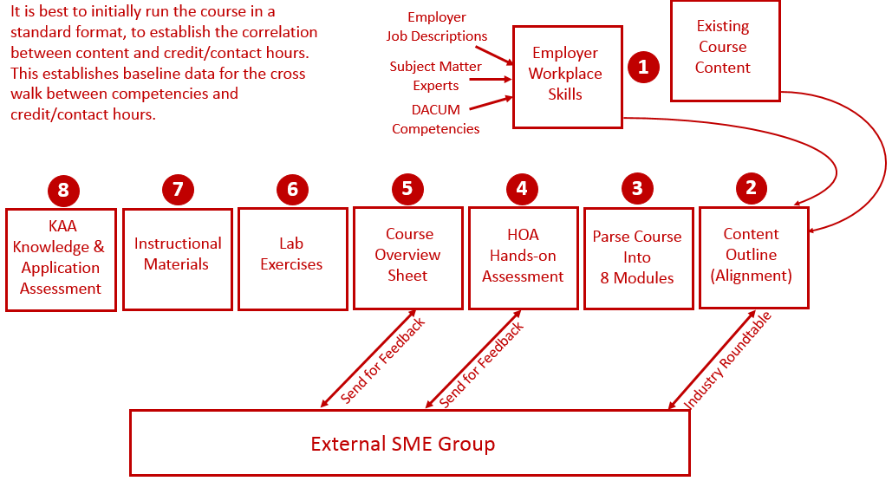
Reverse Design:

Slide 44
Creating a Development Process
Course Blueprint: Course Blueprint is a document that will hold all the module information for the course: Module descriptions, module outcomes, topics, skills assessments, etc. The blueprint can be shared with the development team, allowing multiple people to edit the document.
IND221 Instrumentation and Controls: This course at Northwest State CC in Ohio was converted to a CB/H model in Summer/Fall 2023.
Review the Development Process: Electrical Instructor John Mueller was the faculty, we did a course overhaul, with some new lab equipment, and focused on tasks and equipment that is used in the local process industry.

Slide 45
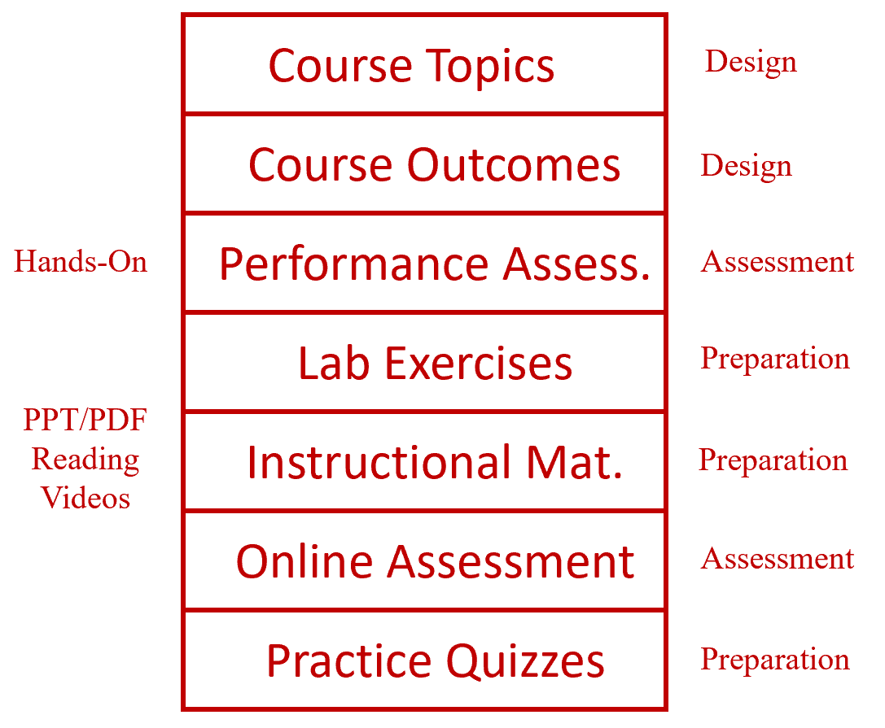
Learning Thread:

Slide 46
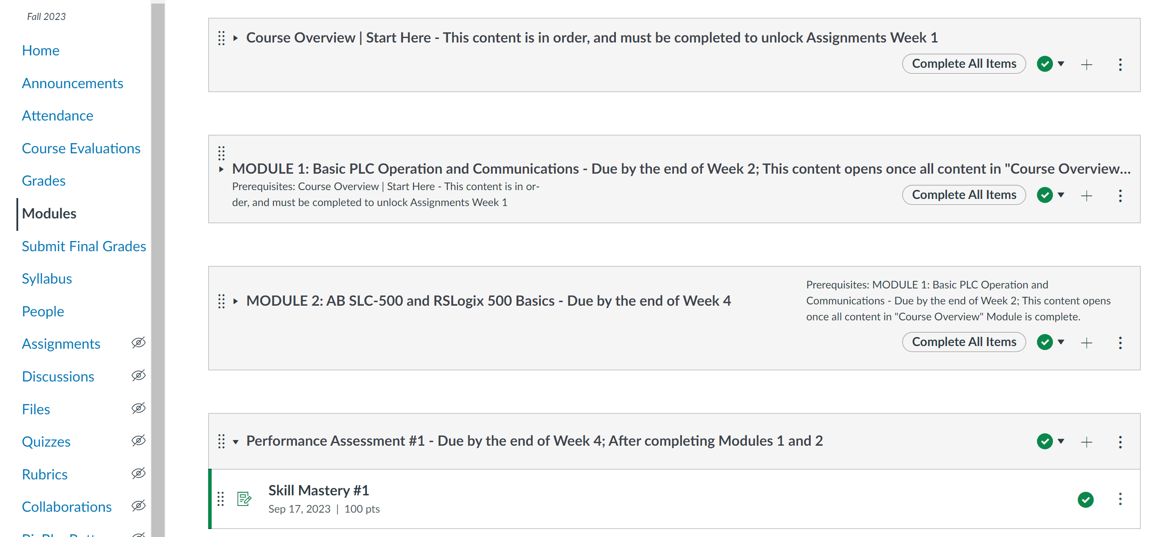
PLC Course in Canvas:

Slide 47
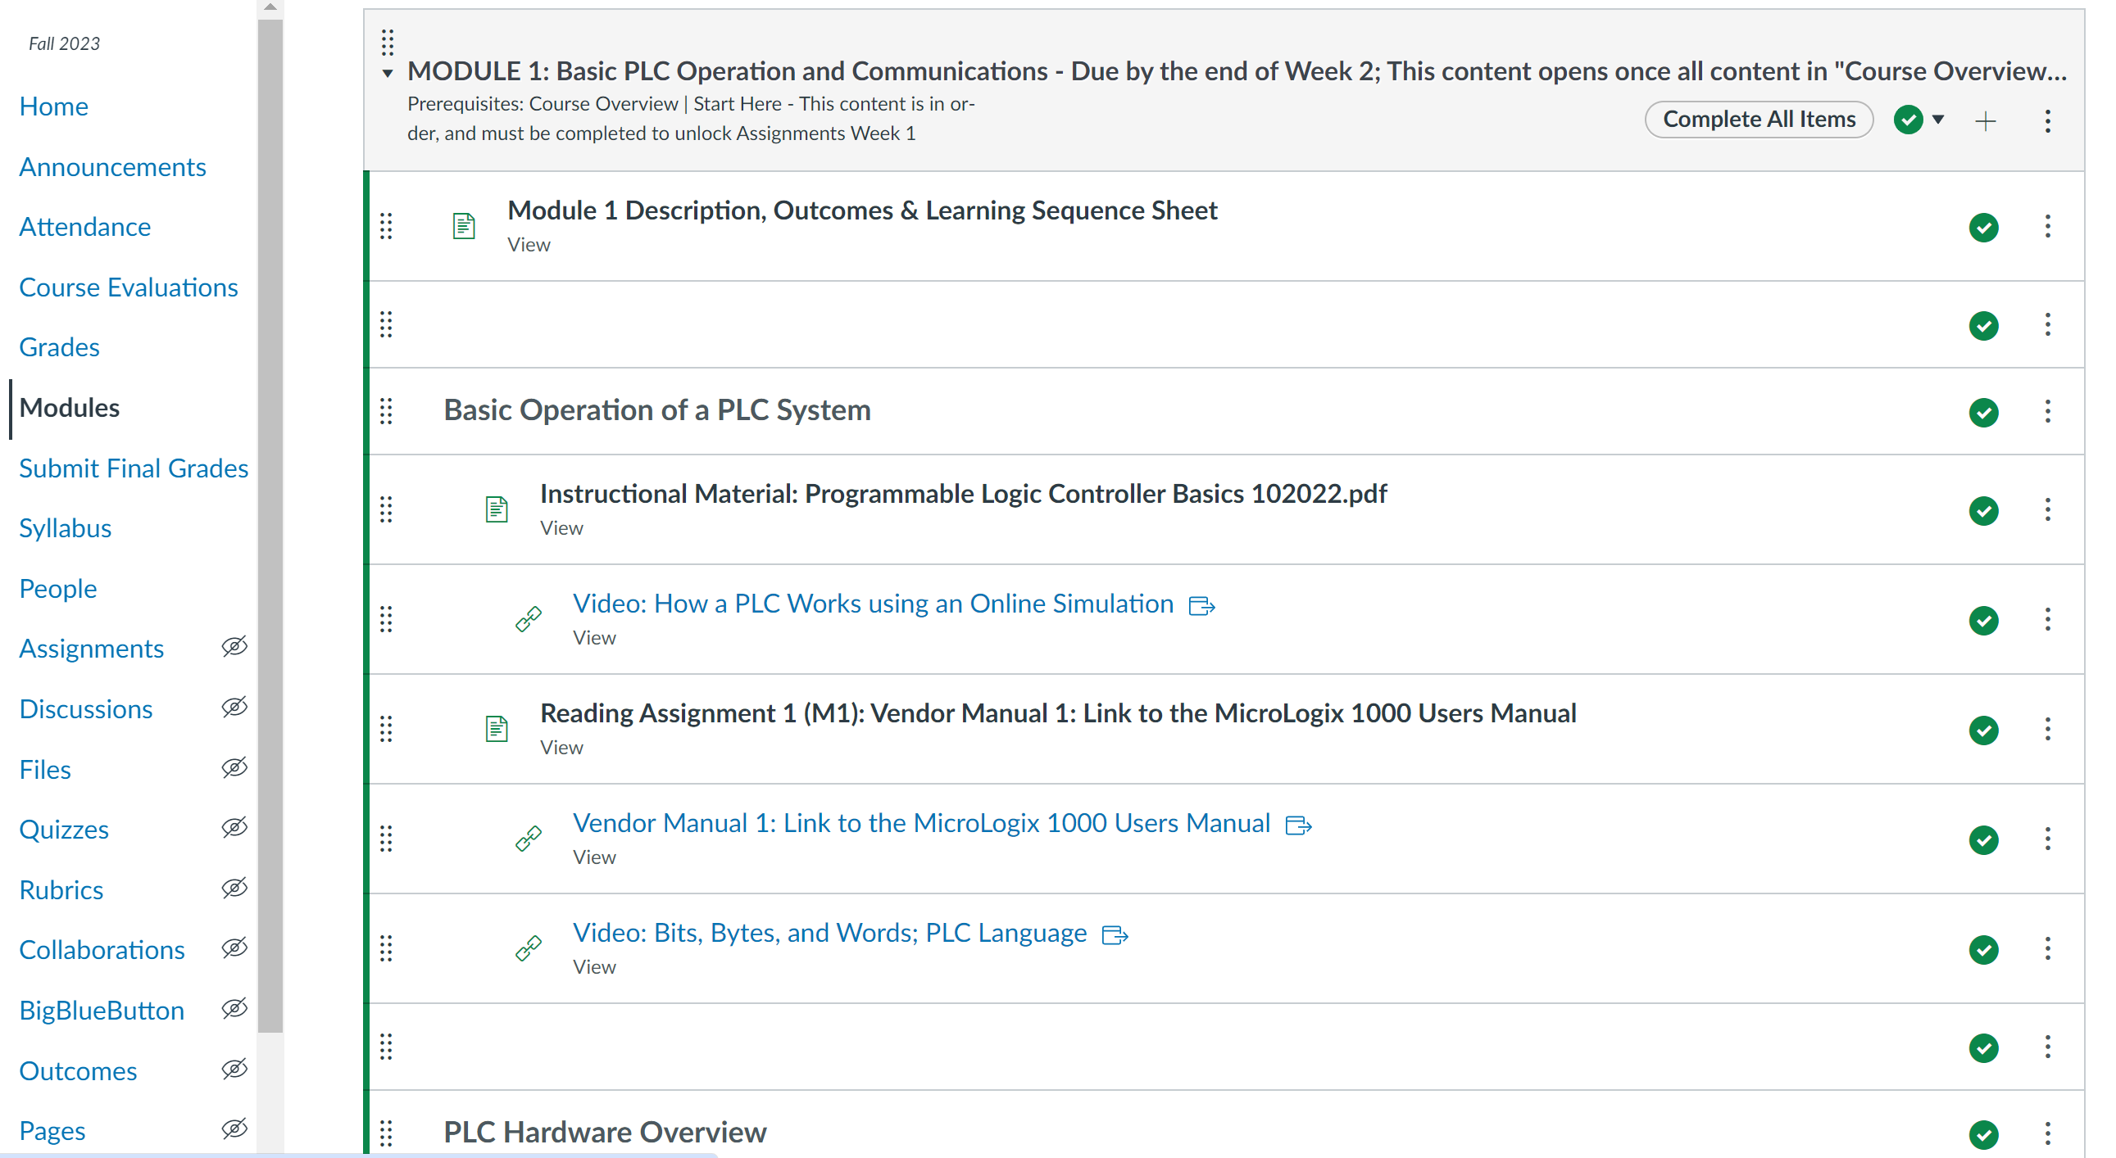
PLC Course in Canvas:

Slide 48
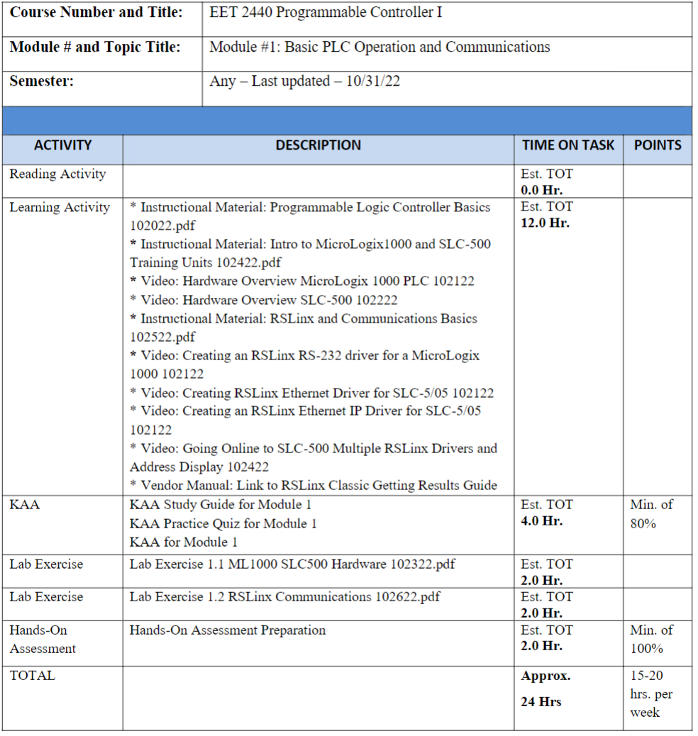
PLC Course in Canvas (Learning Sequence Sheet):

Slide 49
Converted course to a CB/H model
NSCC Instrumentation & Controls Course:
Realigned the content to meet employer needs
Created a course Blueprint to keep track of all information prior to entering into the LMS
Typically get the Skills Assessment done on the front end of the development cycle
Labs, PPT, Videos and Knowledge Assessments all built around the Skills Assessment
Will use examples of each in the training

Slide 50
How to Get Started?
Choose 1 course to start with such as:
Industrial Control Systems
Build Topic List: List out the topics that are in the existing course. Gather topic lists from other ATE projects, or from colleges that will share, then compile into a list to have the industry SMEs review. Try to get a composite list, knowing you will move, add and change topics.
Separate into 8 modules: This could be done before the topic list if it is easier to categorize.
Build the Skills Assessment: At some colleges this would be an Advisory Board for a program. The BILT model was implemented at Terra State CC in Ohio. This group is like a steering committee for their technical curriculum.

Slide 51
The End of the Presentation

