Slide 1
Faculty Professional Development Day 1
Converting to CB/H Model
Presented by:
Tom Wylie, PI for HOME4TECHS & Scaling CBE Elements
Northwest State CC, Archbold, OH

Slide 2
Workshop Materials Available for Download:
https://ate.is/Scaling_CBE

Slide 3
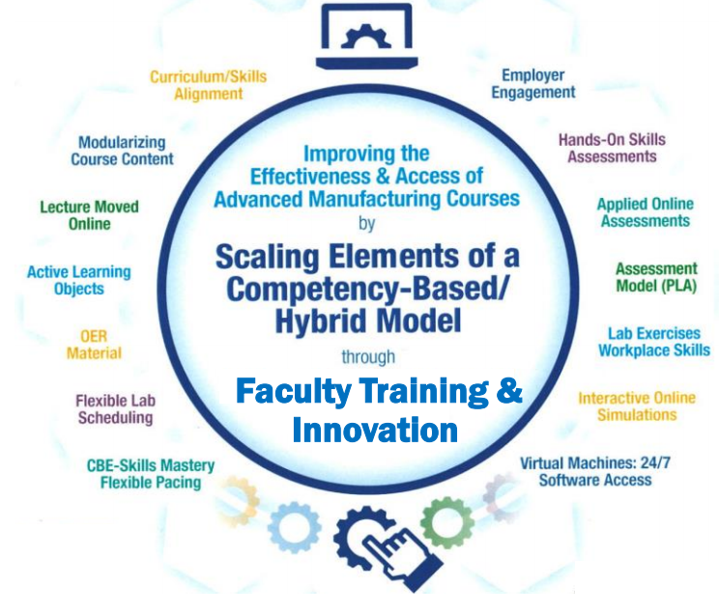
Instructional Elements to Improve Technical Courses

Slide 4
The Competency-Based/Hybrid Model:
Overview of the CB/H Model: Lecture is moved online, more hands-on learning, performance assessment (one-on-one with faculty), plenty of digital assets (learning objects) used in the LMS.
This Model was used in the Private Sector: The General Mills corporations, based in Minneapolis used a similar model to assess the knowledge and skills of their skilled trades employees starting in the late 1990s. Tom Wylie took DACUM results and created their training manuals, knowledge assessments and skills assessments.
Moodle: Online LMS systems were in their infant stages, and GMI used Moodle for their LMS to house all the instructional materials and record the assessments.
Nocti Testing Services: Knowledge assessments were stored at Nocti so information from all 62 domestic plants could be retrieved by GMI training personnel.
DOA: GMI termed their skills assessment as Demonstration Of Abilities (DOA), and had a Maintenance Team Leader at each plant who tested the maintenance personnel individually.

Slide 5
Competency-Based/Hybrid Instructional Model
LMS Canvas
On-campus class time
*Readings
*Videos
*PDFs
*Lec Cap
*Objects
Lab Exercises
Hands-On Assessment
Student 1
Each Course Consists of 8 Modules
Student 2
80% Required to Pass LMS Assessment
(Each module has a KAA assessment)
*Study Guide
*Practice Quiz
*KAAs
Student 3
Skills Assessment (4-8 in each course)
*One-on-One with Faculty
*100% of Tasks Required
*Must complete to continue in the course
*Lab Exercises
*Simulations
*Performance
Faculty
Couse grade is A, B or F (no Cs & Ds)
Self-proctored Online Assessments

Slide 6
Why SECC is moving to a new model?
More Hands-On Skills Development: Moving the lecture online makes more time for hands-on learning. Skills Assessment drives students to develop Hands-On Skills.
Faculty assured of Skillset of each Student: One-on-one skills assessment for each student by the Faculty assures the required skills and knowledge. No students can skirt the system.
Student Access: Students have the flexibility of attending any of the scheduled lab times, or scheduled open lab times. Some faculty take attendance in the lab times to identify students' procrastination.
Realignment of Technical Curriculum to meet employer needs: Some of the curriculum had not been changed for 10-20 years. Technology had changed and employers drove us to change.
Adaptive Learners: Employers need to continually update the skills of their workforce. Employees need to be adaptive learners who can learn from multiple methods of delivery (online materials, videos, etc.). Employers do not typically deliver information through a lecture. It simply is not efficient.

Slide 7
Pedagogy and Learning Styles used in CTE Courses

Slide 8
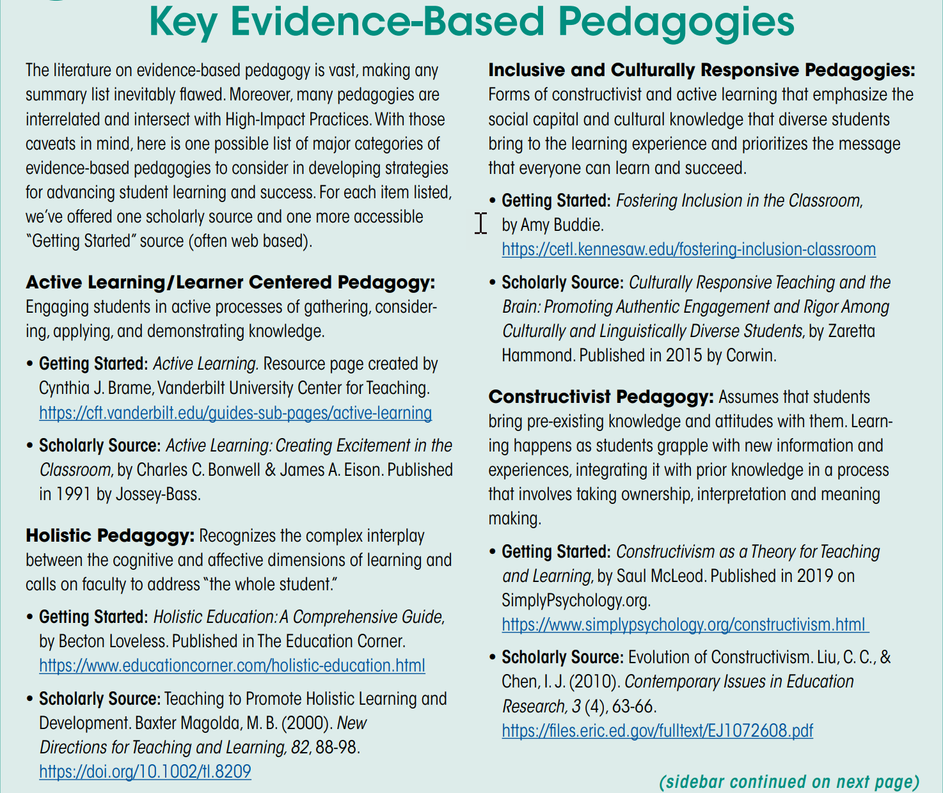
This information was referenced from the:
Achieving the Dream
Teaching and Learning Toolkit

Slide 9
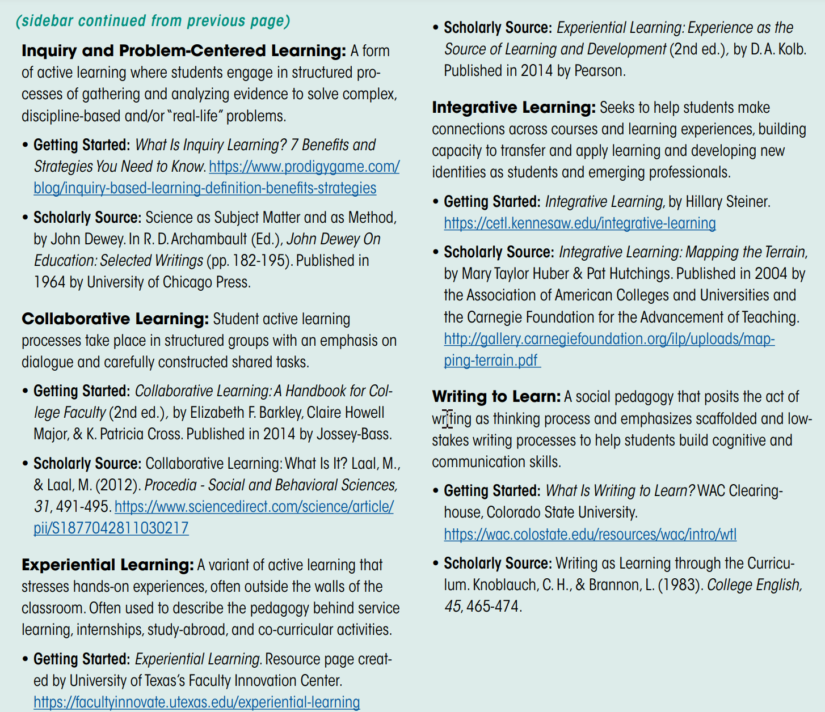
This information was referenced from the:
Achieving the Dream
Teaching and Learning Toolkit

Slide 10
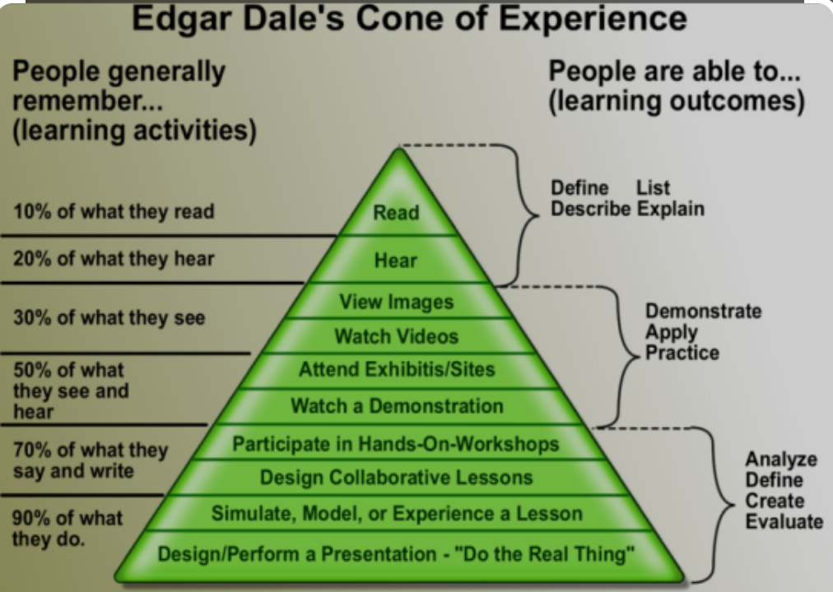
Passive Learning vs. Active Learning
Lecturing and Reading a textbook are both Passive Learning. These are not effective methods of instruction in CTE courses.
Passive Learning is Instructor Centered.
Active Learning is Student Centered. In Active Learning, students will internalize materials such as hands-on, and interactive learning objects: simulations and interactive videos (Questions asked within a video using Canvas Studio).

Slide 11
Traditional Education Model
Versus
Competency-Based/Hybrid

Slide 12
Competency Based Learning:
Competency-based Education (CBE)
The competency-based education (CBE) approach allows students to advance based on their ability to master a skill or competency at their own pace regardless of environment. This method is tailored to meet different learning abilities and can lead to more efficient student outcomes. (Educause)

Slide 13
Competency Based Learning:
Competency-based learning refers to systems of instruction, assessment, grading, and academic reporting that are based on students demonstrating that they have learned the knowledge and skills they are expected to learn as they progress through their education.
Some synonyms to CBL include: Proficiency-based, mastery-based, outcome-based, performance-based, and standards-based instruction.
Reference: https://www.edglossary.org/competency-based-learning/
Achieving the Dream movement fully supports CBE, since it is more effective instruction, and offers more access to the under served population.

Slide 14
What is Competency-based Education (CBE)?
Competency-based Education consists of the following unique elements:
Mastery of Skills - The CBE course is typically parsed into modules, with skills assessments that must be passed at the mastery level.
Flexible Pacing - Student will progress through a course at their pace of learning (and of course mastery). Some students will finish early, and some will take a little longer.
Fixed Learning- Ideally, every student has the same knowledge and skills assessments that require mastery, thus all students should be at the same level when they complete a course.
Variable Time – This refers back to flexible pacing. Student progress through a course at their own pace. Some students finish sooner and can start the next course prior to the start date if they are registered (assessments cannot be open until the start date of the next semester). Some student take a little longer, thus they may need more time than what is in the course (incomplete). Incompletes are awarded by the Dean based on Faculty input. Procrastination is not tolerated.

Slide 15
CBE is Individualized Learning:
Students decide when and how much to work on the modularized online content. The students are responsible for finishing the online content in a timely manner and must determine when they will take the skills assessments. Faculty will add learning objects to help enhance student learning, and to make the time in the lab environment more efficient.
Videos- Instructors create their own videos on their lab equipment to accelerate student learning. These are screen cams, showing how to use software such as RSLinx and Logix Designer, and also videos explaining how equipment works.
Simulations: Simulation software is used to have students do a similar lab in an online simulated environment, as they will in the hands-on lab.
Hands-On Labs are created to guide the student learning path.
Focused PDF Documents: These are created by faculty to explain something to the students that the textbook does not do. This can be more specific to the equipment in the labs.

Slide 16
Competency-Based/Hybrid Instructional Model
LMS Canvas
On-campus class time
*Readings
*Videos
*PDFs
*Lec Cap
*Objects
Lab Exercises
Hands-On Assessment
Student 1
Lab Packs sold in Bookstore (required)
Student 2
*Study Guide
*Practice Quiz
*KAAs
Student 3
Faculty facilitates learning
*Lab Exercises
*Simulations
*Performance
Faculty
Faculty assesses student skill/knowledge
Self-proctored Online Assessments

Slide 17
Assessment Models:
Traditional Assessment Model:
Competency-based Assessment Model:
Test #1
M1 KAA
Performance
Assessment #1
Test #2
M2 KAA
Test #3
M3 KAA
M4 KAA
Performance
Assessment #2
Knowledge
Paper or
Online
10 Point Sys.
A-F Grade
M5 KAA
M6 KAA
Performance
Assessment #3
M7 KAA
M8 KAA
Performance
Assessment #4
Knowledge
Paper or
Online
80% min.
A, B, or F
Skills
Hands-on
100% min.

Slide 18
Grading in the NSCC Assessment Model:
The grades the students are awarded in the NSCC Ind. Tech hybrid courses are: A, B or F.
The hands-on assessment (HOA) must have 100% mastery, so students have to get 100. This is not averaged into the grade. It is required.
The knowledge & application assessment (KAA for short) is the cognitive, online assessment. Student have to get at least an 80% on this assessment to pass the module. They have two tries at taking KAA in each module.
16 assessments in each course (8 online, 8 hands-on)

Slide 19
Traditional Education vs. Competency-Based
In a traditional model, the faculty does primarily teaching (Sage on the Stage), and some assessment.
In a competency-based model, the faculty does primarily assessment, and less teaching than in the traditional model.
The faculty becomes a learning facilitator, both in the Lab (still teaching the hands-on skills), and also within the LMS (Canvas).

Slide 20
Lessons Learned
And
Recommendations

Slide 21
What’s in it for Me? The Stakeholders Perspective
Students: Students like the 24/7 access to the course materials, and knowing what is expected of them for the assessments.
Faculty: Faculty like the consistency in the curriculum, and that all materials are developed, so they do not have to spend time preparing for a class. They also like the flexibility of time on campus.
Employers: Employers like the more accessible classes for their employees, and better prepared graduates. They really like the assessment model of student accountability.
College: Increase in enrollment, increase in retention (SSI), and knowing that the other 3 stakeholders are happy.

Slide 22
Consistency in Instructional Materials:
Consistency is an important thing to the students at NSCC. Not only are all the documents built in a standard format, but also the LMS course layout is an important standard.
LMS formatting is especially critical. At NSCC, many students did not have great experience taking online courses (primarily Gen Ed), since every Instructor would setup a course differently. The standardization in our LMS was a best practice in our student focus groups.
Learning Objects have a specific format in PPT and Word, with text colors, margins, headers, etc.

Slide 23
A Few Lessons Learned cont.:
This model has moved the student learning off the shoulders of the faculty, to the student. Students are responsible for their learning, and when they take their assessments.
Employers really like this model since all of the curriculum is developed. A positive thing for the companies was if they sponsored students into a course that had two sections with two different instructors, the students get the same learning experience. Reducing the variance.

Slide 24
A Few Lessons Learned cont.:
CBE type of technical courses must have a solid structure. How we did technical courses before did not need as much structure.
Until our Ind. Tech. hybrid courses, online courses were a wild west rodeo. 10 different courses, and they may all look different. Huge negative for the students.
Our faculty needed to become more literate in the digital world (not just computer literate), due to the moving online, and they needed a support structure.

Slide 25
Academic
Standards

Slide 26
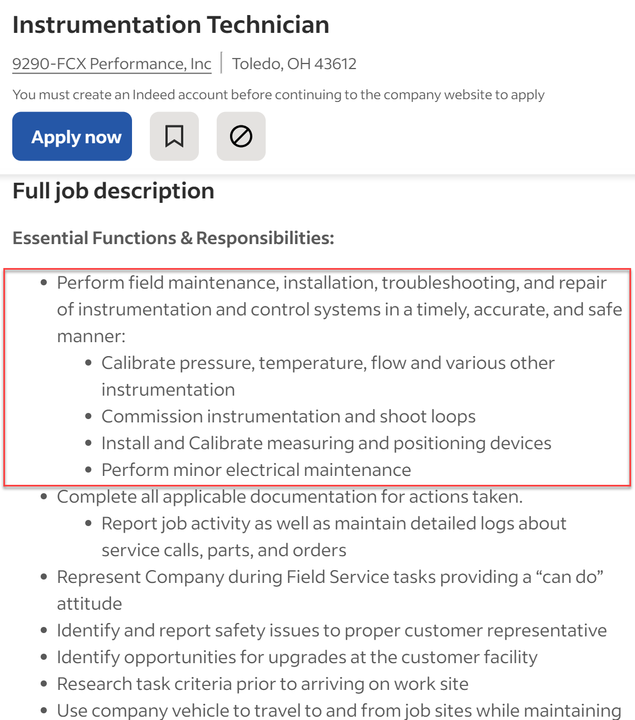
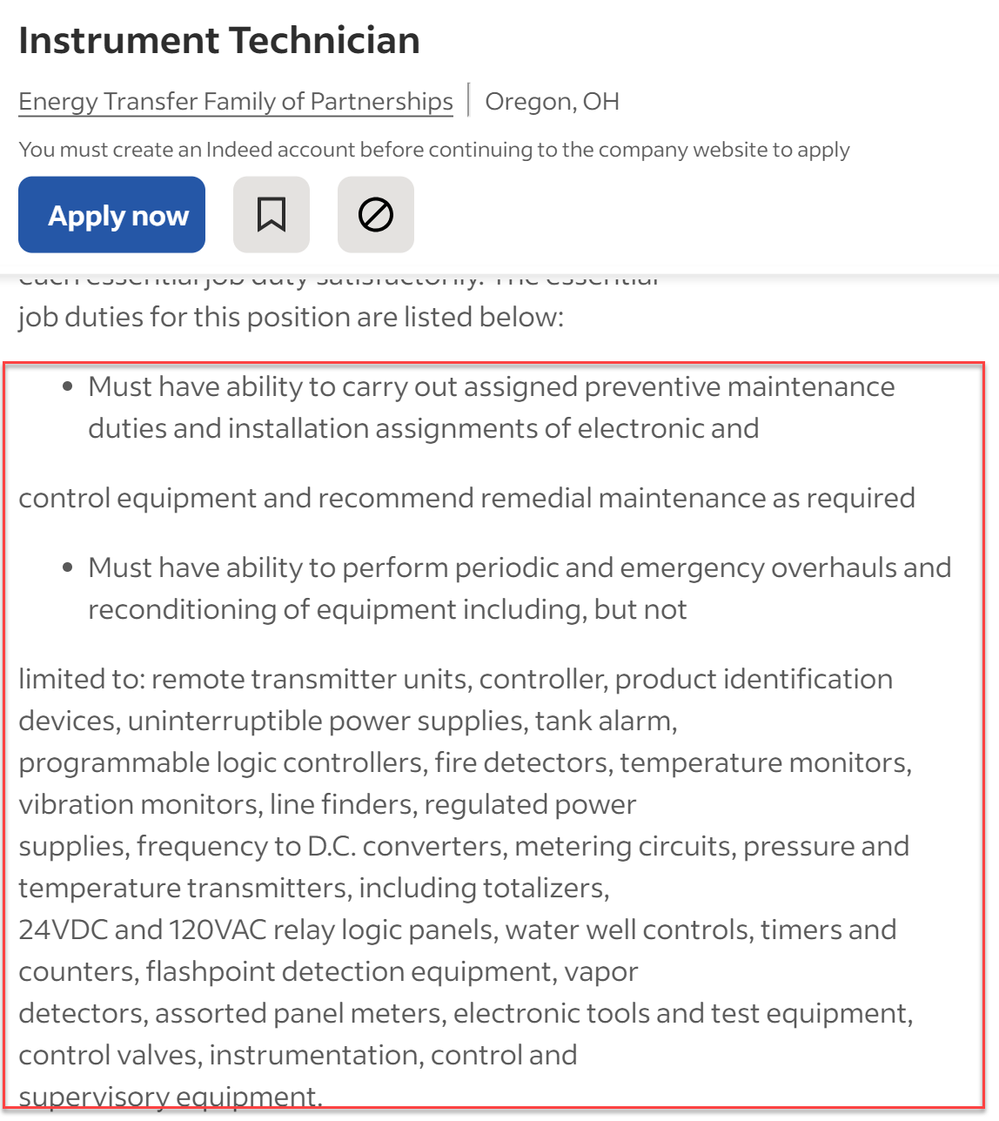

Slide 27
Define the Terms used in the Curriculum:
Competencies: Competency is a set of demonstratable characteristics and skills that enable, and improve the efficiency of, performance on a job. Competencies are not skills, but they are similar to skills. A competency is an over arching statement on a job description, which is many times not measurable. Outcomes are measurable, and thus outcomes are used to build a competency.
Knowledge: Knowledge is the theoretical or practical understanding of a subject. It is important to understand that a student cannot develop skills without first having knowledge.
Skills: Skill is the actual performance or demonstration of a technical task. Skills are the proficiencies developed through training or experience.
Abilities: Ability is defined as the capacity to perform. We are preparing the students to have the ability to transfer their learned skills in an industrial setting.

Slide 28
An example of Competencies & Outcomes:
Competency: Use RSLinx to establish communications between a computer (with PLC programming software) and Allen Bradley PLCs (L5000, SLC-500, PLC-5 & ML1000).
Module Outcomes:
1. Setup communications between a computer and the PLC System (Ports, Cables and Drivers).
2. Identify all the hardware components on a L5571 controller
Skills Assessment:
Create an Ethernet driver in RSLinx to communicate with a 1756-ENET module.
Create an Ethernet/IP driver in RSLinx to communicate with 1756-ENET module.
Create a USB driver in RSLinx to communicate with the controller.
Knowledge Required:
What is an IP address? What is a subnet mask? How does an Ethernet port get an IP address?
How to determine the IP address of a 1756-ENET module
How to use RSWho to view the drivers and communications within a ControlLogix system
How to create a driver in RSLinx
How to go online to a ControlLogix processor

Slide 29
Building Measurable Outcomes
Outcomes must be aligned to a competency, which should align to the workplace
A Quality Matters alignment table is used to align the outcomes to the competencies
Outcomes must be measurable
Students must know what is expected of them. The term “Understanding” is not measurable

Slide 30
Assessment by Faculty
Assessment is the responsibility of the faculty.
Student skills and knowledge are both assessed by the faculty in the Skills Assessment (Knowledge is required, to develop Skills)
Knowledge is also assessed through an online assessment for each module that faculty developed, which consists of M.C., Matching and T.F. questions. LMS is used to assure students cannot cheat. Use questions the LMS will grade, to make Faculty more efficient.
LMS efficiency saves faculty valuable time
The assigned instructor objectively determines if a student passes a module, and the course.
Create a PLA (Prior Learning Assessment) for the course, based on a combination of the Knowledge and Skills Assessments. This process of testing out of a course has tremendous academic integrity.

Slide 31
Employer
Engagement

Slide 32
Critical Information from Employers:
Ask for their skilled Job Classification, and acquire job descriptions (Maintenance Mechanic, Electricians, Instrumentation Tech., Millwright, etc.).
Find out what technology they use in their plants:
*PLC type, HMI type, Robotic type, Connectivity
*Instrumentation, Test Equipment, VFD types, etc.
This will be important information for both the academic division, and also the Workforce Development Group.

Slide 33
External Data
Delivery of Product
Topic Resources
Job Descriptions
DACUM Comp.
WFD Demand
Employer RT
Corp. Faculty
Credit Cert/Degrees
2 Yr. AAS, ATS, AIS
One-year Cert.
Gainful Empl. Cert.
Apprenticeships
-------------------------
Ind. Automation Maint. Cert.
Industrial Elect. Cert.
Industrial Maintenance Degree
Automation Cert.
Job Classifications
Maintenance Mechanic
Electrician
Machine Setup
Internal Product
Technical Topics
Basic Electrical
Handtools
Powertools
Ind. Safety
Pneumatics
Hydraulics
Mech Print Read
Motor Control Cir
Motors & VFDs
PLC Basics
AB CompactLogix
AB ControlLogix
Ethernet basics
Rigging
Pumps
Pipefitting basics
Machine Repair
Technical Courses
IND120 IE1
IND121 IEII
IND223 M&C
PLC200 PLCI
IND134 IFPI
Short Term Public Classes
Students come to the college
4 hr. to 24 hr. courses
Credit or N/C
AB PowerFlex 525 VFDs
Types of Students
Incumbent
Emerging
Contract Training
Students come to the college
College delivers at company
4 hr. to 24 hr. courses
Credit or N/C
------------------------------
AB PowerFlex 525 VFDs
Intro to AB ControlLogix
Technical Courses
Displaced
Underemployed

Slide 34
Show
Electrical Course Sequence
And
Course Overview Sheets

Slide 35
Getting Input from Employers:
Oversight Group: At some colleges this would be an Advisory Board for a program. The BILT model was implemented at Terra State CC in Ohio. This group is like a steering committee for their technical curriculum.
Technical Topic Roundtables: Our project team found the best way to get input on a topic such as the content of a PLC course, or a fluid power course, is to hold an industry roundtable. This consists of 3-4 SMEs in a 45-minute Zoom meeting. An outline is sent to each 1 week ahead of time, consisting of no more than a 2-page outline of topics that will be reviewed. Input is documented, then sent back out to the small group for their final review. A special focus should be on the hands-on skillset that is required. The nice thing about using Zoom, is the college can do a one-on-one meeting with an SME if they cannot get to the Zoom meeting. Most of all, respect their time and thank them for their input.
Communicate the results of the Roundtable back to the Oversight Group and explain how the curriculum will be adjusted to improve effectiveness and/or access.

Slide 36
Engaging Employers
How does the Technology division at SECC engage employers?
Accrediting bodies like a comprehensive employer engagement strategy
Purpose of an Advisory Board
Purpose of an Industry Roundtable
Purpose of a Focused Industry Visit
Industry Consortiums (Adv. Mfg. Consortium & Lean Mfg. Consortium)

Slide 37
Importance of an External SME group
SME stands for Subject Matter Expert
4-6 of these SMEs should be identified to vet information through as part of the development process
It is important to have all knowledge and skills development, align to the workplace
This will be done through validated competencies, and measurable outcomes

Slide 38
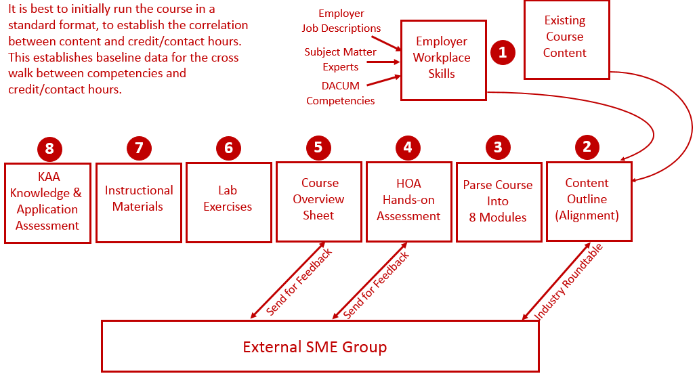
Reverse Design:

Slide 39
Creating a Development Process
Course Blueprint: Course Blueprint is a document that will hold all the module information for the course: Module descriptions, module outcomes, topics, skills assessments, etc. The blueprint can be shared with the development team, allowing multiple people to edit the document.
IND221 Instrumentation and Controls: This course at Northwest State CC in Ohio was converted to a CB/H model in Summer/Fall 2023.
Review the Development Process: Electrical Instructor John Mueller was the faculty, we did a course overhaul, with some new lab equipment, and focused on tasks and equipment that is used in the local process industry.

Slide 40
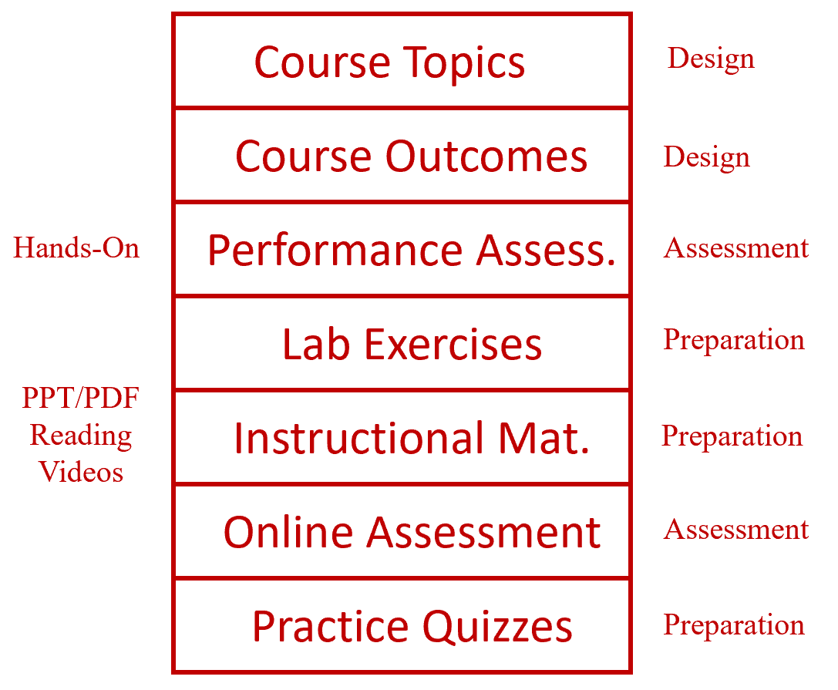
Learning Thread:

Slide 41
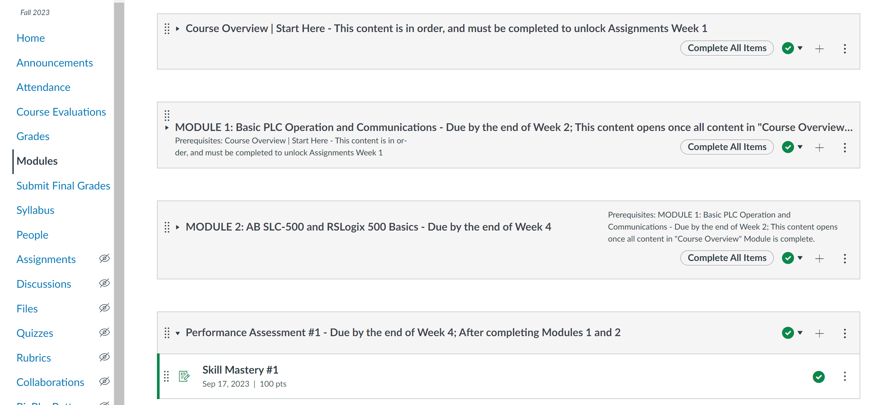
PLC Course in Canvas:

Slide 42
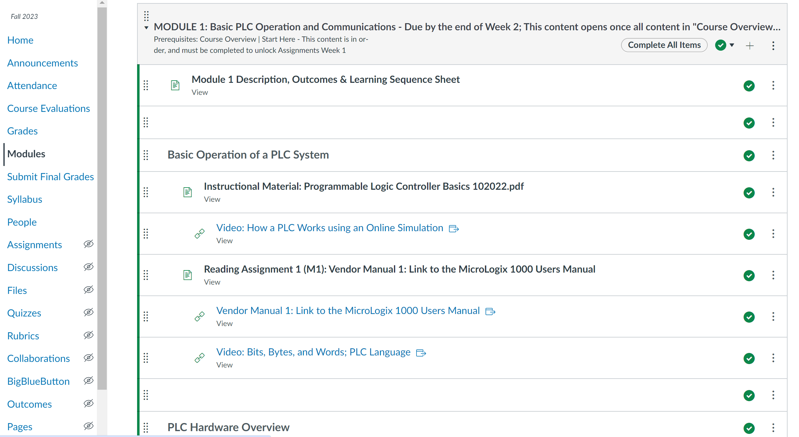
PLC Course in Canvas:

Slide 43
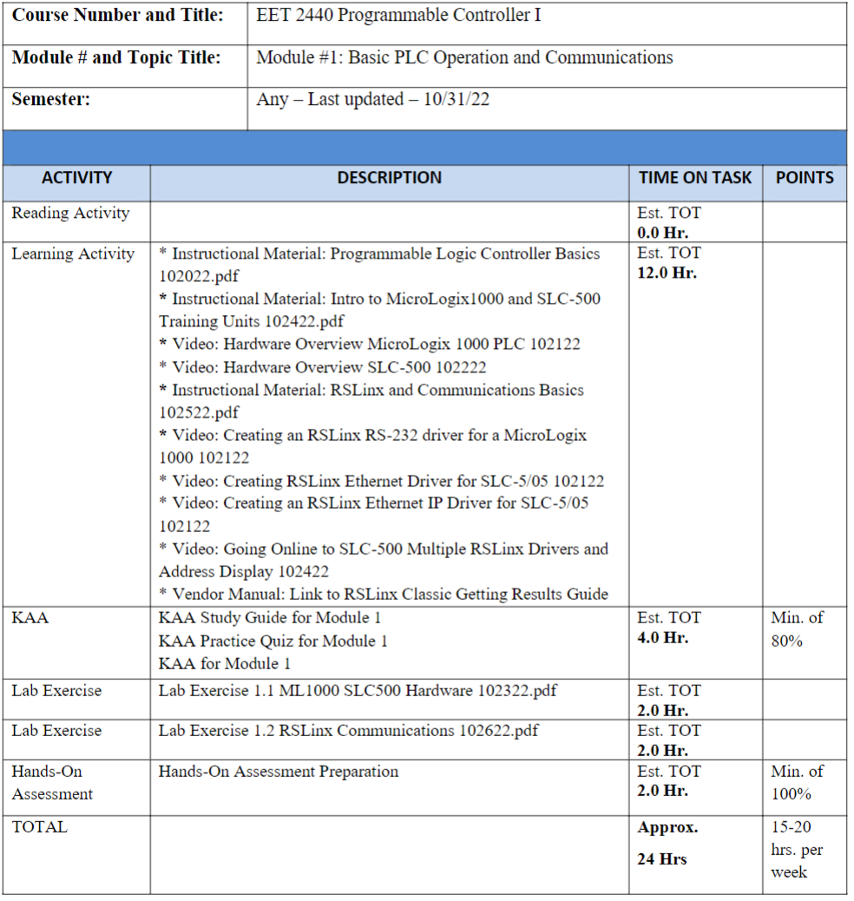
PLC Course in Canvas (Learning Sequence Sheet):

Slide 44
Converted course to a CB/H model
NSCC Instrumentation & Controls Course:
Realigned the content to meet employer needs
Created a course Blueprint to keep track of all information prior to entering into the LMS
Typically get the Skills Assessment done on the front end of the development cycle
Labs, PPT, Videos and Knowledge Assessments all built around the Skills Assessment
Will use examples of each in the training

Slide 45
How to Get Started?
Choose 1 course to start with such as:
Industrial Control Systems
Build Topic List: List out the topics that are in the existing course. Gather topic lists from other ATE projects, or from colleges that will share, then compile into a list to have the industry SMEs review. Try to get a composite list, knowing you will move, add and change topics.
Separate into 8 modules: This could be done before the topic list if it is easier to categorize.
Build the Skills Assessment: At some colleges this would be an Advisory Board for a program. The BILT model was implemented at Terra State CC in Ohio. This group is like a steering committee for their technical curriculum.

Slide 46
The End of the Presentation

