Slide 1
Steps & Lessons on Converting
to a Competency-Based
Hybrid Model Part 2
Presented by:
Tom Wylie, PI for HOME4TECHS & Scaling CBE Elements
Northwest State CC, Archbold, OH

Slide 2
Workshop Materials Available for Download:
https://ate.is/Scaling_CBE

Slide 3
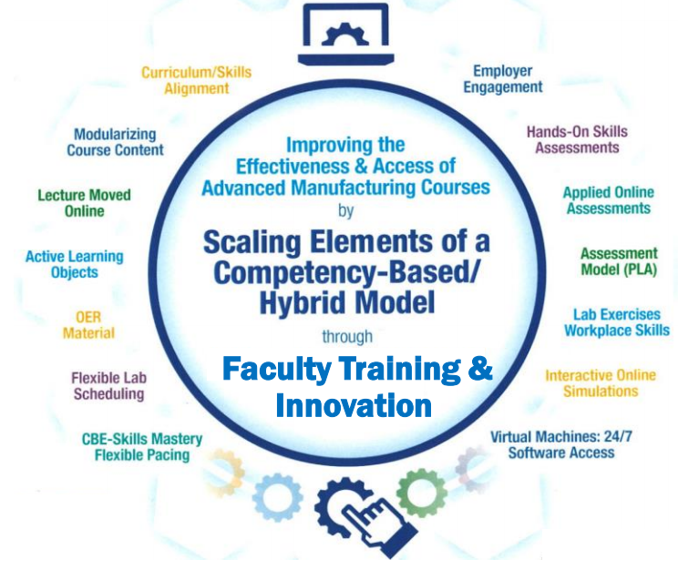
Instructional Elements to Improve Technical Courses

Slide 4
Do we need to discuss your annual report story?
NorthArk has a great story!

Slide 5
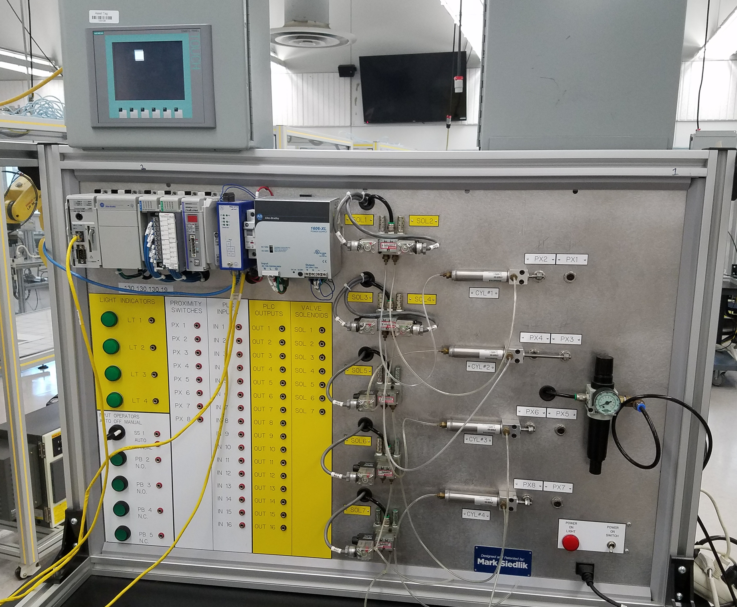
Two-year colleges are great at teaching separate technologies (silos of technology).
Students then go to industry and have to work on machines that have 4-6 technologies on them and they are all integrated together into a system.
We need to implement as many technologies into our courses that we can, in an effort to better prepare our students.

Slide 6
Traditional Lec/Lab Course
Converted to a
Competency-Based/Hybrid
Industrial Control Systems
Lecture
Moved to Canvas
Build Knowledge
Lab
Develop Skills
Skills Assessment
Ability
Perform the
Tasks on the Job
K
S
A

Slide 7
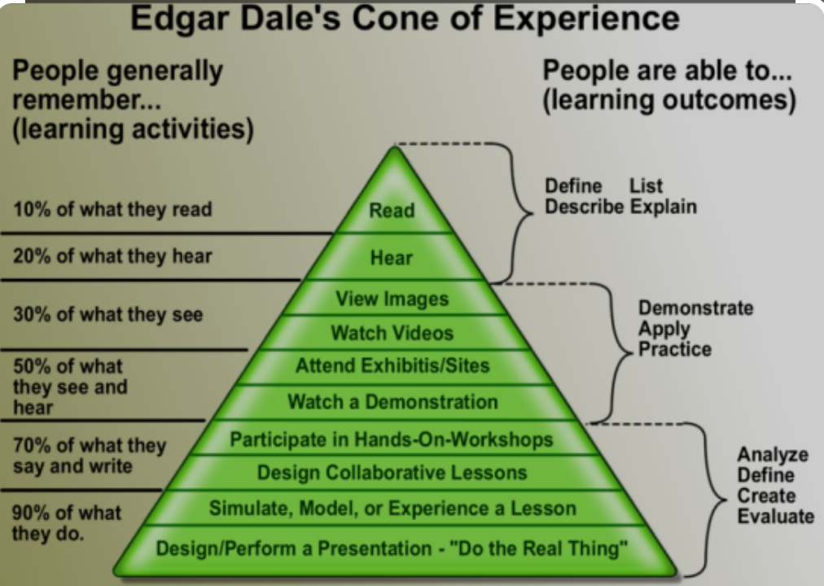
Passive Learning vs. Active Learning
Lecturing and Reading a textbook are both Passive Learning. These are not effective methods of instruction in CTE courses.
Passive Learning is Instructor Centered.
Active Learning is Student Centered. In Active Learning, students will internalize materials such as hands-on, and interactive learning objects: simulations and interactive videos (Questions asked within a video using Canvas Studio).

Slide 8
Competency-Based/Hybrid Instructional Model
LMS Canvas
On-campus class time
*Readings
*Videos
*PDFs
*Lec Cap
*Objects
Lab Exercises
Hands-On Assessment
Student 1
Lab Packs sold in Bookstore (required)
Student 2
*Study Guide
*Practice Quiz
*KAAs
Student 3
Faculty facilitates learning
*Lab Exercises
*Simulations
*Performance
Faculty
Faculty assesses student skill/knowledge
Self-proctored Online Assessments

Slide 9
Grading in the NSCC Assessment Model:
The grades the students are awarded in the NSCC Ind. Tech hybrid courses are A, B or F.
The hands-on assessment (HOA) must have 100% mastery, so students must get 100. This is not averaged into the grade. It is required.
The knowledge & application assessment (KAA for short) is the cognitive, online assessment. Student have to get at least an 80% on this assessment to pass the module. They have two tries at taking KAA in each module.
12-16 assessments in each course (8 online, 4-8 hands-on)

Slide 10
Academic
Standards

Slide 11
Define the Terms used in the Curriculum:
Competencies: Competency is a set of demonstratable characteristics and skills that enable, and improve the efficiency of, performance on a job. Competencies are not skills, but they are similar to skills. A competency is an over arching statement on a job description, which is many times not measurable. Outcomes are measurable, and thus outcomes are used to build a competency.
Knowledge: Knowledge is the theoretical or practical understanding of a subject. It is important to understand that a student cannot develop skills without first having knowledge.
Skills: Skill is the actual performance or demonstration of a technical task. Skills are the proficiencies developed through training or experience.
Abilities: Ability is defined as the capacity to perform. We are preparing the students to have the ability to transfer their learned skills in an industrial setting.

Slide 12
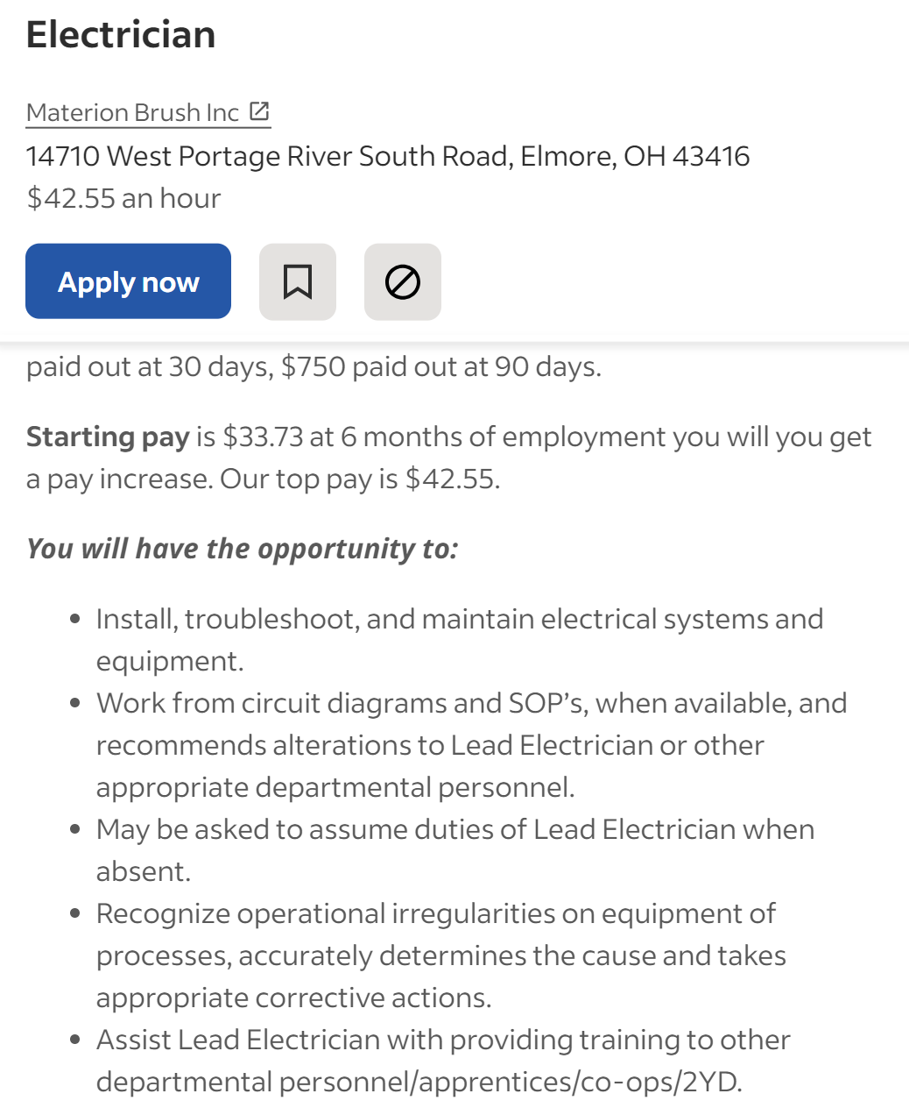
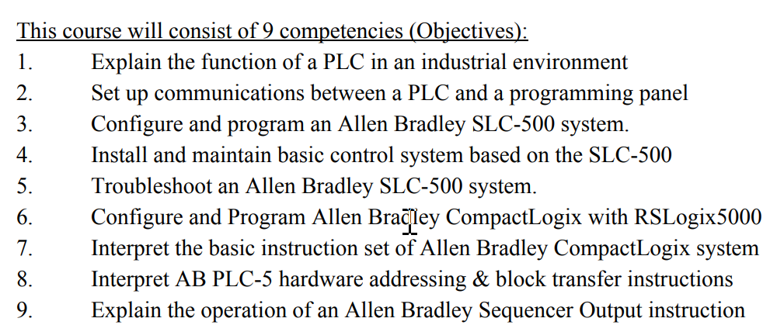
Job Description: Electrician

Slide 13
An example of Competencies & Outcomes:
Competency: Use RSLinx to establish communications between a computer (with PLC programming software) and Allen Bradley PLCs (L5000, SLC-500, PLC-5 & ML1000).
Module Outcomes:
1. Configure RSLinx to communication with a ControlLogix 5571 controller.
2. Identify all the hardware components on a L5571 controller
Skills Assessment:
Create an Ethernet driver in RSLinx to communicate with a 1756-ENET module.
Create an Ethernet/IP driver in RSLinx to communicate with 1756-ENET module.
Create a USB driver in RSLinx to communicate with the controller.
Knowledge Required:
What is an IP address? What is a subnet mask? How does an Ethernet port get an IP address?
How to determine the IP address of a 1756-ENET module
How to drill down to a controller from a driver in RSLinx
How to use RSWho to view the drivers and communications within a ControlLogix system
How to create a driver in RSLinx

Slide 14
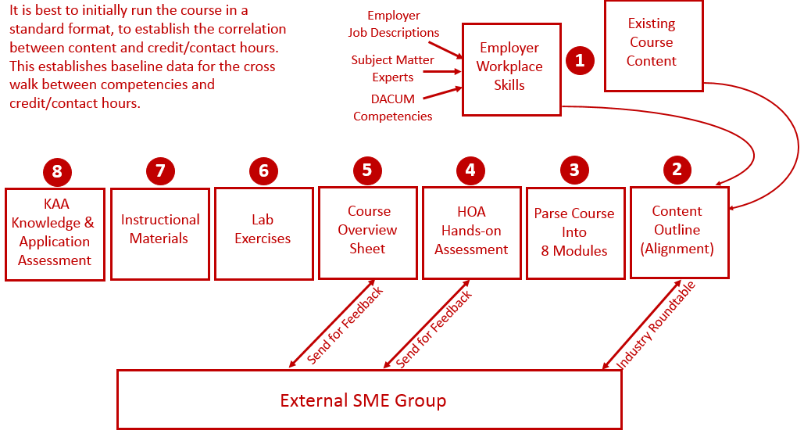
Reverse Design:

Slide 15
Creating a Development Process
Course Blueprint: Course Blueprint is a document that will hold all the module information for the course: Module descriptions, module outcomes, topics, skills assessments, etc. The blueprint can be shared with the development team, allowing multiple people to edit the document.
IND221 Instrumentation and Controls: This course at Northwest State CC in Ohio was converted to a CB/H model in Summer/Fall 2023.
Review the Development Process: Electrical Instructor John Mueller was the faculty, we did a course overhaul, with some new lab equipment, and focused on tasks and equipment that is used in the local process industry.

Slide 16
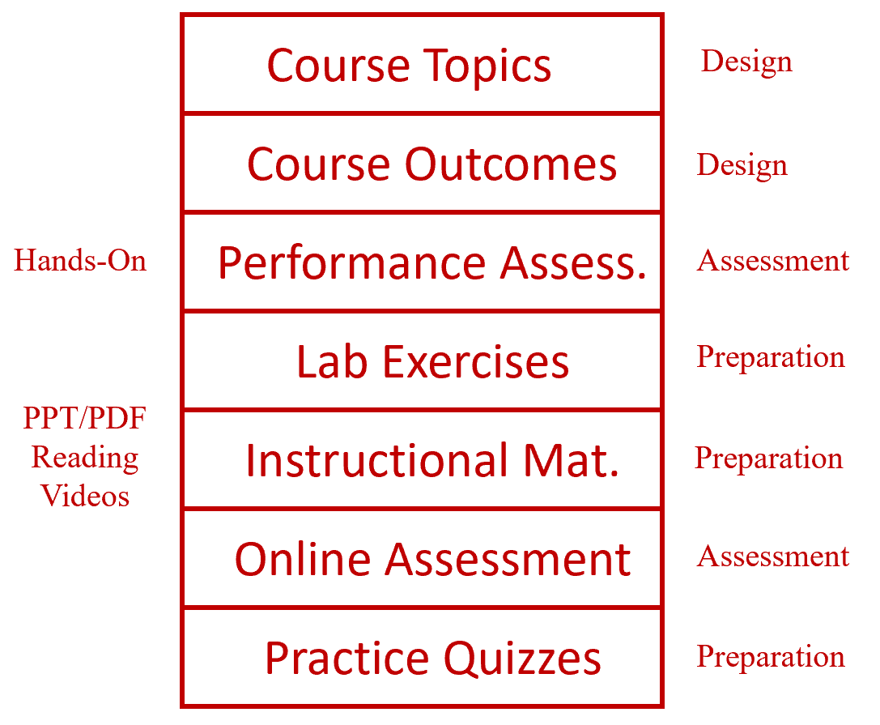
Learning Thread:

Slide 17
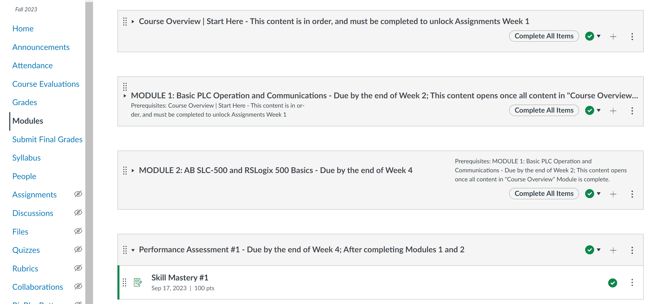
PLC Course in Canvas:

Slide 18
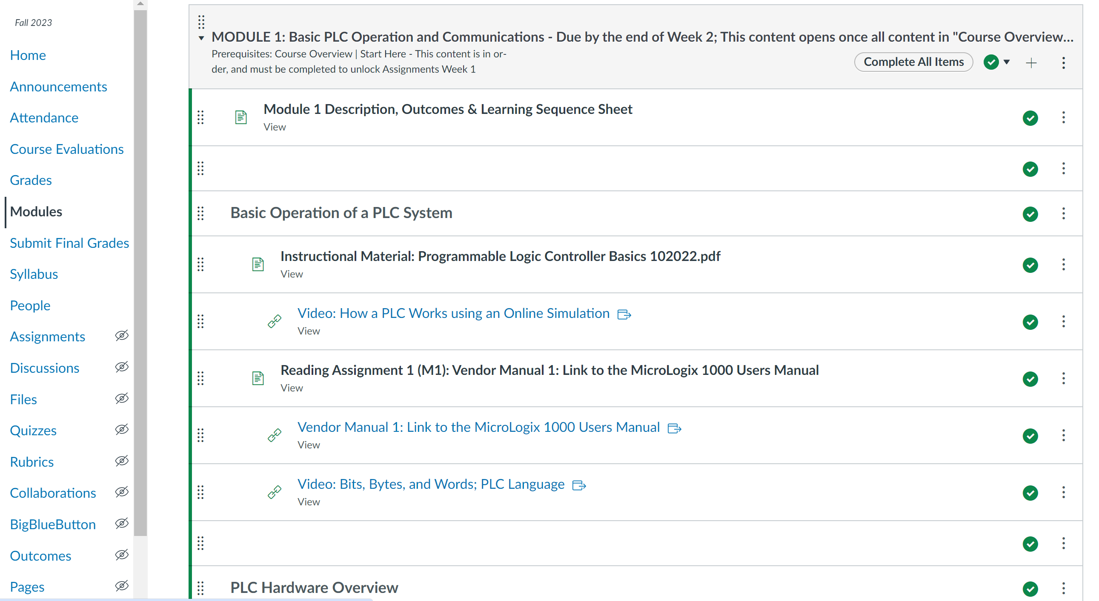
PLC Course in Canvas:

Slide 19
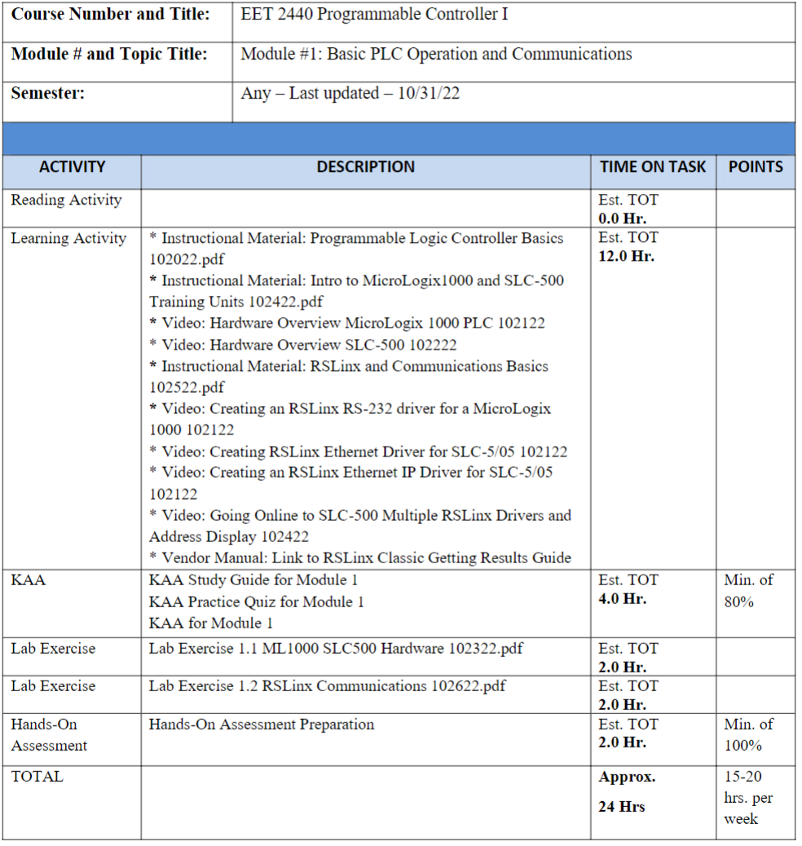
PLC Course in Canvas (Learning Sequence Sheet):

Slide 20
How To Get Started?
Choose 1 course to start with such as:
Industrial Control Systems

Slide 21
Project Planning

Slide 22
Some things that should be done right away:
Microsite: ATE Central offers every project their own microsite that is a multi-purpose website. Store common information for your team and share documents with internal and external constituents.
Create a development shell for each course in Canvas: Have the grant team all added as Instructors to each course. Development will start for one course, once the format is created, can be imported to the other shells.
Determine what student support material is needed in Canvas: Most colleges add links and documents to each course that will inform the student of the college services available to them.
Order Snagit/Camtasia bundle from Techsmith: Instructors should all have at least Snagit, Word and PPT, to develop their basic materials: (labs, assessments, etc.)

Slide 23
More Planning:
Cloud storage for sharing files between Arkansas and Ohio: There could be large files we need to share such as videos, which may be too large to email. Easier to drop them into a shared folder. Google Drive is a good option.
Determine how to handle videos in Canvas: Does the college want videos stored within Canvas, or on YouTube linked to Canvas? If YouTube, IT should create a managed channel for the project. Determine who will be uploading the videos.
Determine what training will need to occur to keep the project moving: Schedule the training as needed. Examples are: OER (finding, remixing, reusing), Using PPT for graphics, Creating videos in Canvas Studio and producing them, creating simulations, etc.
How to track tasks (progress) in the project, and who does this?: You could start with an Excel spreadsheet, or Google Sheets, or a commercial like Wrike or Trello.

Slide 24
More Planning:
Identify 2-3 Industry SMEs that information can be vetted through: These resources are critical. Initially they will review the topic list and the skills assessments. Former graduates are great, if they have 3-5 years of experience.
Set some timelines up for targets: An example would be Industrial Control Systems developed by July 15. The next 2 courses by December 2024. A target date is critical in a project.
Determine who will produce the videos and post in Canvas: Faculty will still create their own videos but may not have the time to produce them and post them.
How will students be oriented into this new model: This will take time and will consist of multiple tasks. I use Intro videos in the first few modules so student know what they must do. An in-person orientation and possibly an explanation with a quiz, to make sure they understand.

Slide 25
Curriculum Development

Slide 26
Development Planning:
Identify the course and the development team: I will recommend we start with Industrial Control Systems, and John, Roger and Tom (more can be added) will focus on the development.
What will be the minimum in each module: 1-2 lab exercises, 20-25 question knowledge assessment, module description and outcomes, skills assessment (every 2 modules), instructional material may vary: vendor manuals, videos, PPT/PDF, OER, etc.
Will a textbook be used or OER & developed materials: If there is a great textbook, use it, but many books are written by educators, not practitioners. Many colleges have moved to OER materials and modify them to fit their needs.
Is Automation Studio used in any courses: If Automation Studio is used for virtual simulations, then build a strategy on what courses it will be used in, who will develop the simulations, and what training will be needed.

Slide 27
Development Planning cont.:
Materials to start with: Look at existing course materials from other colleges to see how they structured their courses. I sent John the PLC course info for our college, as well as another Ohio college who is working on an ATE project converting PLC courses.
Divide the course into 8 modules and list topics: 8 modules is the most common number for a competency-based/hybrid type of course, at multiple colleges.
Determine the hands-on skills in each module: What hands-on activities will the students be doing based on your lab equipment, or future lab equipment.
Build the Skills Assessment: What should the students be able to do at the end of the course. Keep in mind that these need to align to tasks they will perform in industry.
Build the module outcomes: Most of my outcomes are built after the skills assessment.

Slide 28
Getting Started with Development

Slide 29
Development Planning:
Divide the course into 8 modules and list topics: There could be large files we need to share such as videos, which may be too large to email. Easier to drop them into a shared folder. We use Google Docs.
Determine the hands-on skills in each module: 1-2 lab exercises, 20-25 question knowledge assessment, module description and outcomes, skills assessment (every 2 modules), instructional material may vary: vendor manuals, videos, PPT/PDF, OER, etc.
Build the Skills Assessment: These will be based on the industry needs, as well as what equipment you have available.
Build the module outcomes: Module outcomes will be based on the skills assessments and the knowledge required to master these skills.

Slide 30
The End of the Presentation

