Slide 1
SECC Faculty Training on Creating Videos
Created by Tom Wylie, 4/8/24

Slide 2
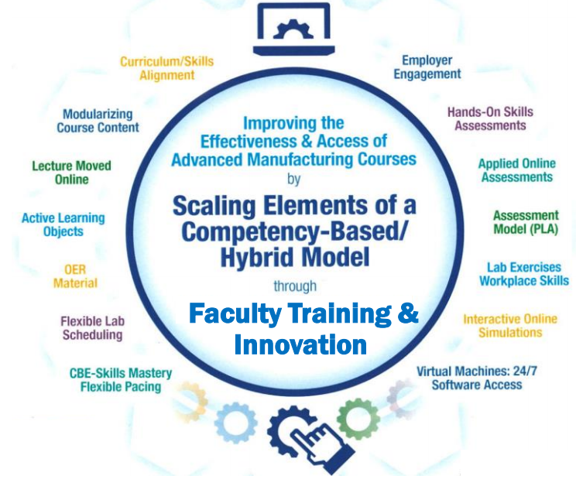
SECC Faculty Training on Creating Videos
Training topics for this training session:
Review the steps to developing a module
Review a Learning Thread
Open Education Resources
Simulations
Review the development of a learning object
6. Introduction to creating Learning Objects
a. PowerPoint
b. Converting PPT to PDF
c. Voice over PPT
d. Creating videos with a camera
e. Creating a screen CAM video to show how to use software

Slide 3
Many good Videos from Eastern Iowa CC

Slide 4
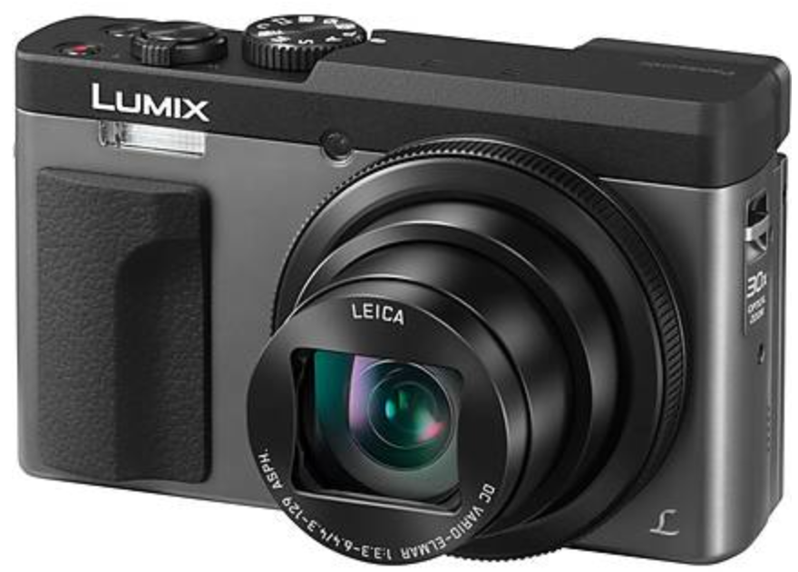
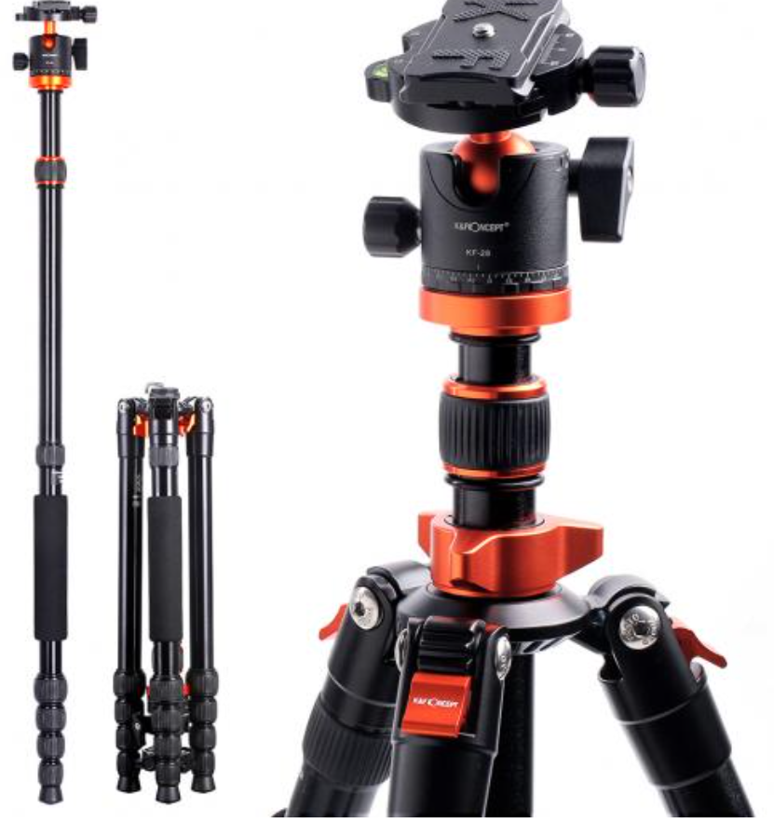
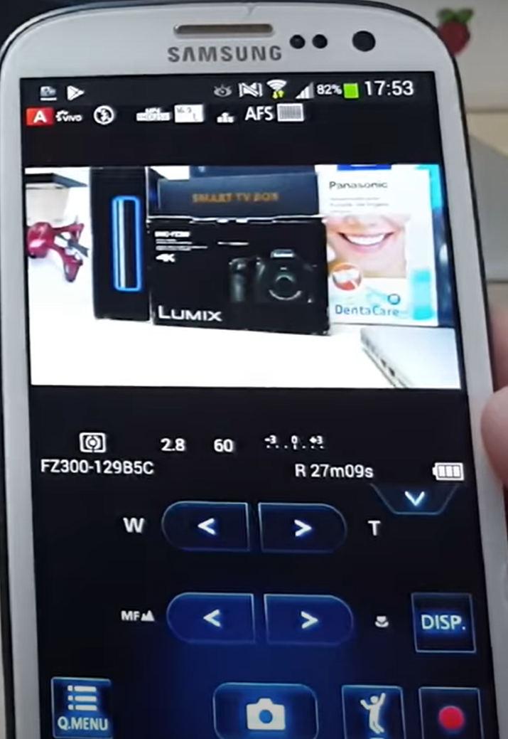
Cameras for Creating Videos:
One of the common tools that our Industrial Technology Instructors use is a simple Panasonic Point and Shoot camera. It is small with a zooming lens, with a removeable SD card, and a very sensitive internal microphone. The inverting tripod allows us to position the camera upside down to shoot onto an object or whiteboard (laying on a desktop). One of the most powerful features is the Panasonic Image app that runs on the smartphone. The camera has its own WiFi portal, thus the phone connects to it, then the image app controls the camera zooming, taking photos and taking videos. The SD card is removed then put into a port on the computer where it is then transferred to the HD, and produced with the Camtasia Producer software.
Panasonic Lumix Point & Shoot
Inverting Tri-Pod
Panasonic Image Smart Phone App

Slide 5
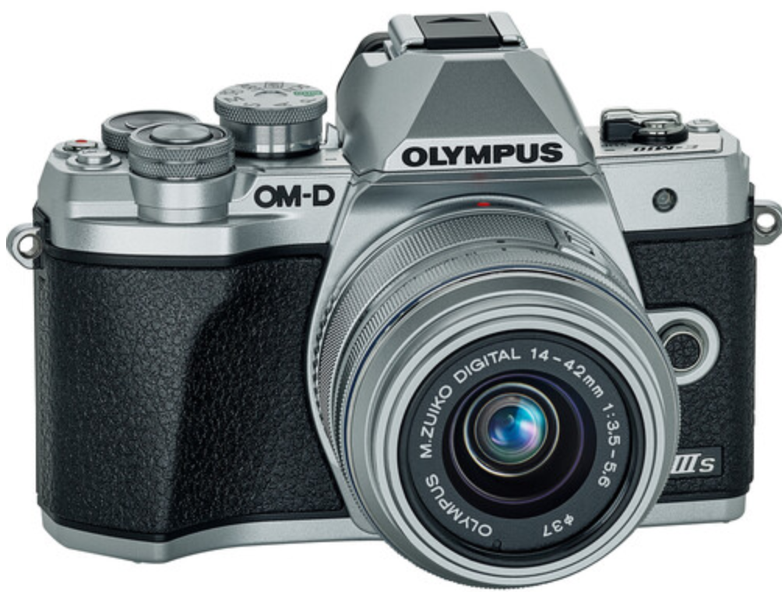
Cameras for Creating Videos:
I also use a high end camera when I need to use different lenses, use different lighting filters and want higher quality images and videos. This is primarily if I am doing something for a vendor who needs a little higher quality than for instruction. I can get UHD 4K video quality. Usually $700+. It also has a removeable SD.
Olympus E-M10 Mark III

Slide 6
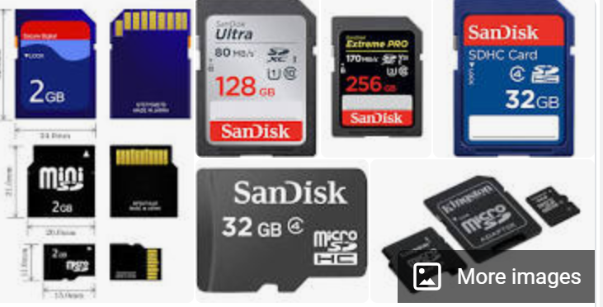
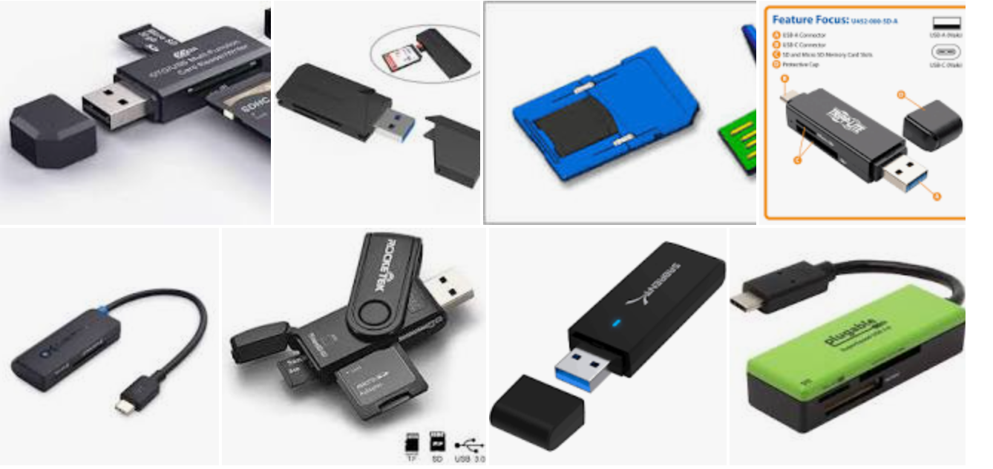
SD Cards for Recording Videos and Images:
The SD cards will be used in most cameras to store the videos and pictures that are taken with the camera. I seldom use an SD less than 128GB in size, because they will fill up quickly. Remove the SD from the camera and connect it to the computer, to load the videos and images, so you can use the software tools to develop the learning objects
SD to USB Interface
SD Cards: GigaBytes

Slide 7
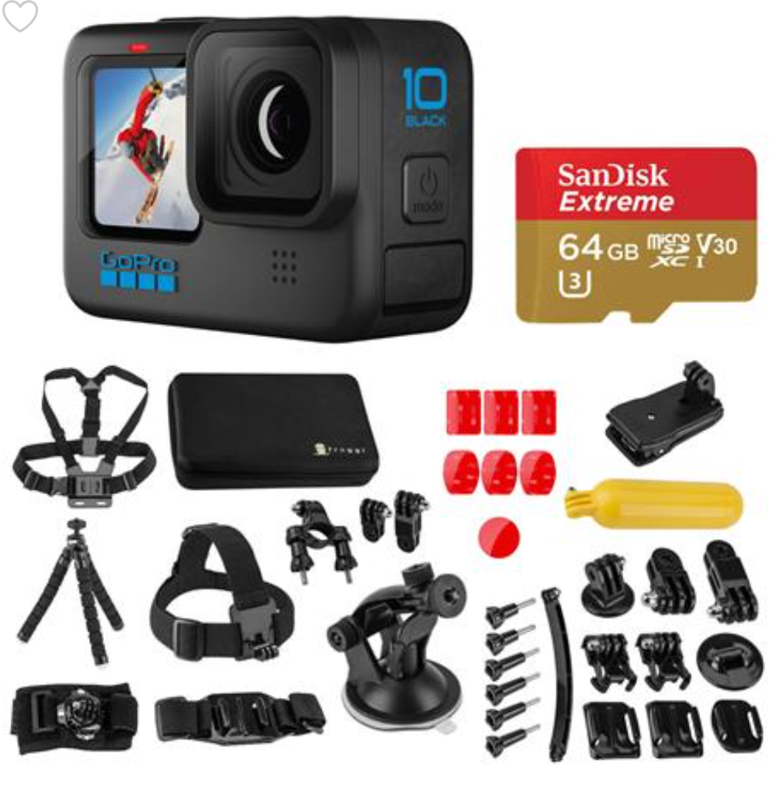
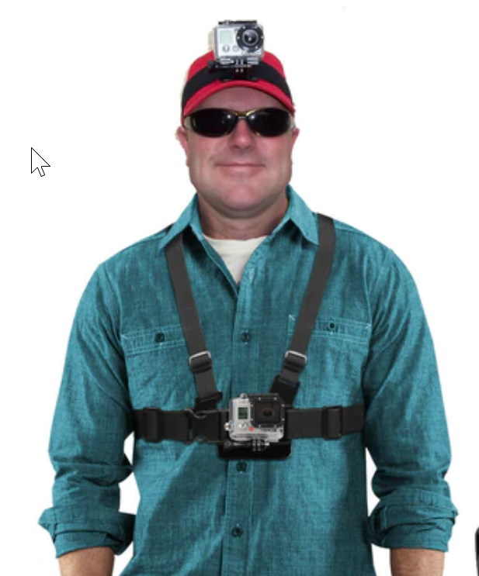
GoPro Cameras:

Slide 8
Software used to Create Objects
TechSmith (Techsmith.com), located in Michigan, developed and distributes Snagit and Camtasia. These products are targeted toward Faculty. They are simple to use and give immediate results. Snagit is an image or video capture software, and Camtasia is a product with multiple uses, but in the end it produces high quality videos. MP4 is the preferred video format for creating instructional videos. MS PowerPoint is the other key software that is needed to create illustrated graphics and animations. Google Slides does not have all of the features that MS PowerPoint has.
Snagit 2019
Camtasia 2019 Recorder
Microsoft PPT
Snagit 2019 Editor
Camtasia 2019

Slide 9
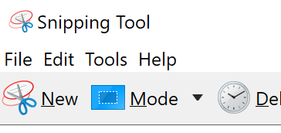
TechSmith Snagit 2019 (Capture):
This is the interface for Snagit capture. The user can designate a hot key such as the “PrtSc” key (Print Screen), which will bring up the cross hairs for capture.
Olympus E-M10 Mark III
Windows 10 Snipping Tools

Slide 10
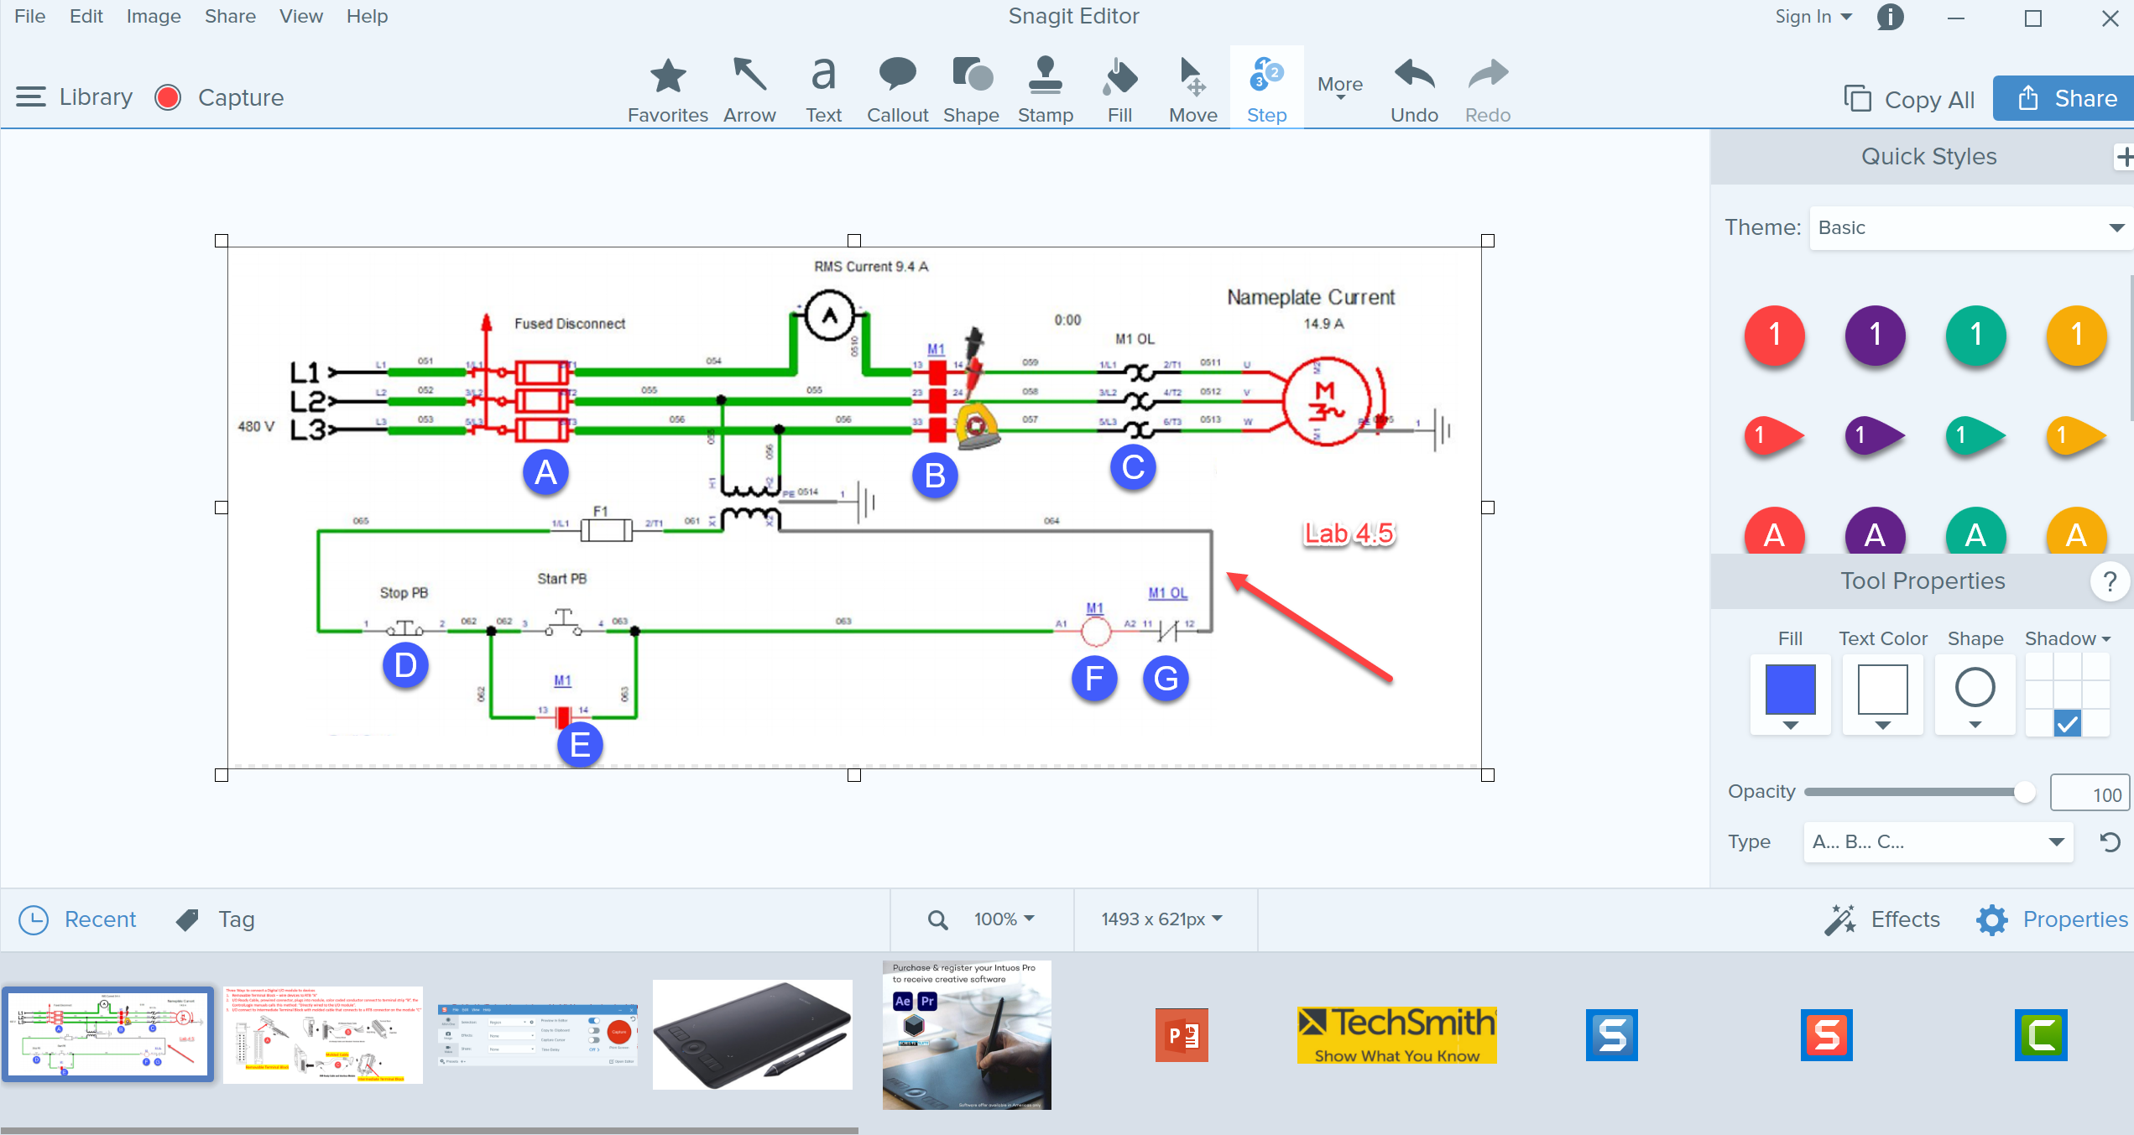
TechSmith Snagit 2019 Editor:
Tools to modify the image
Olympus E-M10 Mark III
Shows recently captured images

Slide 11
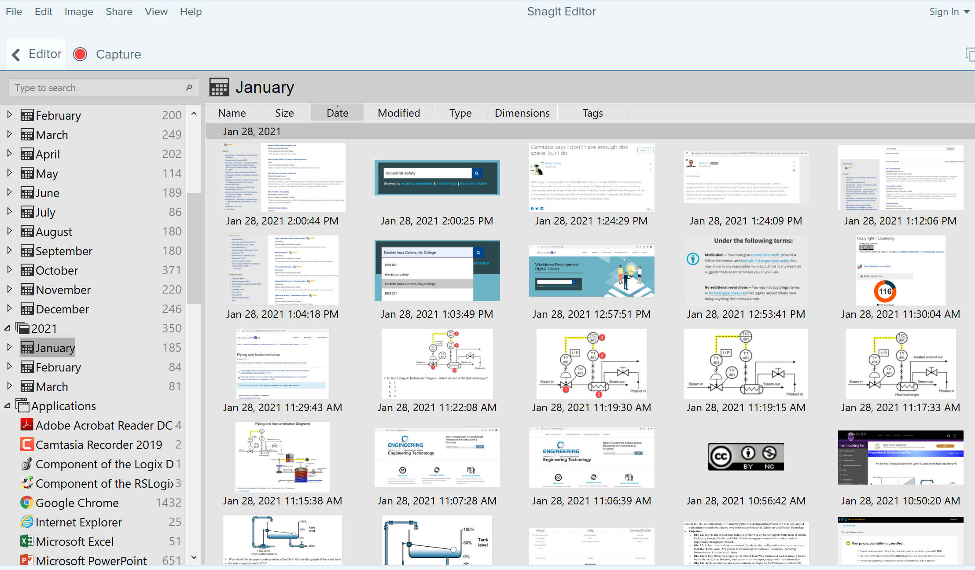
TechSmith Snagit Editor Library
User can go to any Month & Day for images

Slide 12
Four Primary Applications for Snagit
1. Capture a portion of a screen and save as a .PNG file or to clipboard
2. Record video from an existing video. I sometimes use this if I am recording something from a recording on a website that I want to save, or I am capturing an important video on YouTube, just as a backup in case they pull it down and I need to create one from scratch.
3. Capture a panoramic scrolling image. This is if I have a PDF that I want to backup, but the properties will not allow a download or to print it. I will scroll down through the document and save as a PDF. Always follow good legal practices.
4. Capture a block of text from the screen and “grab text” which will use OCR (Optical Character Recognition) and copy all and paste into a document so I can edit the text. I find old labs I created 10 years ago and I do not have the original files. Instead of re-typing them in, I use Snagit to capture the text as an object and convert it to editable text.

Slide 13
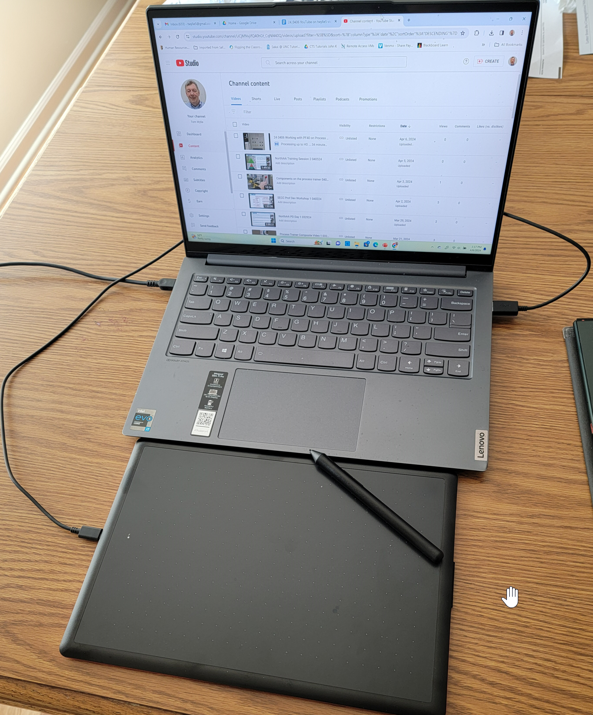
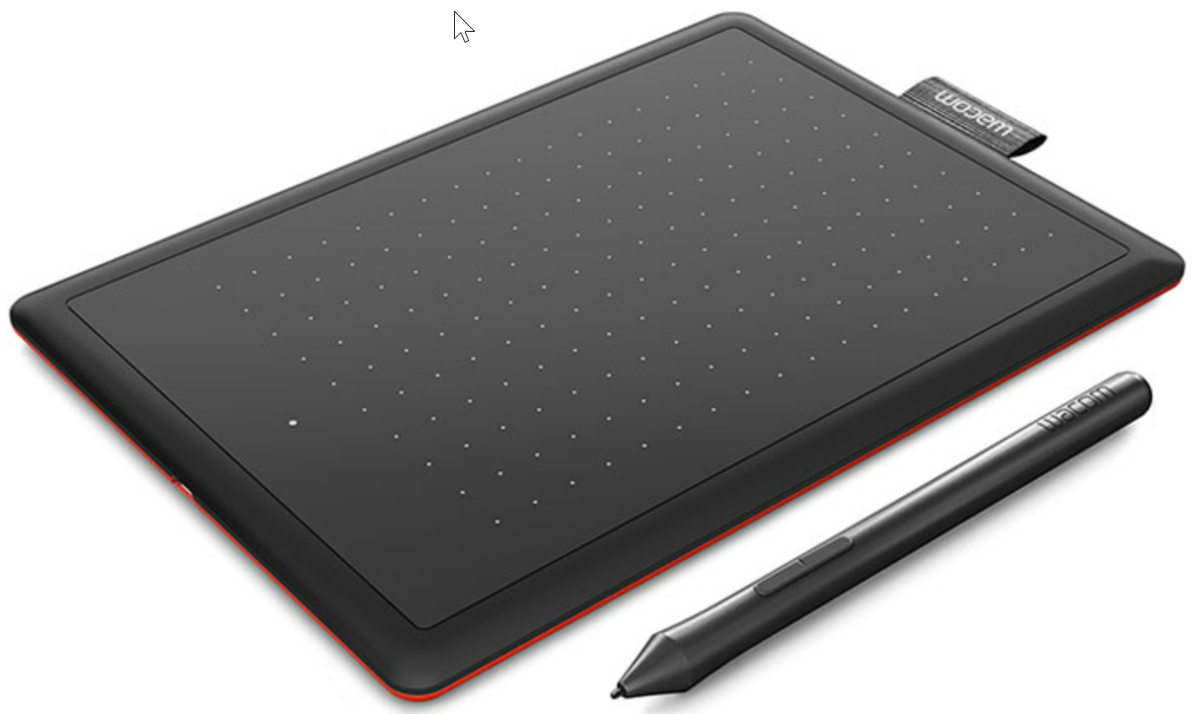
One by Wacom
One by Wacom connects via USB port
One by Wacom connected
To Lenovo IdeaPad
One by Wacom digitizing tablet is primarily for annotating on a PowerPoint slide and recording for a voice over PPT video. The cost for a small tablet is less than $50, and a medium tablet is about $75. This is not a tablet for an artist, those are usually $300 plus.

Slide 14
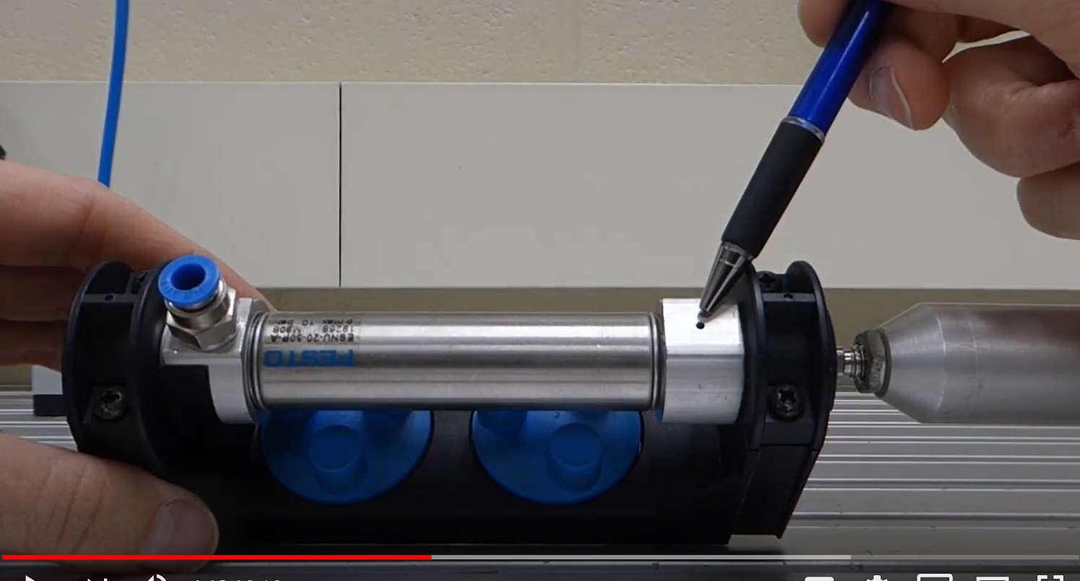
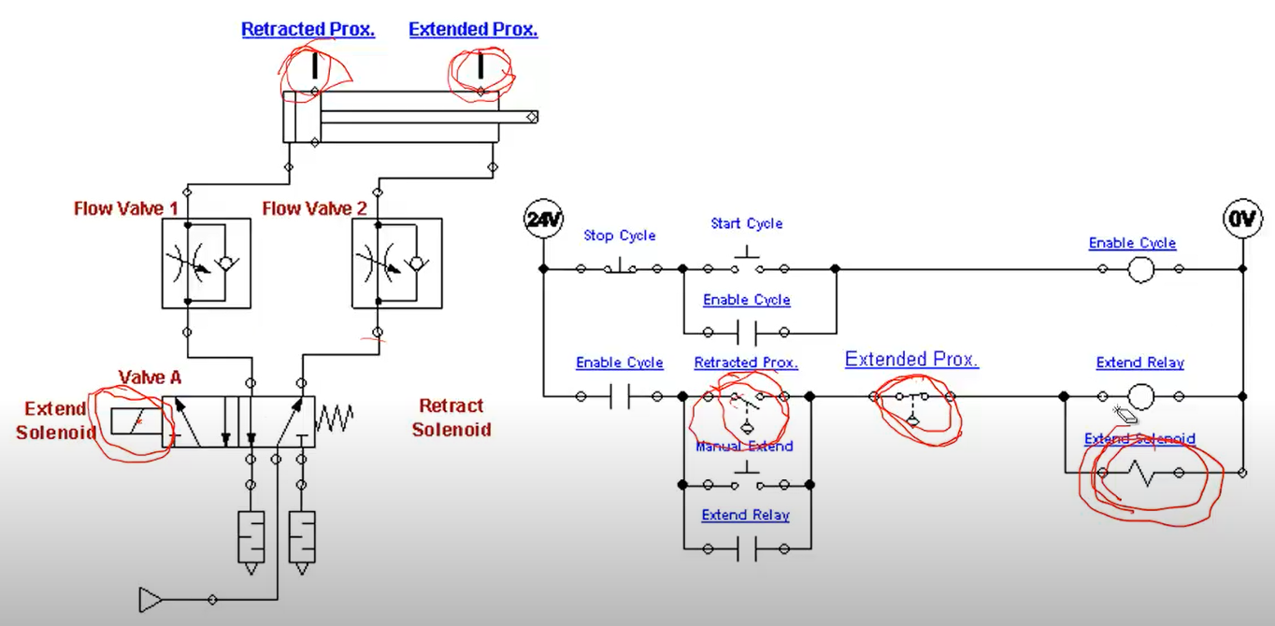
Learning Objects the User Navigates
Videos
Independent Learning Objects are posted in an LMS for student access. These objects can be viewed in any sequence. The upper left graphic shows a video that was shot with a camera, explaining a single acting pneumatic cylinder.
The middle graphic is a PPT that will be converted to a PDF, then posted in the LMS.
The bottom graphic is a voice over PPT, where the graphic was put into PPT, then annotated with a stylus on the computer touch screen.
All of these objects can be viewed on a smart phone, phablet, tablet or computer screen.
PPT/PDFs
Voice over PPT Video

Slide 15
Example Videos:
A video shot in the lab showing how to do something
(Video Links on Scaling Project site, Josh Coupling)
2. A screen cam video (22_0614 AS Basic Electrical Simulation)
3. A voice over PPT in Canvas (Voice over PPT with Wacom)

Slide 16
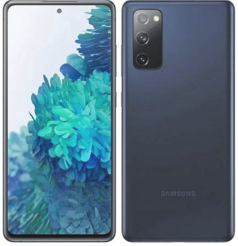
How to Create Videos
Video on how to Setup RSLinx
Recording Computer Screen
Video of how to Operate a CNC Controller
.MP4 or .MOV File
.MP4 File
.MP4 File
Video Quiz
Video Quiz

Slide 17
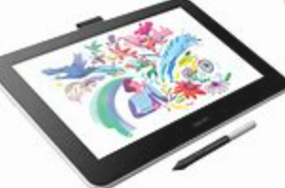
How to Create Videos
Voice over PPT Video of a Print
Recording Computer Screen
Recording voice as you annotate
(Wacom tablet or mouse)
Video Quiz
.MP4 File
Video Quiz

Slide 18
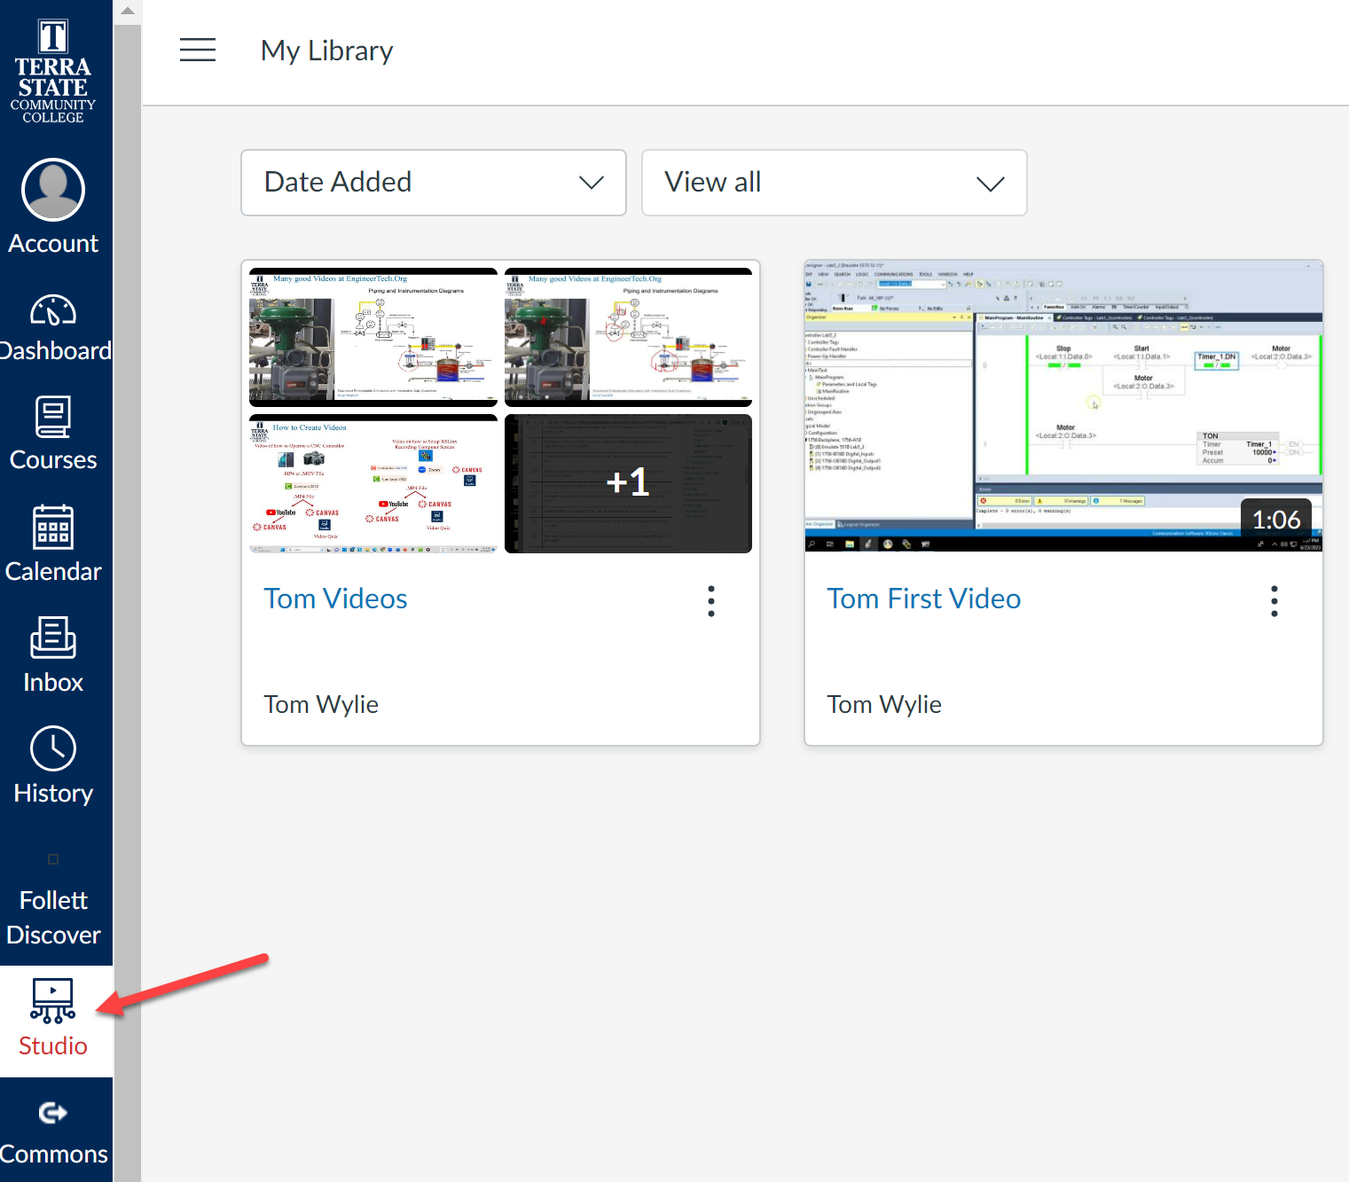
Videos in Canvas:
Collection

Slide 19
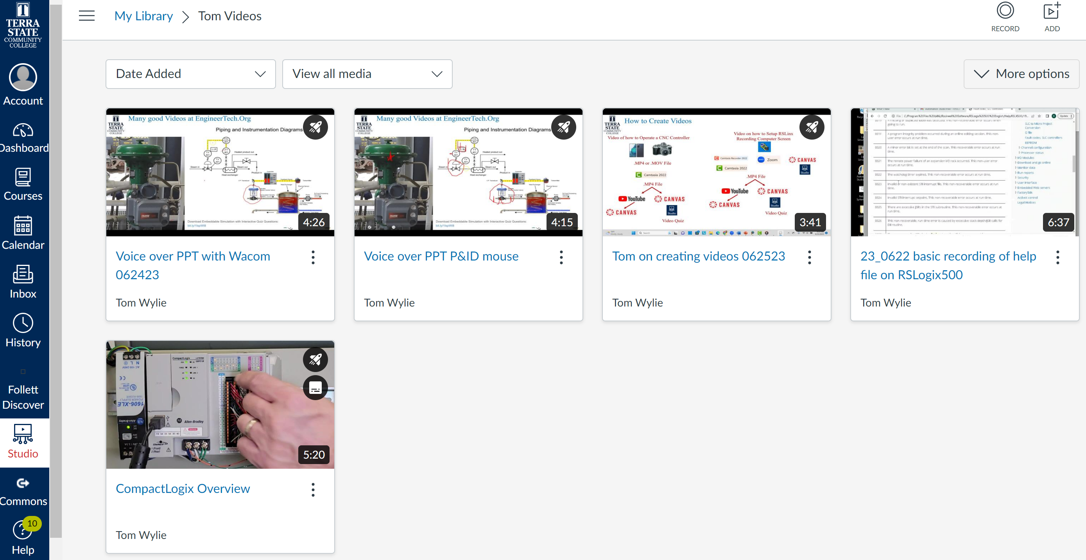
Collection of Videos in Canvas:
Airplane Icon means a Quiz was created for the Video

Slide 20
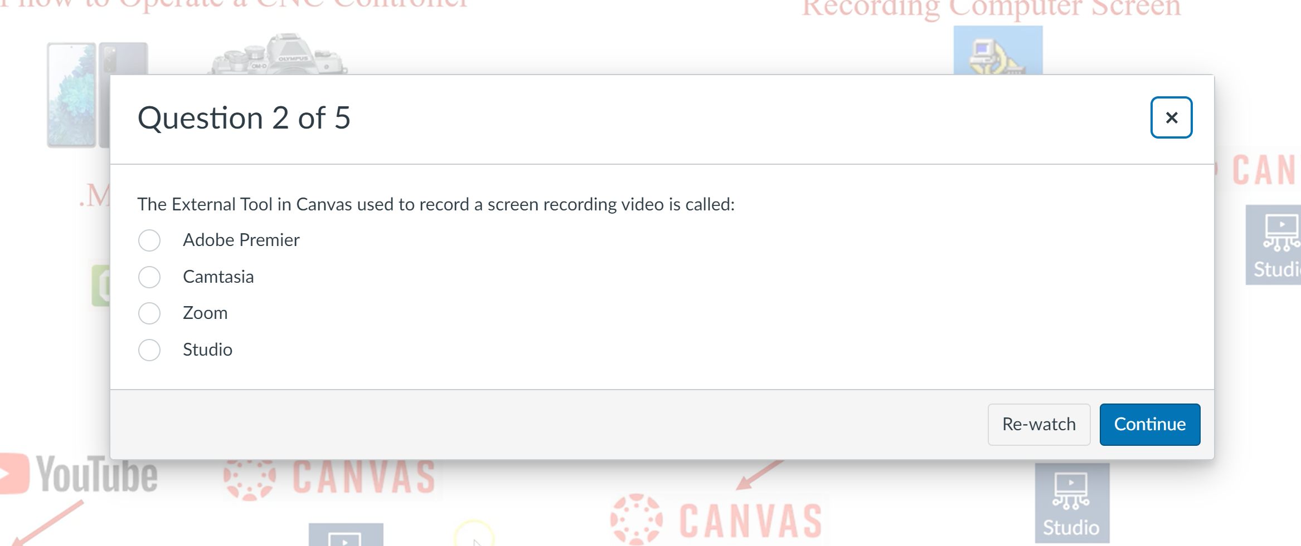
Collection of Videos in Canvas:
Questions in the Video
Studio Quiz Question
Re-watch since last question

Slide 21
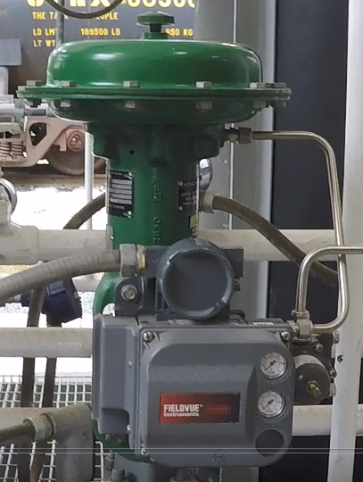
Many good Videos at EngineerTech.Org

Slide 22
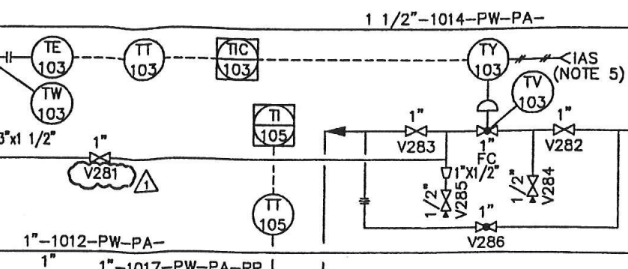
Interpreting a P&ID to the actual hardware:
Digital Valve Controller (I/P)
TCV-103 Control Valve

Slide 23
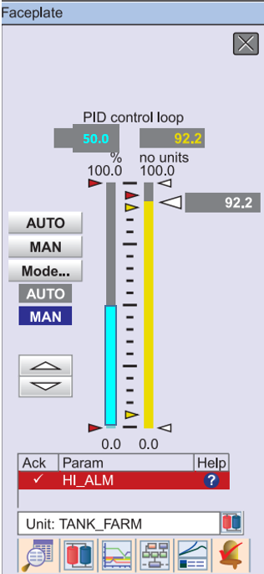
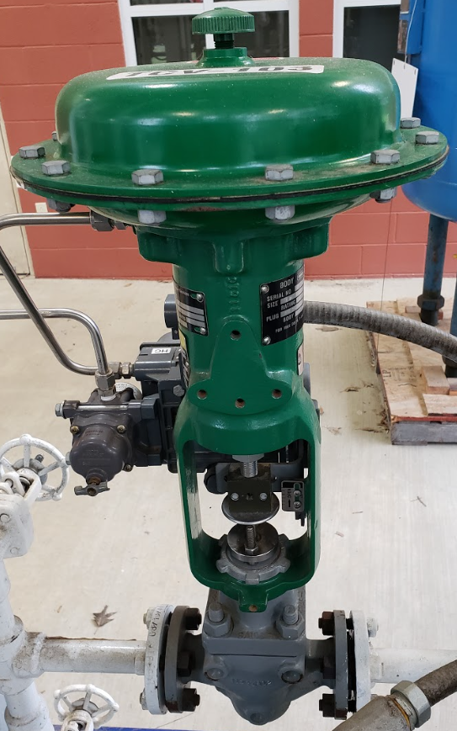
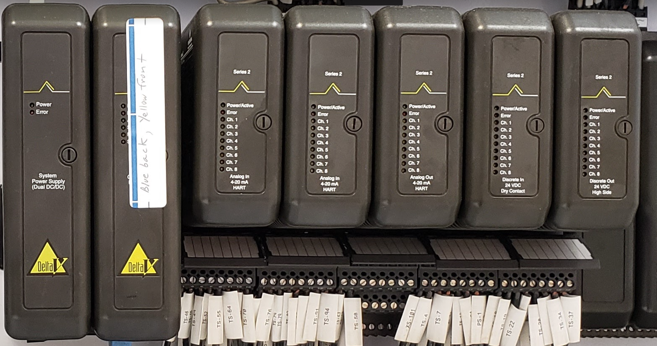
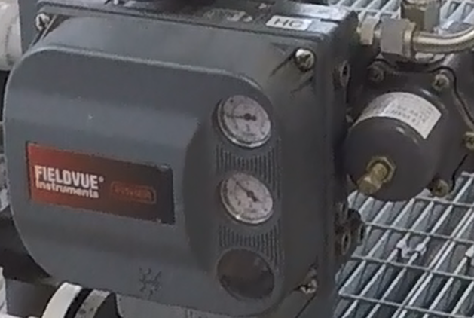
Signal Flow in a Distributed Control System:
Controller
Faceplate
50%
1/2 Open
9 psi
Control Console
50%
12 mA
70 psi
Delta V DCS System
DVC6200 (I/P)
Charge Tank

Slide 24
This Concludes this Instructional Document

