Slide 1
Sylvania IR Remote Control
Transmission function and signal analysis of the SDVD7015 Remote Control

Slide 2
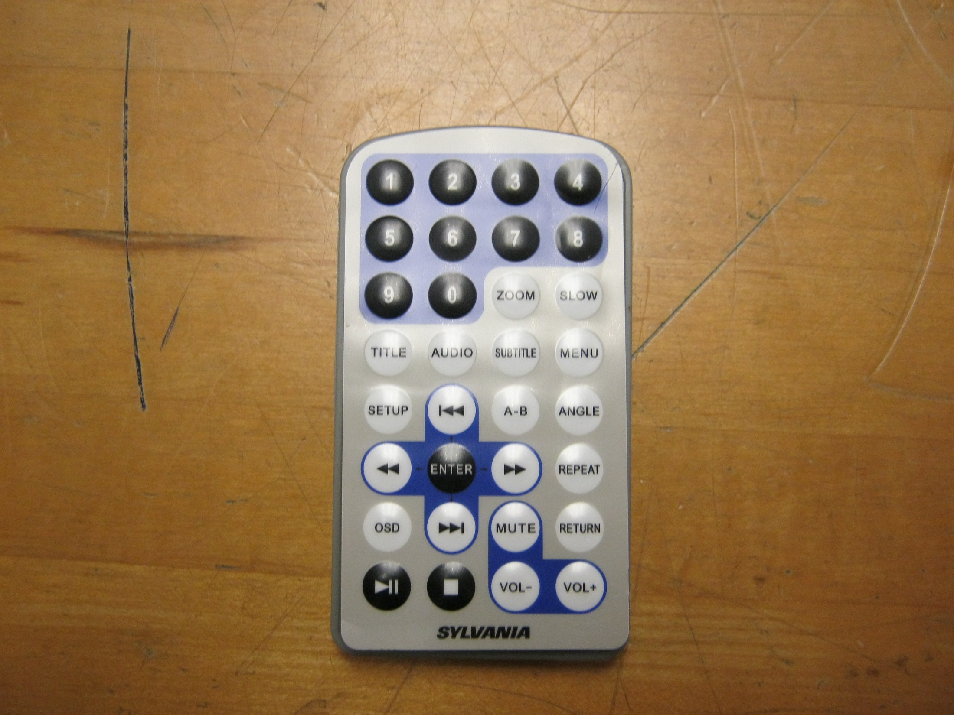

Slide 3
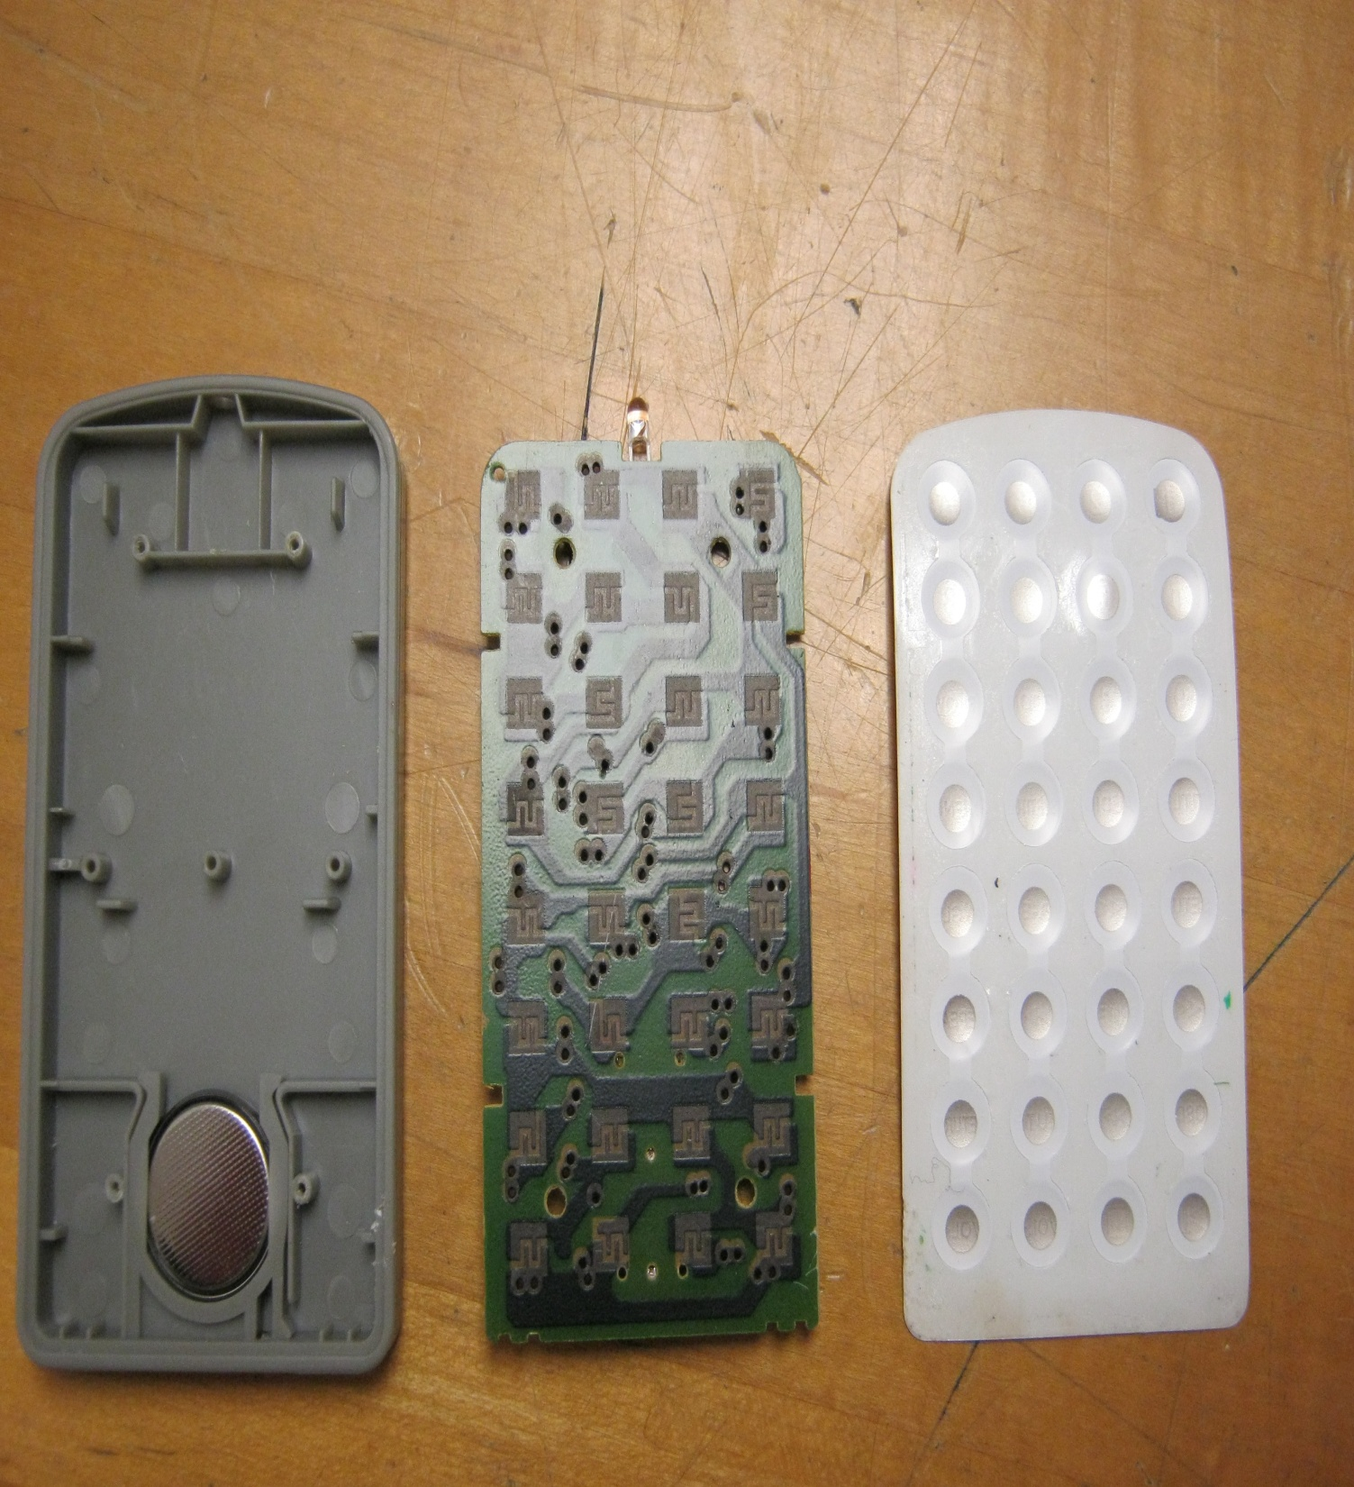
The remote’s button pad, removed and flipped over. When pressed, these contacts complete the corresponding circuit on the back of the remote control’s circuit board

Slide 4
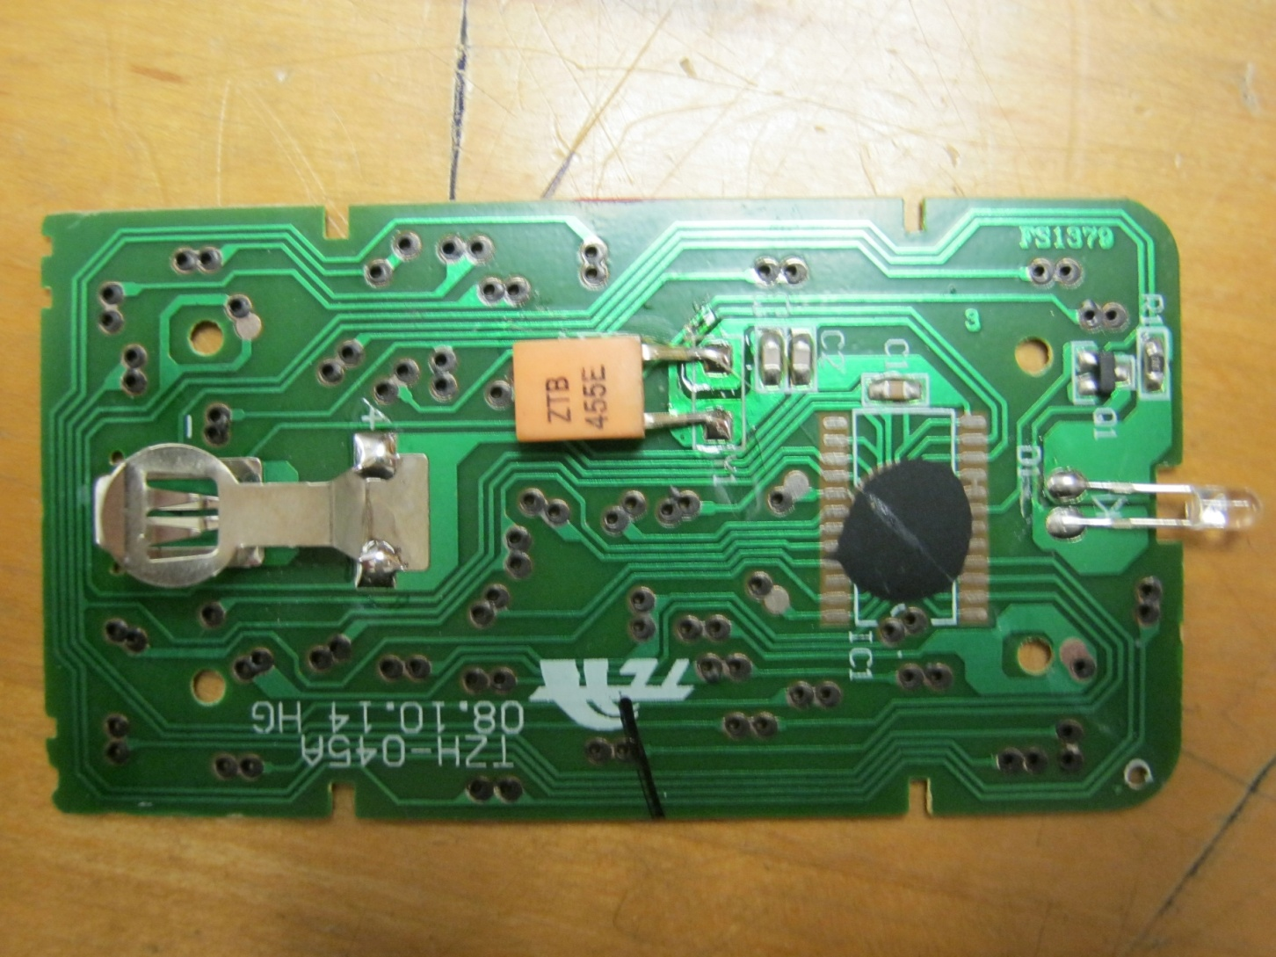
The circuit board of the Sylvania DVD remote control
A 3V battery held in place by this metal latch provides power to the circuit. Normally the circuit is open and no current is present, but pressing a button completes the circuit and sends power to the oscillator.
The oscillator shapes the electrical current to the desired shape and frequency – in this case a 38kHz signal that switches rapidly between 0 Volts and roughly 750 Millivolts in a set pattern
The current passes through this IR LED in bursts, causing it to flash rapidly

Slide 5
The LED turns on and off rapidly, releasing Infrared light in a set pattern at the frequency determined by the oscillator.
This signal can be interpreted by any device in line of site: Since multiple devices may operate on that frequency there is a part of the signal pulse that identifies the remote to the receiving devices, so that only the appropriate device will process the received signal.

Slide 6
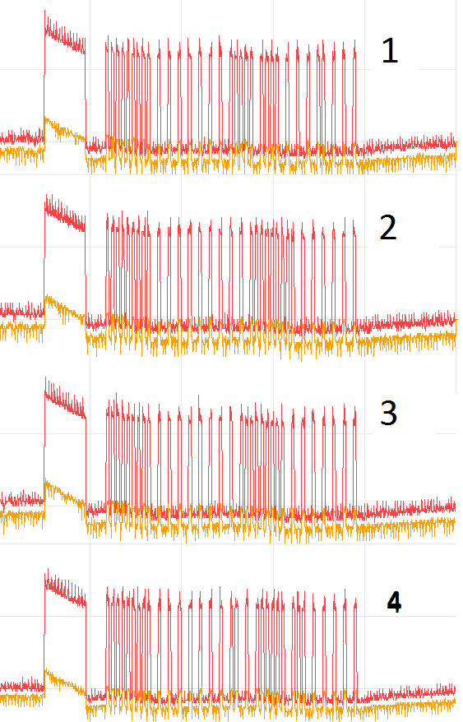
This is the signal being transmitted to the Infrared LED for buttons 1 through 4. The LED is lit when the signal is high. The receiver interprets these flashes as a string of binary code.
These binary digits are shared by every signal sent by the remote
These digits will change depending on which button is pressed
1111111110101010101010101111101111010101011010101
1
1111111110101010101010101010111111111010101010101
2
1
1111111110101010101010101011111111101010101010101
3
1111111110101010101010101101011111101110101010101
4

Slide 7

The light from this LED cannot be seen with the naked eye but some digital cameras will be able to capture it. Here is the LED flashing the signal for “Rewind.”

Slide 8
Transmitter Components
A 3v battery powers the device
A ZTB455E ceramic oscillator
The remote transmits data via an infrared LED

