Slide 1

Test Anxiety Studying for Tests
Bonnie Ogden, Engineering Success Coach
Adapted from Kristin Cartwright – Math Instructor
This material is based upon work supported by the National Science Foundation under Grant No. 2000862. Any opinions, findings, and conclusions or recommendations expressed in this material are those of the author(s) and do not necessarily reflect the views of the National Science Foundation.

Slide 2
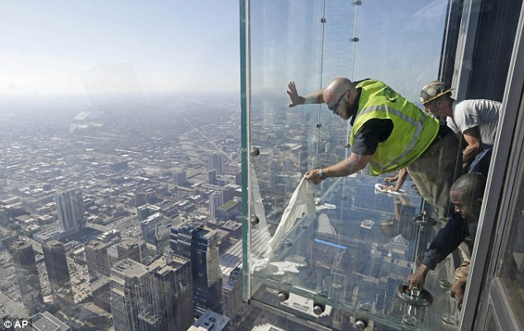

Origins of Anxiety
Anxiety can be a natural response – fight or flight/adrenaline
Level of importance
Preparation will help with success, not always anxiety

Slide 3

Panicky
Chose
incorrect answer
Second Guess
Answer
Feel stupid
Too anxious
Go blank

Slide 4


Slide 5
Ask "Is It True?"
Filters - "I don't know this problem. I don't know this problem. I don't know this problem."
Assumptions- "I'm sure everyone else has an A.”
Predictions - "Yep, I'm totally going to fail this test, fail this class, never graduate, never get a job.”
Memories – "This is just like the last time I took this class and didn’t pass!”
Labels - "I have never been good at tests. I can’t do this!"
Emotions - "I hate this test. I hate my teacher." (tears, exhaustion)
Exaggeration - "Nothing on this test looks like anything I've ever seen before."

Slide 6
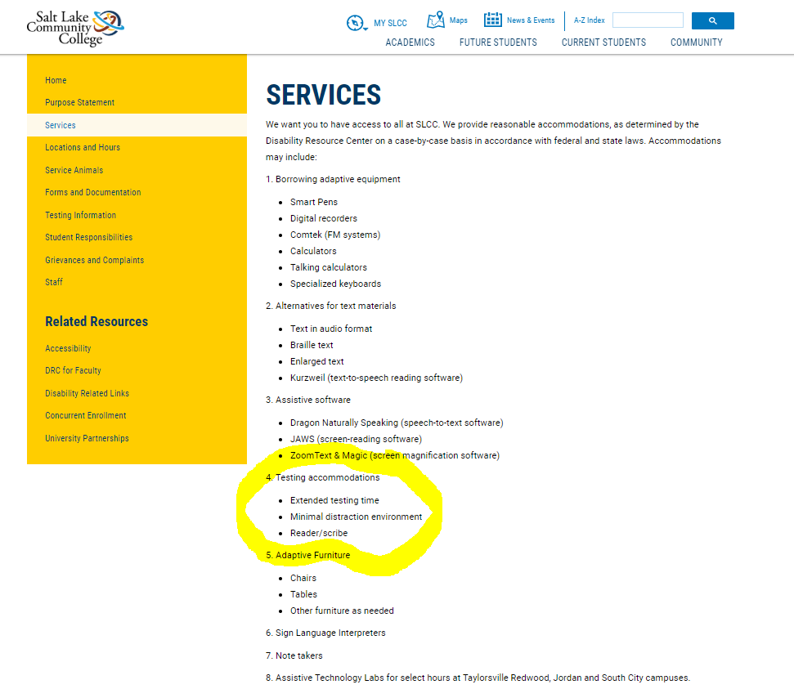
Did you know the SLCC Disability Resource Center (DRC) can give you options if you have documented anxiety?
http://www.slcc.edu/drc

Slide 7
Test Preparation

Slide 8
Begin studying early!
Do tricky practice problems repeatedly (do them once a day!)
Find a group of students or “study buddies” to work with
Make notes on difficult problems as you do your homework to ask your teacher about
Help other students with homework, if you can. Explaining to others can help you remember the material
What to DO to Prepare for Tests!

Slide 9
Make flashcards for vocab words
Discuss homework problems with classmates before class
If your exam will be timed, make sure to practice doing problems in a timed setting, and without help right in front of you (book, notes etc)
Find creative ways to organize your notes that makes them easy to look back on. Sharpen notetaking skills.
Ask questions in class when confused and write down answers in notes
What to DO to Prepare for Tests!

Slide 10
Pre-Test-Day Checklist
Attend any/all review sessions. KNOW TEST FORMAT (open book, formula sheet, calculator?)
Study groups
Formula sheet. Prepare a ‘study’ sheet as you go. Use it during homework and in the exam if allowed
Organize all of your materials the night before (sharpened pencils, calculator, extra calculator batteries? scrap-paper, etc.)
Check the weather. Plan accordingly
Prepare your body! Good night sleep, eat well, pack a lunch
Positive affirmations!

Slide 11

AVOID
Last minute cramming – EARLY & REGULAR STUDY
Distractions (people)
Distracting environment (phone, tv, etc)
Review material that takes longer to make than review-find another method
Avoid Social Media distractions (take break-set a timer)
Don’t study on an empty stomach (eat, fuel your brain)

Slide 12
Test-Day Checklist
Stay hydrated, avoid excessive caffeine
Get to the exam on time, not too early.
Physical activity at least 10 minutes before your exam burns off extra adrenaline.
Focus before rather than talk with fellow students
Acknowledge and prepare for reality
Restroom stop

Slide 13


Recognizing Triggers
Visual and Auditory Triggers
Choose your seat wisely:
What seat with least distractions? (friends talking, scenery, by the door)
Sitting in front might prevent you from scanning the room for distractions.
Stay focused on your exam and avoid the temptation to look up often.
Try and drown out sounds by sitting near a noisy fan or vent.
Use ear plugs.
Practice in similar situations. (Chew Gum)
Practice integrity and honesty and do your best.
STOP the negative talk. Rephrase the positive “I’m great at Math! I’ve got this! I can handle the situation. I feel in control”.
Focus on things you’ve done to prepare, your knowledge, and your growth.

Slide 14
During the Test

Slide 15
10 Test-Taking Strategies to Remember!
“When you’re prepared you’re confident. When you have a strategy, you’re comfortable.” – Fred Couples (professional golfer)
3
4
2
1
Look over entire test to get a sense of the length.
Start with the problems that you know for sure you can do. This builds confidence and means you don't miss any sure points just because you run out of time.
When you get your test, write all formulas you may need at the top of the first page. This is your "cheat sheet."
Show all your work: show what you know. Try to write a well-reasoned solution.
5
TRY TO NEVER LEAVE A PROBLEM BLANK!

Slide 16
Make sure you read the questions carefully, work all parts of each problem.
Don't give up on a several-part problem just because you can't do the first part. Attempt the other part(s) - if the actual solution depends on the first part, at least explain how you would do it.
Verify your answers - does each answer make sense given the context of the problem? If not, write why it doesn’t make sense.
Never waste time erasing! Draw a line through it. (partial credit?)
7
8
9
10
6
If you finish early, check every problem (that means rework everything from scratch).

Slide 17
What do YOU do when you forget WHAT to do??
BOTTOM LINE: Keep moving through their thinking process pathways until the problem is solved.
Write all memorized formulas on the top of the test before you start (data dump) Also WRITE YOUR NAME ON THE TEST
Try to make sense of the wording. Call from memory right formula or approach and solve the problem
If stuck, re-think, re-read, return to memory bank
WRITE SOMETHING! Staring can paralyze. Remember thinking in math involves doing!
If you finish early, remain in your seat and review your test.
Don’t worry if others are finishing before you.

Slide 18
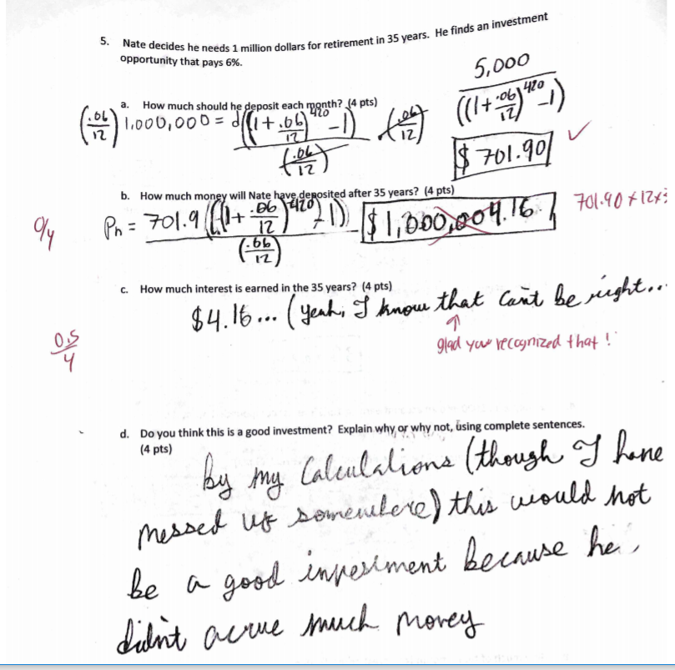
This student got part (a) correct, but not parts (b) or (c ). As they reflected on their answer, they knew it didn't make sense. Teachers love when students recognize if their answer doesn't make sense, and this one even awarded 0.5 points for it! They also got full points for part (d) because they supported their answer.

Slide 19
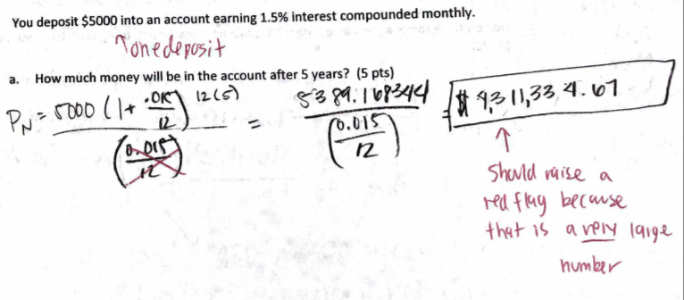
Reflect on your answer to see if it makes sense!
This student got the answer wrong, but could have probably gotten a little partial credit if they would have recognized that $5000 turning into $4.3 million in 5 years is not a reasonable answer.

Slide 20
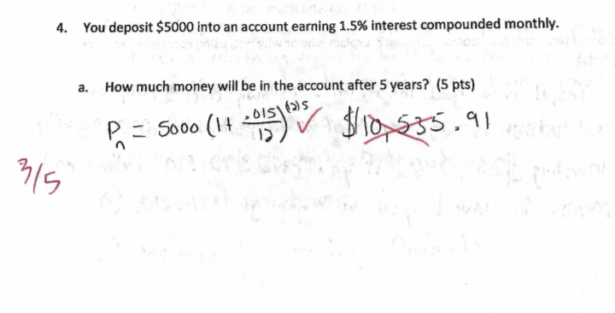
Write in formulas instead of leaving problem blank!
This student got the problem wrong, but used the correct formula, so got partial credit!

Slide 21
After the Test

Slide 22
Do something fun and relaxing
Look over and review test for mistakes. Meet with professor to learn from mistakes
Post-test reviews will strengthen knowledge
Identify style or patterns of the exam
Specific resources…lectures…book bolded text….study guide
Were there patterns you identified
Leaving the test, write as many questions down as you remember.

Slide 23
Sources:
Math Department, SLCC.
Eastern Kentucky University
https://mathtutor.eku.edu/test-anxiety
http://www.theprospect.net/10-things-not-to-do-when-studying-for-an-important-test-54169
https://www.unco.edu/tutoring/pdf/study-skills-resources/Understanding_Anxiety.pdf
https://www.intelligent.com/use-test-taking-strategies-on-exam-day/

Slide 24
THIS IS A TEST!
Instructions:
You have only 5 MINUTES
Turn your paper over.
List as many test tips from the presentation.
> 50 tips

Slide 25


Did note taking help? Did instructions matter? Was a reward motivating?
Group 1-This is an experiment. Please write down a quick word or two for each tip to prepare and take test. Prize for the most answers.
Group 2-This is an experiment. Please take helpful notes.
Group 3-It’s up to you. You can take notes if you want to.

Slide 26
STEM Learning
Free tutoring
STEM Success Resources
https://www.slcc.edu/stem/student-resources.aspx
https://www.unco.edu/university-101/study-skills/SAS_test_taking.pdf
Test tips for True/False, Multiple Choice, Essay, Fill in the blank, Open Book, Math Tests
https://www.slcc.edu/oss/student-success/study-skills.aspx
Note taking, Reading text, how to study, succeeding in class, test prep, time management, eportfolio, financial aid & scholarship

