Slide 1

An Introduction to Colloidal and Self-Assembled Materials
Part 2

Slide 2
Outline
Review of Solutions
Colloids and Colloid Chemistry
Self-Assembly
What is it?
Forces and interactions
Examples from nature
Nanotechnology examples

Slide 3
What is Self-Assembly?
Ever-evolving definitions
Sometimes called self-organization
One possible definition: a reversible process that involves pre-existing, distinct components of an initially disordered structure
Therefore, self-assembly ≠ formation
“Self-Assembly at All Scales,” G.M. Whitesides and B. Grzybowski, Science 2002, 295 (5564), 2418.

Slide 4
More on Self-Assembly
Has origins in organic chemistry: structures are determined bond-by-bond, but the structures are molecules (less than about 0.5 nm in size)
However, it is impossible to direct the formation (bond-by-bond) of larger nano- and micro-scale structures
Lithography is very useful for building larger structures (~100 nm to microns), but is inherently a 2-D process. 3-D structures have to be built layer-by-layer
Self-assembly fills the processing gap by utilizing specific (usually weak) interactions between molecules to build 2-D and 3-D structures in the 10’s to 100’s nm size range
“Self-Assembly at All Scales,” G.M. Whitesides and B. Grzybowski, Science 2002, 295 (5564), 2418.

Slide 5
More on Self-Assembly
It is not a “brute-force” technique
You don’t get it by purchasing a tool from a manufacturer
In fact, it usually requires no tools at all!

Slide 6
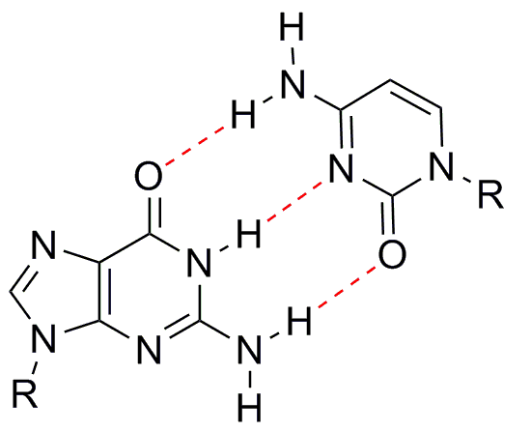
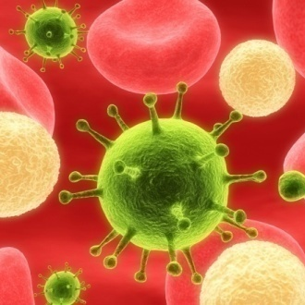

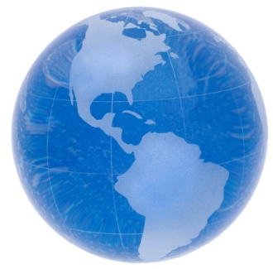
Many things (living and non-living) spontaneously organize over many length scales: Å to light year.
Å
nm
mm
km
AU
ly
10⁻⁹
10⁻⁷
10⁻⁵
10⁻³
10⁻¹
10¹
10³
10⁵
10⁷
10⁹
10¹¹
10¹³
10¹⁵
10⁻¹⁰
10⁻⁸
10⁻⁶
10⁻⁴
10⁻²
10⁻⁰
10²
10⁴
10⁶
10⁸
10¹⁰
10¹²
10¹⁴
10¹⁶

Slide 7
Forces at Work in self assembly
Type or Scale of Self-Assembly
Molecular | Nano & Meso Scale | Macro-scale
van der Waals | Brownian Motion | Gravitation
Electrostatics | Capillary Forces | Electromagnetic Fields
Hydrogen Bonds | Entropic Interactions | Magnetic Interactions
Coordination Bonds
Self-assembly usually occurs in a fluid-like state. The materials (molecules or particles) have to be able to move around. They sample many different orientations and interactions with respect to each other. One orientation (interaction) tends to be more favorable than others. Given enough time, the structural elements optimize their local environments to produce a self-organized structure over a large volume

Slide 8
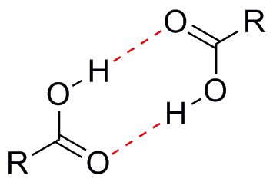
Bonding and Forces Revisited
Cl
Cl
Covalent Bonds
Ionic (electrostatic)
Hydrogen Bonding
van der Waals Forces
Hydrophobic Interactions
-
+

Slide 9
Competition Between Forces
Often, self assembly occurs due to a competition between two types of forces or interactions. Each type of force acts over a characteristic length scale. The table below illustrates the types of self-assembly arising from the interplay of long range repulsions and short range attractions
Long-Range Repulsion | Short-Range Attraction | Example of Self- Organized System
Hydrophobic/Hydrophilic | Covalent Bonding | Micelles, Lyotropic LC
Incompatibility/Insolubility | Covalent Bonding | Block Copolymers
Coulombic Repulsion | Electroneutrality | Ionic Crystals
Excluded Volume | Minimum Space Required | Thermotropic LC
Electric Field | Electric Dipole Interaction | Ferroelectric Domains
Magnetic Field | Magnetic Dipole Interaction | Magnetic Domains
“From Self-Organizing Polymers to Nanohybrid and
Biomaterials,” S. Förster and T. Plantenberg,
Angew. Chem. Int. Ed. 2002, 41(5), 688.

Slide 10
Examples and Applications
Simple case: crystallization of a compound from solution
For example: crystals of sugar forming when a heated sugar solution is cooled
By definition, a crystal is an ordered arrangement of components. In this case, the sugar crystals are comprised of highly ordered sugar molecules
Each sugar molecule develops specific contacts with neighboring molecules in the growing crystal

Slide 11
Example: Molecular Crystals
solvent molecule
(water)
solute molecule
(sugar)
specific
intermolecular
interactions
growing crystal

Slide 12
Inspiration from Nature
More complicated examples that show the power of self-assembly:
DNA double helix
Consists of 2 strands of DNA
Each strand contains base pairs covalently bonded to a phosphate backbone
The 2 strands are held together by hydrogen bonding between complementary base pairs
Protein folding
Proteins are polymers of amino acids
They fold into intricate 3-D structures
This is discussed on the following slides

Slide 13
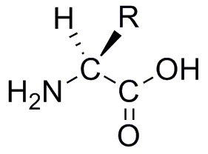
Example: Self-Assembly in Nature
Data storage on the molecular level
Translation
(Ribosome)
Transcription
DNA
RNA
Protein
DNA sequence is the code for protein synthesis
Codon: 3 adjacent base pairs of DNA that code for one amino acid in the resulting protein
20 possible amino acids: each has a different side-chain
The side-chains have different chemical properties:
large vs. small size (vdW volume and surface area)
hyrdophobic vs. hydrophilic
acidic vs. basic
hydrogen bond donors/acceptors
ability to form disulfide bonds (Cysteine: R-SH + HS-R → R-S-S-R)
ability to coordinate to metal atoms
Side-chains help guide the protein to fold into a particular structure
Proteins must be folded properly in order to perform their functions
Some diseases arise from mis-folded proteins
Side-Chain

Slide 14
Example: Self-Assembly in Nature
The terminology of protein folding
…-Gly-Ala-Tyr-…
amino acids bearing
different side-chains
Primary Structure: The order of amino acids that make up the protein. They are attached, via covalent bonds, into a polymer chain
Secondary Structure: Folding of the backbone chain of the protein into sheet-like or helical structures. This occurs to satisfy the hydrogen bonding capabilities of the back bone amide linkages
Tertiary Structure: Packing together of secondary structure elements to form a functional protein. Hydrophobic side-chains generally pack to the inside of the protein, while hydrophilic side-chains remain on the solvent-exposed surface of the protein. The solvent here is water

Slide 15
Nanotechnology Applications
The mechanisms involved in protein folding are still being explored by molecular biologists
But, not all examples of self-assembly are so complex
In fact, scientists use much simpler versions of self-assembly all the time
Many applications have found their way into nanotech processes and devices

Slide 16
Applications of Self-Assembly
Self-Organizing System | Application
Atomic, ionic, and molecular crystals | Materials, optoelectronics
Self-assembled monolayers (SAMs) | Microfabrication, sensors, nano-electronics
Lipid bilayers and lipid films | Biomembranes, emulsions, liposomes for drug delivery
Phase-separated and ionic layered polymers | Nano-structured templates
Liquid crystals | Displays and TVs
Colloidal crystals | Nanosphere lithography, photonic band gap materials
“Self-Assembly at All Scales,” G.M. Whitesides and B. Grzybowski, Science 2002, 295 (5564), 2418.

Slide 17
Example: Self-Assembled Monolayers
Self assembled monolayers (SAMs) refer to the organization of extremely thin films (one molecule thick) on solid surfaces
Common examples: thiols on gold; silanes on oxide surfaces
The molecules that form SAMs are like surfactants. They have two distinct regions: One part is attracted to the surface; the other is not
The molecules are sometimes called “Ligands,” especially when talking about SAMs on metal surfaces.
Applications: improved PDMS mold release; altered hydrophobicity of surfaces

Slide 18
Example: Self-Assembled Monolayer (SAM)
Octadecanethiol: C₁₈H₃₇-SH
Surface Active Molecules
van der Waals
Forces
Specific
Interactions
Metal Surface
Specific example: alkane thiols on gold. These molecules have a long greasy tail and an –SH head group. The –SH is attracted to the gold while the hydrocarbon tail is exposed to the solvent or air

Slide 19
SAMs: Choosing the Best Ligand
Ligands have to be chosen so that they will bind and assemble on a surface
Some ligands work on many surfaces
Others work best only on selected surfaces
If a ligand does not bind well to a surface, then it can be easily rinsed off and a SAM does not form
When designed properly, SAMs are durable surface treatments

Slide 20
Ligands for Various Surfaces
 | Alkylated Ligand
✓ = Yes SAM ✗ = No SAM Surface | Thiol R-SH | Sulfide R-S-R |  | Phosphine R₃P | Isonitrile R-NC | Carboxylic Acid R-COOH Phosphonic Acid R-PO(OH)₂ | Alcohol R-OH Amine R-NH₂ Amide R-CONH₂
Cr, Ni, Fe, Al | ✗ | ✗ |  | ✓ | ✓ | ✓ | ✓
Pt | ✓ | ✗ |  | ✓ | ✓ | ✓ | ✓
Cu, Ag | ✓ | ✗ |  | ✓ |  | ✓
Au | ✓ | ✓ |  | ✓ | ✓ | ✗ | ✗
Zn | ✓ | ✗ |  | ✓ | ✓ | ✓ | ✓
Other Surfaces
Metal & Silicon Oxides |  |  | ✓ Silanes R-SiCl₃
Adsorption generally follows “Hard-Soft-Acid-Base” rules: Carboxylic and phosphonic acids adsorb onto any metal oxide surface. Thiols and isonitriles adsorb onto soft metals (Cu, Ag, Au, Pt). However, phosphines (which are considered soft) form monolayers on many surfaces (soft or hard). This could be due to their oxidation to phosphine oxides
Pure and Applied Chemistry 1991, 63(6), 821-828.

Slide 21
Application: Surface Modification
OH
OH
OH
SAM
+
Hydrophobic Surface
Hydroxyl-Rich Surface
(Hydrophilic)
Reacts with hydroxyls
Water Drop
Contact Angle and Wettability
Hydrophilic
<30°
Hydrophobic
>90°
Super Hydrophobic
>150°

Slide 22
Application: Microcontact Printing
Liquid PDMS
Precursor
Cured PDMS Stamp
Master
Thiol
Coating
Gold Film
Substrate
Thiol SAM
Gold
Public Domain: Image Generated by CNEU Staff for free use

Slide 23
Example: Block Copolymers
Block copolymers are similar to surfactants in that they have two chemically dissimilar parts
When cast into films, the two blocks do not want to mix with each other (like oil and water)
But the blocks are covalently attached to each other, so they cannot move too far apart
This causes a phase separation on the nanoscale.
Nanoscale domains form a pattern that is characteristic of the block copolymer composition (spheres, cylinders, lamellae)
Changing the ratio (1:2) changes the pattern
One Block Copolymer Molecule
Block 1
Block 2

Slide 24
Example: Block Copolymers
One block
copolymer molecule
Increasing Length of A → |  | ← Increasing Length of B
20:80 | 30:70 | 50:50 | 70:30 | 80:20
Spheres of A | Cyl of A | Lamellae | Cyl of B | Spheres of B
Structures form due to phase-separation on the nano-scale
Minimization of surface area between two incompatible phases

Slide 25
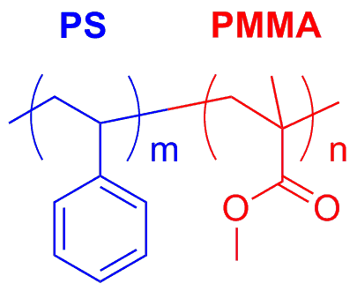
Example Process for Block Copolymers
The exact process route depends on the properties of the block copolymer being used to create the pattern. This example is for PS-b-PMMA, which self-assembles when heated to about 175 °C (above the T_{g} of both blocks, but not totally melted)
Clean the substrate to remove any contamination
Neutralize (randomize) the surface so that both blocks (PS and PMMA) have an equal affinity for the surface. In other words, neither block will preferentially wet or stick to the substrate surface
Dissolve the polymer in a solvent (toluene or PGMEA) to make a dilute solution of the polymer (1 wt% works well)
Spin coat a thin film (35 nm) of PS-b-PMMA onto the randomized substrate
Anneal (heat) the sample in a 175 °C vacuum oven for approximately 24 hours
Cool the sample back to rt and verify the self-assembled pattern via FESEM or AFM
PS Block
PMMA Block
http://www.internano.org

Slide 26
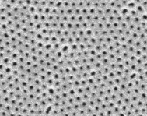
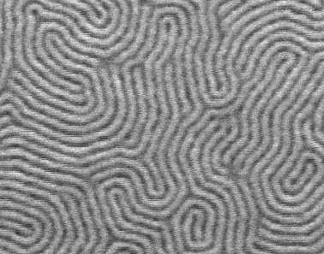
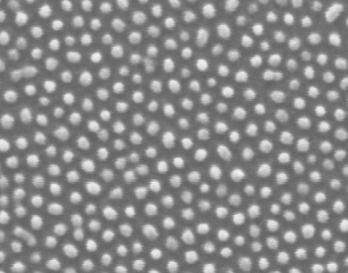
Images of Block Copolymers
30:70 PMMA to PS
Cylinders of PMMA in a matrix of PS
50:50 PMMA to PS
Lamellae
100 nm
70:30 PMMA to PS
Cylinders of PS in a matrix of PMMA
Increasing size of PMMA block
Decreasing size of PS block
Overall size (PS + PMMA) remains constant
Light gray: PS
Dark gray: PMMA
Public Domain: Image Generated by CNEU Staff for free use

Slide 27
Surfactants
Soaps and detergents are common examples of surfactants
Each molecule has a hydrophobic tail and hydrophilic head
When dissolved in water, surfactants self-assemble into micelles to minimize interactions between the hydrophobic tails and the water
hydrophobic tail
hydrophilic head
Surfactants can be classified according to their head group:
Anionic – negative charge
Cationic – positive charge
Non-ionic – no charge
Zwitterionic – both (+) and (-)
The choice of surfactant depends on the application:
Common soaps: anionic (good cleansing and high foaming)
Baby shampoo: zwitterionic (mildness)
Laundry detergent: non-ionic (lower foam and less sensitive to hardness ions)

Slide 28
Example: Micelle and Reverse Micelle
Polar Solvent (Water)
Non-Polar Solvent (Oil)

Slide 29
Example: Lipid Bilayers
Lipids are natural surfactants that self-
assemble into cell membranes
Polar Head
Group
Non-polar Tails
Aqueous Extracellular
Environment
Protein
Non-polar
Membrane Interior
Aqueous Cytoplasm

Slide 30
Liquid Crystals
Liquid crystals exist somewhere between a solid crystal (very ordered) and an isotropic liquid (no order)
Kind of like an organized liquid
The molecules arrange themselves so that they stack into a highly ordered pattern
But the material is still fluid-like
Phase change = transition from one state (arrangement of molecules) to another state

Slide 31
Liquid Crystals
Two general types of liquid crystals (LC):
Thermotropic LC: change phase as temperature increases/decreases
Lyotropic LC: phase changes induced by addition of solvent (change in concentration)
Some liquid crystals have an interesting property: they rotate the plane of polarization of light. This property is used in some LCD displays

Slide 32
Example: Liquid Crystals (LC)
Thermotropic LC: change phase as temperature increases/decreases
Lyotropic LC: phase changes induced by addition of solvent (change in concentration)
Example of a liquid
crystalline phase
(there are many)
Heat
Liquid Crystal
Long range order but still behaves like a fluid
Isotropic liquid
no long range order

Slide 33
Application: TFT LCD
Backlight
Unpolarized Light
Polarizer 1
Polarized Light
Self-Assembled
Liquid Crystal
No Voltage
Applied
Voltage
Applied
Polarizer 2
✗ Light Blocked
✓ Light Passes

Slide 34
Example: Colloidal Crystals
Similar to atomic and molecular crystals, except that the size of the building blocks are much larger and the forces holding them together are much weaker (compared to the size of the particles)
Colloidal: encompasses particles that have at least one characteristic dimension in the 1 nm to 1 um range – small enough to be the subjects of Brownian motion
Spherical
Colloidal
Particle
Colloidal Crystal
Closest-Packed Colloidal Spheres
White
Blood Cell
12-15 um
HIV Virus
100 nm
E. Coli
0.8-2 um
Proteins
Red
Blood Cell
6-8 um
Colloidal Particles
Nano-Scale
Meso-Scale
1 nm
10 nm
100 nm
1 μm
10 μm
100 μm

Slide 35
Application: Nanosphere Lithography
Colloidal Solution of Nanospheres
Self-Assembled
Nanospheres
Solvent
Evaporation
Drop Cast
Substrate
Side View
Deposit
Metal
Dissolve
Spheres
Top View
Feature spacing can be tailored by adjusting size of colloidal spheres

Slide 36
Summary
Colloid: refers to small size of objects; encompasses nano- and meso-scale
Colloids scatter light; homogeneous solutions do not scatter light
There are many everyday examples of self-assembly: soaps, proteins, LCDs
Emerging nanotech applications rely heavily on self-assembling molecules, polymers, and particles
Advances in self-assembly may eventually lead to true “bottom-up” manufacturing

