Slide 1

Nanoparticle Synthesis and Applications

Slide 2
Outline
Nanoparticle Synthesis
  Colloidal Chemical Methods
  Attrition
  Pyrolysis
  RF Plasma
  Thermal decomposition
  Pulsed Laser Method
Some Nanoparticle Applications

Slide 3
Colloidal Methods
Colloidal chemical methods are some of the most useful, easiest, and cheapest ways to create nanoparticles.
Colloidal methods may utilize both organic and inorganic reactants.
Typically, a metal salt is reduced leaving nanoparticles evenly dispersed in a liquid.
Aggregation is prevented by electrostatic repulsion or the introduction of a stabilizing reagent that coats the particle surfaces.
Particle sizes range from 1-200nm and are controlled by the initial concentrations of the reactants and the action of the stabilizing reagent.

Slide 4
Colloidal Methods
Examples: Gold
  A common method for preparing colloidal gold nanoparticles involves combining hydrogen tetrachloroaurate (HAuCl₄) and sodium citrate (Na₃C₆H₅O₇) in a dilute solution.
  Upon dissociation, the citrate ions (C₆H₅O₇³⁻) reduce Au³⁺ to yield 30-40 nm gold particles.
  Half reaction equations:
    Au³⁺⁽aq) + 3e⁻ → Au(s)
    C₆H₅O₇³⁻(aq) +H₂O(l) → C₅H₄O₄²⁻(aq) + CO₂(g) + H₃O(aq) + 2e⁻

Slide 5
Example: Formation of Gold Nanoparticles
Sodium
Citrate
Red Color = Gold NP
HAuCl₄
HAuCl₄
Gold
NP
Heat
Heat a solution of chloroauric acid (HAuCl₄) up to reflux (boiling). HAuCl₄ is a water soluble gold salt.
Add trisodium citrate, which is a reducing agent.
Continue stirring and heating for about 10 minutes.
  During this time, the sodium citrate reduces the gold salt (Au³⁺) to metallic gold (Au⁰).
  The neutral gold atoms aggregate into seed crystals.
  The seed crystals continue to grow and eventually form gold nanoparticles.
http://mrsec.wisc.edu/Edetc/nanolab/gold/index.html
J. Chem. Ed. 2004, 81, 544A.

Slide 6
Example: Formation of Gold Nanoparticles
Reduction of gold ions: Au(III) + 3e⁻ → Au(0)
Seed Crystal
10’s to 100’s of Atoms
Nucleation of Au(0) seed crystals:
Growth of nanoparticles:
Isotropic
Growth
Spherical
Nanoparticles
Surface capped
with citrate anions
Seed
Adding surfactant to growth solution
caps certain crystal faces and promotes
growth only in selected directions.
Anisotropic
Growth
Nanorods

Slide 7
Colloidial Methods
Examples: Molybdenum
  1-5 nm molybdenum nanoparticles can be created at room temperature by reducing MoCl₃ in a toluene solution in the presence of sodium triethylborohydride (NaBEt₃H).
  Reaction equation:
  MoCl₃ + 3NaBEt₃H → Mo + 3NaCl + 3BEt₃ + (3/2)H₂

Slide 8
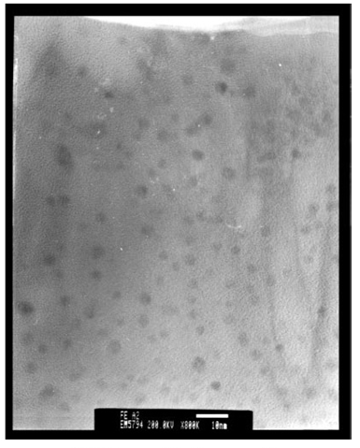
Colloidal Methods
Examples: Iron
  The TEM image to the right shows 3nm Fe nanoparticles produced by reducing FeCl₂ with sodium borohydride (NaBH₄) in xylene.
  Trioctylphosphine oxide (TOPO) was introduced as a capping agent to prevent oxidation and aggregation
TEM image of Fe nanoparticles
Phys. Chem. Chem. Phys., 2001, 3, 1661È1665

Slide 9
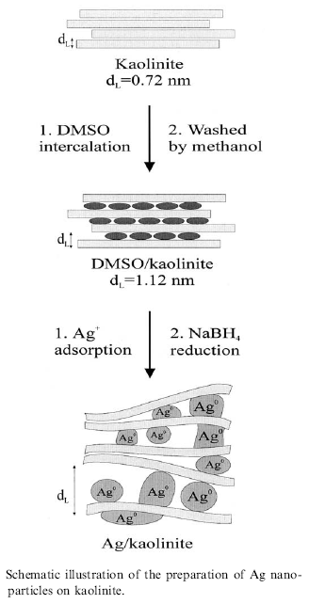
Colloidal Methods
Examples: Silver
  The reduction of AgNO₃ by NaBH₄ in aqueous solution can produce small diameter (<5nm) silver nanoparticles
  In one reported method, the reduction takes place between layers of kaolinite, a layered silicate clay material that functions to limit particle growth.
  Dimethyl sulfoxide (DMSO) is used as a capping agent to prevent corrosion and aggregation of the Ag particles.
R. Patakfalvi et al. / Colloids and Surfaces A: Physicochem. Eng. Aspects 220 (2003) 45/54

Slide 10
Attrition
Attrition is a mechanical method for creating certain types of nanoparticles.
Macro or micro scale particles are ground in a ball mill, a planetary ball mill, or other size reducing mechanism.
The resulting particles are separated by filters and recovered.
Particle sizes range from tens to hundreds of nm.
Broad size distribution and varied particle geometry.
May contain defects and impurities from the milling process.
Generally considered to be very energy intensive.
Cao, Guozhong. Nanostructures and Nanomaterials: Synthesis, Properties & Applications. Imperial College Press. 2004

Slide 11
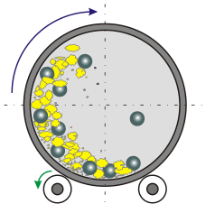
Attrition: Rotary Ball Mill
A hollow steel cylinder containing tungsten balls and a solid precursor rotates about its central axis.
Particle size is reduced by brittle fracturing resulting from ball-ball and ball-wall collisions.
Milling takes place in an inert gas atmosphere to reduce contamination.
http://www.ktf-split.hr/glossary/image/ball_mill.gif

Slide 12
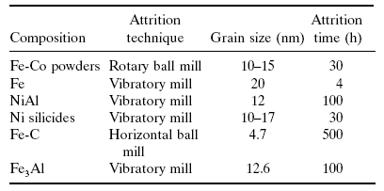
Attrition
Attrition Examples
Claudio L. De Castro, Brian S. Mitchell. Nanoparticles from Mechanical Attrition.
Department of Chemical Engineering, Tulane University, New Orleans, Louisiana, USA

Slide 13
Outline
Nanoparticle Synthesis
  Colloidal Chemical Methods
  Attrition
  Pyrolysis
  RF Plasma
  Thermal Decomposition
  Pulsed Laser Method
Nanoparticle Applications

Slide 14
Pyrolysis
History
System Overview
Aggregation and agglomeration
Impact of oxygen flow
Jet design
Flame quenching
    Nozzle quenching
    Electrostatic Charging

Slide 15
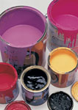
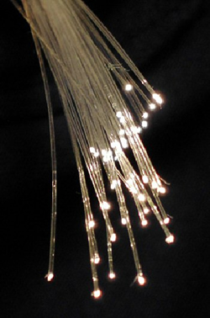


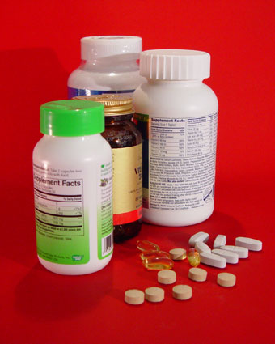

Pyrolysis: Material Applications
TiO₂
Tires
Optical
fibers
Paints
SiO₂
Carbon Black
Makeup
Flowing aid
Images clockwise from top left:
1. Tire <www.Safercar.gov>
2. Paint cans <http://www.ndhealth.gov/wm/PollutionPreventionAndRecyclingProgram/ MercuryContainingDevicesProducts.htm>
3. Optical Fibers <https://lasers.llnl.gov/publications/photons_fusion/2009/january
_february.php>
4. Vitamans <www.fda.gov/AboutFDA/WhatWeDo/History/ThisWeek/ucm117726.htm>
5. Makeup <https://pa-online.pa.gov.sg/NASApp/sdsol/sdsol/common
/Bring_Out_Best_In_You.htm>
6. Ink Quil < http://www.orovalleyaz.gov/Town_Government/Town_Clerk/notary_services.htm>
Inks

Slide 16
Annual Production of
Flame made materials
Carbon black – 8 million tons $8 billion
TiO₂ - 2.5 million tons, $5 billion
SiO₂ 2.0 million tons, $2 billion

Slide 17
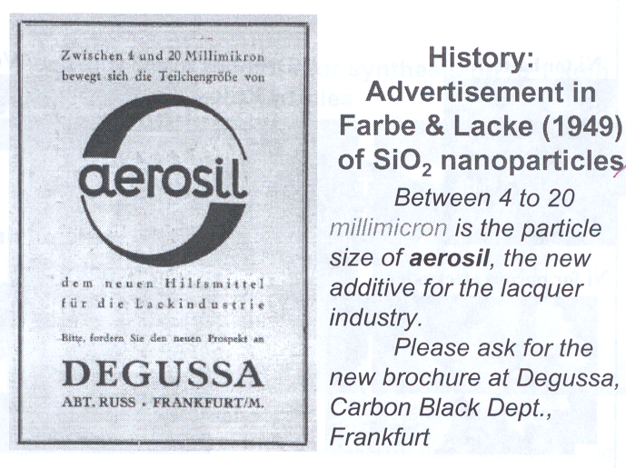
Pratsinis, Sotiris E., Functional Nanoparticles and Films Made in the Gas-phase. Nano Science and Technology Institute, Cambridge. 2008

Slide 18
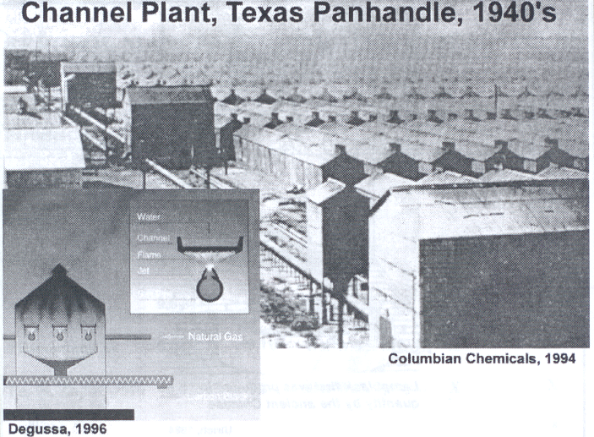
Pratsinis, Sotiris E., Functional Nanoparticles and Films Made in the Gas-phase. Nano Science and Technology Institute, Cambridge. 2008

Slide 19
Pyrolysis
Pyrolysis is a popular method for creating nanoparticles, especially oxides. A precursor (liquid or gas) is forced through an orifice at high pressure and burned.
The resulting ash is collected to recover the nanoparticles.
Large volume of gas leads to high rate of material synthesis

Slide 20
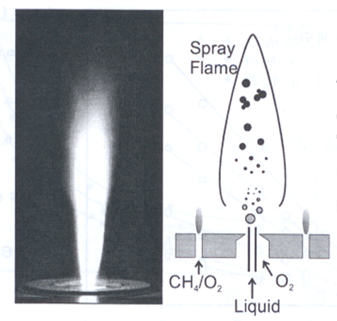

Flame Spray Pyrolysis (FSP)
Versatile
Large Variety of precursors
Controllable
Scalable
Aggregation
Condensation
Coagulation
Nucleation
Droplet evaporation

Slide 21
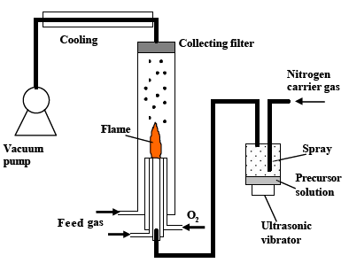
Pyrolysis: System Overview
Xiao Q., Yiguang J., Stefan B. and Nan Y. Synthesis of Y2O3:Eu Phosphor Nanoparticles by Flame Spray Pyrolysis. Princeton University, Princeton, NJ

Slide 22
Pyrolysis
Aggregates and Agglomerates:
Aggregate – An assemblage of particles rigidly joined together by chemical or sinter-forces.
Agglomerate – A loosely coherent assembly of particles and/or aggregates held together by weak interactions
Current aerosol instruments cannot distinguish between them.
  Aggregates Agglomerates

Slide 23
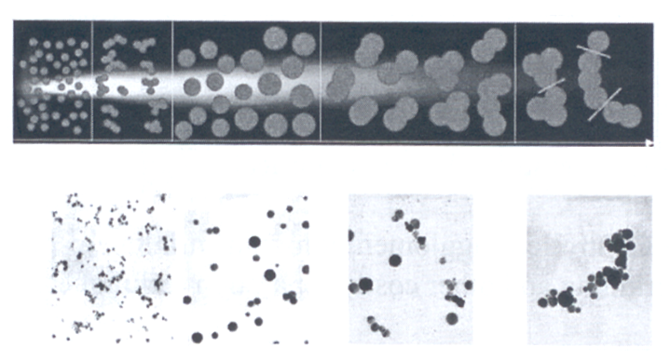

Pyrolysis
Agglomerate Formation Sequence
TiO₂
Monomers
Transient Hard
Agglomerates
Spherical
Particles
Hard Agglomerates
Soft Agglomerates
Residence time

Slide 24
Pyrolysis
Degree of agglomeration matters:
Agglomerated
  Fillers
  Catalysts
  Lightguide preforms
  Particles for CMP
Non-agglomerated
  Pigments
  Composites
  Electronics
Distinction between hard and soft agglomerates is largely empirical.
Controlled agglomeration can minimize post-grinding and other costly separation techniques.
Pratsinis, Sotiris E., Functional Nanoparticles and Films Made in the Gas-phase. Nano Science and Technology Institute, Cambridge. 2008

Slide 25
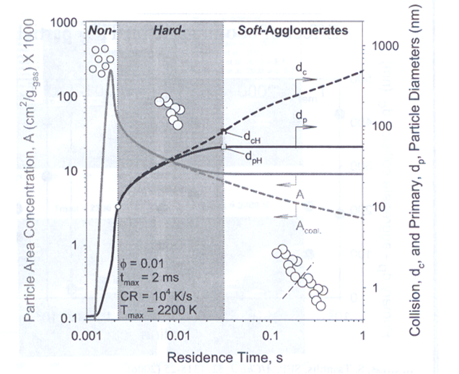



Pyrolysis
Regions of Agglomeration
Non-Agglomerates
Hard Agglomerates
Soft Agglomerates
Pratsinis, Sotiris E., Functional Nanoparticles and Films Made in the Gas-phase. Nano Science and Technology Institute, Cambridge. 2008

Slide 26
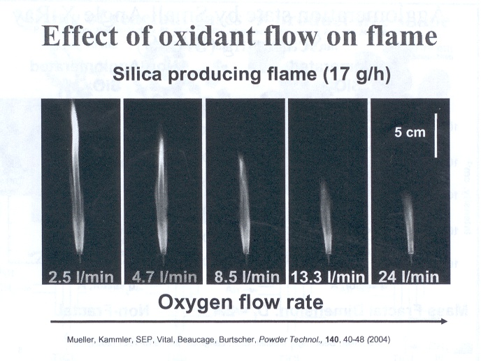
Pyrolysis

Slide 27
Pyrolysis
Impact of oxygen
Aids in combustion
Provides chemistry in the reaction
Acts as a dilutent, cools the flame, prevents agglomeration
All of these variables can be decoupled by burner design. Which is cheaper than increasing oxygen flow.

Slide 28
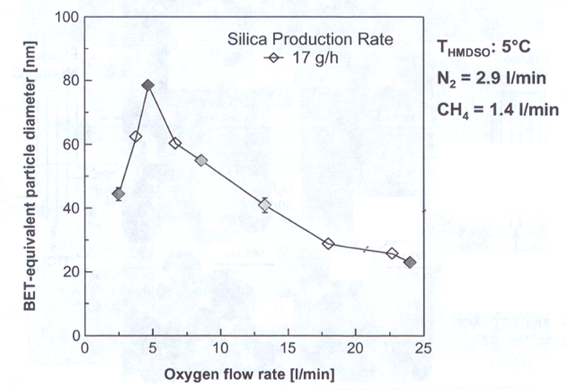

Pyrolysis
Particle Size Controlled by O₂ Flow
Excess oxygen makes the flame burn cooler resulting in smaller diameter particles

Slide 29
Pyrolysis
Particle Formation and Growth by Gas Phase Chemical Reaction, Coagulation, Sintering and Surface Growth:
O₂
TTIP
Molecules
TiO₂
Molecules
TiO₂
Particles
TiO₂
Aggregates
Decreasing Temperature
Titanium-Tetra-Iso-Propoxide
C₃H₇O
OC₃H₇
Ti
C₃H₇O
OC₃H₇
Pratsinis, Sotiris E., Functional Nanoparticles and Films Made in the Gas-phase. Nano Science and Technology Institute, Cambridge. 2008

Slide 30
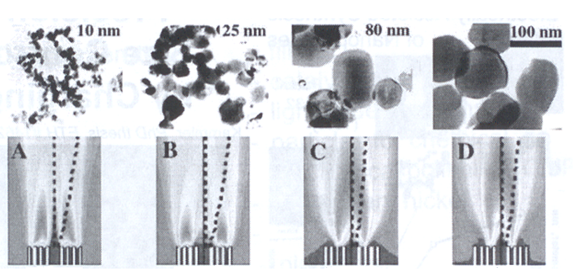
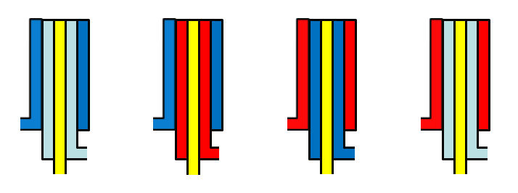

Pyrolysis: Jet Design
CH₄
CH₄
Air
Air
Air
CH₄
Air
Air
TiCl₄
TiCl₄
TiCl₄
TiCl₄

Slide 31
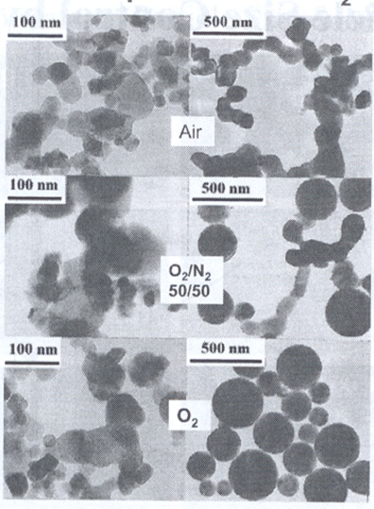



Pyrolysis: Jet Design
Effect of Oxidant Composition on TiO₂ Morphology:
Flame mixing B
Flame mixing C
CH₄
Oxidant
Oxidant
CH₄
TiCl₄
TiCl₄

Slide 32
Pyrolysis: Nozzle Quenching
Desired
Flame length is controlled by rapid quenching
Prevents agglomeration by inhibiting growth processes in the early stages of growth.
Provides precise control of particle size
Vapor
Pratsinis, Sotiris E., Functional Nanoparticles and Films Made in the Gas-phase. Nano Science and Technology Institute, Cambridge. 2008

Slide 33
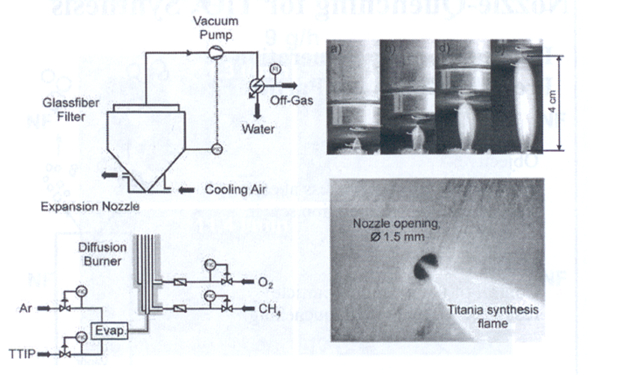
Pyrolysis: Nozzle Quenching
Nozzle Quenching controls flame length and particle size.

Slide 34
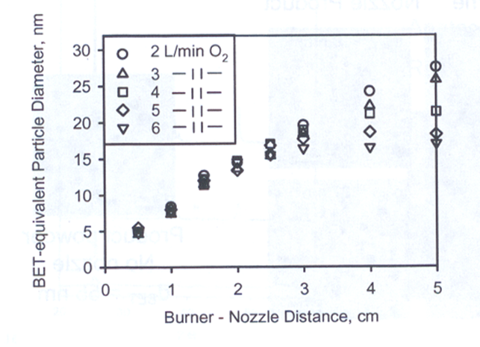
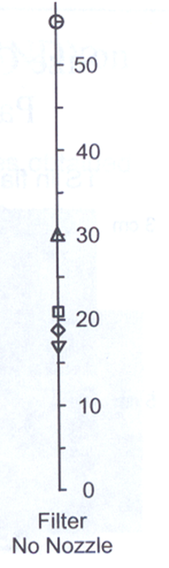
Pyrolysis: Nozzle Quenching
TiO₂ Particle Size Control by Nozzle Quenching
Pratsinis, Sotiris E., Functional Nanoparticles and Films Made in the Gas-phase. Nano Science and Technology Institute, Cambridge. 2008

Slide 35
Pyrolysis: Electrostatic Charging
Particle size can also be controlled by generating an electric field across the flame.
A large electric field (hundreds of kV/m) is generated between two plate electrodes situated on opposite sides of the flame.
Similar to nozzle quenching, the electric field limits particle growth by reducing the residence time in the high temperature region of the flame.
In addition, the electric field charges the particles. This results in electrostatic repulsion between newly formed particles, preventing coagulation.
S. Vemury, S.E. Pratsinis, L. Kibbey, Electrically-controlled flame synthesis of nanophase TiO₂, SiO₂, and SnO₂ powders. JMR, Vol. 12, 1031-1042. 1997.

Slide 36
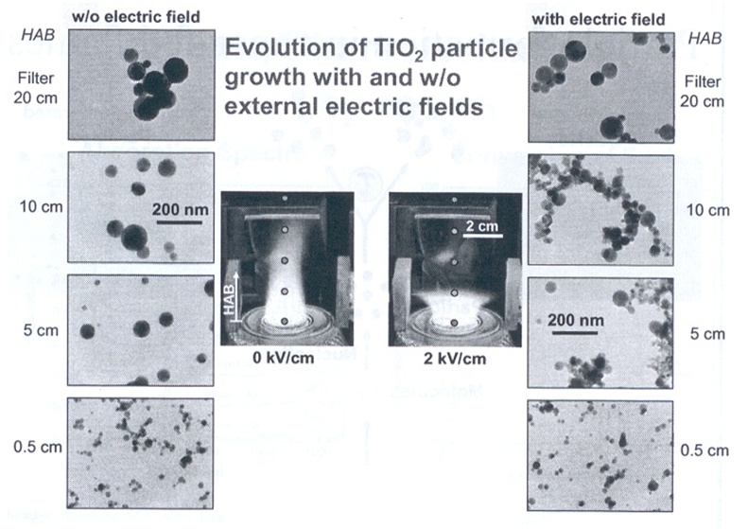

Pyrolysis: Electrostatic Charging

Slide 37
Pyrolysis: Advantages & Disadvantages
Pyrolysis is a high yield method that can fulfill the strong demand for nanoparticles.
Can be customized to produce unique nanoparticles.
Broad distribution of particle sizes and morphology.

Slide 38
Outline
Nanoparticle Synthesis
  Colloidal Chemical Methods
  Attrition
  Pyrolysis
  RF Plasma
  Thermal Decomposition
  Pulsed Laser Method
Nanoparticle Applications

Slide 39
RF Plasma Synthesis
The starting material is placed in a pestle and heated under vacuum by RF heating coils.
A high temperature plasma is created by flowing a gas, such as He, through the system in the vicinity of the coils.
When the material is heated beyond its evaporation point, the vapor nucleates on the gas atoms which diffuse up to a cooler collector rod and form nanoparticles.
The particles can be passivated by introducing another gas such as O₂.
In the case of Al nanoparticles the O₂ forms a thin layer of AlO₃ around the outside of the particle inhibiting aggregation and agglomeration.
RF plasma synthesis is very popular method for creating ceramic nanoparticles and powders
Low mass yield.
Poole, C., Owens, F. Introduction to Nanotechnology. Wiley, New Jersey. 2003

Slide 40
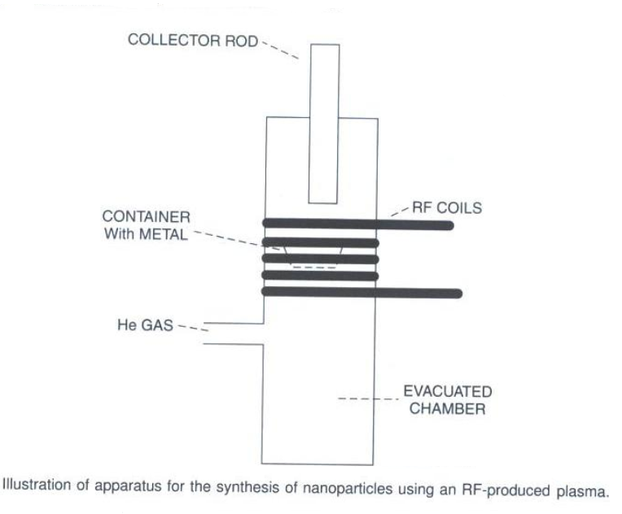
RF Plasma Apparatus
Poole, C., Owens, F. Introduction to Nanotechnology. Wiley, New Jersey. 2003

Slide 41
Thermal Decomposition
  Thermal decomposition is the chemical decomposition of a substance into ins constituents by heating.
  A solid bulk material is heated beyond its decomposition temperature in an evacuated furnace tube.
  The precursor material may contain metal cations and molecular anions, or metal organic solids.
  Example: 2LiN₃(s)→ 2Li(s) +3N₂(g)
  Lithium particles can be synthesized by heating LiN₃ in a quartz tube under vacuum.
  When heated to 375ºC the nitrogen outgases from the bulk material and the Li atoms coalesce to form metal nanoparticles.
Poole, C., Owens, F. Introduction to Nanotechnology. Wiley, New Jersey. 2003

Slide 42
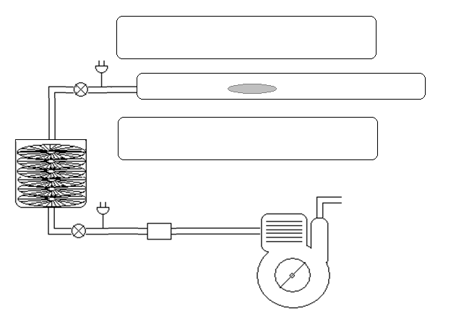
Thermal Decomposition Apparatus
Sample in Ta foil
Furnace
Evacuated
Quartz Tube
Turbo Molecular
Pump
Mechanical Pump

Slide 43
Outline
Nanoparticle Synthesis
  Colloidal Chemical Methods
  Attrition
  Pyrolysis
  RF Plasma
  Thermal Decomposition
  Pulsed Laser Methods
Nanoparticle Applications

Slide 44
Pulsed Laser Methods
Pulsed Lasers have been employed in the synthesis silver nanoparticles from silver nitrate solutions.
A disc rotates in this solution while a laser beam is pulsed onto the disc creating hot spots.
Silver nitrate is reduced, forming silver nanoparticles.
The size of the particle is controlled by the energy in the laser and the speed of the rotating disc.
Poole, C., Owens, F. Introduction to Nanotechnology. Wiley, New Jersey. 2003

Slide 45
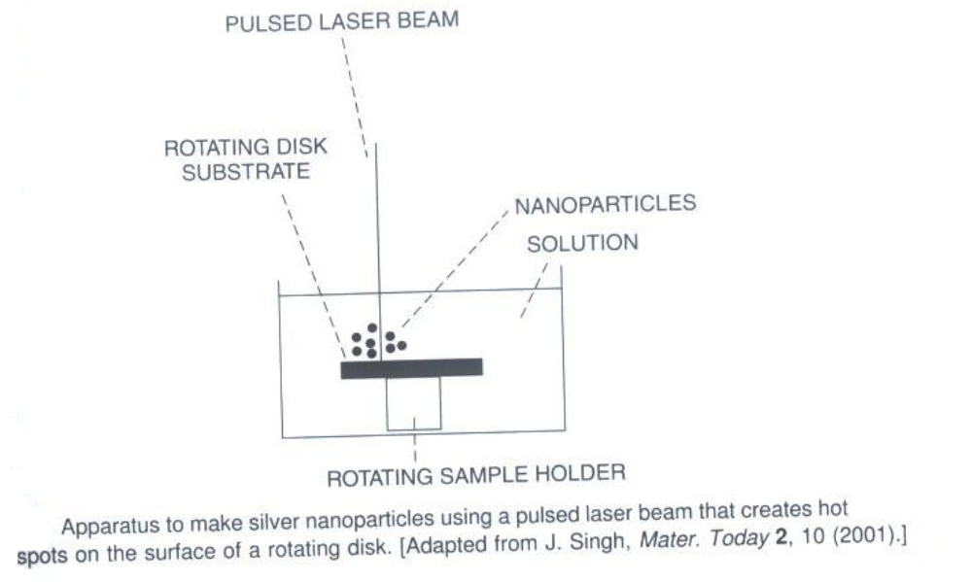
Pulsed Laser Apparatus for Ag Nanoparticles
Poole, C., Owens, F. Introduction to Nanotechnology. Wiley, New Jersey. 2003

Slide 46
Nanoparticle Applications: ZnO
Zinc Oxide has opaque and antifungal properties.
Used as UV blocking pigments in sunscreens, cosmetics, varnishes, and fabrics
Incorporated in foot powders and garden supplies as an antifungal.
ZnO nanowires can improve the elastic toughness of bulk materials

Slide 47
Nanoparticle Applications: TiO₂
Titanium Dioxide is used as an inorganic white pigment for paper, paints, plastics, and whitening agents.
TiO₂ nanoparticles are used as UV blocking pigments in sunscreens, cosmetics, varnishes, and fabrics.
TiO₂ has unique photocatalytic properties that make it suitable for a number of advanced applications:
  Self-cleaning glass and antifogging coatings
  Photoelectrochemical cells (PECs)
  Detoxification of waste water
  Hydrolysis

Slide 48
Nanoparticle Applications: Fe
50-100nm Iron nanoparticles are used in magnetic recording devices for both digital and analog data.
Decreasing the diameter to 30-40nm increases the magnetic recording capacity by 5-10 times per unit.

Slide 49
Nanoparticle Applications:
Iron Oxide
Iron Oxide nanoparticles have unique magnetic and optical properties.
Iron oxide nanoparticles can be translucent to visible light while being opaque to UV light.
Applications include UV protective coatings, various electromagnetic uses, electro-optic uses, and data storage.

Slide 50
Nanoparticle Applications:
Iron Alloys
Iron-platinum nanoparticles have increased magnetism and it is predicted that 3nm particle can increase the data storage capacity by 10 times per unit area.
Iron-palladium nanoparticles 100-200nm in diameter have been shown to reduce toxic chlorinated hydrocarbons to nontoxic hydrocarbon and chloride compounds.
SCIENCE VOL 287 17 MARCH 2000

Slide 51
Nanoparticle Applications: Alumina
Alumina (Aluminum Oxide) is used in Chemical Mechanical Polishing (CMP) slurries, as well as ceramic filters.
Nano-alumina is used in light bulb and fluorescent tube coatings because it emits light more uniformly and allows for better flow of fluorescent materials.

Slide 52
Nanoparticle Applications: Ag
Silver has excellent conductivity and has been used as an antimicrobial material for thousands of years.
Silver’s anti-microbial potential increase with increased surface area.
Applications include biocides, transparent conductive inks, and antimicrobial plastics, and bandages.

Slide 53
Nanoparticle Applications: Gold
Gold nanoparticles are relatively easy to produce compared to other types of nanoparticles due to its high chemical stability.
Uses for gold nanoparticles are typically catalytic and include DNA detection and the oxidation of carbon monoxide.
Gold has superior conductivity allowing gold nanoparticles to be used in various probes, sensors, and optical applications.

Slide 54
Nanoparticle Applications: Gold
The First Response® home pregnancy test uses 1µm polystyrene sphere and 50nm gold particles coated with an antibody to human chorionic gonadotropin (hCG), a hormone produced during pregnancy.
When urine containing hCG comes in contact with the polystyrene-gold-antibody complex, the nanoparticles coagulate into red clumps. Fluids pass through a filter where the clumps are caught yielding a pink filter.
Suspended (un-coagulated) nanoparticles pass through the filter and no color change occurs.
Bangs, L. B. New Developments in Particle-based Immunoassays. Pure & Appl. Chem. Vol. 68, No 10 p 1873-1879. 1996

Slide 55
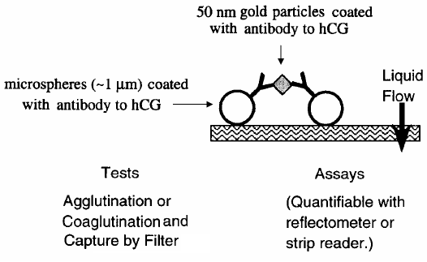
Nanoparticle Applications: Gold
Bangs, L. B. New Developments in Particle-based Immunoassays. Pure & Appl. Chem. Vol. 68, No 10 p 1873-1879. 1996

Slide 56
Nanoparticle Applications: ZrO
Zirconium Dioxide nanoparticles can increase the tensile strength of materials when applied as a coating.
This has many possible applications in wear coatings, ceramics, dies, cutting edges, as well as piezoelectric components, and dielectrics.

