Slide 1

Introduction to Nanoparticles and Nanostructures

Slide 2
Outline
Definition and Examples
Physical Properties
  Size
  Crystal Structure
  Melting Point
  Mechanical Strength
Optical Properties
  Surface Plasmons
  Quantum Confinement Effects
Electrical Properties
Health Concerns

Slide 3
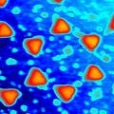
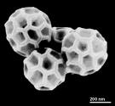
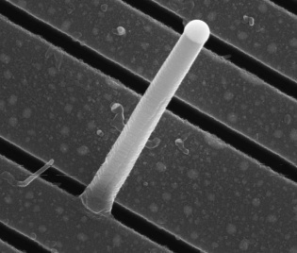
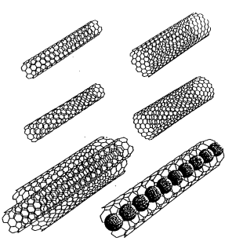
Definition of Nanoparticle
A structure with at least 1 dimension less than 1 µm.
Examples:
  Sphere-like particles
    Ag nanoparticles, buckyballs
  Rod-like particles
    Si & Ni nanowires
  Tube-like particles
    Carbon nanotubes
    TiO₂ nanotubes

Slide 4
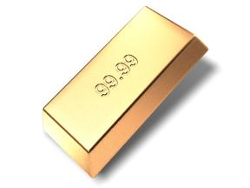
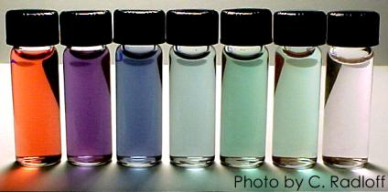
Size is a Material Property?
The gold we know:
Material properties don’t change with size
- resistivity
- melting point
- optical absorption
The gold we are discovering:
Material properties (such as optical
Absorption, shown here) change with the size of the gold nanoparticle.

Slide 5
Outline
Definition and Examples
Physical Properties
  Size
  Crystal Structure
  Melting Point
  Mechanical Strength
Optical Properties
Electrical Properties
Health Concerns

Slide 6
Unique Characteristics of Nanoparticles
Large surface to volume ratio
High percentage of atoms/molecules on the surface
Surface forces are very important, while bulk forces are not as important.
Metal nanoparticles have unique light scattering properties and exhibit plasmon resonance.
Semiconductor nanoparticles may exhibit confined energy states in their electronic band structure (e.g., quantum dots)
Can have unique chemical and physical properties
Same size scale as many biological structures

Slide 7
Examples of Unusual Properties
Lowered phase transition temps
Increased mechanical strength
Different optical properties
Altered electrical conductivity
Magnetic properties
Self-purification and self-perfection

Slide 8
Physical Properties of Nanoparticles
Physical properties of nanoparticles are dependent on:
  Size
  Shape (spheres, rods, platelets, etc.)
  Composition
  Crystal Structure (FCC, BCC, etc.)
  Surface ligands or capping agents
  The medium in which they are dispersed

Slide 9
Size
# of atoms
Molecules, nanoparticles, and bulk materials can be distinguished by the number of atoms comprising each type of material.
Note: these are very approximate numbers!
1
Molecules
10
10²
10³
Nanoparticles
10⁴
10⁵
10⁶
Bulk
Poole, C., Owens, F. Introduction to Nanotechnology. Wiley, New Jersey. 2003

Slide 10
Size
Nanoparticles exhibit unique properties due to their high surface area to volume ratio.
A spherical particle has a diameter (D) of 100nm.
  Calculate the volume (V) and surface area (SA)
Poole, C., Owens, F. Introduction to Nanotechnology. Wiley, New Jersey. 2003

Slide 11
Surface Area:Volume Ratio
This gives an approximate surface area to volume ratio of >10⁷:1 which is significantly larger than a macro sized particle.
As the surface area to volume ratio increases so does the percentage of atoms at the surface and surface forces become more dominant.
Generally accepted material properties are derived from the bulk, where the percentage of atoms at the surface is miniscule. These properties change at the nanoscale.

Slide 12
Size
Some example calculations for volume and surface area of nanoparticles.
These calculations use nm as unit of length.
Nanoparticle | Nanoparticle | Volume | Surface Area | SA:Vol Ratio
Diameter (nm) | Diameter (um) | (nm³) | (nm²) | (nm²/nm³)
1 | 0.001 | 0.524 | 3.14 | 6
10 | 0.01 | 524 | 314 | 0.6
100 | 0.1 | 523598 | 31416 | 0.06
1000 | 1 | 5.24E+08 | 3.14E+06 | 0.006
10000 | 10 | 5.24E+11 | 3.14E+08 | 0.0006
100000 | 100 | 5.24E+14 | 3.14E+10 | 0.00006
1000000 | 1000 | 5.24E+17 | 3.14E+12 | 0.000006

Slide 13
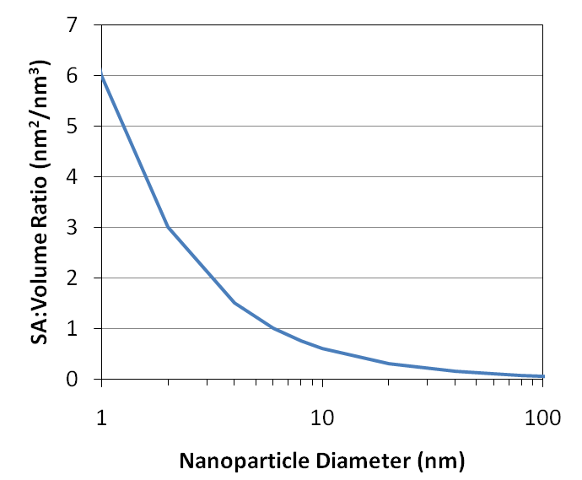
Surface Area:Volume Ratio
In this graph:
SA = nm²
Vol = nm³
SA:Vol Ratio = nm²/nm³
The ratio increases dramatically when the nanoparticle diameter drops below about 100 nm

Slide 14
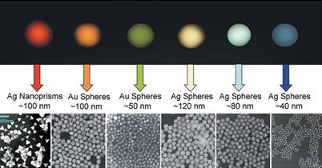
Size
As the percentage of atoms at the surface increases, the mechanical, optical, electrical, chemical, and magnetic properties change.
  For example optical properties (color) of gold and silver change, when the spatial dimensions are reduced and the concentration is changed.

Slide 15
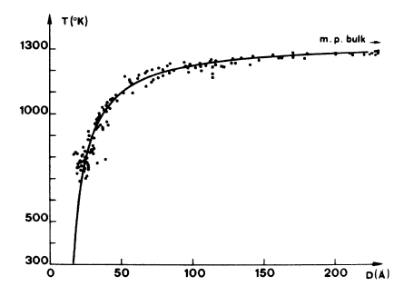
Size
Melting point as a function of particle size
Nanoparticles have a lower melting point than their bulk counterparts
Melting point of gold nanoparticles as a function of size.
Source: Ph. Buffat and J-P. Borel, Phys. Rev. A 13, 2287–2298 (1976)

Slide 16
mp versus Shape
Particles: May sinter together at lower than expected temperature.
Rods: Can melt and form spherical droplets if heated too high.
Films: Thin films can form pin-holes. Continued heating can lead to de-wetting behavior and island formation.

Slide 17
Crystal Structure
Most solids are crystalline with their atoms arranged in a regular manner.
This arrangement of atoms impacts the functionality of the material.
Some solids have this order presented over a long range as in a crystal.
Amorphous materials such as glass and wax lack long range order, but they can have a limited short range order, defined as the local environment that each atom experiences.
Poole, C., Owens, F. Introduction to Nanotechnology. Wiley, New Jersey. 2003

Slide 18
Crystal Structure
The spatial arrangement of atoms in a crystal lattice is described by its unit cell.
The unit cell is the smallest possible volume that displays the full symmetry of the crystal.
Many materials have a “preferred” unit cell.

Slide 19
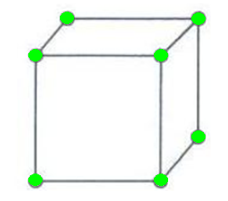
Crystal Structure
In 3 dimensions, unit cells are defined by 3 lattice constants and 3 angles.
This leads to 14 Bravais lattices, each having characteristic restrictions on the lattice constants, angles, and centering of atoms in the unit cell.
b
c
a

Slide 20
Crystal Structures
For cubic unit cells, there are three centering types:
Simple Cubic
(SC)
Body Centered Cubic
(BCC)
Face Centered Cubic
(FCC)

Slide 21
Size & Crystal Structure
Most metals in the solid form close packed lattices
Ag, Al, Cu, Co, Pb, Pt, Rh are Face Centered Cubic (FCC)
Mg, Nd, Os, Re, Ru, Y, Zn are Hexagonal Close Packed (HCP)
Cr, Li, Sr can form Body Centered Cubic (BCC) as well as (FCC) and (HCP) depending upon formation energy

Slide 22
Size & Crystal Structure
How does crystal structure impact nanoparticles?
Nanoparticles have a “structural magic number”, that is, the optimum number of atoms that leads to a stable configuration while maintaining a specific structure.
Structural magic number = minimum volume and maximum density configuration
If the crystal structure is known, then the number of atoms per particle can be calculated.
Poole, C., Owens, F. Introduction to Nanotechnology. Wiley, New Jersey. 2003

Slide 23
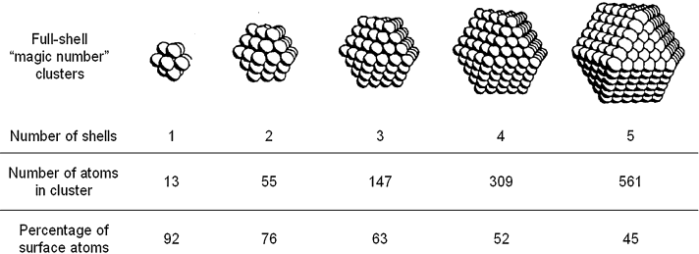
Close-Packed Magic Number Clusters
Magic Number = Cluster has a complete, regular outer geometry
Formed by successively packing layers around a single metal atom.
Number of atoms (y) in shell (n): y = 10n² + 2 (n = 1,2,3…)
Maximum number of nearest neighbors (metal-metal hcp packing)
Decreasing percentage of surface atoms as cluster grows
J. D. Aiken III, R. G. Finke, J. Mol. Catal. 1999, 145, 1

Slide 24
Size & Crystal Structure
For n layers, the number of atoms N in an approximately spherical FCC nanoparticle is given by the following formula:
  N = 1/3[10n³ – 15n² + 11n - 3]
The number of atoms on the surface N_{surf}
  N_{Surf} = 10n² – 20n +12

Slide 25
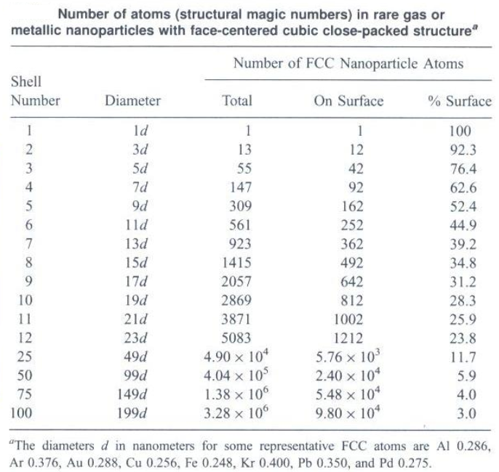
Size & Crystal Structure
Example Calculations:
How many atoms (N) are in idealized Au NP’s with the following diameters?
5 nm Au NP:
With 9 shells, n = 9 and
NP diameter = 17d = 4.896 nm
N = 1/3[10n³ – 15n² + 11n - 3] N = 2057
Other Approximate Values
10 nm = 17,900
20 nm = 137,000
30 nm = 482,000
40 nm = 1.1 million
50 nm = 2.2 million
Poole, C., Owens, F. Introduction to Nanotechnology. Wiley, New Jersey. 2003

Slide 26
Wulff Crystal Shapes
Used to determine the shape of a crystal when formed under thermodynamic equilibrium conditions.
Surfaces = areas of high energy
Different facets have different surface energies.
Objective is to minimize the total surface energy of the xtal.

Slide 27
Wulff Crystal Shapes
These plots represent a simplified view of crystal faces in 2-dimensions.
Intercepts
(x = ∞, y = 1)
Face (0 1)
y
y
Intercepts
x = 1, y = 1
Face (1 1)
Miller Indices in 2-D:
Notation is based on where the “plane” (or face) crosses the x- and y-axes.
x
x
{1 0}
Family of Crystal Faces
includes all of the following faces
(1 0), (-1 0), (0 1), (0 -1)
{1 1}
Family of Crystal Faces
includes all of the following faces
(1 1), (-1 1), (-1 -1), (1 -1)

Slide 28
Wulff Crystal Shapes
Wulff Plots: Length of arrow is proportional to surface energy of that face. Longer arrows denote higher energy surfaces.
Increasing energy of {1 1} faces
Energy of {1 0} remains constant.
Crystal Shapes: Draw outline of inner-most facets to determine shape of the crystal. The result is that high energy faces expose less surface area to the external environment.
low energy face
high energy face

Slide 29
Deviations from Ideal Crystals
Often, nanoparticles (nanocrystals) do not form well-defined crystal facets.
The Wulff crystal shapes are idealized cases where the crystal surface energies determine the shape (thermodynamic control).
Kinetic factors often play a major role in crystal growth. This explains why different processing conditions can lead to different morphologies for the same material.
Roughening Temperature: Above this temperature, surface atoms on a growing crystal have increased mobility (liquid-like surface) and well-defined facets do not form.
At elevated temps, all faces tend to have similar energy (e.g., on macroscale consider the C-Z process for Si).

Slide 30
Altered Lattice Constants
Compare lattice structure of nano and bulk materials
Shortening of bonds near the surface
Surface reconstruction
Original Structure
Shortened Surface Bonds
Shifted Surface Bonds

Slide 31
Mechanical Strength
Calculated values for mechanical strength of idealized xtals = 100 to 1000X than experimental
Differentiate between wires and nanocomposites
Transition to higher strength occurs at about 10 microns (above the nanoscale)
2 possible reasons:
  Lower number of defects inside the nanowire
  Fewer surface defects

Slide 32
Outline
Definition and Examples
Physical Properties
Optical Properties
  Surface Plasmons
  Quantum Confinement
Electrical Properties
Health Concerns

Slide 33
Optical Properties
The size dependence on the optical properties of nanoparticles is the result of two distinct phenomena:
  Surface plasmon resonance for metals
  Increased energy level spacing due to the confinement of delocalized energy states. Most prominent in semiconductors
Poole, C., Owens, F. Introduction to Nanotechnology. Wiley, New Jersey. 2003

Slide 34
Optical Properties
Surface Plasmons
  Recall that metals can be modeled as an arrangement of positive ions surrounded by a sea of free electrons.
  The sea of electrons behaves like a fluid and will move under the influence of an electric field
-
-
-
-
-
-
-
-
-
-
-
-
-
-
-
-
-
-
-
-
-
-
-
-
-
-
-
-
+
+
-
+
-
-
+
-
-
-
-
-
-
-
-
-
-
-
-
-
-
-
-
-
-
-
-
-
-
-
-
-
+
+
-
+
-
-
+
-
-
-
-
-
-
-
-
-
-
-
-
-
-
-
-
-
-
-
-
-
-
-
+
-
+
-
+
-
+
-
-
-
-
-
-
-
-
-
-
-
-
-
-
-
-
-
-
-
-
-
-
+
-
+
-
+
-
+
-
-
-
-
-
-
-
-
-
-
-
-
-
E-field

Slide 35
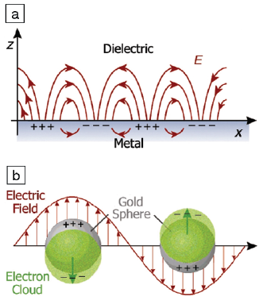
Optical Properties
Surface Plasmons
  If the electric field is oscillating (like a photon), then the sea of electrons will oscillate too. These oscillations are quantized and resonate at a specific frequency. Such oscillations are called plasmons.
Resonance at a metal surface
Resonance in metal NP
Source: MRS Bulletin 2005, 30(5), 338.

Slide 36
Optical Properties
Surface Plasmons
  Formal definition: Plasmons are the coherent excitation of free electrons in a metal.
  The plasmon resonance frequency (f) depends on particle size, shape, and material type. It is related to the plasmon energy (E) by Planck’s constant. E=h*f
  Surface plasmons are confined to the surface of the material.
  The optical properties of metal nanoparticles are dominated by the interaction of surface plasmons with incident photons.

Slide 37
Optical Properties
Surface Plasmons
  Metal nanoparticles like gold and silver have plasmon frequencies in the visible range.
  When white light impinges on metal nanoparticles the wavelength corresponding to the plasmon frequency is absorbed.
  The spectral locations, strengths, and number of plasmon resonances for a given particle depend on the particle’s shape and size.

Slide 38
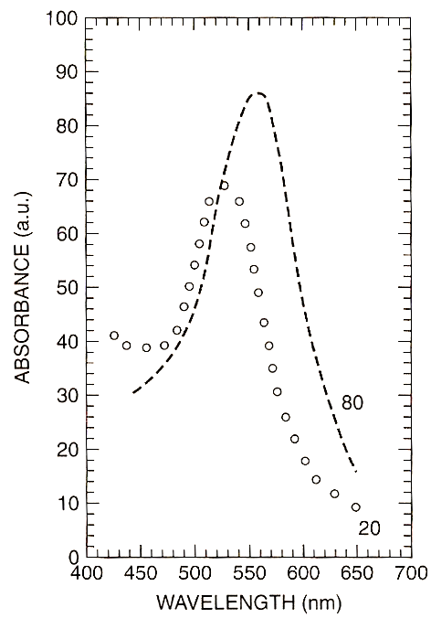
Optical Properties
Absorption spectra of spherical Au nanoparticles
Optical absorption spectrum of 20- and 80-nm gold nanoparticles embedded in glass.
[Adapted from F. Gonella et al., in Handbook of Nanostructured Material and Nanotechnology,
H. S. Nalwa, ed., Academic Press, San Diego, 2000, Vol. 4, Chapter 2, p.85.]

Slide 39
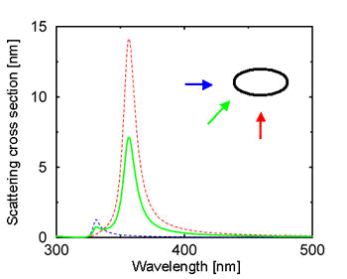
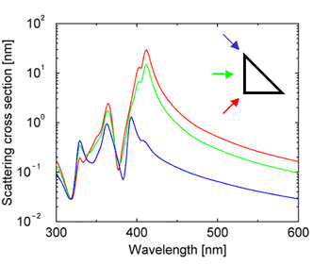
Optical Properties
Surface Plasmons: Shape dependence of absorption spectra
The amount of light that is scattered into the far field is described by the scattering cross section (SCS). The SCS is plotted against the wavelength of light used to illuminate a particle from a specific angle.
The arrows indicate the illumination angle, and their colors correspond to the different plot lines.
Martin, Olivier J.F. “Spectral response of plasmon resonant nanoparticles with non-regular shape”. Optics Express Col. 6. No. 11 May 2000

Slide 40
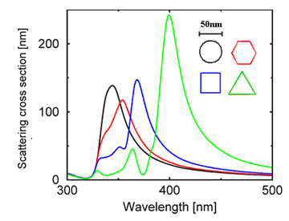
Optical Properties
Surface Plasmons: Shape dependence of absorption spectra
Triangular shaped nanoparticles produce plasmons with altered frequency and magnitude
Martin, Olivier J.F. "Plasmons". Plasmons. 22 Mar. 2006. Ecole Polytechnique Fédérale de Lausanne. 26 Jan. 2003.

Slide 41
Optical Properties
Energy levels: from atoms to bulk materials…
  The Pauli Exclusion Principle states that electrons can only exist in unique, discrete energy states.
  In an atom the energy states couple together through spin-orbit interactions to form the energy levels commonly discussed in an introductory chemistry course.
  When atoms are brought together in a bulk material, the energy states form nearly continuous bands of states, or in semiconductors and insulators, nearly continuous bands separated by an energy gap.
Atoms: Discrete Energy Levels
Bulk Materials: Band Structures
Energy
Energy
N

Slide 42
Optical Properties
Energy levels
  In semiconductors and insulators, the valance band corresponds to the ground states of the valance electrons.
  In semiconductors and insulators, the conduction band corresponds to excited states where electrons are a free to move about in the material and participate in conduction.
  In order for conduction to take place in a semiconductor, electrons must be excited out of the valance band, across the band gap into the conduction band. This process is called carrier generation.
  Conduction takes place due to the empty states in the valence band (holes) and electrons in the conduction band.
E_{c}
band gap
E_{v}
Electron excited into conduction band

Slide 43

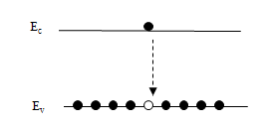

Optical Properties
Energy level spacing
  In semiconductors and insulators a photon with an energy equal to the band gap energy is emitted when an electron in the conduction band recombines with a hole in the valance band.
  The electronic band structure of a semiconductor dictates its optical properties.
  GaP, a material commonly used for green LEDs, has an intrinsic band gap of 2.26 eV. Carrier recombination across the gap results in the emission of 550 nm light.
E_{g} = 2.26 eV
λ=550 nm

Slide 44
Optical Properties
Energy level spacing and quantum confinement
  The reduction in the number of atoms in a material results in the confinement of normally delocalized energy states.
  Electron-hole pairs become spatially confined when the dimensions of a nanoparticle approach the de Broglie wavelength of electrons in the conduction band.
  As a result the spacing between energy bands of semiconductor or insulator is increased (Similar to the particle in a box scenario, of introductory quantum mechanics.)
Bulk Materials
Nano Materials
Energy
Increased band gap
E_{g}
E_{g}

Slide 45
Optical Properties
Energy level spacing and quantum confinement
  Semiconductor nanoparticles that exhibit 3 dimensional confinement in their electronic band structure are called quantum dots.
  What does this all mean?
    Quantum dots are band gap tunable.
    We can engineer their optical properties by controlling their size.
    For this reason quantum dots are highly desirable for biological tagging.

Slide 46
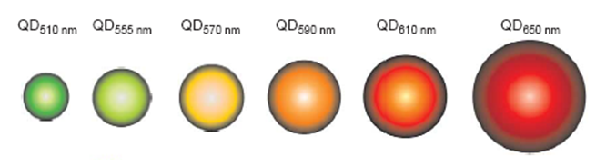
Optical Properties
Energy level spacing and quantum confinement
  As semiconductor particle size is reduced the band gap is increased.
  Absorbance and luminescence spectra are blue shifted with decreasing particle size.
CdSe quantum dots
Jyoti K. Jaiswal and Sanford M. Simon. Potentials and pitfalls of fluorescent quantum
dots for biological imaging. TRENDS in Cell Biology Vol.14 No.9 September 2004

Slide 47
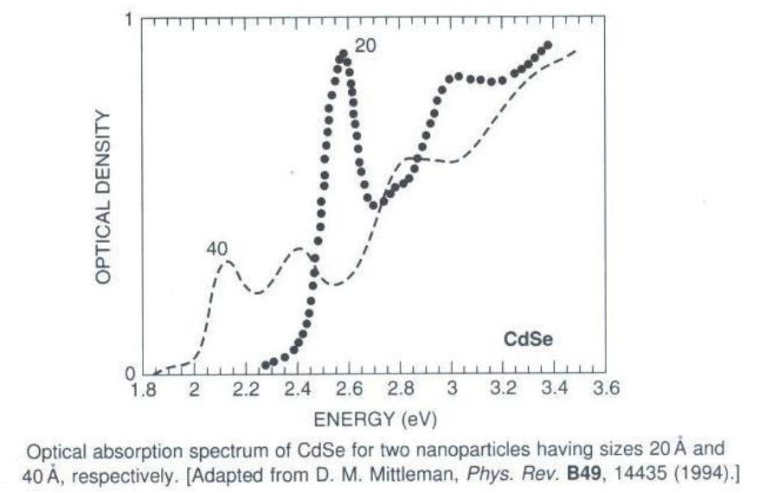
Optical Properties
Example: Absorption Spectra of CdSe quantum dots

Slide 48
Outline
Definition and Examples
Physical Properties
Optical Properties
Electrical Properties
Health Concerns

Slide 49
Electrical Properties
Effect of structure on conduction
  If nanostructures have fewer defects, one would expect increased conductivity vs macroscale
Other electrical effects on the nanoscale:
  Surface Scattering
  Change in Electronic Structure
  Ballistic Conduction
  Discrete Charging
  Tunneling Conduction
  Microstructural Effects

Slide 50
Surface Scattering
Electrons have a mean-free-path (MFP) in solid state materials.
MFP is the distance between scattering events as charge carriers move through the material.
In metals, the MFP is on the order of 10’s of nanometers.
If the dimensions of a nanostructure are smaller than the electron MFP, then surface scattering becomes a factor.

Slide 51
Surface Scattering
There are two types of surface scattering: elastic and inelastic.
Elastic scattering does not affect conductivity, while inelastic scattering decreases conductivity.
Elastic
Inelastic
Macroscale Material
d > MFP
Nanowire
d < MFP
MFP

Slide 52
Outline
Definition and Examples
Physical Properties
Optical Properties
Electrical Properties
Health Concerns

Slide 53
Potential Health Concerns
Cause for concern:
  Nanoparticles are similar in size to many biological structures → easily absorbed by the body.
  Nanoparticles remain suspended in the environment for extended periods of time.
Health Impacts of nanoparticles are expected to be dependant on composition and structure.

Slide 54
Potential Health Concerns
The potential health concerns of nanomaterials are largely unknown.
The EPA has started the National Nanotechnology Initiative which is providing funding to further investigate this issue.

