Slide 1

Light Trapping

Slide 2
Outline
Flat solar cells
  ARC for flat solar cells
  Manifestations of Fabry Perot Resonances
Light trapping
  Advantage of a nanodome
  Yablonovitch limit
  Bloch modes
  Diffraction aided waveguiding
  Mie resonances
  Hybridizations
  Plasmonics
Examples

Slide 3
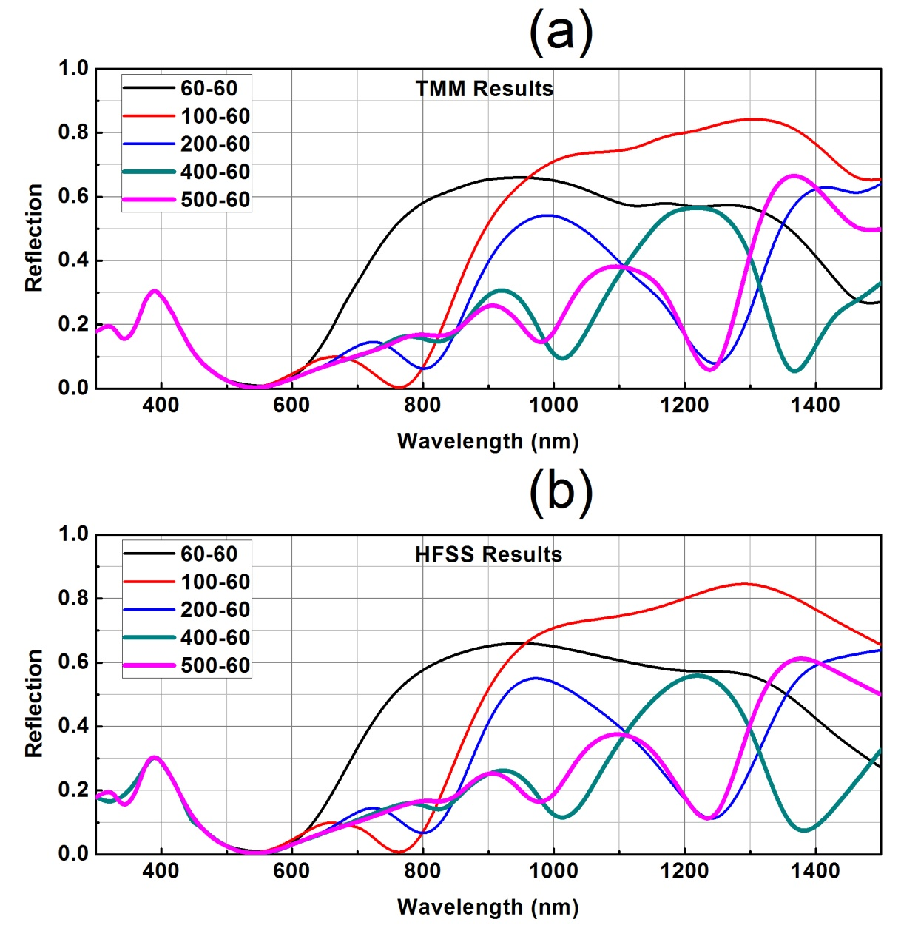
Flat Solar Cells
Antireflection Coating
light
ARC (60nm)
ZnO
t
PbS
metal

Slide 4


Flat Solar Cells: Manifestations of Fabry Perot Resonances
light
ZnO
t₂=500nm
h: height
PbS (absorber)
r: radius
t₁=100nm
L: period
Au

Slide 5
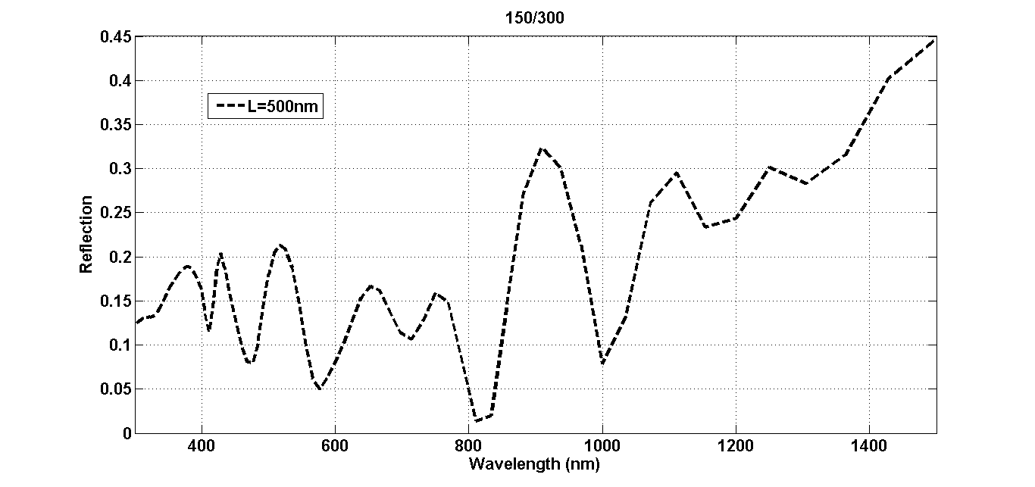
Flat Solar Cells: Manifestations of Fabry Perot Resonances
r/h
What can be the sources of these peaks?

Slide 6
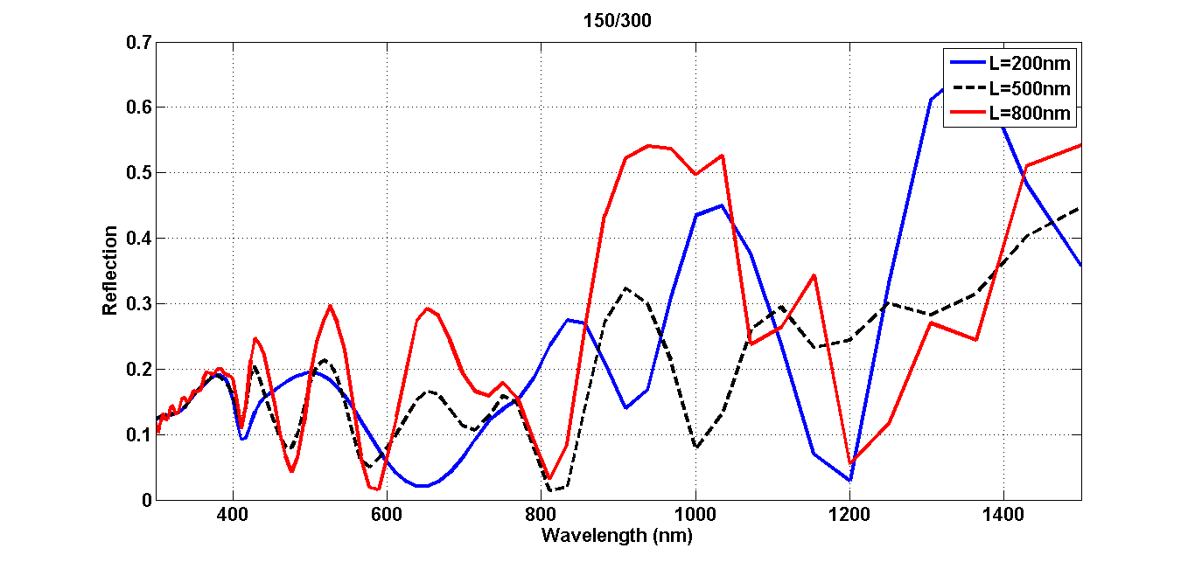
Flat Solar Cells: Manifestations of Fabry Perot Resonances
Resemblance?

Slide 7
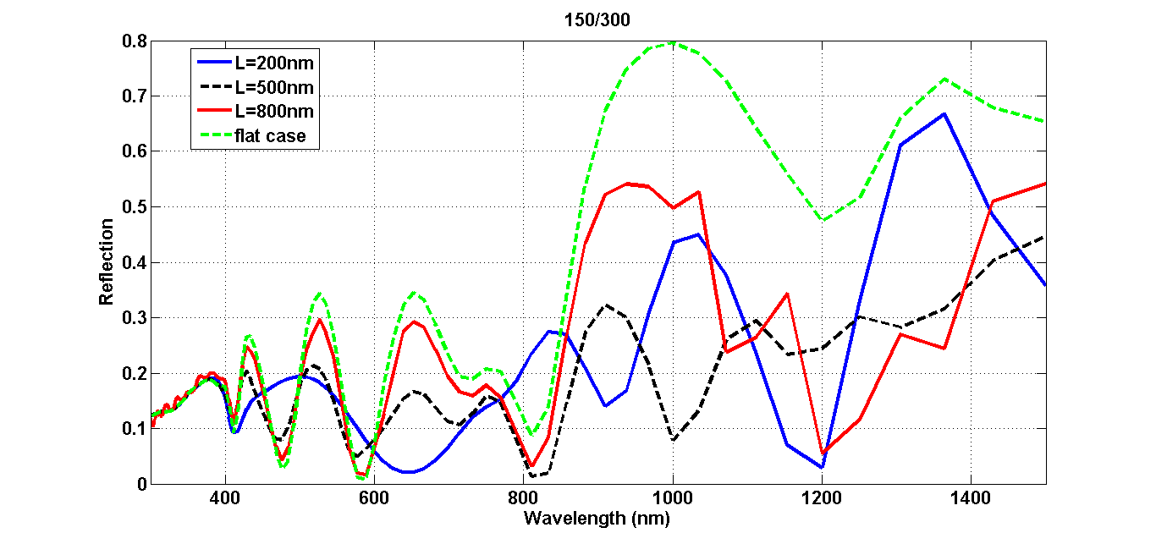
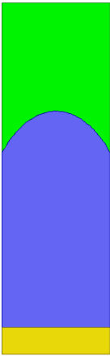

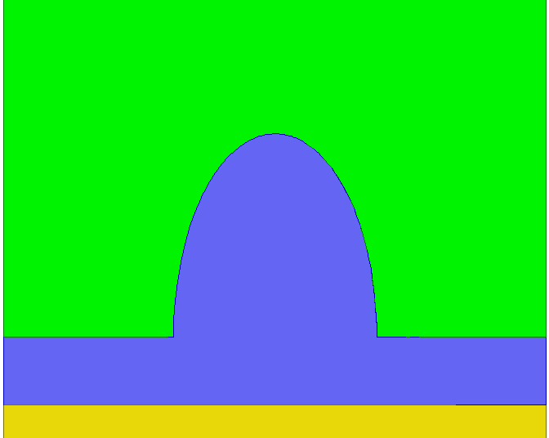
Flat Solar Cells: Manifestations of Fabry Perot Resonances
200nm
500nm
800nm

Slide 8
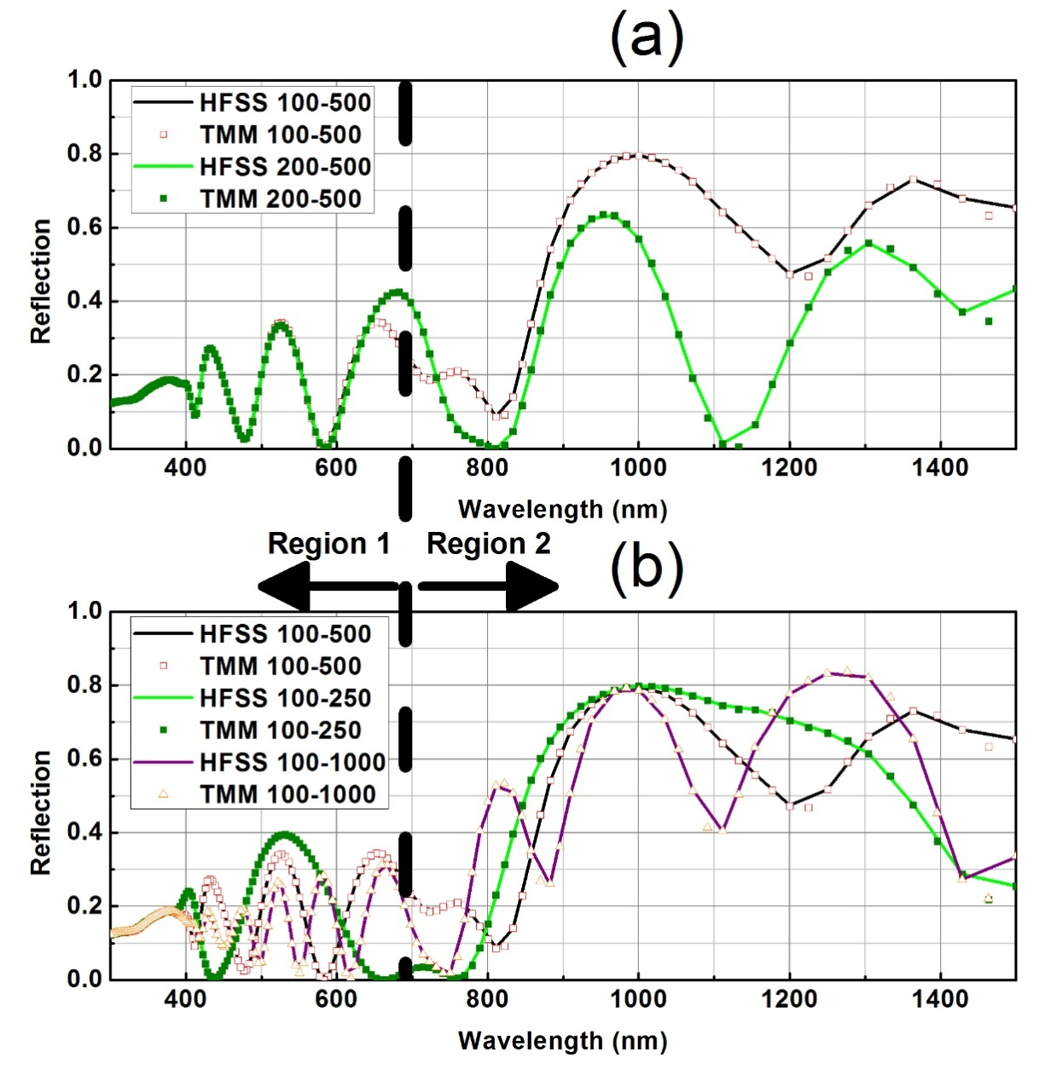

Flat Solar Cells: Manifestations of Fabry Perot Resonances
t₁
t₂

Slide 9
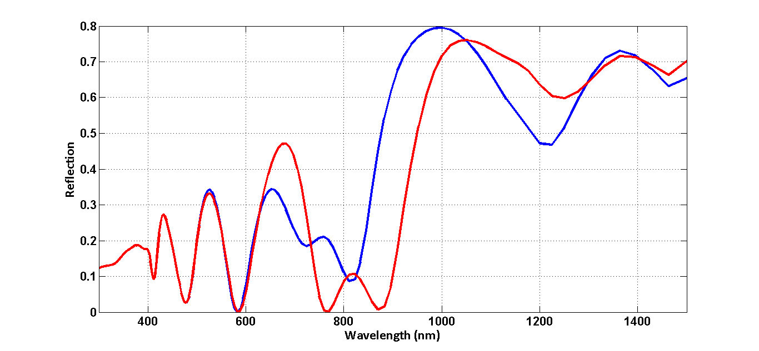
Flat Solar Cells: Manifestations of Fabry Perot Resonances
Flat cells: Increasing t₁ to 125nm from 100nm
Shift R_{peak}
Cutoff wavelength

Slide 10
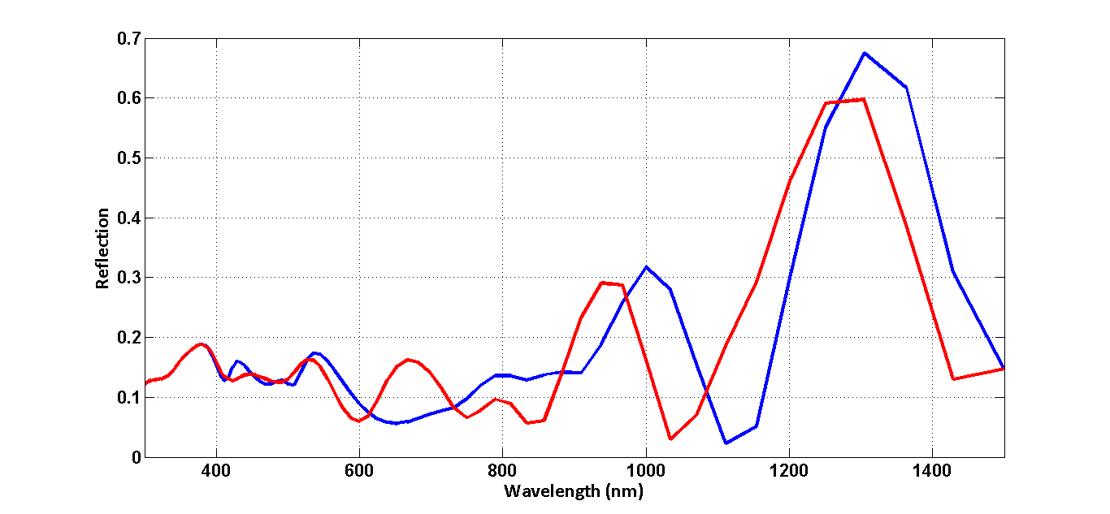
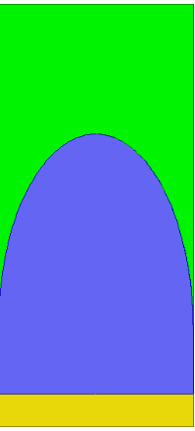
Flat Solar Cells: Manifestations of Fabry Perot Resonances
150/300
L=300nm
L=400nm
Killing FP ringings
Shifting FP peaks outside of cutoff wavelength
L=Ltouch

Slide 11
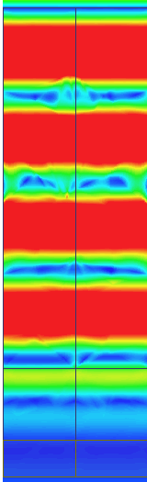
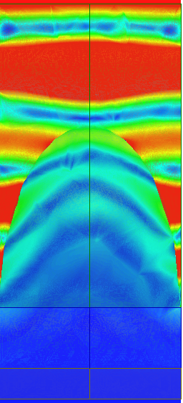
Light trapping: Advantage of a nanodome
Same effective
thickness: a jump
from 30 to 37 mA/cm²
ZnO
ZnO
PbS
PbS
metal
metal
Flat layers
Dome case
Increasing optical length, wavefront shaping
Focusing
Increasing the absorber volume

Slide 12
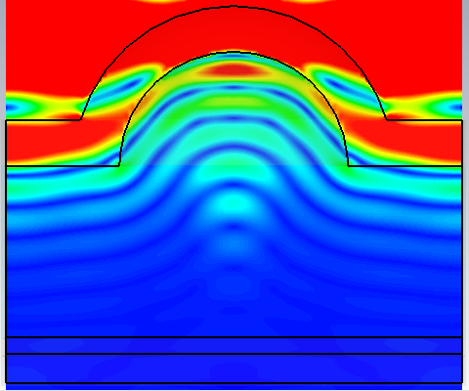
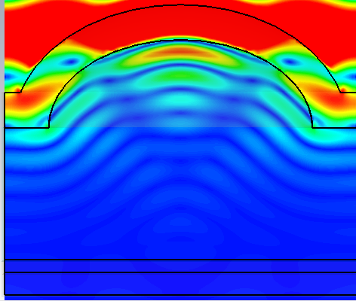
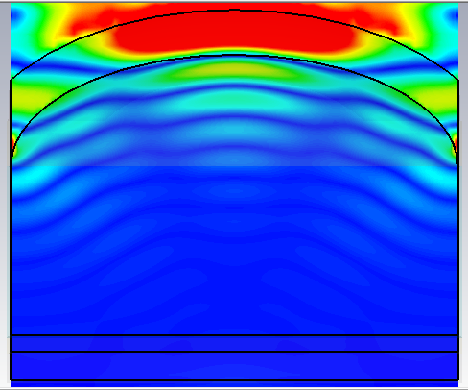
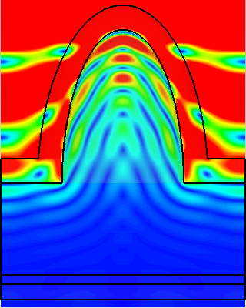
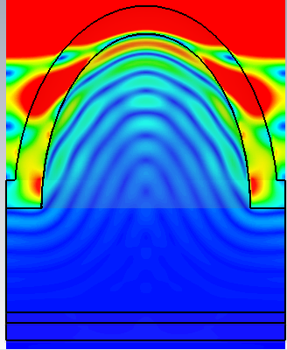
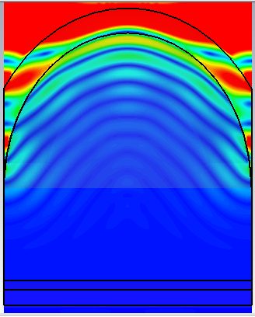
Light trapping: Advantage of a nanodome
L=Ltouch
High aspect ratio

Slide 13
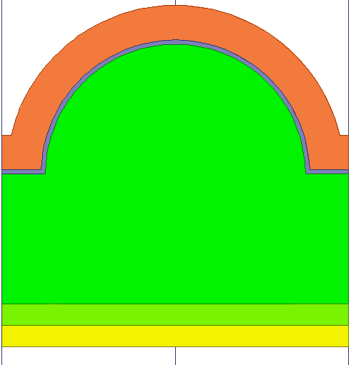
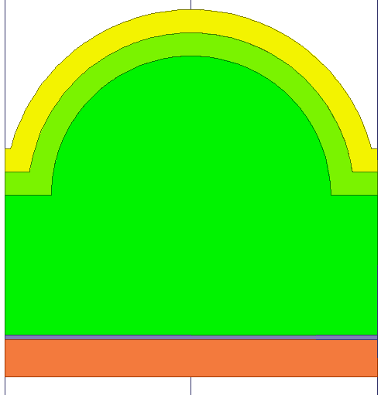
Light trapping: Advantage of a nanodome
light
Superstrate configurations
300nm
300nm
AZO=>80nm
Au=>50nm
TiO2=>10nm
NiO=>50nm
600nm
600nm
nSi=>300nm
nSi=>300nm
NiO=>50nm
TiO2=>10nm
Au=>50nm
AZO=>80nm
Substrate configurations
light

Slide 14
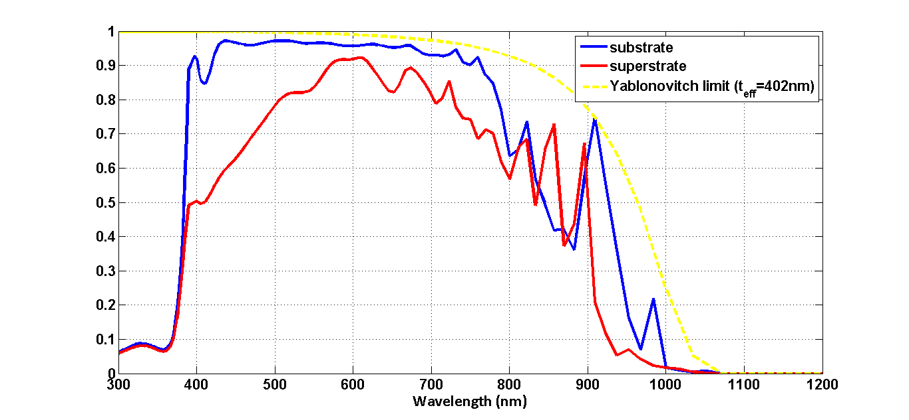
Light trapping: Advantage of a nanodome
Short wavelengths

Slide 15
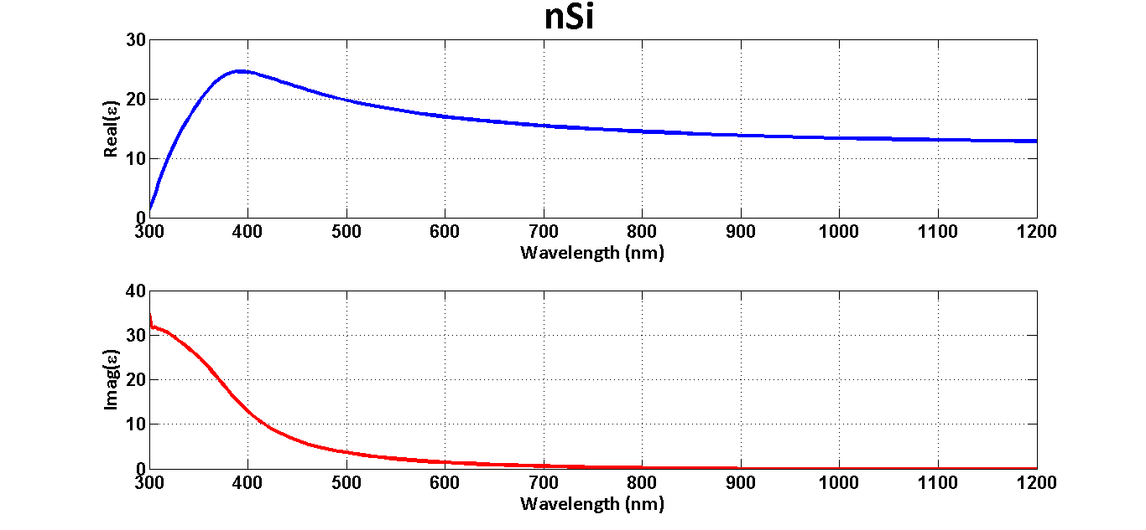
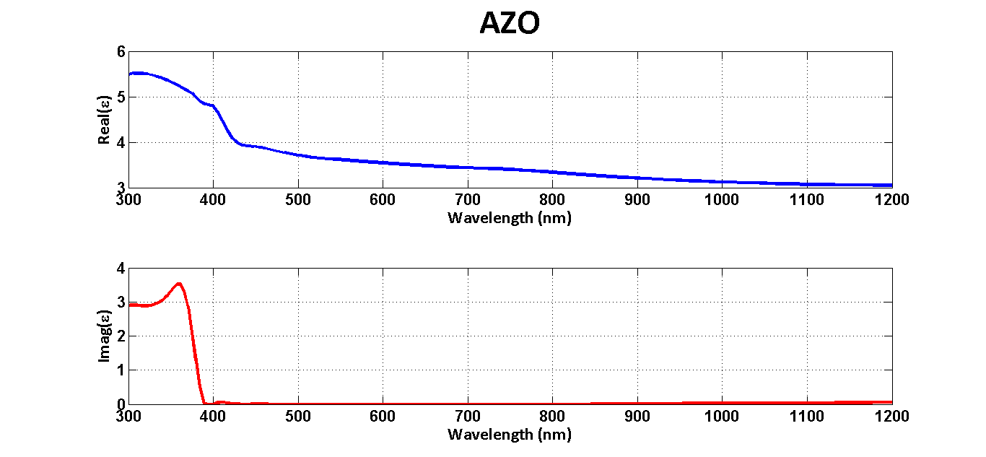
Light trapping: Advantage of a nanodome

Slide 16
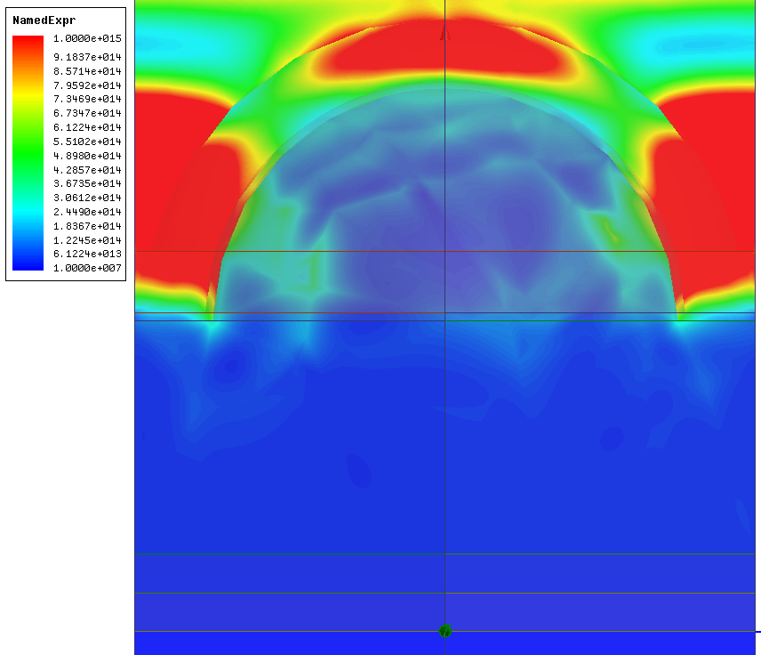
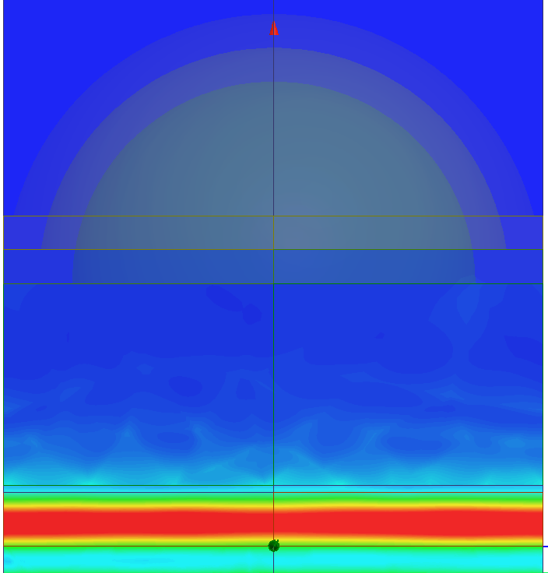
Light trapping: Advantage of a nanodome
(E-field)² @ 458nm – 650 THz
Substrate | Superstrate
All intensity plots are on the same scale

Slide 17
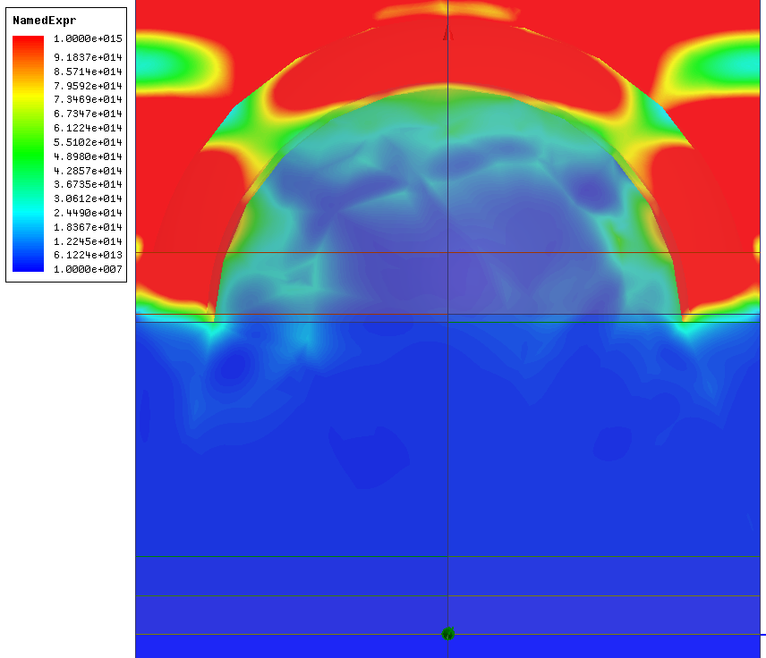
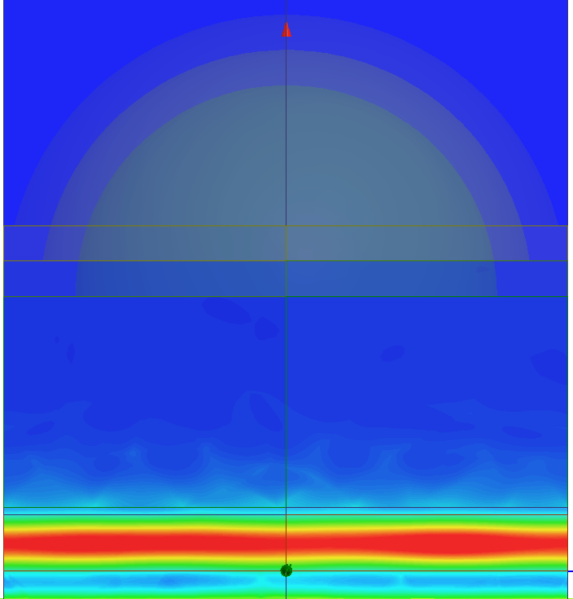
Light trapping: Advantage of a nanodome
(E-field)² @ 434nm – 690 THz
Substrate | Superstrate
All intensity plots are on the same scale

Slide 18
Light trapping: Yablonovitch limit
light
Paper: E. Yablonovitch, J. Opt. Soc. Am. vol. 72, 899, 1982

Slide 19
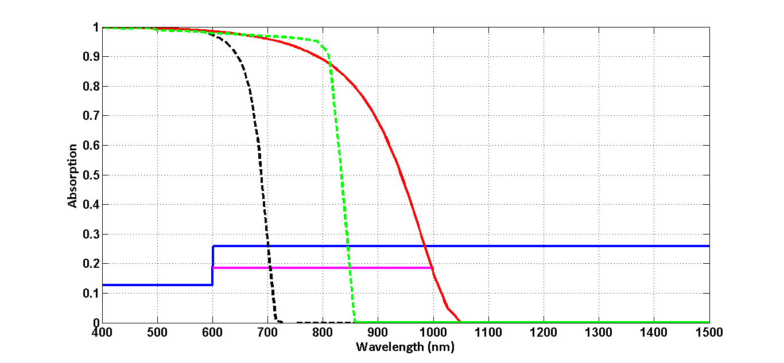
Light trapping: Yablonovitch limit
Short wavelength
Long wavelength
aSi: 7.3mA, 600-700nm
CdTe: 17.3mA, 600-850nm
nSi: 27.6mA 600-1050nm
aSi
CdTe
nSi
400-600nm: 11.84mA/cm²
600-1500nm: 39.26mA/cm²
600-1000nm: 24.8mA/cm²
Long wavelength
Yablonovitch limited absorption curves for h=250nm

Slide 20
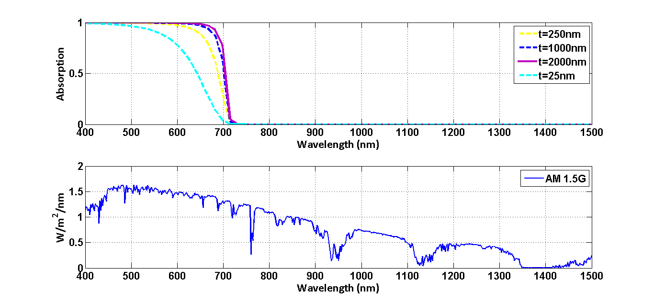
Light trapping: Yablonovitch limit
aSi
Absorber thickness | Jsc (mA/cm²)
25nm | 14.01
250nm | 17.61
500nm | 18.24
1000nm | 18.73
2000nm | 19.07
Mostly governed by short wavelength response

Slide 21
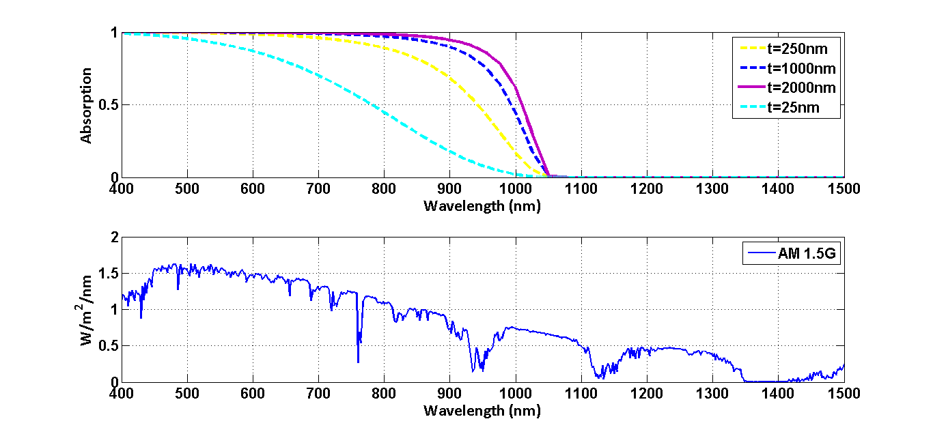
Light trapping: Yablonovitch limit
nSi
Absorber thickness | Jsc (mA/cm²)
25nm | 23.1
250nm | 32.32
500nm | 34
1000nm | 35.33
2000nm | 36.37
Mostly governed by long wavelength response

Slide 22
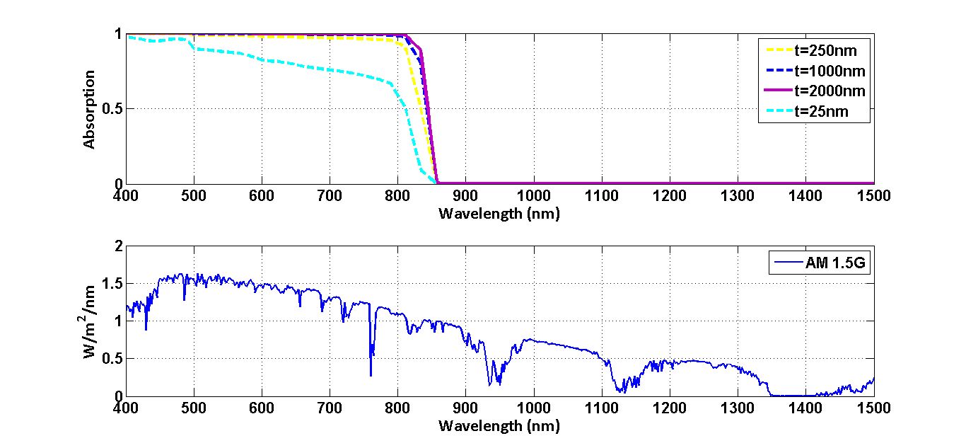
Light trapping: Yablonovitch limit
CdTe
Absorber thickness | Jsc (mA/cm²)
25nm | 22.12
250nm | 27.36
500nm | 27.93
1000nm | 28.31
2000nm | 28.54
Governed by short wavelength response

Slide 23
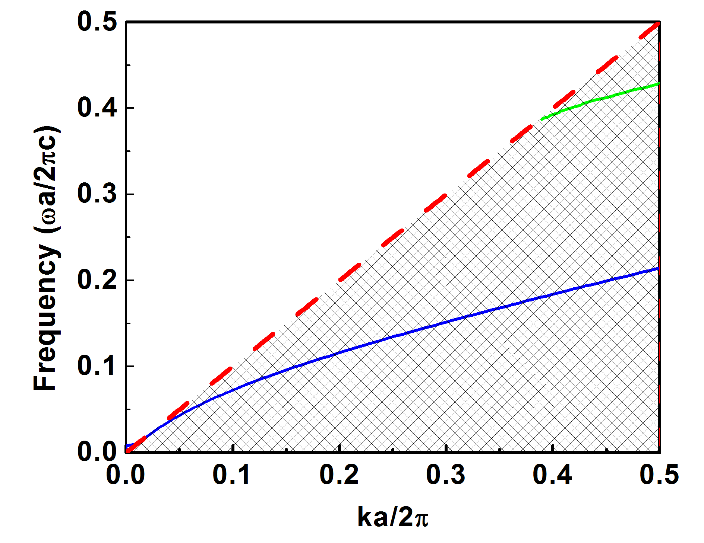
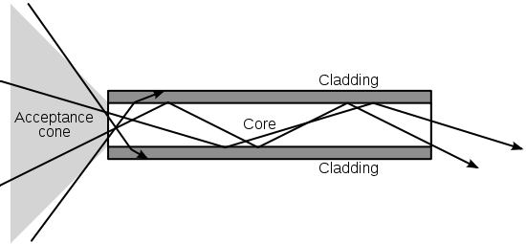
Light trapping: Bloch modes
(a)
Slab modes
Odd mode
Air line
Even mode
Fig. 1
slab
k
- Fig. 1 taken from: http://photonicswiki.org/index.php?title=File:Optical-fibre.svg

Slide 24
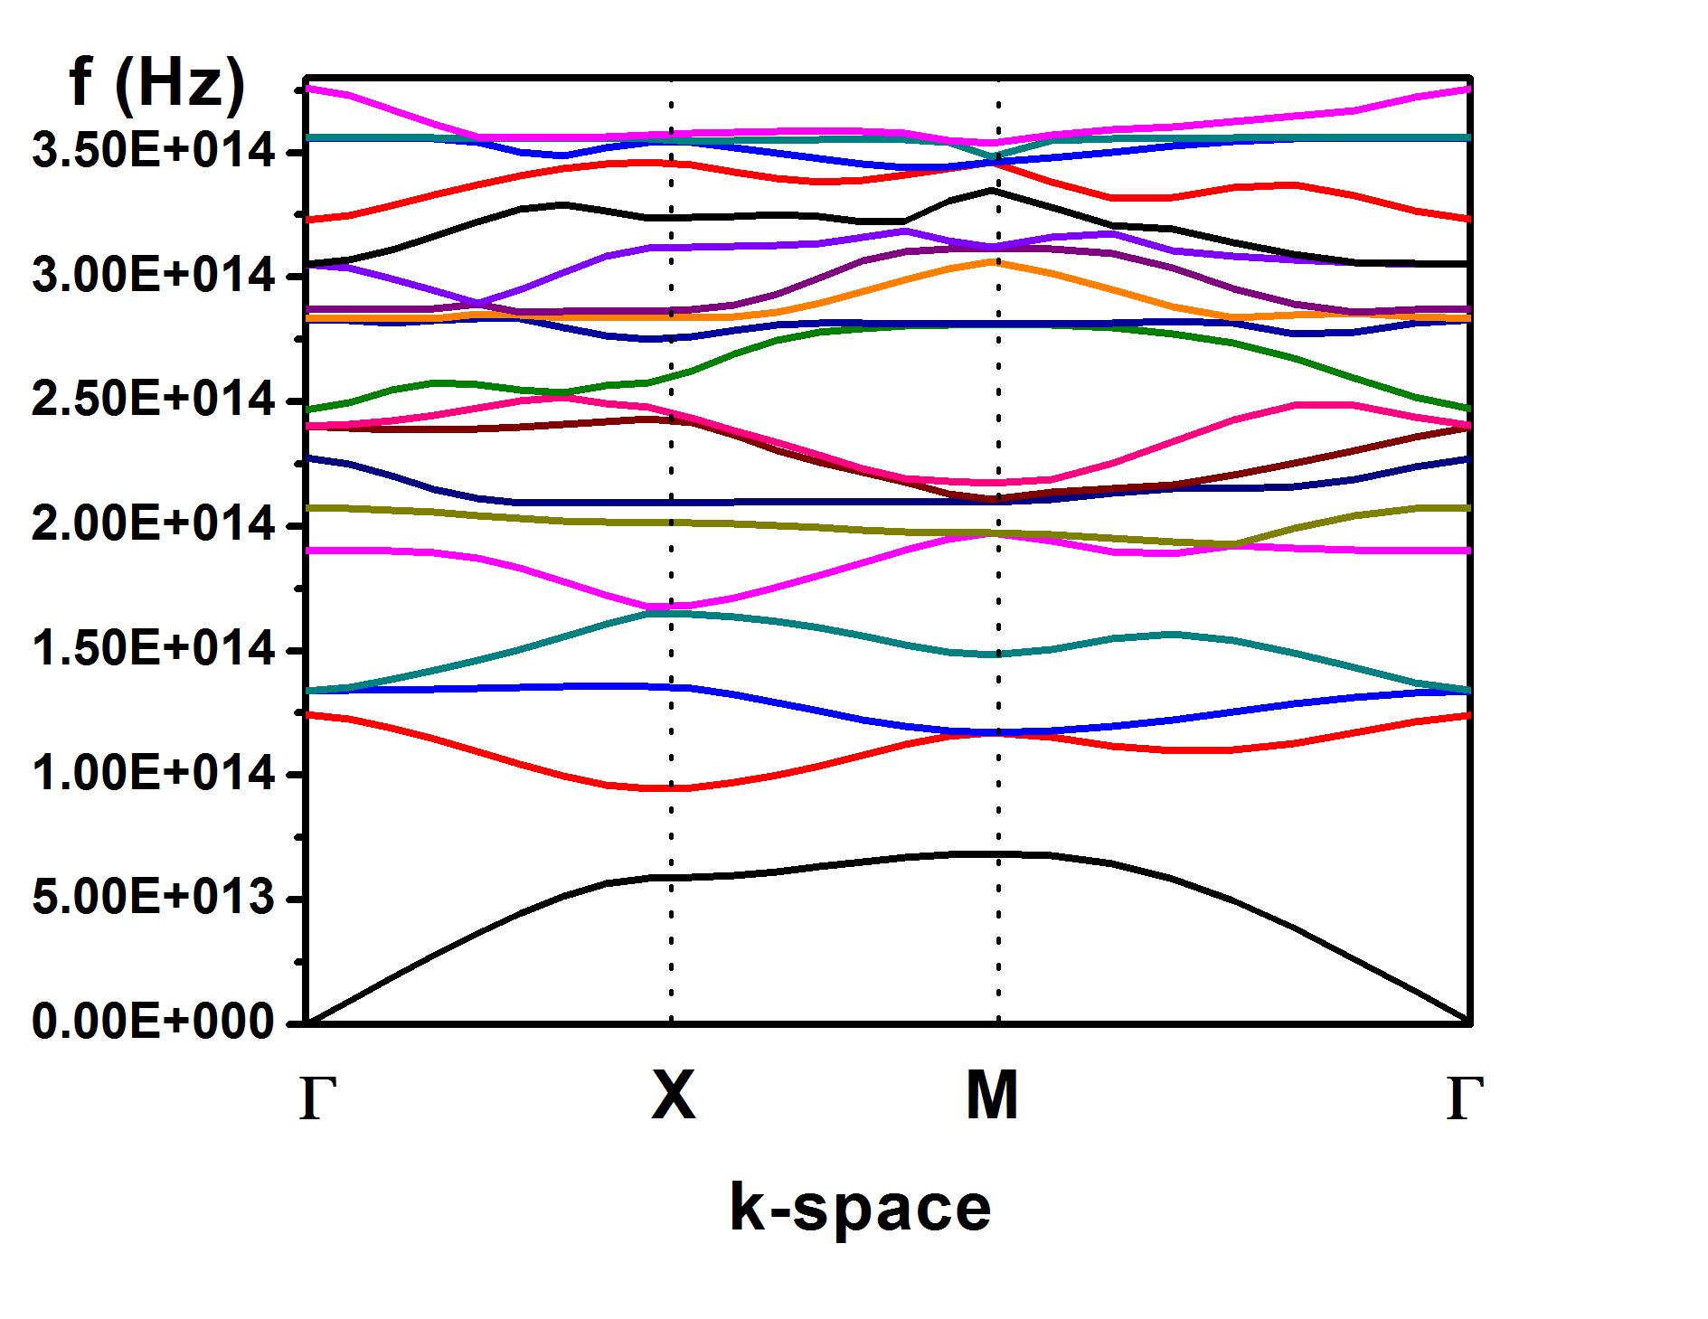
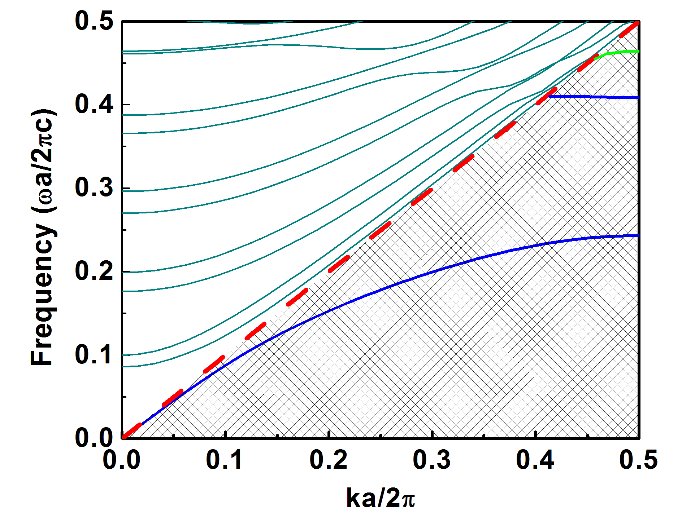
Light trapping: Bloch modes
(b)
Scatterer modes
Continous modes
Coupled to air
k

Slide 25
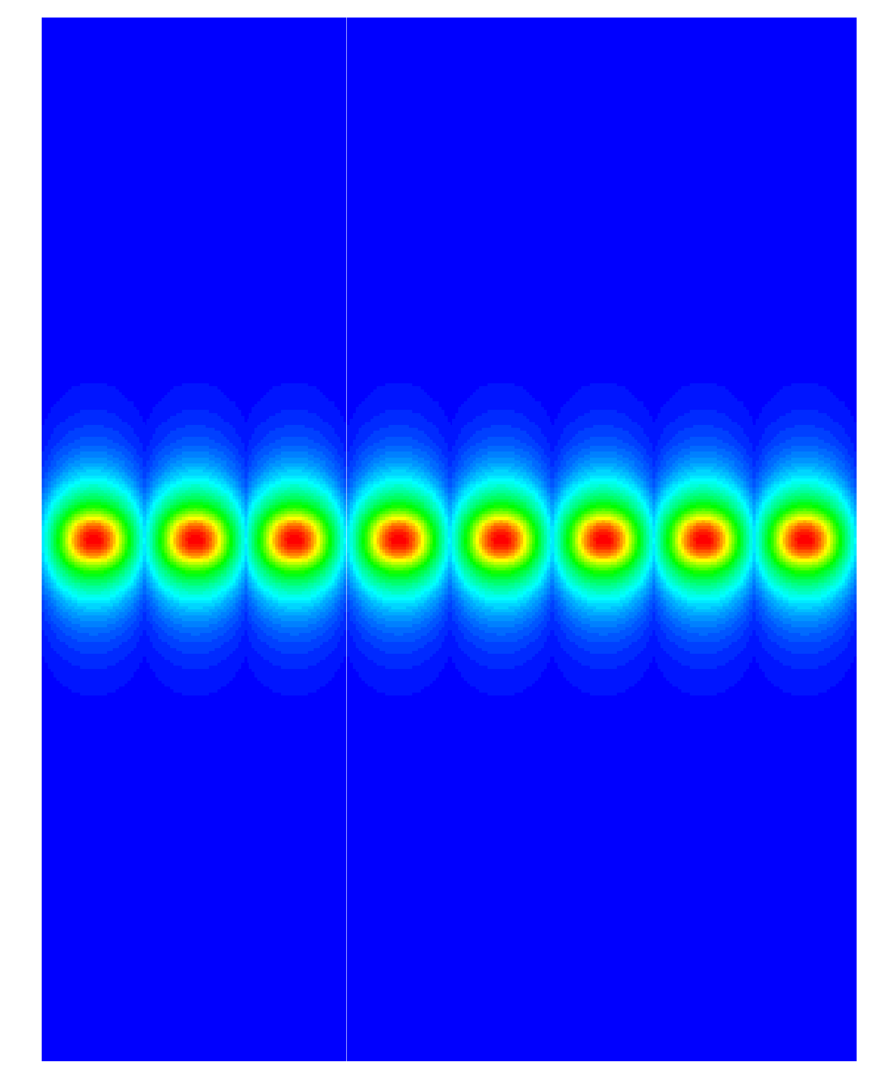
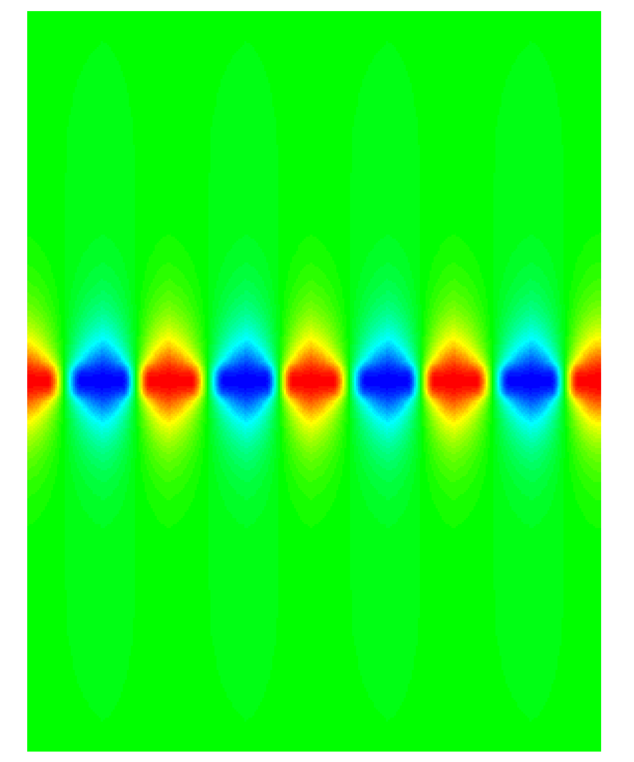
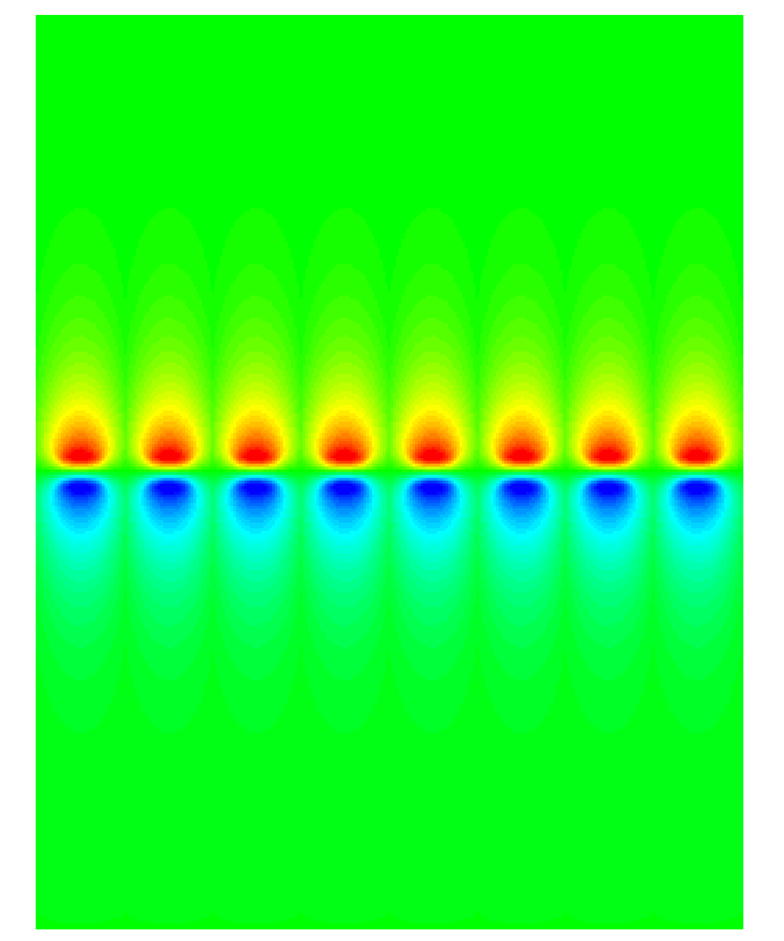
Light trapping: Bloch modes
Even mode 1
Even mode 2
Odd mode
z
x

Slide 26
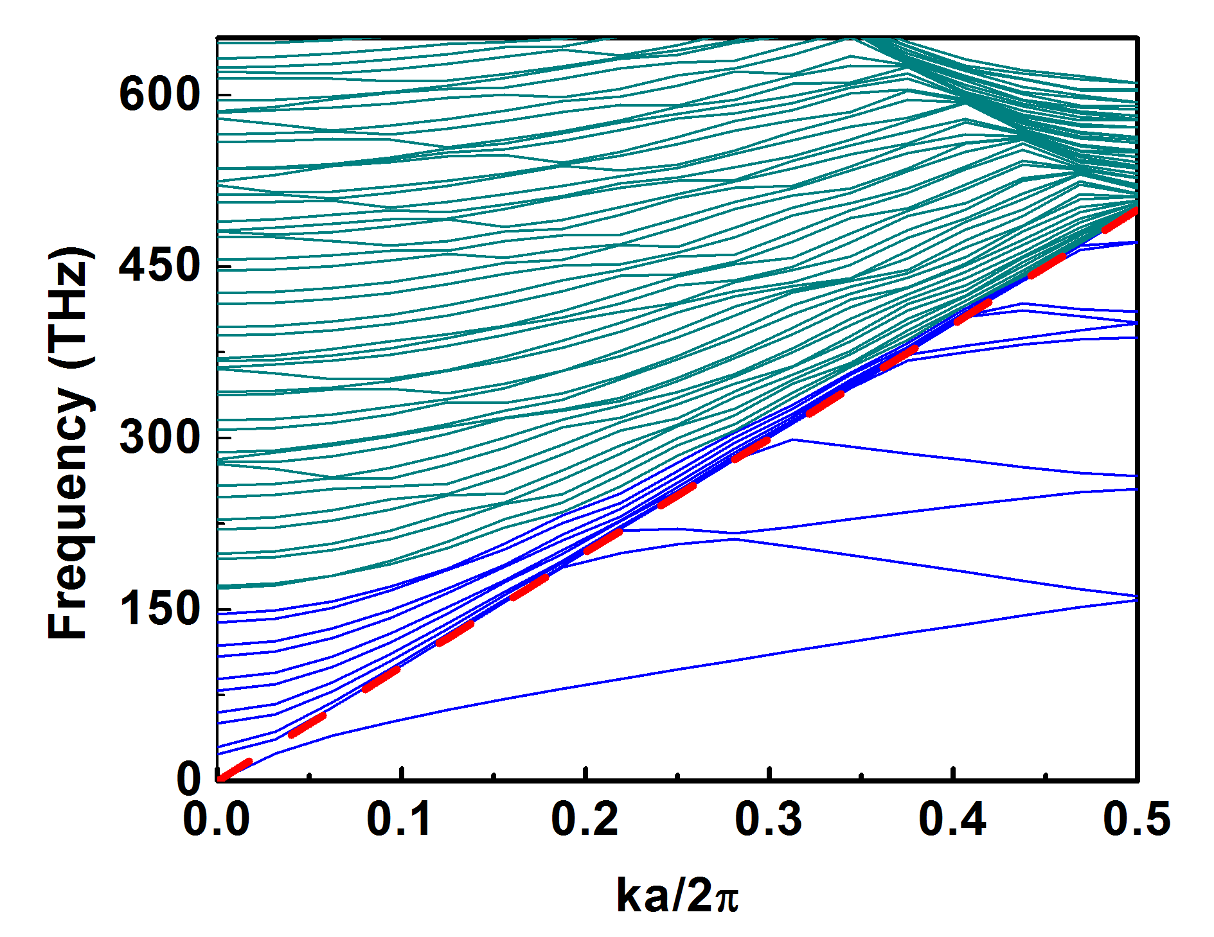

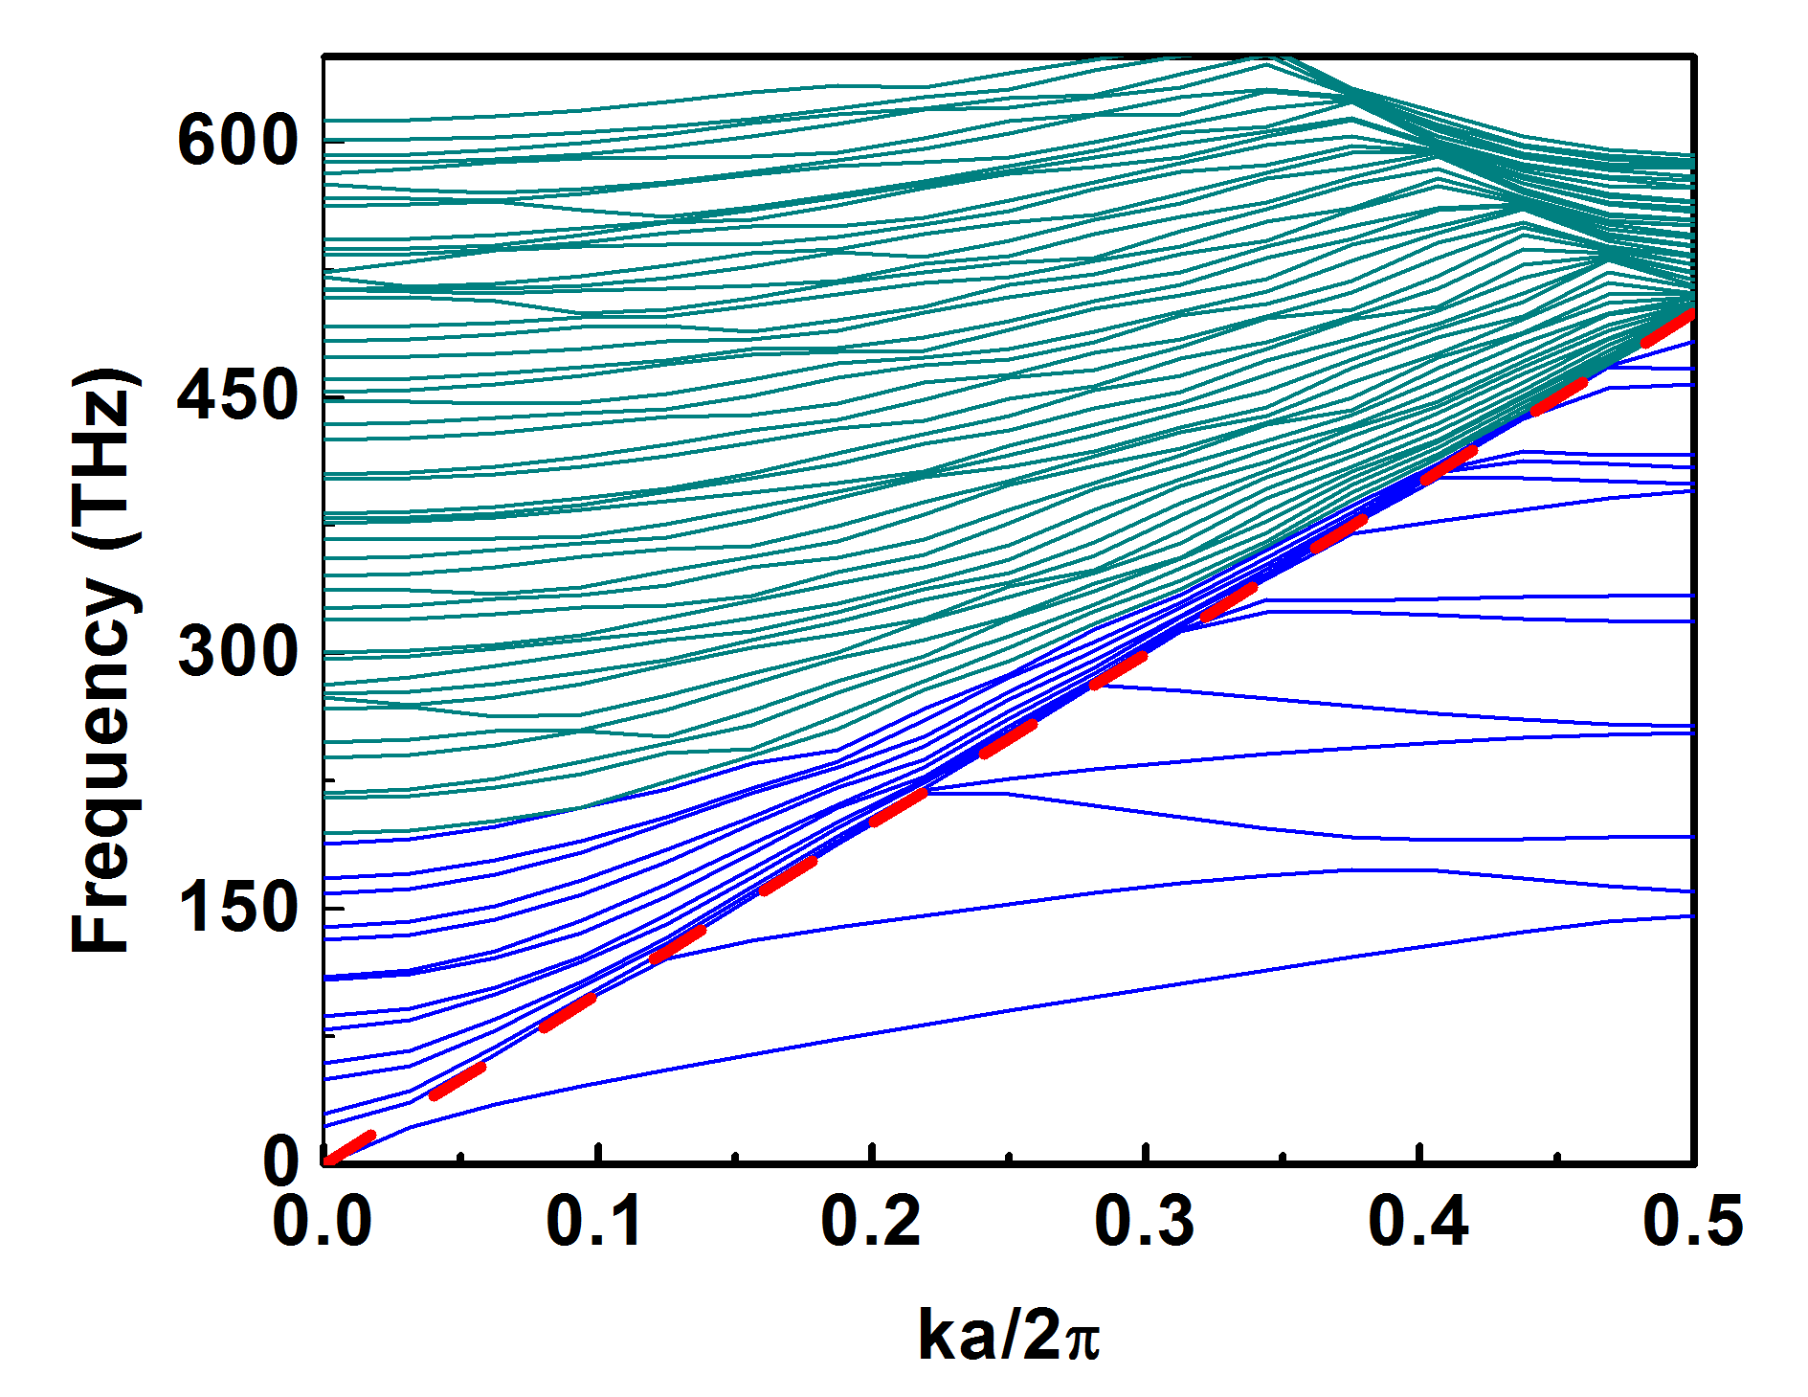
Light trapping: Bloch modes
Starts to get
separated
folding
Gets separated
L=300nm, w= 150nm, d2=200nm, d1=20nm (left), d1=100nm (middle), d1=200nm (right)
nSI
air
d₁
w
nSi (200nm)
L

Slide 27
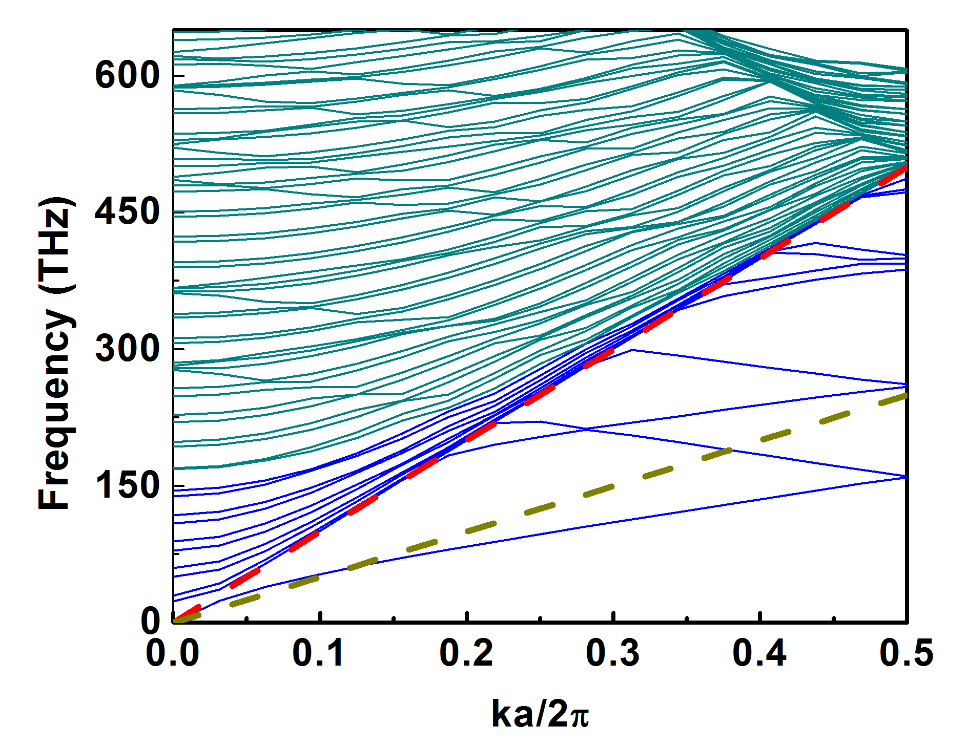


Light trapping: Bloch modes
L=300nm, w= 150nm, d2=200nm, d1=20nm (left), d1=100nm (middle), d1=200nm (right)
air
nSI
d₁
air
w
ZnO (80nm)
nSi (200nm)
L

Slide 28


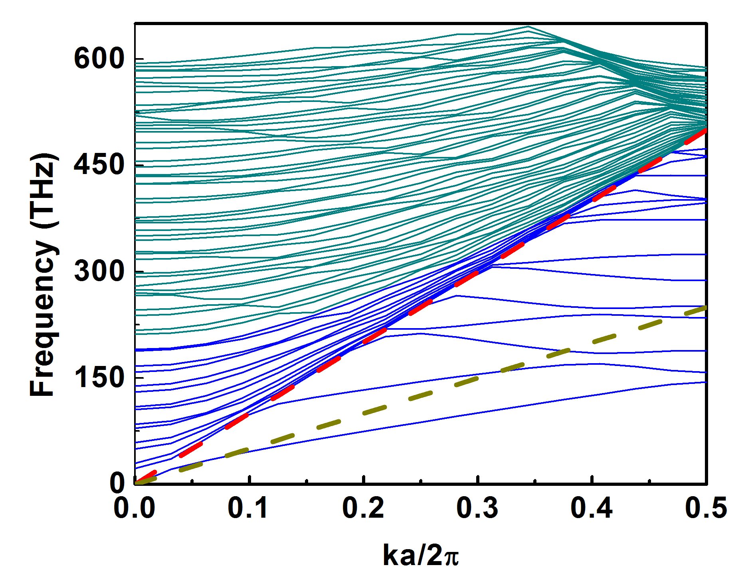
Light trapping: Bloch modes
L=300nm, w= 150nm, d2=200nm, d1=20nm (left), d1=100nm (middle), d1=200nm (right)
air
nSI
ZnO (80nm)
d₁
air
w
nSi (200nm)
L

Slide 29
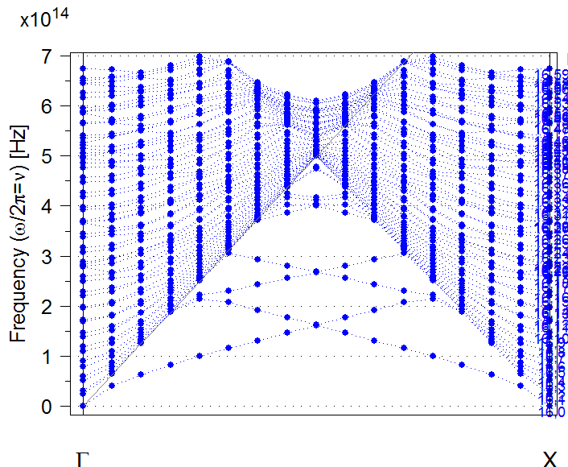
Light trapping: Bloch modes
nSI
air
d₁
w
nSi (200nm)
L

Slide 30
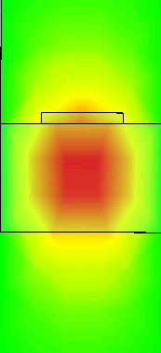
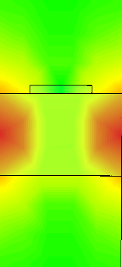
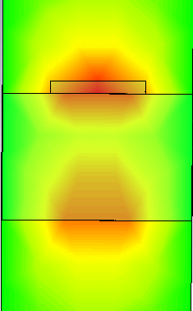
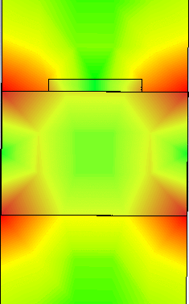

Light trapping: Bloch modes
Air mode
Bloch modes

Slide 31
Light trapping: Diffraction aided Waveguiding
Light at normal incidence
nSI
air
Coupled tangential k
d₂
w
Outgoing
tangential
Incoming
tangential
Phase
term
nSi (200nm)
L

Slide 32
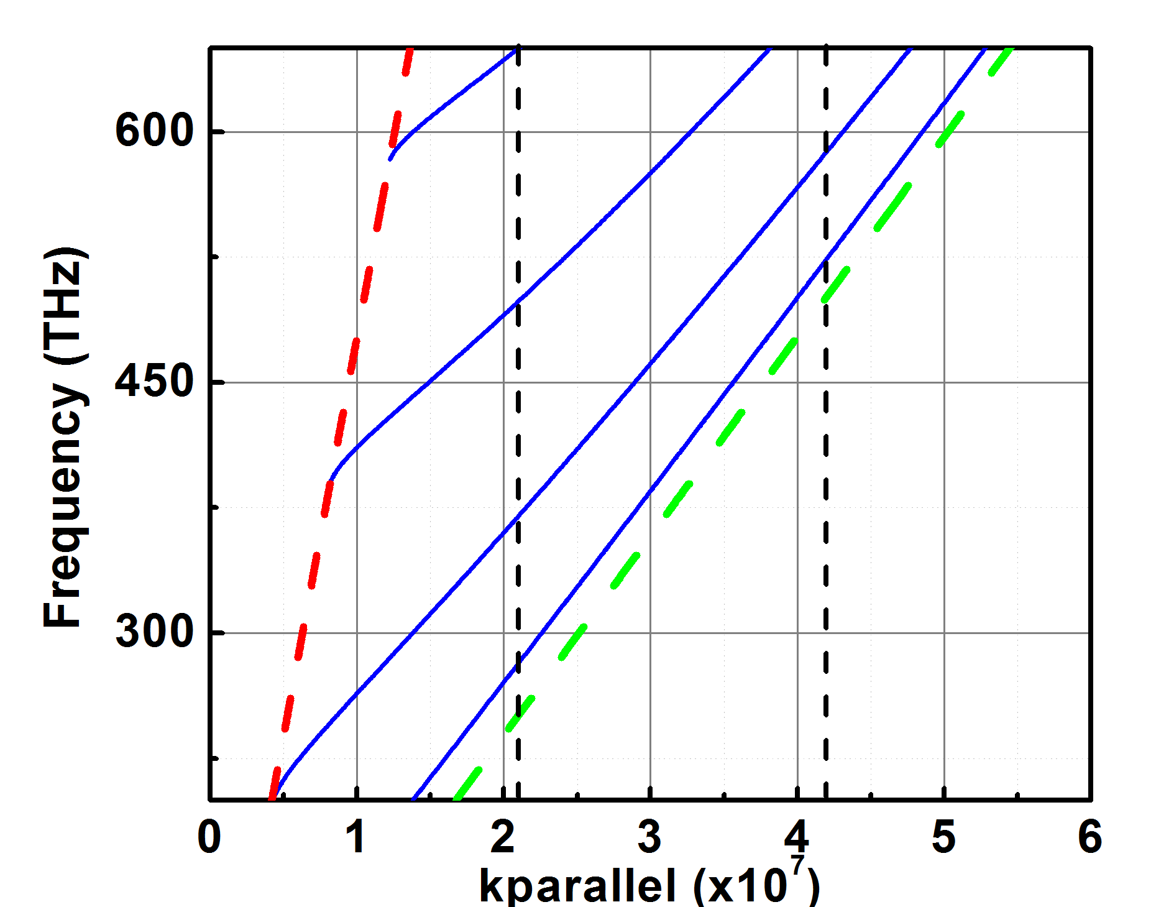
Light trapping: Diffraction aided Waveguiding
Diffraction order, mode number | Frequency (THz)
1st order diffraction, 1st mode | 282
1st order diffraction, 2nd mode | 369
1st order diffraction, 3rd mode | 496
1st order diffraction, 4th mode | 647
2nd order diffraction, 1st mode | 524
2nd order diffraction, 2nd mode | 587
perturbation

Slide 33
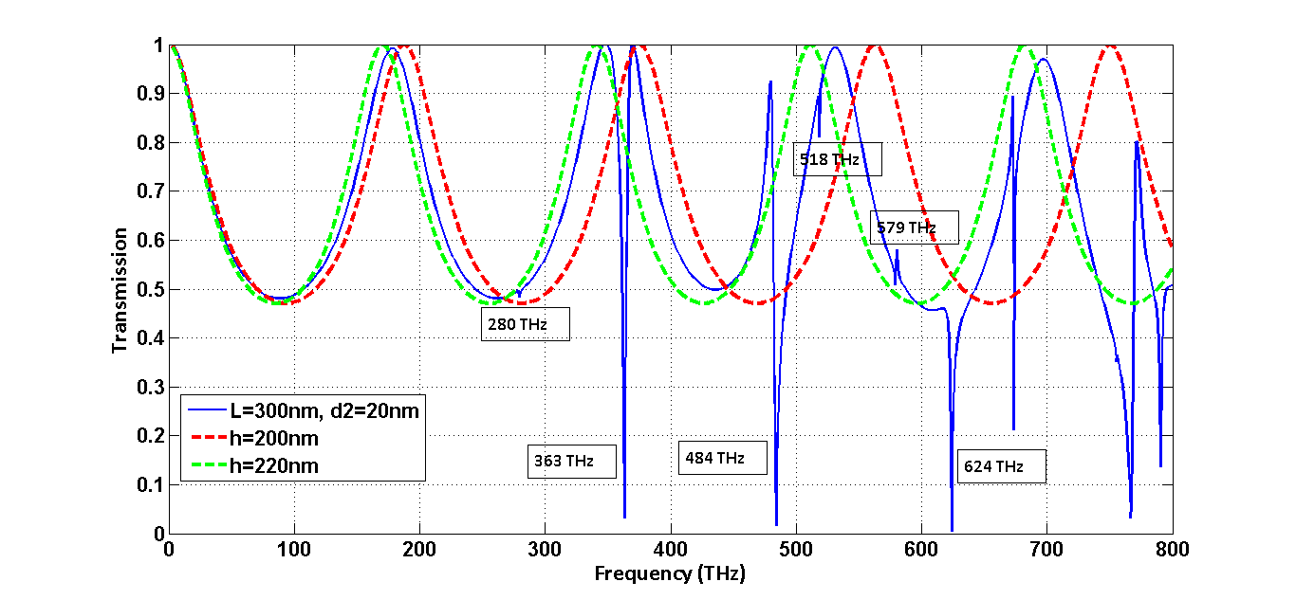
Light trapping: Diffraction aided Waveguiding
Flat layers

Slide 34


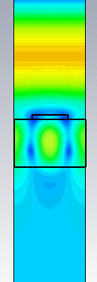


Light trapping: Diffraction aided Waveguiding
100 THz
200 THz
280 THz
363 THz
484 THz

Slide 35




Light trapping: Diffraction aided Waveguiding
518 THz
579 THz
600 THz
624 THz

Slide 36

Light trapping: Diffraction aided Waveguiding
nSI
d₁
air
w
ZnO (80nm)
nSi (200nm)
L
Diffraction order, mode number | Frequency (THz)
1st order diffraction, 1st mode | 279
1st order diffraction, 2nd mode | 363
1st order diffraction, 3rd mode | 485
2nd order diffraction, 1st mode | 524
2nd order diffraction, 2nd mode | 585

Slide 37


Light trapping: Mie resonances
AZO
nSi
nanowire
air

Slide 38



Light trapping: Mie resonances
AZO
nSi
nanowire
nSi slab
Without slab
Without slab
metal

Slide 39



Light trapping: Hybridization
AZO
1000nm nSi

Slide 40


Light trapping: Hybridization
Mie/Bloch wave Hybridization

Slide 41


Light trapping: Hybridization
Waveguiding

Slide 42


Light trapping: Hybridization
Mie/Bloch wave Hybridization

Slide 43



Light trapping: Hybridization
Mie Hybridization

Slide 44





Light trapping: Hybridization
1
2
3
4
Smaller nanowire/dome

Slide 45



Light trapping: Hybridization
Longer L

Slide 46



Light trapping: Hybridization
ω
ZnO
ncSi
k
The effect of L spacing

Slide 47


Light trapping: Hybridization
Shorter L

Slide 48



Light trapping: Hybridization
Waveguide thickness

Slide 49

Light trapping: Hybridization
ω
ZnO
nc-Si
k
The effect of waveguide thickness

Slide 50

Light trapping: Hybridization

Slide 51

Light trapping: Hybridization

Slide 52

Light trapping: Hybridization

Slide 53

Light trapping: Plasmonics
losses

Slide 54

Light trapping: Plasmonics

Slide 55

Examples: Mie Resonances
Introduction of a leaky channel into the substrate
sphere
cylinder
Fig. 2
Fig. 2: “Broadband omnidirectional antireflection coating based on subwavelength surface Mie resonators” P. Spinelli, M. A. Verschuuren, A. Polman, Nature Comm. 3, 692 (2012).

Slide 56

Examples: Mie Resonances
Bare Si
With 60nm ARC
from 40º
Fig. 3
Fig. 3: “Broadband omnidirectional antireflection coating based on subwavelength surface Mie resonators” P. Spinelli, M. A. Verschuuren, A. Polman, Nature Comm. 3, 692 (2012).

Slide 57

Examples: Mie Resonances
ARC tuned for UV-blue
Scattering after 800nm
Red-shift
Fig. 4
Fig. 4: “Broadband omnidirectional antireflection coating based on subwavelength surface Mie resonators” P. Spinelli, M. A. Verschuuren, A. Polman, Nature Comm. 3, 692 (2012).

Slide 58

Examples: Hybridization
Fig. 5
Fig. 5: “Nanophotonics light trapping with patterned transparent conductive oxides” A. P. Vasudev, J. A. Schuller, M. L. Brongersma Optics Express 10, A385-A394 (2012).

Slide 59

Examples: Hybridization
Fig. 6
Fig. 6: “Nanophotonics light trapping with patterned transparent conductive oxides” A. P. Vasudev, J. A. Schuller, M. L. Brongersma Optics Express 10, A385-A394 (2012).

Slide 60

Examples: Hybridization
Fig. 7
Fig. 7: “Nanophotonics light trapping with patterned transparent conductive oxides” A. P. Vasudev, J. A. Schuller, M. L. Brongersma Optics Express 10, A385-A394 (2012).

Slide 61

Examples: Hybridization
Fig. 8
Fig. 8: “Nanophotonics light trapping with patterned transparent conductive oxides” A. P. Vasudev, J. A. Schuller, M. L. Brongersma Optics Express 10, A385-A394 (2012).

Slide 62

Examples: Plasmonics
Fig. 9
Fig. 9: “Light trapping in ultrathin plasmonic solar cells” V. E. Ferry, M. A. Verschuuren, H. B. T. Li, E. Verhagen, R. J. Walters, R. E. I. Schropp, H. A. Atwater, A. Polman Optics Express 18, A237-A245 (2010).

Slide 63

Examples: Plasmonics
Fig. 10
Fig. 10: “Light trapping in ultrathin plasmonic solar cells” V. E. Ferry, M. A. Verschuuren, H. B. T. Li, E. Verhagen, R. J. Walters, R. E. I. Schropp, H. A. Atwater, A. Polman Optics Express 18, A237-A245 (2010).

Slide 64

Examples: Plasmonics
Fig. 10
Fig. 10: “Light trapping in ultrathin plasmonic solar cells” V. E. Ferry, M. A. Verschuuren, H. B. T. Li, E. Verhagen, R. J. Walters, R. E. I. Schropp, H. A. Atwater, A. Polman Optics Express 18, A237-A245 (2010).

Slide 65

Examples: Plasmonics
simulation
measurement
Fig. 11
Fig. 11: “Light trapping in ultrathin plasmonic solar cells” V. E. Ferry, M. A. Verschuuren, H. B. T. Li, E. Verhagen, R. J. Walters, R. E. I. Schropp, H. A. Atwater, A. Polman Optics Express 18, A237-A245 (2010).

Slide 66

Examples: Plasmonics
Fig. 12
Fig. 12: “Light trapping in ultrathin plasmonic solar cells” V. E. Ferry, M. A. Verschuuren, H. B. T. Li, E. Verhagen, R. J. Walters, R. E. I. Schropp, H. A. Atwater, A. Polman Optics Express 18, A237-A245 (2010).

Slide 67

Examples: Waveguiding
Fig. 13
Fig. 13: “Light Trapping in Solar Cells: Can Periodic Beat Random?” C. Battaglia, C.-M. Hsu, K. Soderstrom, J. Escarre, F.-J. Haug, M. Charriere, M. Boccard, M. Despeisse, D. T. L. Alexander, M. Cantoni, Y. Cui, C. Ballif ACS Nano 6, 2790-2797, 2012.

Slide 68

Examples: Waveguiding
Diffraction peaks
Fig. 14
Fig. 14: “Light Trapping in Solar Cells: Can Periodic Beat Random?” C. Battaglia, C.-M. Hsu, K. Soderstrom, J. Escarre, F.-J. Haug, M. Charriere, M. Boccard, M. Despeisse, D. T. L. Alexander, M. Cantoni, Y. Cui, C. Ballif ACS Nano 6, 2790-2797, 2012.

Slide 69

Examples: Waveguiding
Most of the power is here
Fig. 15
Fig. 15: “Light Trapping in Solar Cells: Can Periodic Beat Random?” C. Battaglia, C.-M. Hsu, K. Soderstrom, J. Escarre, F.-J. Haug, M. Charriere, M. Boccard, M. Despeisse, D. T. L. Alexander, M. Cantoni, Y. Cui, C. Ballif ACS Nano 6, 2790-2797, 2012.

Slide 70

Examples: Waveguiding
Fig. 16
Fig. 16: “Light Trapping in Solar Cells: Can Periodic Beat Random?” C. Battaglia, C.-M. Hsu, K. Soderstrom, J. Escarre, F.-J. Haug, M. Charriere, M. Boccard, M. Despeisse, D. T. L. Alexander, M. Cantoni, Y. Cui, C. Ballif ACS Nano 6, 2790-2797, 2012.

Slide 71

Examples: Photonic Crystals
Fig. 17
Fig. 17: “Light Trapping in ultrathin silicon photonic crystal superlattices with randomly-textured dielectric incouplers” D. M. Callahan, K. A. W. Horowitz, H. A. Atwater Optics Express 21, 30315-30326 (2013).

Slide 72

Examples: Photonic Crystals
Fig. 18
Fig. 18: “Light Trapping in ultrathin silicon photonic crystal superlattices with randomly-textured dielectric incouplers” D. M. Callahan, K. A. W. Horowitz, H. A. Atwater Optics Express 21, 30315-30326 (2013).

Slide 73

Examples: Photonic Crystals
Fig. 19
Fig. 19: “Light Trapping in ultrathin silicon photonic crystal superlattices with randomly-textured dielectric incouplers” D. M. Callahan, K. A. W. Horowitz, H. A. Atwater Optics Express 21, 30315-30326 (2013).

Slide 74

Examples: Photonic Crystals
Fig. 20
Fig. 20: “Light Trapping in ultrathin silicon photonic crystal superlattices with randomly-textured dielectric incouplers” D. M. Callahan, K. A. W. Horowitz, H. A. Atwater Optics Express 21, 30315-30326 (2013).

Slide 75

Examples: Photonic Crystals
Fig. 21
Fig. 21: “Light Trapping in ultrathin silicon photonic crystal superlattices with randomly-textured dielectric incouplers” D. M. Callahan, K. A. W. Horowitz, H. A. Atwater Optics Express 21, 30315-30326 (2013).

Slide 76

Examples: Photonic Crystals
Fig. 22
Fig. 22: “Light Trapping in ultrathin silicon photonic crystal superlattices with randomly-textured dielectric incouplers” D. M. Callahan, K. A. W. Horowitz, H. A. Atwater Optics Express 21, 30315-30326 (2013).

