Slide 1

Plasma Removal Process

Slide 2
Outline
Introduction
Models to understand the plasma process
Chemistry
Analyzing recipe parameters, and the resultant etch profiles
Endpoint

Slide 3
Sidewall Passivation
Sidewall passivation can be used in an etch process to control sidewall profile
A film forms on the sidewalls, preventing the material from being etched isotropically
The film is actually a polymer formed from the process gases and the photoresist layer on the substrate
The polymers are basically combinations of carbon and hydrogen. May contain oxygen and nitrogen and other etch byproducts. Polymer chemistry depends on process conditions.
Specific gases can be added to the recipe to insure passivation film formation

Slide 4
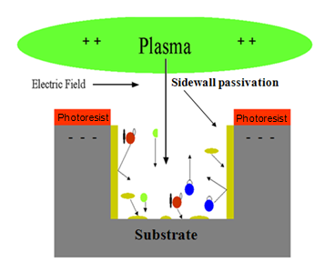
Etch Profile with Sidewall Passivation
Radicals: reactive etching species
Reaction Products: volatile etch products
Film formers: provide sidewall passivation, photoresist can be a large contributor
Positive ions: provide physical bombardment on surface, breaking surface film formers at bottom, physically etching and providing energy to help drive chemical reactions
Public Domain: Image Generated by CNEU Staff for free use

Slide 5
Sidewall Passivation
Polymers coat the sidewalls and act as a “pseudo-mask” for protection from chemical attack
Ions, for the most part, strike vertically and remove polymer buildup at the bottom of the etch
The sidewall polymers are removed by using O₂ plasma at 500-750mT
  This exposure uses a lot of chemistry and little bombardment

Slide 6
Outline
Introduction
Models to understand the plasma process
Chemistry
Analyzing recipe parameters, and the resultant etch profiles
Endpoint

Slide 7
Controlling the Etch Process by Balancing Chemistry and Bombardment
In dry etch processes choosing the correct chemistries can greatly increase the etch rate
Increasing MFP of the plasma (decreasing the pressure) also increases the etch rate, this will aid uniformity
Combining chemistry and bombardment will produce an etch rate that is greater than either contributor alone
Combining chemistry and bombardment allows the profile to be “tuned” between isotropic and anisotropic
The etch profile can also be enhanced with side wall passivation

Slide 8
Example Sidewall Chemistries
Material | Chemistry | Volatile Etch Product | Sidewall Material
Oxide Etch | SiO₂ + CF₄ + CHF₃ + Ar → | SiF, SiOF, SiF₄, SiH₄↑ | Si, C, CHx, F ↓
Poly Si Etch | Si + HBr + Cl₂ → | SiBr_{x} ↑ SiCl_{x} | Si,Br,C,Cl ↓
Al Etch | Al + BCl₃ + Cl₂ + N₂ → | AlCl₃ ↑ | Al,B,C,N,Cl ↓

Slide 9
Some etching Gases
Formula | Common Name | Chemical Name | Formula | Chemical Name
CF₄ | Freon 14 | Tetrafluoro-methane | SiCl₄ | Silicon Tetrachloride
C₂F₆ | Freon 116 | Perfluoro-ethane | BCl₃ | Boron-trichloride
C₃F₈ | Freon 218 | Perfluoro-propane | Cl₂ | Chlorine
CHF₃ | Freon 23 | Trifluoro-methane | HCl | Hydrogen Chloride
CF₃Br | Freon 13B1 | Bromo- trifluoro-methane | HBr | Hydrogen Bromide
SF₆ |  | Sulfur Hexafluoride | He | Helium
NF₃ |  | Nitrogen Trifluoride | N₂ | Nitrogen
SiF₄ |  | Silicon Tetrafluoride | O₂ | Oxygen

Slide 10
Some Materials and Selected Etchants
Material
Chemistry
Material
Chemistry
PolySilicon | Cl₂ or BCl₃/CCl₄ HBr /CF₄ /CHCl₃ /CHF₃ | WSi₂,TiSi₂,CoSi₂ | CCl₂F₃
Aluminum | Cl₂ BCl₃ + passivating gases SiCl₄ | Single crystal Si | Cl₂ or BCl₃ + passivating gases
AlSi(1%)-Cu(0.5%) | same as Al | SiO₂ (BPSG) | CCl₂F₂,CF₄,C₂F₆, C₃F₈
Al-Cu(2%) | BCl₃/Cl₂/CHF₃ | Si3N4 | CCl₂F₂ CHF₃
Tungsten | SF₆/Cl₂/CCl₄ | GaAs | CCl₂F₂
TiW | SF₆/Cl₂/O₂

Slide 11
Outline
Introduction
Models to understand the plasma process
Chemistry
Analyzing recipe parameters and the resultant etch profiles
Endpoint

Slide 12
The “Egg” Chart
This analytical model is a graphical representation of various process parameters. The Y axis represents bombardment energy, the X axis represents chemical energy, and the “dog leg” boundary represents polymer formation.
For an ideal anisotropic etch, the required parameter zone resembles an “egg” in the middle of the chart
This chart shows the combined effects of chemistry, bombardment, and polymerization (C*B+P) to predict sidewall profiles
There are also other factors that determine the etch profile that are not included in this exercise. These parameters will be discussed after this first iteration analysis.

Slide 13
The “Egg” Chart
A chart like this can be found and/or generated for any dry etchable material
Due to its wide use in micro and nanofabrication, we will analyze the egg chart for SiO₂
Naturally this chart is not “exact”, but can be used as a starting point for building a etch recipe.

Slide 14
Oxide Egg Chart Considerations
F/C Ratio- the ratio of fluorine to carbon etching species
Increasing DC bias, increases bombardment
The addition of H₂ to the chamber increases polymerization
The addition of O₂ to the chamber increases free fluorine
Aspect Ratio- the ratio of depth to width for a small gap, trench, or hole

Slide 15
Fluorine to Carbon Ratio (F/C) of Gas Phase Etching Species vs DC Bias Level
High
C₂F₄
C₄F₁₀
C₂F₆
CF₄
Etching
Bias Applied to Surface (Volts)
DC Bias
O₂ Addition
Loading
Polymerization
H₂ Addition
Low
0
1
2
3
4
F/C Ratio
Public Domain: Image Generated by CNEU Staff for free use

Slide 16
Fluorine to Carbon Ratio (F/C) of Gas Phase Etching Species vs DC Bias Level
High
C₂F₄
C₄F₁₀
C₂F₆
CF₄
Etching
1
Bias Applied to Surface (Volts)
DC Bias
O₂ Addition
Loading
Polymerization
H₂ Addition
Low
0
1
2
3
4
F/C Ratio
Public Domain: Image Generated by CNEU Staff for free use

Slide 17
The Ideal Profile
To be “in the egg” is to achieve the ideal anisotropic etch
  The ideal F/C ratio is approximately 2
  An equal mix of hydrogen and oxygen to balance polymerization and etch
  DC bias level that provides just enough bombardment

Slide 18
The Ideal Profile
W
D
Public Domain: Image Generated by CNEU Staff for free use

Slide 19
Sidewall Profile Two
Low DC bias – little/no bombardment
No H₂ - no polymerization
A lot of O₂ – can increase etching
F/C ratio = 4, SiF₄ is formed
Aspect ratio < 1, an isotropic etch profile

Slide 20
Fluorine to Carbon Ratio (F/C) of Gas Phase Etching Species vs DC Bias Level
High
C₂F₄
C₄F₁₀
C₂F₆
CF₄
Etching
Bias Applied to Surface (Volts)
DC Bias
O₂ Addition
Loading
Polymerization
H₂ Addition
2
Low
0
1
2
3
4
F/C Ratio
Public Domain: Image Generated by CNEU Staff for free use

Slide 21
Sidewall Profile Two
Public Domain: Image Generated by CNEU Staff for free use

Slide 22
Sidewall Profile Three
Low DC bias – no bombardment
A lot of H₂ - a lot of polymerization
No O₂ – no etch
F/C = ¹/₃, SiF₄ is not formed

Slide 23
Fluorine to Carbon Ratio (F/C) of Gas Phase Etching Species vs DC Bias Level
High
C₂F₄
C₄F₁₀
C₂F₆
CF₄
Etching
Bias Applied to Surface (Volts)
DC Bias
O₂ Addition
Loading
Polymerization
3
H₂ Addition
Low
0
1
2
3
4
F/C Ratio
Public Domain: Image Generated by CNEU Staff for free use

Slide 24
Sidewall Profile Three
Polymer buildup
Public Domain: Image Generated by CNEU Staff for free use

Slide 25
Sidewall Profile Four
High DC bias – high bombardment
No H₂ – no polymerization
A lot of O₂ – high etch
F/C ratio = 4, SiF₄ is formed
Aspect ratio >1, a dry etch profile

Slide 26
Fluorine to Carbon Ratio (F/C) of Gas Phase Etching Species vs DC Bias Level
High
C₂F₄
C₄F₁₀
C₂F₆
CF₄
Etching
4
Bias Applied to Surface (Volts)
DC Bias
O₂ Addition
Loading
Polymerization
H₂ Addition
Low
0
1
2
3
4
F/C Ratio
Public Domain: Image Generated by CNEU Staff for free use

Slide 27

Sidewall Profile Four
3
6
Sharp angles due
to high bombardment
with no polymerization
Public Domain: Image Generated by CNEU Staff for free use

Slide 28
Sidewall Profile Five
High DC bias – high bombardment
A lot of H₂ – a lot of polymerization
No O₂ – no etch
F/C ratio =¹/₅, SiF₄ is not formed
Aspect ratio > 1, Dry etch profile with undesirable features

Slide 29
Fluorine to Carbon Ratio (F/C) of Gas Phase Etching Species vs DC Bias Level
High
C₂F₄
C₄F₁₀
C₂F₆
CF₄
5
Etching
Bias Applied to Surface (Volts)
DC Bias
O₂ Addition
Loading
Polymerization
H₂ Addition
Low
0
1
2
3
4
F/C Ratio
Public Domain: Image Generated by CNEU Staff for free use

Slide 30

Sidewall Profile Five
Jagged features
due to
polymer buildup
Public Domain: Image Generated by CNEU Staff for free use

Slide 31
Sidewall Profile Six
Medium DC bias – medium bombardment
No H₂ – no polymerization
A lot of O₂ – high etch
F/C = 4, SiF₄ is formed
Aspect ratio < 1, a wet etch profile

Slide 32
Fluorine to Carbon Ratio (F/C) of Gas Phase Etching Species vs DC Bias Level
High
C₂F₄
C₄F₁₀
C₂F₆
CF₄
Etching
Bias Applied to Surface (Volts)
DC Bias
6
O₂ Addition
Loading
Polymerization
H₂ Addition
Low
0
1
2
3
4
F/C Ratio
Public Domain: Image Generated by CNEU Staff for free use

Slide 33
Sidewall Profile Six
Wider and deeper
than profile one
due to increased
bombardment
Public Domain: Image Generated by CNEU Staff for free use

Slide 34
Sidewall Profile Seven
Medium DC bias – medium bombardment
A lot of H₂ – a lot of polymerization
No O₂ – no etch
F/C ratio = ¼, SiF₄ is not formed
Aspect ratio > 1, Dry etch profile with undesirable features

Slide 35
Fluorine to Carbon Ratio (F/C) of Gas Phase Etching Species vs DC Bias Level
High
C₂F₄
C₄F₁₀
C₂F₆
CF₄
Etching
7
Bias Applied to Surface (Volts)
DC Bias
O₂ Addition
Loading
Polymerization
H₂ Addition
Low
0
1
2
3
4
F/C Ratio
Public Domain: Image Generated by CNEU Staff for free use

Slide 36
Sidewall Profile Seven
Less bombardment than profile four
Public Domain: Image Generated by CNEU Staff for free use

Slide 37
Considerations Beyond
the Egg Chart
The “egg chart” is a useful first approximation to define some process parameters, but it does not cover some important considerations.
We will discuss 4 additional considerations:
  Residence time
  Microloading
  Proximity effect
  Post etch evaluation

Slide 38
Residence Time
The average time gas is present in the chamber (seconds)
The residence time is a balance of the pressure, input gas flow, and the pump efficiency
Naturally the residence time will impact the etch process, because etch chemistry and byproducts are constantly being pumped away at a certain rate

Slide 39
Microloading
The change in local etch rate relative to the whole area of material being etched
  A large area will load the etching process with volatile etch products, slowing the etch down in that area while a smaller etch area proceeds at a faster rate
Etch rates change according to pattern and exposed area

Slide 40
Microloading
Photoresist on top of Wafer
Patterned holes in the PR where etching of the wafer occurs
Larger area loading
the process with removed
material- less etching gas
relative to area
More etching
gas relative to area-
etches quicker
Public Domain: Image Generated by CNEU Staff for free use

Slide 41
Proximity Effect- Etch Rate Based on Feature Size
SiF₄
SiF₄
F
F
Si
Si
Si
Si
“Crowded”-
harder to remove byproducts,
slower etch rate
Easier to remove byproducts,
faster etch rate
Public Domain: Image Generated by CNEU Staff for free use

Slide 42
Etch Evaluation
Process quality parameters:
  Etch rate, selectivity, uniformity
  Sidewall Profile
  Loss or gain of critical dimensions
  Corrosion (in metal etch)
  Reproducibility

Slide 43
Outline
Introduction
Models to understand the plasma process
Chemistry
Analyzing recipe parameters, and the resultant etch profiles
Endpoint

Slide 44
Endpoint Detection
General term describing when an etch process has finished
Two common methods of detection
  Optical emission
  Mass spectroscopy

Slide 45
Optical Emission
Each volatile etch product emits a specific wavelength
The wavelength intensity shows the relative amounts of products being formed
A decrease in intensity corresponds to a decrease in etch products.

Slide 46
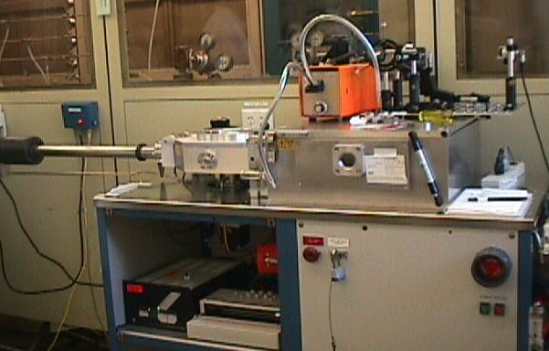
RIE With Optical
Endpoint Detector
Endpoint Detector
Oxford Instruments Plasmalab System 100
Public Domain: Image Generated by CNEU Staff for free use

Slide 47
Optical Emission
Material to be etched | Etchant Gases | Emitting Species | λ(nm)
Silicon | CF₄/O₂; SF | F(product) | 704
 | CF₄/O₂; SF | SiF(product) | 440, 777
 | Cl₂ | SiCl(product) | 287
SiO₂ | CHF₃ | CO(product) | 484
Si₃N₄ | CF₄/O₂ | N₂(product) | 337
 | CF₄/O₂ | CN(product) | 387
 | CF₄/O₂ | N(product) | 674
 | CF₄/O₂ | F(etchant) | 704
Al | Cl₂; BCl₃ | Al(product) | 391, 394, 396
 | Cl₂; BCl₃ | AlCl(product) | 261
Resist | O₂ | O(etchant) | 777, 843
 | O₂ | CO(product) | 484
 | O₂ | OH(product) | 309
 | O₂ | H(product) | 656

Slide 48
Example Graph of Optical Endpoint Detection
Endpoint detection
Normal etch
Change in etch rate - detection occurs here.
Etch Parameter
Endpoint signal stops the etch.
Time
Public Domain: Image Generated by CNEU Staff for free use

Slide 49
Mass Spectroscopy
This method of endpoint detection measures the mass/charge ratio of the etch products
As the mass/charge ratio peak declines, the products being generated by the etch decline due to the material being etched away
A residual gas analyzer is a mass spectrometer

Slide 50
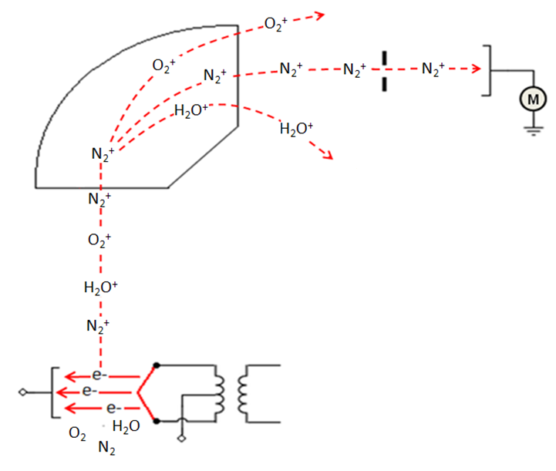
Mass Spectrometer Schematic
Detector
A
Steering magnets
Particle Accelerator
Ionizing electron stream
Public Domain: Image Generated by CNEU Staff for free use

Slide 51
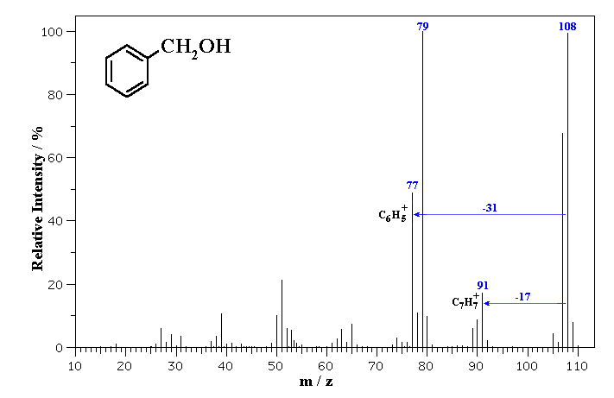
Example Mass Spectra: Benzyl Alcohol
Benzyl Alcohol
Public Domain: Image Generated by CNEU Staff for free use

