Slide 1

Understanding Variation and Statistical Process Control:
Process Variation and Statistical Process Control (SPC)

Slide 2
Outline
Normal and Special Cause Variation
Specification Limits vs Control Limits
Calculations for the Individuals Chart.
Nelson Rules to determine out-of-control signals (special cause variation) from process data.
Calculations for the X bar & R Chart.
Advantages of subgroup data collection.

Slide 3
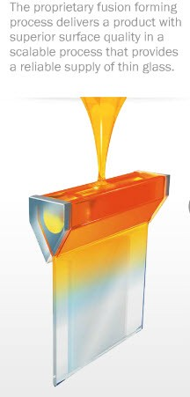
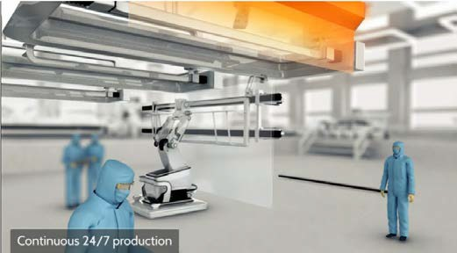

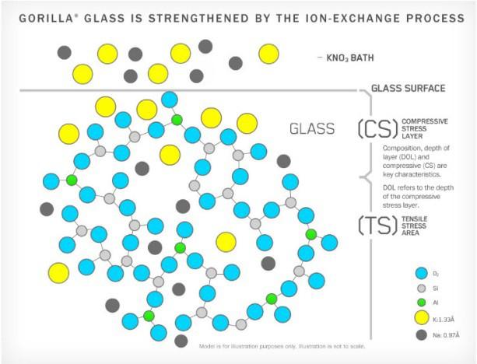
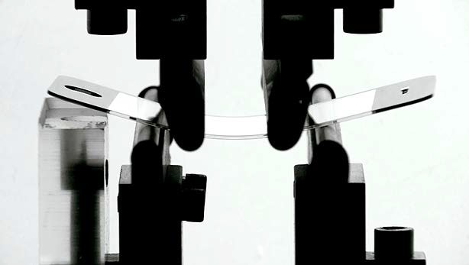
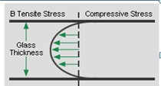
Corning Process to Manufacture Gorilla Glass
Quality = Strong, flexible, scratch resistant.

Slide 4
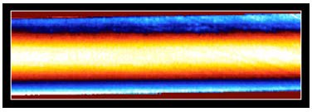
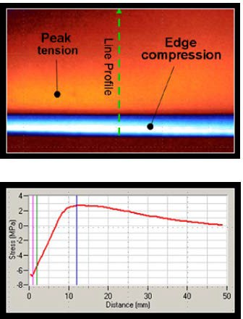
Measuring the Compression Layer in Glass
The quality of the ultra-thin glass used for phones and tablets is a function of the compression induced strength developed from the ion exchange treatment. With this compression, comes a band of tension just inside the compressive edge. It is important that this tension not exceed limits or flow too far into the glass where a simple scratch or check can turn into a run away crack. Gauges use the polarization of light passing through the glass to measure the level of compression / tension.
Distance (nm)
SnapDatInc copyright 2014

Slide 5
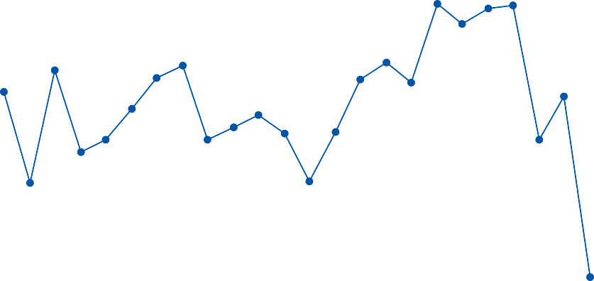
Responding to Variation in the Process
Take another measurement
Glass Strain (MPascal) over Time
3.2
Upper Spec
3.0
Wait for the next 4 hr sample
2.8
Target
Strain
2.6
2.4
Shut down & adjust process
Lower Spec
2.2
1/2/14 0
1/2/14 8
1/2/14 16
1/3/14 0
1/3/14 8
1/3/14 16
1/4/14 0
1/4/14 8
1/4/14 16
1/5/14 0
1/5/14 8
1/5/14 16
1/6/14 0
Adjust minor input
Date
SnapDatInc copyright 2014

Slide 6
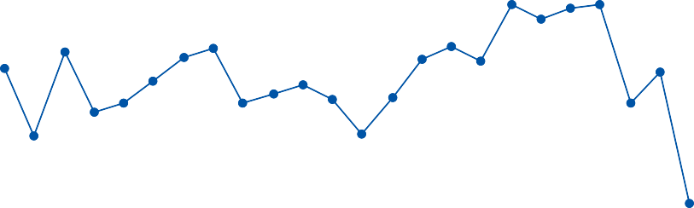
Responding to Variation in the Process
Take another measurement
Glass Strain (MPascal) over Time
3.50
Upper Spec
3.25
3.00
2.75
Wait for the next 4 hr sample
Strain
Target
2.50
2.25
2.00
Shut down & adjust process
Lower Spec
1/2014 0
1/2014 8
1/2014 16
1/2014 0
1/2014 8
1/2014 16
1/2014 0
1/2014 8
1/2014 16
1/2014 0
1/2014 8
1/2014 16
1/2014 0
Adjust minor input
Date
SnapDatInc copyright 2014

Slide 7
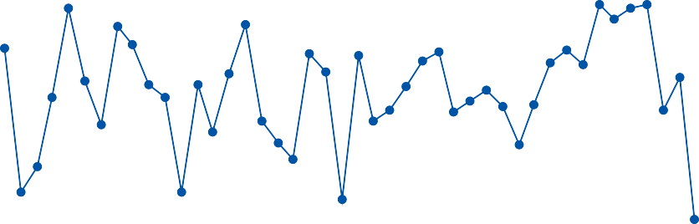
Limits to the Process vs Specification Limits
Take another measurement
Glass Strain (MPascal) over Time
3.4
Upper Spec 2
3.2
Upper Spec
Wait for the next 4 hr sample
3.0
2.8
Strain
Target
2.6
2.4
Lower Spec
Shut down & adjust process
2.2
Lower Spec 2
2.0
1/1/14 0
1/2/14 0
1/3/14 8
1/4/14 8
1/5/14 0
1/6/14 0
1/1/14 8
1/2/1 4 8
1/3/14 0
1/4/1 4 0
1/5/14 8
12/30/1 3 0
1/1/14 16
1/2/14 16
1/3/14 16
1/4/14 16
1/5/14 16
12/30/13 8
12/31/13 0
12/31/13 8
12/29/13 1⁶
12/30/13 1⁶
1 2/31/13 16
Adjust minor input
Date
SnapDatInc copyright 2014

Slide 8
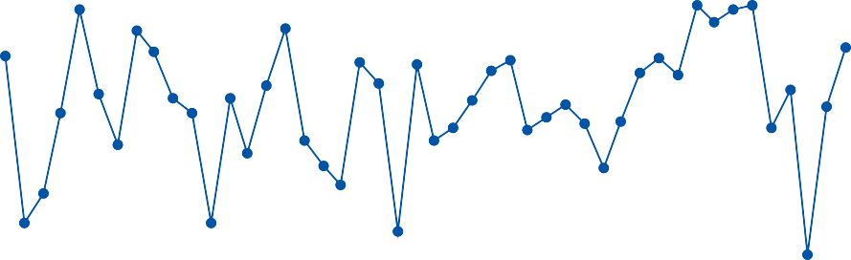
Limits to the Process vs Specification Limits
Take another measurement
Glass Strain (MPascal) over Time
3.4
Upper Spec 2
3.2
Upper Spec
Wait for the next 4 hr sample
3.0
2.8
Strain
Target
2.6
2.4
Lower Spec
Shut down & adjust process
2.2
Lower Spec 2
2.0
1/1/14 0
1/2/14 0
1/3/14 8
1/4/14 8
1/5/14 0
1/6/14 0
1/1/14 8
1/2/1 4 8
1/3/14 0
1/4/1 4 0
1/5/14 8
12/30/1 3 0
1/1/14 16
1/2/14 16
1/3/14 16
1/4/14 16
1/5/14 16
12/30/13 8
12/31/13 0
12/31/13 8
Adjust minor input
12/29/13 1⁶
12/30/13 ¹⁶
1 2/31/13 16
Date
SnapDatInc copyright 2014

Slide 9
Histogram of the Glass Strain Data
Histogram of Glass Strain
Normal
Upper Control Limit
Lower Control Limit
10
Mean 2.635
StDev 0.2017
N 44
8
Frequency
6
4
2
0
2.0
2.2
2.4
2.6
Strain
2.8
3.0
3.2

Slide 10
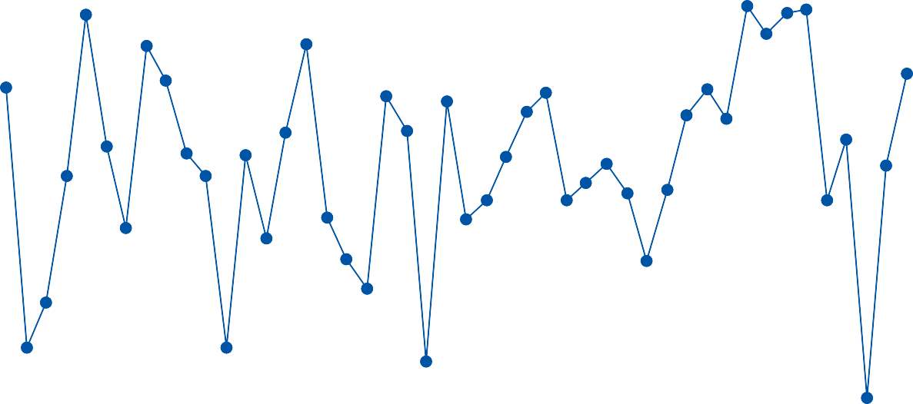
Histogram Converted to a Control Chart
Individuals Chart of Glass Strain
3.2
UCL=3.171
3.0
2.8
Glass Strain
_ X=2.638
2.6
2.4
2.2
LCL=2.105
2.0
1
6
11
16
21 26
Observation
31
36
41
46

Slide 11
Characteristics of a Control Chart
Control Chart – a time series plot for process monitoring which allows one to tell common cause variation from special cause variation by identifying the natural variation in the process with control limits.
Control Limits – a range of values that contain the natural variation of the process. One must collect process data and calculate the standard deviation to determine the control limits.
  Data within the control limits is normal variation. One data point outside the limits must have been caused by something special.
  Control charts also test each data point for the formation of patterns which would not occur under normal random variation. Any of these eight patterns indicate that something special occurred, beyond normal random variation.

Slide 12
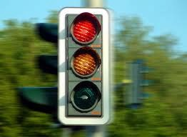

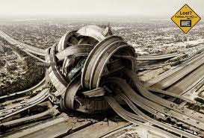
Sources of Variation – Time to Drive to Work
Stoplights in your favor (or not).
Slow driver in front of you.
Have to drop off your spouse at their work (or not).
Forgot; wallet, keys, coffee mug, phone, daughter, etc.
Flat tire.
Number of cars on the road (congestion).
Construction on your typical route.
You’re in the mood for some speed.
Accident; other guy’s fault, of course.

Slide 13
Sources of Variation – Common or Special?
Special Cause Variation Common Cause Variation
Non-normal Variation, Does not follow a bell curve
Out-of-control
Larger changes
Fast (spike)
Often, single known source
Does not occur most of the time
Can not be predicted
1. Normal Variation, Follows a bell curve
In-control, stable
Smaller changes
Slow (drift)
Unknown source, sum of many small contributors
Occurs all the time
Can be quantified as having a certain size
Responding will most likely make it worse
8. Most likely, you should respond and fix

Slide 14
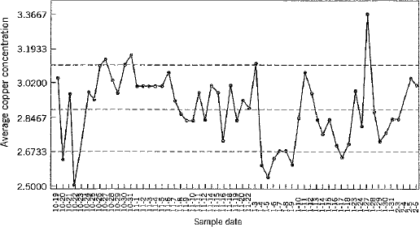





Identifying Special Cause Variation
What patterns in the data in the copper concentration shown below seem to identify special cause variation in the average copper concentration?

Slide 15
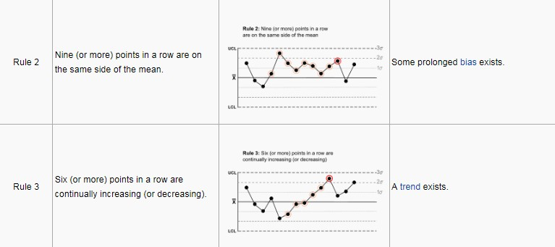
Additional Unusual or Non-random Patterns
In 1984, Lloyd Nelson published 8 patterns that you won’t seen in the data if there is only normal random variation at play. These are based on the original Shewhart 5 patterns which later became the Western Electric 6 patterns. Some more commonly used tests are;
Lloyd S. Nelson, “Technical Aid”, Journal of Quality Technology, Vol.16, No.4, 1984, p238-239

Slide 16
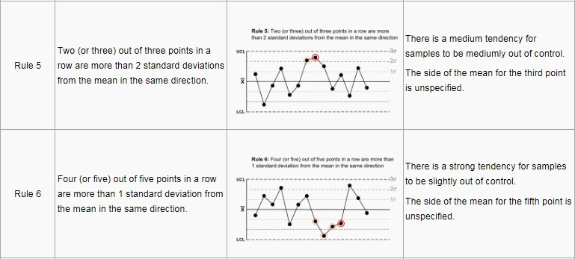
Additional Unusual or Non-random Patterns
In 1984, Lloyd Nelson published 8 patterns that you won’t seen in the data if there is only normal random variation at play. These are based on the original Shewhart 5 patterns which later became the Western Electric 6 patterns. Some more commonly used tests are;
Lloyd S. Nelson, “Technical Aid”, Journal of Quality Technology, Vol.16, No.4, 1984, p238-239
SnapDatInc copyright 2013

Slide 17
Determining Patterns from Special Cause Variation
How common is each pattern?
6 points trending will only occur about .27% ** of the time under normal random variation.
Test 3
Paint Viscosity Over Time
4 points*Point
Common
5 points*Point
Not Uncommon
6 points*Point
Special Cause
15.6
15.6
15.5
15.4
15.4
15.2
15.2
15.0
15.0
15.0
14.8
14.5
14.8
14.6
14.0
14.6
14.4
14.4
14.2
13.5
14.0
14.2
13.0
1 2 3 4 5 6 7
1 2 3 4 5 6 7
Time
1 2 3 4 5 6 7
** Montgomery, Douglas (2005)) , Introduction to Statistical Quality Control, 5th Edition

Slide 18
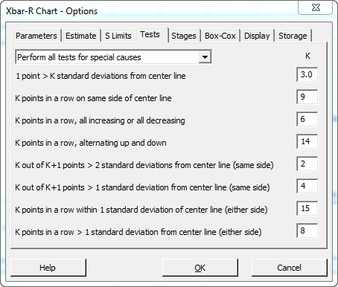
Eight Tests for Special Cause Variation
The probability that any one of these 8 patterns will be seen in the data if there is only normal random variation is very low. Therefore, if one of these patterns is seen, it was likely caused by a special source of variation.

Slide 19


Identifying Special Cause Variation with 8 Tests
What patterns in the data shown below seem to identify special cause variation in the average copper concentration?

Slide 20
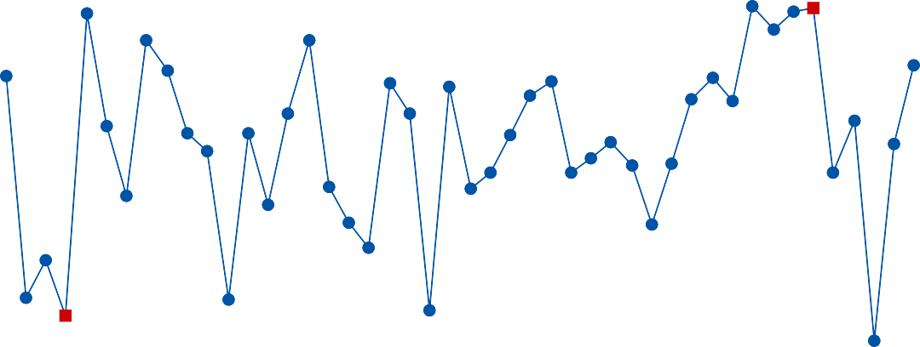
Identifying Special Cause Variation with 8 Tests
Individuals Chart of Glass Strain
3.2
UCL=3.179
3.0
6
Glass Strain
2.8
_ X=2.630
2.6
2.4
2.2
5
LCL=2.081
2.0
12/29/13 16
12/30/13 12
12/31/13 8
1/1/14 4
1/2/14 0
1/2/14 20
1/3/14 16
1/4/14 12
1/5/14 8
1/6/14 4
Date

Slide 21



Dry Etch Process for Microprocessor Mfg
Isotropic
Anisotropic
Dry etch technology has been greatly refined for today’s advanced fabrication of integrated circuits. One etch quality characteristic that affects the performance of the semiconductor product is anisotropy, a high level of vertical etching vs horizontal etching. This is measured as the aspect ratio, the depth / the width of the etched area.
Problem: The aspect ratio of grooves from the dry etch process should have an aspect ratio of 1.00, but can vary from .9 to 1.1 and still meet specifications. Five wafers are sampled every 4 hours and the aspect ratio is measured to monitor the quality of the product from the etch process.

Slide 22
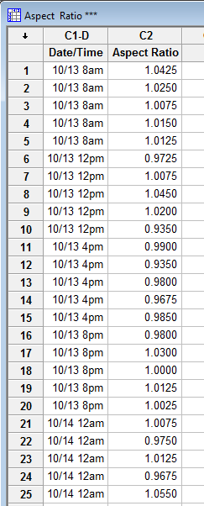
Value of Collecting Subgroup Data
Create an X-bar (Mean) and R (Range) Chart
Range1/Mean1 Subgroup 1
Range2/Mean2
Subgroup 2
Range3/Mean3
Subgroup 3
Range4/Mean4
Subgroup 4
SnapDatInc copyright 2013

Slide 23
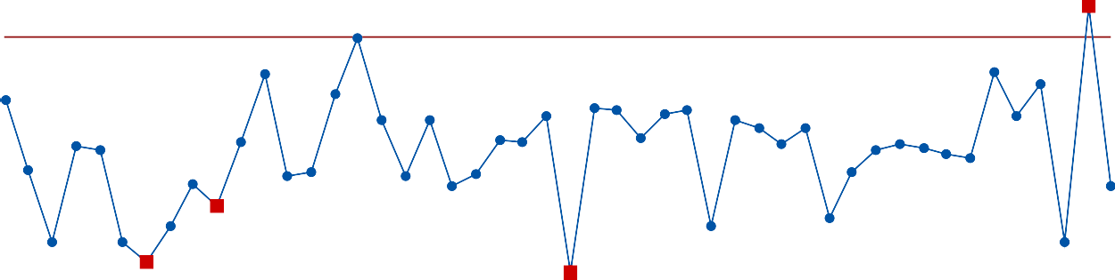
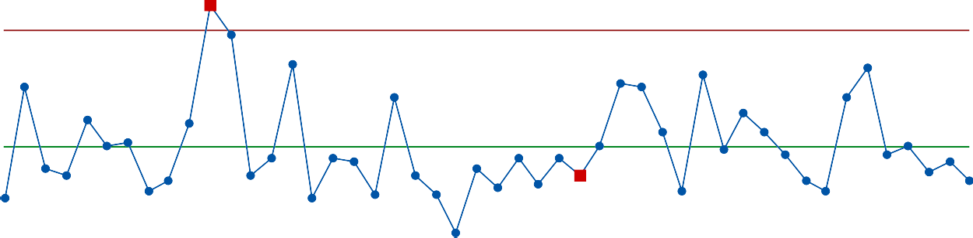
X-bar & R Chart of the Process
Xbar-R Chart of Aspect Ratio
1.050
1
UCL=1.0433
Sample Mean
1.025
_ X=1.0030
1.000
0.975
6
5
1
LCL=0.9626
0.950
26
Sample
1
6
11
16
21
31
36
41
46
0.16
1
UCL=0.1479
Sample Range
0.12
0.08
_ R=0.0699
0.04
2
0.00
LCL=0
1
6
11
16
21
26
Sample
31
36
41
46

Slide 24
Identification of Out-of Control Subgroups
Test Results for Xbar Chart of Aspect Ratio
TEST 1. One point more than 3.00 standard deviations from center line. Test Failed at points: 25, 47
TEST 5. 2 out of 3 points more than 2 standard deviations from center line (on one side of CL).
Test Failed at points: 7
TEST 6. 4 out of 5 points more than 1 standard deviation from center line (on one side of CL).
Test Failed at points: 10
Test Results for R Chart of Aspect Ratio
TEST 1. One point more than 3.00 standard deviations from center line. Test Failed at points: 11
TEST 2. 9 points in a row on same side of center line. Test Failed at points: 29
* WARNING * If graph is updated with new data, the results above may no
* longer be correct.

Slide 25
Advantages of the X-bar & R Chart over Individuals
Lower Variation – Clear Picture
Standard Deviation of the Average
Standard Deviation
of the Individuals Sqrt (N )
=
Means are Normal – the Central Limit Theorem dictates that the mean of several measurements will follow a normal distribution even if the individual readings do not. Normality is assumed for the 8 tests.
Monitor the Mean and Variation –
the X-bar chart monitors the
center of the process distribution while the R or S chart monitors the variability. Both are important.
SnapDatInc copyright 2014

Slide 26
When to use the I- Chart
Individuals Control Chart (I-MR )
Used when monitoring is a single continuous process.
Common application; long, expensive or difficult measurement .
Works best with low measurement variation.
Works best with normally distributed data.

Slide 27
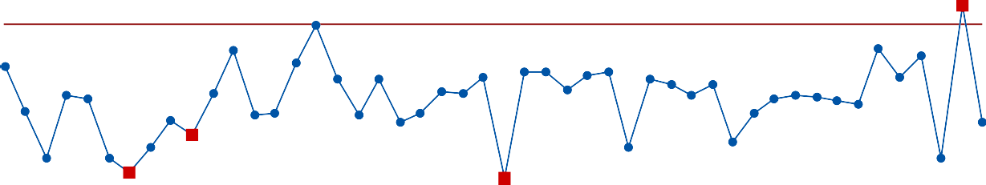
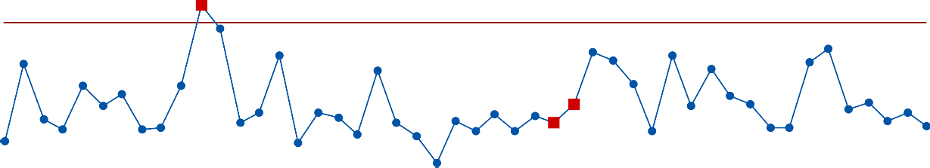
The Xbar and S Chart
Xbar-S Chart of Aspect Ratio
1.050
1.025
1.000
0.975
0.950
1
Sample Mean
UCL=1.0435
_ X=1.0030
6
5
1
LCL=0.9625
10/13 8am
10/14 4am
10/15 12am
10/15 8pm
10/16 4pm
10/17 12pm
10/18 8am
10/19 4am
10/20 12am
10/20 8pm
Date/Time
1
0.060
0.045
0.030
0.015
0.000
UCL=0.05927
Sample StDev
_ S=0.02837
2
2
LCL=0
10/13 8am
10/14 4am
10/15 12am
10/15 8pm
10/16 4pm
10/17 12pm
10/18 8am
10/19 4am
10/20 12am
10/20 8pm
Date/Time

Slide 28
When to use the S Chart
Xbar - S Control Chart
Used when you have a calculator or computer generated chart.
Equivalent to an X-bar & R with small subgroup sizes (5 or less) .
Right choice for subgroup size 9 or larger.
Right choice for unequal subgroup size.

Slide 29
Conclusions
The complexity of modern nanoscale processes demand accurate control plans that minimize the false alarms and detect changes to the process that require remediation. Control charts are a key tool in these plans.
Control limits define the normal variation in the process which does not require follow-up and distinguishes it from the special cause variation that should be addressed.
Eight patterns in the response data from your process have been identified as having a low probability of occurrence without a special cause. Modern software can be used to identify these patterns in your data to trigger an appropriate response.
If process data is collected in subgroups and analyzed using control charts for subgrouped data, the sensitivity of the chart to special cause variation and the information about the process are improved over the standard control chart of individual data points.

Slide 30
References
Automotive Industry Action Group, (2005). Statistical Process Control 2nd Edition . AIAG Press, Detroit, MI.
Hoyer, Robert W. and Ellis, Wayne C., “A Graphical Exploration of SPC”, Quality Progress, May,1996, p65-73.
Lloyd S. Nelson, “Technical Aid”, Journal of Quality Technology,
Vol.16, No.4, 1984, p238-239.
Montgomery, Douglas (2005). Introduction to Statistical Quality Control , 5th Edition. John Wiley & Sons Inc. Hoboken NJ.
Wheeler, Donald J. and Chambers, David S. (1992). Understanding Statistical Process Control. SPC Press: Knoxville, TN.

