Slide 1
Electric Guitar Controls
D. Hunt
Southern Wells Jr-Sr High School
dhunt@swell.k12.in.us

Slide 2
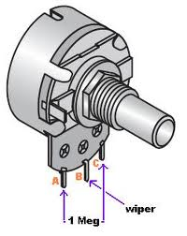
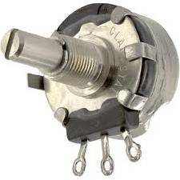
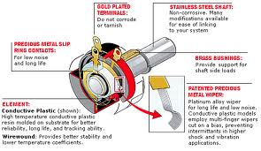
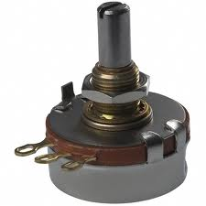
Potentiometer
Variable resistor, or voltage divider

Slide 3
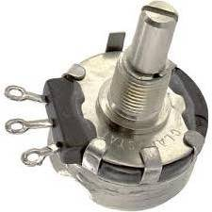
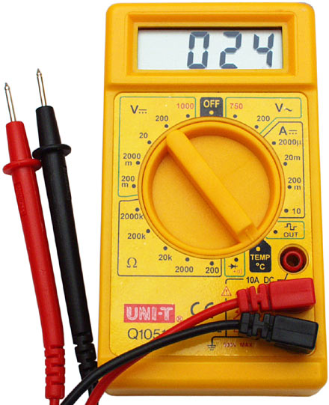
Potentiometer Continuity Testing
Continuity Testing
Shows the amount of electricity permitted to pass through Potentiometer by measuring resistance Ω (ohms)
Potentiometer
Multimeter
Required Materials
Multimeter
Potentiometer

Slide 4
Potentiometer Testing cont.
Set Multimeter to 2000K Ohms
Then connect red probe to left connection and black probe to middle.

Slide 5
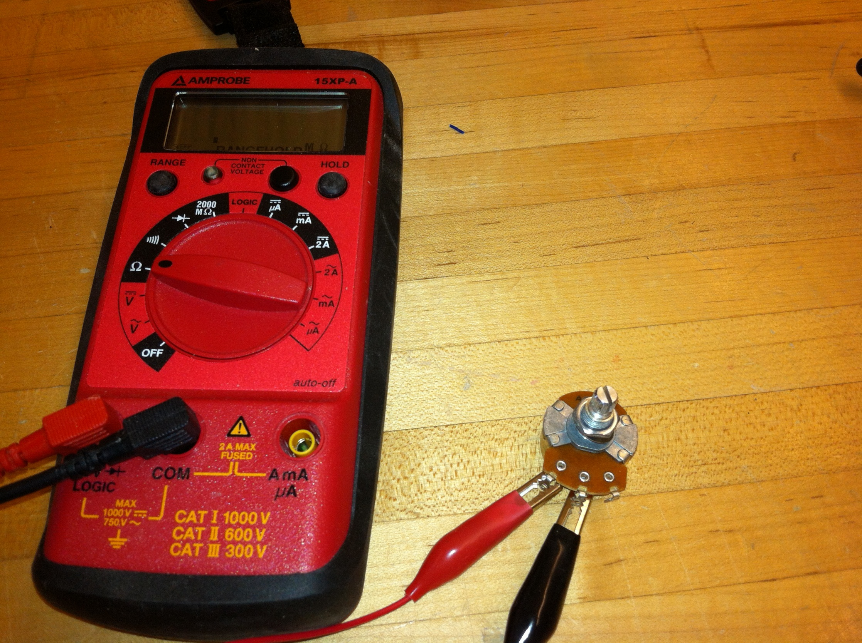

Slide 6
Potentiometer Testing Cont.
500K ohms
0 K ohms
Turn fully counter-clockwise for max ohms
Turn fully clockwise for zero ohms

Slide 7
Potentiometer Testing Cont.
Reversed
0 K ohms
500K ohms
Turn fully counter-clockwise for zero ohms
Turn fully clockwise for max ohms

Slide 8
Potentiometer Testing cont.
Shows max capacity of ohms
Turning in either direction causes
no significant change

Slide 9
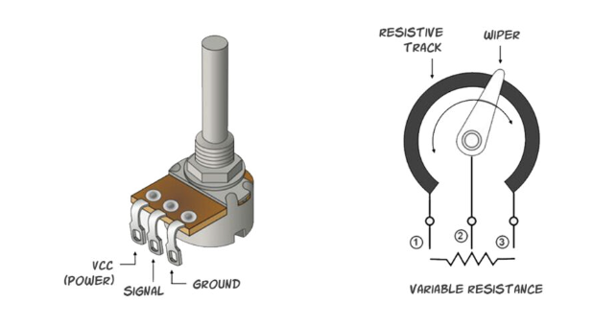
Potentiometer:
controls the volume and tone of an electric guitar by changing the electrical resistance in the circuit
How it works:
A potentiometer is a variable resistor that has a circular resistor strip inside called the "element"
A component called the "sweeper" contacts the element
Turning the knob on the potentiometer adjusts the position of the sweeper along the resistor strip.
This changes how far the electricity travels on the strip before reaching the output.
How it's used
Volume control: The amount of electrical current flowing through the pot is varied.
Tone control: The sound is changed, including how the signal from guitar pickups is muted or blended.

Slide 10
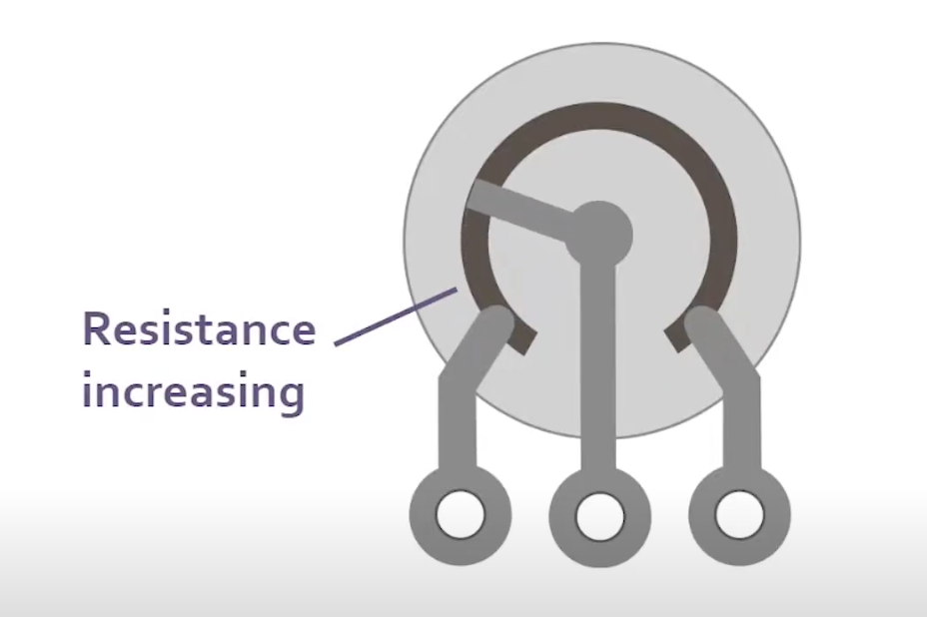
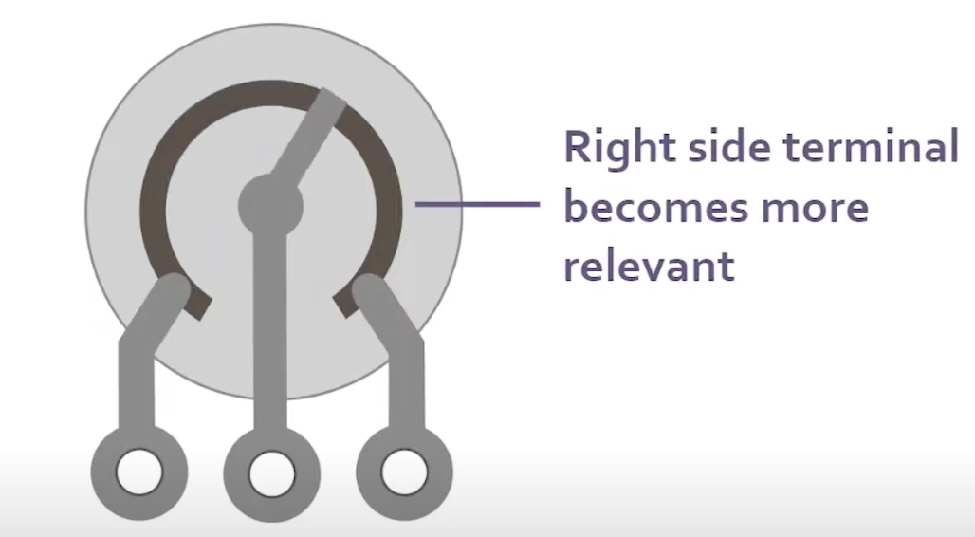
Watch How a Potentiometer Works
Rotating wire bridge that drags along an arc made of semiconductive material
As the wiper rotates it varies the resistance between the outside terminals and the center terminal

Slide 11
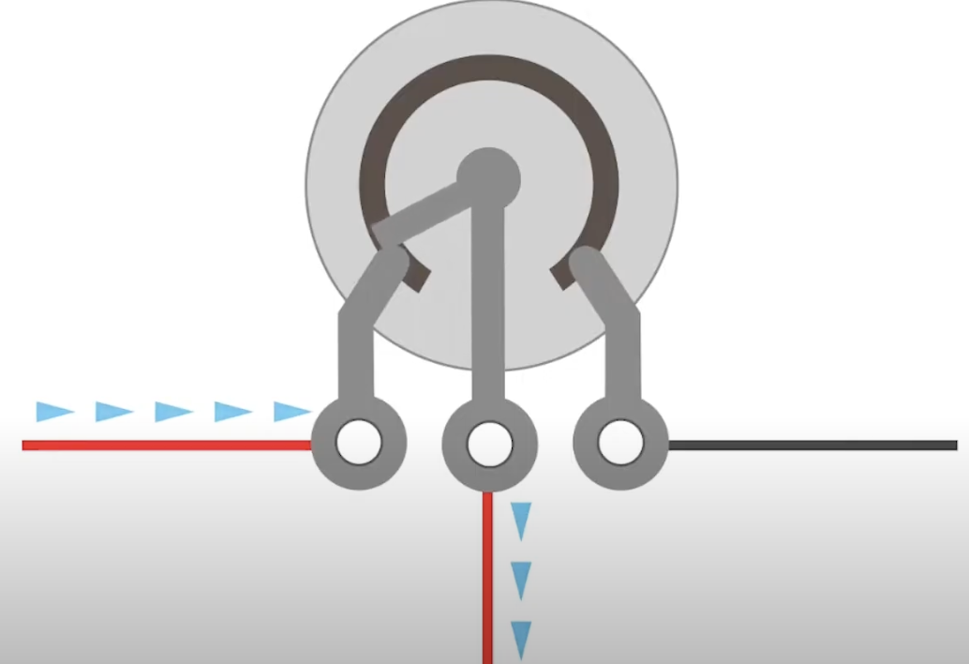
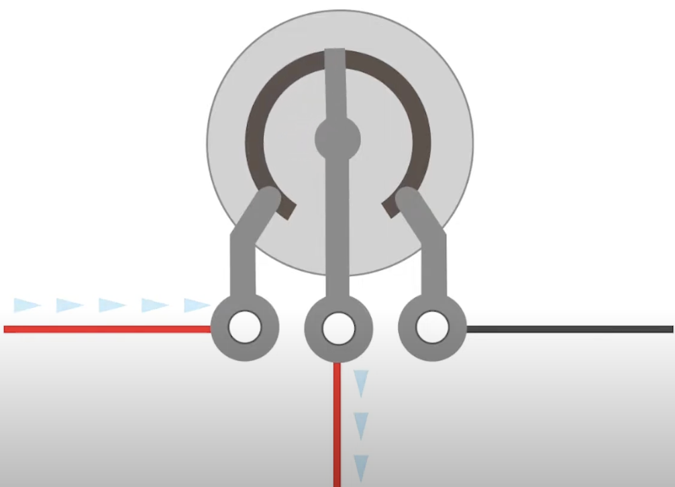
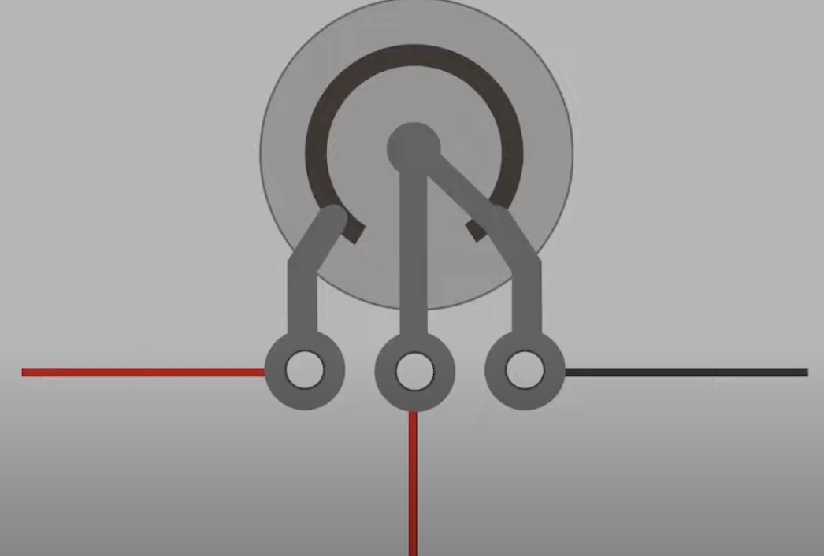
Volume Pot
in this example the model is more indicative of how a volume pop would be wired the signal from the pickups is connected to the left terminal the wire on the center terminal is going to the amps input and the wire on the right terminal is going to ground with the knob turned up completely the connection to the amplifier is 100 percent as the knob is turned down the wiper moves from the left to the right terminal and the resistance increases between the left terminal and the center terminal essentially turning off the signal to the amp but gradually

Slide 12
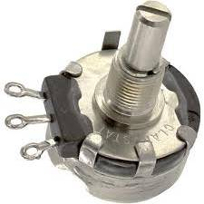
Volume Control
Potentiometer is grounded on one side
Signal out to amplifier
Signal from pickup

Slide 13
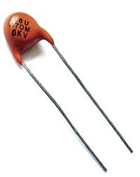
Tone Control
Capacitor is grounded to back of case
Potentiometer plus capacitor makes tone control
“Low Pass Filter”
Blocks high frequencies
Only allows low frequencies to pass
Signal from pickup

Slide 14
Volume and Tone together
The cases of the potentiometers are tied together and ground

Slide 15
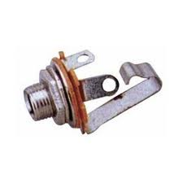
¼” jack for plug
Signal out
Ground

Slide 16
Controls with Jack
This wire goes to bridge ground
Guitar buzzes if you forget it

Slide 17
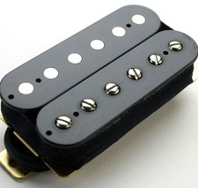
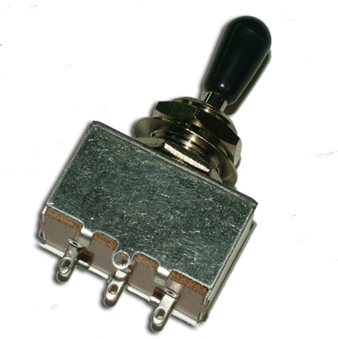
Selector switch for pickups
To ground.
(Forgetting to ground the switch results in a constant buzz)
Signal to volume

Slide 18

The Entire Circuit
This wire goes to bridge ground

Slide 19
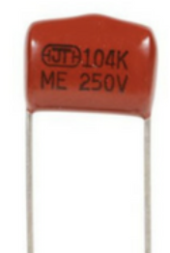
Capacitor
Capacitor
A capacitor in an electrical circuit functions by storing electrical energy by accumulating electric charges on two closely spaced plates that are insulated from each other, effectively acting like a temporary battery that can quickly charge and discharge, allowing it to smooth out voltage fluctuations and filter out certain frequencies in a circuit; it primarily passes alternating current (AC) while blocking direct current (DC) flow.

Slide 20
Key points about capacitors:
Energy storage:
The primary function of a capacitor is to store electrical energy in the form of an electric field between its plates.
Charging and discharging:
When connected to a power source, a capacitor charges up by accumulating electrons on one plate and depleting them from the other. When disconnected, it can release this stored energy back into the circuit.

Slide 21
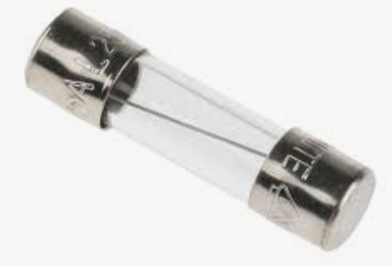
Fuse:
A fuse's function is to protect electrical systems and equipment from damage caused by power surges and short circuits. It does this by breaking the circuit when too much current flows through it.
How a Fuse works
A fuse contains a metal wire or strip that melts when too much current passes through it.
The melted fuse element creates an open circuit, stopping the flow of electricity.
The fuse needs to be replaced with a new fuse of the same rating to restore power.

Slide 22
Fuse
Why it's important
Fuses are an essential safety device that protect people and property.
They are a deliberate weak link in a circuit that protects the wiring and appliances.
Fuses are used in plugs, and there are many different designs with specific current and voltage ratings.

Slide 23
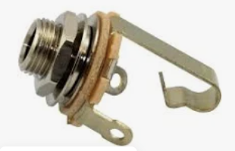
JACK
Jack:
A guitar jack, also called an "output jack," is the connection point on an electric guitar where you plug in a cable to transmit the electrical signal generated by the guitar's pickups to an amplifier, allowing the sound to be amplified and heard through a speaker; essentially, it's the part that lets the guitar's sound be heard through an external system.

Slide 24
Key points about a guitar jack:
Signal transmission: Its primary function is to transfer the electrical signal from the guitar's internal circuitry to an amplifier via a cable.
Location: Typically found on the side or front of the guitar body.
Cable type: Uses a standard "mono" ¼ inch jack cable.
Internal workings: The jack connects to the guitar's internal wiring, where all the pickups, pots, and switches converge.

