Slide 1
Where do we go from here? A Practical Approach to SustainABILITY
ITHAKA S+R
Nancy Maron
Jessie Brown
ATE Conference 2014
Omni Shoreham Hotel
October 22, 2014

Slide 2
To support your efforts to develop strong sustainability plans for your ATE programs and centers.
To introduce tools and techniques to help you do this.
Aims of the Workshop

Slide 3
Welcome
What is Sustainability?
Goal Setting
Defining your Value Proposition
Audience Assessment
Break
Environmental Scan
Wrap-up
Agenda

Slide 4
What is Sustainability?

Slide 5
Grant-funded projects rarely “fail”…
…but is that good enough??

Slide 6
Why planning for sustainability matters
Risks
Key services or content disappear
Content becomes dated
Technical incompatibility
Low usage and impact
Failure to fulfill sustainability promises that were part of your proposal
Best case
Increased usage of services or content
Evidence of impact
Low cost-base to support upgrades
Leads to measurable impact and enthusiasm about project or center
Resulting in continued resources to support ongoing value

Slide 7
Sustainability is . . .
the ability to generate or gain access to the resources—financial or otherwise—needed to protect and increase the value of the content or service for those who use it.
A sustainability plan is an evidence-based strategy for identifying and securing these ongoing sources of support for your project or center, over time

Slide 8
Not (only) about the money
Sources of support can include
Direct funding (from grants, from donations)
Revenue generation (from selling or licensing content or tools)
But they can also include
In-kind contributions from your host institution
In-kind contributions from industry partners and others
Volunteer time/labor

Slide 9
What Resources do you need?
Resources Needed
Project Management
IT Development
Content Creation
Event Planning
Outreach and Promotion
Legal Guidance
Financial Guidance
Office/Classroom Space

Slide 10
Resources Needed
Project Management
IT Development
Content Creation
Event Planning
Outreach and Promotion
Legal Guidance
Financial Guidance
Office/Classroom Space
From…?
Direct Payment | In-kind support | Volunteer Labor
X
X
 |  | X
 |  | X
 |  | X
 | X
 | X
 | X

Slide 11
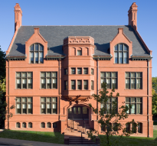
Resources Needed
Project Management
IT Development
Content Creation
Event Planning
Outreach and Promotion
Legal Guidance
Financial Guidance
Office/Classroom Space
From…?
Direct Payment | In-kind support | Volunteer Labor
X
X
 |  | X
 |  | X
 |  | X
 | X
 | X
 | X
$
Strategy to generate revenue
Focus on host, partners, stakeholders
Strategy to drive audience, incentivize volunteers

Slide 12
What does your sustainability Pie Look Like?

Slide 13
Sustainability Plans…
are built to fit the project
describe ongoing, renewable, reliable systems of support
build value for users (not just for creators!)
include preservation and financial models, but also address audience, usage, and impact
will need to be revisited and revised
Notes:
.

Slide 14
GOAL SETTING

Slide 15
What questions will you have to answer?
How much will it cost to maintain a stable and useful digital resource for your users?
How soon will these funds be needed?
What are the possible sources for these funds?

Slide 16
But first…
What impact do you want your project to have?
and…
What needs to be sustained in order for this to happen?

Slide 17
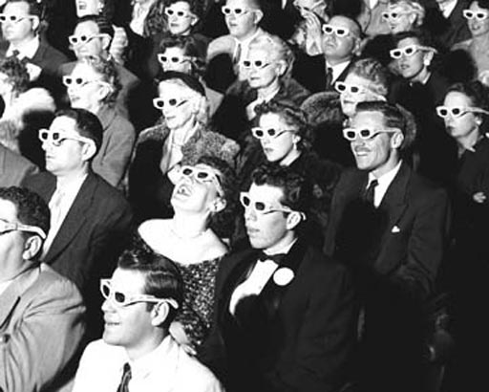
It might be…
CONTENT CURATION & CURRENCY
AUDIENCE & USAGE
IMPACT

Slide 18
Developing a plan for post-grant sustainability
Describe the future impact you have in mind
Set specific goals for each element you will need to achieve this impact
Identify necessary activities and staff
Determine the resources this will require
Identify the financial and other sources of support needed to fuel ongoing activities

Slide 19
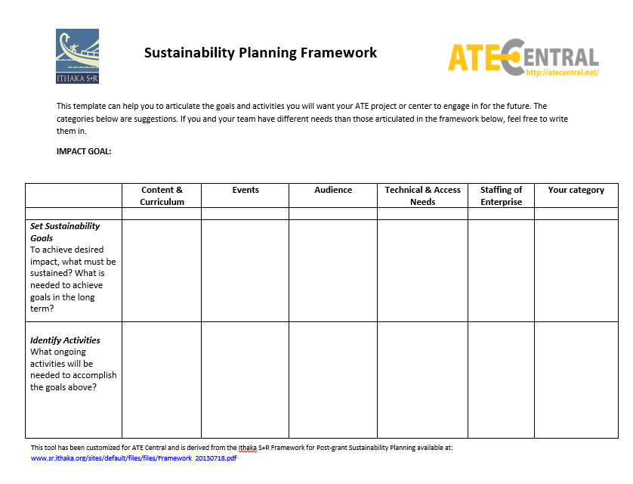
Notes:
Replace with new one

Slide 20
How do I know these are the right goals?
What do I want?
What do our users want and need?
What do our funders and our host institution expect?
If you are not sure of #2 and #3, it’s time to start doing a little research…

Slide 21
DEFINING YOUR Value Proposition

Slide 22
What is a value proposition?
A clear understanding of the unique value your project delivers to your users or stakeholders
Getting this right requires hard work; testing your hypotheses about what users like and need from you.
A statement that clearly communicates that value
Once you know what it is, it needs to be well crafted and communicated.

Slide 23
First, there is…
A Great Idea

Slide 24
There are forces that may help you refine that idea…
EXTERNAL FACTORS
A Great Idea
Audience
(users, stakeholders)
Environment
(competition)

Slide 25
A recurring Cycle of investment and value…
EXTERNAL FACTORS
Clear Value Proposition
Audience
(users, stakeholders)
Environment
(competition)
GOALS
INTERNAL FACTORS
ACTIVITIES
COSTS /RESOURCES
FUNDING SOURCES

Slide 26
What Does your Project offer?
To its users?
To its funders?
Who else?

Slide 27
Audience ASSESSMENT

Slide 28
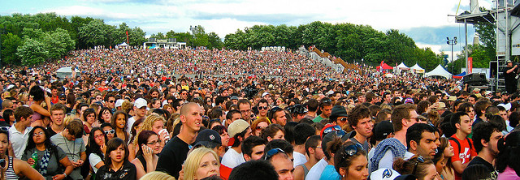
How well do you know your audience?

Slide 29
Segmenting your audience:
Your audience will likely consist of a variety of different segments, each of which may value your project and contribute to it in different ways. Be sure to consider….
End-users (e.g. students, faculty, partner institutions)
Your host institution
Industry partners

Slide 30
For each segment, Consider:
Usage stats
Number of website visitors, workshop participants, industry sponsors, etc.
Demographics
Who they are, by title, age, background, interest.
Behavioral
How do they engage with your program?
Attitudes and Motivations
What value they find in the program, why they use it.
Notes:
Leave for now, Nancy will figure out what to do about it. –probably not an exercise

Slide 32
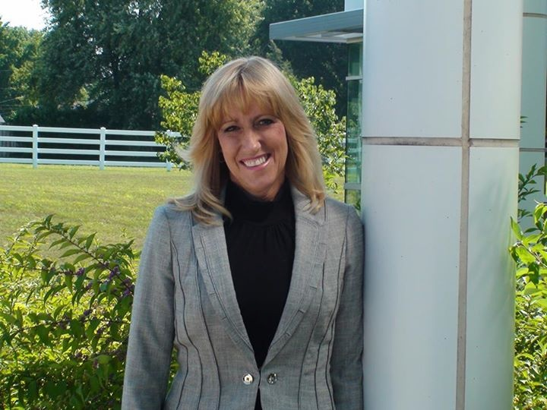
Case Study:
VESTA (Viticulture and Enology Science and Technology Alliance)
VESTA establishes programs of study in viticulture, enology, and wine business entrepreneurship through collaborations with educational institutions, government and industry. This unique partnership of universities and community colleges across the nation provides students access to online coursework, thereby enabling learning to occur anytime, anywhere.
Michelle Norgren, Principal Investigator
Notes:
REMEMBER TO ADD PHOTOS OF CASE STUDY PIs

Slide 33
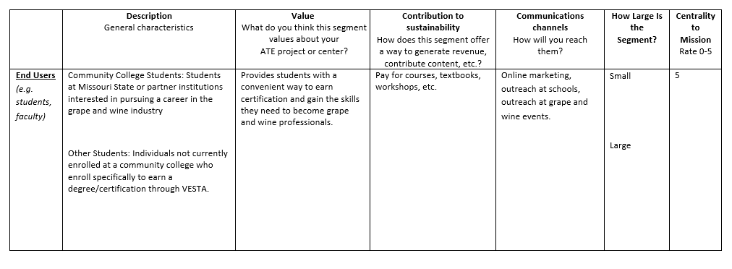
Case Study: VESTA
Notes:
On end users—not just her college students—people who want to learn grape and wine regardless. ---what is the upside of thinking about these other guys? How big is this group of users? And how are they contributing
2n category: partners/other stakeholders
3rd row-host institutions

Slide 34
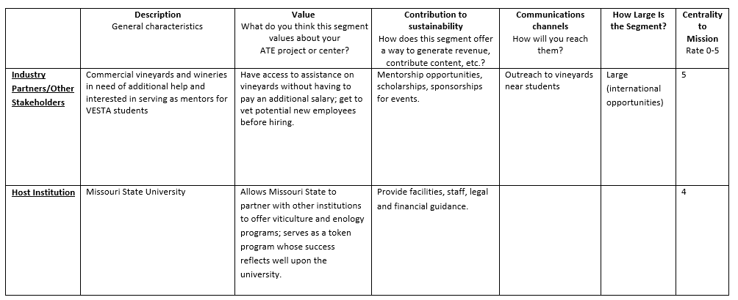
Case Study: VESTA

Slide 35
How can our resource best address the needs of our target audience?
The project: Web-based resource intended to support teachers in finding high-quality content for their teaching.
The problem: Concerns about low uptake. Question: How can we maximize usage of the course materials on the site?
In-depth interviews revealed that:
Instructors (target audience) did not know of the site.
Those who viewed it could not find the lesson plans.
Many instructors’ practices suggested that only a few would actively seek new materials to teach an “optional” part of the curriculum.

Slide 36
Settling for less:
The project: Web-based resource offering content to automotive manufacturing instructors and programs.
The problem: How do we know if “enough” people are using the site?
Market Sizing Revealed that: While large percentage increases in visits felt substantial (and looked good in reports), the actual user base was just a small fraction of total possible market.

Slide 37
Environmental Scan
Notes:
No man is an island---there are two ways in which we would like to suggest aht any logic for sustainability has to be keeping an eye on the outside envionrment
what’s going on in the world---Mike is case study.
And other is wine industry—Michelle saw that there was a huge gap.
Give a couple of examples of what it means to do an environmental scan.
2. Are there compettiors?
Send nancy outline.
Think about how you want to promp the audience. ---sell these people on why it’s important to think about the outside world.

Slide 38
What Is an Environmental Scan?
An environmental scan consists of understanding the world around you, positioning yourself within it, and determining how to make a demand-driven and differentiated contribution.

Slide 39
By understanding market conditions and analyzing the strengths and weaknesses of your competitors, you can…
Identify and respond to unexpected changes that might impact your project
Better understand the feasibility of your project
Assess the alignment of your project’s mission, goals and strategies with the changing environment
Compare the project’s strengths and weaknesses to its competitors
Identify good ideas and innovative directions that you can adapt to your project

Slide 40
Market Analysis
Is there demand for your project? Does it fulfill a need?
Is your project feasible?
What opportunities can you identify for your project? Are there external threats you will need to consider?

Slide 41
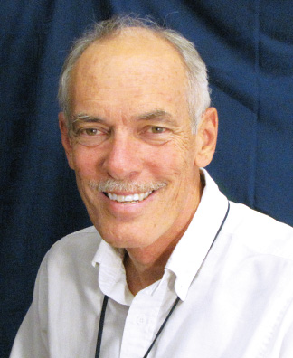
Case Study:
MATEC (Maricopa Advanced Technology Education Center)
MATEC develops programs, materials, and training that enables students, faculty, and technicians to continuously master the evolving competencies in science, mathematics, technology, and communications required by the workforce of the semiconductor, electronics, and advanced manufacturing industries.
Mike Lesiecki, Executive Director
Notes:
REMEMBER TO ADD PHOTOS OF CASE STUDY PIs

Slide 42
Do you have competitors?

Slide 43
Sure! Projects compete for:
Users’ time and attention
Their perception of relative value is more important than “reality”!
Scarce resources
As a non-profit, competition takes on an ethical dimension – is your project making the best possible use of philanthropic funding or institutional resources?

Slide 44
Understanding the competitive LAndscape
Identify your competition
Analyze their strengths and weaknesses on criteria that are important to users
Determine your relative position

Slide 45
Identifying your Competition
Direct competitors: Alternatives to your project that may include projects similar to your own, aimed at audiences quite similar to yours.
Indirect competitors: Projects that offer overlapping benefits to similar audiences.

Slide 46
How does your project compare?
What attributes do your users, funders and contributors care about?
e.g. ease of access, quality of content, etc.
How do your competitors measure up on these dimensions?

Slide 47
How will this help me move forward?
Reality check
Is what we are trying to accomplish realistic?
What are our unique strengths, and how can we build on them?
What are our greatest sources of vulnerability, and what can we do to address or mitigate them?
Help to inform decisions about strategic direction
How can we differentiate our offer from others?
Where should we prioritize our efforts and focus attention?
Turn competitors into allies
Identify those with complementary assets/skills, compatible goals

Slide 48
Bringing it all Together

Slide 49
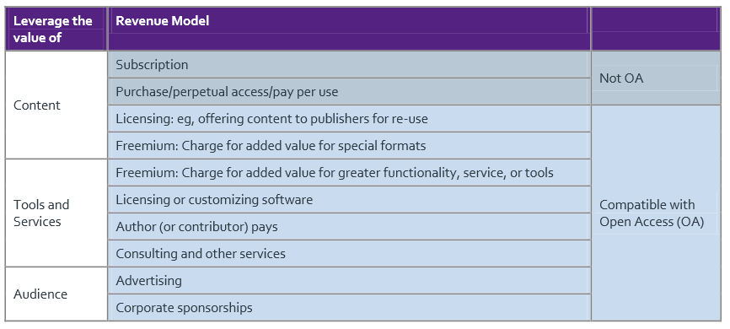
Value assessment framework
Short presentation on using information gathered to create funding model.

Slide 50
Case Study
Stanford encyclopedia of philosophy
Notes:
It started as grant funded, and its funder made clear it would need to transition away from grant funding.
Support for this resource includes
Endowment (80%)
Institutional funds (10%)
Individual membership (10%) between $5-$25/year
VOLUNTEER LABOR!!!

Slide 51
SEP’s Sustainability Plan Includes:
Delivering Value to its supporters:
Audience of readers Level, style, quality of content
Community of authors and editors Professional recognition
Participating institutions Open access mission
Host university Impact, quality of scholarship

Slide 52
SEP’s Sustainability Plan Includes:
Delivering Value to its supporters:
A diversified funding model:
Audience of readers Level, style, quality of content
Community of authors and editors Professional recognition
Participating institutions Open access mission
Host university Impact, quality of scholarship

Slide 53
SEP’s Sustainability Plan Includes:
Delivering Value to its supporters:
A diversified funding model:
Audience of readers Level, style, quality of content
Community of authors and editors Professional recognition
Participating institutions Open access mission
Host university Impact, quality of scholarship
Individual donations Friends of the SEP Society
Free content and editorial Volunteer authors/editors
Endowment Institutional Participation
Institutional Support Financial management of the endowment, direct support

